Slide 1
H1 2026 · EVIDENCE REVIEW
H1 growth missed plan,
and two cities declined in Q2
Investigate why booked tests grew 5.01% in H1 2026 versus an 18% plan, and what the Q2 booking declines in Chennai and Jaipur show.

Slide 2
THE SIGNAL
The signal is real; the cause is not yet established
GROWTH
CITIES
COUNTING
+5.01%
−7.6% · −10.7%
Falls get larger
H1 booked tests rose from 435,008 to 456,788, versus an 18% plan.
Adjusted Q2 bookings fell in Chennai and Jaipur; four Legacy cities grew 2.1%.
Removing superseded records made both declines larger, but did not explain all of either decline.
The evidence establishes the gap and the city pattern. It does not yet establish the cause.
02

Slide 3
METHOD
One consistent counting rule connects the analysis
01
02
03
04
05
Booking + plan data
Standardize dates, cities, periods, definitions
Remove superseded reschedules; flag questionable rows
Compare H1 actual with plan and Q2 cities with Legacy peers
Decompose growth; check patient/activity and sensitivity
Method notes. H1 means January–June. Q2 comparisons use the same rule in every city and exclude superseded rescheduled bookings.
03

Slide 4
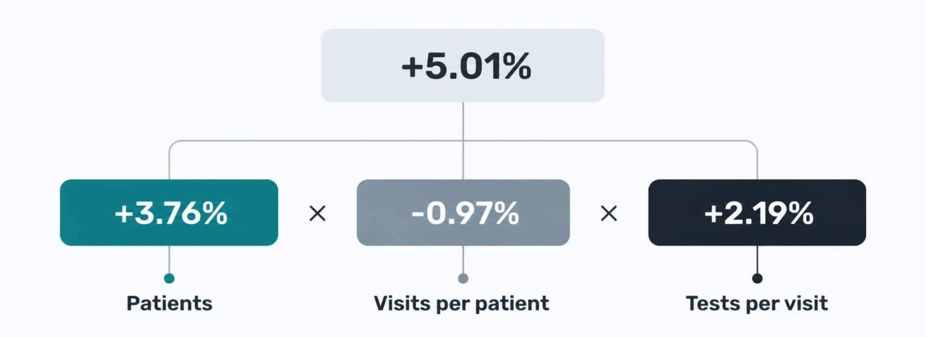
H1 GROWTH DECOMPOSITION
Patients drove most of the H1 gap, while activity partly offset it
The factors combine multiplicatively; do not multiply the percentage changes directly.
04

Slide 5
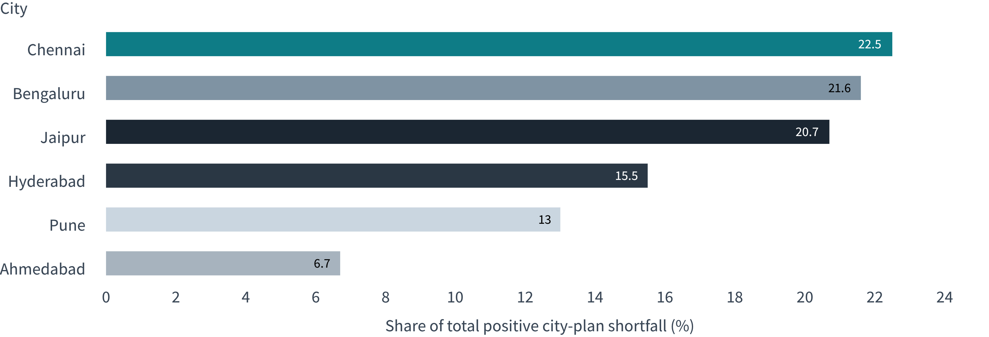
PLAN SHORTFALL · H1 2026
Three cities explain about 65% of the positive plan shortfall
Chennai, Bengaluru, and Jaipur contribute 64.8% combined. All six cities were below their H1 2026 plans.
05

Slide 6
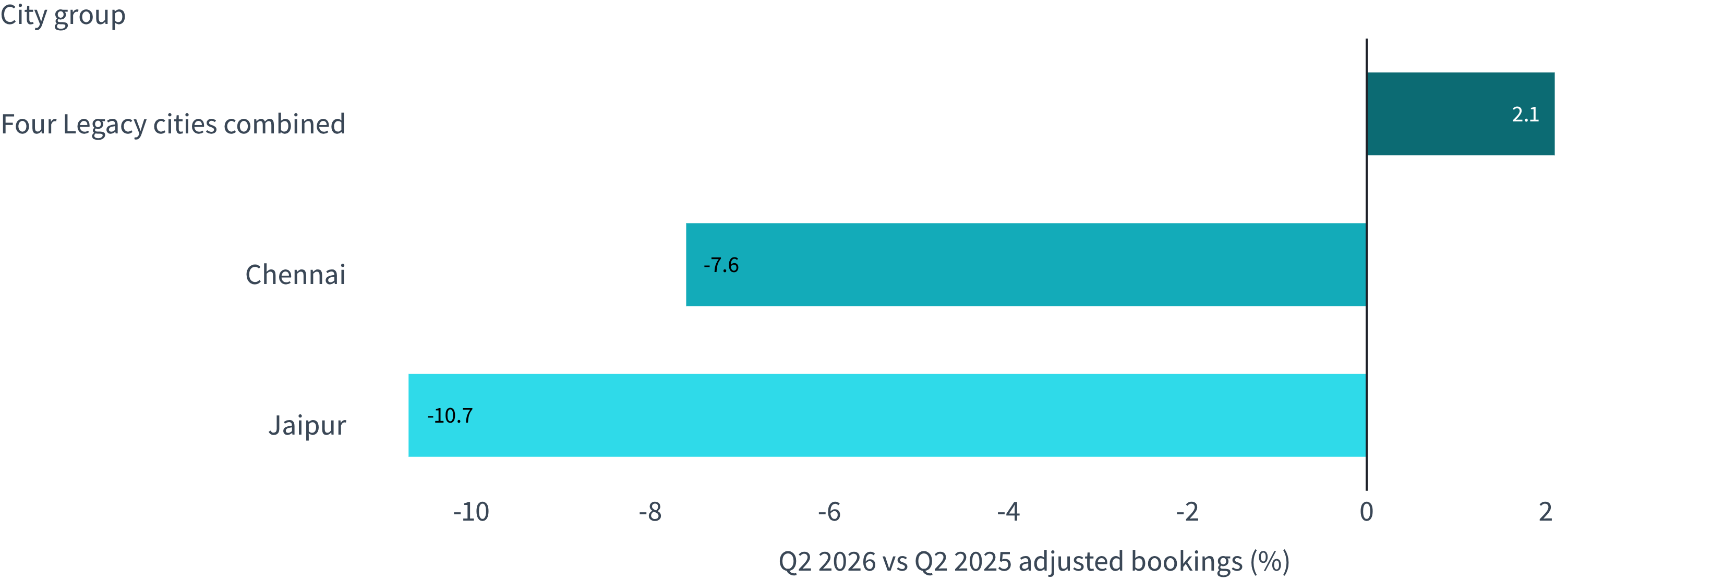
CITY COMPARISON · ADJUSTED BOOKINGS
Chennai and Jaipur fell while Legacy peers grew
Q2 2025 → Q2 2026. Chennai: 17,444 → 16,116. Jaipur: 9,136 → 8,161. Rule: exclude superseded rescheduled bookings.
06

Slide 7
SENSITIVITY TO COUNTING
Superseded records softened the reported falls
City | Q2 2025 baseline | Q2 2026 raw | Superseded records removed | Adjusted Q2 2026 | Raw → adjusted change
Chennai | 17,444 | 17,086 | 970 | 16,116 | −2.1% → −7.6%
Jaipur | 9,136 | 8,655 | 494 | 8,161 | −5.3% → −10.7%
Counting differences softened the reported falls; they did not explain all of either decline.
07

Slide 8
WHAT THE EVIDENCE CAN AND CANNOT SAY
Patient counts fell; the evidence does not say why
ACTIVITY SPLIT
Chennai
Jaipur’s decline was visible before the April 2026 Legacy-to-Nova move. 2,442 rows with slot date exactly two days before booking date were excluded.
Patients −8.3%
Visits per patient +0.8%
Tests per visit +2.8%
1,311 rows had missing or invalid test codes. 21 Nova visits had no accepted test row. Lab-result rows grew 6.09% but are a separate cross-check. H1 growth is 5.01% with the excluded rows, 4.97% if counted as tests.
Jaipur
Patients −10.7%
Visits per patient about 0.0%
Tests per visit +2.4%
08

Slide 9
NEXT DECISION
Reconcile the measure,
then investigate the patient decline
01
02
03
04
Reconcile city dashboards with booking-level visits.
Agree on consistent replacement and superseded-booking definitions.
Verify whether the patient-count declines persist.
If they do, investigate with city teams before choosing city-specific actions.
Do not claim the vendor move caused the decline, or that this analysis identifies why patients fell. No financial cost estimate was provided.

