Slide 1
Continuous Model Validation Using Reference Attribute Grammars paper accepted to SLE 2018
Johannes Mey, Rene Schöne, Görel Hedin, Emma Söderberg, Thomas Kühn, Niklas Fors, Jesper Öqvist, Uwe Assmann

Slide 2
Contents
Compare RAGs and Conceptual Models
the missing part: bidirectional non-containment relations
How to encode Conceptual Models in RAGs
Relational RAGs: direct support for Conceptual Models
Evaluation on the Train Benchmark
continuous (incremental) model validation after injections and repairs of faults

Slide 3
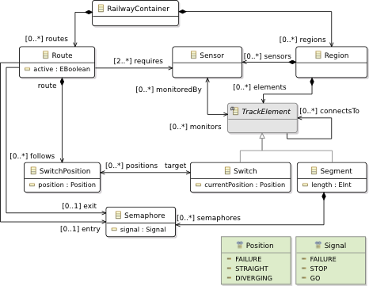
A Conceptual Model (In Ecore–Core metamodel for the Eclipse Modeling Framework)
RAG abstract grammar
RailwayContainer ::= Route* Region*;
Route ::= <active:Boolean> SwitchPosition*;
SwitchPosition ::= <pos:Pos>,
Region ::= TrackElement* Sensor*;
abstract TrackElement;
Switch : TrackElement ::= <currentPos:Pos>;
Segment : TrackElement ::= <length:Int> Semaphore*;
Semaphore ::= <signal:Signal>;
Train Benchmark
But how capture the non-containment relations?
containment relation
non-containment relation
bidirectional non-containment relation
Notes:
Explain what a conceptual model is
Blind the non-containment relations
Show that this is straight-forward to capture in a RAG abstract grammar.
But then the problem is how to capture the non-containment relations.

Slide 4
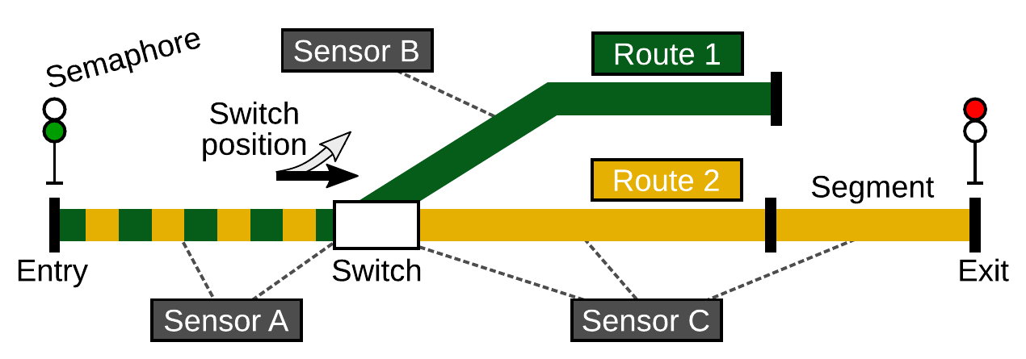
Example model instance
RailwayContainer ::= Route* Region*;
Route ::= <active:Boolean> SwitchPosition*;
SwitchPosition ::= <pos:Pos>,
Region ::= TrackElement* Sensor*;
abstract TrackElement;
Switch : TrackElement ::= <currentPos:Pos>;
Segment : TrackElement ::= <length:Int> Semaphore*;
Semaphore ::= <signal:Signal>;
AST
non-containment relations
RailwayContainer
List
List
Region
Route1
Route2
requires
List
List
SensA
SensB
SensC
List
List
Switch
Seg1
Seg2
Seg3
monitors
SwitchPosition
SwitchPosition
Sem
Sem
Notes:
Discuss the train model a bit
Show the corresponding AST (very sketchy done, the tree is not complete or completely correct – I was in a hurry when drawing it)
Show some of the non-containment relations. Discuss what they mean to exemplify such relations.

Slide 5
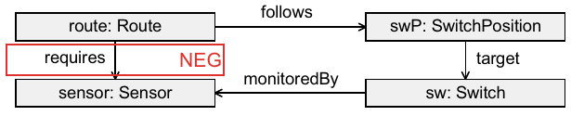
Goals
Handle non-containment relations
Support validation of constraints
Incremental (continuous) validation when model instance (AST) is edited
Example query for validation constraint:
If the above pattern is found, there is an error in the model.
(Required sensor is not monitored by any switch followed by the Route.)
Notes:
Discuss our overall goals
Show an example pattern.
Explain that the pattern shows an undesirable situation.
Discuss the example in detail:
A Route object requires a number of sensors. All those sensors must be monitored by the switches that the Route follows. If this is not so (an edge is missing). There is an error.

Slide 6
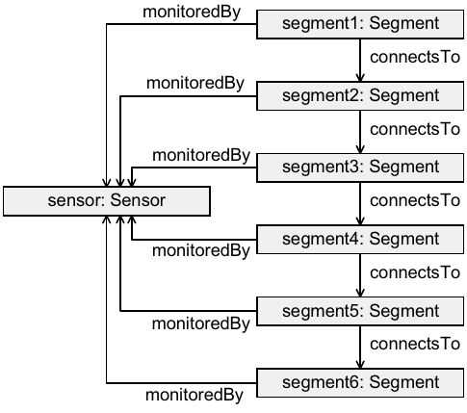
Another query example
If the above pattern is found, there is an error in the model.
(Too many segments in a row).
Notes:
Show another example.

Slide 7
Handling non-containment relations using encodings
Solution 1: Name analysis
Use the globally unique identifiers of all objects
Encode non-containment relations as Id uses
Resolve using name analysis
Solution 2: Explicit intrinsic reference attributes
Bidirectional relations:
Either use collection attributes to reverse references
Or two unidirectional relations
Drawbacks:
Boilerplate code
Global name analysis hampers performance of incremental updates
Notes:
Briefly introduce the two approaches to encoding.
Briefly discuss how bidirectional relations can be handled.
Briefly discuss the drawbacks of these approaches.

Slide 8
Name analysis
RailwayContainer ::= Route* Region*;
Route ::= <active:Boolean> SwitchPosition*;
SwitchPosition ::= <pos:Pos>,
Region ::= TrackElement* Sensor*;
abstract TrackElement;
Switch : TrackElement ::= <currentPos:Pos>;
Segment : TrackElement ::= <length:Int> Semaphore*;
Semaphore ::= <signal:Signal>;
AST
non-containment relations
RailwayContainer
List
List
Region
Route1
Route2
decl
requires
List
List
SensA
SensB
SensC
List
List
Switch
Seg1
Seg2
Seg3
monitors
SwitchPosition
SwitchPosition
Sem
Sem
RailwayElement ::= <ID:String>; // unique ID
TrackElement : RailwayElement ::= ...
Route ::= ... Ref*
Ref ::= <ID:String>; // Use of id
syn Sensor Ref.decl() = lookup(getID());
inh Sensor Ref.lookup(String s);
...
Notes:
Exemplify how the name analysis approach works.
The slides should be improved, showing the Ref nodes explicitly, the Ids, and the derived decl attribute. I didn't have time to fix this.

Slide 9
Intrinsic reference attributes
RailwayContainer ::= Route* Region*;
Route ::= <active:Boolean> SwitchPosition*;
SwitchPosition ::= <pos:Pos>,
Region ::= TrackElement* Sensor*;
abstract TrackElement;
Switch : TrackElement ::= <currentPos:Pos>;
Segment : TrackElement ::= <length:Int> Semaphore*;
Semaphore ::= <signal:Signal>;
AST
non-containment relations
RailwayContainer
List
List
Region
Route1
Route2
requires
List
List
SensA
SensB
SensC
List
List
Switch
Seg1
Seg2
Seg3
monitors
SwitchPosition
SwitchPosition
Sem
Sem
RailwayElement ::= <ID:String>; // unique ID
TrackElement : RailwayElement ::= ...
Route ::= ... Ref*
Ref ::= <requires:Sensor>; // intrinsic reference
...
Notes:
Discuss the other solution.
Again, the slides should be improved, showing the Ref nodes and the intrinsic reference attributes.

Slide 10
A nicer solution
RAG abstract grammar
RailwayContainer ::= Route* Region*;
Route ::= <active:Boolean> SwitchPosition*;
SwitchPosition ::= <pos:Pos>,
Region ::= TrackElement* Sensor*;
abstract TrackElement;
Switch : TrackElement ::= <currentPos:Pos>;
Segment : TrackElement ::= <length:Int> Semaphore*;
Semaphore ::= <signal:Signal>;
Extending RAGs with relations
rel Route.requires* -> Sensor;
rel Route.entry? -> Semaphore;
rel Route.exit? -> Semaphore;
rel SwitchPosition.target <-> Switch.positions*;
rel Sensor.monitors* <-> TrackElement.monitoredBy*;
rel TrackElement.connectsTo* -> TrackElement;
containment relation
non-containment relation
bidirectional containment relation
Notes:
Discuss the nicer solution - how the relations can be specified in an extended version of RAGs.

Slide 11
The RelAST preprocessor
X.ast
X.relast
RelAST preprocessor
JastAdd
X.jrag
Notes:
Discuss the preprocessor. The slide needs to be improved to be understandable outside of the JastAdd community.

Slide 12
Results
Performs on par with state-of-the-art incremental model tools
Faster for some queries
Opens possibility for RAGs on Models
Notes:
Should give some more explicit results.
Could discuss some more future work as well.

