Slide 1

Homework 1
Jules Baud A20387950
Thomas Thous A20387922
Patipat Duangchalonin A20351140
Automatic Lens smear detection

Slide 2
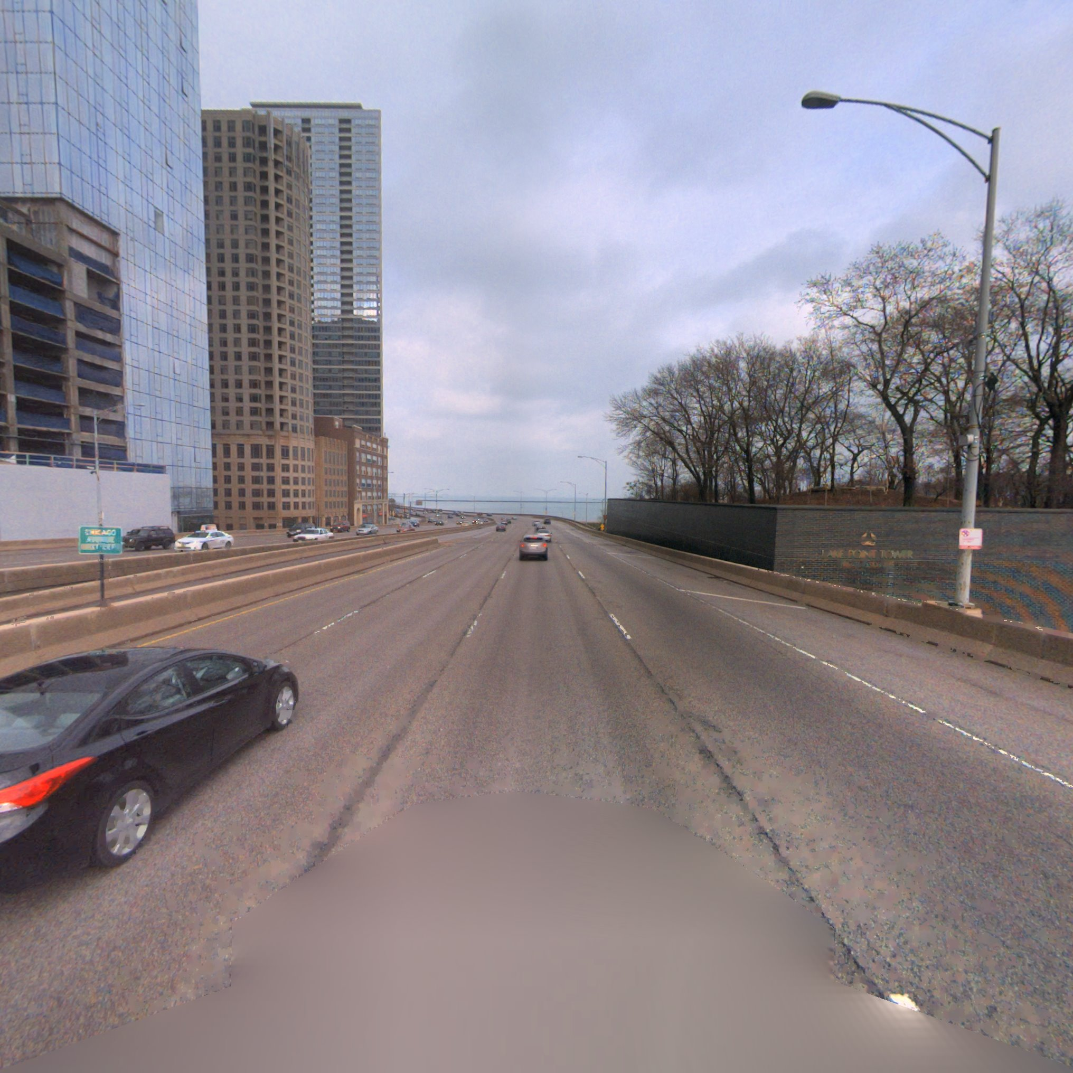
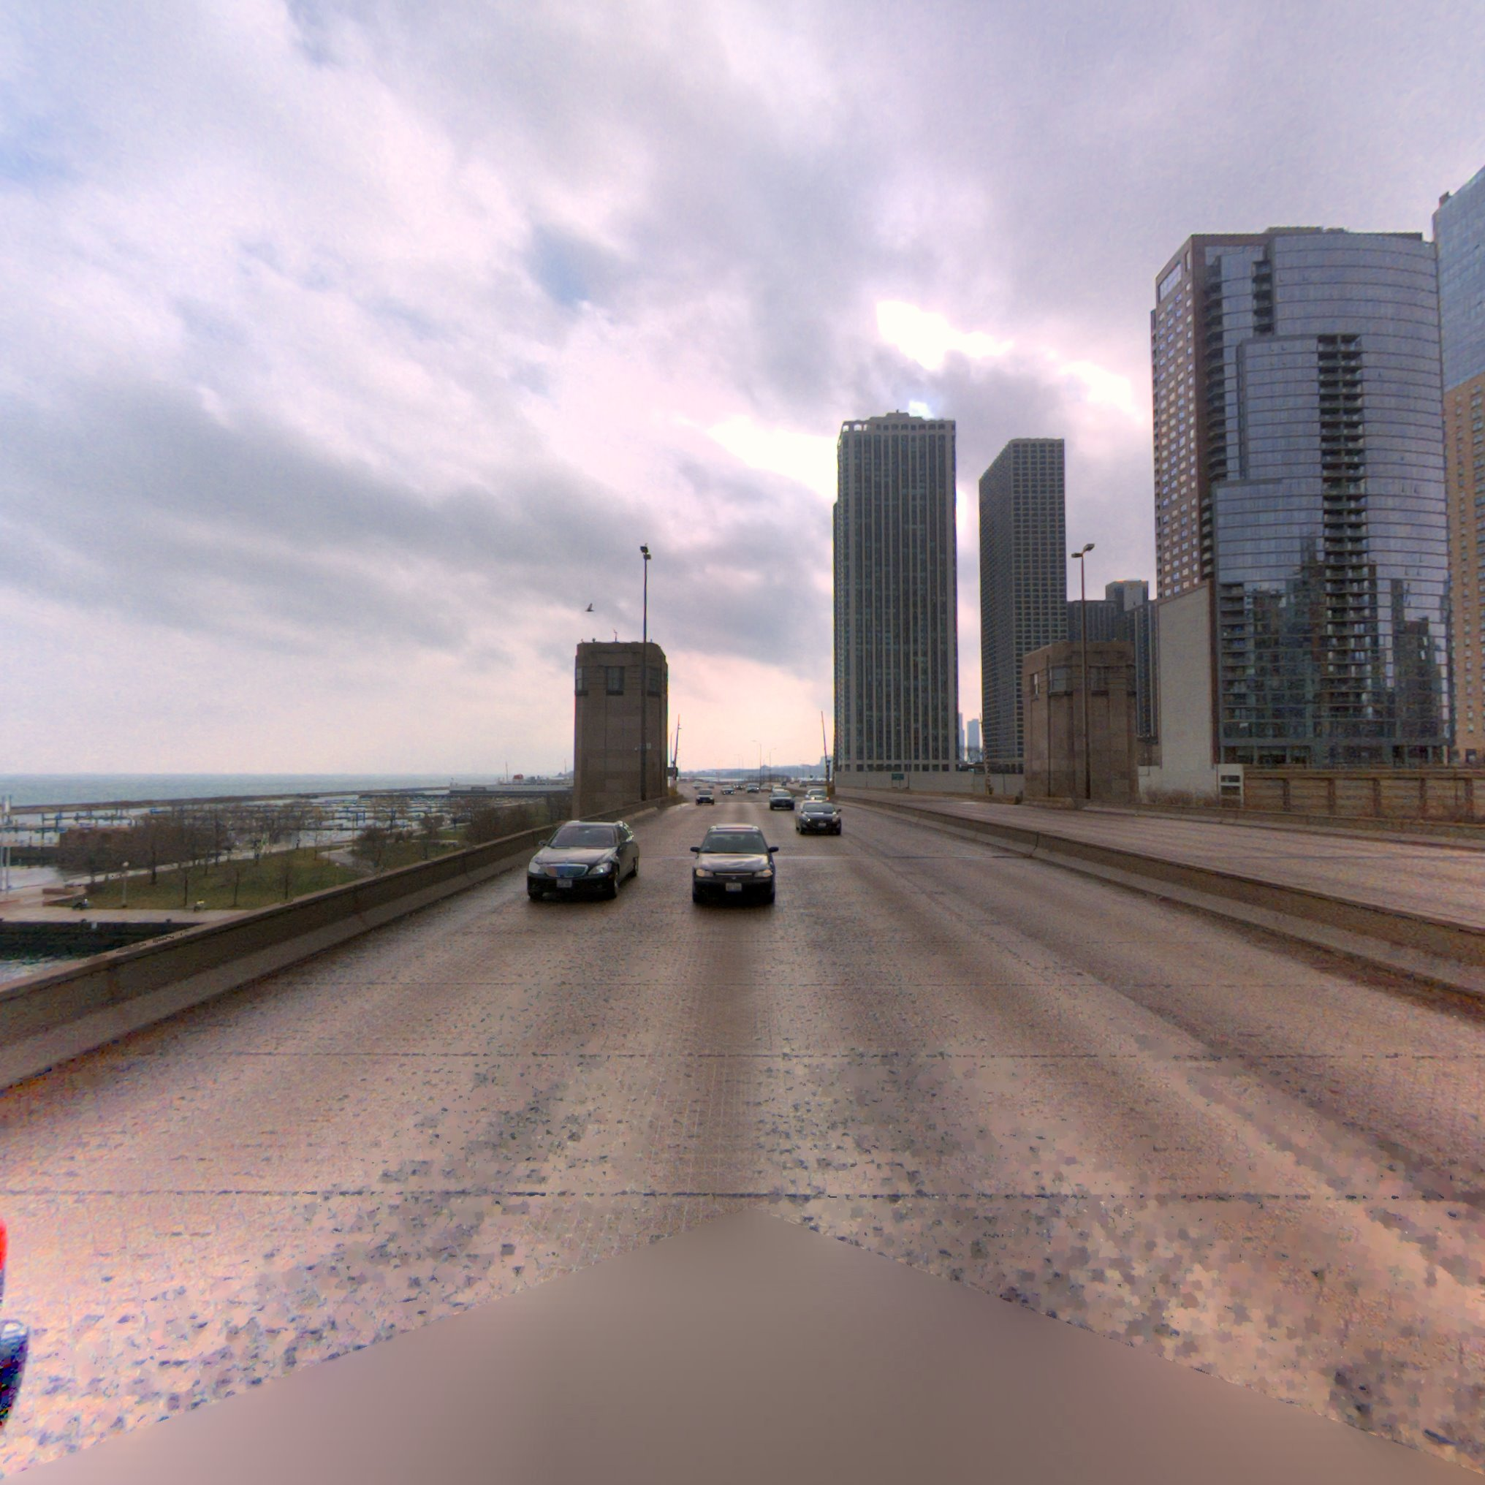
Presentation of the problem
We were provided with 10Gb of pictures showing some smear

Slide 3
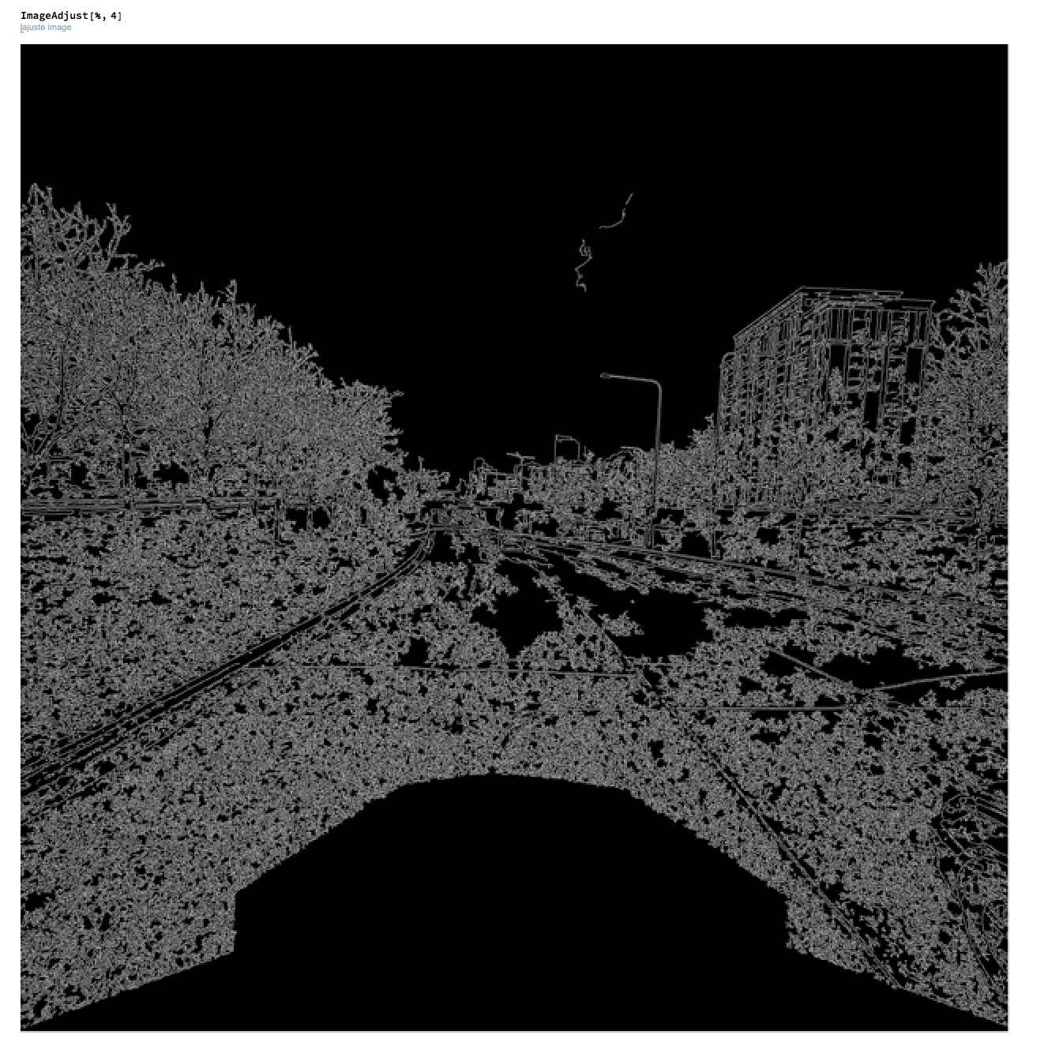
First try
We tried to do image transformation on Mathematica first
We tried several algorithms for edges detection and we tried to determine how well they performed with different parameters
We also adjusted the luminosity and converted to greyscale
One problem we had was how to discriminate the sky and the actual region of interest

Slide 4
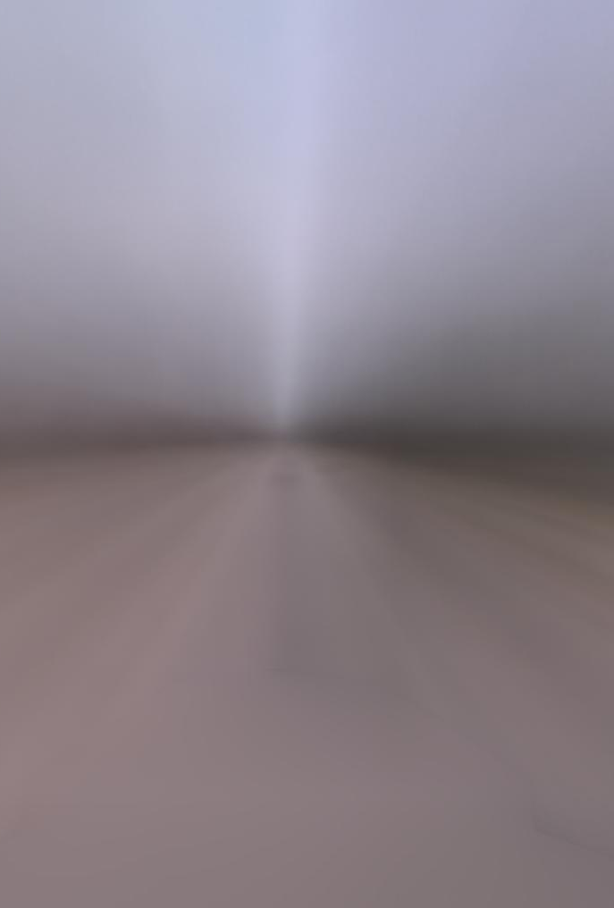
First approach on Mathematica
Our first approach was to do on average on and then try an edge detection on the result. This proved to be ineffective because the average was to blurry to detect any form ( see the left picture)

Slide 5
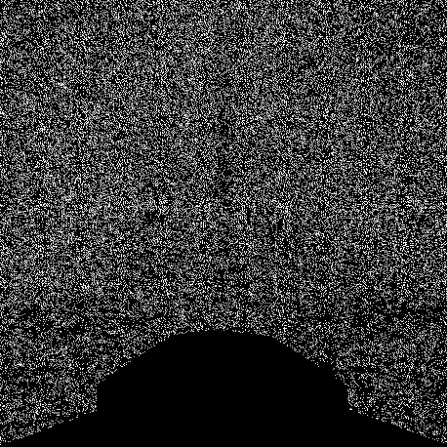
Second approach on Mathematica
This time we performed an edge detection with high contrasted images for each image of the folder and then averaged the resulting pictures.
This approach proved to be effective and allowed us to detect precisely the blurred parts of the camera.
By using very low threshold we were able to eliminate the sky detection and to only keep the blurred region

Slide 6

Getting a mask
We know had to get the mask from the previous image
We used Dilation algorithm to get this image
We tried multiple iterations to find the best value for our problem

Slide 7
Conclusion – Pseudo Code
For each image :
1: Augment the contrast of the picture
(this will make a noisy picture)
2: Convert to Greyscale
3: Perform an edge detection on the picture, because of the noisy picture we get a lot of edges
2) Perform an average of the generated pictures
3) Invert the pixels (Black to White)
4) Perform 6 Dilations

Slide 8
Implementing the process in Python
We had then to program those steps in Python in order to automate the process
Library used :
OpenCV (2.4) Numpy, Scipy, PIL, and Matplotlib
OS:
OSX and Ubuntu 16.04.2

Slide 9



Final Results
Generated from Cam_0
Generated from Cam_2
Generated from Cam_3

Slide 10
Conclusion
Pros :
Dynamic , works with every set of images
Fast
Cons :
Need a lot of samples images
Not 100 % accuracy

Slide 11
What to do next
Optimize memory usage for very large set of files
Try another statistic method
Allow the user to change the Edge detection algorithm values

