Slide 1
Cellular Automation
pdubey, vdong, gnagaraj, aakulkar

Slide 2
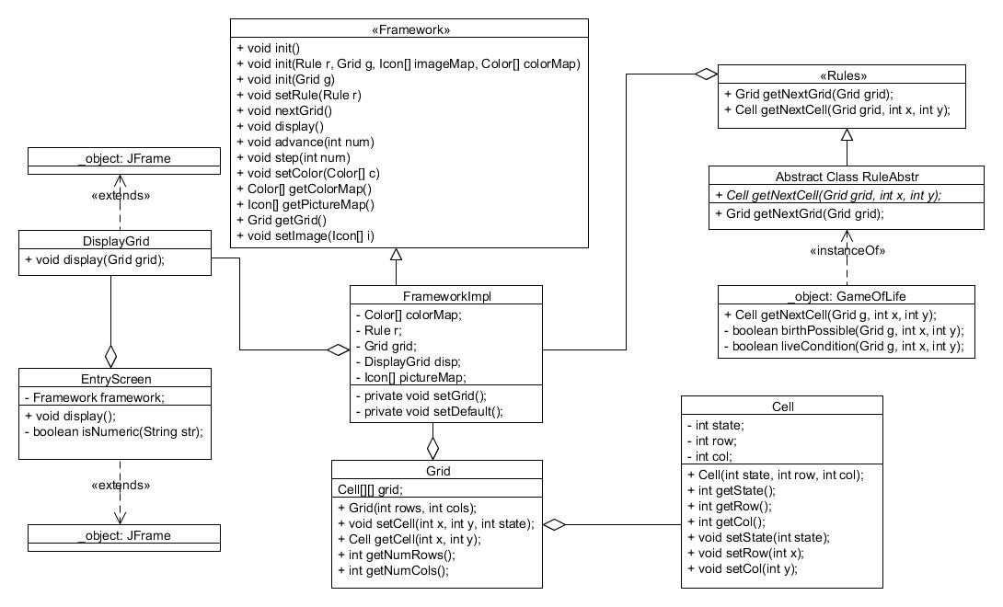

Slide 3
Design Patterns: Template method
public abstract class RuleAbstract implements Rule{
public abstract Cell getNextCell(Grid g, int x, int y);
public Grid getNextGrid(Grid g){
Grid toReturn = new Grid(g.getNumRows(), g.getNumCols());
for(int x = 0; x < g.getNumRows(); x++){
for(int y = 0; y < g.getNumCols(); y++){
toReturn.setCell(x, y, getNextCell(g, x, y).getState());
}
}
return toReturn;
}
}
Framework provides how to return a grid.
User provides plugin consisting of how to map the next cell for a given rule.

Slide 4
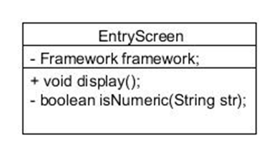
Design Pattern: Decorator
Framework is a private field in the EntryScreen class.
Adds additional functionality to the framework.
GUI options

Slide 5
Design Pattern: Observer
public void display(){
JPanel panel = new JPanel();
setTitle("Entry Screen");
setSize(400, 400);
setLocationRelativeTo(null);
.
.
.
.
step.addActionListener(new ActionListener() {
public void actionPerformed(ActionEvent event) {
framework.step(1);
}
});
advance.addActionListener(new ActionListener() {
public void actionPerformed(ActionEvent event) {
String getsteps = advancenum.getText();
if(getsteps!=null){
if(isNumeric(getsteps)){
.
.
.
}
Allows functionality on certain button events.
Gives client added control.

Slide 6
Features
Allow a multitude of rules to be implemented via the framework.
Rule110, Brian’s Brain, etc.
Client can use color maps OR picture maps for visualization purposes.
Toroid world – wrapping

Slide 7
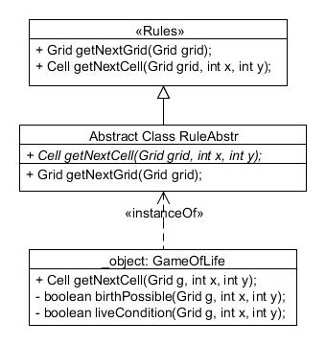
Plugins
Client needs to provide a single method.
Cell getNextCell(Grid g, int x, int y);
This is in the form of a class which extends the abstract rules class provided by the framework.
Client must also provide, image/color map.
Default settings will be used if user fails to provide plugins.
Conway’s Game of Life

Slide 8
SAMPLE CLIENT PLUGIN
Framework f = new FrameworkImpl();
//Client initializes world to predefined values.
Grid grid = createGrid(8, 8);
f.init(grid);
//Client initializes default colors
Color[] colors = new Color[3];
colors[0] = Color.blue;
colors[1] = Color.black;
colors[2] = Color.green;
f.setColor(colors);
//MyRule contains the logic for whatever game you want to implement
Rule myRule = new MyRule();
f.setRule(myRule);
EntryScreen screen = new EntryScreen(f);
screen.display();

