Slide 1
Implementing Matrix Factorization to Improve Model Performance
By: Philippe Wee

Slide 2
Assignment
Try to implement some things in the research paper Crime Event Prediction with Dynamic Features by Shakila Khan Rumi, Ke Deng, and Flora Dilys Salim.
Preferably on similar data if available
Preferably in Python.
My Objective: Try to implement dynamic features to improve model performance.

Slide 3

Important Python Libraries Used
GeoPandas
Pandas
Numpy
Shapefile
Sklearn
TensorFlow

Slide 4
Data
FourSquare check-in data from Kaggle
https://www.kaggle.com/chetanism/foursquare-nyc-and-tokyo-checkin-dataset
1060 user IDs
169,312 rows of data
March 4, 2012 - Feb 16, 2013
GIS shapefiles of neighborhoods in NYC
https://geo.nyu.edu/catalog/nyu-2451-34563
5 boroughs
276 neighborhoods
NYPD complaint Data Historic
https://data.cityofnewyork.us/Public-Safety/NYPD-Complaint-Data-Historic/qgea-i56i
All valid felony, misdemearnor, and violation crimes reported to NYPD from 2006 – 2017
6 million rows

Slide 5
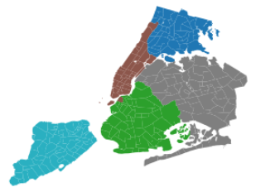
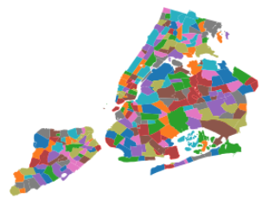
GIS Shapefiles
NYC shapefiles of coordinates were plotted with geopandas using Coordinate Reference Systems and epsg 4326: coordinate frame for Earth.

Slide 6
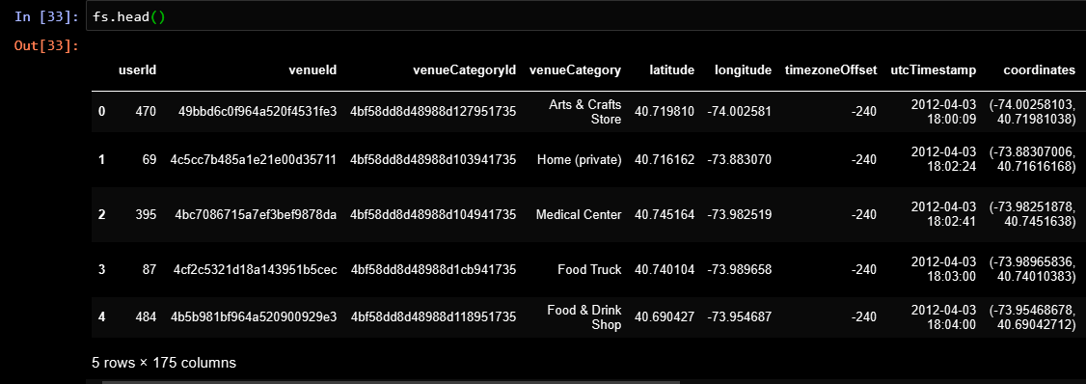
FourSquare

Slide 7
Assign Coordinate to Neighbohood
Rtree used to determine which polygon, neighborhood, a shapely Point coordinate belonged to.
Interesting Findings:
Dataset contains coordinates outside of NYC, mainly New Jersey.
Check-ins were in coordinates that do not belong to any high spatial resolution neighborhoods; such as bridges.

Slide 8
Preparing Sparse Features
Features
Visitor Count – Number of unique users in a neighborhood n at time internal t.
Observation Frequency – Number of check-ins in neighborhood n at time interval t.
Visitor Entropy – Diversity of visitors in a location with respect to their visits; safety indicator.
Region Popularity – Assesses popularity of neighborhood n at time interval t.
Visitor Ratio – Number of check-ins by new users considering only their top 4 venues.

Slide 9
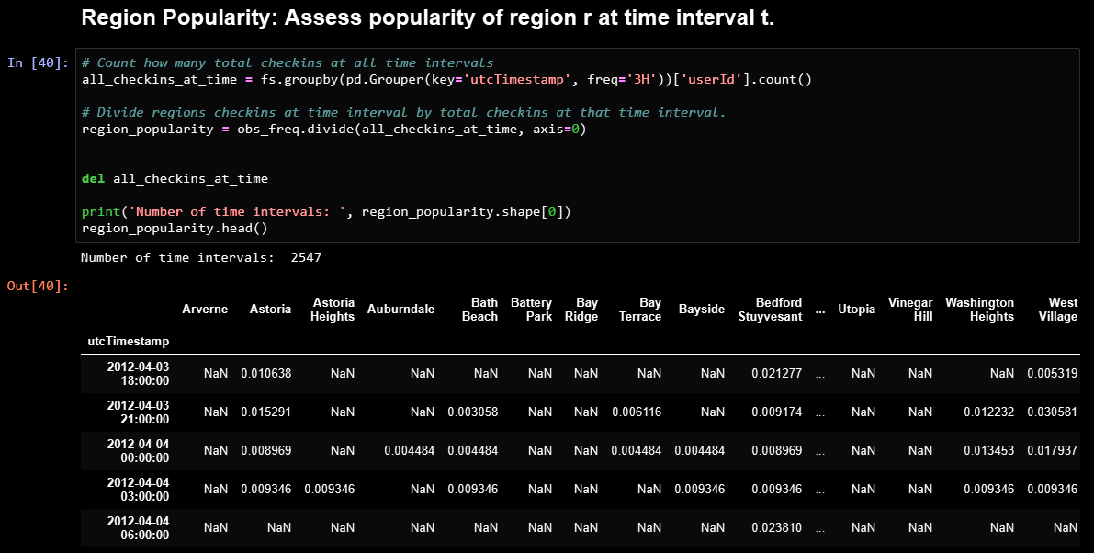
View of Region Popularity Feature

Slide 10
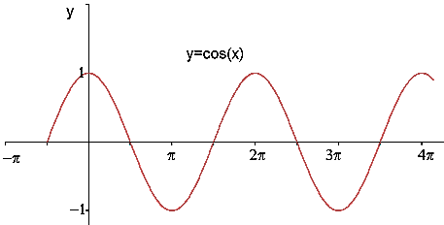

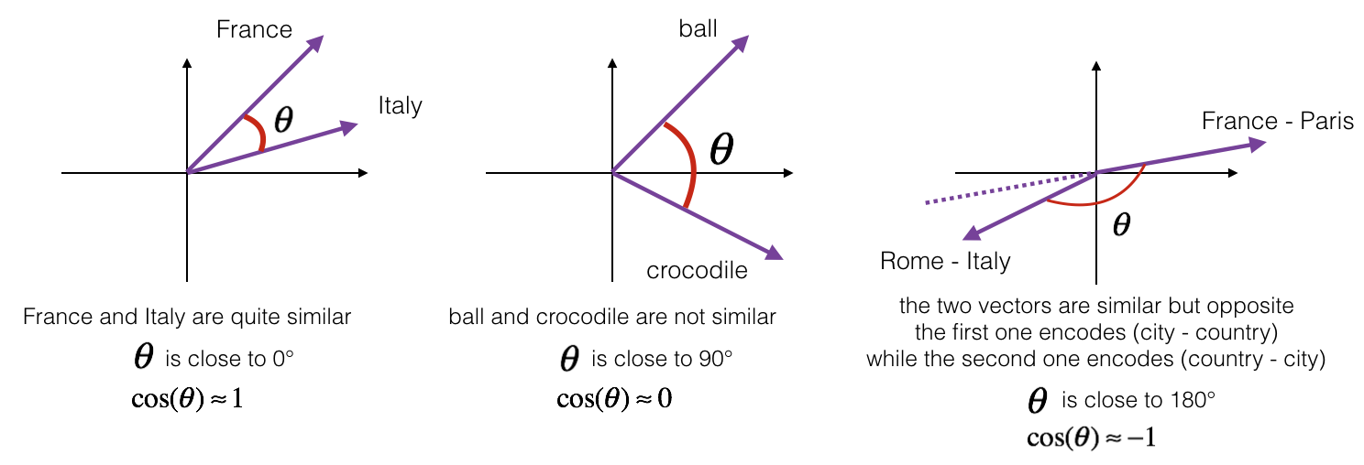
Cosine Similarity
A

Slide 11
Dynamic Features with Matrix Factorization
Features that show similarities at many time intervals can be used to estimate missing data points.
Author, Shakila rumi used a library, https://github.com/sanealytics/recommenderlabrats, in R for converting the sparse features to dynamic features.
Wrote my own script that does matrix factorization with Stochastic Gradient Descent.
Another alternative would be to do a vector implementation of my script or use Sklearn Surprise for Recommendation Systems.

Slide 12
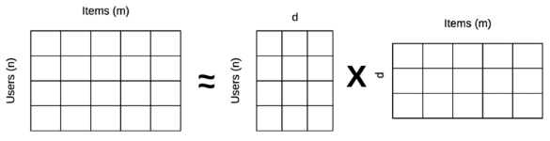
Latent Matrices
Take a matrix and reduce its dimensionality with dimension d by factorization. This creates 2 latent matrices of inferred observations. The 2 matrices can be matrix multiplied for feature estimation; dynamic features.
Parameters: d, learning rate, regularization, and number of epochs.

Slide 13
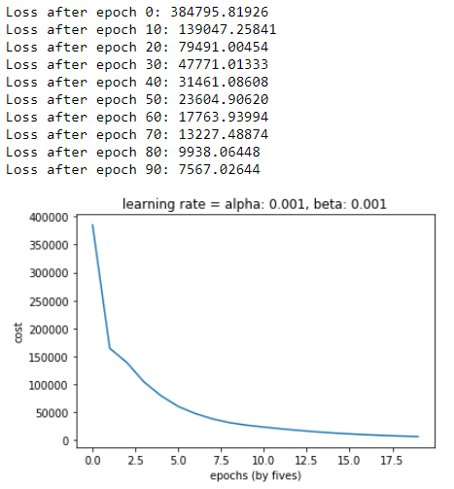
Matrix Factorization Parameters
Early Stopping with 20 epochs.
Probably not the best choice but good if your computer is weak.
Latent dimensions d = 250
Learning rate = 0.001
Regularization = 0.001

Slide 14
Target Lables

Slide 15
Crime – Target Labels
NYPD complaint Data Historic
https://data.cityofnewyork.us/Public-Safety/NYPD-Complaint-Data-Historic/qgea-i56i
All valid felony, misdemearnor, and violation crimes reported to NYPD from 2006 – 2017
6 million rows
Focused on predicting “Grand Larceny”; theft crimes between April 3, 2012 – February 6, 2013.
Coordinates of theft were used to identify the neighborhood; same method used in FourSquare preparation.

Slide 16
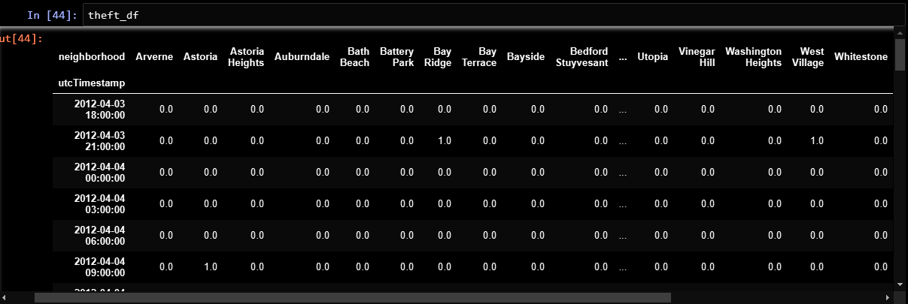
Target Label View

Slide 17
Modelling
Sklearn
SVM
Logistic Regression
Random Forest
TensorFlow
Fully connected 1-layer Neural Network
Non-scaled features vs Scaled features
Crime is a rare event – Imbalanced Classes
Solution: Undersampling
Disadvantages: can result in loss of important data
Train/dev split: 70%/30%

Slide 18
Evaluation
Neighborhood of interest – West Village
50%/50% balanced set
220 crime examples: 220 non-crime examples
Sparse vs Dynamic
Sparse Feature Scaled vs Dynamic Feature Scaled
Primary evaluation metric: AUC 5-Kfold cross validation (excluding Neural Network)

Slide 19
Results
Average of 5-Kfold after 14 runs
Dynamic features improved AUC ~2-5% for West Village

Slide 20
Critiques
Only looked at West Village
Many Hyper-parameters that could have been optimized
Never tried testing a trained model on a particular neighborhood and testing on a different neighborhood.
Data was only split for 70%/30%. There was never a test set. Only train and dev set.

Slide 21
Thanks for Listening!

