Slide 1

What is data science and what tools are there?
Philippe Wee

Slide 2
Meetup Structure
15 min presentation
Rest of the time: WORK ON DATASETS IN SMALL GROUPS! 😁
Regular meetups: Twice a month

Slide 3
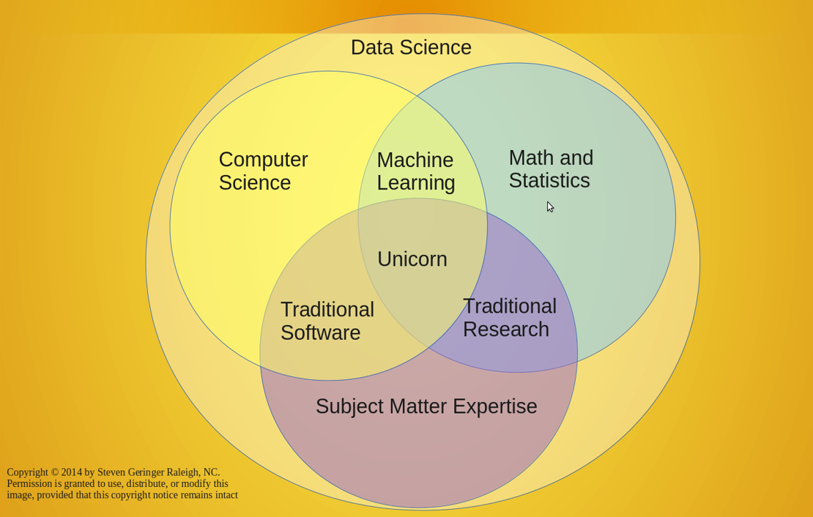
Data Science
Interdisciplinary field
Unification of theories, concepts, tools, and technologies that enable the extraction of valuable information from raw data that may be used for multiple purposes; such as decision making, product development, trend analysis, and forecasting.
http://www.anlytcs.com/2014/01/data-science-venn-diagram-v20.html

Slide 4
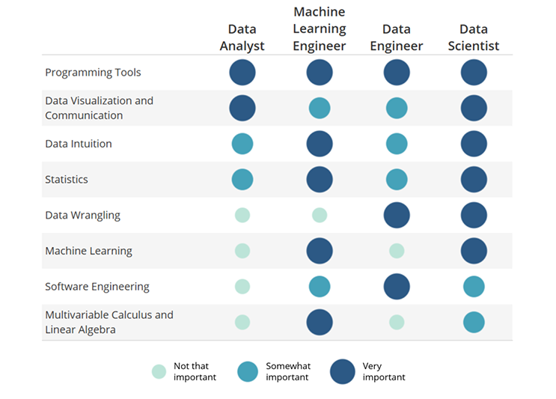
https://blog.udacity.com/2014/11/data-science-job-skills.html

Slide 5
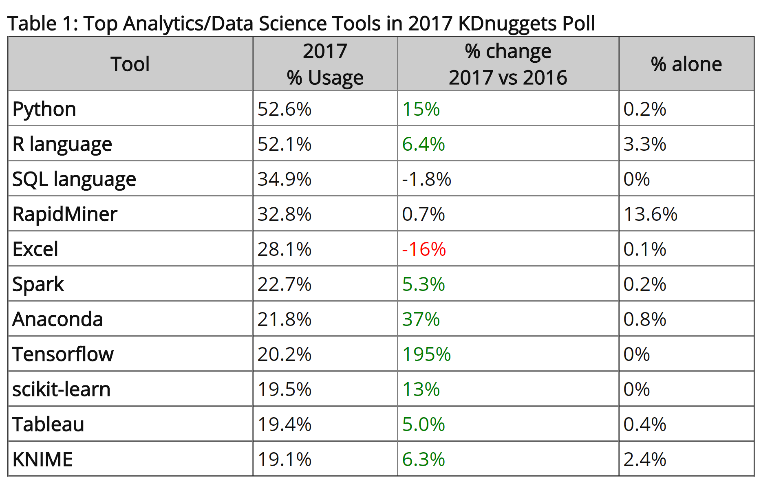
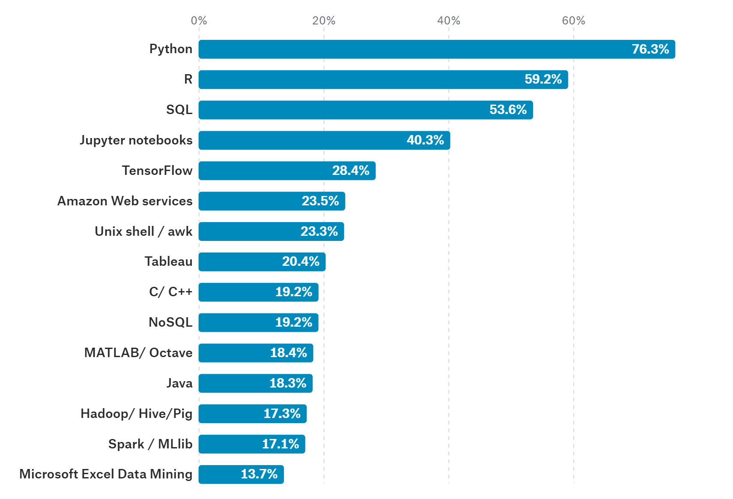
Popular Data Science Tools
https://www.kdnuggets.com/2017/05/poll-analytics-data-science-machine-learning-software-leaders.html
https://www.kaggle.com/surveys/2017

Slide 6
Some of Many Other Tools
Programming languages: Julia, Perl, Ruby, scala
Data mining: Rapidminer, SSAS, Knime
Big data: Hadoop, Spark, Storm
Libraries: Tidyverse, Epic, Numpy, Dplyr, Ggplot2, PyTorch, Tensorflow, Scikit-learn
BI: Qlik

Slide 7
kaggle
Platform for data science and machine learning
Hosts business competitions
Public datasets
Cloud based kernels for code
Tutorials
Notes:
Play petter abbeel and point out the important messages

Slide 8
TRY THINGS OUT AND IMPLEMENT IT!

Slide 9
Airbnb
Predict which country new users will book there first trip to
Explore and analyze the datasets

Slide 10
Next Meetup on JUNE 14
Intro to R by Olof Rännbäck-Garpinger
WORKING ON DATASETS 😁

Slide 11
Hands On Data Science (Malmö, Sweden)
Join the Meetup Group to keep updated on what’s going on

Slide 12
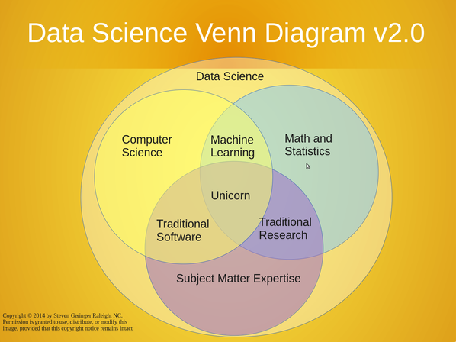

Slide 13
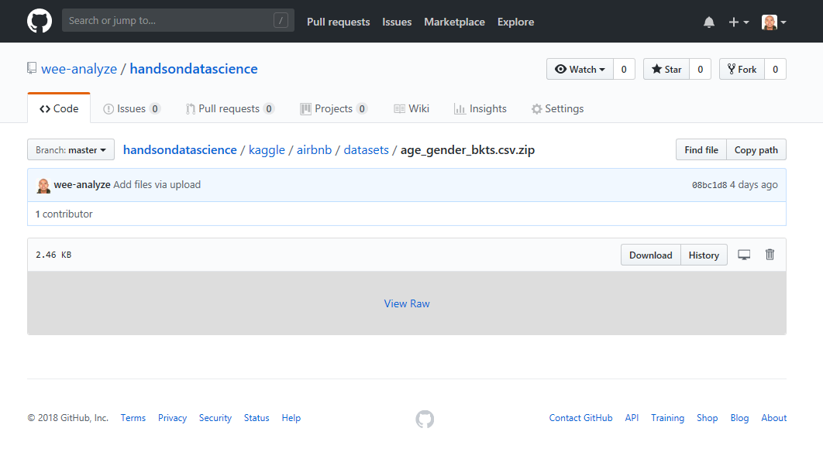
Beginner Exercises https://github.com/wee-analyze/handsondatascience/tree/master/kaggle/airbnb/datasets
Train_user_2 set
Load datasets
Convert “account_created” column into a timestamp
Change column “affiliate_provider” to “marketing”
Return all the different categories that are in the newly made “marketing” column
Count how many users used Chrome as their “first_browser_type”
Count how many users are between the ages of 23 and 36
Parse “data_account_created” column into datetime object
Sessions set
Return all users who used “iPad Tablet”
how many MINUTES and SECONDS did those “iPad Tablet” users look at the Airbnb website
Return the date the “iPad Tablet” users created an Airbnb account
Visualization
Make a histogram of the age distribution for females in the country IT
Make a histogram of the “country_destination” countries in the train_users_2 set

Slide 14
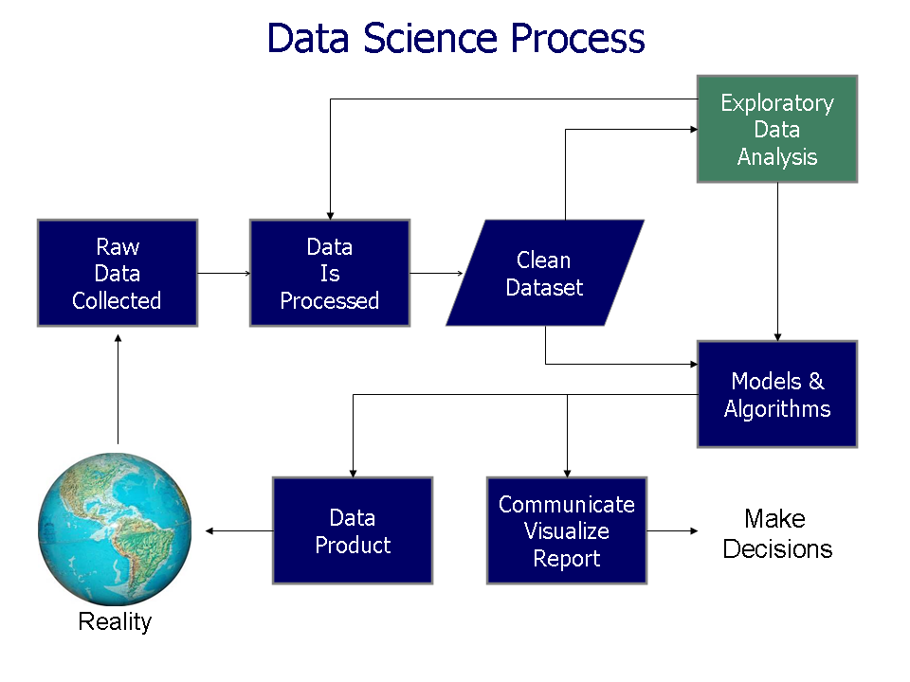
https://commons.wikimedia.org/wiki/File:Data_visualization_process_v1.png

Slide 15
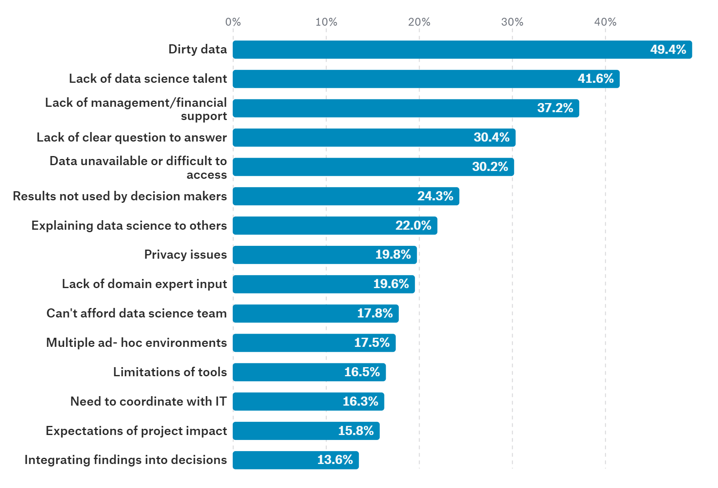
Work Barriers
https://www.kaggle.com/surveys/2017

