Slide 1
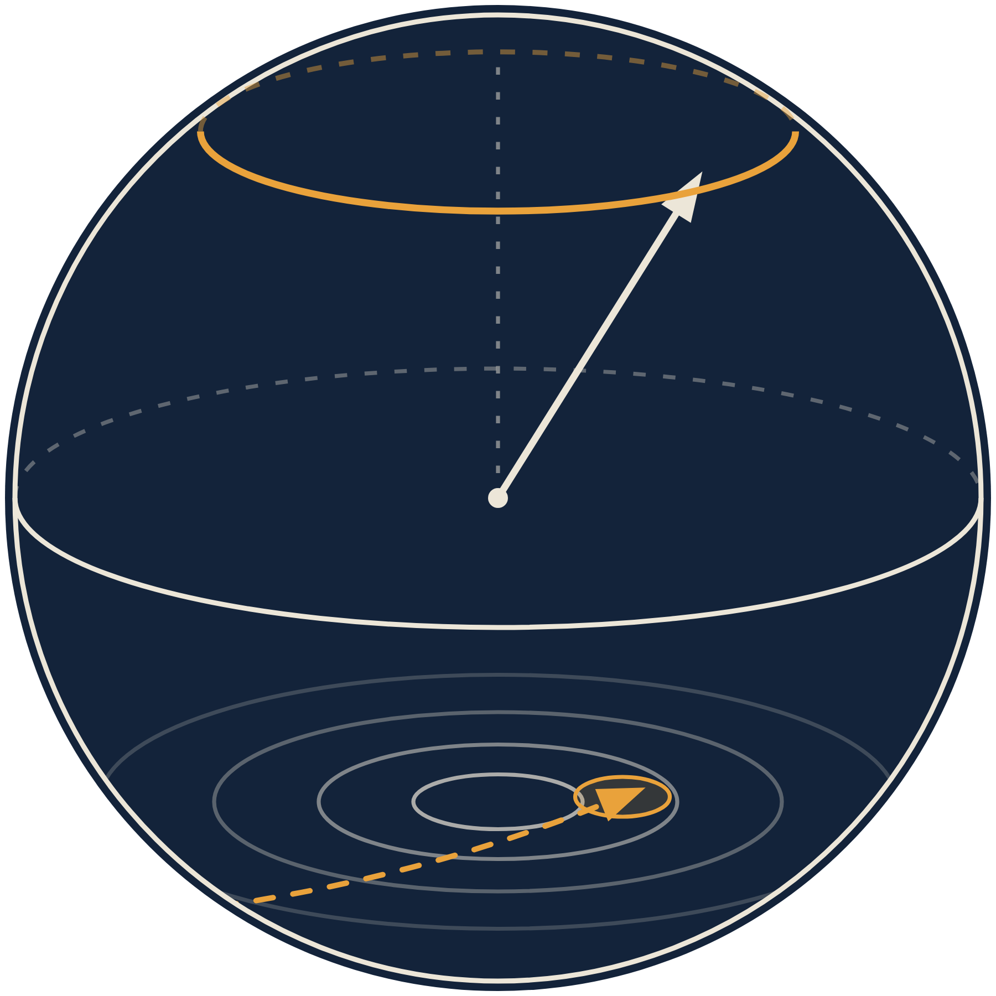

Navigation that keeps working when GNSS is jammed, spoofed or simply absent.
PETER DUNNIECE · ALEXANDER O'SULLIVAN · LORCAN GRIMES
EUDIS DEFENCE HACKATHON 2026 · DUBLIN · CHALLENGE 1: NAVIGATION WITHOUT GNSS
Notes:
Open with the problem in one line: when GPS is jammed, drones get lost. We built navigation that reads Ireland's own magnetic map with a quantum sensor. ~10 s on this slide.

Slide 2
GNSS jamming is now routine
THE PROBLEM
123,000
~1,500
+193%
flights hit by GNSS interference over the Baltic in four months
flights a day experience some form of GPS jamming
rise in GPS spoofing, 2023 to 2025 (jamming +67%)
Report to ICAO, Jan–Apr 2025
IATA, via Irish Times, Jun 2026
IATA, via Irish Times, Jun 2026
It has reached Irish-controlled Atlantic airspace, and drones have no ground beacons to fall back on.
Notes:
Jamming is not hypothetical: 123,000 Baltic flights in four months; 1,500 flights a day worldwide. Airliners have backups; small drones lose their mission. Sources: SVT/ICAO report via Travel Tomorrow (Sep 2025); Irish Times 29 Jun 2026 citing IATA.

Slide 3
Ireland: a huge sea, a small fleet
WHY IRELAND
880,000 km²
of sea to watch, more than 10× Ireland's land area
Marine Institute
IRISH WATERS
~75%
of transatlantic subsea cables pass through or near Irish waters
TechCentral, Jul 2026
8 ships
in the Naval Service; often only 1–4 can sail
TechCentral, Jul 2026
LAND
2027–28
before Ireland's first long-range primary military radar is in place
Irish Times, Jul 2026
Areas to scale
Notes:
Ireland's sea is ten times its land. Three-quarters of transatlantic cables pass nearby; Yantar has been escorted out of the Irish Sea; unidentified drones flew around Zelenskyy's arrival in Dublin (Dec 2025). Ireland needs cheap persistent uncrewed patrol, which is exactly where GNSS will be jammed.

Slide 4
At sea, every GNSS backup fails
THE GAP
CAMERAS
LIDAR / RADAR
STAR TRACKERS
INS ONLY
MAGNETIC MAP
The sea looks the same everywhere; nothing to lock on to. Blind at night and in fog.
The surface is flat and moving, so terrain matching has no terrain. Both emit.
Need a clear sky. Ireland rarely gives one.
Error grows without bound: hundreds of metres within minutes on a small drone.
Fixed to the rock below. Ignores waves, weather and daylight. Emits nothing.
FAILS
FAILS
FAILS
FAILS
WORKS
Notes:
Every other backup is defeated by the sea or by Irish weather. The magnetic anomaly field is fixed to the rock, needs no line of sight, and the sensor emits nothing. Northrop/SandboxAQ make the same point about open water.

Slide 5
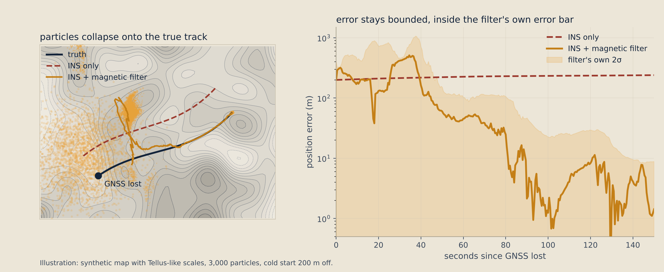
How it works: match the field to the map
OUR APPROACH
1
INS DRIFTS
2
QUANTUM SENSOR
3
PARTICLE FILTER
4
BOUNDED FIX
GNSS is lost; the drone's IMU keeps going but drifts
An OPM reads the field strength to a few picotesla
3,000 guesses are scored against the Tellus map
Position with an honest error bar, every half second
Notes:
Four steps. The INS drifts; the quantum sensor reads the field; the particle filter keeps thousands of guesses of the drift and scores each one against the Tellus map; the survivors give a position with an error bar. The figure is an illustration on a synthetic map - swap for the A7 run once it's final.

Slide 6
Why quantum: a normal compass can't see the map
WHY QUANTUM
7 Hz/nT
Rubidium spins precess at a rate set by nature. No drift, no calibration decay.
3 pT
noise floor, thousands of times finer than the anomalies on the map
Notes:
The core argument, from our own data. The drone's built-in compasses wander 400-1,000 nT in flight; on the QuSpin flight data the vector channel wandered 884 nT while the scalar OPM wandered 79 nT. Tellus anomalies are tens to hundreds of nT, so a normal compass can't see them. The OPM measures field strength as a frequency, 7 Hz per nT, so tilting the drone doesn't fool it.

Slide 7
You can't jam it from a distance
WHY IT WINS
~1 W
~3 TW
radio jammer overpowers GPS 16,000× at 10 km
to shift the field by just 10 nT at 10 km: about the average output of every power station on Earth
GPS reaches the ground at ~10⁻¹⁶ W (IS-GPS-200)
100 m
1 km
10 km
A magnetic jammer's field falls with distance cubed, so power grows with distance to the sixth: each 10× in range costs 1,000,000× in power. And MagNav emits nothing, so there is nothing to locate.
~3 W
~3 MW
~3 TW
First-principles estimates: on-axis dipole, 20 m, 5 t copper loop, DC.
Notes:
Headline: about 1 W denies GPS at 10 km; about 3 TW is needed to disturb MagNav at 10 km. B falls as 1/r^3 so power scales as r^6. The only real threat is within tens of metres - the same platform-interference problem we already measure and compensate. These are our own order-of-magnitude estimates, not a threat assessment.

Slide 8
The map already exists: Tellus, completed 2026
WHY NOW
16 years
of airborne survey; final flight June 2026
[ TELLUS A7 ANOMALY MAP ]
440,000 km
of flight lines over the whole island
60 m · 200 m
survey height and line spacing: far finer than most national maps
Free
open data, CC BY 4.0; merged national grid due 2027
Notes:
Ireland is one of the few countries with a complete detailed national airborne magnetic survey, and it is free. A navigation map normally costs a survey campaign; ours is already flown. Offshore coverage is coarser (EMAG2) - an honest gap, and an opportunity to extend Tellus offshore as INFOMAR did for the seabed. Source: gov.ie press release, 24 Jun 2026.

Slide 9
GNSS lost: the INS drifts, we don't
RESULTS
[ HEADLINE PLOT: ERROR VS TIME, INS ONLY VS INS + MAGNAV, OVER A7 ]
[ ___ m ]
final error with the magnetic filter
[ ___ m ]
final error, INS only, same IMU
[ ___× ]
better, consumer-grade IMU
Notes:
Fill from COH-16 (scripts/run_pf_demo.py, outputs/pf_headline.png). Say the number once, slowly. Mention that the readings come from a different, degraded map than the one the filter uses, so it isn't checking the map against itself.

Slide 10
Real data, not just simulation
EVIDENCE
REAL QUANTUM SENSOR
PUBLIC BENCHMARK
OUR OWN DRONE
QuSpin QTFM flight data: map from half the survey lines, navigate along the other half
DAF–MIT MagNav challenge: a real flight with its own map, run through our filter
X500 + RM3100: lawnmower survey, map from odd strips, navigate the even strips
[ RESULT ]
[ RESULT ]
[ RESULT ]
Notes:
Answer 'is it only a simulation?' before they ask. Fill each result from COH-28, COH-29 and COH-31. If one isn't ready, replace its result with 'in progress' rather than leaving a bracket.

Slide 11
Two airframes, one sensor, interference measured
BUILT THIS WEEKEND
[ PHOTO: X500 + BOOM ]
[ PHOTO: FLIGHTORY MOOSE ]
[ PHOTO: MAGPIE MOCKUP ]
[ BEFORE / AFTER INTERFERENCE ]
Holybro X500 V2, Pixhawk 6C, ArduPilot, RM3100 on DroneCAN
Printed fixed wing for long offshore legs
Printed sensor mockup in its cradle
Motor interference, bench-measured before and after the boom mount
Particle filter and map tools written here, on top of our pre-event INS and sensor models
Every part near the sensor printed non-magnetic, by design
Notes:
Progress is scored: show it. Everything after the 'EVENT BEGIN COMMIT' (0de38ff) was built here: filter, flights, mounts, the Moose. Quote one number from the before/after chart.

Slide 12
The race is on; Europe has no small-drone answer
THE MARKET
NORTHROP GRUMMAN + SANDBOXAQ
HONEYWELL + DIU
Q-CTRL
Sep 2026
Sep 2026
2025
Quantum MagNav on the Lumberjack uncrewed aircraft; reported jam-resistant and working over open water
Embraer 170 flew 4 h 23 min over the Pacific without GPS; 89% better than conventional backups
Airborne quantum MagNav up to ~46× lower error than an aided strategic-grade INS
Cohera: European, built on an open national map, sized for small drones that Ireland can afford to fly in numbers.
Notes:
Validation that the method works, from the biggest names, all in the last few weeks. All are US or Australian and on large platforms. Our angle: European, open map, small drones. Sources: Northrop Grumman release 9 Sep 2026; DefenseScoop 8 Sep 2026; arXiv:2504.08167.

Slide 13
From hackathon to a Defence Forces trial
ROADMAP
NOW
3 MONTHS
6 MONTHS
Filter validated on simulated and real data; X500 and Moose built; interference measured and reduced
Fly a real QTFM on the X500 over a Tellus survey block; real-time filter on a companion computer
Maritime trial with the Naval Service; evaluate the export-friendly QTFM-B; close the offshore map gap
THE ASK
A Defence Forces test range and a loaned quantum sensor, so we can fly the real thing over Irish geology.
Notes:
End on the ask. Concrete, small, and something the people in the room can say yes to. Check the roadmap wording with the commercial mentor (COH-59/COH-67).

Slide 14
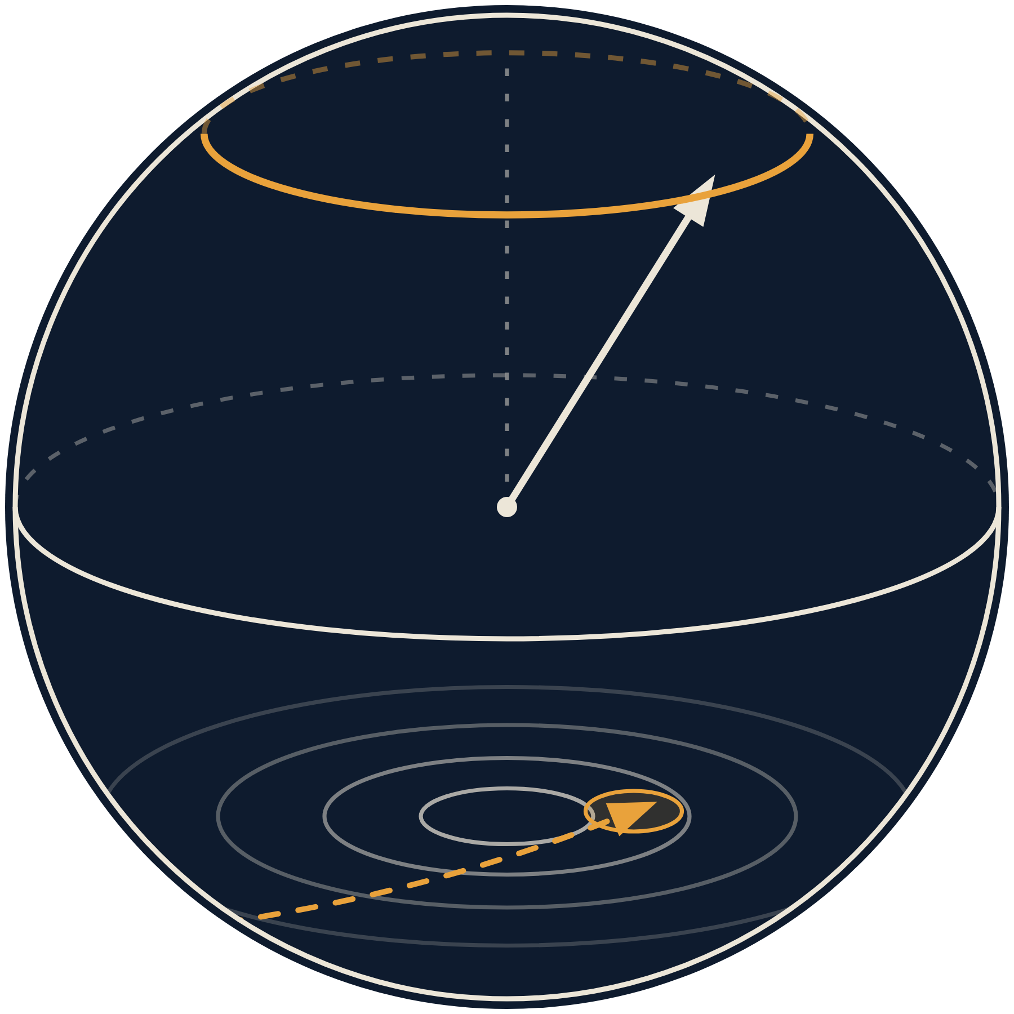

Navigation that keeps working when GNSS is jammed, spoofed or simply absent.
PETER DUNNIECE · ALEXANDER O'SULLIVAN · LORCAN GRIMES
THANK YOU · QUESTIONS
Notes:
Pause. Repeat the one line. Take questions; backup slides follow.

Slide 15
What is real and what is modelled
BACKUP
COMPONENT | STATUS | EVIDENCE
Quantum sensor (QTFM) | Real flight data; emulated on our drone until we have a unit | QuSpin logs, notebooks/quspin, dynamic
Drone, IMU, RM3100 | Real hardware, flown with DroneCAN logging | hardware/drone_files/logs
Tellus magnetic map | Real national data (GSI, CC BY 4.0) | Block A7, merge_tmi
Particle filter | Built this weekend; tested on simulated and real data | modelling/src/navfilter, tests
Platform interference | Bench-measured on our X500, then compensated | Sweeps A, B, C
Notes:
Use if a judge asks what is simulated. The honest one-liner: the drone, the logs and the QTFM data are real; the QTFM on our drone is emulated from real data until we have a unit.

Slide 16
How the quantum sensor works
BACKUP
PUMP
Circularly polarised 795 nm laser light lines up the spins of rubidium atoms in a heated vapour cell.
PRECESS
In the Earth's field the spins wobble around the field direction at f = γB, with γ ≈ 7 Hz per nT.
READ
The light through the cell flickers at that frequency. Measure it, and |B| = f / γ.
Over Ireland: 49,000 nT → 343 kHz. A 1 nT anomaly moves it by 7 Hz. It depends on the field's strength, not its direction, so tilting the drone can't fool it.
The Bloch sphere in our logo is the precessing spin
Notes:
If asked 'why is it quantum?': discrete energy levels, photons transferring exactly one unit of angular momentum, a coherent superposition whose phase winds at the Larmor frequency, and a sensitivity limit set by quantum projection noise. See opm_explained.pdf.

Slide 17
Hard questions, short answers
BACKUP
Export control?
Outside Ireland?
QTFM is ECCN 6A006.a.2. The derated QTFM-B (>20 pT/√Hz) is 6A996.a; our sensitivity sweep tests whether it is enough.
Any national aeromagnetic survey works; global EMAG2 covers the rest at lower resolution.
Flat geology?
The drone's own field?
The filter's error bar grows and it says so. Our navigability map shows where it works before you fly.
Boom distance, twisted leads, then Tolles–Lawson plus motor-current compensation, all measured on our X500.
Magnetic storms?
Cost?
Subtract MagIE observatory data (Dunsink, Birr, Armagh, Valentia); integrity checks flag the rest.
A gram-scale sensor and a free map, instead of a strategic-grade inertial unit.
Notes:
Assign an owner per question (COH-61). Keep each answer to one breath.

