Slide 1
Project Management portal
Instructor – Dr. Jia Zhang pariskshit Dutt, Jie Zhu
[18655] Service Oriented Computing, Spring 2018

Slide 2
Roadmap
Introduction
Motivation
System design
System implementation
Analysis and discussions
Demo
Conclusions and future work

Slide 3



Introduction and Motivation
Project approval system for new projects.
Big companies need projects to be approved by an admin before it can be put in production
Web based system for management

Slide 4
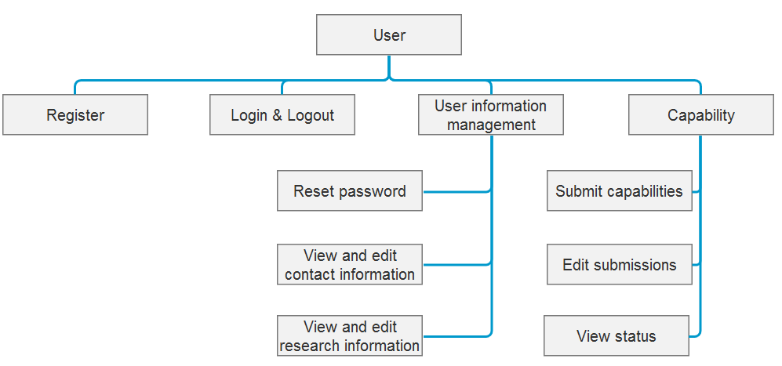
System Design

Slide 5
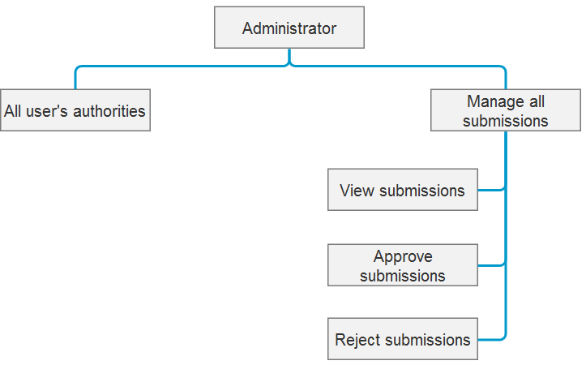
System Design

Slide 6
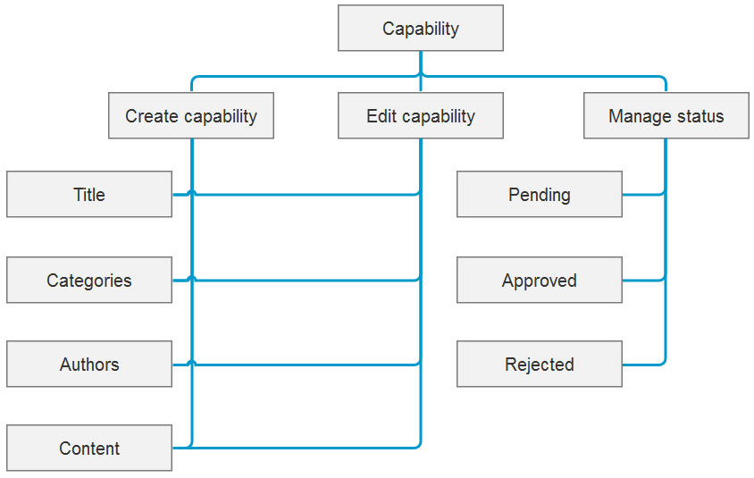
System Design

Slide 7

Architecture
Frontend server
Backend server
MySQL server

Slide 8
System Implementation
Libraries used-
HikariCP (DB)
ebean (DB)
Javamail api
Unirest (http calls)
Play-bootstrap (frontend)
jbcrypt (password encryption)

Slide 9
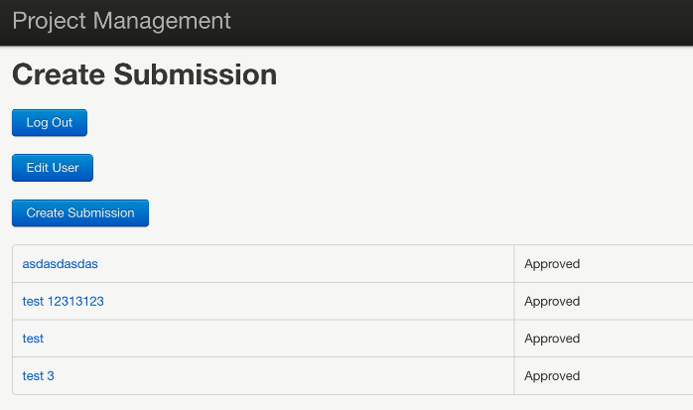
Analysis and Discussions
User features
submit capability
edit user info
view the status
change submissions

Slide 10
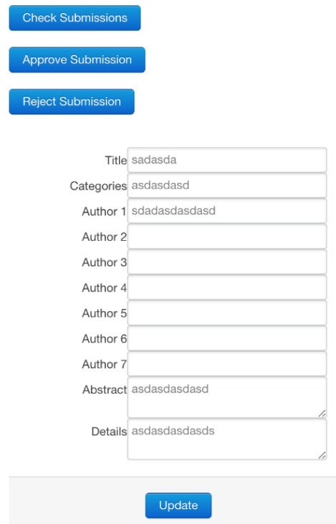
Analysis and Discussions
Admin features
View submissions
Approve/Reject submissions
change submissions

Slide 11
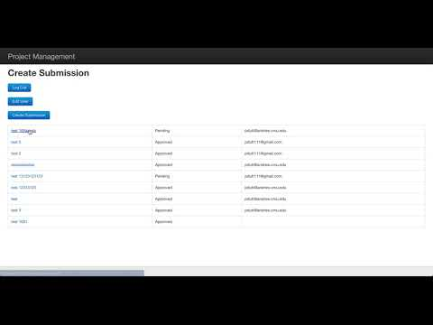
Demo

Slide 12
Design Features
MySQL connection pool higher throughput
utf8_unicode_ci in mysql to support equations
REST api on the backend
Password encrypted using bcrypt
Forms using form data for requests
deployment using executable jar

Slide 13
Future Work
All known bugs & issues fixed
Things to try
Cloud deployments
angularjs etc.
stress test
highly scalable system

Slide 14

Questions?

