Slide 1
Fast matrix multiplication;
Cache usage
Assignment #2

Slide 2
Multiplication of 2D Matrices
Simple algorithm
Time and Performance Measurement
Simple Code Improvements

Slide 3
Matrix Multiplication
C
A
B
=
*

Slide 4
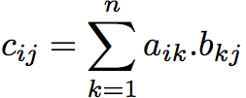
Matrix Multiplication
C
A
B
c_{ij}
=
*
a_{i*}
b_{*j}

Slide 5
The simplest algorithm
Assumption: the matrices are stored as 2-D NxN arrays
for (i=0;i<N;i++)
for (j=0;j<N;j++)
for (k=0;k<N;k++) c[i][j] += a[i][k] * b[k][j];
Advantage: code simplicity
Disadvantage: performance (?)

Slide 6
First Improvement
for (i=0;i<N;i++)
for (j=0;j<N;j++)
for (k=0;k<N;k++) c[i][j] += a[i][k] * b[k][j];
c[i][j]:
  Requires address (pointer) computations
  is constant in the k-loop

Slide 7
First Performance Improvement
for (i=0;i<N;i++){
for (j=0;j<N;j++) {
int sum = 0;
for (k=0;k<N;k++) {
sum += a[i][k] * b[k][j];
}
c[i][j] = sum;
}
}

Slide 8
Performance Analysis
clock_t clock() – Returns the processor time used by the program since the beginning of execution, or -1 if unavailable.
clock()/CLOCKS_PER_SEC – the time in seconds (approx.)
#include <time.h>
clock_t t1,t2;
t1 = clock();
mult_ijk(a,b,c,n);
t2 = clock();
printf(“Running time = %f seconds\n", (double)(t2 - t1)/CLOCKS_PER_SEC);

Slide 9


The running time
The simplest algorithm:
After the first optimization:
15% reduction

Slide 10
Profiling
Profiling allows you to learn where your program spent its time.
This information can show you which pieces of your program are slower and might be candidates for rewriting to make your program execute faster.
It can also tell you which functions are being called more often than you expected.

Slide 11
gprof
gprof is a profiling tool ("display call graph profile data")
Using gprof:
  compile and link with –pg flag (gcc –pg)
  Run your program. After program completion a file name gmon.out is created in the current directory. gmon.out includes the data collected for profiling
  Run gprof (e.g. “gprof test”, where test is the executable filename)
For more details – man gprof.

Slide 12
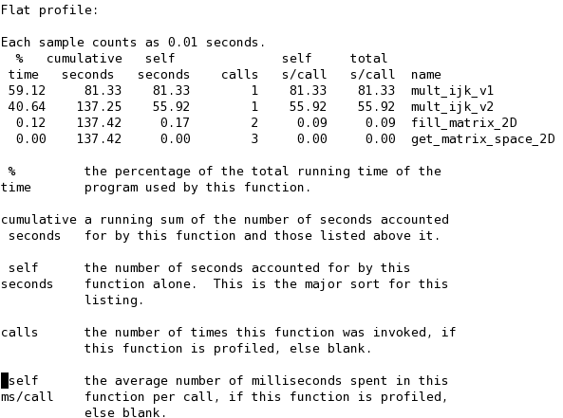
gprof outputs (gprof test gmon.out | less)
The total time spent by the function WITHOUT its descendents

Slide 13
Cache Memory

Slide 14
Cache memory (CPU cache)
A temporary storage area where frequently accessed data can be stored for rapid access.
Once the data is stored in the cache, future use can be made by accessing the cached copy rather than re-fetching the original data, so that the average access time is lower.

Slide 15
Memory Hierarchy
CPU Registers
500 Bytes
0.25 ns
CPU
word transfer (1-8 bytes)
 access time
 size of transfer unit
 cost per bit
 capacity
 frequency of access
Cache
16K-1M Bytes
1 ns
cache
block transfer (8-128 bytes)
Main Memory
64M-2G Bytes
100ns
main memory
Disk
100 G Bytes
5 ms
disks
The memory cache is closer to the processor than the main memory.
It is smaller, faster and more expensive than the main memory.
Transfer between caches and main memory is performed in units called cache blocks/lines.
Notes:
Most computers possess four kinds of memory: registers in the CPU, CPU caches (generally some kind of static RAM) both inside and adjacent to the CPU, main memory (generally dynamic RAM) which the CPU can read and write to directly and reasonably quickly; and disk storage, which is much slower, but also much larger. CPU register use is generally handled by the compiler and this isn't a huge burden as data doesn't generally stay in them very long. The decision of when to use cache and when to use main memory is generally dealt with by hardware so generally both are regarded together by the programmer as simply physical memory.

Slide 16
Types of Cache Misses
1. Compulsory misses: caused by first access to blocks that have never been in cache (also known as cold-start misses)
2. Capacity misses: when cache cannot contain all the blocks needed during execution of a program. Occur because of blocks being replaced and later retrieved when accessed.
3. Conflict misses: when multiple blocks compete for the same set.

Slide 17
Main Cache Principles
Temporal Locality (Locality in Time): If an item is referenced, it will tend to be referenced again soon.
  LRU principle: Keep last recently used data
Spatial Locality (Locality in Space): If an item is referenced, close items (by address) tend to be referenced soon.
  Move blocks of contiguous words to the cache
Notes:
Here is a simple overview of how cache works. Cache works on the principle of locality.
It takes advantage of the temporal locality by keeping the more recently addressed words in the cache.
In order to take advantage of spatial locality, on a cache miss, we will move an entire block of data that contains the missing word from the lower level into the cache.
This way, we are not ONLY storing the most recently touched data in the cache but also the data that are adjacent to them.
+1 = 15 min. (X:55)

Slide 18
Improving Spatial Locality:
Loop Reordering for Matrices Allocated by Row
M
Allocation by rows
X
N

Slide 19
Writing Cache Friendly Code
N
Assumptions: 1) block-size= β words (word = int)
2) N is divided by β
3) The cache cannot hold a complete row / column
N
int sumarrayrows(int a[N][N])
{
int i, j, sum = 0;
for (i = 0; i < N; i++)
for (j = 0; j < N; j++)
sum += a[i][j];
return sum;
}
int sumarraycols(int a[N][N])
{
int i, j, sum = 0;
for (j = 0; j < N; j++)
for (i = 0; i < N; i++)
sum += a[i][j];
return sum;
}
no spatial locality!
  Accesses successive elements:
  a[0][0],...,a[0][N-1],a[1][0],..
  Accesses distant elements:
  a[0][0],...,a[N-1][0],a[0][1],...
Miss rate = 1/ β
Miss rate =
1

Slide 20
Matrix Multiplication (ijk)
every element of A and B is accessed N times
/* ijk */
for (i=0; i<n; i++) {
for (j=0; j<n; j++) {
int sum = 0;
for (k=0; k<n; k++)
sum += a[i][k] * b[k][j];
c[i][j] = sum;
}
}
Inner loop:
(*,j)
(i,j)
(i,*)
A
B
C
Row-wise
Column-
wise
Fixed
Misses per Inner Loop Iteration (i=j=0):
  A B C
  1/β 1.0 1.0
*what happens when i=0 and j=1?

Slide 21
Matrix Multiplication (jik)
every element of A and B is accessed N times
/* jik */
for (j=0; j<n; j++) {
for (i=0; i<n; i++) {
int sum = 0;
for (k=0; k<n; k++)
sum += a[i][k] * b[k][j];
c[i][j] = sum;
}
}
Inner loop:
(*,j)
(i,j)
(i,*)
A
B
C
Row-wise
Column-
wise
Fixed
Misses per Inner Loop Iteration (i=j=0):
  A B C
  1/ β 1.0 1.0
*what happens when j=0 and i=1?

Slide 22
Matrix Multiplication (kij)
every element of B and C is accessed N times
/* kij */
for (k=0; k<n; k++) {
for (i=0; i<n; i++) {
int x = a[i][k];
for (j=0; j<n; j++)
c[i][j] += x * b[k][j];
}
}
Inner loop:
(i,k)
(k,*)
(i,*)
A
B
C
Fixed
Row-wise
Row-wise
Misses per Inner Loop Iteration (i=j=0):
  A B C
  1.0 1/β 1/β
*what happens when k=0 and i=1?
Notes:
Partial calculation of the elements of C

Slide 23
Matrix Multiplication (jki)
every element of A and C is accessed N times
/* jki */
for (j=0; j<n; j++) {
for (k=0; k<n; k++) {
int x = b[k][j];
for (i=0; i<n; i++)
c[i][j] += a[i][k] * x;
}
}
Inner loop:
(*,k)
(*,j)
(k,j)
A
B
C
Column -
wise
Fixed
Column-
wise
Misses per Inner Loop Iteration (i=j=0):
  A B C
  1.0 1.0 1.0
*what happens when j=0 and k=1?

Slide 24
Summary: misses ratios for the first iteration of the inner loop
ijk (& jik): (β+1)/(2β) >1/2
kij: 1/β
jki: 1
for (i=0; i<n; i++) {
for (j=0; j<n; j++) {
int sum = 0;
for (k=0; k<n; k++)
sum += a[i][k] * b[k][j];
c[i][j] = sum;
}
}
for (k=0; k<n; k++) {
for (i=0; i<n; i++) {
int x = a[i][k];
for (j=0; j<n; j++)
c[i][j] += x * b[k][j];
}
}
for (j=0; j<n; j++) {
for (k=0; k<n; k++) {
int x = b[k][j];
for (i=0; i<n; i++)
c[i][j] += a[i][k] * x;
}
}

Slide 25
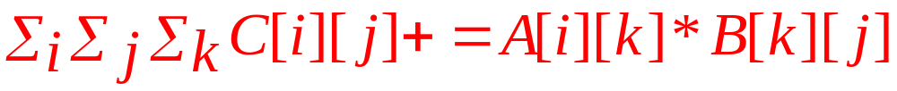
Cache Misses Analysis
Assumptions about the cache:
  β = Block size (in words)
  The cache cannot hold an entire matrix
  The replacement policy is LRU (Least Recently Used).
Observation: for each loop ordering one of the matrices is scanned n times.
➔Lower bound = 2n²/β + n³/β = Θ (n³/β)
For further details see the tutorial on the website.
The inner indices point on the matrix scanned n times
one read of 2 matrices
(compulsory misses)
n sequential reads of one matrix
(compulsory + capacity misses)

Slide 26
Improving Temporal Locality:
Blocked Matrix Multiplication

Slide 27
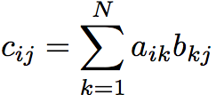
“Blocked” Matrix Multiplication
j
r elements
i
cache block
i
C
A
j
B
Key idea: reuse the other elements in
each cache block as much as possible

Slide 28
“Blocked” Matrix Multiplication
r elements
j
cache blocks
cache block
i
i
r elements
r elements
C[i][j]
C[i][j+r-1]
C
A
j
B
The blocks loaded for the computation of C[i][j] are appropriate for the computation of C[i,j+1]...C[i,j+ r-1]
compute the first r terms of C[i][j],...,C[i][j+r -1]
compute the next r terms of C[i][j],...,C[i][j+r -1]
.....

Slide 29
“Blocked” Matrix Multiplication
r elements
j
i
i
C
A
j
B
Next improvement:
Reuse the loaded blocks of B for the computation of next (r -1) subrows.

Slide 30
“Blocked” Matrix Multiplication
j
j
cache block
B₁
i
i
C₁
A₁
A₂
A₃
A₄
B₂
B₃
B₄
C
A
B
Order of the operations:
Compute the first r terms of C1 )=A₁*B₁)
Compute the next r terms of C1 (=A₂*B₂)
. . .
Compute the last r terms of C1 (=A₄*B₄)

Slide 31
“Blocked” Matrix Multiplication
C₁₁
C₁₂
C₁₃
C₁₄
A₁₁
A₁₂
A₁₃
A₁₄
B₁₁
B₁₂
B₁₃
B₁₄
C₂₁
C₂₂
C₂₃
C₂₄
A₂₁
A₂₂
A₂₃
A₂₄
B₂₁
B₂₂
B₂₃
B₂₄
C₃₁
C₃₂
C₄₃
C₃₄
A₃₁
A₃₂
A₃₃
A₃₄
B₃₂
B₃₂
B₃₃
B₃₄
C₄₁
C₄₂
C₄₃
C₄₄
A₄₁
A₄₂
A₄₃
A₁₄₄
B₄₁
B₄₂
B₄₃
B₄₄
N = 4 *r
C₂₂ = A₂₁B₁₂ + A₂₂B₂₂ + A₂₃B₃₂ + A₂₄B₄₂ =
∑_{k} A_{2k}*B_{k2}
Main Point: each multiplication operates on small “block” matrices, whose size may be chosen so that they fit in the cache.

Slide 32
Blocked Algorithm
The blocked version of the i-j-k algorithm is written simply as
for (i=0;i<N/r;i++)
for (j=0;j<N/r;j++)
for (k=0;k<N/r;k++)
C[i][j] += A[i][k]*B[k][j]
  r = block (sub-matrix) size (Assume r divides N)
  X[i][j] = a sub-matrix of X, defined by block row i and block column j
r x r matrix addition
r x r matrix multiplication

Slide 33
Maximum Block Size
The blocking optimization works only if the blocks fit in cache.
That is, 3 blocks of size r x r must fit in memory (for A, B, and C)
M = size of cache (in elements/words)
We must have: 3r² ≈ M, or r ≈ √(M/3)
Lower bound = (r²/β) (2(n/r)³ + (n/r)²) =
(1/β)(2n³/r +n²) = Θ (n³/(rβ)) = Θ(n³/(β√M))
Therefore, the ratio of cache misses ijk-blocked vs. ijk-unblocked: 1:√M

Slide 34
Home Exercise

Slide 35
Home exercise
Implement the described algorithms for matrix multiplication and measure the performance.
Store the matrices as arrays, organized by columns!!!
M
a[i][j] = A[i+j*N]
j*N
i
X
N
X
i
A[i+j*N]
a[i][j]

Slide 36
Question 2.1: mlpl
Implement all the 6 options of loop ordering (ijk, ikj, jik, jki, kij, kji).
Run them for matrices of different sizes.
Measure the performance with clock() and gprof.
Plot the running times of all the options (ijk, jki, etc.) as the function of matrix size.
Select the most efficient loop ordering.

Slide 37
Question 2.2: block_mlpl
Implement the blocking algorithm.
  Use the most efficient loop ordering from 1.1.
Run it for matrices of different sizes.
Measure the performance with clock()
Plot the running times in CPU ticks as the function of matrix size.

Slide 38
User Interface
Input
  Case 1: 0 or negative
  Case 2: A positive integer number followed by values of two matrices (separated by spaces)
Output
  Case 1: Running times
  Case 2: A matrix, which is the multiplication of the input matrices (C=A*B).

Slide 39
Files and locations
All of your files should be located under your home directory
/soft-proj09/assign2/
Strictly follow the provided prototypes and the file framework (explained in the assignment)

Slide 40
The Makefile
mlpl: allocate_free.c matrix_manipulate.c multiply.c mlpl.c
gcc -Wall -pg -g -ansi -pedantic-errors allocate_free.c matrix_manipulate.c multiply.c mlpl.c -o mlpl
block_mlpl: allocate_free.c matrix_manipulate.c multiply.c block_mlpl.c
gcc -Wall -pg -g -ansi -pedantic-errors allocate_free.c matrix_manipulate.c multiply.c block_mlpl.c -o block_mlpl
Commands:
make mlpl – will create the executable mlpl for 2.1
make block_mlpl - will create the executable block_mlpl for 2.2

Slide 41
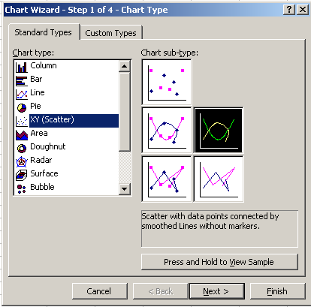
Plotting the graphs
Save the output to *.csv file.
Open it in Excel.
Use the Excel’s “Chart Wizard” to plot the data as the XY Scatter.
  X-axis – the matrix sizes.
  Y-axis – the running time in CPU ticks.

Slide 42
Final Notes
Arrays and Pointers:
The expressions below are equivalent:
  int *a
  int a[]

Slide 43
Good Luck in the Exercise!!!

