Slide 1


Specific Activity Recognition in a video
Shubham Kumar Agrawal Ms. Disha.G.Deothale/Dr. Madhushi Varma
Shaik Mohammed Khalid Naveed
Christyl Thomas Sunny
Tummala Sai Teja
Rohit NSV

Slide 2

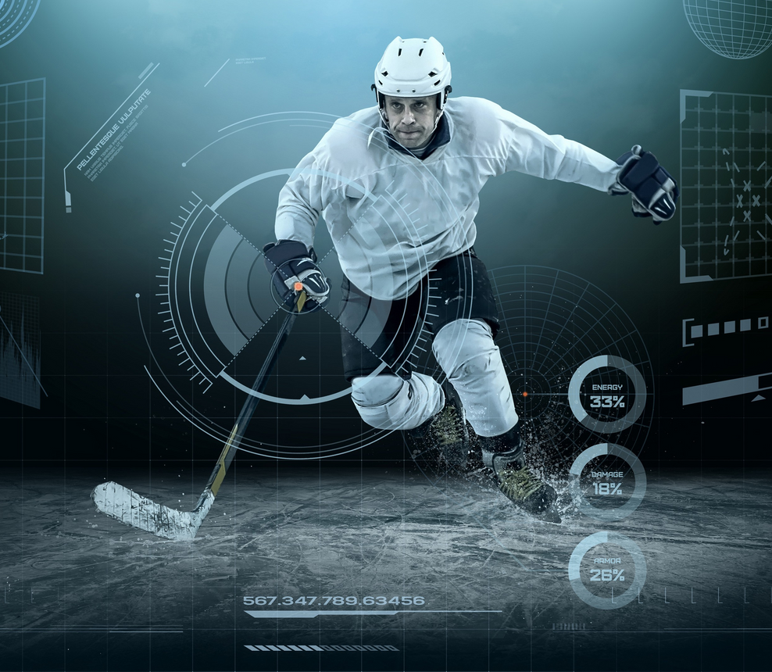
Introduction
To recognize the specific sport activities and sub-activities from a video.

Slide 3
Dataset
UCF101 dataset is used.
Data was extracted from the sports videos and was processed to be used for building the model.
There are 122 trained videos and 52 test videos.
https://drive.google.com/open?id=12u_tsQEsWVG5EjG6GMG-6cOhCOB3l5f-

Slide 4
Methodology and the Model
Spatial Featuring : Extracting 200 special features
Temporal Featuring : Manual Featuring & Automatic Featuring
LSTM Model : Giving sequential inputs with extracted features

Slide 5

Results Achieved
Model | Training Accuracy | Test Accuracy
0 ConvNet(for subactivity recognition) | .95 | .70
1 LSTM | .88 | .52

Slide 6
Conclusion
We can conclude that Convolutional Neural Networks gives better test accuracy while performing subactivity recognition and LSTM(Long-Short Term Memory) model lags behind the ConvNet model in both Training accuracy 6 and test accuracy.
In the future, we will keep making efforts to advance the performance of our model with more benchmark datasets.

Slide 7
Many other features can be added not only temporary and spacial features.
Limitations:
Data is outdated.
Trimmed data is used, not supportable for untrimmed data.

Slide 8
References
Xianyuan Wang, Zhenjiang Miao, Ruyi Zhang and Shanshan Hao:I3D-LSTM: A New Model for Human Action Recognition,Xianyuan Wang et al 2019 IOP Conf. Ser.: Mater. Sci. Eng. 569 032035 Khurram Soomro, Amir Roshan Zamir and Mubarak Shah, UCF101: A Dataset of 101 Human Action Classes From Videos in The Wild, CRCV-TR-12-01, November, 2012.

Slide 9
Thank You

