Slide 1
Machine Learning - Introduction
Yeganeh Jalalpour

Slide 2
Motivation
AI goal: replace human programming with "self-programming" (= predict appropriate behavior based on experience)
The example: infants
language skills
motor skills
other behaviors
Usual dichotomy:
Algorithmic/heuristic "tricks"
Simulate human behavior (infant brain)

Slide 3
ML and Systems
Data flow in ML systems
Data complexity
ML system evaluation

Slide 4
Data flow in ML systems
Supervised Learning
Classification
Regression
Unsupervised Learning
Clustering
Association
Reinforcement Learning

Slide 5
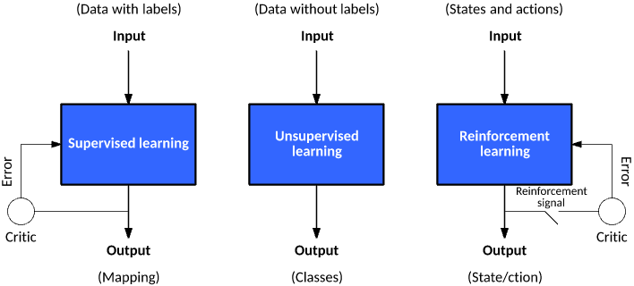
https://docs.paperspace.com/machine-learning/wiki/supervised-unsupervised-and-reinforcement-learning

Slide 6
Data complexity
Numerical Data
Continuous
Discrete
Ordinal Data
Categorical Data
Fancy Data

Slide 7
ML System Evaluation
Binary Classifications:
True Positive
False Positive
True Negative
False Negative

Slide 8
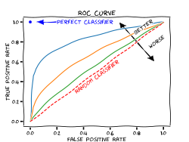
Some Binary Classification Metrics
Accuracy = correct predictions / all predictions
Recall = true positives / (true positives + false negatives)
Precision = true positives / (true positives + false positives)
Receiver Operating Characteristic (ROC) curve
https://upload.wikimedia.org/wikipedia/commons/thumb/3/36/Roc-draft-xkcd-style.svg/375px-Roc-draft-xkcd-style.svg.png

Slide 9
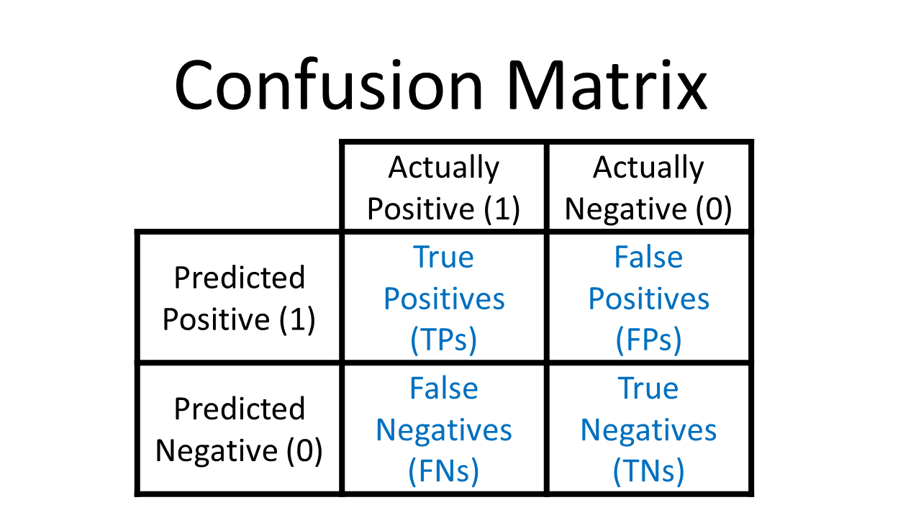
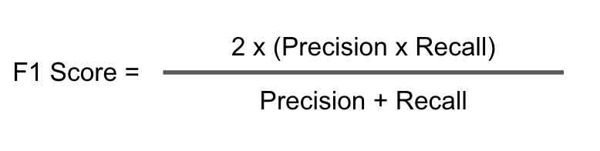
More Binary Classification Metrics
Confusion Matrix
F1 Score
https://glassboxmedicine.files.wordpress.com/2019/02/confusion-matrix.png

Slide 10

More Classification Metrics
Prediction “Loss”
Inputs
Outputs + Prediction Error Term
(Image: Wikimedia Commons)
Typically various norms, e.g. L0, L1, L2

