Slide 1
Games Computers Play
Bart Massey
Computer Science Dept.
Portland State University
bart@cs.pdx.edu
http://www.cs.pdx.edu/~bart

Slide 2
45 Years Ago...
Computer world chess champion: "soon"
Widespread agreement on this!
Other games sure to follow...
Big lessons about human reasoning!

Slide 3
What Happened?
Human players were underestimated
Benefits of better computers overestimated
Clever approach to computer game play!

Slide 4
Overview
How computers play games
Survey of computer game play
Lessons from computer game play

Slide 5
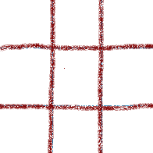


How To Play Tic­Tac­Toe
Game characteristics:
  ``zero sum''
  two player
  alternating
  terminating
  no ``luck''
  no ``hidden info.''
Notes:
luck = chance/probability/randomness
O has lost this game, even though it is O's turn.

Slide 6
How Humans Play Tic­Tac­Toe
Identify and block
immediate wins
Set up two­way traps
Try something new
Soon learn how to
force a draw
Notes:
This game is already drawn, since each potential win already contains X and O.

Slide 7
How Computers Play Tic­Tac­Toe
Game tree search
Minimize opponent maximum
Must play every possible game out!
Notes:
Tree grows down from ``root''.
Only part of tree shown here: dashes indicate more stuff.
Whole TTT tree = couple hundred moves (ab + symmetry), couple hundred Kmoves (dumb minmax).

Slide 8
How Computers Play Chess
Cannot try every possible game
Play for "a while", then evaluate
In practice,
deeper is better
Opening book,
endgame code
Notes:
Positions after 3 moves by each side.

Slide 9
How Well Does Search Work?
Easy to program
Better for simple games
Better for faster computers
Notes:
Tough meaning:
difficult to improve search much
rarely other good approaches

Slide 10
Computers Play These Perfectly
"Solved" games
  Tic­Tac­Toe
  3D 4x4 Tic­Tac­Toe (Qubic),
  Gomoku, Connect Four
  Mastermind
  awari
  Features
    Small search
    regular structure
Notes:
Victor Allis solved many of these.

Slide 11
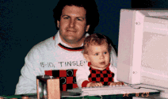
Checkers
Chinook (Jonathan Schaeffer) 1989 world human-machine champion, solved Checkers 2007 (draw)
Characteristics
  Powerful parallel computer
  (very deep search)
  Huge opening book, endgame database
"Must­read" book: One Jump Ahead (Springer­Verlag)
Notes:
Jonathan, w. Tinsley shirt, programming with son.

Slide 12

Chess
Deep Blue (IBM team) beats Kasparov, February 1997 (3.5-2.5, experts dispute significance)
Deep Fritz draws Kramnik,
Oct. 2002 (4-4); Deep Junior
draws Kasparov, Feb. 2003)
Kramnik accused of using Fritz 9 in match against Topalov, September 28 2006
Notes:
Deep Blue team:
Murray Campbell, AI
Joel Benjamin, chess GM

Slide 13
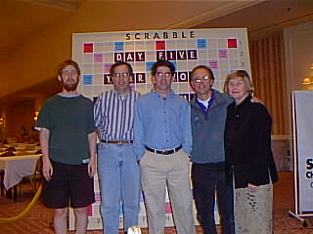
Scrabble
Maven (Brian Sheppard) was roughly par with top human players (e.g. GM Adam Logan), though now stronger
What does this mean?
  Top human players
  know most words
  More strategy
  "Luck": randomization (draw)
  tough for computers
Notes:
1998 National Championships
Adam Logan @ left

Slide 14
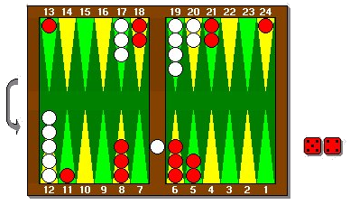
Backgammon
TD­Gammon (Gerald Tesauro, 1990s) roughly par with top human players (e.g. Malcolm Davis)
Performance near optimal
Program learns by playing
(neural nets)
Handles "luck" (probability)
surprisingly well
Notes:
Game v. TD annotated by Kit Woolsey

Slide 15
Go
1997: Janice Kim beats Handtalk in demo with 25­stone handicap!
2010: MoGo beats US champ with 9-stone handicap
2017: AlphaGo destroys the world’s top Go players.
Notes:
19x19 = 361 points
Position is unrealistic
Handtalk in 386 assembly!
Zhixing: not enough search!

Slide 16
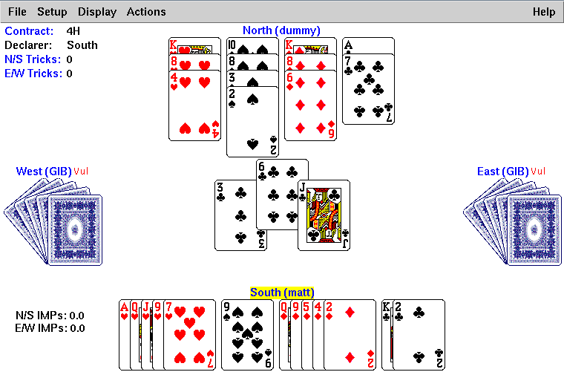
Bridge
Zia Mahmood 1991-1997: £1M bet
GIB (Ginsberg) was world computer champion
= good club player
  Bidding so­so
  Play usually strong
Current programs not
way better
Notes:
GIBson?

Slide 17
The Near Future
Games of chance (poker, CCGs)
Hidden information (poker, Stratego)
Learning

Slide 18
Longer Term
Multiplayer
Better strategic play
  planning
  pattern recognition
Not just games any more!
  military, economic tool
  general problem solving techniques

Slide 19
AI Lessons From
Computer Games
AI does not scale well with computer size/speed
Intelligence and game playing ability
not necessarily related
"Pride goes before destruction, and a haughty spirit before a fall. " —Proverbs 16:18
Notes:
``If computers can do it, it isn't AI''

Slide 20
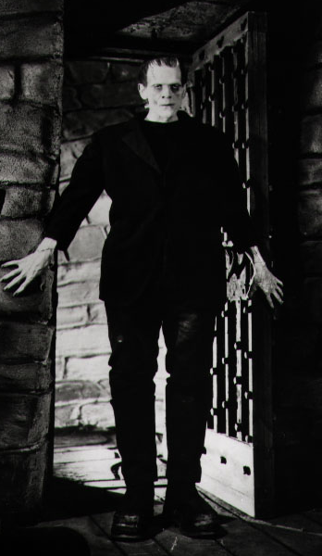
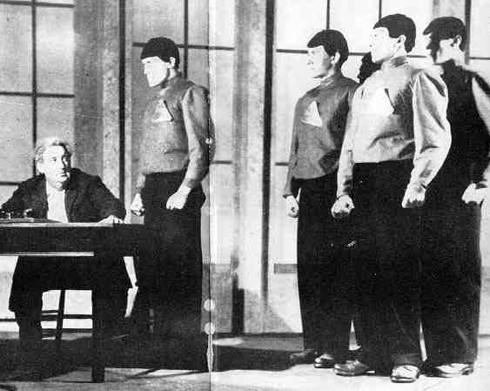
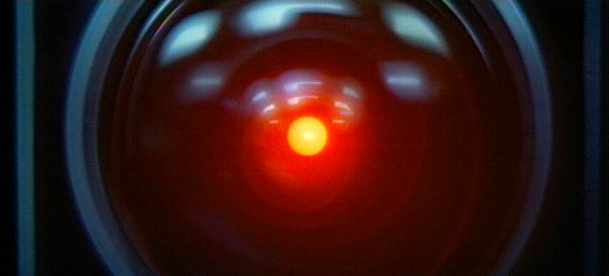

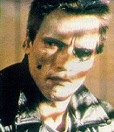

General Lessons From Computer Games
Old view: John Henry, Frankenstein, R.U.R., HAL, Terminator
New view: Adding machine
  Complementary skills
  Solve specific problems
Notes:
AI ``simulating human intelligence'' vs. ``achieving superhuman performance''

Slide 21
Things To Learn
Search basics
Adversary search basics
Hidden information and probability
Games-specific tricks and SE
Theory and formal analysis

