Slide 1
Machine Learning Issues
Yeganeh Jalalipour

Slide 2
Practical Issues In ML
Sample size
Evaluation
Overfitting
Linearity
Bad Data
Feature Selection

Slide 3
Sample Size
Induction with only a few samples is a fool's errand
How much is enough?
Worse, some of the samples need to be held out for evaluation. Tradeoff: more training samples = better accuracy (probably) but poorer validation

Slide 4
Evaluation
Imagine training with all instances and then evaluating performance against all instances
Brute force learner would be perfect
Need to measure generalization across as-yet-unknown instances
Typical method: hold out an evaluation set
ugh, less data for training
What if we are unlucky in our choice of evaluation set? Maybe training and evaluation set are not comparable anymore?

Slide 5
Cross-Validation
Idea: Partition the data S into n equal subsets
For each subset S[i] train on S - S[i] and evaluate on S[i]
Do statistics on these n runs to get some kind of min/max/average accuracy
Limiting case: "Leave-one-out" Cross-Validation; let n = |S|
Cross-Validation is n× as expensive

Slide 6
Measures Of Accuracy
For our binary case
Name 0 0 true negative 1 1 true positive 0 1 false negative 1 0 false positive
Once we have counted each of these, we can form various sums and ratios depending on what we want to do
Accuracy: (tn+tp)/|S|
Precision: tp/(tp+fp)
Recall: tp/(tp+fn)
https://towardsdatascience.com/precision-vs-recall-386cf9f89488

Slide 7
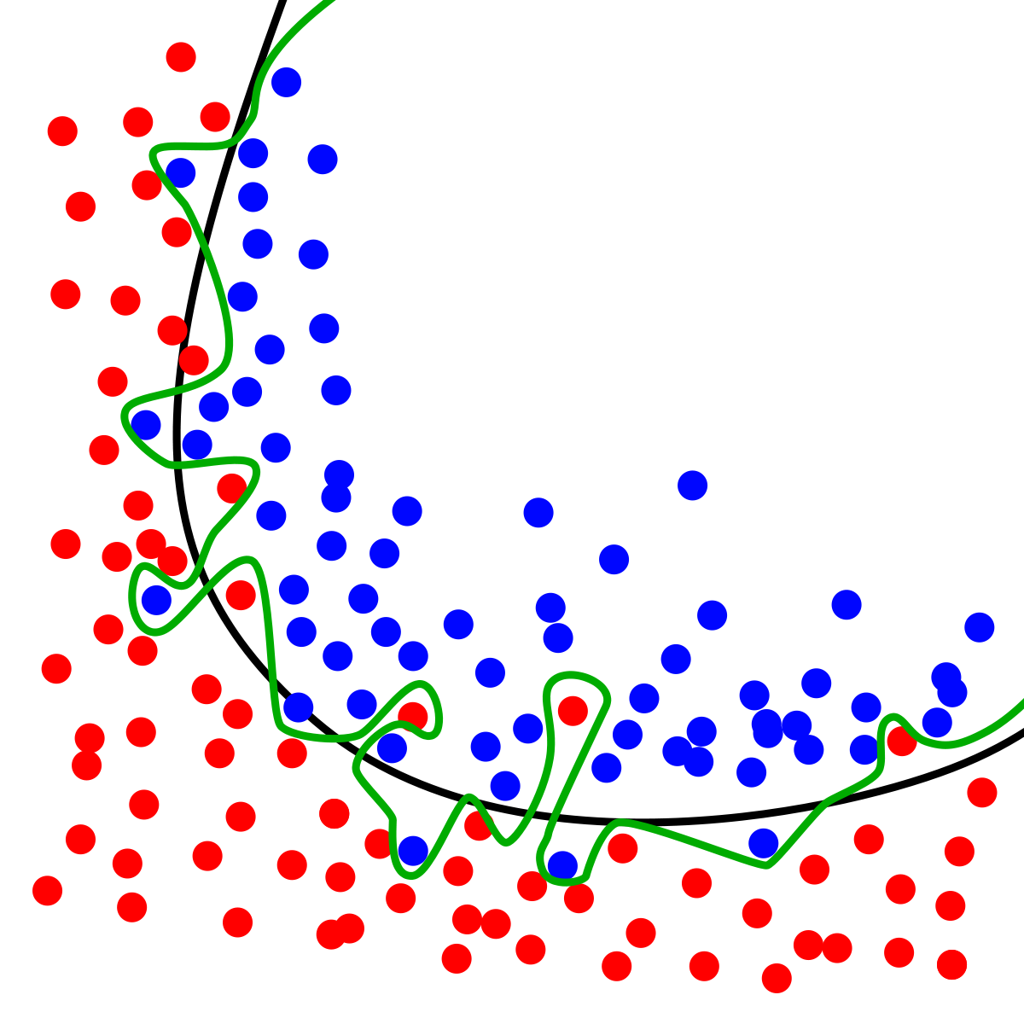
Overfitting
Never enough data
Learner "masters" the training set, building a model that predicts it quite accurately
This mastery includes all the anomalies of the data set; outliers, and over-represented features
This degree of accuracy may reduce generalization, making the predictor worse on new instances
https://upload.wikimedia.org/wikipedia/commons/thumb/1/19/Overfitting.svg/1200px-Overfitting.svg.png

Slide 8
Controlling Overfitting
Decrease amount of data in training set
Have some principled measure of fit (Naive Bayes, Decision Trees)
Use a validation set. Hold out more of the data and train on the training set until the performance on the validation set starts to get worse

Slide 9
Linearity
Think of the feature vector as residing in an n-dimensional space
A "linear" learner can find an n-1 dimensional plane in that space that best separates positive and negative training instances
A "nonlinear" learner can find more complicated boundaries
Linear: Naive Bayes, Perceptron
Nonlinear: Decision Trees, k-Nearest Neighbor

Slide 10
Bad Data
Real-world training instances will have:
Wrong classification
Mis-measured features
Missing features
Algorithms need to be able to cope with this

Slide 11
Feature Selection
Rare for a real-world inductive ML problem to come with instances that have a vector of Boolean features
Choosing the right features makes a huge difference
Summarize the information useful for classification
Leave out features that can confuse the learner or kill performance
Consider a "random feature" that is computed for each instance by flipping a coin
This feature will be accidentally correlated with classification on small datasets, so learner will try to use it
It won't generalize well at all

Slide 12
Feature Types
Boolean features allow all algorithms, but may lose information
Set-valued features are only OK with some algorithms, require more data to exploit (hypothesis-space size)
Scalar features only work with a few algorithms, but provide a lot of information (sometimes)
Can always Booleanize a feature
Characteristic vector for set values
Scalar above/below mean, median
Scalar by gain split point

