Slide 1
Machine Learning Methods
Yeganeh Jalalpour

Slide 2
Brute Force
Collect training instances in a bag.
Pick matching training instance from bag, and classify target identically
Problems:
no/multiple matches
huge bag
slow classification

Slide 3
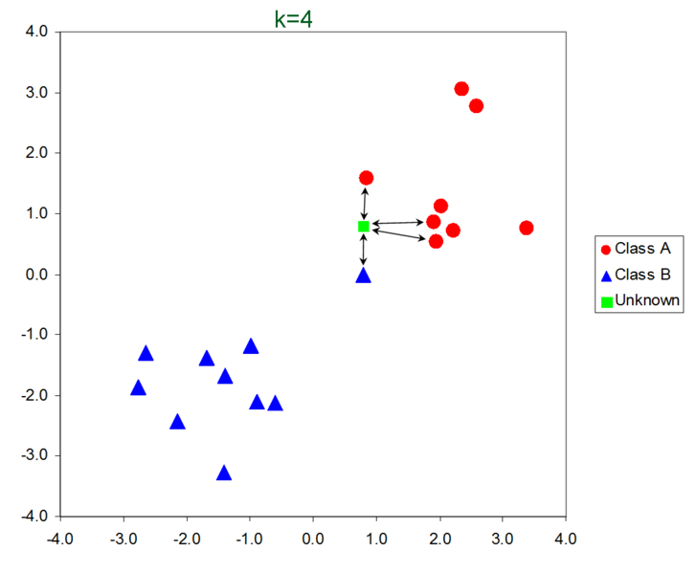
Minimum Distance Voting (k-Nearest Neighbor)
Help with some of the problems of brute force
Pick k "closest" instances from bag
Metric for boolean features is usually "Hamming Distance"
H(v1, v2) = sum[i](v1[i] ⊕ v2[i])
Example:
111 ⊕ 101 = 010 and H(111,101) = 1
Vote the instances
Peterson, L. (2009). K-nearest neighbor. Scholarpedia Journal., 4(2), 1883. http://www.scholarpedia.org/article/File:Knn_sample_plot.png

Slide 4
Naïve Bayesian learning
(We've already looked at this)
Binary setting: Count the number of occurrences of each feature in positive and negative setting
Compare underestimates of probabilities using products
Take logs to turn products into sums
Use m-separation to get accurate products

Slide 5
Decision Trees and ID3
Want to build a "binary decision tree" that splits training set on binary features for a binary class
ID3 (Quinlan) idea:
Greedily pick a feature that splits the training set "as well as possible" into positive and negative subsets.
For each subset, recurse: pick a remaining feature to try to improve the split
Stop when the current subset is (almost) all one class

Slide 6
Information Gain
Select next feature f in tree to maximize information gain
Recall
U(S) = sum[x in 0, 1] -pr(x in S) log pr(x in S)
Where pr(x in S) = |S[c=x]| / |S|
Now compute information gain Δu for each feature f
S+ = S[f=1]
S- = S[f=0]
Δu = u(S) - (|S+|/|S|) u(S+) - (|S-|/|S|) u(S-)
Avoid overfitting (gain is probably just training set anomaly)
Greedy is not optimal: mild independence assumption

Slide 7
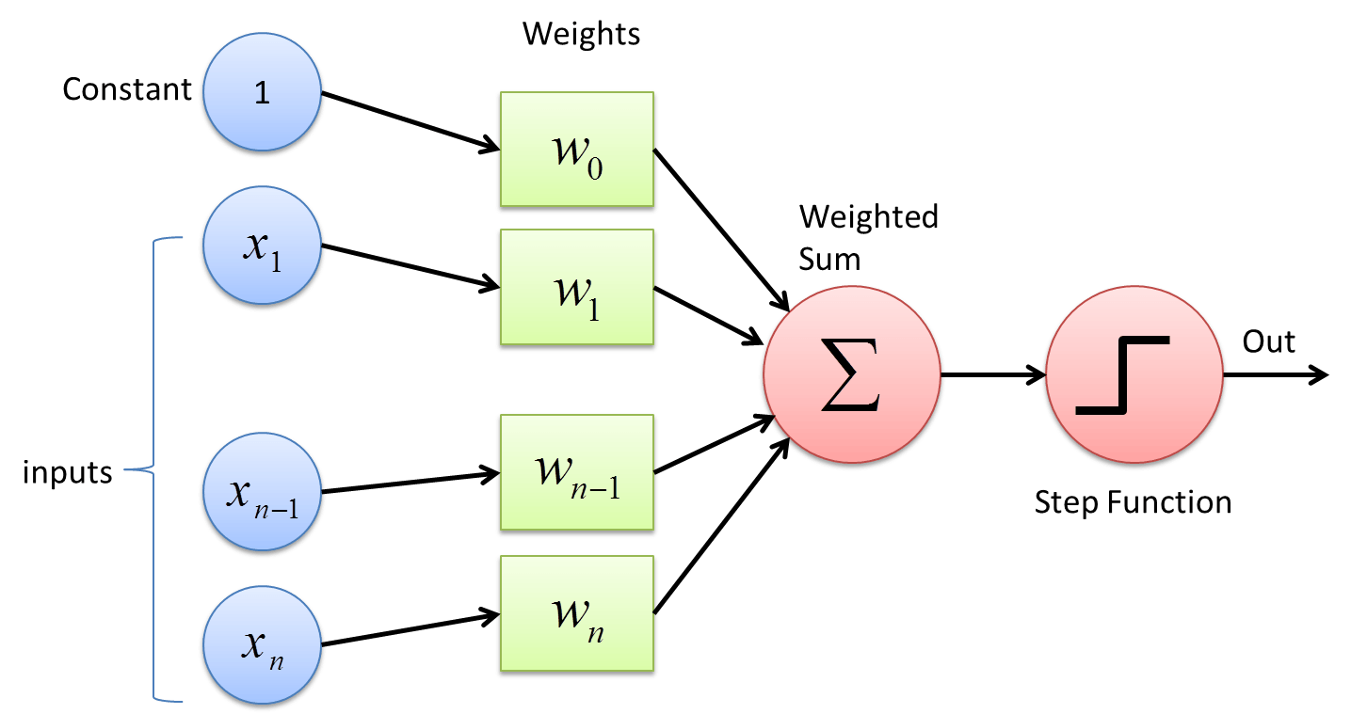
Perceptrons
"Artificial Neuron" (Papert et al): basis of neural nets
Handles continuous inputs and outputs well: (we binarize)
Idea: predict the binary class as a thresholded weighted sum of the features
c = sum[i] w[i] x[i] + w0 > 0
https://deepai.org/machine-learning-glossary-and-terms/perceptron

Slide 8
Perceptron Training
Training consists of learning appropriate weights w
Assign some initial weights
Feed each training instance through the perceptron
Adjust the weights "toward the true classification"
w[i] += a (c - y) x[i]
w0 += a (c - y) where y is the unthresholded output. Remember that c and x are 0 or 1. a is the "learning rate": smaller (a < 0.1) means more reliable convergence, larger a can mean faster learning or divergence
Run all the training instances repeatedly until the average accuracy isn't getting better

