Slide 1

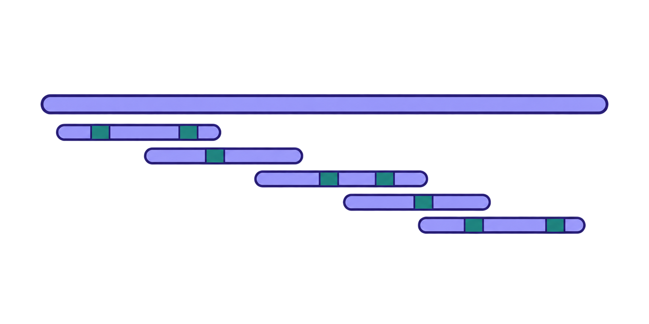

Inputs
36 libraries / 9 groups / 4 replicates per group / GRCh38 + GENCODE v50
Adapter trimming
fastp
Read alignment
STAR / GATK
Candidate detection
REDItools2 / VEP
Editor comparison
Sites / targets / context
Editing quantification
Four-replicate medians
SNP / sequence filters
Control / FDR screening
Outputs
Candidate sites / Editing profiles / Planned training and evaluation
Notes:
Core logic
Module 1 provides a consistent measurement and data-processing platform for reference editors, variants and future joint constructs. The sequence is quality control, read alignment, candidate editing-site detection, background and artifact filtering, editing quantification, and comparative analysis.
Meaning of the v1 graphic
The input band identifies reference and variant RNA-seq, matched controls, biological replicates, the reference genome and transcript annotation. The six process boxes describe analytical operations; the output band contains high-confidence editing sites, site-level editing fractions, transcriptome-wide editing profiles, and training/evaluation datasets. Arrows show the order of processing and do not encode performance or effect magnitude.
Conceptual or proposed content
This is a pipeline diagram, not a display of observed editing measurements or performance results. The figure does not establish any editor as superior.
Detail moved from the page
Compare variants across jointly callable sites and account for coverage and replicate consistency. This supports PUF/APOBEC comparisons, model training and held-out evaluation. Raw site counts alone do not establish specificity, because detection depends on coverage and other measurement conditions. Sites not detected as edited are not automatically confirmed negatives. Biological replicates and matched controls are necessary to support reliable comparisons.

