Slide 1
CREDIT CARD FRAUD DETECTION

Slide 2
Introduction
Credit card fraud is a wide-ranging term for theft and fraud committed using or involving a payment card, such as a credit card or debit card, as a fraudulent source of funds in a transaction.
The purpose may be to obtain goods without paying, or to obtain unauthorized funds from an account. Credit card fraud is also an adjunct to identity theft.

Slide 3
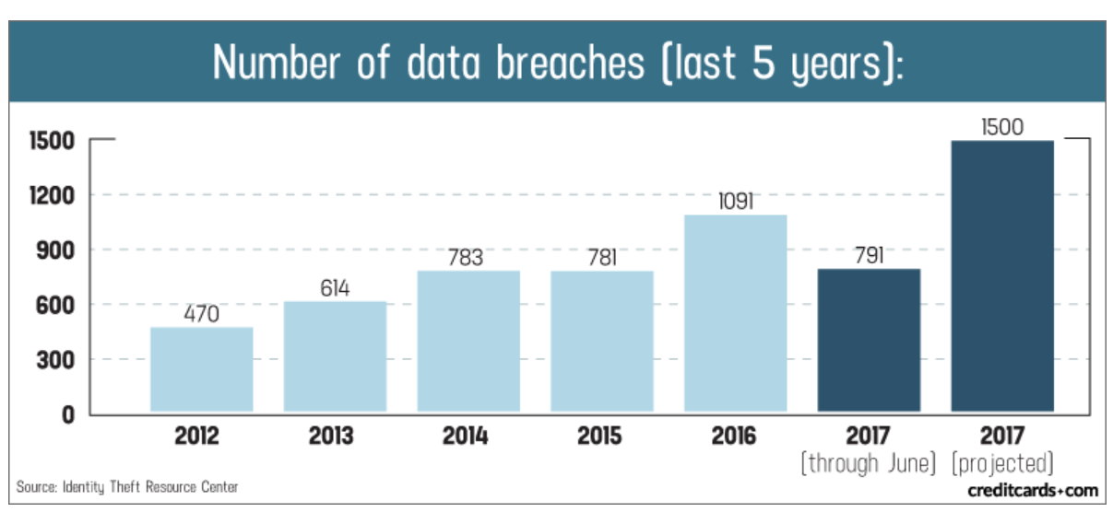

Slide 4
Problem Statement
To enable credit card companies to recognize fraudulent credit card transactions so that customers are not charged for items that they did not purchase.

Slide 5
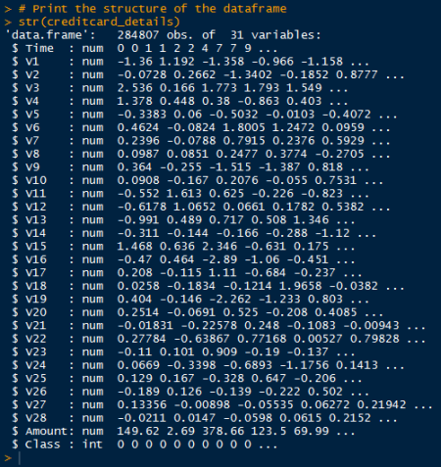
Dataset
V1 to V28 are components after performing PCA (Principal Component Analysis) on the original (confidential) features
Class Labels:
0 for Genuine
1 for Fraud
NA values are absent

Slide 6
Challenges
The huge imbalance in the dataset: frauds only account for 0.172% of fraud transactions.
In this case, it is much worse to have false negatives than false positives in our predictions because false negatives mean that someone gets away with credit card fraud
False positives, on the other hand, merely cause a complication and possible hassle when a cardholder must verify that they did, in fact, complete said transaction (and not a thief)

Slide 7
Exploratory Data Analysis

Slide 8
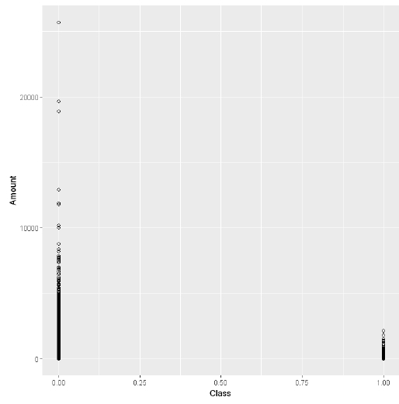
Plot of Amount vs Class
From the plot, we can infer that most of the fraud cases involve transaction amount less than $2500
Max amount - $2126

Slide 9
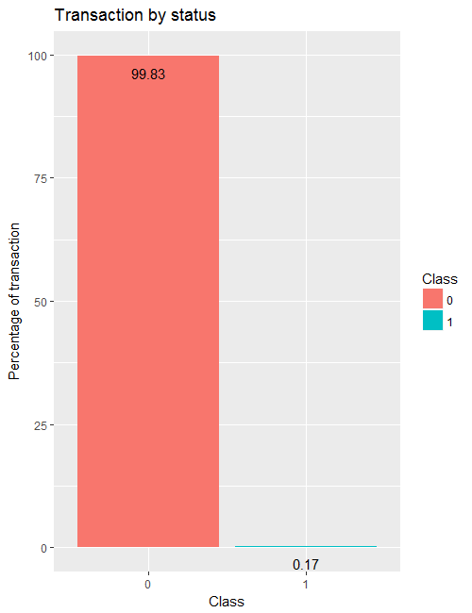
Checking for imbalanced data
Group the data based on Class value using dplyr package containing group_by function

Slide 10
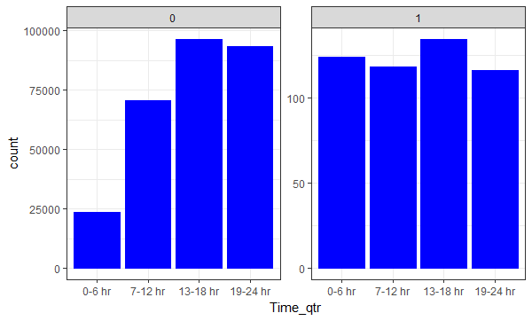
Checking Number of Transactions by Hour
To check the number of transactions by day and hour, normalize the time by day and categorize them into four quarters according to the time of the day
The above graph shows the transactions of two days. It states that most of the fraudulent transactions occurred between 13 to 18 hours

Slide 11
Pre-processing the data
In predictive modelling, data needs to be partitioned for the training set (70% of data) and testing set (30% of data)
After partitioning the data, feature scaling is applied to standardize the range of independent variables
We normalise the dataset before training and testing – Feature Scaling

Slide 12
Creating a balanced dataset
As data is imbalanced we have to make the data set balanced by performing oversampling of under represented class and under-sampling of over represented class
Synthetic Minority Over-sampling Technique (SMOTE) is a technique that generates synthetic samples from the minority class (here fraudulent class) and undersampling of majority classes
It accomplishes this by boot-strapping and considering the k-nearest neighbours.
SMOTE must be performed on training data and not test data because it will not be representative of real world
Notes:
As data is imbalanced we have to make the data set balanced by performing oversampling of under represented class and under-sampling of over represented class
Synthetic Minority Over-sampling Technique (SMOTE) is a technique that generates synthetic samples from the minority class (here fraudulent class) and undersampling of majority classes
It accomplishes this by boot-strapping and considering the k-nearest neighbours.
SMOTE must be performed on training data and not test data because it will not be representative of real world

Slide 13
Applying Sampling Methods to Balance Dataset
In R, Random Over Sampling Examples (ROSE) and DMwR packages are used to quickly perform sampling strategies.
The ROSE package is used to generate artificial data based on sampling methods and smoothed bootstrap approach.
This package provides well-defined accuracy functions to quickly perform the tasks.

Slide 14
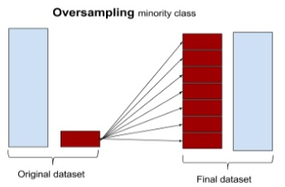
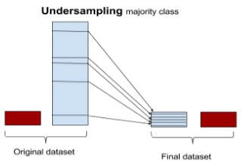
Types of sampling
Over-sampling
This method over instructs the algorithm to perform oversampling. As the original dataset had 227K good observations, this method is used to oversample minority class until it reaches 227K. The dataset has a total of 454K samples.
Under-sampling
This method functions similar to the oversampling method and is done without replacement. In this method, good transactions are equal to fraud transactions. Hence, no significant information can be obtained from this sample

Slide 15
Algorithms Applied
Logistic Regression
Support Vector Machine
Decision Tree
ANN

Slide 16
Logistic Regression

Slide 17
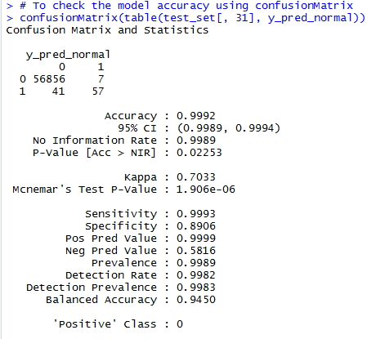
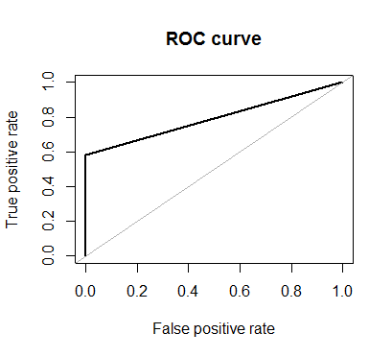
Using the Confusion Matrix, the test result shows 99.9% accuracy due to the Class 1 records. So, let's neglect this accuracy. Using ROC curve, the test result shows 79% accuracy. That is very low.
Area under the ROC Curve: 0.791

Slide 18
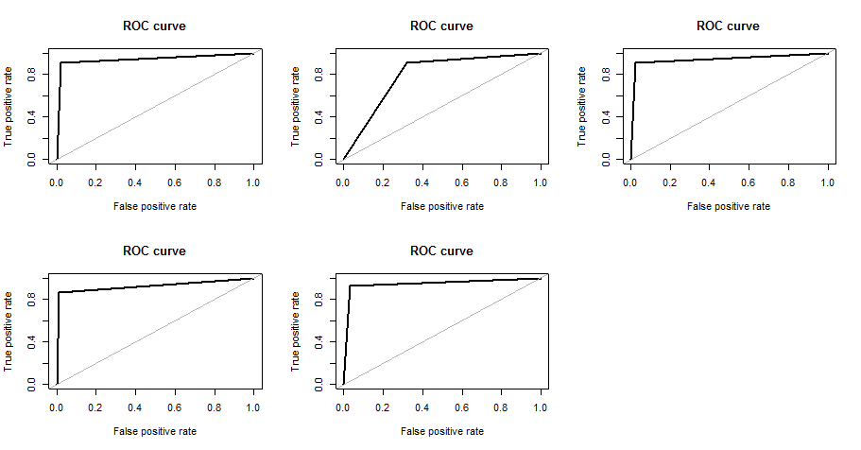
Applying Sampling Methods to Balance Dataset
Over-sampling data
Under-sampling data
Both-sampling data
ROSE-sampling data
SMOTE-sampling data

Slide 19
Support Vector Machine

Slide 20
Training data ratio before sampling
CLASS | FREQ. | PERCENTAGE
0 | 199019 | 99.826
1 | 346 | 0.1735
Testing data ratio
CLASS | FREQ. | PRECENTAGE
0 | 85296 | 99.829
1 | 146 | 0.171

Slide 21
Training data ratio after SMOTE sampling
CLASS | FREQ. | PERCENTAGE
0 | 3114 | 50
1 | 3114 | 50

Slide 22
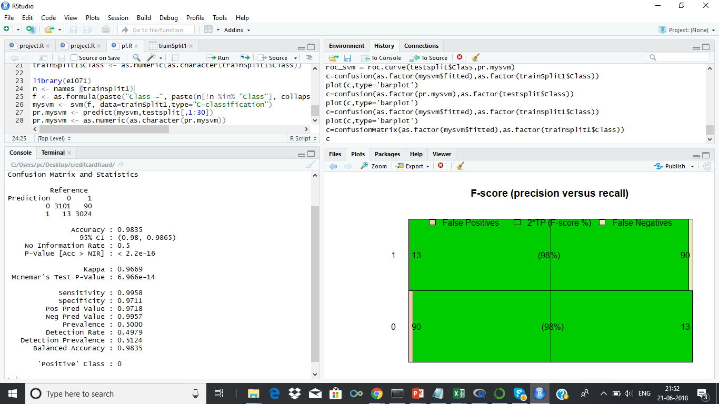

TRAINING TESTING

Slide 23
Training accuracy parameters
 | Fscore | Recall | Precision | Specificity | BalAcc
0 | 0.983664 | 0.995825 | 0.971796 | 0.971098 | 0.983462
1 | 0.983255 | 0.971098 | 0.995719 | 0.995825 | 0.983462
Testing accuracy parameters
 | Fscore | Recall | Precision | Specificity | BalAcc
0 | 0.996873 | 0.994044 | 0.999717 | 0.835616 | 0.91483
1 | 0.314433 | 0.835616 | 0.193651 | 0.994044 | 0.91483

Slide 24
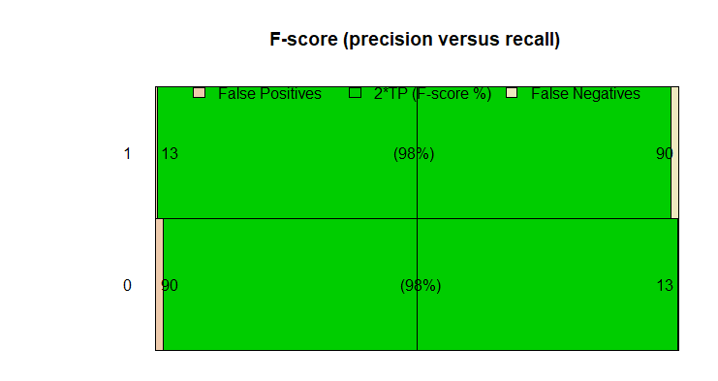
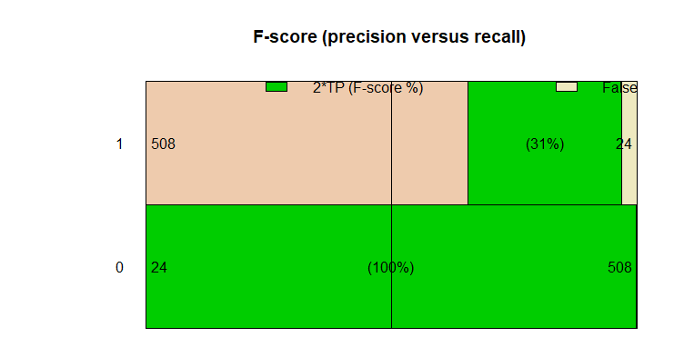
TRAIN- FSCORE
TEST-FSCORE

Slide 25
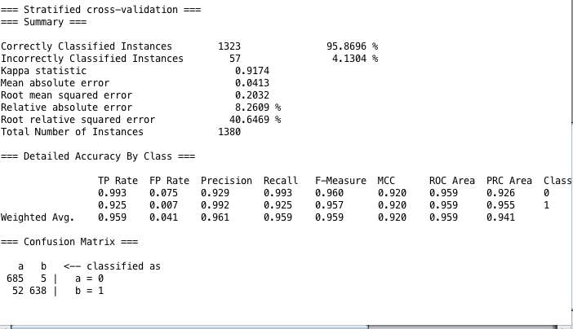
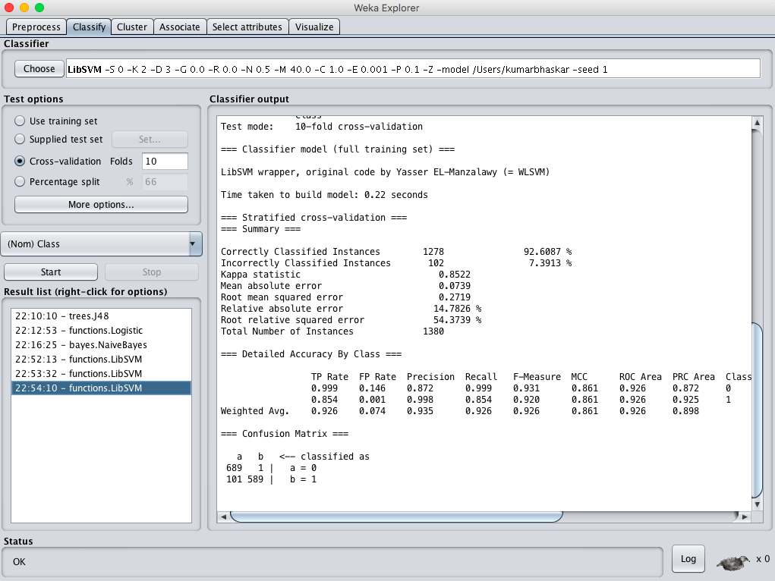
Weka
Linear model
Radial model

Slide 26
Decision Tree

Slide 27
Before under-sampling data
Accuracy using Decision tree 99.91 %
Recall: 78.81%
F-Score : 1.0625
After under-sampling data
Accuracy using Decision tree 92.23 %
Recall: 92.52%
F-score : 1.59

Slide 28
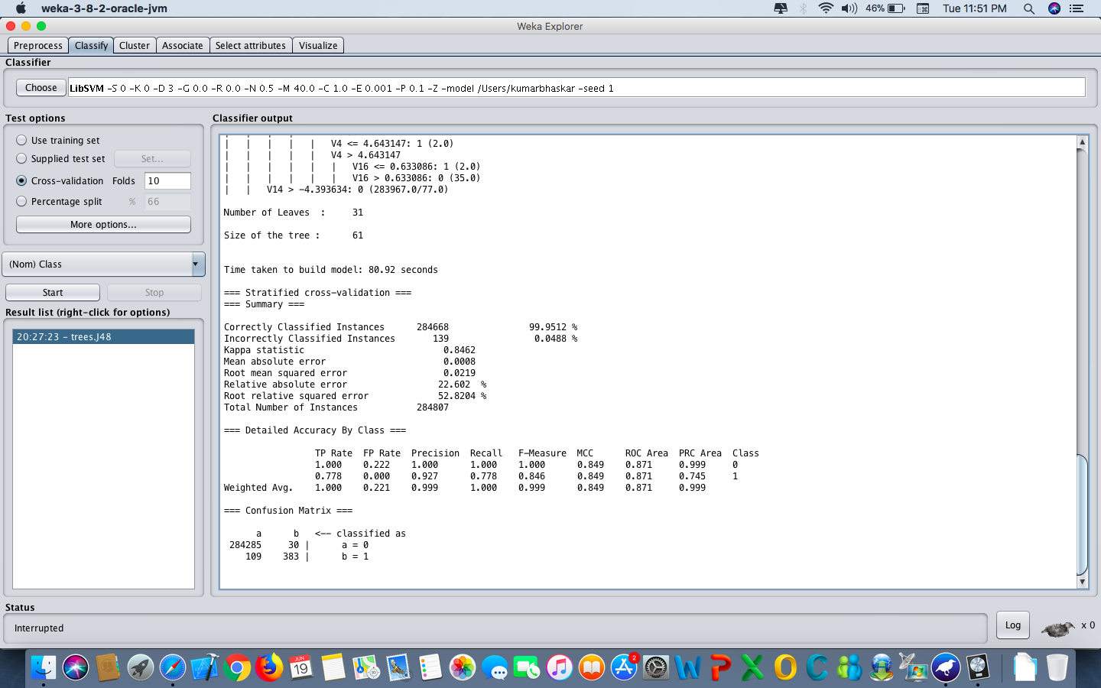
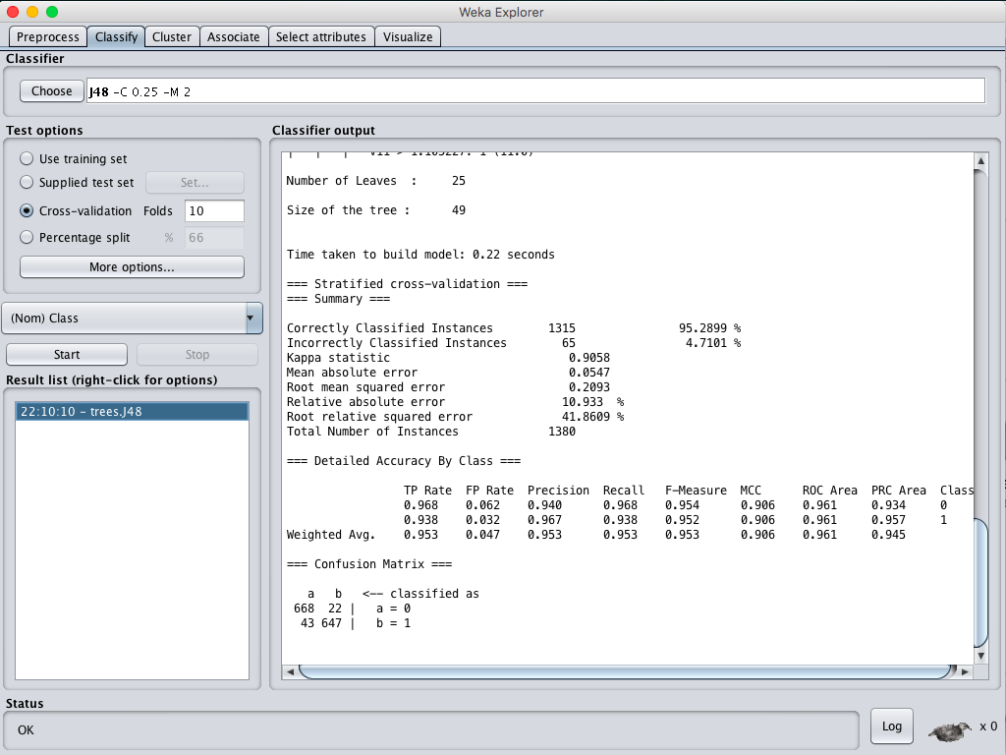
Before Sampling
After Sampling

Slide 29
Artificial Neural Network

Slide 30
Before Sampling of the Data :
Accuracy using Decision tree 99.98 %
Precision: 99.8%
F-Score :0.99857
Recall : 1(For Non Fraud)

Slide 31
After Sampling of the Data :
Accuracy using Decision tree 91.69 %
Precision:0.001835
F-Score :0.00366
Recall : 0.664

Slide 32
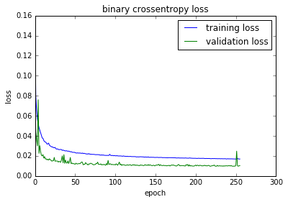

Slide 33
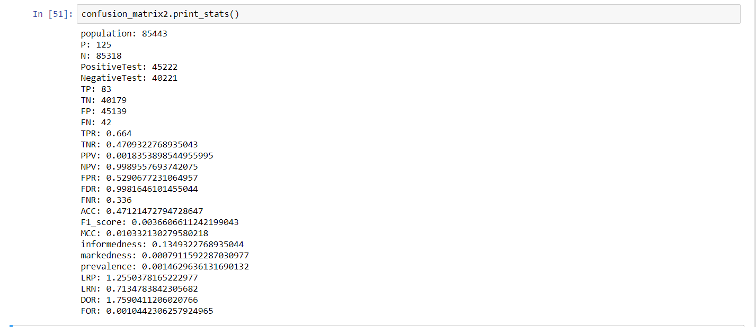

Slide 34
Comparison of Models
Logistic regression outperformed the SVM, decision tree,neural network.
SVM was next, but as there are lot of features and we cannot visualise the hyperplane separation , proper choice of kernel and parameters are required by tuning.
The neural network was next,as the value of true positive is very low in Neural networks and we face problems like overfitting in neural networks which prevents better accuracy in Neural networks.
Notes:
We believe that it is because of how the decision boundary changed with the class weights features. SVM was next, we got an accuracy of 95.86 using svm with linear kernel with 0.95 f score and 92.6087 accuracy with radial kernel with 0.92 fscore.

