Slide 1

Rust and WebAssembly
Nick Fitzgerald

Slide 2
WebAssembly
Virtual machine and instruction set
Safe
Fast
Portable
Extensively specified
Stack machine with linear memory heap

Slide 3
WAT: WebAssembly Text
(module
(func $factorial (param f64) (result f64)
get_local 0
f64.const 1
f64.lt
if (result f64)
f64.const 1
else
get_local 0
get_local 0
f64.const 1
f64.sub
call $factorial
f64.mul
end)
(export "fac" (func $factorial)))

Slide 4

It’s Happening!

Slide 5
Why Rust + WebAssembly?
Rust doesn’t require GC or a runtime
Small .wasm binaries
Low-level control and unsurprising performance
Enables incremental adoption
Surgically replace just hot code paths

Slide 6
Tools
#[wasm_bindgen]
wasm-pack: publish .wasm to npm
twiggy: a code size profiler

Slide 7
Importing JavaScript Functions
#[wasm_bindgen]
extern {
fn alert(s: &str);
}

Slide 8
Exporting Rust Functions
#[wasm_bindgen]
pub fn greet(name: &str) {
alert(&format!("Hello, {}!", name));
}

Slide 9
Using the WebAssembly from JavaScript
import { greet } from "./hello_world";
greet("Rust and WebAssembly");

Slide 10
Importing JavaScript Types
#[wasm_bindgen]
extern {
type Array;
#[wasm_bindgen(constructor)]
fn new() -> Array;
#[wasm_bindgen(method)]
fn push(this: &mut Array,
x: &JsValue) -> u32;
}

Slide 11
Exporting Rust Types
#[wasm_bindgen]
pub struct Foo {
contents: u32,
}

Slide 12
Exporting Rust Types
#[wasm_bindgen]
impl Foo {
pub fn new() -> Foo {
Foo { contents: 0 }
}
pub fn add(&mut self, n: u32) -> u32 {
self.contents += n;
self.contents
}
}

Slide 13
Let’s write some code!
github.com/pdxrust/rust-wasm-workshop
Follow the instructions in the README.md until you have a working “Hello, World!” program

Slide 14
Game of Life
2D grid of square cells
Each cell is either alive or dead
Next generation of cells is computed by looking at each cell’s neighbors

Slide 15
Game of Life
Alive w/ alive_neighbors < 2 → dead
Alive w/ alive_neighbors == 2 or 3 → alive
Alive w/ alive_neighbors > 3 → dead
Dead w/ alive_neighbors == 3 → live

Slide 16
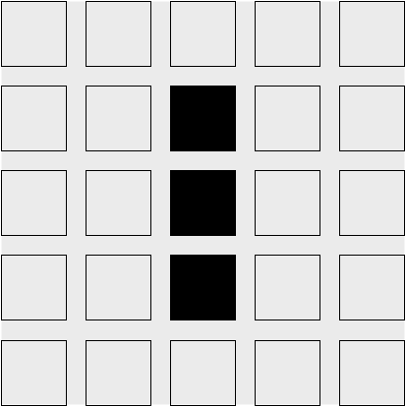
Game of Life

Slide 17
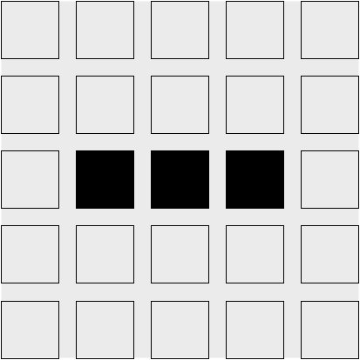
Game of Life

Slide 18
Game of Life
Epic Conway's Game of Life

Slide 19
Let’s write some more code!
Continue with the “Game of Life” section in the README.md!

