Slide 1

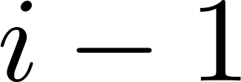




node2vec random walks: Regular graphs and recurrence
Lars Schroeder
Joint work with Clara Stegehuis, Gianmarco Bet and Luca Avena
$$β$$
$$γ$$
$$α$$
$$α$$
$$γ$$
.

Slide 2
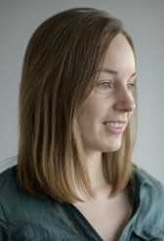
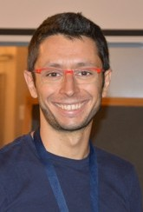
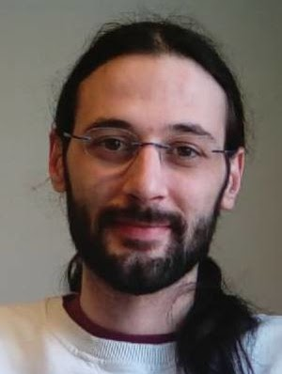
Collaborators
Clara Stegehuis
(University of Twente)
Gianmarco Bet
(University of Florence)
Luca Avena
(University of Florence)

Slide 3




node2vec random walks
$$β$$
$$γ$$
$$α$$
$$γ$$

Slide 4

node2vec random walks
$$α$$

Slide 5



node2vec random walks
$$γ$$
$$γ$$
$$γ$$
$$α$$

Slide 6





node2vec random walks
$$γ$$
$$γ$$
$$γ$$
$$β$$
$$α$$

Slide 7
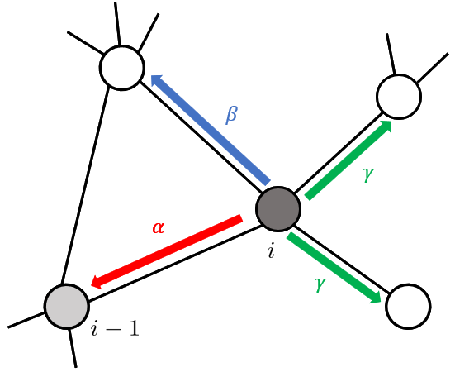
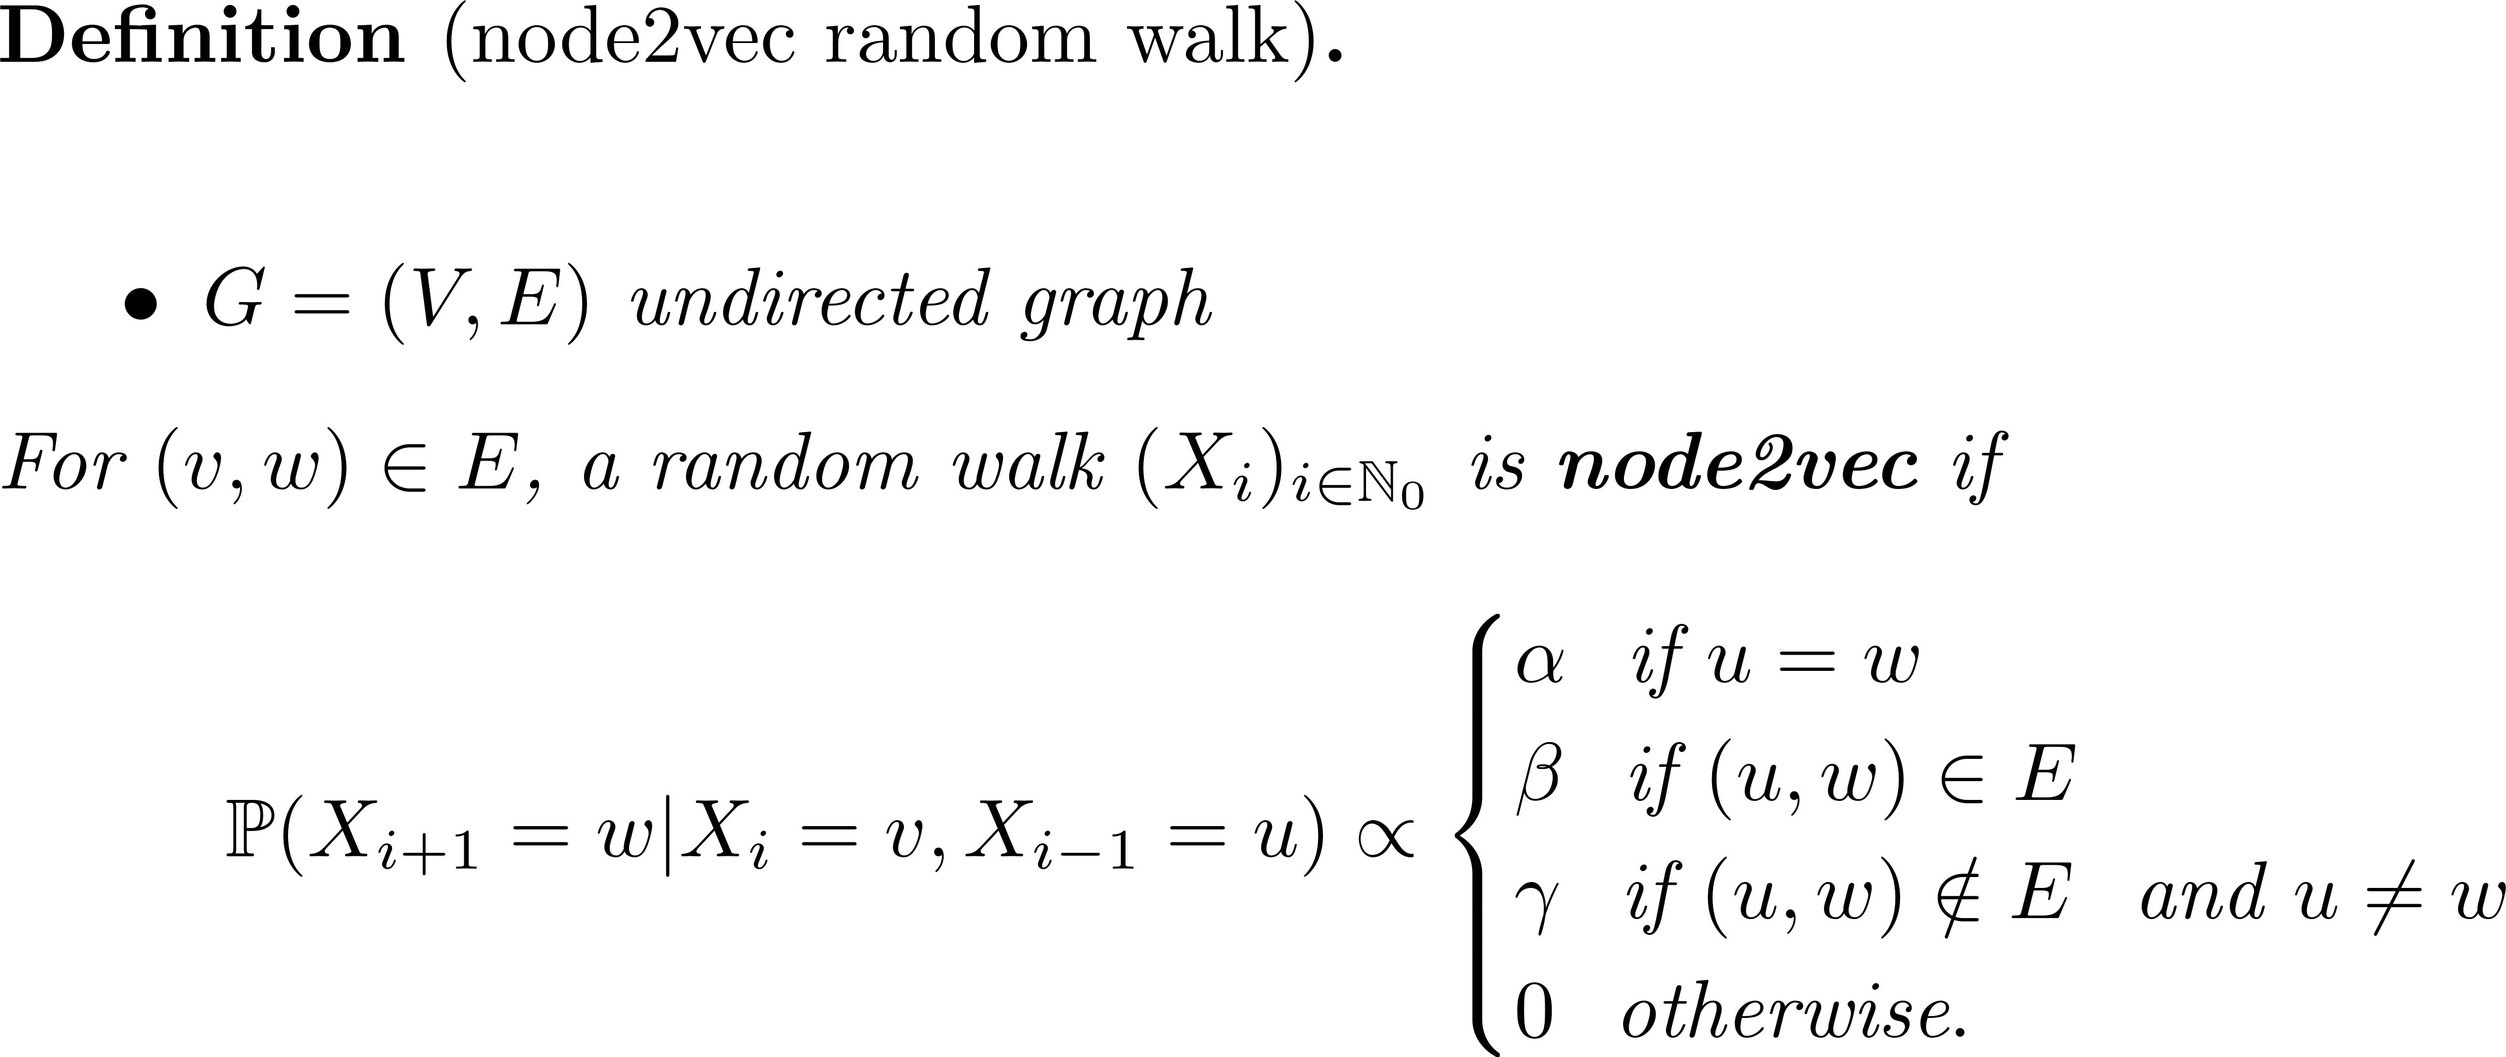
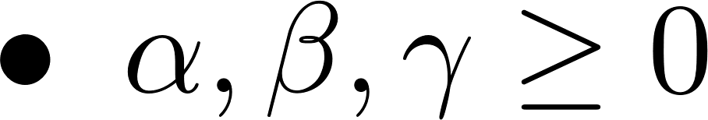
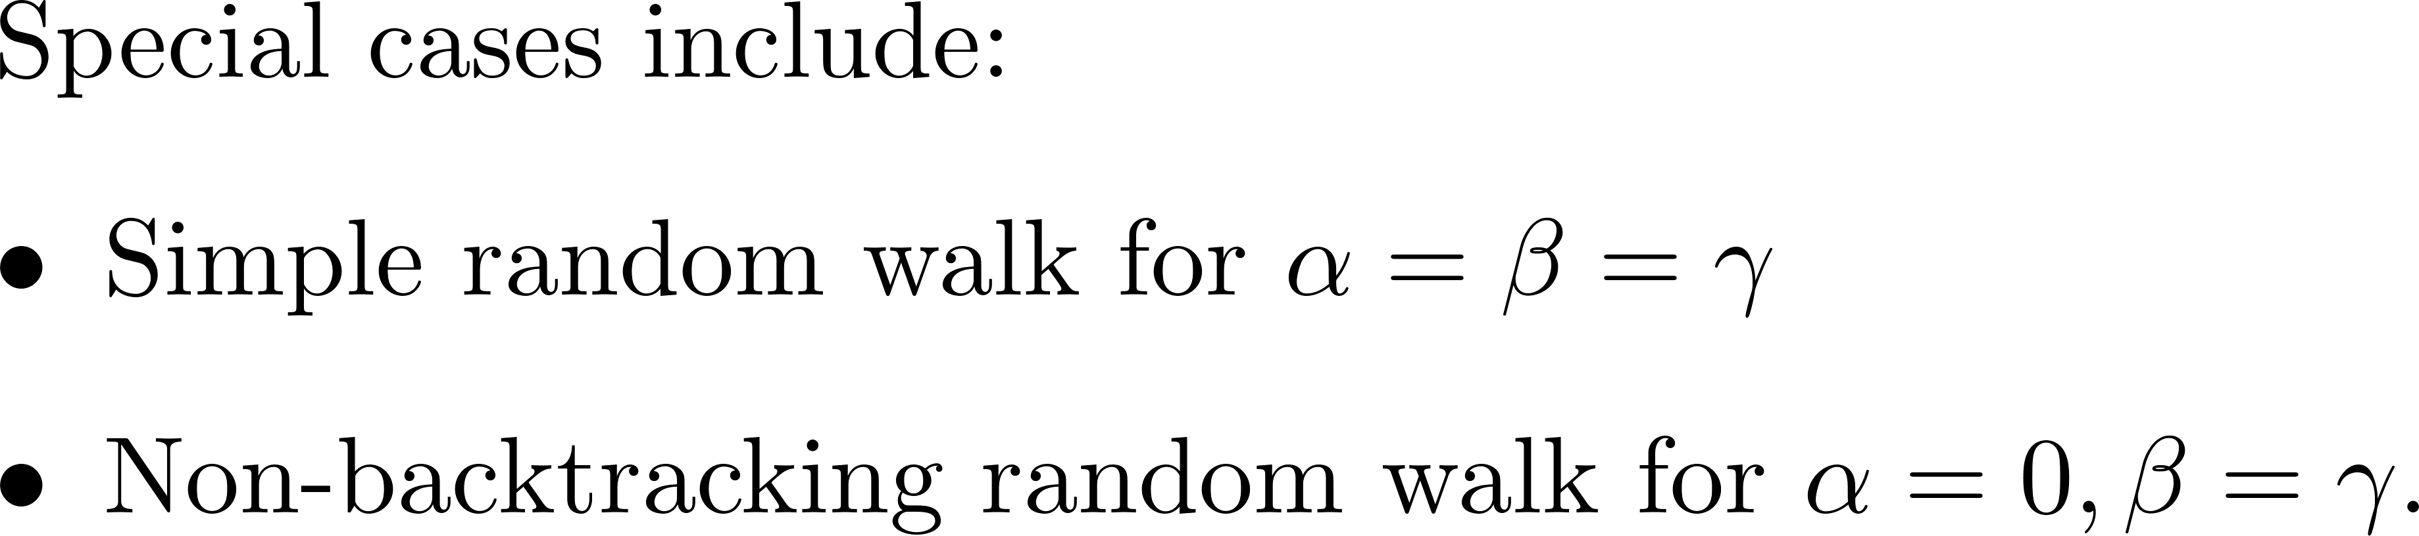
node2vec random walks

Slide 8


Motivation: node2vec algorithm
$$α=0.5,β=0.5,γ=1$$
$$α=2,β=2,γ=1$$

Slide 9
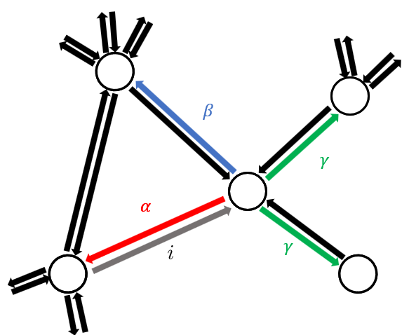
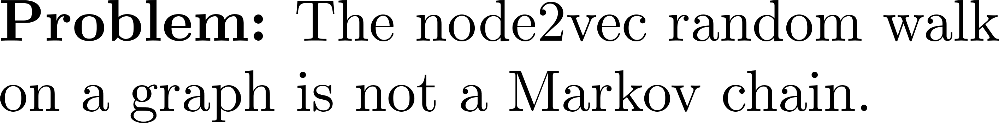
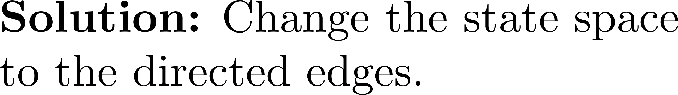
node2vec: A markov chain?

Slide 10
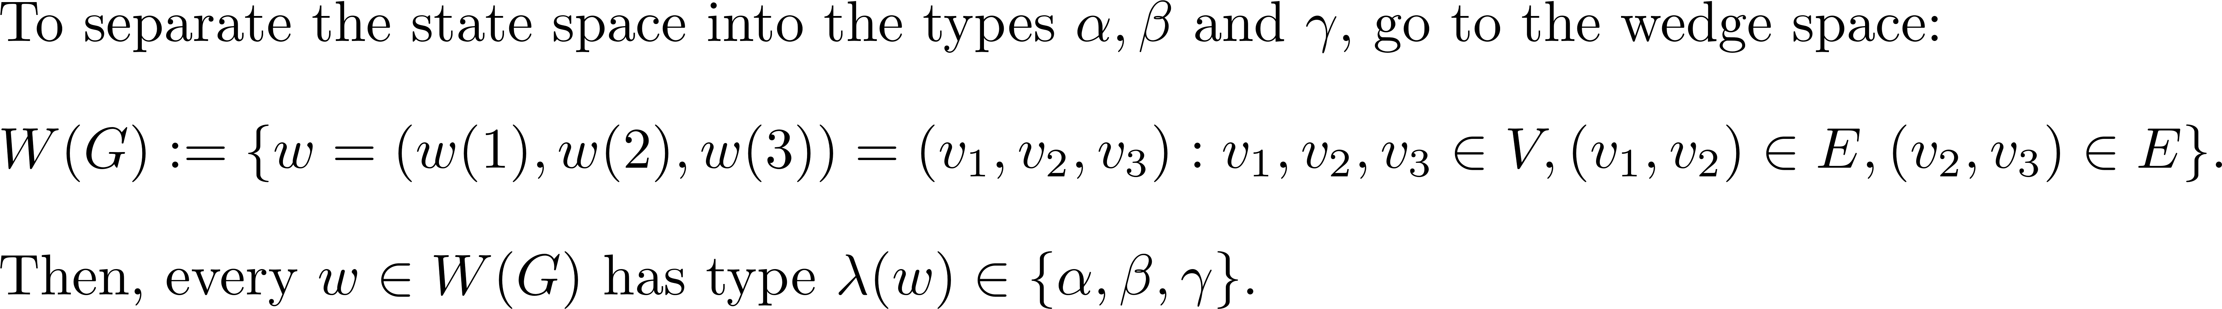
The wedge space

Slide 11
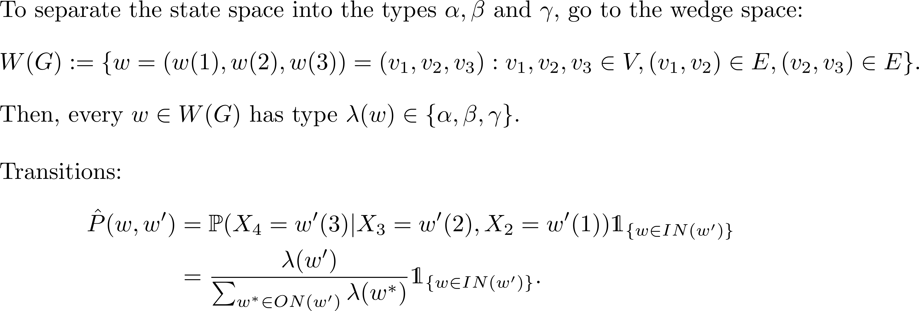
The wedge space

Slide 12
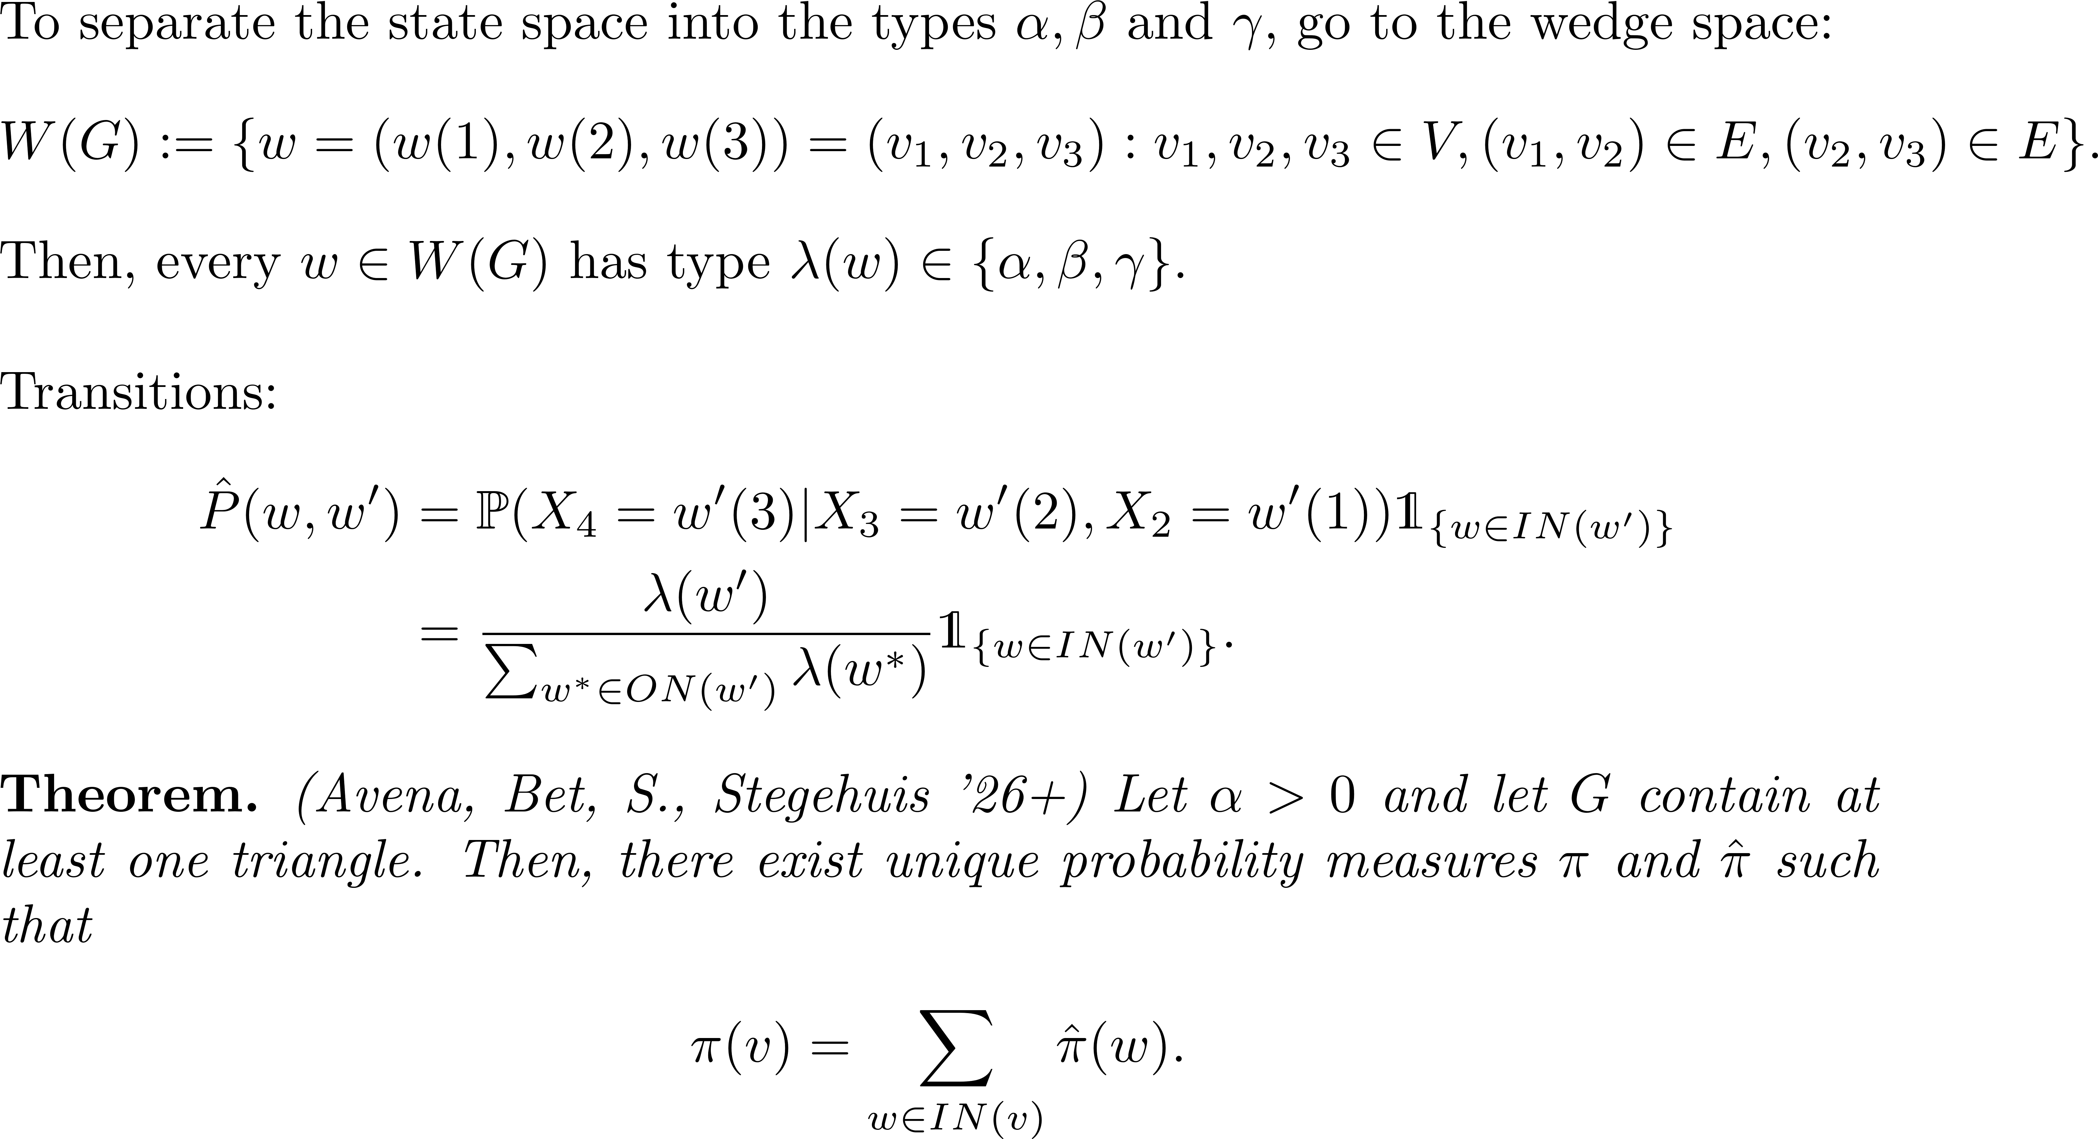
The wedge space

Slide 13
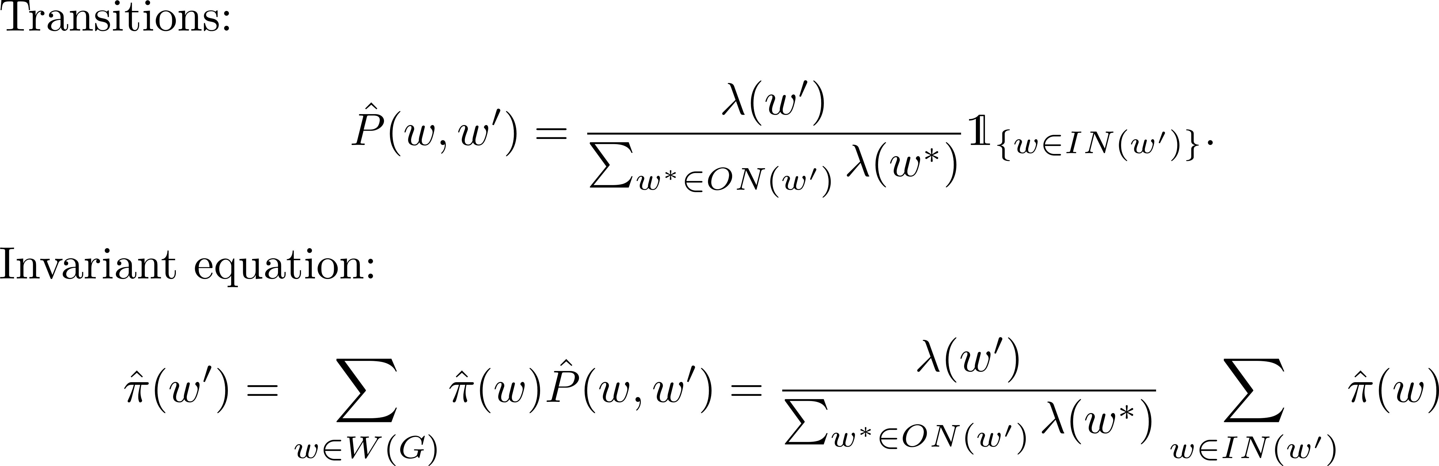
Regular graphs

Slide 14
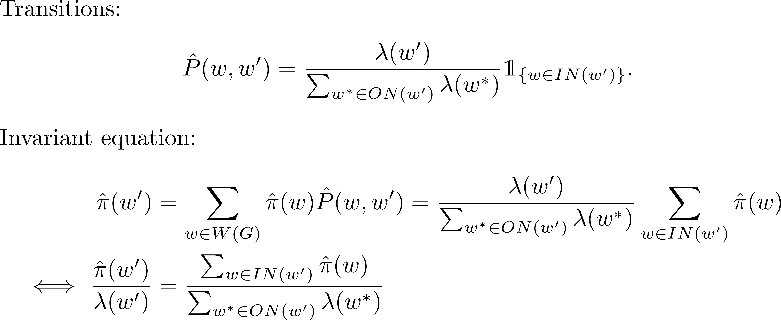
Regular graphs

Slide 15
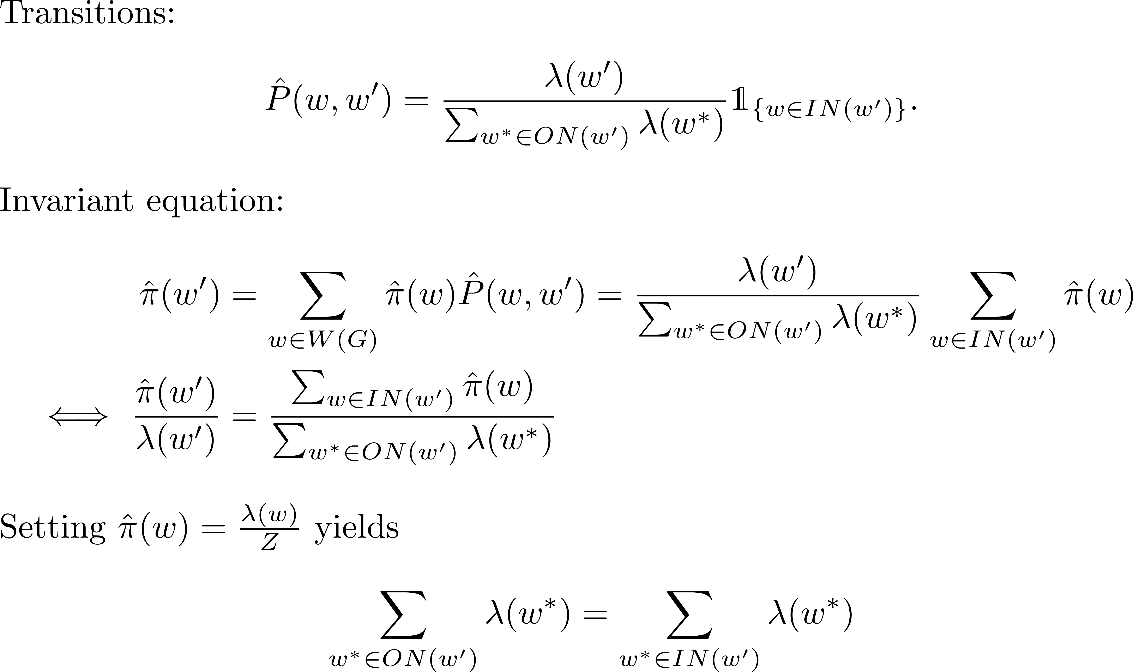
Regular graphs

Slide 16
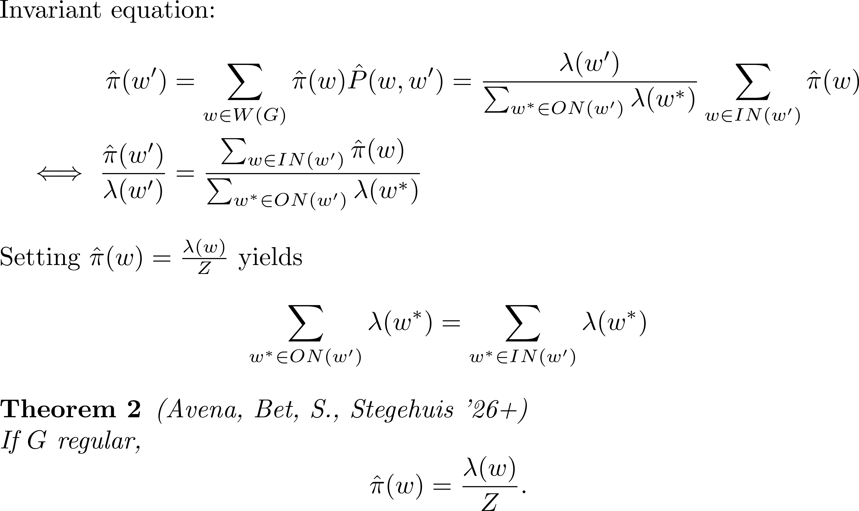
Regular graphs

Slide 17
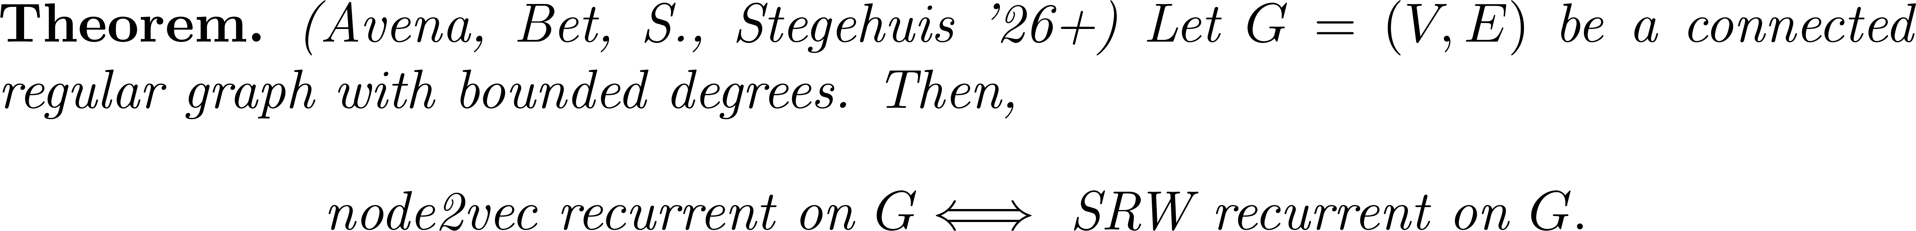
Recurrence of node2vec random walks

Slide 18
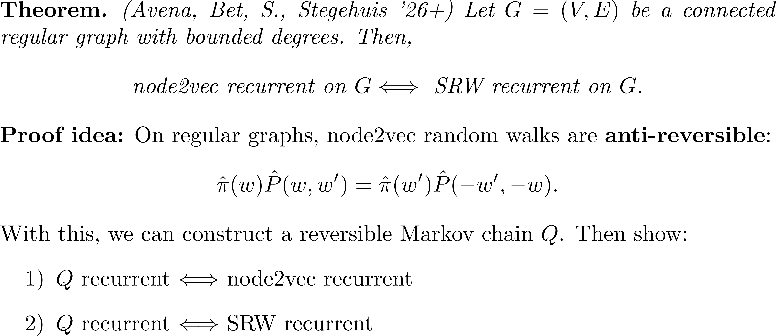
Recurrence of node2vec random walks

Slide 19

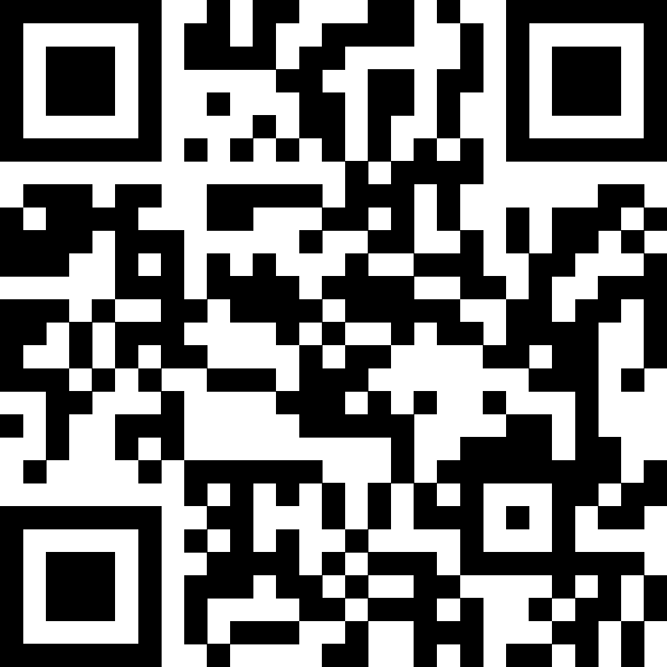
Recurrence of node2vec random walks

