Slide 1
Introduction to
Phase 2

Slide 2

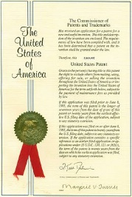
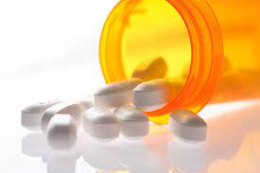
What is innovation opportunity discovery?
Science
（Research Paper）
Technology
（Patent）
Product/
Service
Author/
Inventor
Applicant
1. Science comes before Technology
2.Global and large samples of firms to get hints
as regards to market opportunities
Machine learning model
to predict potential technology/market (innovation) opportunities
Youtube video for detail : https://www.youtube.com/watch?v=Y6TIHxfKsmM

Slide 3
Process of works
Data Preparation
・Patent info. (available)
・Website info. (scraping)
・Patent-Website Link (Use administration data or so)
Transformation Model
・Extract product keywords from web info. (DA model)
・Transformation Model
Innovation Discovery works
・Suggesting TLO about potential application of (univ) patents
Data will be provided
Python codes will be provided

Slide 4
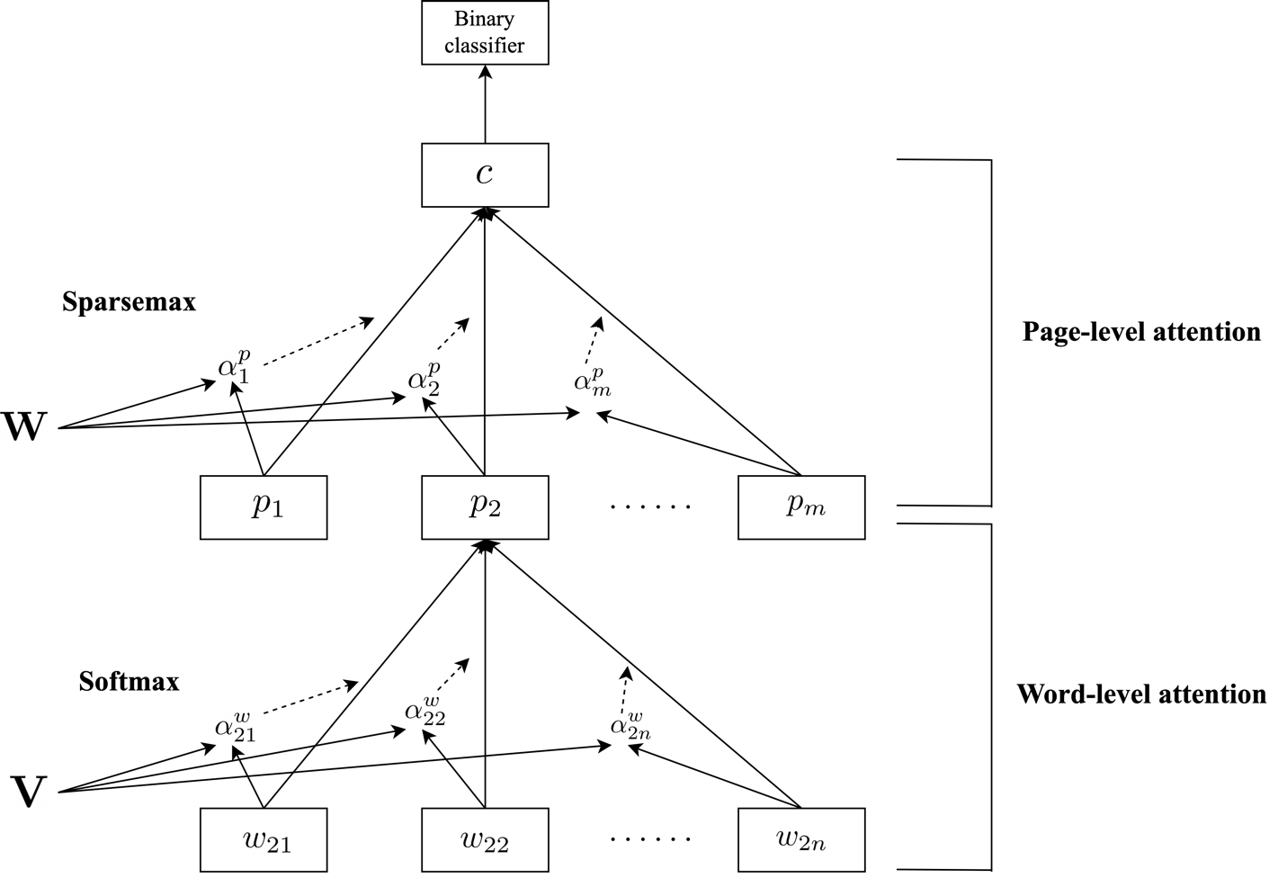
Dual attention model for keywords extraction (Skimming product information from company web information)
(With patent or not)
attention coefficients
Product keyword extraction
attention coefficients
Motohashi, K. and Zhu, C., Identifying Technology Opportunity Using a Dual-attention Model and a Technology-market Concordance Matrix, forthcoming Technology Forecasting and Social Change

Slide 5
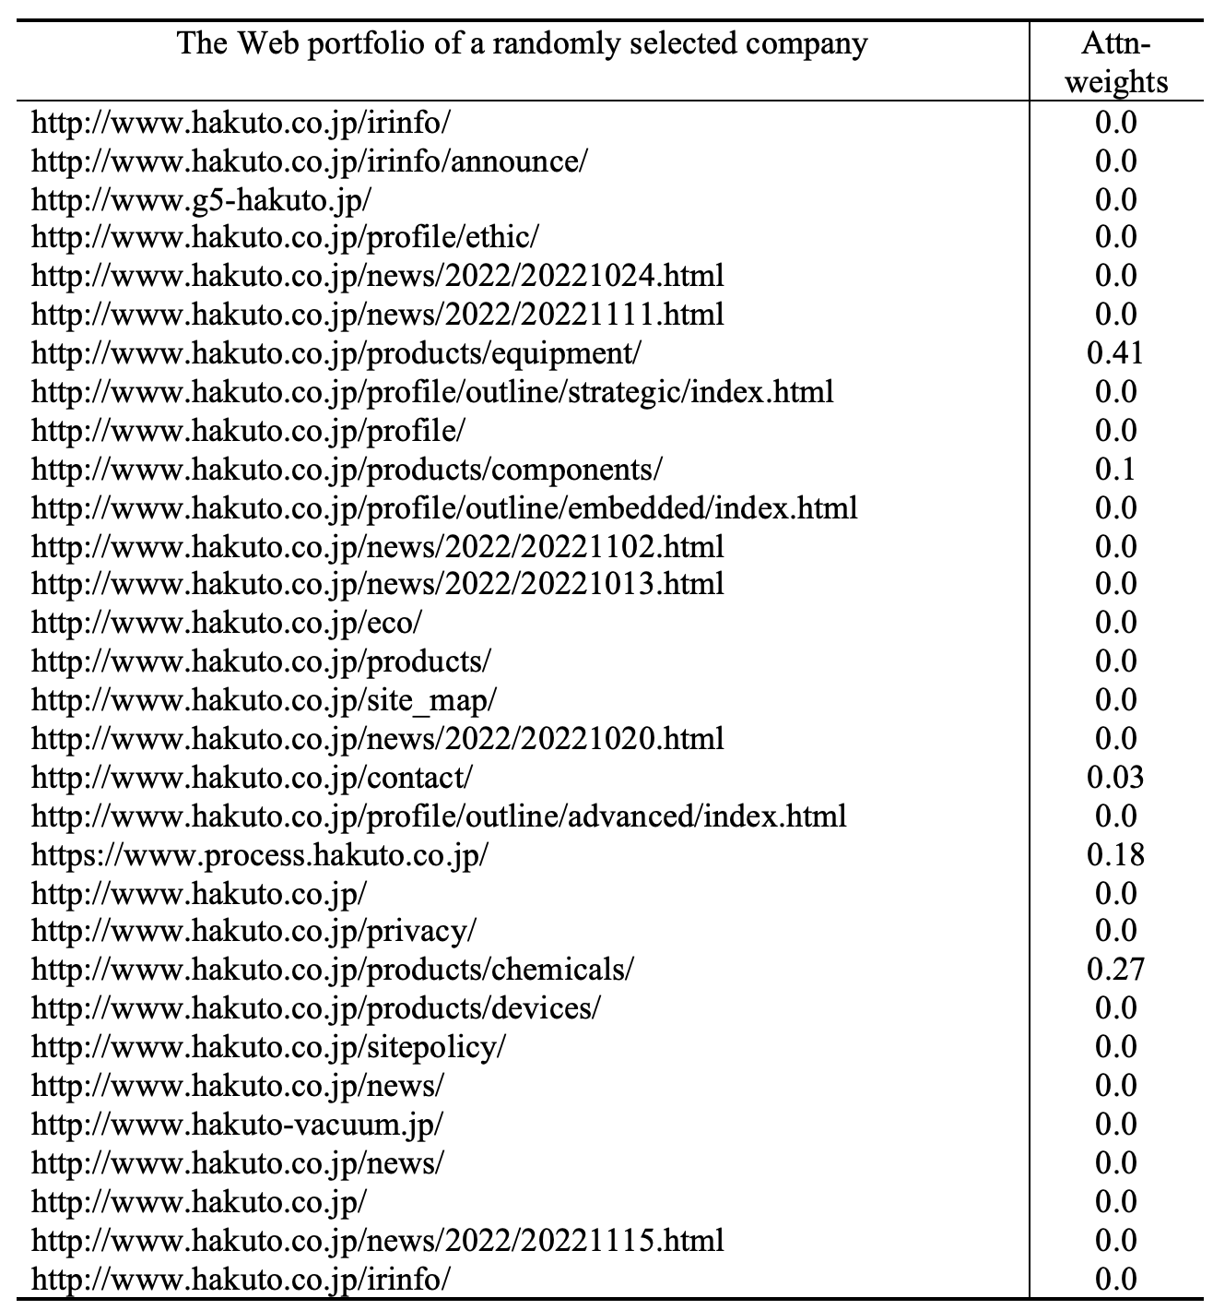
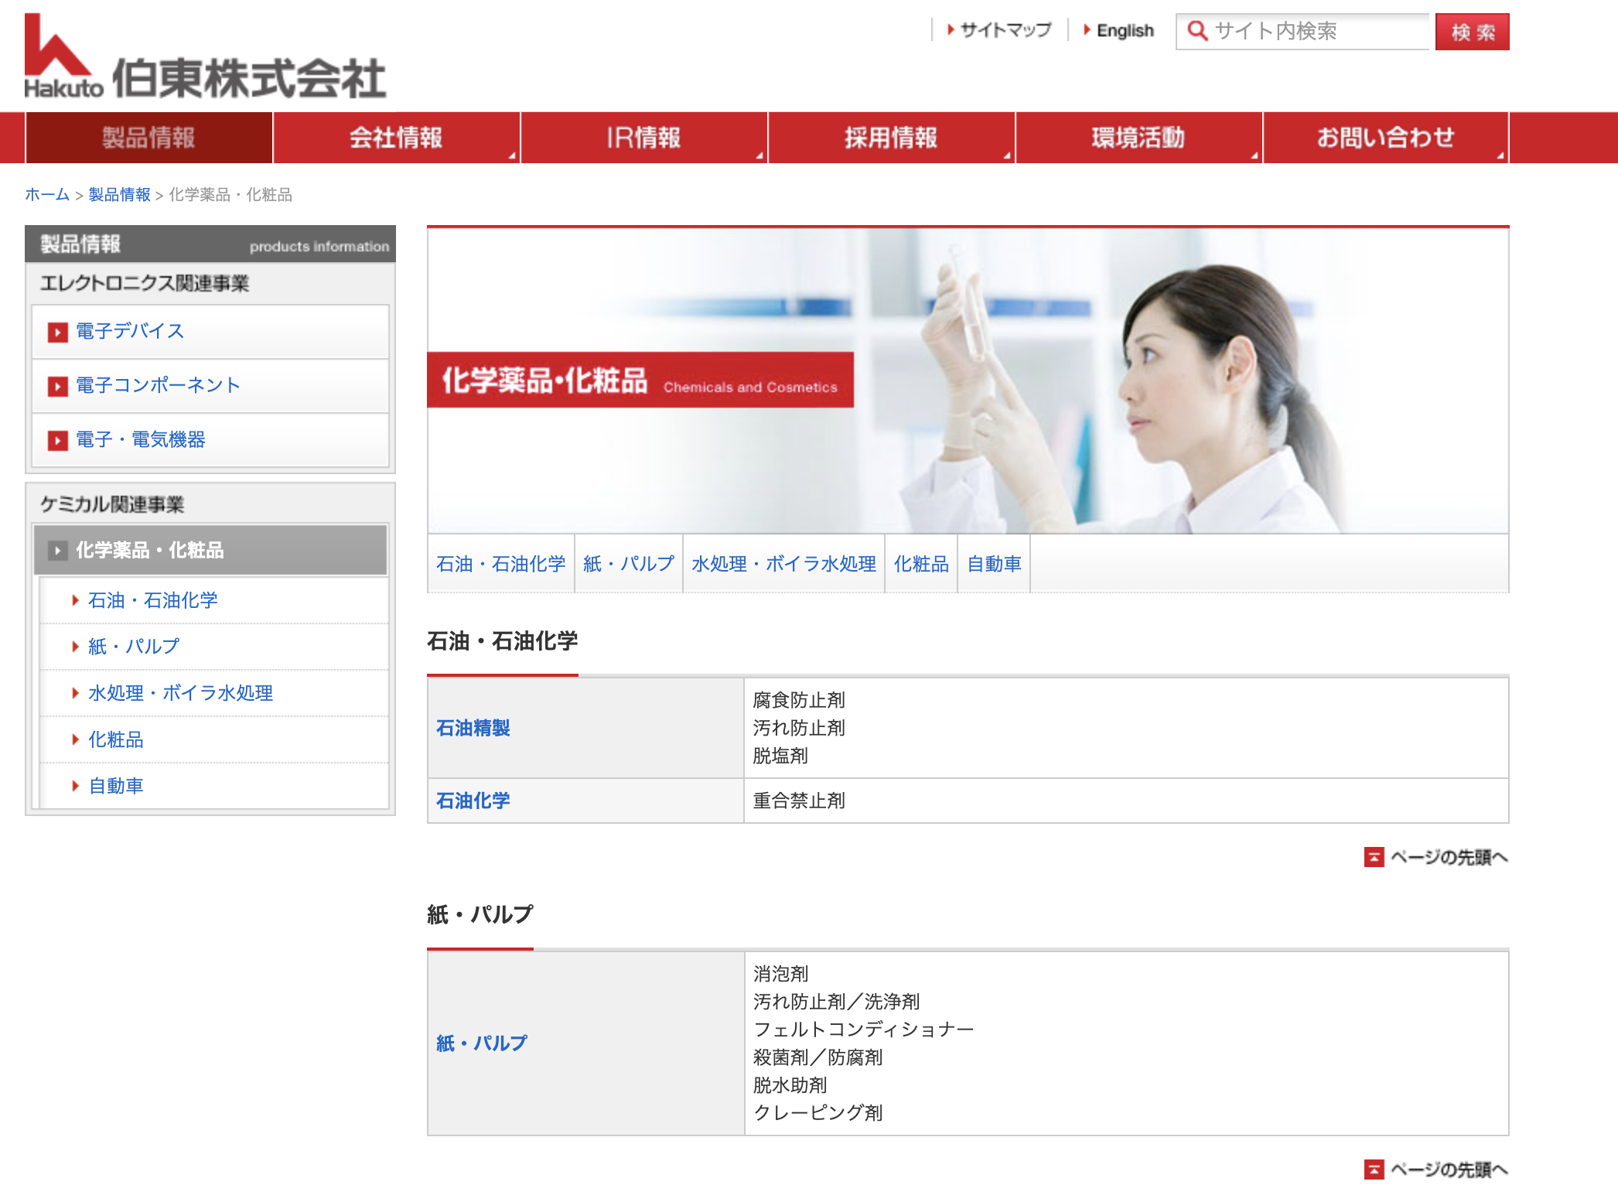
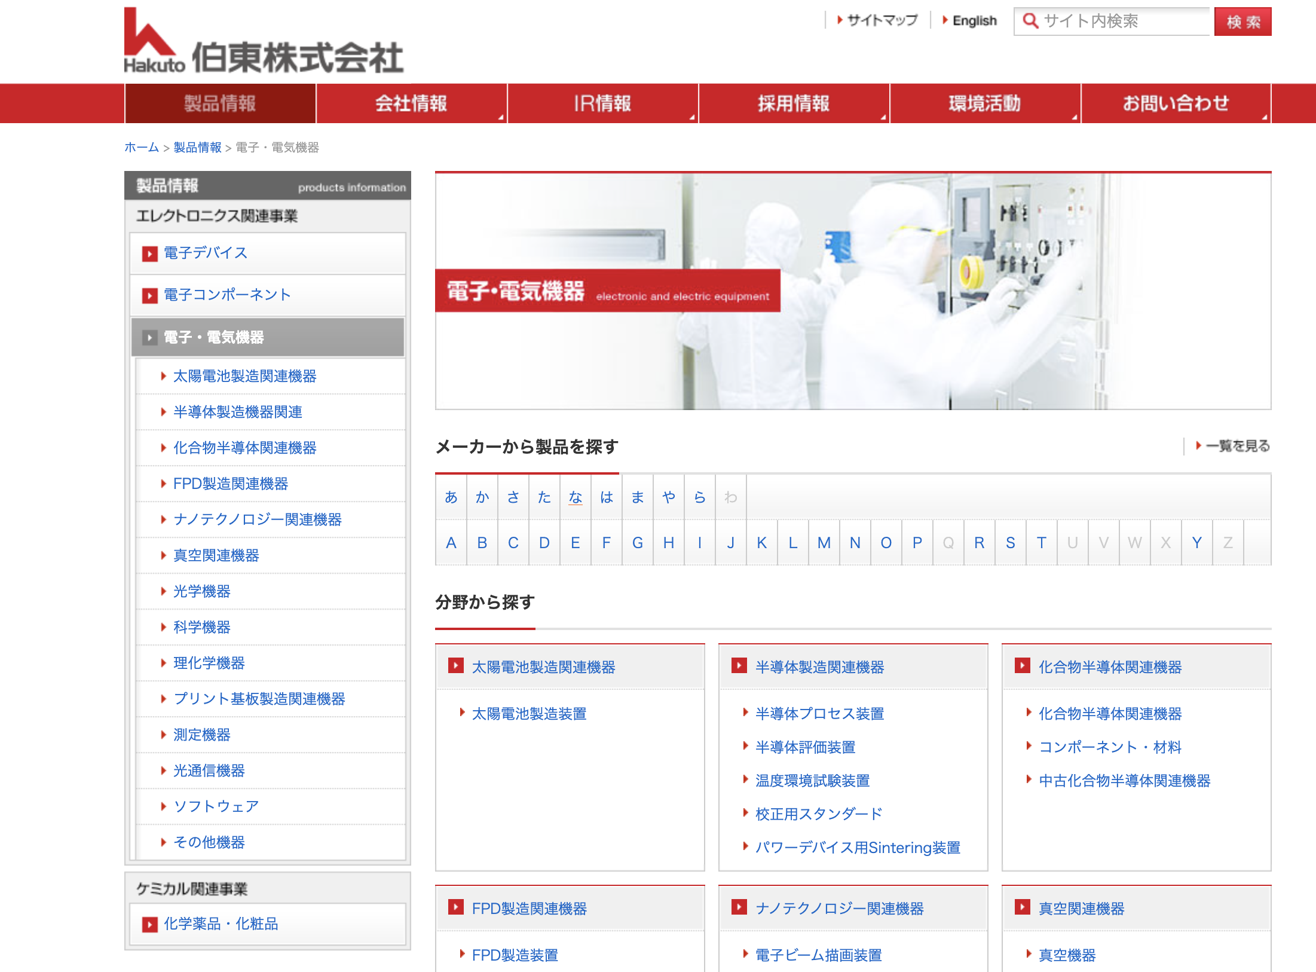
Example of Dual Attention Model Hakuto Co. Ltd (Electronics Device Distributor)
Page level attention
Product page
word level attention

Slide 6
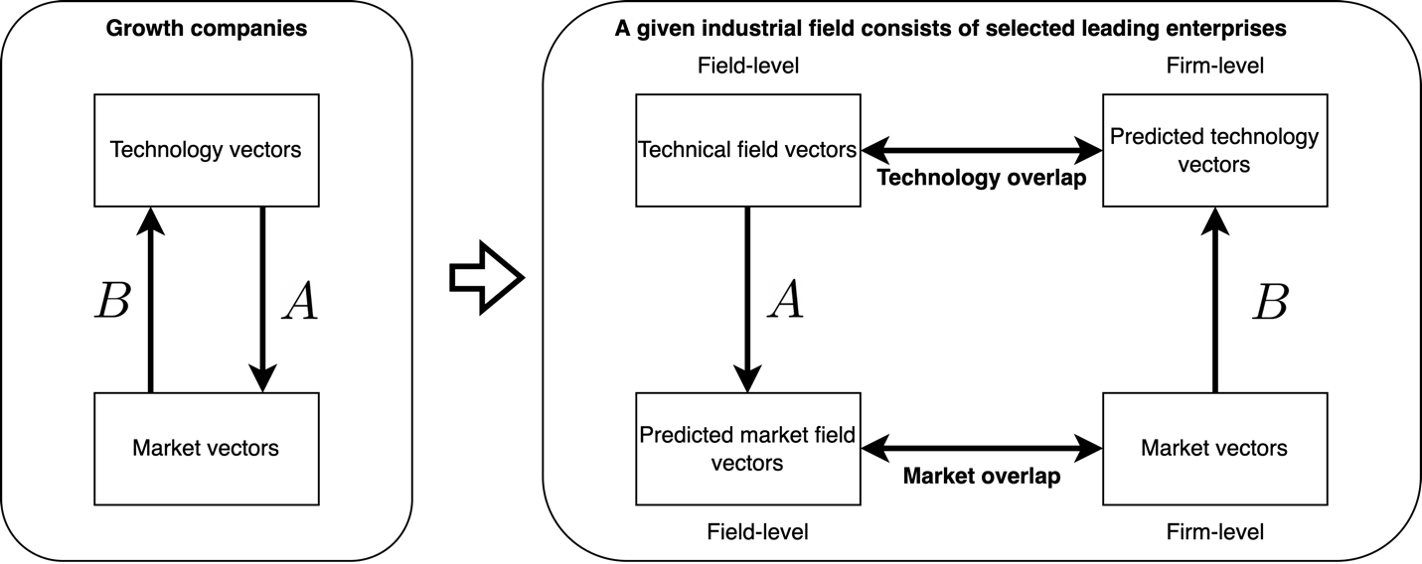
Transformation model and its usage
Use of new firm’s alignment information for opportunity identification
COS Similarity
Estimated
COS Similarity
Motohashi, K. and Zhu, C., Identifying Technology Opportunity Using a Dual-attention Model and a Technology-market Concordance Matrix, forthcoming Technology Forecasting and Social Change

Slide 7
Introduction for Phase 2
(Goal) Suggesting product/service for patents by using technology-product converting model
(Dataset)
Firm’s web text + patent info for three countries (CN, JP, US) (will be supplied by Tong Xinyu)
(Process)
Topic modeling of tech (patent info.) to see the technology evolution
Extract product related keywords by dual attention model from scraped website information
Develop technology-product converting model and come up with suggested products based on some existing patents

Slide 8
To do by timeline
1st Week : June 16-20 :
Topic modeling, understanding technical contents
Start scraping firm’s webpage in 2018 (wayback machine) -> Meeting June 23, 12:00- JST
2nd-3rd Weeks : June 23-July 4 :
Dual attention model + transformation matrix face validation -> Meeting July 3, 12:00-JST
4th-5th Weeks : July 7-July 18 :
Time difference model : topic modeling of 2013-18 patents, 2018-23 patents, 2018 HP and 2023 HP, any change?, Model building 2013-18 P -> 2018 HP and 2018-23 P -> 2023HP) -> Meeting July 14 and July 21, 12:00-JST
6th-7th Weeks : July 21-Aug 1 :
Methodological development -> dual attention model (methodological development, use of existing corpus such as Wikipedia), transformation model (not linear projection)
Demo-day Aug 1 12:00- JST
* Please note that July 3 is Thursday, not Monday!

