Slide 1




TEAM_D
ALL-IN LESSON
Bi-weekly progress meeting#2
Team D
이승환, 이채연, 박문희, 정재윤
2024.11.08

Slide 2


ALL-IN LESSON
CONTENTS
1
Objective & Goals
2
Weekly Progress
3
Role Distribution
4
Front-end
5
Back-end
6
Challenges & Limitations
7
Scheduled Plans

Slide 3
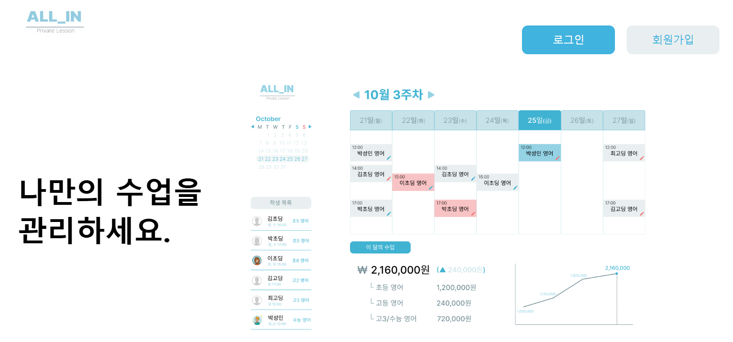
ALL-IN LESSON
01. Objective & Goals
all-in-one web application designed for each roles
(tutors, students, parents)

Slide 4
ALL-IN LESSON
02. Weekly Progress
 | Week 9 | Week 10 | Week 11 | Week 12 | Week 13 | Week 14
Backend | DB Schema
 | Login API
Frontend | Figma
 | Implementation
Integration |  |  | FE/BE Integration
Beta Version |  |  |  |  | Beta Testing
 |  |  |  |  | Debugging

Slide 5








ALL-IN LESSON
[ Front-end ]
03.
Role
Distribution
Home / Signup page
Login page
Tutor Home
Tutor Manager
Student Home / Manager
Parent Home / Manager
박문희
정재윤
이승환
이채연
Login API - Naver
Login API - Google/Kakao
Login API – Custom
Link with FE
Link with FE / DB
Authentication / Link with DB
[ Back-end ]

Slide 6
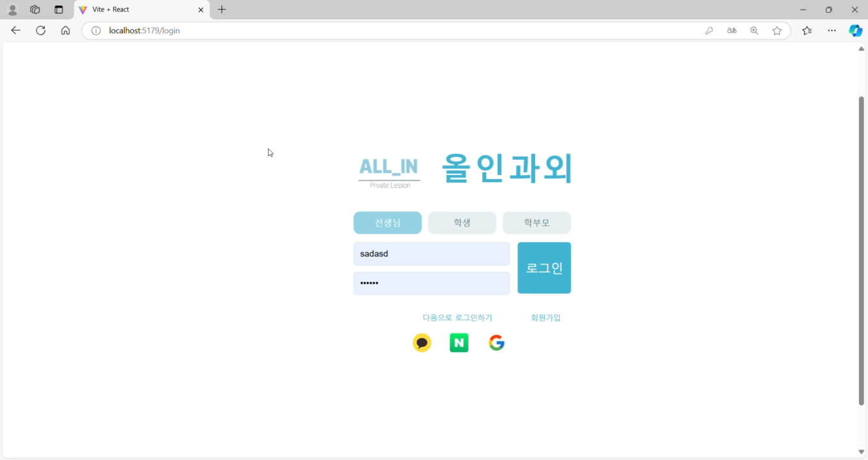
ALL-IN LESSON
04. Front-end (Login Homepage)

Slide 7

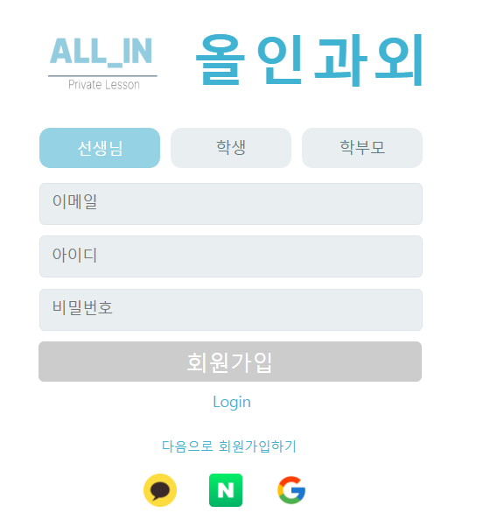
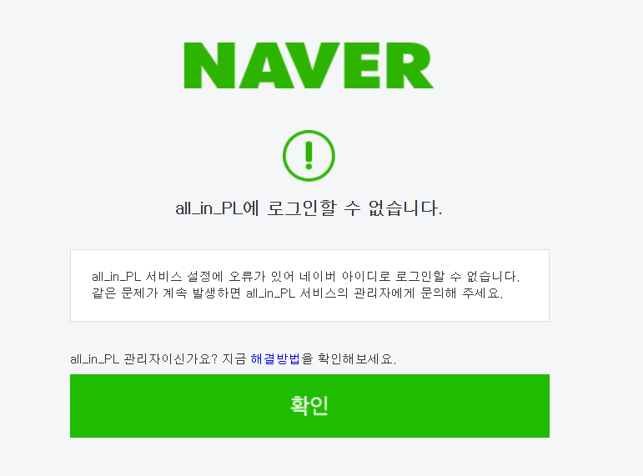
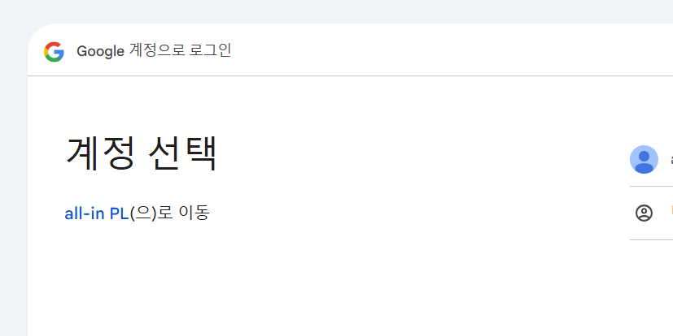
ALL-IN LESSON
04. Front-end (Login Homepage)
Main Login Page
Tutor/ student/ parent
Sign Up
Third Party Login
Kakao/ Naver/ Google

Slide 8
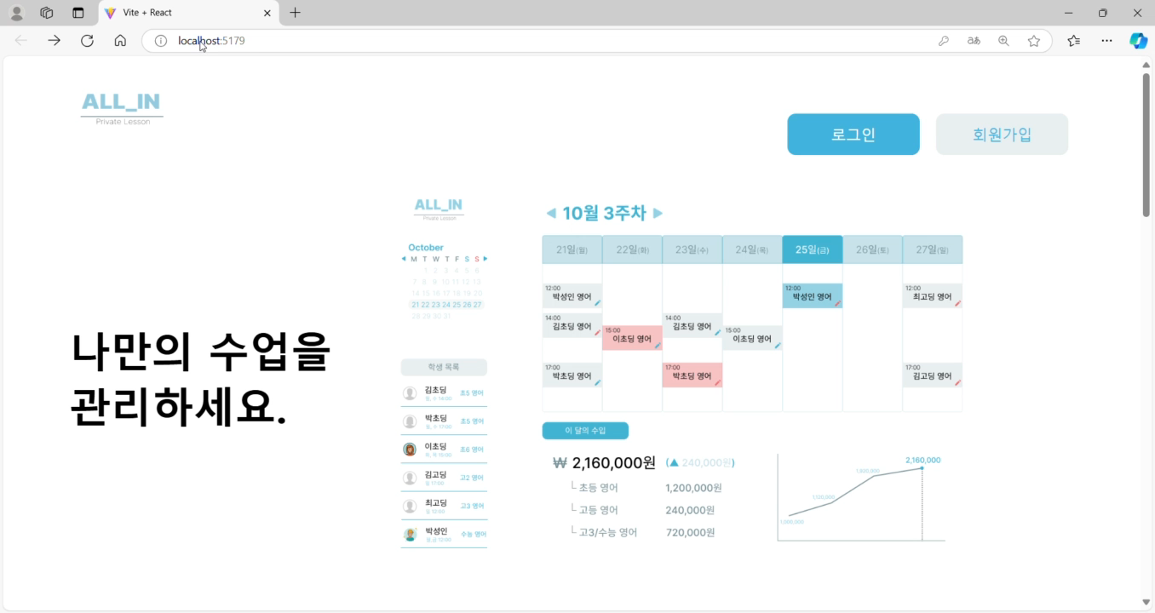
ALL-IN LESSON
04. Front-end (Tutor Homepage)

Slide 9
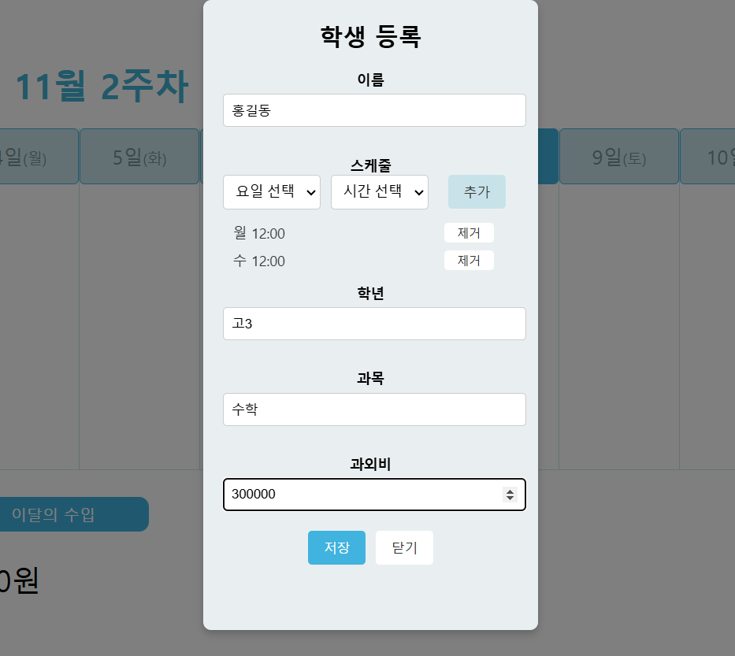
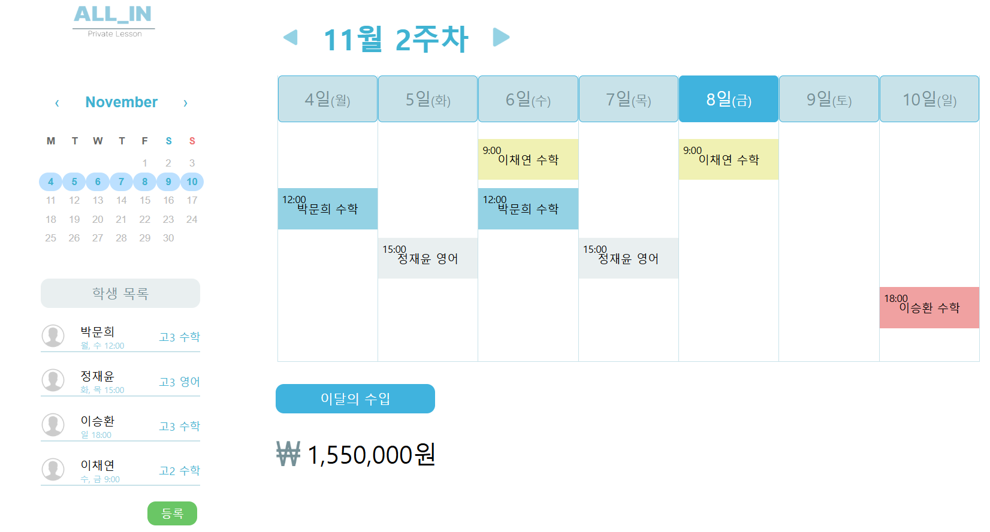
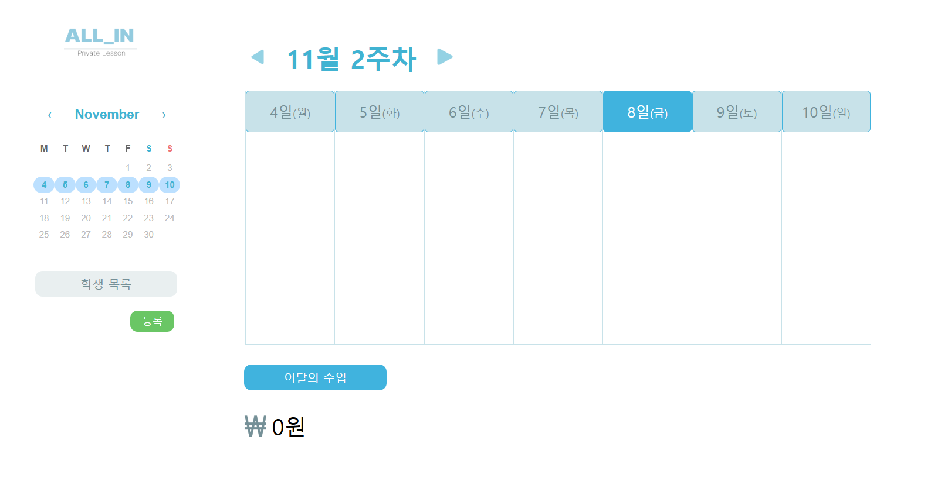
ALL-IN LESSON
04. Front-end (Tutor Homepage)
Initial state
- Nothing registered
Add student information,
subject, tuition fees
View this week’s schedule, tuition fees
View missing class/make-up class sched.

Slide 10
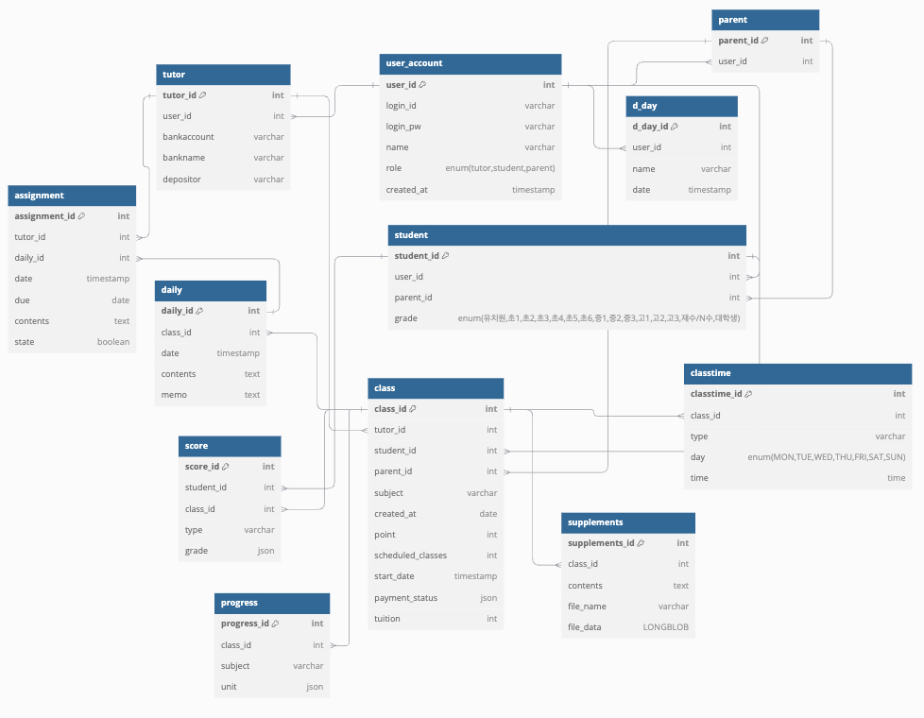
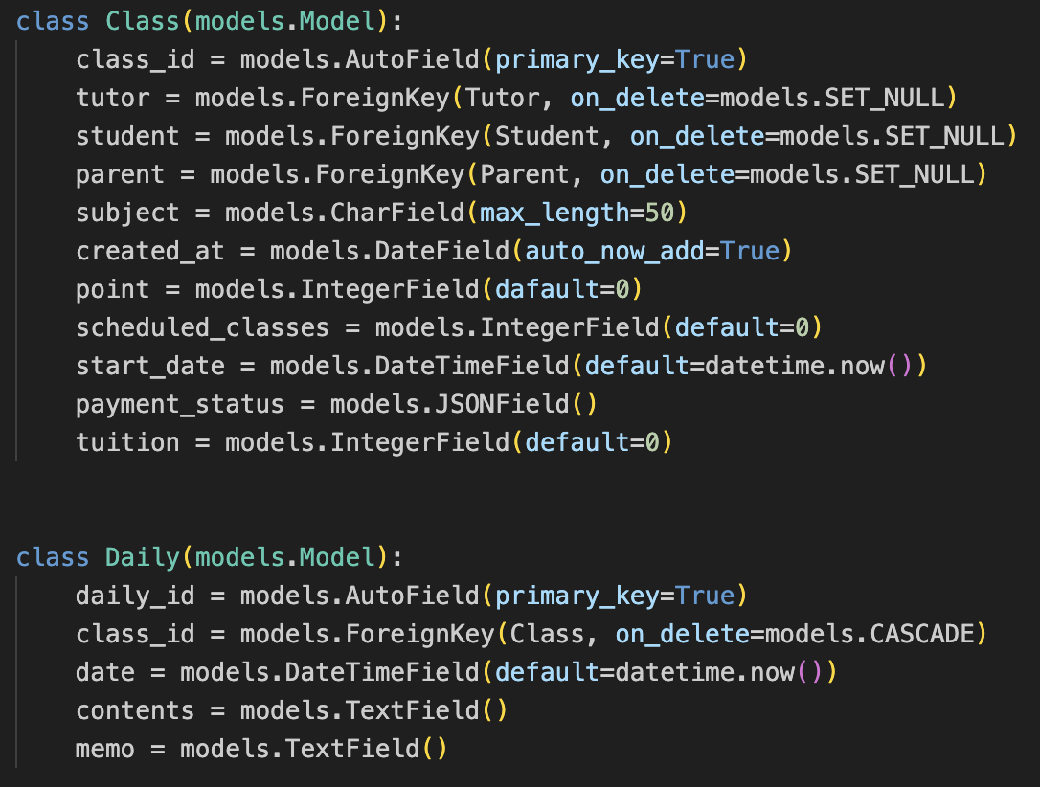
ALL-IN LESSON
05. Back-end

Slide 11

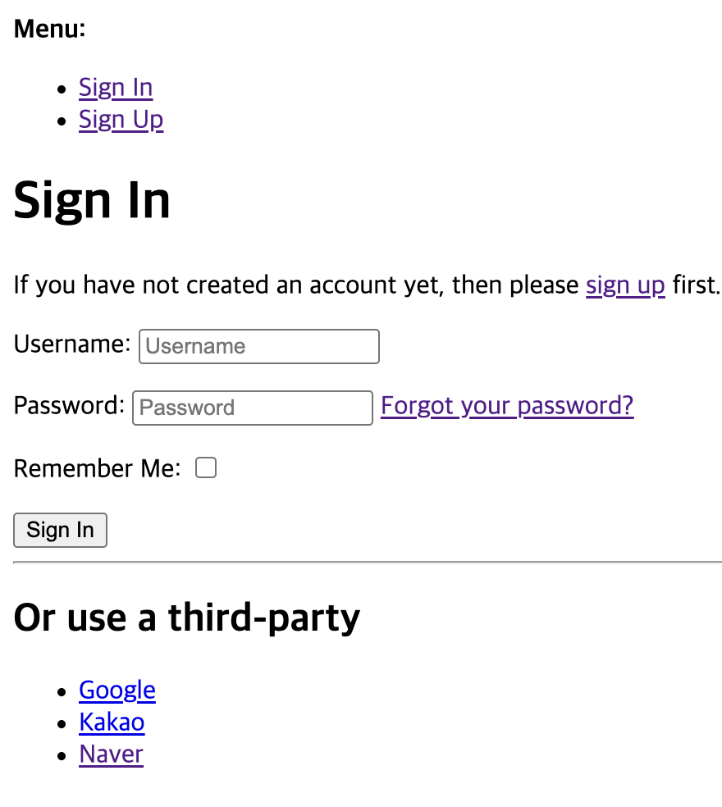
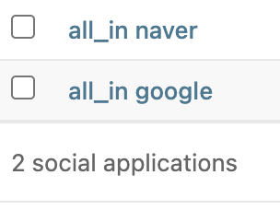
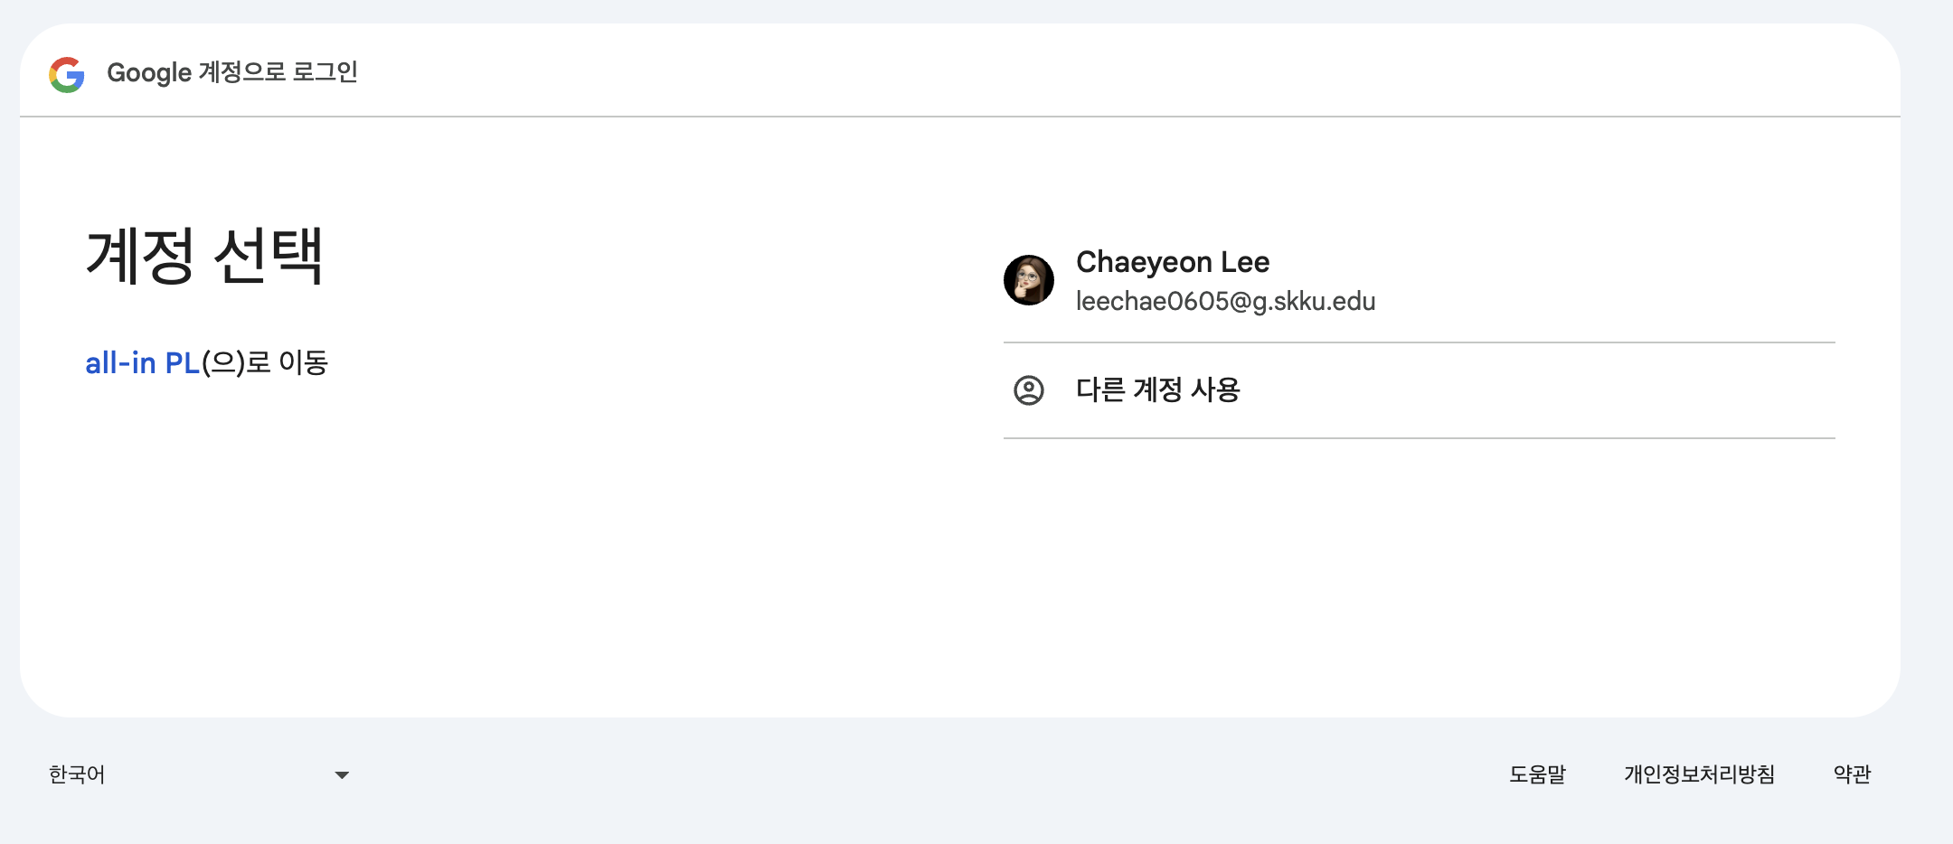
ALL-IN LESSON
05. Back-end
(Django Admin)
(FE Test Server)

Slide 12
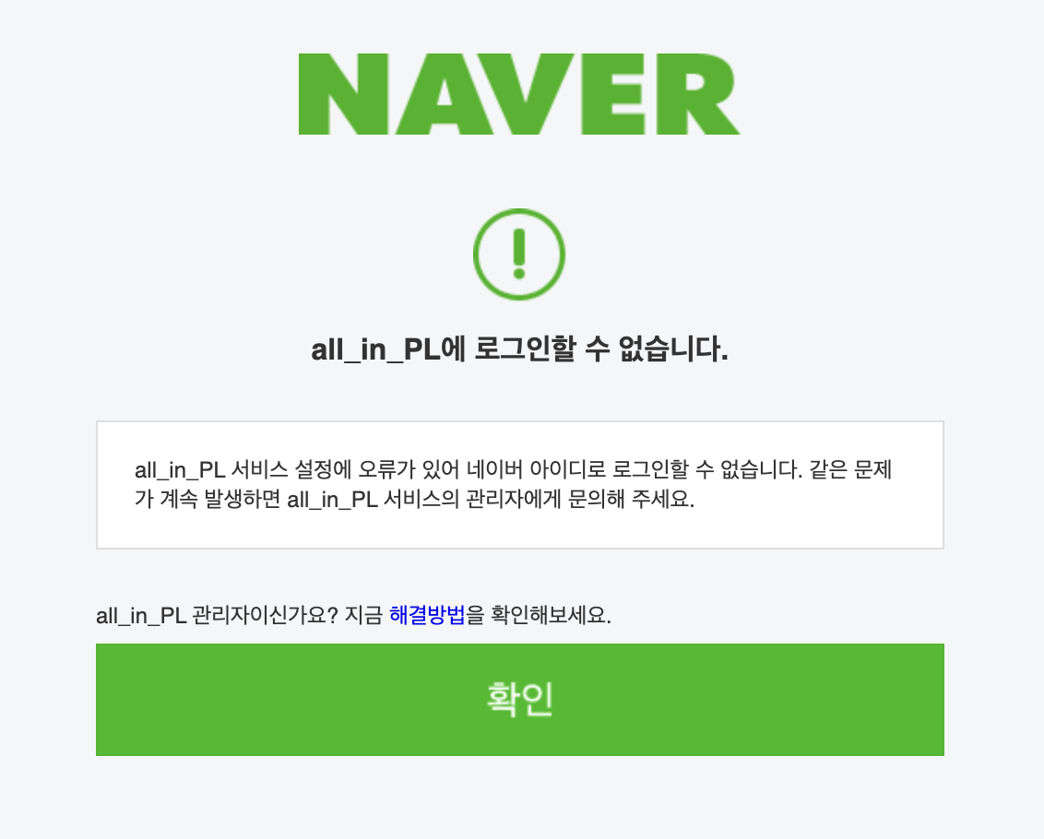
ALL-IN LESSON
05. Back-end
(Django Admin)
(FE Test Server)

Slide 13
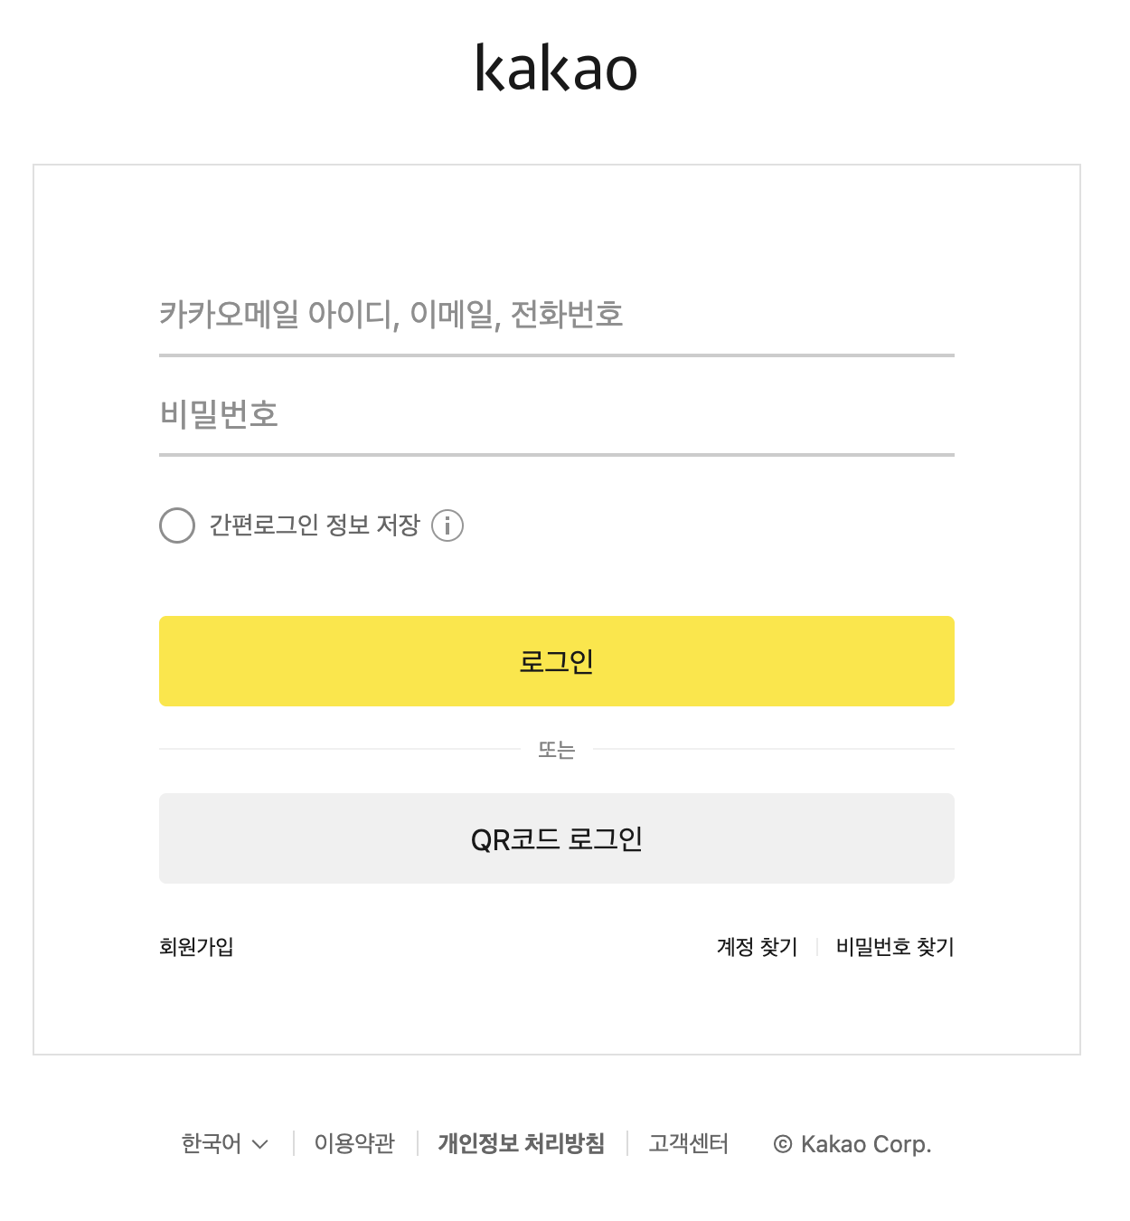
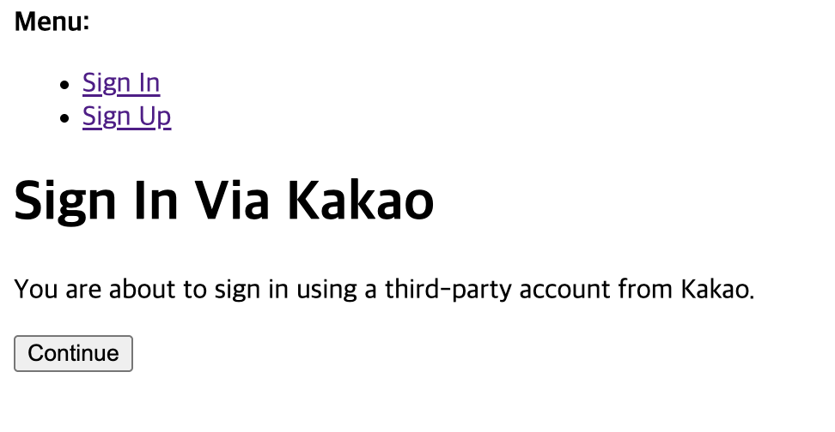
ALL-IN LESSON
05. Back-end
(Django Admin)
(FE Test Server)

Slide 14



ALL-IN LESSON
06. Challenges & Limitations
| Technological Issues |
| Limitations |
Slow reloading
with testing (FE)
→
Use VITE
Business Registration issues with Kakao
Fail to login with Naver
Backend development delay

Slide 15

ALL-IN LESSON
07. Scheduled Plans
 | Week 11 | Week 12 | Week 13 | Week 14
Frontend
 | Implementation
Backend | FE/BE Integration
 | Database Linkage
Beta Version |  |  | Beta Testing
 |  |  | Debugging

Slide 16
ALL-IN LESSON
THANK YOU.
Team_D

