Slide 1
Communicable diseases
Dr. E. Mwaniki

Slide 2
A communicable disease is a disease that spreads from person to person. It is caused by a specific biologic agent and can be transmitted either directly or indirectly from man to man, animal to man, or from the environment (air, food, water, etc) to man.
Communicable diseases are diseases that you can "catch" from someone or something else. Communicable Diseases = Infectious diseases.

Slide 3
DEFINITIONS
Infection is the entry and multiplication of an infectious agent in the body of man or animals.
Contamination: The presence of an infectious agent on a body surface, on or in clothes, beddings, toys, surgical instruments or dressings, or other articles or substances including water and food
Contagious disease is the one that is transmitted through contact. Examples include scabies, trachoma, STD and leprosy.
Vector: An insect or any living carrier that transports an infectious agent from an infected individual or its wastes to a susceptible individual or its food or immediate surroundings. Both biological and mechanical transmissions are encountered
Reservoir: Any person, animal, arthropod, plant, soil, or substance, or a combination of these, in which an infectious agent normally lives and multiplies. It is the natural habitat of the infectious agent from where it is transmitted to a susceptible host.

Slide 4
Epidemic: The unusual occurrence in a community of disease, specific health related behavior, or other health related events clearly in excess of expected occurrence”
Pandemic: An epidemic usually affecting a large proportion of the population, occuring over a wide geographic area such as a section of a nation, the entire nation, a continent or the world, e.g. Influenza pandemics.
Zoonosis is an infection that is transmissible under natural conditions from vertebrate animals to man, e.g. rabies, plague, bovine tuberculosis
Opportunistic Infection: This is infection by organisms that take the opportunity provided by a defect in host defense (e.g. immunity) to infect the host and thus cause disease. For example, opportunistic infections are very common in AIDS. Organisms include Herpes simplex, cytomegalovirus, M. tuberculosis….
Incubation period: time from exposure to development of disease. In other words, the time interval between invasion by an infectious agent and the appearance of the first sign or symptom of the disease in question.

Slide 5
For an infectious agent, infectivity refers to the proportion of exposed persons who become infected.
Pathogenicity refers to the proportion of infected individuals who develop clinically apparent disease.
Virulence refers to the proportion of clinically apparent cases that are severe or fatal.
infective dose (ID) that amount of a pathogenic agent that will cause infection in susceptible host

Slide 6
GLOSSARY OF TERMS
https://www.cdc.gov/reproductivehealth/data_stats/glossary.html

Slide 7
The communicable disease process.
Chain (Dynamics) of Infection
Source or Reservoir -> Mode of transmission -> susceptible host
The source of infection is defined as “the person, animal, object or substance from which an infectious agent passes or is disseminated to the host (immediate source).
The reservoir is “any person, animal, arthropod, plant, soil, or substance, or a combination of these, in which an infectious agent normally lives and multiplies, on which it depends primarily for survival, and where it reproduces itself in such a manner that it can be transmitted to a susceptible host. It is the natural habitat of the infectious agent

Slide 8
Chain of Transmission
Reservoir
Portal of exit
Susceptible host
Person-to-person transmission
Portal of entry
Agent

Slide 9
Six links of the chain
Agent: virus, bacteria, fungi, protozoa, helminths, ectoparasites
Source (reservoir): Humans and animals (symptomatic, incubating, convalescent, asymptomatic carrier) insects, environment (water, soil)
Portal of exit: Respiratory tract (nose, mouth), gastrointestinal tract (anus), genitourinary tract (urethra and cervix), skin, mucosa, placenta.
Route of transmission: Direct (contact or droplet), indirect (vehicle, vector), airborne
Portal of entry: Respiratory tract (nose, mouth), gastrointestinal tract (anus), genitourinary tract (urethra and cervix), skin, mucosa.
Susceptible host: anyone who is not immune

Slide 10
Transmission of communicable diseases.
Exit from ‘infected’ body by:
Blood
Nose or Mouth
Sex organs
Fecal waste
Travel to second body (Transmission) by:
Food
Air
Water
Blood
Sex
Insects
Animals

Slide 11
Transmission Routes:
Person – person spread: STIs, Hepatitis B, Herpes, Influenza
Air-borne spread: Chicken-pox, TB
Water-borne: Hepatitis A, cholera, typhoid, shigella
Food-borne: Salmonela, typhoid
Vector-borne: malaria

Slide 12
Communicable diseases of public health importance.
Anthrax
Chholera
Diarrhoea
Measles
Meningitis
Plague
Typhoid
Yellow Fever
Hemorhagic fevers (ebola, rift valley, lassa)
Leprosy
Tetanus
Poliomyelitis
HIV/AIDS
Malaria
Rabies
STIs
Trachoma
Tuberculosis
Influenza
SARS (Severe Acute Respiratory Syndrome) e.g COVID-19

Slide 13
Triad of Causation: Host, Agent, Environment
Host Factor
Factors which make the host susceptible include:
Age
Genetics
Nutritional status
Immunization status
Education level, Socio-economic factors
Presence of other illness

Slide 14
2. Agent Factors
Virulence
Infectious dose
Mode of transmission
Adaptation ability
3. Environment
Shelter and housing
Sanitation and hygiene
Water supply
Overcrowding
Availability of health and other services

Slide 15
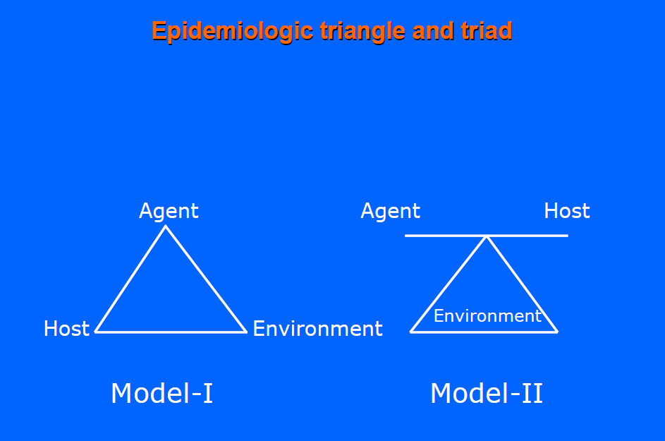

Slide 16
Transmission of diseases
Transmission\spread
The process of the pathogen(dses causing organism) leaving one host and infecting a new host.
For transmission to be complete two factors are crucial:-
Source of disease
Target population

Slide 17
Classification of communicable diseases
Two ways of classifying communicable diseases
Clinical classification: based on the main clinical manifestations (symptoms and signs) of the disease.
Epidemiologic classification: based on the main mode of transmission of the disease.

Slide 18
Clinical classification of communicable diseases
Diarrhoeal diseases: clinical symptom is diarrhoea, which means passage of loose stool (liquid faeces) three or more times per day
Febrile illnesses, because they all have the main symptom of fever, for example, malaria.
Respiratory diseases: their main symptoms include cough and shortness of breath, as in pneumonia.
ETC

Slide 19
Epidemiologic classification of communicable diseases
Based on the mode of transmission of the infectious agent, communicable diseases can be classified as:
Waterborne diseases: transmitted by ingestion of contaminated water.
Foodborne diseases: transmitted by the ingestion of contaminated food.
Airborne diseases: transmitted through the air.
Vector-borne diseases: transmitted by vectors, such as mosquitoes and flies.

Slide 20
Principles of Communicable disease control
Attacking the source | Interrupting transmission | Protecting the host
Treatment Immunization Isolation Chemoprophylaxis Reservoir control Notification | Environmental sanitation Immunisation Personal hygiene Behaviour change Vector control Disinfection and sterilization | Immunisation Chemoprophylaxis Personal protection Better nutrition

Slide 21
Control of vectors
Vectors of Public Health Importance
Mosquitoes : Malaria, Dengue Fever, Yellow fever, elephantiasis
Fleas: plague
Sand flies: leishmaniais
Ticks: lyme disease
Tse tse flies: sleeping sickness
Flies: diarrhoeal diseases
Rats: leptospirosis
Bedbugs, cockroaches

Slide 22
Measures should be taken to get rid of vectors which pose danger of diseases transmission. Measures include:
A. Environmental management
Destroying their bleeding sites e.g. Clearing bushes to control mosquitoes
B. Biological control
Biological predators e.g. Using Bats to feed on mosquitoes
Bacteria or fish that destroy larva

Slide 23
C. Chemical methods
Chemical sprays- using Doom to control house flies
Indoor residual spraying
Chemical larvicides

Slide 24
D. Personal protection
Insecticide treated nets
Insect repellent creams
Personal hygiene
Disease diagnosis and treatment
Mechanical killing
e.g., using your hands to kill mosquitoes

Slide 25
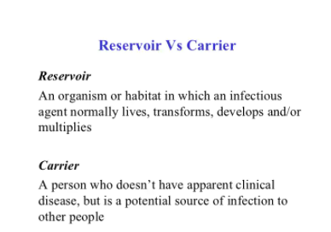

Slide 26
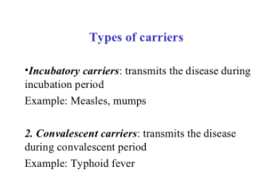

Slide 27
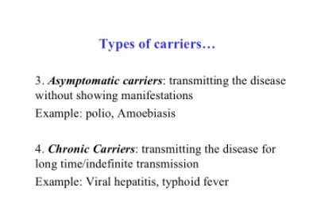

Slide 28
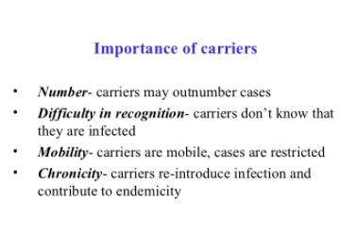

Slide 29
Summary
In reality, all of the following contribute in some measure to reducing the burden of infectious diseases circulating in the community
Hand hygiene and personal hygiene
Food hygiene(cooking, storing, preventing cross contamination)
Control of vectors like house flies

Slide 30
Cont…
Ensuring safe water at point of use
Respiratory hygiene
Safe disposal of faeces (both human and animal)
General hygiene(laundry, surfaces, toilets, baths, sinks)
Disposal of solid waste, control of wastewater and rainwater
Health education

Slide 31
Review Questions
Classify the following diseases based on the mode of transmission of the infectious agent
1. COVID-19
2. Pneumonia
3. Malaria
4. Cholera
5. HIV/AIDs
1. Why is it important to classify diseases based on the mode of transmission?
Post your answers in e-learning discussion forum

Slide 32
UCCC 1201: Interrelated Concepts in Prevention of Communicable Diseases
Dr. E mwaniki

Slide 33
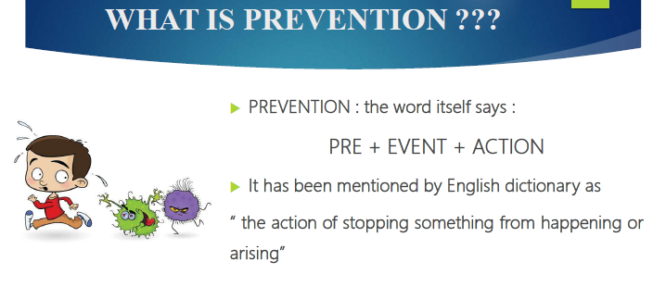

Slide 34
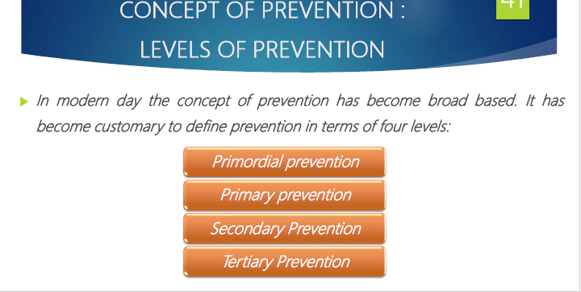

Slide 35
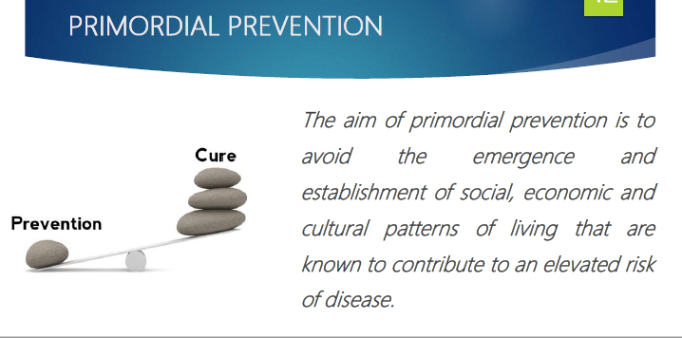

Slide 36
PREVENTION OF DISEASES (cont’d.)
Primary Prevention:
Primary prevention targets the pre-pathogenesis period or the period before the disease infects the individual.
The goal is to limit the incidence of disease and disability in the population by measures that eliminate or reduce causes or determinants of departures from good health, control exposure to risk, and promote factors that are protective of health
Common measures include health education and health promotion programs designed to foster healthier lifestyles and environmental health programs designed to improve environmental quality
Specific examples include immunization against communicable diseases; public health education about good nutrition, exercise, stress management, and individual responsibility for health; chlorination and filtration of public water supplies; and legislation requiring child restraints in motor vehicles.

Slide 37
PREVENTION OF DISEASES (cont’d.)
Secondary Prevention
happens during the early stages of the disease process.
Secondary prevention aims to reduce progression of disease through early detection, usually by screening at an asymptomatic stage, and early intervention.
Its purpose is to cure disease, slow its progression, or reduce its impact on individuals or communities.
A common approach to secondary prevention is screening for disease, such as the non-invasive computerized test for the early detection of heart disease
Occasionally, secondary disease control measures may include isolation or quarantine
Isolation = separation, for the period of communicability, of infected persons or animals from others so as to prevent the direct or indirect transmission of the communicable agent to a susceptible person/host
Quarantine = limitation of the freedom of movement of well persons or animals that have been exposed to a communicable disease until the incubation period has passed
Further measures may include disinfection

Slide 38
PREVENTION OF DISEASES (cont’d.)
Tertiary Prevention
This takes place during the advanced stages of the disease progression to minimise the complications or reverse the effects
The goal of tertiary prevention is to improve function and includes minimisation of the impact of established disease, and prevention or delay of complications and subsequent events through effective management and rehabilitation.
Tertiary Prevention strategies involve both therapeutic and rehabilitative measures once disease is firmly established.
Examples include treatment of diabetics to prevent complication of the disease and the ongoing management of chronic heart disease patients with medication, diet, exercise, and periodic examination.
Other examples include improving functioning of stroke patients through rehabilitation by occupational and physical therapy, nursing care, speech therapy, counseling and treating those suffering from complications of diseases such as meningitis, multiple sclerosis, or Parkinson’s disease.

Slide 39
Control
The reduction of disease incidence, prevalence, morbidity or mortality to a level that is locally acceptable as a result of deliberate efforts.
Continued intervention measures are required to maintain the reduction.
Concept of control:
The term disease control describes ongoing operations aimed at reducing:
The incidence of disease
The duration of disease and consequently the risk of transmission
The effects of infection, including both the physical and psychosocial complications
The financial burden to the community.

Slide 40
CONTROL
Control activities focus on primary prevention or secondary prevention, but most programs combine both.
control
elimination
eradication

Slide 41
Disease Elimination
Reduction to zero of the incidence of a specified disease in a defined geographical area as a result of deliberate efforts.
Between control and eradication, an intermediate goal has been described, called "regional elimination"
The term "elimination" is used to describe interruption of transmission of disease, as for example, elimination of measles, polio and diphtheria from large geographic regions or areas
Regional elimination is now seen as an important precursor of eradication

Slide 42
Disease Eradication
Eradication is the extinction of the pathogen that causes the infectious disease in question
Eradication literally means to "tear out by roots".
It is the process of “Termination of all transmission of infection by extermination of the infectious agent through surveillance and containment”.
Eradication implies that disease will no longer occur in a population.
To-date, only one disease has been eradicated, that is smallpox.

Slide 43
Immunity and communicable diseases
Immunity: Protection from an infectious disease. If you are immune to a disease, you can be exposed to it without becoming infected.
Vaccine: A preparation that is used to stimulate the body’s immune response against diseases. Vaccines are usually administered through needle injections, but some can be administered by mouth or sprayed into the nose.
Vaccination: The act of introducing a vaccine into the body to produce protection from a specific disease.
Immunization: A process by which a person becomes protected against a disease through vaccination. This term is often used interchangeably with vaccination or inoculation.

Slide 44
Passive immunization: Taking ready-made antibodies from one person, or animal, and giving to another person. Thus the recipient does not make any antibodies of their own. Horses are a common source of ready-made antibodies. E.g Anti-tetanus serum, diphtheria antitoxin, snake antiserum. A pregnant mother immunized against tetanus is able to pass the antibodies to her unborn child thus protecting the child from tetanus after birth.
Herd Immunity: In a community, the reduced risk of getting an infection among those who are NOT immunized, due to the presence of large numbers of already immunized people. Umbrella effect: high percent of immunized people providing protection against infection to those who are not immunized. Good population coverage of immunization results in Herd Immunity.

Slide 45
Vaccination is one of the most convenient and safest preventive care measures available.
Categorized of vaccines include
a) Adult vaccines
b) Pregnant women vaccines
c) Child and adolescent vaccines
d) Children under five years vaccines
e) Travel vaccines
f) High risk /special groups

Slide 46
Some of the recommended vaccines for children under five years
Immunization | Vaccine | Schedule
 | BCG Vaccination | Birth
 | Oral Polio Vaccination | Birth, 6, 10, 14 weeks
 | Pentavalent vaccination | 6, 10, 14 weeks
 | Rotavirus vaccination (oral) | 6, 10 weeks
 | Pneumo-Coccal-Vaccine (PCV) – 10 vaccination (inj) | 6, 10, 14 weeks
 | Measles vaccination | 9 months
 | Yellow fever vaccination | 9 months

Slide 47
Other vaccines
Yellow Fever – Given at 9 months, or to travelers
Rabies – usually given after assessment by a medical officer
Typhoid – not often used due to reactions
Cholera - Given in special circumstances to limit risk of outbreaks
Meningococcal – Given in mass campaigns following meningitis outbreaks

Slide 48
Pneumococcal (PCV)– recommended for children and other high risk groups against pneumonia.
Rubella – Given at 9 months in combination with measles vaccine (MMR – Mumps, Measles, Rubella)
Rotavirus – vomiting and diarrhea. Two vaccines have been recommended by WHO
Human Papilloma Virus – adolescent girls 12 yrs
COVID-19 Virus – Approved for children, adolescents and adults during the COVID -19 Pandemic
Vaccines under pilot programme
Since 2019, Malaria vaccine has been under implementation programme also known as pilot programme, in Kenya, Ghana and Malawi (2023)

Slide 49
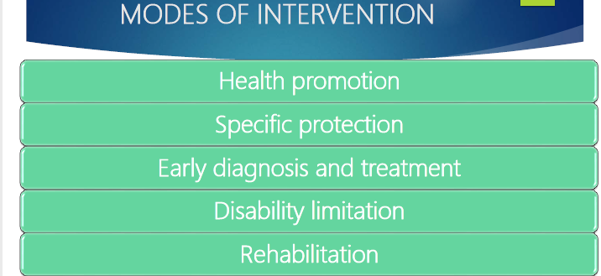

Slide 50
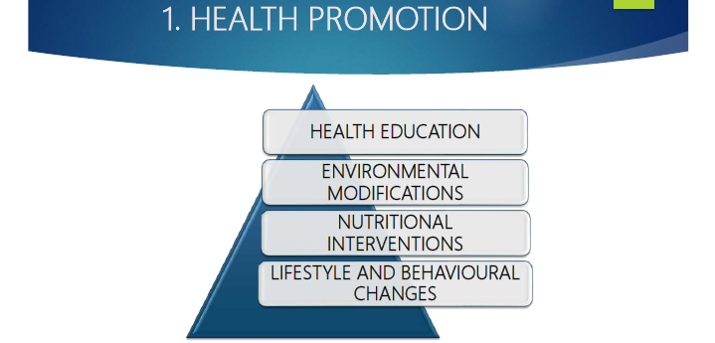

Slide 51
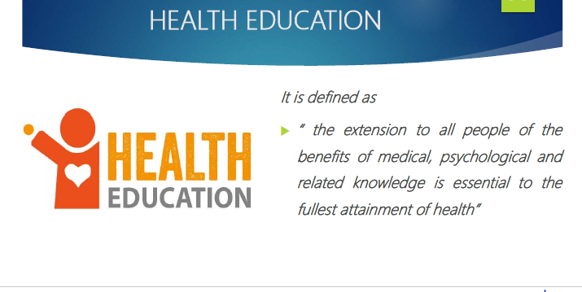

Slide 52
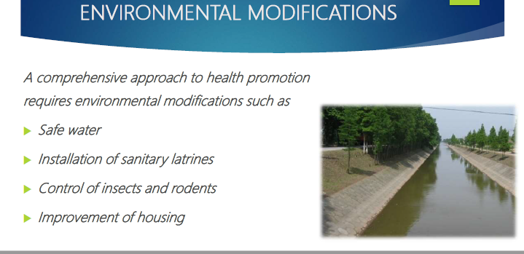

Slide 53
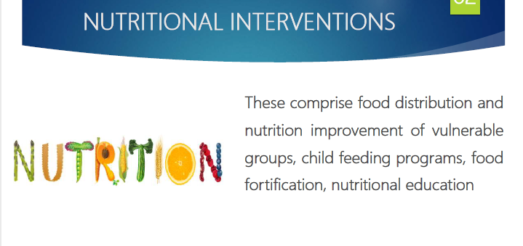

Slide 54
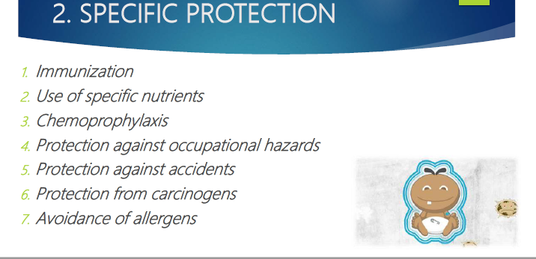

Slide 55
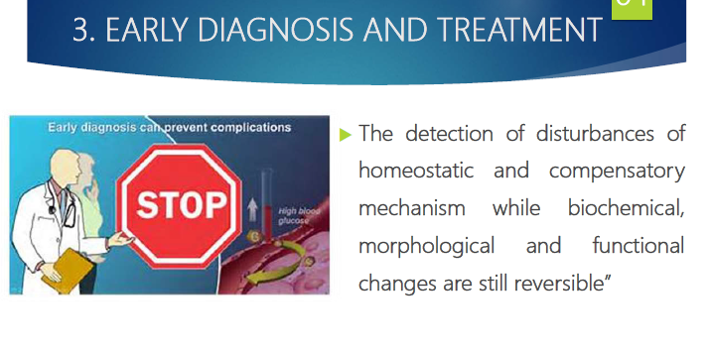

Slide 56
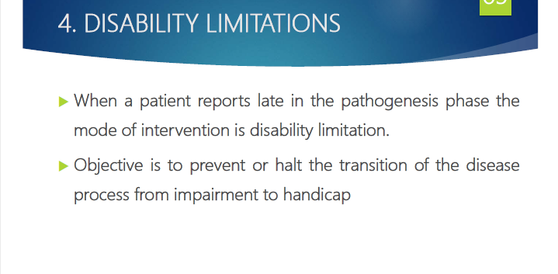

Slide 57
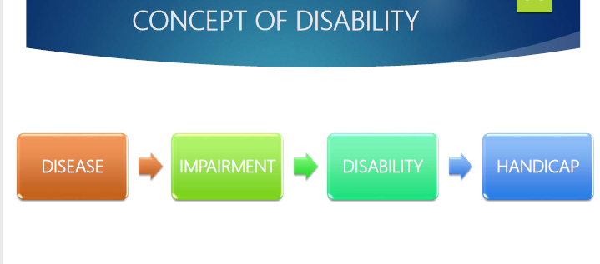

Slide 58
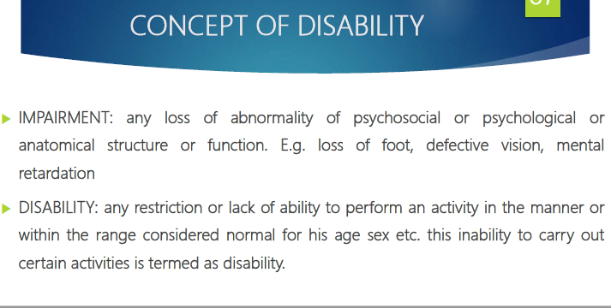

Slide 59
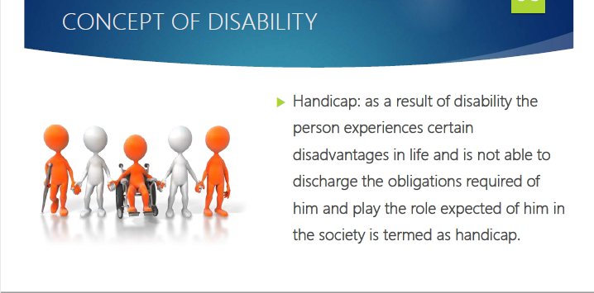

Slide 60
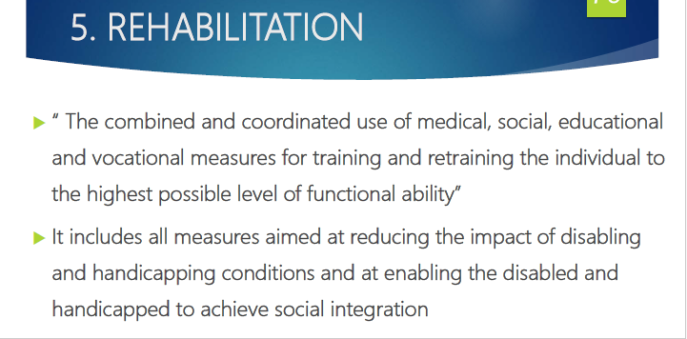

Slide 61
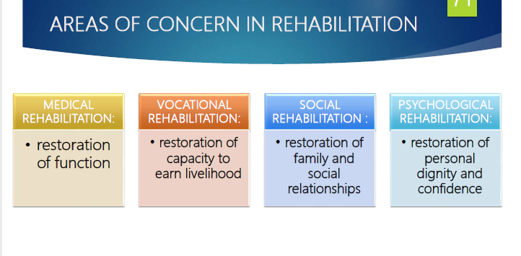

Slide 62
Epidemiology, Prevention, Control and Treatment of communicable diseases

Slide 63
Cholera
Background
Acute illness with profuse watery diarrhoea caused by Vibrio cholerae serogroups O1 or O139. The disease is transmitted mainly through the faecal-oral route; that is through eating or drinking contaminated food or water. Cholera causes over 100 000 deaths per year. It may produce rapidly progressive epidemics or worldwide pandemics. In endemic areas, sporadic cases (less than 5% of all non-outbreak-related diarrhoea cases) and small outbreaks may occur. Incubation period is from a few hours to 5 days, usually in the range of from 2 to 3 days. There has been a resurgence of cholera in Africa since the mid-1980s, where over 80% of the world’s cases occurred in 1999. The majority of cases occurred from January through April. Cholera may cause severe dehydration in only a few hours. In untreated patients with severe dehydration, the case fatality rate (CFR) may exceed 50%. If patients present at the health facility and correct treatment is received, the CFR is usually less than 1%. At least 90% of the cases are mild, and they remain undiagnosed. Risk factors: eating or drinking contaminated foods such as uncooked seafood or shellfish from estuarine waters, lack of continuous access to safe water and food supplies, attending large gatherings of people including ceremonies such as weddings or funerals, contact with persons who died of cholera. Other enteric diarrhoea may cause watery diarrhoea, especially in children less than 5 years of age. Please see Diarrhoea with dehydration summary guidelines.

Slide 64
Standard case definition for Cholera
Suspected case: In a patient age 5 years or more, severe dehydration or death from acute watery diarrhoea. If there is a cholera epidemic, a suspected case is any person age 5 years or more with acute watery diarrhoea, with or without vomiting. Confirmed case: A suspected case in which Vibrio cholerae O1 or O139 has been isolated in the stool.

Slide 65
Foodborne Illnesses
Background
Foodborne illnesses are caused by a variety of bacterial, viral, parasitic and bacterial or fungal pathogens or their toxins that enter the body through consumption of food or water. A foodborne illness occurs when two or more people have shared common food or drink followed by an onset of symptoms within a short time period. Most people with a foodborne illness do not seek medical care, so cases and outbreaks of foodborne illness usually are neither recognized nor reported. The first symptoms often occur in gastrointestinal tract. Nausea, vomiting, abdominal cramps and diarrhoea are frequent symptoms of foodborne diseases. Outbreaks may be localized affecting as few as 2 individuals who ate a common meal or product, but large and geographically widespread outbreaks may also occur. Large outbreaks occur when food is contaminated prior to distribution and is widely consumed by many people in many areas. Surveillance for foodborne illnesses is needed to monitor food safety and target health promotion actions aimed at food handlers for safer food practices and improved personal hygiene.

Slide 66
Foodborne Illnesses Standard case definition
A foodborne illness is suspected when 2 or more people present with similar symptoms and who consumed common food or drink A foodborne illness is defined according to the specific agent causing the disease (for example, cholera, hepatitis A, salmonellosis, shigellosis). A confirmed foodborne illness is a laboratory confirmed case of a specific agent with a link to a common food or drink source.
Prevention and control
Reduce sporadic and outbreak-related cases by promoting handwashing with soap and water after defaecating/urinating and before food handling/meals; strengthen access to safe water supply and storage, use of latrines and safe human waste disposal Scale-up food inspection activities

Slide 67
Malaria
Background
Malaria is a highly prevalent tropical illness with fever following the bite of infected female Anopheles mosquitoes which transmit a parasite, Plasmodium falciparum, P. ovale, P. vivax, or P. malariae. Serious malarial infections are usually due to P. falciparum which may result in severe anaemia and vital organ involvement. Malaria is one of the leading causes of illness and death in many African countries. There are 900 000 deaths per year in Africa mainly in children less than 5 years of age and pregnant women. Incubation period from the time of being bitten to onset of symptoms is 7 to 30 days. The incubation period may be longer, especially with non- P. falciparum species. Transmission of malaria is highly seasonal (rainy) in some areas in African countries but is perennial in the rest of the region

Slide 68
Malaria Standard case definition
Uncomplicated malaria Any person living in area at risk of malaria with fever or history of fever within 24 hours; without signs of severe disease (vital organ dysfunction) is diagnosed clinically as malaria. Severe malaria Any patient hospitalized with P. falciparum asexual parasitaemia as confirmed by laboratory tests with accompanying symptoms and signs of severe disease (vital organ dysfunction) diagnosed through laboratory.
Prevention and control
Evaluate and improve, as needed, prevention strategies, such as vector spraying, use of ITNs(Insecticide Treated Nets) and IRS (Indoor Residual Spraying) for all at risk of malaria, as well as Intermittent Preventive Therapy (IPT) for pregnant women and treatment of cases with Coartem (Artemether - Lumefantrine)
Laboratory confirmation
Diagnostic test | Microscopy: Presence of malarial parasites in blood films for suspected cases Malaria Rapid diagnostic test (RDT): Positive or negative test

Slide 69
Meningococcal Meningitis
Background
Neisseria meningitidis, Haemophilus influenzae type b (Hib), and Streptococcus pneumoniae constitute the majority of all cases of bacterial meningitis and 90% of bacterial meningitis in children. Meningococcal meningitis is the main form of meningitis to cause epidemics and remains a major public health challenge in the African meningitis belt, an area that extends from Senegal to Ethiopia. In these countries, large outbreaks may occur during the dry season (e.g., November through May). Outside of the meningitis belt, smaller outbreaks may occur year-round. Epidemics in the meningitis belt are traditionally associated with Neisseria meningitides serogroup A although in 2002 an epidemic due to Nm serogroup W135 occurred in Burkina and in 2006 Nm serogroup X was isolated in Niger. Human-to-human disease transmission is via large respiratory droplets from the nose and throats of infected people. Incubation period is 2 to 10 days. Attack rates are highest among children aged less than 15 years. Case fatality rates are usually 8-15% among treated patients, and >70% among untreated cases. Many survivors suffer long-term sequelae including mental retardation, hearing loss and loss of limb use. Oily chloramphenicol is the drug of choice during epidemics because a single dose of this long-acting formulation has been shown to be effective. Antimicrobial resistance to chloramphenicol has not yet been detected in Africa, however, resistance to sulphonamides is widespread. The current response to meningitis epidemics consists of reactive mass vaccination campaigns A meningococcal A conjugate vaccine has been developed which is immunogenic in both infants and adults and is expected to confer long-term protection. It is expected that introduction of this conjugate vaccine into meningitis belt countries is likely to dramatically reduce the circulation of Nm A and eliminate Nm A epidemics.

Slide 70
Meningococcal Meningitis Standard case definition
Suspected case: Any person with sudden onset of fever (>38.5ºC rectal or 38.0ºC axillary) and one of the following signs: neck stiffness, altered consciousness or other meningeal signs. Confirmed case: A suspected case confirmed by isolation of N. meningitidis from cerebrospinal fluid (CSF) or blood.
Prevention and control
Respond to epidemic threshold: Immediately vaccinate the epidemic district as well as any contiguous districts in alert phase. Mobilize community to permit early case detection and treatment, and improve vaccine coverage during mass vaccination campaigns for outbreak control. Treat all cases with appropriate antibiotics as recommended.

Slide 71
Poliomyelitis (Acute flaccid paralysis)
Background
Poliovirus is transmitted from person-to-person via faecal-oral spread. Incubation period is 7 to 14 days for paralytic cases and the range is approximately 3 to 35 days. The virus may be shed for several years by immuno-compromised persons. Infection is usually asymptomatic, but may cause a febrile syndrome with or without meningitis. In less than 5% of infections paralysis results, often of a single leg. Polio infection occurs almost exclusively among children. Infection may occur with any of 3 serotypes of Poliovirus. Immunity is serotype-specific and lifelong. Paralytic polio, though not fatal, has devastating social and economic consequences among affected individuals. The Polio Eradication Program has nearly halted ongoing wild-type polio transmission worldwide through use of oral poliovirus (OPV) vaccine. Areas with low vaccine coverage may allow ongoing wild-type transmission. Other neurological illnesses may cause AFP, for example, Guillain-Barré syndrome and transverse myelitis.

Slide 72
Poliomyelitis (Acute flaccid paralysis) Standard case definition
Suspected case: Any child under 15 years of age with acute flaccid paralysis or any person with paralytic illness at any age in whom the clinician suspects poliomyelitis. Confirmed case: A suspected case with virus isolation in stool.
Prevention and control
If a case is confirmed: If wild polio virus is isolated from stool specimen, refer to national polio eradication program guidelines for recommended response actions. The national level will decide which actions to take. They may include the following: Immediately conduct “mopping-up” vaccination campaign around the vicinity of the case. Conduct surveys to identify areas of low OPV coverage during routine EPI activities, and improve routine vaccine coverage of OPV and other EPI antigens. Lead supplemental vaccination campaigns during National Immunization Days (NIDs) or Sub-National Immunization Days (SNIDs). Focus supplemental vaccination activities in areas of low vaccine coverage during EPI. Consider use of house-to-house vaccination teams in selected areas.
Laboratory confirmation
Diagnostic test | Isolation of polio virus from stool

Slide 73
Sexually transmitted infections
Background
Infections of the human genito-urinary and reproductive systems transmitted via human sexual contact (sexually transmitted disease, STIs). The most common causes of male urethral discharge are a) the gonococcus Neisseria gonorrhoea and b) Chlamydia trachomatis. The most common causes of male and female genital ulcer are c) syphilis (Treponema pallidum), d) herpes simplex virus (HSV1 or 2) and e) chancroid (Haemophilus ducreyi). STIs are endemic in most countries of the world, including countries in Africa. Multiple simultaneous STIs are common (for example, gonorrhoea plus Chlamydia). STIs may be most highly prevalent in areas where HIV occurs and may facilitate HIV transmission. STIs may be primary or from repeated attacks of urethral discharge. STIs are a leading cause of abortion and stillbirth, prematurity, and congenital infections. They may lead to pelvic inflammatory disease (PID), a major cause of decreased fertility. Incubation periods for gonorrhoea are 2 to 7 days; Chlamydia 7 to 14 days (or longer); syphilis, 10 days to 12 weeks (usually around 3 weeks), and chancroid, 3 to 14 days. STIs may be more commonly diagnosed in men, in whom clinical evidence of infection may be more readily apparent.

Slide 74
Sexually transmitted infections Standard case definition
Genital ulcer syndrome (non-vesicular): Suspected case: Any male with an ulcer on the penis, scrotum, or rectum, with or without inguinal adenopathy, or any female with ulcer on labia, vagina, or rectum, with or without inguinal adenopathy. Urethral discharge syndrome: Suspected case: Any male with urethral discharge with or without dysuria. Confirmed case: Urethral discharge syndrome: A suspected case confirmed by a laboratory method (for example Gram stain showing intracellular Gram-negative diplococci).
Prevention and control
Conduct active case finding for specific target groups. Conduct primary prevention activities such as promotion of safer sexual behaviours and provision of condoms. Train health workers in the detection and treatment of STIs. Include STI prevention and care services in maternal and child health, and family planning services. Target acceptable and effective STI prevention and care services to populations identified as vulnerable to STI transmission. Promote early STI health seeking behaviour.

Slide 75
Trachoma
Background
Trachoma is the leading cause of preventable blindness worldwide. It is caused by infection with Chlamydia trachomatis bacteria, and is both treatable and preventable. Infections often begin during infancy or childhood and can become chronic. If left untreated, the infection eventually causes the eyelid to turn inwards, which in turn causes the eyelashes to rub on the eyeball, resulting in intense pain and scarring of the front of the eye. This ultimately leads to irreversible blindness, typically between 30 and 40 years of age. Trachoma is easily spread through direct personal contact, shared towels and cloths, and flies that have come in contact with the eyes or nose of an infected person. WHO estimates that approximately 6 million cases of blindness due to trachoma and 11 million cases of trichiasis occur worldwide each year. Prevalence of active disease in children varies from 10-40% in some African countries. The infection primarily affects young children, with blindness occurring later in life. Females are three times more likely than males to suffer from trichiasis, the in-turning of the eyelashes that can lead to blindness. People are most at risk for trachoma infection in areas where there is poor sanitation, lack of latrines, poor sources of clean water, and the presence of flies. Primary interventions advocated for preventing trachoma infection include improved sanitation, reduction of fly breeding sites and increased facial cleanliness (with clean water) among children at risk of disease. The scaring and visual change for trachoma can be reversed by a simple surgical procedure performed at village level which reverses the in-turned eyelashes.

Slide 76
Trachoma Standard case definition
Suspected case: Any patient with red sticky eyes who complains of pain and itchiness of the eyes.
Prevention and control
The World Health Organization has developed a series of interventions to control trachoma known by the acronym SAFE: Surgery, Antibiotics, Facial cleanliness, and Environmental improvement. Effective Trachoma control has four main components: Eye lid surgery for those at immediate risk of blindness Antibiotics to treat individual cases and to reduce infection in a community The promotion of facial cleanliness and hygiene to reduce transmission Environmental improvements such as provision of water and household sanitation

Slide 77
Typhoid Fever
Background
Typhoid fever is a bacterial disease, caused by Salmonella typhi. Symptoms usually develop 1–3 weeks after exposure, and may be mild or severe. They include high fever, malaise, headache, constipation or diarrhoea, rose-coloured spots on the chest, and enlarged spleen and liver. Healthy carrier state may follow acute illness. Typhoid fever remains a serious public health problem throughout the world, with an estimated 16–33 million cases and 500 000 to 600 000 deaths annually. In the last outbreak in the Democratic Republic of Congo, between 27 September 2004 and early January 2005, no less than 42 564 cases of typhoid fever were reported, including 214 deaths and 696 cases of peritonitis and intestinal perforations. In virtually all endemic areas, the incidence of typhoid fever is highest in children from 5–19 years old. The disease is almost exclusively transmitted by food and water contaminated by the faeces and urine of patients and carriers. Polluted water is the most common source of typhoid transmission. In addition, shellfish taken from sewage-contaminated beds, vegetables fertilized with night-soil and eaten raw, contaminated milk and milk products have been shown to be a source of infection. Typhoid fever has been virtually eliminated in most areas of the industrialized world with the advent of proper sanitary facilities. Most cases in developed countries are imported from endemic countries. People can transmit the disease as long as the bacteria remain in their body; most people are infectious prior to and during the first week of convalescence, but 10% of untreated patients will discharge bacteria for up to 3 months. Typhoid fever can be treated with antibiotics. However, resistance to common antimicrobials is widespread. Healthy carriers should be excluded from handling food.

Slide 78
Typhoid Fever Standard case definitions
Suspected case: Any person with gradual onset of steadily increasing and then persistently high fever, chills, malaise, headache, sore throat, cough, and, sometimes, abdominal pain and constipation or diarrhoea. Confirmed case: Suspected case confirmed by isolation of Salmonella typhi from blood, bone marrow, bowel fluid or stool.
Respond to action threshold If Typhoid Fever cases are confirmed Identify areas/populations at high risk to identify source(s) and mode(s) of transmission in order to prevent and control the disease. Conduct health education programmes on hygiene with simple messages on safe water, safe food handling practices, hygiene and handwashing. Support provision of clean water and proper sanitation to affected population(s). Chlorinate suspected water supplies. All drinking water should be chlorinated or boiled before use. More than 90% of patients can be managed at home with oral antibiotics, reliable care and close medical follow-up for complications or failure to respond to therapy. Patients with persistent vomiting, severe diarrhoea and abdominal distension may require hospitalization and parenteral antibiotic therapy.

Slide 79
Communicable Diseases:
Helminth Infections

Slide 80
Types of internal parasites
Ascaris – Roundworms
Necator – Hookworms
Trichuris – Whipworm
Strongyloides
Taenia - Tapeworm

Slide 81
Roundworm
Common, 15-25cm long, lives in small intestine.
Adult female produces 200,000 eggs a day
Eggs pass out thru faeces
Infection is by swallowing eggs from dirt or food
Diagnosis: see adult worms passed out, or examine stool for eggs
Prevention: use of proper toilets by everyone.

Slide 82
Hookworm
Common. 1 cm in length.
Live in upper small intestine
Hook onto intestine and such blood and proteins
Eggs passed out in feces hatch in moist soil into larva
Larva can penetrate skin, travel thru the body into small intestine where they develop into adults.

Slide 83
Hookworm cont.
Main problem is anaemia: weak, tired, dizzy due to loss of blood
Diagnosis: examine stool for eggs
Prevention: Use toilets, where shoes if possible

Slide 84
Whipworm
2.5 cm
Affects humans and pigs
Diarhea with blood, anaemia
STRONGYLOIDES
V.small, upper intestine

Slide 85
tapeworms
Different types of Taenia. Common is Beef TW and Pork TW.
Infection is from eating infected beef or pork
Metres long!, but little harm
Prevention:
Treat patients
Inspect meat and pork
Properly cook meat

Slide 86
Treatment of worms
Different drugs available:
Pyrantel
Albendazole
Mebendazole
Levamisole

Slide 87
Communicable Diseases:
Diarrheal Diseases

Slide 88
introduction
Leading cause of preventable death
Especially among children under 5 yrs
Definition: 3 or more stools in 24 hrs, liquid to take shape of container.

Slide 89
transmission
Fecal-oral: from stool of one individual to mouth of another.
Bacteria: Shigella, cholera, salmonella (typhoid), pathogenic E.coli, staphylococcus
Viruses: rotavirus
Protozoa: amoebiasis, giardiasis, cryptosporidium

Slide 90
Classification (types)
Acute Watery: rapidly dehydrating (rotavirus, etc, cholera)
Persistent Diarrhea: malnutrition, wasting
Bloody diarrhea: bloody stools, intestinal damage

Slide 91
Who is affected
All: rich, poor, old, young are affected.
But Especially: Poor
Poor housing
Unhygienic environment
Crowding
Dirty floors poor sanitary disposal of faeces
Lack of refrigerated storage of food

Slide 92
Controlling diarrhoea in children
Exclusive breastfeeding upto age 6 months
Encourage BF, discourage bottle feeding
Treating mild to moderate Diarrhoea with New ORS
Continue breastfeeding and complementary foods during Diarrhoea
Zinc supplements
Mothers to increase fluids during Diarrhoea
Measles vaccination

Slide 93
General control
Safe and adequate water supply
Proper disposal of human waste
Boiling drinking water
Cooking food
Thorough washing of vegetables, salads, fruits
Examination and treatment of food handlers

Slide 94
Signs of dehydration in children
Restlessness
Irritability
Sunken eyes
Thirsty
Skin pinch goes back slowly
Sunken eyes
Drinking poorly
unconsciousness

Slide 95
Diarrhoea with dehydration in children less than 5 years of age
Background
Diarrhoea with dehydration in children less than 5 years of age is due to infections of the gastrointestinal tract caused by viruses (especially Rotavirus), bacteria (E. Coli, Salmonellae, shigellae, Campylobacter, Yersinia, and others), and parasites (Giardia, Entamoeba, cryptosporidia, and cyclospora). These diseases are transmitted through eating contaminated food or water, or through faecal-oral spread. Diarrhoeal diseases represent the second leading cause of death among children less than 5 years of age in many African countries, with more than 3 million deaths per year.

Slide 96
Diarrhoea with dehydration in children less than 5 years of age Standard case definition
Suspected case: Passage of 3 or more loose or watery stools in the past 24 hours with or without dehydration and: Some dehydration -- two or more of the following signs: restlessness, irritability; sunken eyes; thirsty; skin pinch goes back slowly, or Severe dehydration -- two or more of the following signs: lethargy or unconsciousness; sunken eyes; not able to drink or drinking poorly; skin pinch goes back very slowly. Confirmed case: Suspected case confirmed with stool culture for a known enteric pathogen
Prevention and control
Teach mothers about home treatment with oral rehydration. Conduct community education about boiling and chlorinating water, and safe water storage and preparation of foods.

Slide 97
Review Question
1. In Kibra one of the slums in Nairobi Kenya Cholera is an endemic disease.
1. Give 4 possible reasons and give a solution for each.
Post your answers in the e-learning discussion forum

