Slide 1
HEALTH EDUCATION
INTRODUCTION

Slide 2
OBJECTIVES OF HEALTH EDUCATION
Enable people to identify their health problems and needs. Help people in solving their health problems using their potential. Build normal health trends. Establish proper health seeking behaviors.
Attain high-quality, longer lives free of preventable disease, disability, injury, and premature death. Achieve health equity, eliminate disparities, and improve the health of all groups. Create social and physical environments that promote good health for all.

Slide 3
VALUE OF HEALTH EDUCATION I
Health education builds students' knowledge, skills, and positive attitudes about health.
Health education teaches about physical, mental, emotional and social health.
It motivates students to improve and maintain their health, prevent disease, and reduce risky behaviors.
Health education curricula and instruction help students learn skills they will use to make healthy choices throughout their lifetime.

Slide 4
VALUE OF HEALTH EDUCATION II
Effective curricula results in positive changes in behavior that lower student risks around:
alcohol, tobacco, and other drugs, injury prevention, mental and emotional health, nutrition, physical activity, prevention of diseases and sexuality and family life.
Health education promotes learning in other subjects

Slide 5
VALUE OF HEALTH EDUCATION III
Research shows that performance of students who received comprehensive health education were significantly higher than those who did not
In general, healthy students learn better. Numerous studies have shown that healthier students tend to do perform better in attendance of lectures and improved performance

Slide 6
WORLD HEALTH ORGANISATION: DETERMINANTS OF HEALTH
Providing for Health in your profession:
“Whether people are healthy or not, is determined by their circumstances and environment. To a large extent, factors such as where we live, the state of our environment, genetics, our income and education level, and our relationships with friends and family all have considerable impacts on health …”

Slide 7
DEFINING HEALTH AND WELL-BEING
The World Health Organisation now defines health not as the absence of ill-health but as “a state of complete physical, mental and social well-being”³.
The definition of health has been changing and now includes an awareness of the interrelationships between social and psychological, as well as medical factors.
The way in which an individual functions in society is seen as part of the definition of health, alongside biological and physiological symptoms.

Slide 8
DEFINING HEALTH AND WELL-BEING
Health is no longer simply a question of access to medical treatment but it is determined by a range of factors related to the quality of our built environment⁴.
This wider definition of health comes at a time of increasing pressures on health services as a result of an ageing population, increasing obesity, rising mental health problems and higher expectations⁵.
Thus, the narrow focus on individual symptoms and medical treatment is no longer sufficient or sustainable, and a more holistic appreciation of the spectrum of health-related considerations, including the prevention of ill-health, is timely.
This approach sees “health and well-being as interdependent; it holds ‘prevention’ as important as ‘cure’, and looks for long-term solutions rather than more immediately attainable treatments”⁶.

Slide 9
DEFINING HEALTH AND WELL-BEING
Staying healthy in your home and in your community is the way to limit the increasing pressure on health services, and thus designing the home, neighbourhood and work environment to improve health and well-being is an opportunity that presents itself.

Slide 10
TOP TEN LEADING CAUSES OF MORTALITY Source: Kenya Demographics Heath Survey, 2014.
Malaria
Pneumonia
Cancer
HIV / AIDS
TB
Anaemia
7. Traffic Accidents
8. Other accidents
9. Heart Disease
10. Meningitis

Slide 11
CAUSAL & PREVENTION FACTORS OF DISEASE
MALARIA
Malaria is caused by Plasmodium parasites. The parasites are spread to people through the bites of infected female Anopheles mosquitoes, called "malaria vectors.
ENVIRONMENTAL FACTORS
Presence of bushes and stagnant water around homes, rainfall, low altitude and high temperatures favor the breeding of malaria vectors, as well as parasite reproduction within them
PREVENTION AND CONTROL MEASURES
Implement/improve drainage and sewerage services
Trim grass and bushes around community homes
Sleep under Insect Treated Nets
Take Malaria prevention medicine prior to visiting a malaria prone area

Slide 12
CAUSAL & PREVENTION FACTORS OF DISEASE
PNEUMONIA
Lung disease characterized by inflammation of the airspaces in the lungs, most commonly due to an infection.
CAUSES
Caused by viral infections, bacterial infections, or fungi; less frequently by other causes. The most common bacterial type that causes pneumonia is Streptococcus pneumoniae.
CONTROL AND PREVENTION MEASURES
Wash your hands regularly, especially after you go to the bathroom and before you eat.
Eat right, with plenty of fruits and vegetables.
Exercise.
Get enough sleep.
Quit smoking.
Stay away from sick people

Slide 13
CAUSAL & PREVENTION FACTORS OF DISEASE
CANCER
Cancer is a disease caused when cells divide uncontrollably and spread into surrounding tissues.
CAUSES
Caused by changes to DNA specifically in the genes. These changes are also called genetic changes.
DISEASE ASSOCIATED WITH
Smoking and Tobacco.
Diet and Physical Activity.
Sun and Other Types of Radiation.
Viruses and Other Infections.
PREVENTION AND CONTROL
Avoid tobacco/cigarettes and alcohol
Eat a healthy diet (avoid excessive nyama choma)
Maintain a healthy weight and be physically active. ...
Protect yourself from the sun. ...
Get vaccinated. ...(cervical cancer)
Avoid risky behaviors
Get regular medical care

Slide 14
CAUSAL & PREVENTION FACTORS OF DISEASE
TRAFFIC ACCIDENTS
A road traffic accident (RTA) is any injury due to crashes originating from, terminating with or involving a vehicle partially or fully on a public road. It is projected that road traffic injuries will move up to the third position by the year 2020 among leading causes of the global disease burden
MAIN CAUSES
Equipment/vehicles failure – mechanical engineering
Human error (fatigue, carelessness, policy)
Poor road design – civil engineering, architectural, urban/rural design
Environmental (weather, animals etc)
PREVENTION MEASURES
Improved and services equipment
Better human awareness and policing
Improved road and environmental designs

Slide 15
APPLICATION OF KNOWLEDGE FROM THIS COURSE
THIS PURPOSE OF THIS COURSE IS:
TO MAKE YOU AWARE OF HEALTH AND RELATED FACTS FOR YOUR PERSONAL CARE
HEALTH IS NOT JUST ABOUT NOT BEING ILL OR OBTAINING TREATMENT BUT INCLUDES A STATE OF COMPLETE PHYSICAL, MENTAL AND SOCIAL WELL-BEING
WELL BEING GOES BEYOND THE INDIVIDUAL WELLBEING BUT INCORPORATES OUR LIFESTYLE & EXPOSURE TO DISEASE RISK FACTORS; THE EFFECTS OF THE ENVIRONMENT, POLLUTIONS, INDUSTRY & PRODUCTS; FARMING & FOOD PRODUCTS, BUSINESS & ETHICS; SOCIETY & SOCIAL INTERACTIONS; INFRASTRUCTURE & THEIR DESIGN; MATERIALS, CLOTHING & DESIGN; THE WEATHER, EQUIPMENT, NOISE & USES; ROADS AND THEIR DESIGN, ETC … ON POPULATIONS

Slide 16
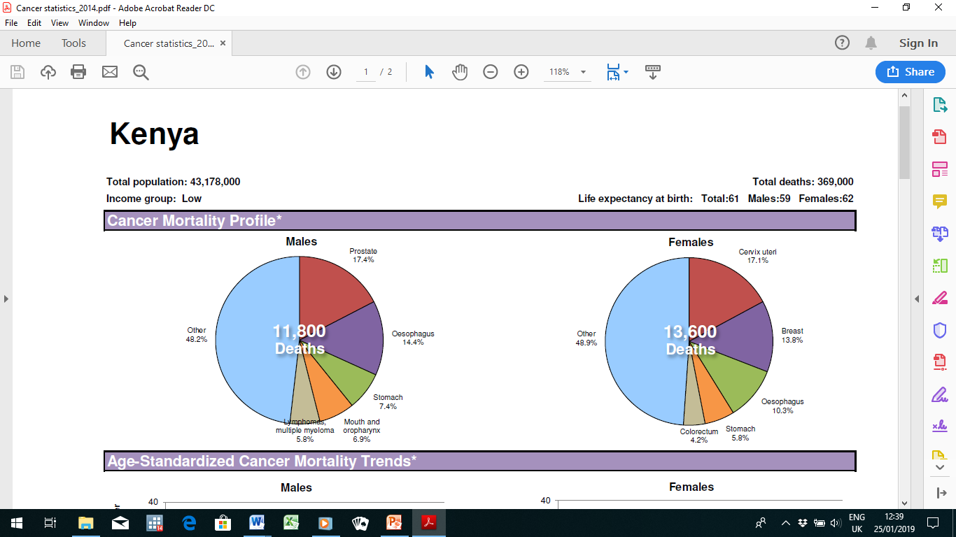
KENYA - CANCER STATISTICS

Slide 17
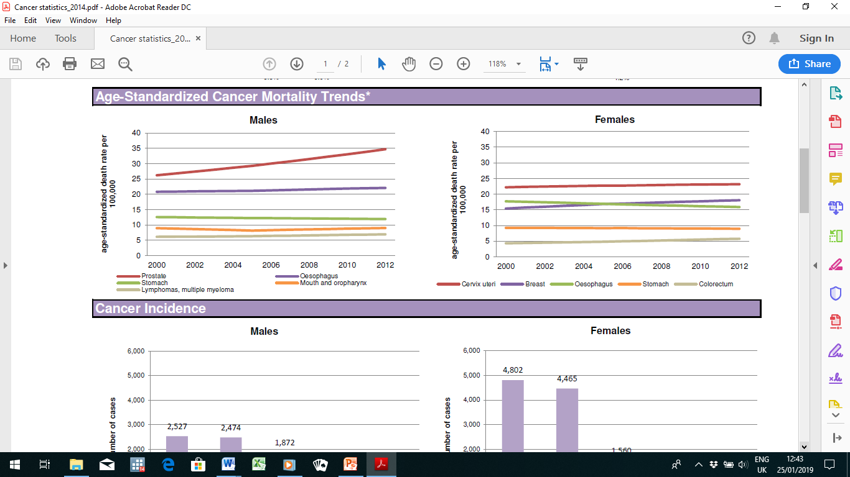
CANCER MORTALITY TRENDS

Slide 18
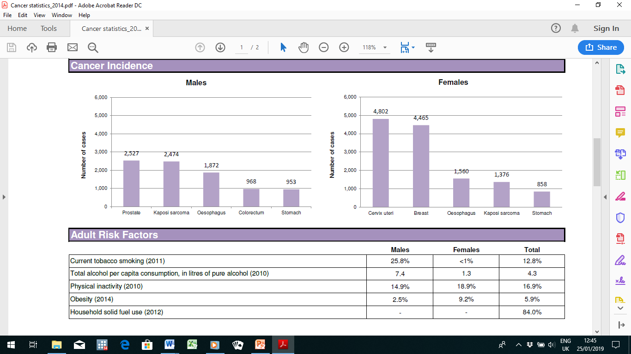
CANCER INCIDENCE

Slide 19
THE END

