Slide 2
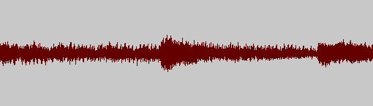

1. ACIDへドラッグドロップでファイルをやり取り可能なwavviewer
01 Drumkit Jdella 100 beats .wav
01 Drumkit Jdella 100 beats .wav
01 Drumkit Jdella 100 beats .wav
01 Drumkit Jdella 100 beats .wav

Slide 3
ACIDへドラッグドロップでファイルをやり取り可能なwavviewer
01 Drumkit Jdella 100 beats .wav
01 Drumkit Jdella 100 beats .wav
01 Drumkit Jdella 100 beats .wav
01 Drumkit Jdella 100 beats .wav

Slide 4
ACIDへドラッグドロップでファイルをやり取り可能なwavviewer
01 Drumkit Jdella 100 beats .wav 44100Hz 16bit 4:21
01 Drumkit Jdella 100 beats .wav 44100Hz 16bit 4:21
01 Drumkit Jdella 100 beats .wav 44100Hz 16bit 4:21
01 Drumkit Jdella 100 beats .wav 44100Hz 16bit 4:21
01 Drumkit Jdella 100 beats .wav 44100Hz 16bit 4:21
01 Drumkit Jdella 100 beats .wav 44100Hz 16bit 4:21
01 Drumkit Jdella 100 beats .wav 44100Hz 16bit 4:21
01 Drumkit Jdella 100 beats .wav 44100Hz 16bit 4:21

Slide 5
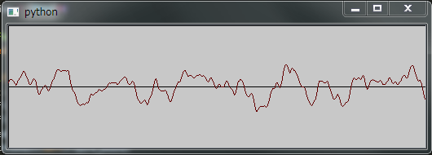
ACIDへドラッグドロップでファイルをやり取り可能なwavviewer
01 Drumkit Jdella 100 beats .wav 44100Hz 16bit 4:21
01 Drumkit Jdella 100 beats .wav 44100Hz 16bit 4:21
01 Drumkit Jdella 100 beats .wav 44100Hz 16bit 4:21
01 Drumkit Jdella 100 beats .wav 44100Hz 16bit 4:21
01 Drumkit Jdella 100 beats .wav 44100Hz 16bit 4:21
01 Drumkit Jdella 100 beats .wav 44100Hz 16bit 4:21
01 Drumkit Jdella 100 beats .wav 44100Hz 16bit 4:21
01 Drumkit Jdella 100 beats .wav 44100Hz 16bit 4:21
01 Drumkit Jdella 100 beats .wav 44100Hz 16bit 4:21
01 Drumkit Jdella 100 beats .wav 44100Hz 16bit 4:21

Slide 6
720
Window title
TRACK MASTER
01 Drumkit Jdella 100 beats .wav 44100Hz 16bit 4:21
01 Drumkit Jdella 100 beats .wav 44100Hz 16bit 4:21
01 Drumkit Jdella 100 beats .wav 44100Hz 16bit 4:21
480
01 Drumkit Jdella 100 beats .wav 44100Hz 16bit 4:21
01 Drumkit Jdella 100 beats .wav 44100Hz 16bit 4:21
01 Drumkit Jdella 100 beats .wav 44100Hz 16bit 4:21
01 Drumkit Jdella 100 beats .wav 44100Hz 16bit 4:21
01 Drumkit Jdella 100 beats .wav 44100Hz 16bit 4:21
01 Drumkit Jdella 100 beats .wav 44100Hz 16bit 4:21
01 Drumkit Jdella 100 beats .wav 44100Hz 16bit 4:21

Slide 7
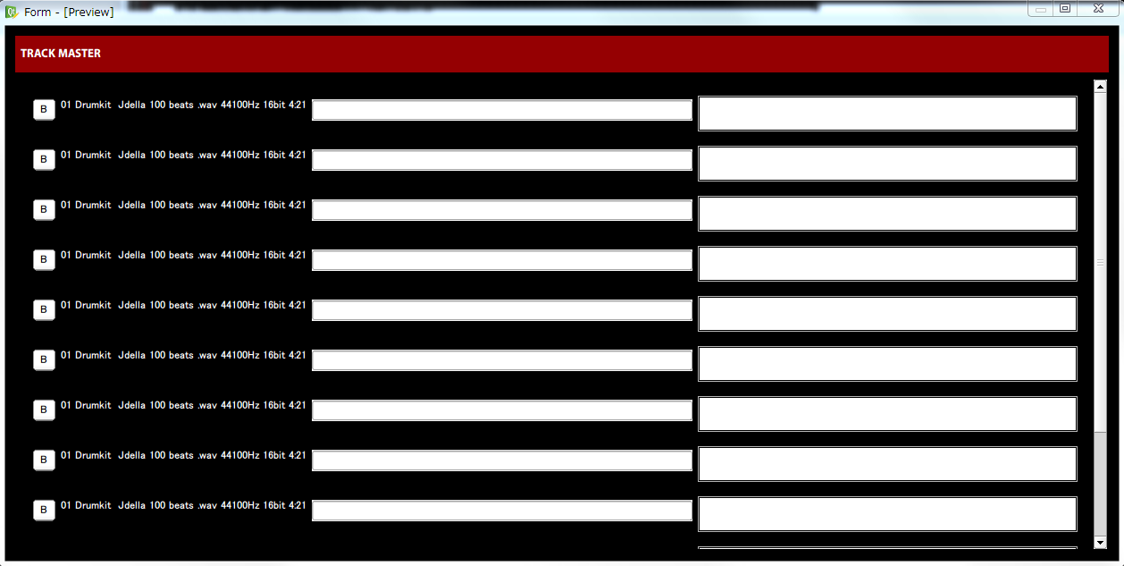
QWidget
H:50px
QLabel
QScrolArea – QVBoxLayout – Qwidget(setMinimumSize)
H:50px
Spring

Slide 8
default
push
hover
Buttons

Slide 9


Slide 10
Window title
TRACK MASTER
01 Drumkit Jdella 100 beats .wav 44100Hz 16bit 4:21
01 Drumkit Jdella 100 beats .wav 44100Hz 16bit 4:21
01 Drumkit Jdella 100 beats .wav 44100Hz 16bit 4:21
TrackMasterApp(sQwidget)
- QVBoxLayout
- Header_label(Qlabel)
- ScrolArea(QScrolArea)
- QHBoxLayout
- TrackController(QWidget)
- TrackController(QWidget)
- TrackController(QWidget)
…
D&D:files
Create controller
Remove Controller
01 Drumkit Jdella 100 beats .wav 44100Hz 16bit 4:21
01 Drumkit Jdella 100 beats .wav 44100Hz 16bit 4:21
Window title
TRACK MASTER
01 Drumkit Jdella 100 beats .wav 44100Hz 16bit 4:21
01 Drumkit Jdella 100 beats .wav 44100Hz 16bit 4:21
01 Drumkit Jdella 100 beats .wav 44100Hz 16bit 4:21
01 Drumkit Jdella 100 beats .wav 44100Hz 16bit 4:21
01 Drumkit Jdella 100 beats .wav 44100Hz 16bit 4:21
01 Drumkit Jdella 100 beats .wav 44100Hz 16bit 4:21
01 Drumkit Jdella 100 beats .wav 44100Hz 16bit 4:21
01 Drumkit Jdella 100 beats .wav 44100Hz 16bit 4:21
01 Drumkit Jdella 100 beats .wav 44100Hz 16bit 4:21
01 Drumkit Jdella 100 beats .wav 44100Hz 16bit 4:21

Slide 11
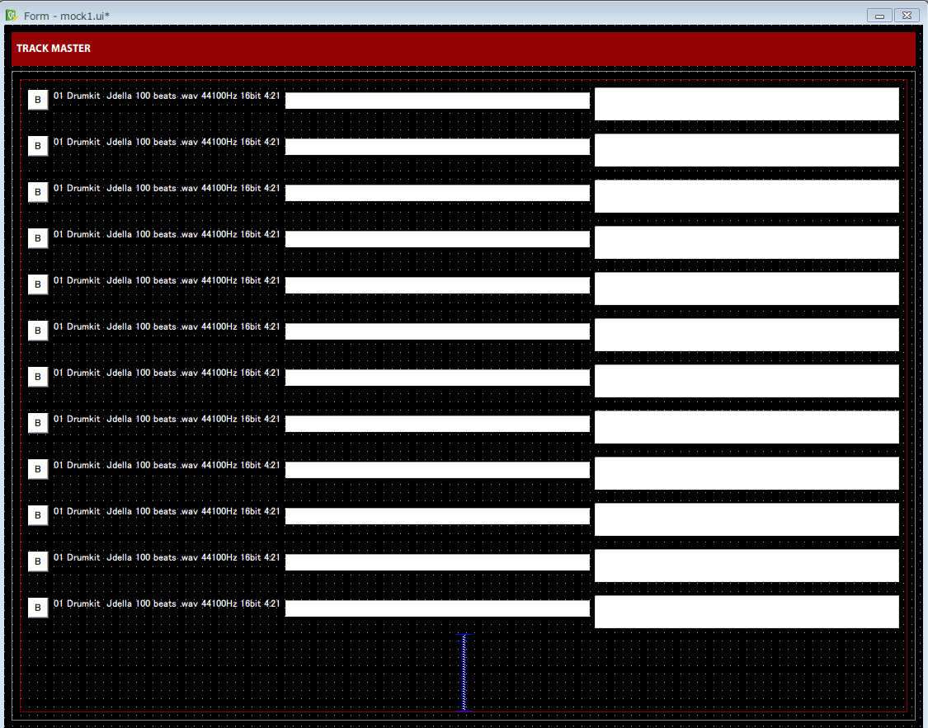
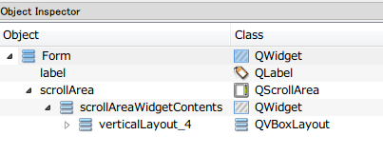

Slide 12
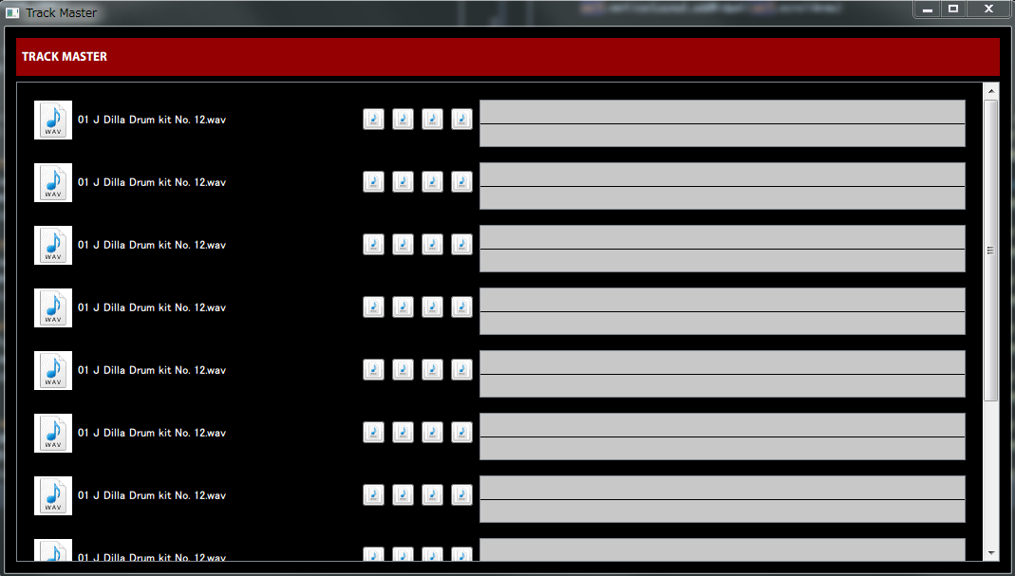

Slide 13
