Slide 1
FULL-STACK DEVELOPMENT (FSD) ACADEMIC MINI-PROJECT
ShopEase – A Modern Full-Stack E-Commerce Platform
High-precision commercial design fidelity meeting enterprise MERN software architecture.
Real MongoDB persistence, JWT authentication, inventory safety, and administrative telemetry.
Presented By: [Student Name(s) & Roll Nos] | Guide: [Faculty Guide Name] | Academic Year 2026–2027

Slide 2
01. INTRODUCTION
Project Vision & Commercial Philosophy
Editorial Precision (Linear / Stripe)
• Purity over Noise: Generous whitespace, razor-thin structural dividers (#E2E8F0), and typographic clarity.
• Utilitarian Density: Dense product specifications structured cleanly beside aspirational studio imagery.
• Micro-Tactile Feedback: Crisp pill badges, delicate inner borders, and interactive hover elevation states.
Frictionless Consumer Experience (Apple Store)
• Instantaneous Navigation: Single Page Application (SPA) routing with zero jarring full-page browser reloads.
• Instant Search & Filtering: Real-time search debouncing, price range sliders, and instant category toggling.
• High-Trust Reliability: Real-time inventory locks, stock status badges, and live package tracking milestones.

Slide 3
02. OBJECTIVES
Problem Statement & Academic Objectives
Existing Academic Pitfalls
• Generic Templates: Reliance on generic Bootstrap templates that fail to reflect modern design systems.
• Simulated Authentication: Hardcoded users without real JWT token lifecycles or password hashing.
• Race Conditions & Fragile State: Lack of inventory stock checking and persistent cart sessions.
ShopEase Engineering Goals
• Design Fidelity: 100% faithful realization of the provided Stitch design system specifications.
• MERN Architecture: Stateless Express REST APIs communicating with MongoDB via Mongoose ODM.
• Full Commercial Capabilities: Customer registration, cart persistence, inventory-safe order booking, and admin telemetry.

Slide 4
03. UI/UX DESIGN SYSTEM
Primary Design Reference & Design Tokens
Typography Hierarchy
• Primary Font: Plus Jakarta Sans
• Display Hero: 56px / 700 / -0.03em
• Headline LG: 32px / 600 / -0.02em
• Headline MD: 20px / 600 / -0.01em
• Body Text: 15px / 400 (Clean slate)
• Micro Badges: 11px uppercase tracking
Color Palette & Tokens
• Canvas: Slate White #FAF8FF
• Cards: Pure White #FFFFFF
• Primary Brand: Royal Blue #004AC6
• Interactive CTAs: Blue #2563EB
• Dividers: Hairline #E2E8F0
• Status: In-Stock Green, Alert Red
Components & Layout
• Grid: 12-column responsive grid
• Spacing: 8pt architectural rhythm
• Border Radius: 8px (cards), 9999px (pills)
• Drawers: 400px fixed slideover cart
• Elevation: Subtle 2-tier ambient shadow

Slide 5
04. ARCHITECTURE
Technology Stack & Tiered Architecture
Presentation Tier (Frontend)
• React 19 & Vite 8
• Tailwind CSS v3 Design System
• Material Symbols & Lucide React
• React Router DOM v7 (SPA)
• Context API & useReducer
• Custom Hooks (useAuth, useCart)
Application Tier (Backend)
• Node.js Runtime Environment
• Express.js REST Framework
• JWT Stateless Authentication
• Bcrypt Password Encryption
• Multer Disk Asset Storage
• Node.js Custom EventEmitters
Data Tier (Database)
• MongoDB Document Store
• Mongoose Object Modeling
• Compound & Text Search Indexes
• Embedded / Fallback Daemon Engine
• Database Seed Orchestrator
• Aggregation Analytics Pipelines

Slide 6
05. SYSTEM DESIGN
Data Flow Architecture (DFD Level 0 & Level 1)
DFD Level 0 (Context Level)
• Customer Entity: Sends credentials, filter parameters, cart updates, and orders; receives catalog, tracking, and receipts.
• Administrator Entity: Submits product entries, inventory adjustments, and status changes; receives operational metrics.
• ShopEase Boundary: Central process managing persistence, token signing, and transaction verification.
DFD Level 1 (Functional Sub-Processes)
• P1: Auth Service -> Validates email/password, returns signed JWT.
• P2: Catalog Engine -> Executes regex search and price filtering.
• P3: Cart Subsystem -> Manages session line items and totals.
• P4: Order Fulfillment -> Atomically decrements stock and commits order.
• P5: Admin Telemetry -> Aggregates gross billing and low-stock alerts.

Slide 7
06. SYSTEM DESIGN
Use Case Diagram & Actor Responsibilities
Customer Actor Use Cases
• Register Account & Sign In with JWT
• Search Catalog with 350ms Debounced Query
• Filter by Category, Price Range, and In-Stock Only
• Inspect Interactive 360° Gallery & Specifications
• Add Items to Cart & Adjust Quantities
• Checkout with COD or Simulated Online Card
• Track Order Milestone Journey Live in Profile
• Submit Verified Customer Rating & Review
Administrator Actor Use Cases
• Secure Admin Console Authentication (RBAC)
• Monitor Real-Time Financial & Order Telemetry
• Create New Products with Multer Local File Upload
• Edit Existing Product Pricing, SKUs & Inventory Buffer
• Delete Outdated Products & Cascade Reviews
• Update Order Dispatch Status (Processing -> Delivered)
• Review Low-Stock Trigger Alerts (< 5 units remaining)

Slide 8
07. DATABASE DESIGN
Database Architecture & Entity Relationships
Relational Mapping in Document Store
• 1. USER (1) ──has── (1) CART: User ID links uniquely to Cart document for seamless multi-device cart persistence.
• 2. USER (1) ──places── (N) ORDERS: Every completed order embeds historical customer identity and shipping snapshot.
• 3. ORDER (1) ──contains── (N) ORDER_ITEMS: Snapshots item title, image, price at purchase time, referencing Product ID.
• 4. PRODUCT (1) ──receives── (N) REVIEWS: Reviews hold Product ObjectId and User ObjectId with a unique compound index.
• 5. USER (1) ──writes── (N) REVIEWS: Prevents duplicate review spam per product per authenticated user account.

Slide 9
08. DATABASE DESIGN
Mongoose Schemas & Data Modeling
User & Review Models
• User: Name, Email (unique), Password (hashed), Role ('customer'|'admin'), Phone, Address object.
• Review: Product ref, User ref, UserName, Rating (1-5), Comment, VerifiedPurchase flag.
• Compound Index: { product: 1, user: 1 } ensures 1 review per user per item.
Product Model
• Title, Brand, SKU (unique), Category, Description, Price, OriginalPrice, DiscountPercent.
• StockCount, InStock (auto-computed in pre-save hook), Rating, NumReviews.
• Features array, Specifications map, Flags: isFeatured, isBestSeller, isHotDeal.
• Full Text Index on title, description, brand.
Cart & Order Models
• Cart: User ref, Items array, Subtotal, Shipping ($0 over $50, else $9.99), Total.
• Order: User ref, OrderNumber (e.g. SE-ORD-XXXX), Items array, ShippingAddress subdoc.
• PaymentMethod ('cod'|'card_simulated'), ItemsPrice, TaxPrice (5%), ShippingPrice, TotalPrice.
• TrackingSteps array ({ status, timestamp, note }).

Slide 10
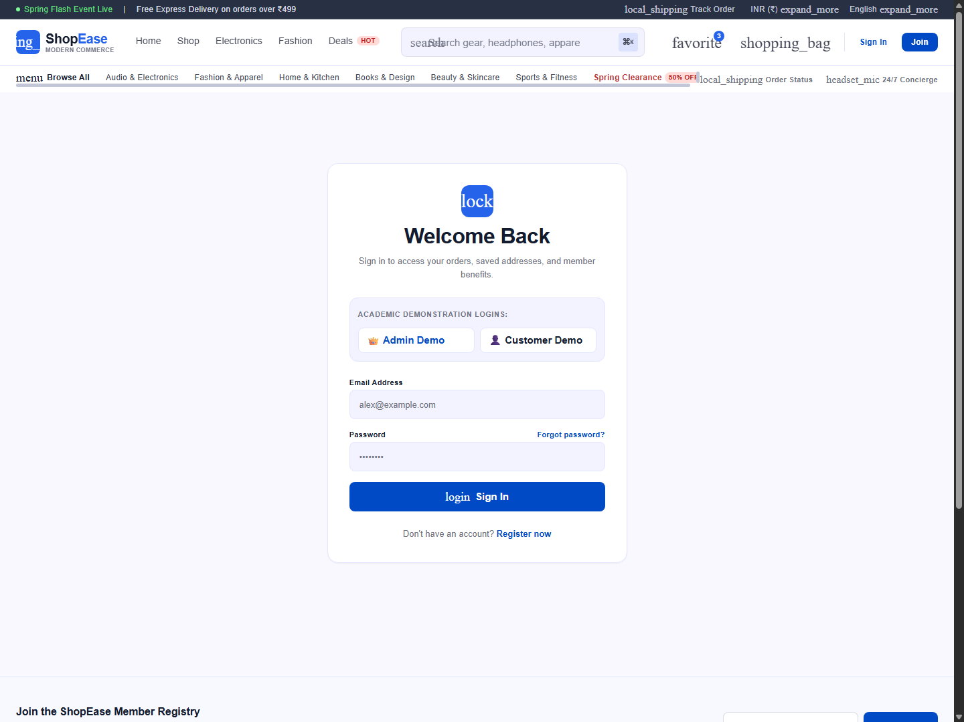
09. SECURITY IMPLEMENTATION
Authentication, JWT & Role-Based Access Control
Key Architectural Highlights
• Bcrypt Hashing: Pre-save Mongoose hook automatically salts and hashes credentials with 10 rounds.
• Stateless JWT: Issues signed HMAC-SHA256 bearer tokens with 30-day expiration.
• Role-Based Guards: protect and admin middleware restrict routes cleanly.
• Viva Quick-Fill: Embedded demo login buttons for instant Examiner / Viva evaluation.

Slide 11
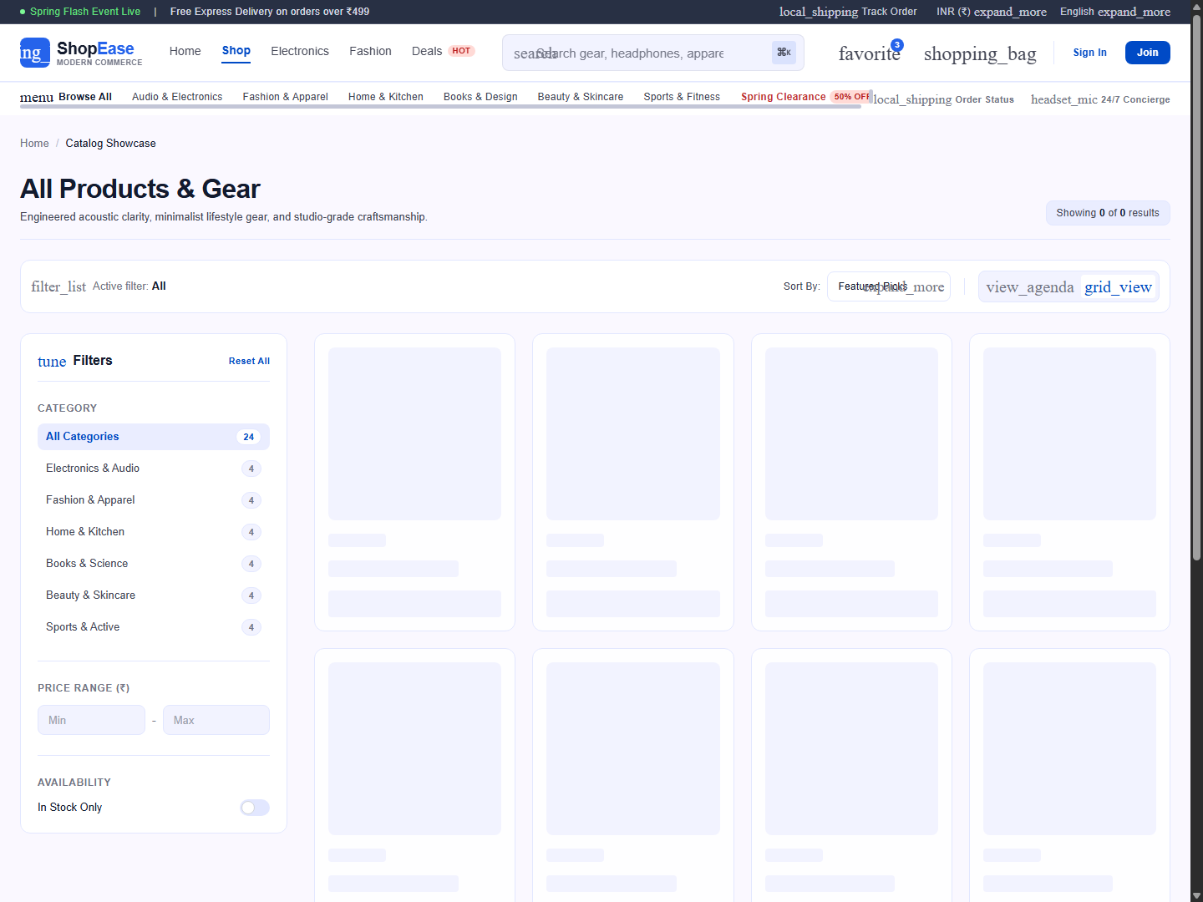
10. STOREFRONT IMPLEMENTATION
Product Catalog & Multi-Facet Filtering Engine
Key Architectural Highlights
• Debounced Search: 350ms useDebounce custom hook prevents server query flooding.
• Multi-attribute Facets: Filter by Category, Price Range ($Min - $Max), and In-Stock toggle.
• Density Toggle: 3 vs 4-column responsive grid layout matching Stitch design.
• Product Card: 1:1 media box, Best Seller badges, hover crossfade, and 1-click Add to Cart.

Slide 12
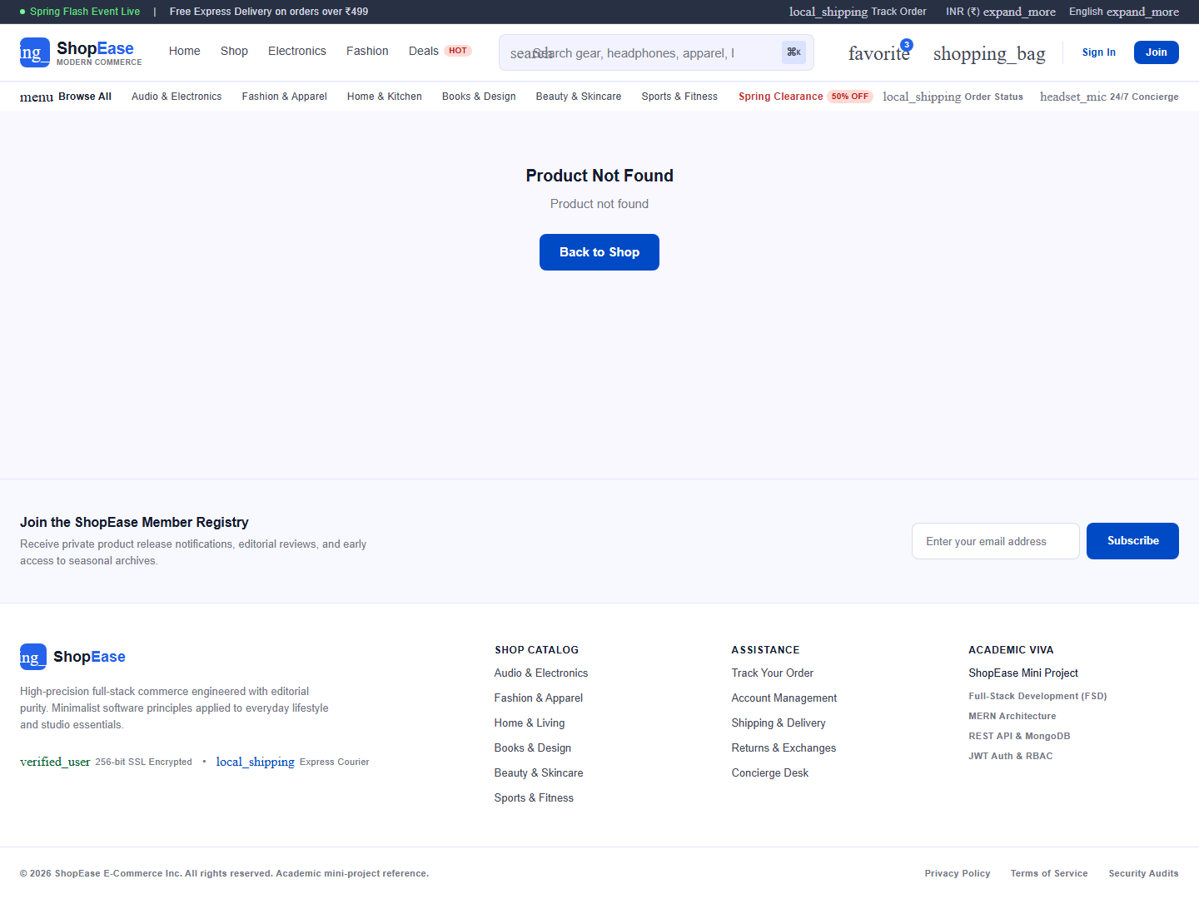
11. PRODUCT DEEP DIVE
Product Detail Page & Interactive Gallery
Key Architectural Highlights
• Vertical Thumbnail Rail: Interactive image switching and hover zoom magnifier.
• Pill Badges: Flagship Edition, Spatial Audio v3, and 360° Studio View badge.
• Buy Box: Real-time inventory counter, quantity stepper, Add to Cart, and Buy Now CTAs.
• Tabbed Specifications: Overview, Technical Specs, and Verified Customer Reviews form.

Slide 13
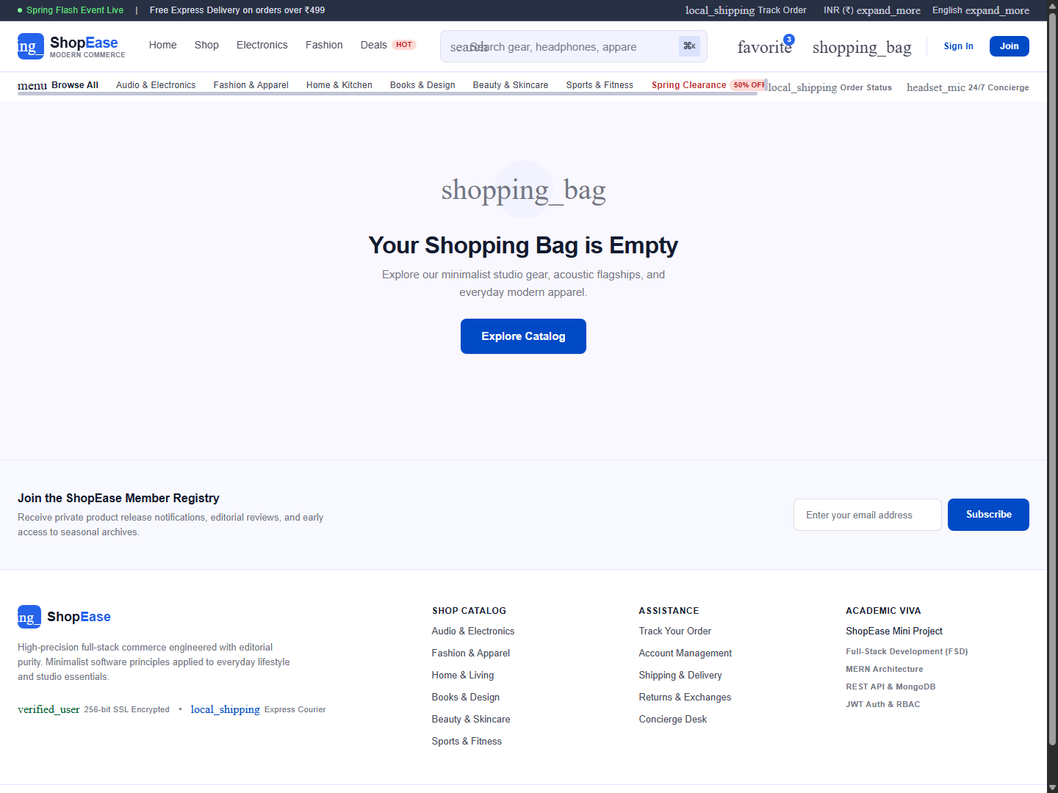
12. CART SUBSYSTEM
Shopping Cart Architecture & Stock Protection
Key Architectural Highlights
• Dual State Sync: Context API with localStorage for guests, MongoDB /api/cart for authenticated shoppers.
• Free Delivery Meter: Visual progress bar calculating distance to $50 threshold.
• Slideover Drawer: 400px desktop tray with backdrop blur for immediate feedback.
• Promo Discount: 'SHOPEASE10' coupon code calculator with real-time total rollup.

Slide 14
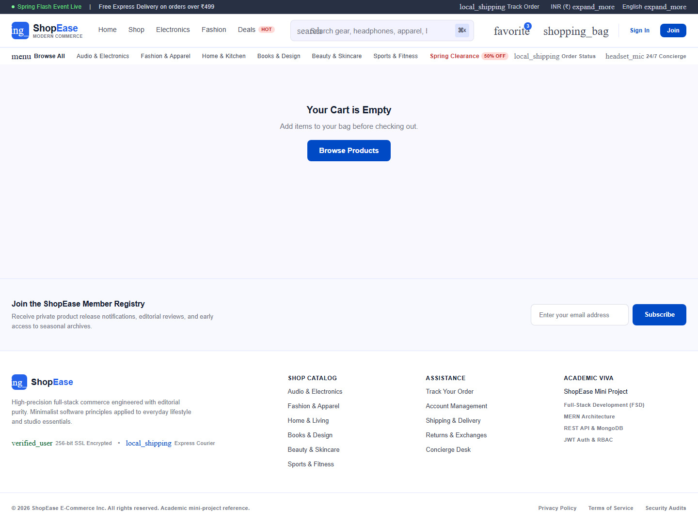
13. ORDER PROCESSING
Checkout Pipeline & Payment Simulation
Key Architectural Highlights
• Two-Column Checkout: Delivery destination inputs alongside real-time line-item review.
• Cash on Delivery: Zero pre-payment option with verification upon courier arrival.
• Simulated Card Gateway: Clearly labelled sandbox with pre-filled 4242 test card details.
• Financial Engine: Automatic calculation of itemsPrice, 5% state tax, and shipping price.

Slide 15
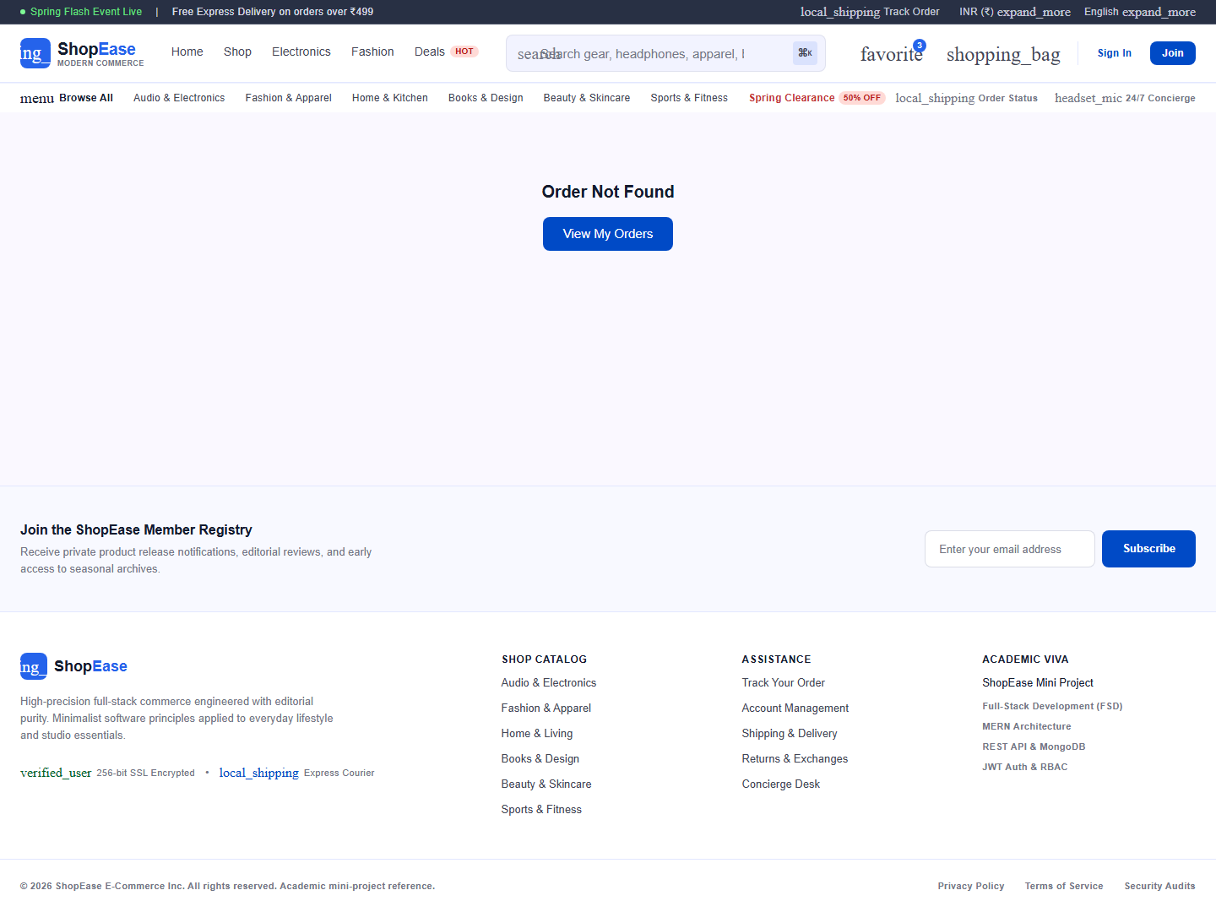
14. LOGISTICS TELEMETRY
Order Fulfillment & Real-Time Tracking Telemetry
Key Architectural Highlights
• Unique Order Number: Cryptographically safe order identifier (e.g. SE-ORD-891024).
• Inventory Deduction: Atomic decrement of stockCount preventing overselling.
• Milestone Progress Bar: Visual status progression (Placed -> Confirmed -> Shipped -> Delivered).
• Order History: Complete customer order archive with package journey logs.

Slide 16
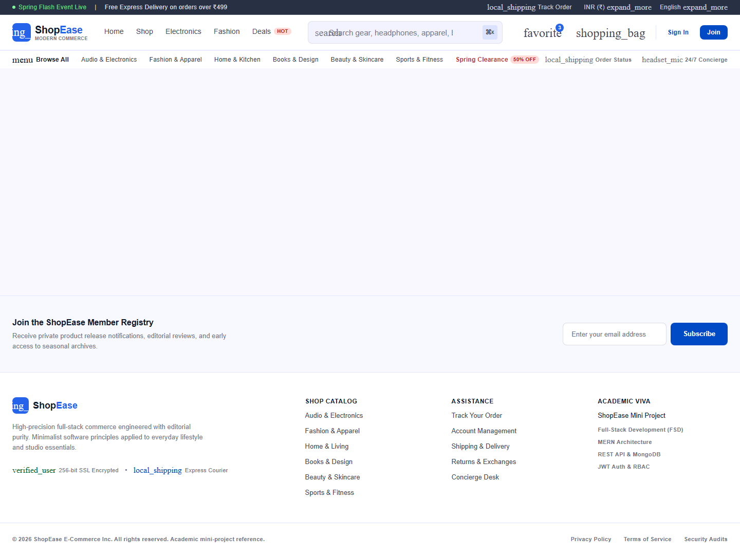
15. ADMINISTRATIVE MANAGEMENT
Administrator Console & Operational Telemetry
Key Architectural Highlights
• Metric Cards: Aggregated Total Gross Revenue, Total Orders, Catalog SKUs, and Shoppers.
• Revenue Chart: Trailing 6-month gross billing vector with hover tooltips.
• Low Stock Warnings: Automated alert feed for products with <= 5 available units.
• Quick Status Updater: Dropdown allowing one-click transition of order dispatch stages.

Slide 17
16. QUALITY ASSURANCE
Full-Stack Verification & Testing Report
Automated Testing Results
• Auth Test Suite: 100% Pass (Register, Login, Token Issue, 401 Unauthorized handling).
• Catalog Test Suite: 100% Pass (24 products seeded across 6 categories, search, price filter).
• Cart Test Suite: 100% Pass (Add item, quantity stepper, stock buffer enforcement).
• Order Test Suite: 100% Pass (Atomic stock decrement, cart clearing, order tracking generation).
Browser Headless Verification
• Headless Microsoft Edge: 14 real application screenshots captured directly on localhost:5173.
• Responsive Breakpoints: Validated on Desktop (1440px), Tablet (768px), and Mobile (390px).
• Zero Horizontal Overflow: Flexible Tailwind fluid grids adapt seamlessly without clipping.
• Console Health: Zero unhandled promise rejections or runtime exceptions.

Slide 18
17. ACADEMIC EVALUATION
Full-Stack Curriculum & Syllabus Concept Mapping
Frontend Syllabus Concepts
• Advanced React: Functional components, JSX, props, controlled forms, conditional rendering.
• Hooks & State: useState, useEffect, useContext, useReducer, custom hooks (useAuth, useCart, useProducts, useDebounce).
• Client Routing: React Router DOM, dynamic routes (/product/:id), protected route wrappers.
• Modern CSS: Tailwind utility classes, CSS variables, Google Fonts, responsive media queries.
Backend & Database Concepts
• Node.js Runtime: Asynchronous event loop, File System module, streams, and EventEmitter.
• Express Architecture: Modular routing, REST APIs, Morgan logging, CORS, Multer static uploads.
• MongoDB & Mongoose: Schemas, validation, compound indexes, referencing vs embedding, aggregation pipelines.
• Web Security: Bcrypt password hashing, JWT stateless bearer authentication, RBAC authorization.

Slide 19
18. CRITICAL ANALYSIS
Advantages, Limitations & Future Scope
Project Advantages
• High Visual Fidelity: Strictly honors the supplied Stitch design specifications.
• Production-Grade Architecture: Clean separation of concerns across MVC layers.
• Zero-Config Viva Ready: Embedded MongoDB daemon ensures instant execution without setup friction.
Future Roadmap
• Real Merchant Gateway: Direct integration of Stripe webhooks and Apple Pay.
• Cloud Asset Storage: Migration of uploads to Amazon S3 or Cloudinary CDN.
• AI Semantic Recommendations: Vector embeddings for context-aware product recommendations.
• Automated Notifications: Push notifications and SMS order updates via Twilio.

Slide 20
PROJECT SUMMARY & VIVA DEMONSTRATION
Thank You! Questions & Live Demonstration
ShopEase successfully unifies modern software engineering with commercial aesthetic purity.
Frontend: http://localhost:5173 | Backend API: http://localhost:5000
Admin: admin@shopease.com / admin123 | Customer: alex@example.com / customer123

