Slide 1
Comparison OF Different XDP MODES

Slide 2
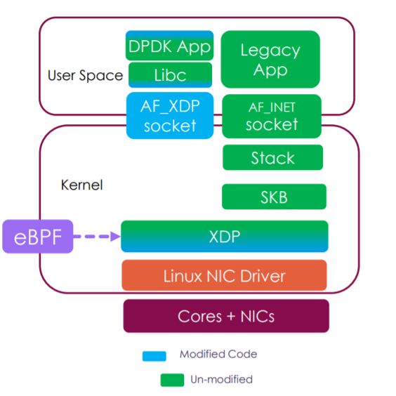
Block Diagram

Slide 3
XDPSOCK TX PERFORMANCE
Setup | PPS | Pkts | Ratio PPS/PPS (SBD)
Poll mode, TX, SBD ./xdpsock -i ens1f0 -p -S -n 60 -t | 2,559,304 | 153,559,033 | 1
Poll mode, TX, DRV, force copy ./xdpsock -i ens1f0 -p -N -n 60 -t –c | 2,539,292 | 152,358,279 | 0.992
Poll mode, TX, DRV, zero copy ./xdpsock -i ens1f0 -p -N -n 60 -t –z | 14,877,877 | 892,677,220 | 5.81
TX, SBD ./xdpsock -i ens1f0 -S -n 60 –t | 2,712,920 | 162,776,028 | 1
TX, DRV, force copy ./xdpsock -i ens1f0 -N -n 60 -t –c | 2,727,690 | 163,662,236 | 1.01
TX, DRV, zero copy ./xdpsock -i ens1f0 -N -n 60 -t -z | 14,877,838 | 892,675,111 | 5.48

Slide 4
Resources
DPDK PMD Driver (https://www.dpdk.org/wp-content/uploads/sites/35/2018/10/pm-06-DPDK-PMD-for-AF_XDP.pdf)

