Slide 1


Exploring AI Powered Teleprompter
& PPT Enhancer
Aman Kumar
Google Cloud Platform Corporate Trainer
Notes:
Hello Kites, I'm Aman and I’m from Google Cloud Team at Koenig Solution. I'm a google cloud certified ML, DE and Database Engineer.
Talking about personal background, I'm like most of you kites, an Engineer. I have done my bachelors from IIT Roorkee. After that, I also in worked training of LLMs like Gemini-2.5 Pro and ChatGPT's O1. I worked in training of these LLMs for software codes.
So, when i got the opportunity by Koenig solutions to built agents, I thought why not put my skills to test.
So, let me introduce you to my workflow I have built to simplify your lives when it comes to building presentations.
This agent is designed to solve your PowerPoint-related issues, whether it’s creating professional slides, fixing formatting problems, or making your presentations more impactful — all in a matter of seconds.

Slide 2

Today's Agenda
01
02
03
Introduction to PPT Studio
Pain Points in Presentation Workflows
Features & Capabilities
Overview of our AI-powered presentation toolkit and its core capabilities
Deep dive into PPT Studio's powerful automation and creation features
Identifying challenges in traditional presentation creation and enhancement processes
04
05
Demo Walkthrough
Q&A Session
Live demonstration of both Enhancer and Creator workflows in action
Open discussion and answers to your questions about PPT Studio
Processed by PPT Studio
Notes:
**(Slide Title: Today's Agenda)**
Good morning/afternoon, everyone. We'll cover five key areas today: First, a brief introduction to PPT Studio and its core AI capabilities. Next, we'll identify common presentation workflow pain points. Then, we'll dive into PPT Studio's features and automation. Following that, a live demo of both the Enhancer and Creator functionalities. Finally, we'll have a Q&A session. Let's begin!

Slide 3
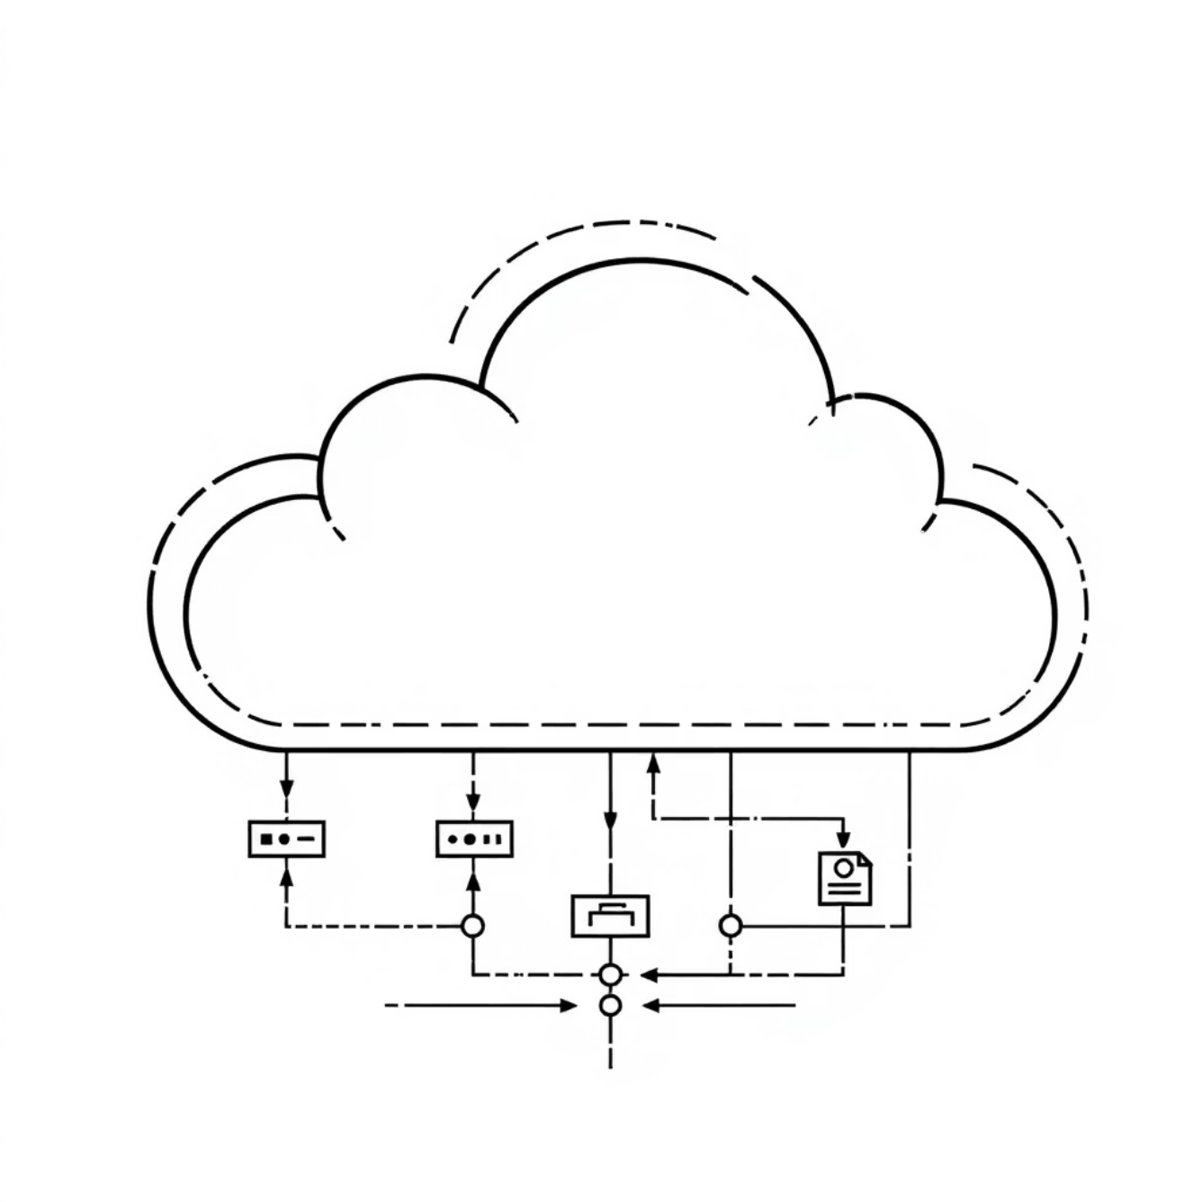
Introducing PPT Studio
PPT Studio is an AI-driven application designed to enhance and create professional PowerPoint presentations with unprecedented efficiency and quality.
Enhancer Workflow
Automates branding, watermark cleanup, and speaker note generation for existing presentations
Creator Workflow
Generates new, polished presentations from raw documents and images using intelligent design
Built on a fully scalable, serverless architecture deployed on Google Cloud, ensuring reliable performance and seamless user experience.
Processed by PPT Studio
Notes:
Slide Title: Introducing PPT Studio
**(Speaker Notes):** Good morning/afternoon everyone. Today, I'm excited to introduce PPT Studio, an AI-powered application revolutionizing PowerPoint creation and enhancement. It offers two key workflows: an *Enhancer* for automating tasks like branding, watermark removal, and speaker note generation on existing presentations, and a *Creator* that leverages AI to build stunning presentations from scratch using just your documents and images. Crucially, PPT Studio's serverless architecture on Google Cloud ensures reliable, scalable, and cost-effective performance for a seamless user experience. This means you get high quality, quickly and efficiently.

Slide 4
Pain Points in Traditional Presentation Workflows
Current presentation creation processes are plagued with inefficiencies that consume valuable time and resources. Let's examine the key challenges professionals face daily.
Manual Branding & Logo Insertion
Watermark & Image Cleanup
Tedious process of applying consistent branding across multiple slides, often requiring individual attention to each slide's layout and positioning.
Removing watermarks and duplicate images is incredibly time-consuming, often requiring specialised software and manual editing expertise.
Lack of Speaker Notes
Raw Content Transformation
Presenters struggle without comprehensive speaker notes, leading to less confident delivery and missed key messaging opportunities.
Converting raw documents and images into professional slides requires hours of design work and formatting expertise.
Processed by PPT Studio
Notes:
**(Slide Title: Pain Points in Traditional Presentations)**
"This slide highlights the common frustrations in creating presentations. We're all familiar with the tedious tasks: manually branding every slide, painstakingly removing watermarks, lacking robust speaker notes, and the significant time investment in transforming raw content into polished presentations. This is where PPT Studio steps in to solve these problems."

Slide 5
PPT Studio Capabilities
Our comprehensive feature set addresses every aspect of presentation creation and enhancement, delivering professional results with minimal effort.
Enhancer Workflow
Creator Workflow
Automated Watermark Removal
Intelligent Content Analysis
Intelligent detection and removal of watermarks and duplicate images across all slides
Upload raw documents and images for AI-powered slide plan generation
Interactive Editing Suite
Dynamic Branding Integration
Real-time preview and editing capabilities with professional design templates
Seamless logo and credits insertion with consistent positioning and styling
Advanced Layout Engine
AI-Generated Speaker Notes
Sophisticated algorithms ensure optimal visual hierarchy and professional aesthetics
Comprehensive, contextual notes that enhance presenter confidence and delivery
Integrated Feedback System
Enterprise Deployment
Built-in user feedback collection for continuous improvement and feature development
CI/CD pipeline on Google Cloud Run and Firebase Hosting ensures reliability and scalability
Processed by PPT Studio
Notes:
Slide Title: PPT Studio Capabilities
**Key takeaway:** PPT Studio streamlines presentation creation & enhancement, offering automated features, AI assistance, and robust deployment.
**Talking points:**
* **Enhancer Workflow:** Focus on automated watermark removal & dynamic branding for professional consistency.
* **Creator Workflow:** Highlight AI-powered slide generation from raw content, intuitive editing, and advanced layout features. Mention real-time preview.
* **Integrated Feedback:** Emphasize continuous improvement driven by user feedback.
* **Enterprise Deployment:** Reinforce reliability and scalability via Google Cloud.
**Conclude:** PPT Studio empowers you to create stunning, professional presentations with ease.

