Slide 1
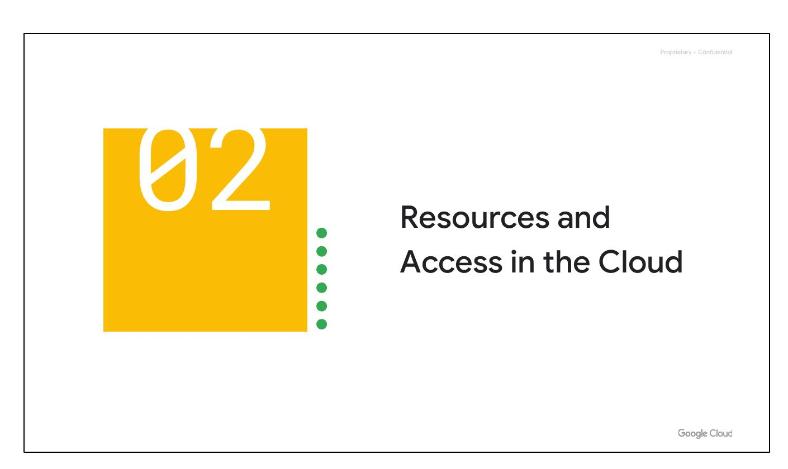
Resources & Access
Explore cloud computing
Pricing structure & billing
Google Cloud security
Environmentally friendly platform
Notes:
This section explores cloud computing, pricing, billing, security, and Google's environmental commitment to the platform.

Slide 2
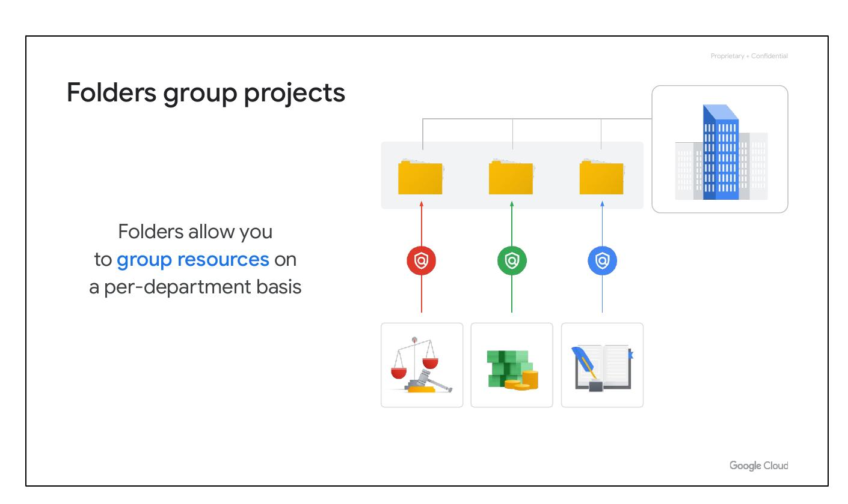
Resource Hierarchy
Resources organized with projects
Access shared via IAM
Interact via Web UI
Command-Line Interface
Mobile apps
Notes:
Resources are organized within projects, and access is managed using Identity and Access Management (IAM). Users can interact with Google Cloud through the web user interface, command-line interface, and mobile apps.

Slide 3
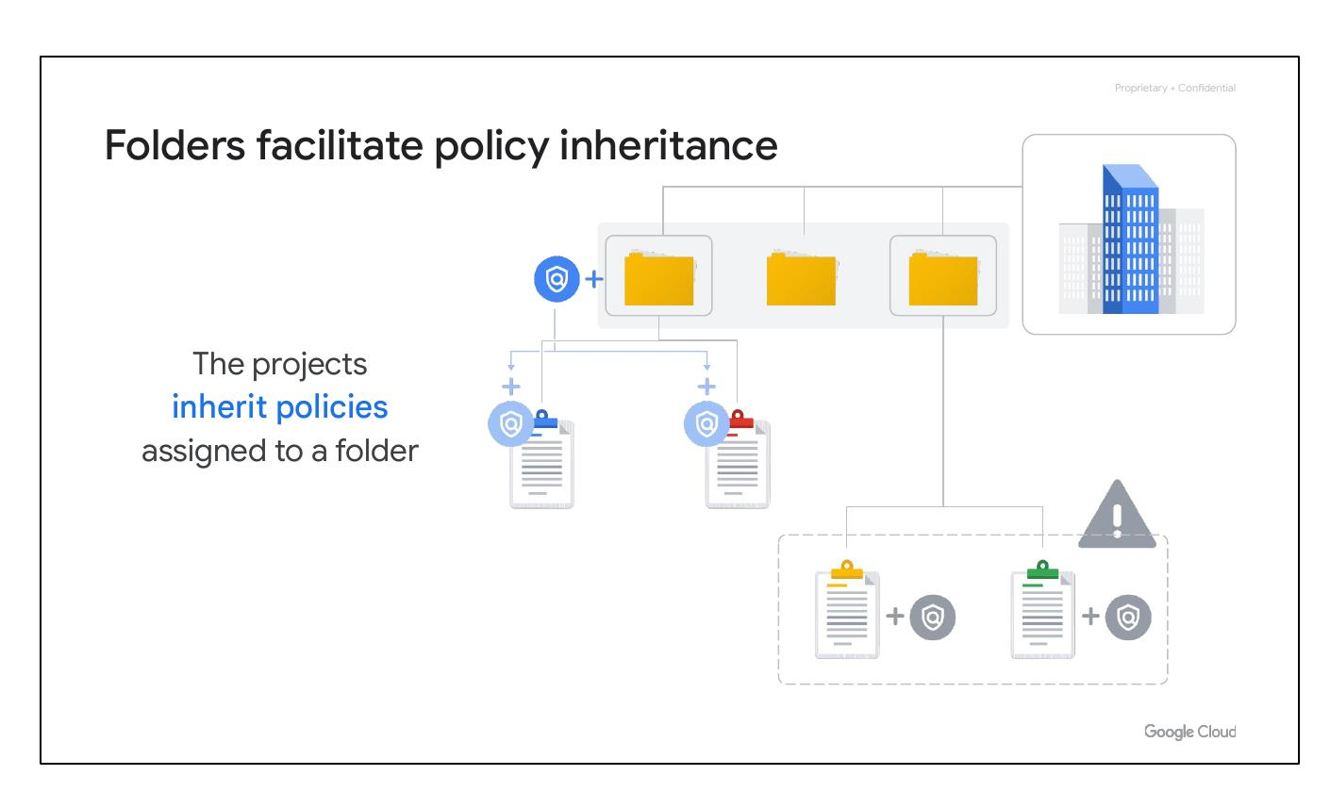
Resource Hierarchy
Google Cloud Resource Hierarchy
Notes:
This section focuses on the Google Cloud Resource Hierarchy.

Slide 4
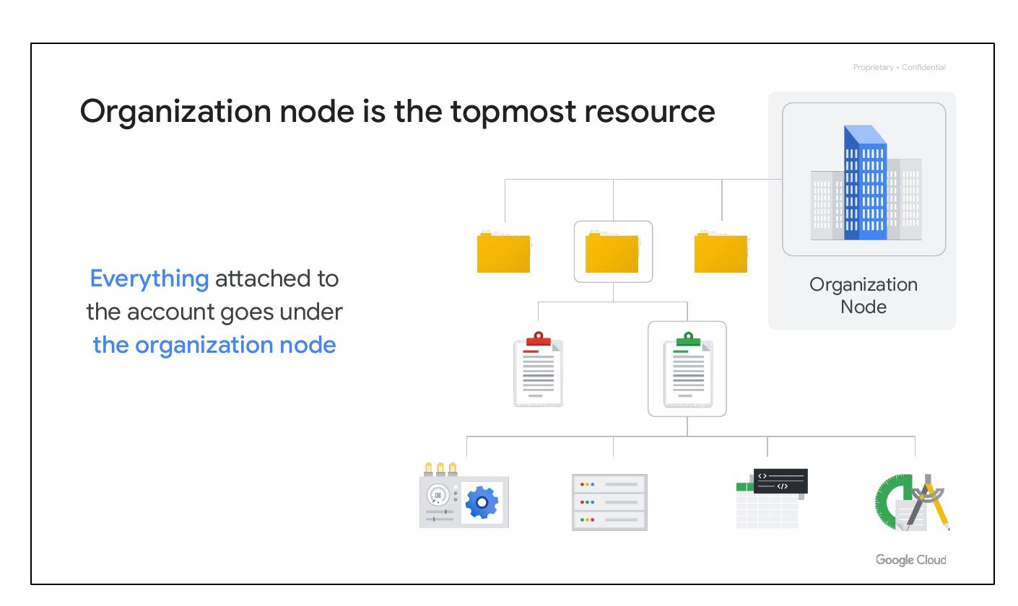
Hierarchical Resources
Four-level hierarchy:
- Resources
- Projects
- Folders
- Organization node
Notes:
The resource hierarchy consists of four levels: resources, projects, folders, and an organization node. Resources represent virtual machines, storage buckets, and other Google Cloud services. These resources are organized into projects, which can be further organized into folders and subfolders. The organization node encompasses all projects, folders, and resources.

Slide 5
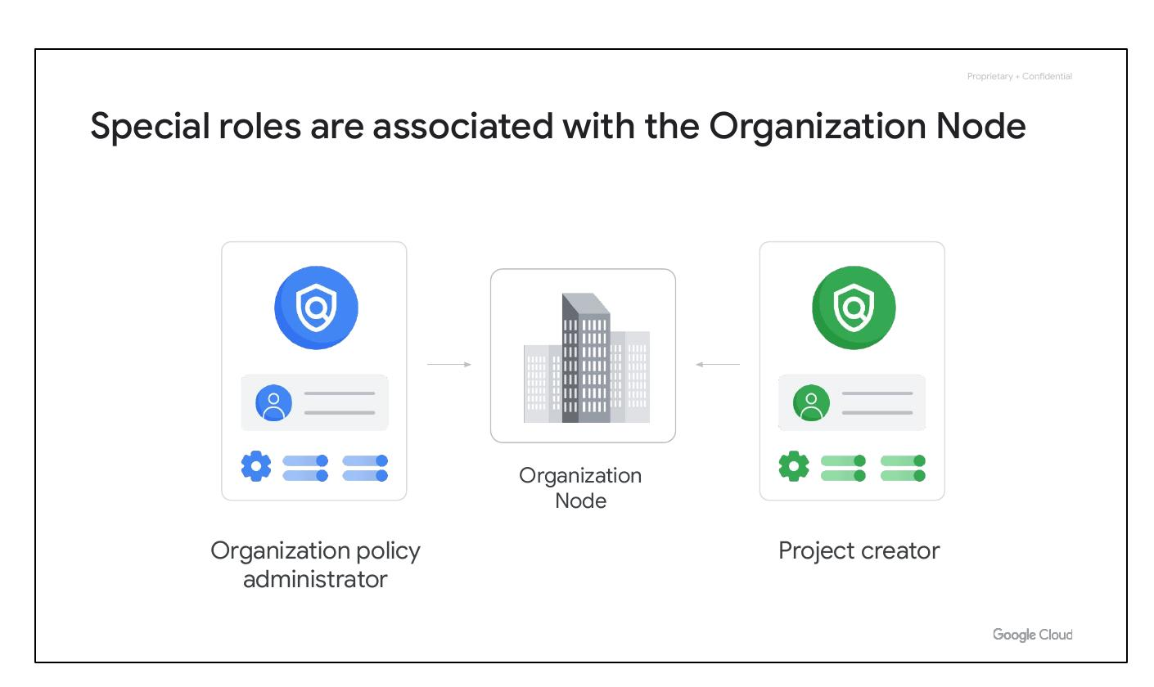
Policy Management
Hierarchy determines policies
Policies defined at project, folder, node
Policies inherited downward
Notes:
The resource hierarchy is crucial for policy management. Policies can be defined at the project, folder, and organization node levels. Policies are inherited downward, meaning a policy applied to a folder applies to all projects within that folder. Some services allow policies to be applied to individual resources.

Slide 6
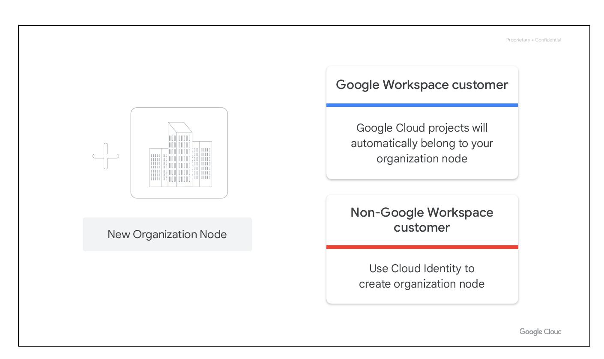
Project Basis
Basis for Cloud services
Hold resources
Projects billed separately
Separate entities
Different owners and users
Notes:
Projects form the basis for using Google Cloud services, including managing APIs, enabling billing, adding collaborators, and enabling other Google services. Each project is a separate compartment, with each resource belonging to exactly one project. Projects can have different owners and users and are billed and managed separately.

Slide 7
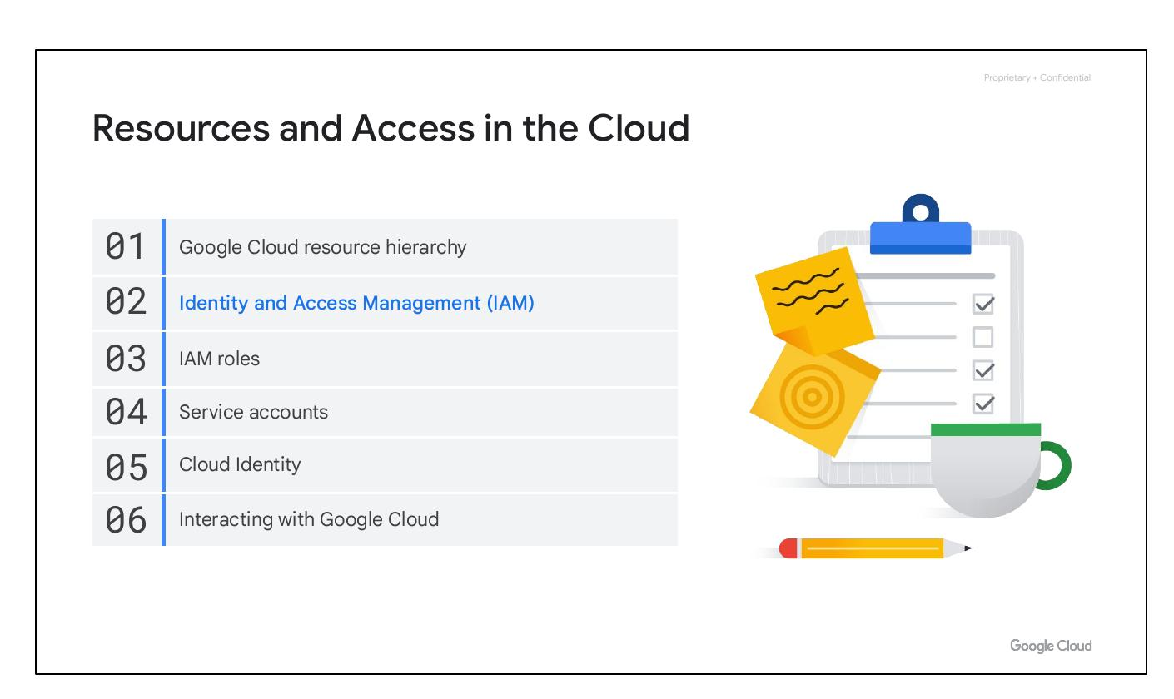
Project Attributes
Project ID: Globally unique, immutable
Project Name: Mutable, not unique
Project Number: Unique, immutable
Notes:
Each Google Cloud project has three identifying attributes: a project ID, a project name, and a project number. The project ID is globally unique and immutable after creation. Project names are user-created, mutable, and need not be unique. Google Cloud assigns a unique project number for internal tracking.

Slide 8
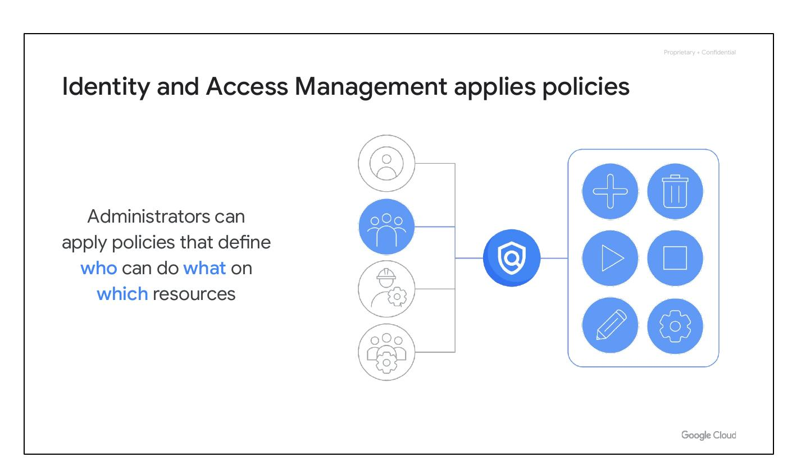
Resource Manager
Manages projects programmatically
Create, update, delete projects
Recover deleted projects
Access via RPC API and REST API
Notes:
The Resource Manager tool is designed to manage projects programmatically. It allows users to list projects, create new projects, update existing projects, delete projects, and even recover previously deleted projects. The Resource Manager is accessible through the RPC API and the REST API.

Slide 9
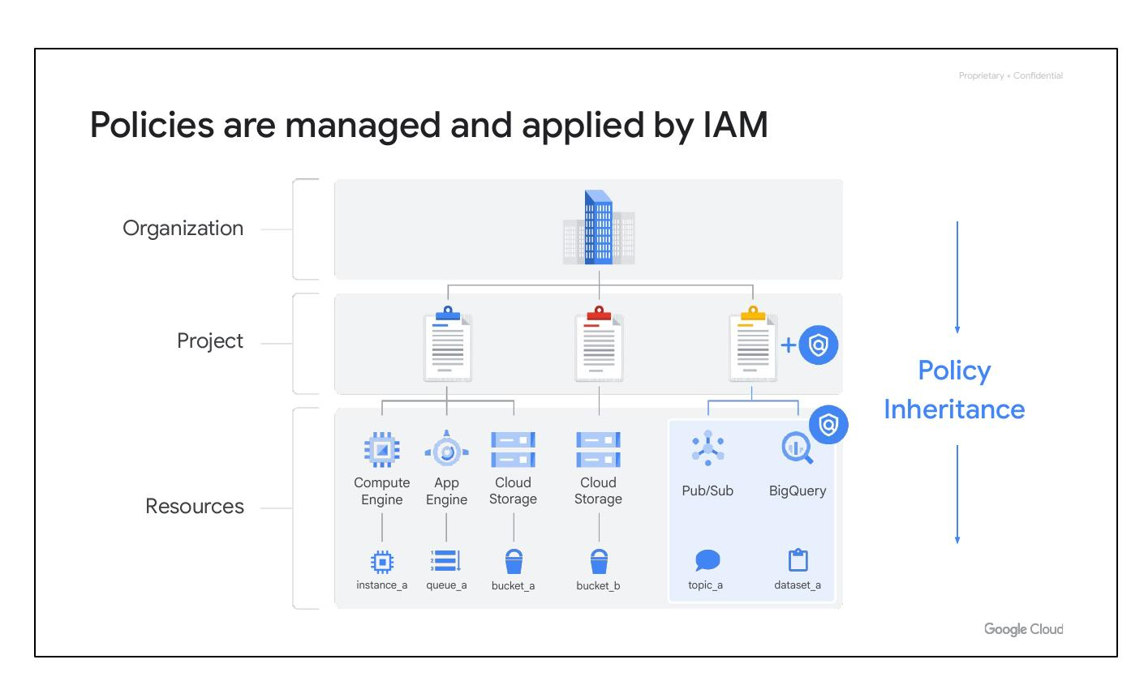
Folder Policies
Resources inherit policies
Folders can contain subfolders
Folders contain projects
Notes:
Folders allow users to assign policies to resources at a chosen level of granularity. Projects and subfolders within a folder inherit the policies and permissions assigned to that folder. A folder can contain projects, other folders, or a combination of both.

Slide 10
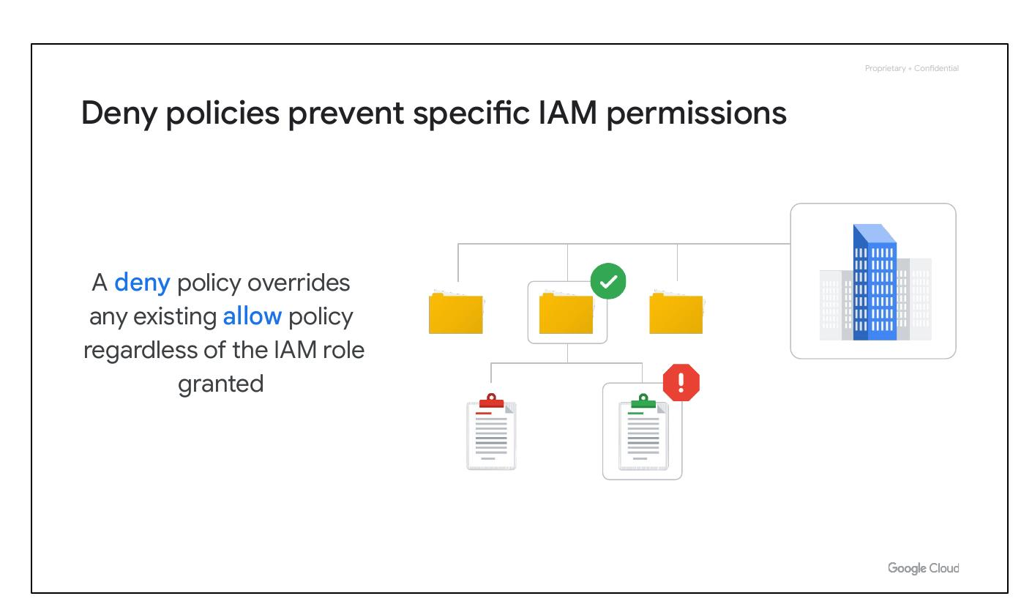
Group Projects
Group projects in a hierarchy
Group resources by department
Delegate administrative rights
Notes:
Folders enable you to group projects under an organization in a hierarchical manner. This allows resources to be grouped on a per-department basis, and provides teams with the ability to delegate administrative rights for independent work.

Slide 11
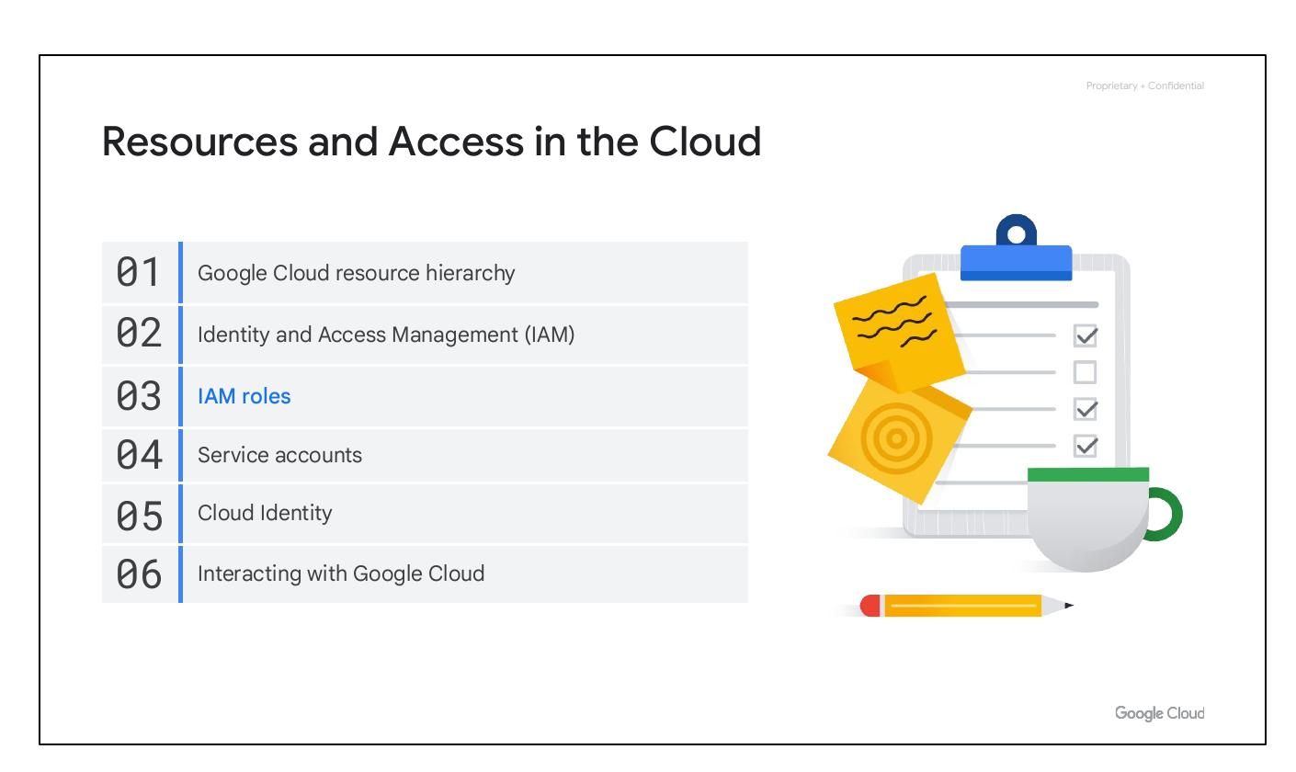
Policy Inheritance
Folders facilitate policy inheritance
Permissions inherited from folders
Notes:
Resources in a folder inherit policies and permissions from that folder. Centralizing policies in folders avoids duplication and simplifies permission management, reducing potential errors.

Slide 12

Organization Node
Topmost resource
Everything goes under node
Notes:
The organization node is the topmost resource in the Google Cloud hierarchy. All projects, folders, and other resources are attached to this node.

Slide 13
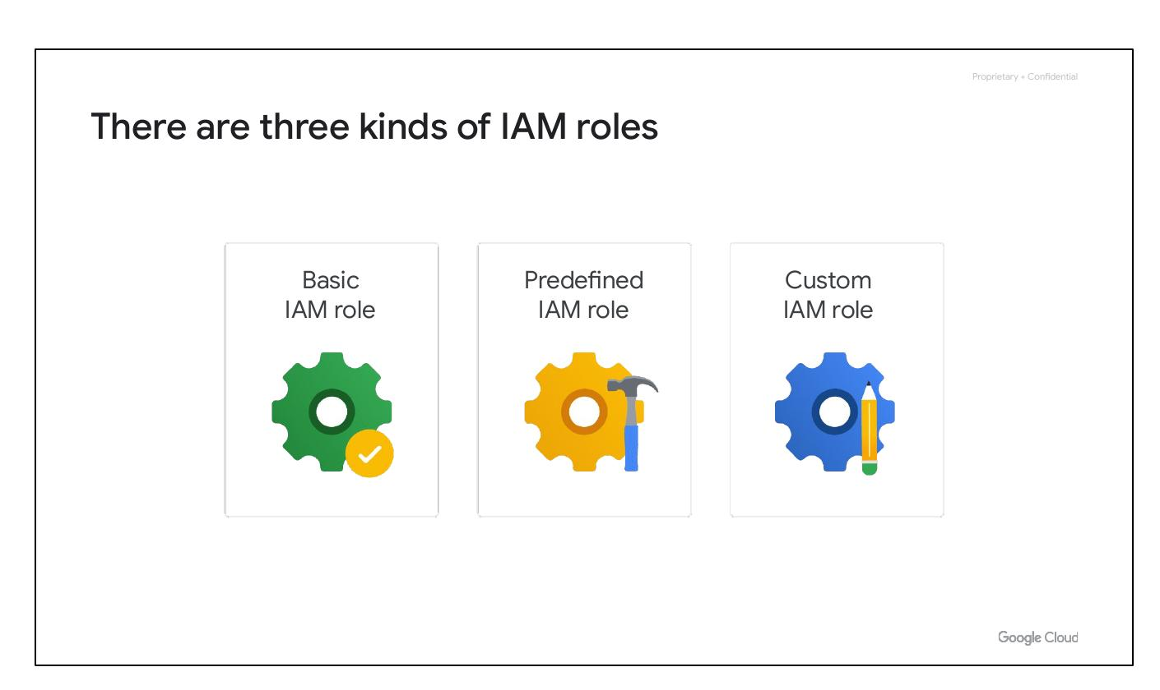
Node Roles
Special roles associated
Policy administrator
Project creator
Notes:
Special roles, like organization policy administrator (to control policy changes) and project creator (to control who can create projects and spend money), are associated with the top-level organization node.

Slide 14
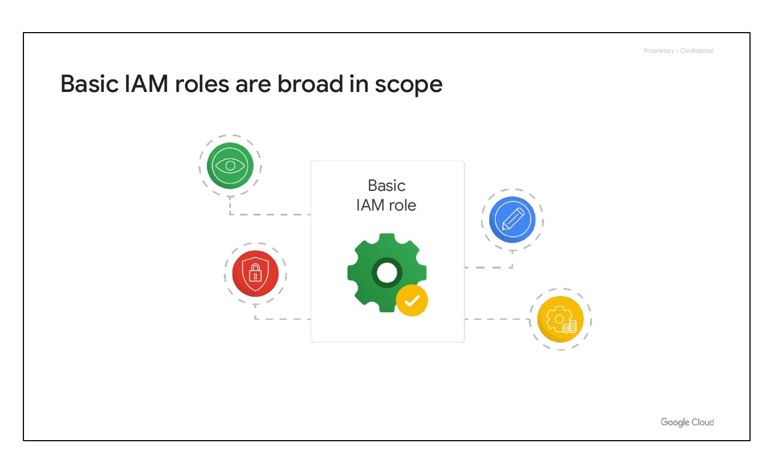
New Node
Projects automatically belong
Google Workspace customer
Cloud Identity to create node
Notes:
Creating an organization node depends on whether the company is a Google Workspace customer. If so, Google Cloud projects automatically belong. Otherwise, use Cloud Identity to create one.

Slide 15
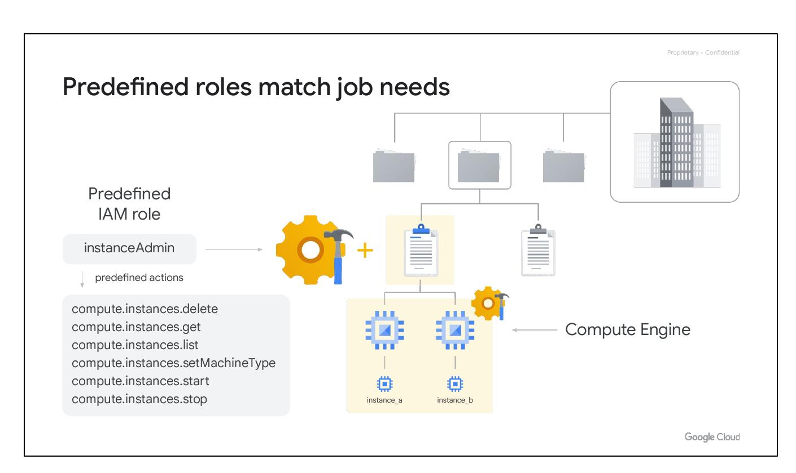
Identity and Access Management
Google Cloud resource hierarchy
Identity and Access Management (IAM)
IAM roles
Service accounts
Cloud Identity
Interacting with Google Cloud
Notes:
This slide introduces Identity and Access Management (IAM) within the Google Cloud resource hierarchy, including IAM roles, service accounts, Cloud Identity, and methods for interacting with Google Cloud.

Slide 16
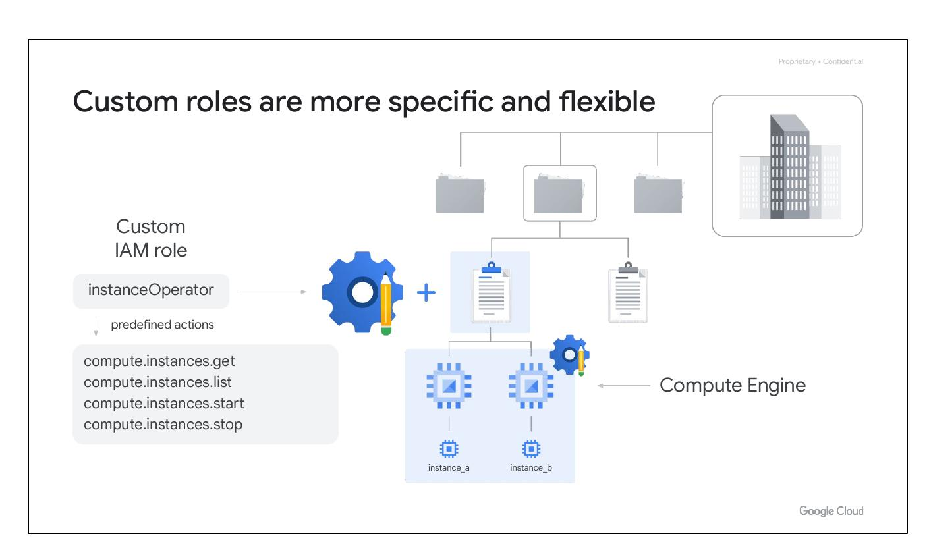
IAM Policies
Administrators apply policies
Define who can do what
Defines what resources
Notes:
Administrators use IAM to apply policies that define who can do what on which resources. 'Who' can be a Google account, group, service account, or Cloud Identity domain. 'Can do what' is defined by a role, which is a collection of permissions.

Slide 17
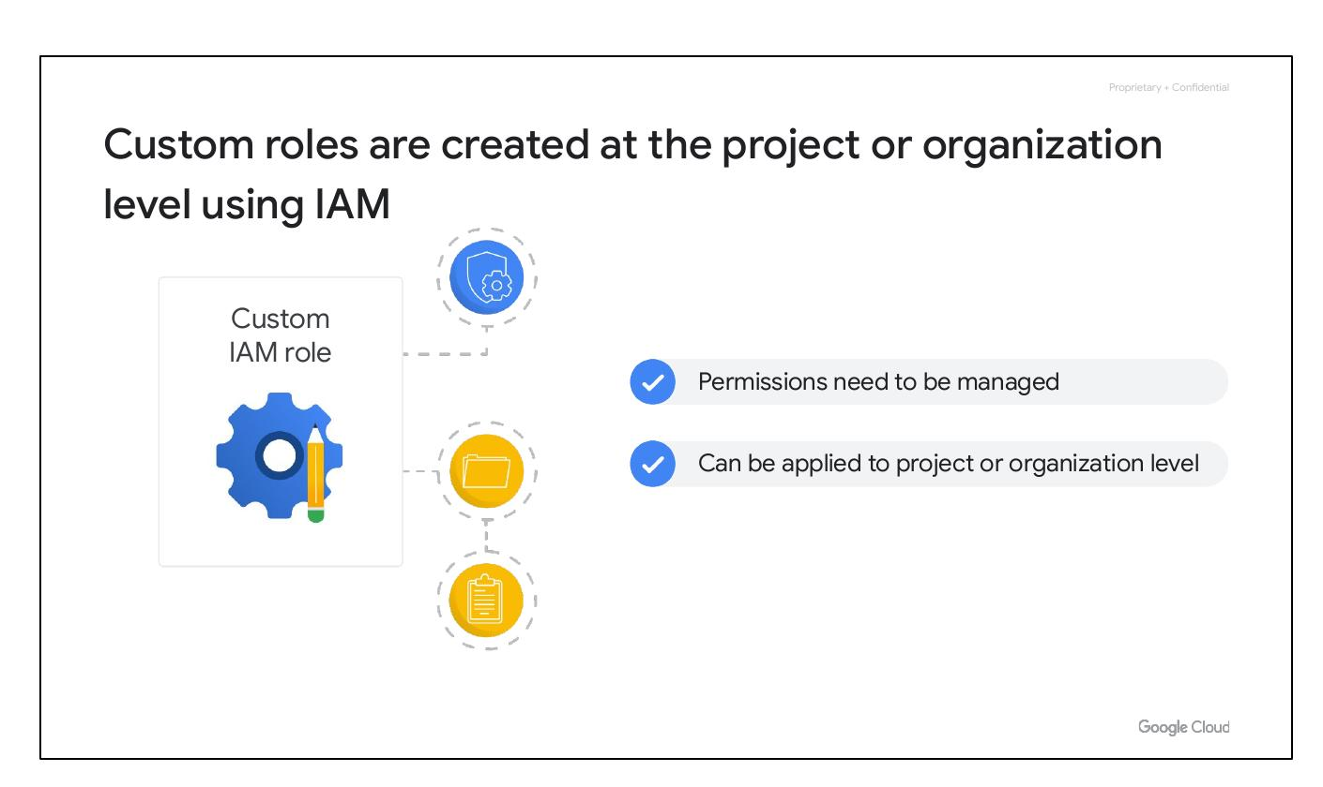
Policy Inheritance
Policies managed by IAM
Inheritance in resource hierarchy
Notes:
When a principal (user, group, or service account) is granted a role on a specific element within the resource hierarchy, the resulting policy applies to the chosen element, as well as all elements below it.

Slide 18

Deny Policies
Prevent specific permissions
Override existing allow policies
Inherited through hierarchy
Notes:
Deny policies prevent certain principals from using specific permissions, regardless of the roles they're granted. IAM always checks relevant deny policies before allow policies. Deny policies, like allow policies, are inherited through the resource hierarchy.

Slide 19
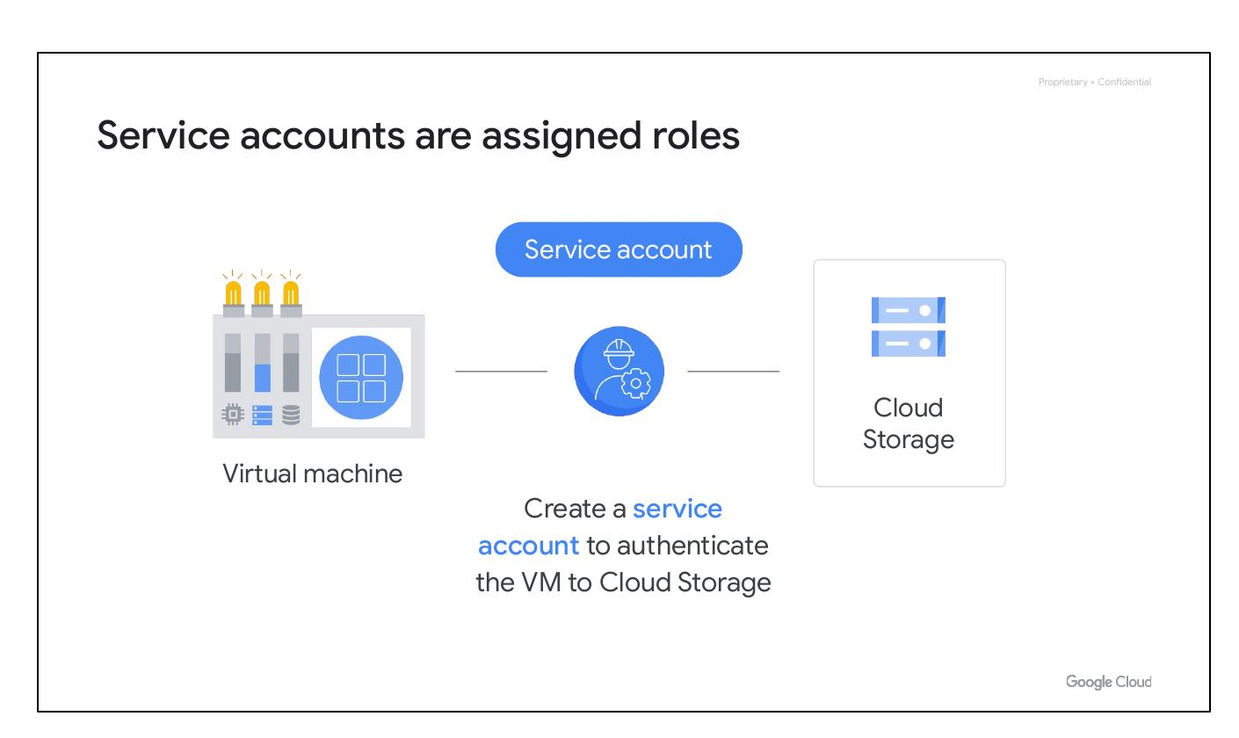
IAM Roles
Google Cloud resource hierarchy
Identity and Access Management (IAM)
IAM roles
Service accounts
Cloud Identity
Interacting with Google Cloud
Notes:
This slide focuses on IAM Roles within the Google Cloud environment.

Slide 20
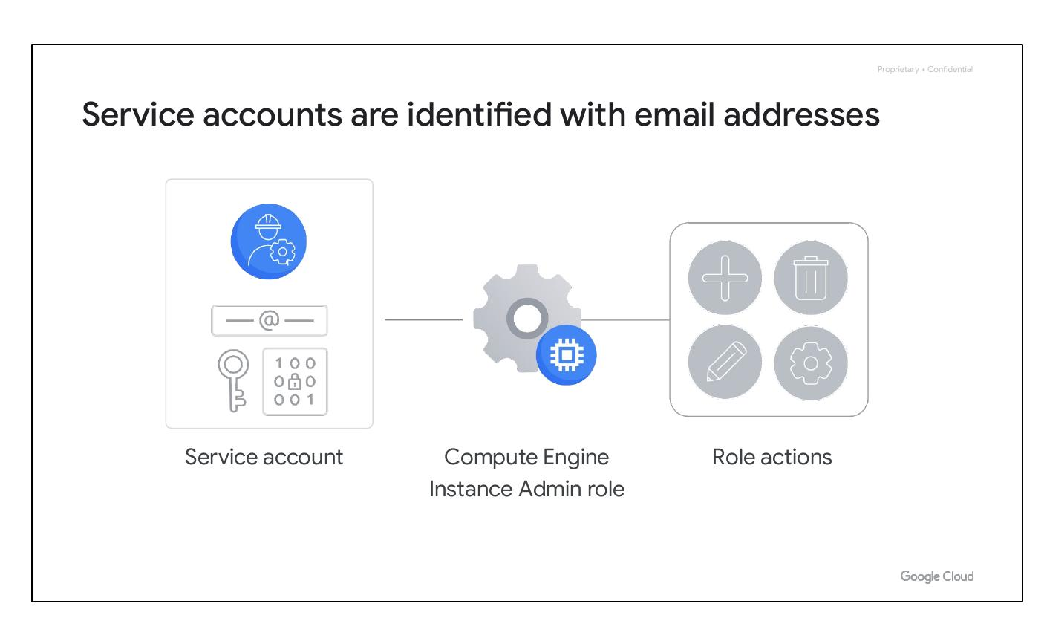
IAM Role Types
Three kinds of IAM roles:
- Basic
- Predefined
- Custom
Notes:
There are three main types of roles in IAM: basic, predefined, and custom. Each type offers different levels of granularity and control over permissions.

Slide 21
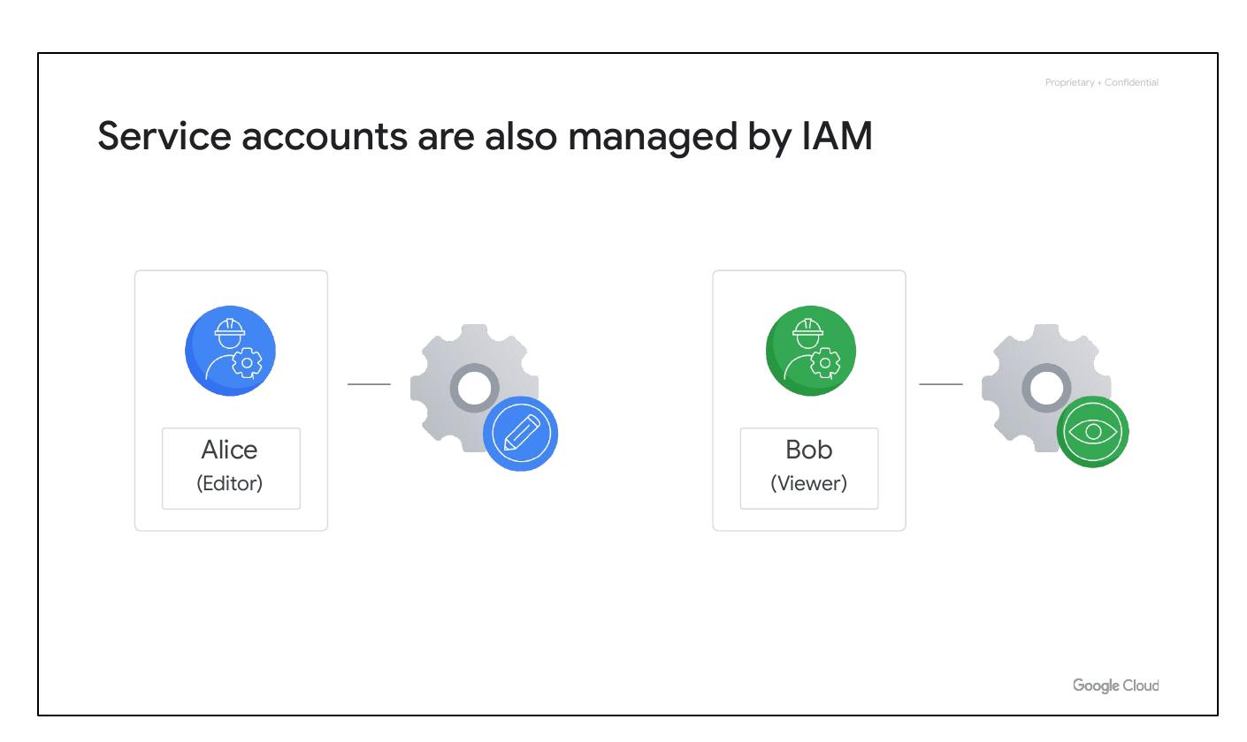
Basic IAM Roles
Broad in scope
Affect all resources
Include owner, editor, viewer
Billing administrator
Notes:
Basic roles are broad in scope and affect all resources in a Google Cloud project. Basic roles include owner, editor, viewer, and billing administrator. They are often too broad for projects containing sensitive data.

Slide 22

Predefined Roles
Match job needs
Specific Google Cloud services
Roles applied to resources
Notes:
Specific Google Cloud services offer sets of predefined roles that can be applied to resources. For example, Compute Engine has roles like “instanceAdmin” that allow specific actions on Compute Engine resources.

Slide 23

Custom Roles
Specific, flexible permissions
Follow least-privilege model
Example: instanceOperator role
Notes:
Custom roles provide the most specific permissions. Using a 'least-privilege' model, an 'instanceOperator' role could allow users to start/stop Compute Engine VMs without reconfiguration permissions.

Slide 24
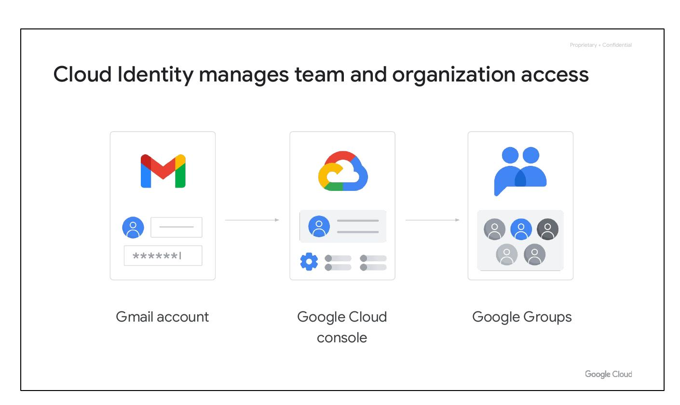
Custom Role Creation
Created at project/organization level
Permissions need management
Applied to project or organization
Notes:
Custom roles are created at the project or organization level. They require careful management of permissions and can be applied at either the project or organization level, not the folder level.

Slide 25
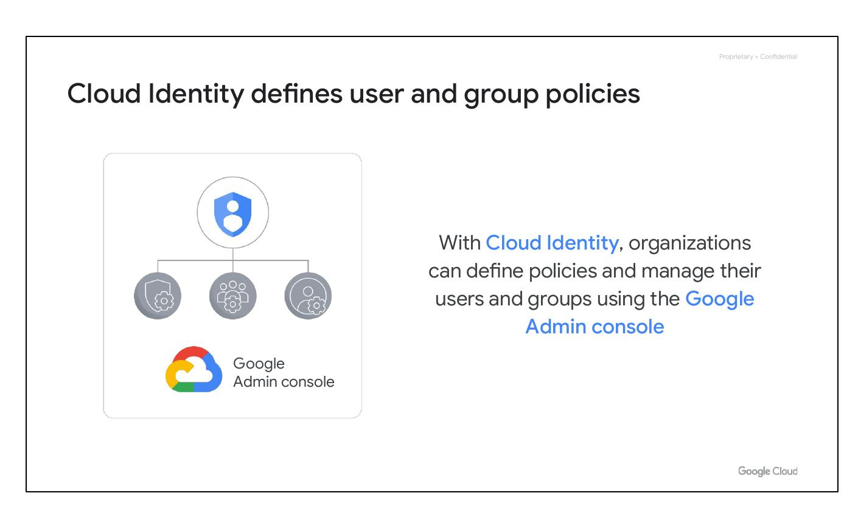
Service Accounts
Google Cloud resource hierarchy
Identity and Access Management (IAM)
IAM roles
Service accounts
Cloud Identity
Interacting with Google Cloud
Notes:
Introduces service accounts within Google Cloud, highlighting its place within the IAM framework.

Slide 26
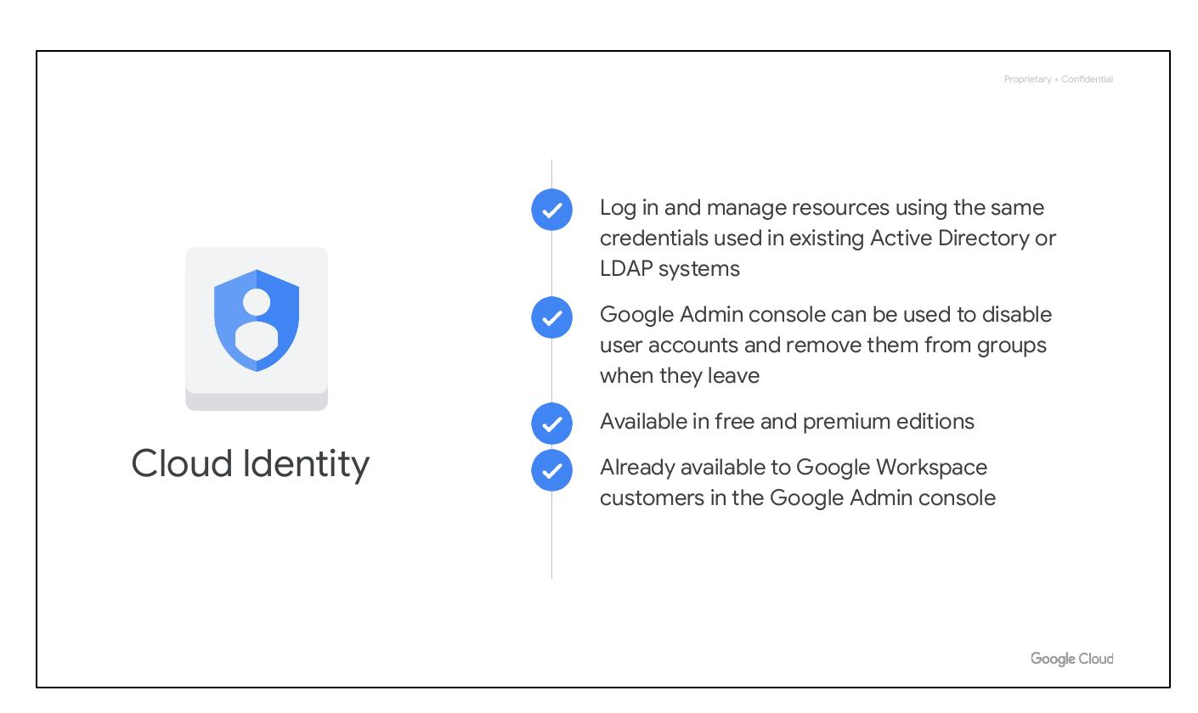
Service Accounts Role
Authenticate VM to Cloud Storage
Create service account
Notes:
Service accounts are used to assign specific permissions to a virtual machine, enabling it to interact with other cloud services without human intervention. For example, a service account can authenticate a VM to Cloud Storage.

Slide 27

Account Identification
Identified with email addresses
Use cryptographic keys
Granted roles enable actions
Notes:
Service accounts are identified by email addresses but use cryptographic keys instead of passwords to access resources. If granted Compute Engine's Instance Admin role, an application running in a VM with that service account could create, modify, and delete other VMs.

Slide 28
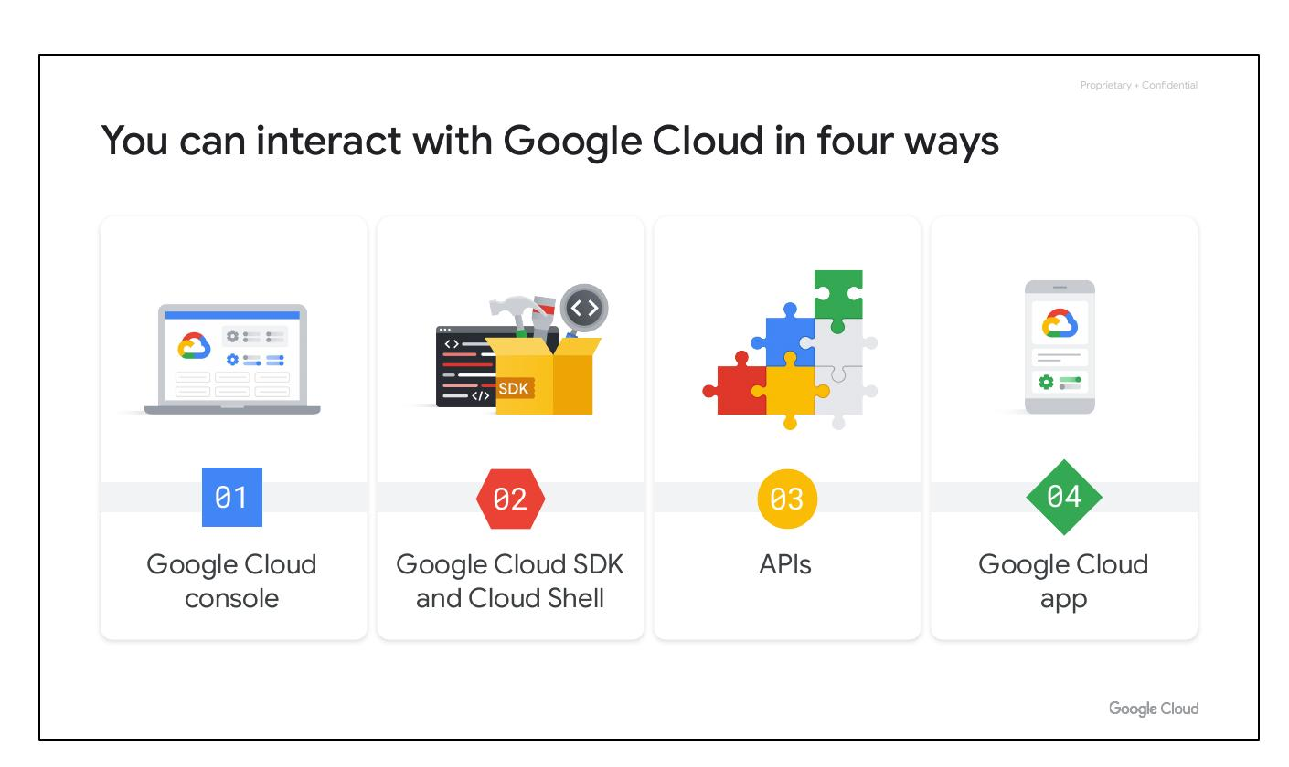
Managed by IAM
Managed by IAM policies
Service account is also a resource
Assign roles for management
Notes:
Service accounts are managed by IAM policies just like any other Google Cloud resource. You can assign roles to users to manage service accounts.

Slide 29
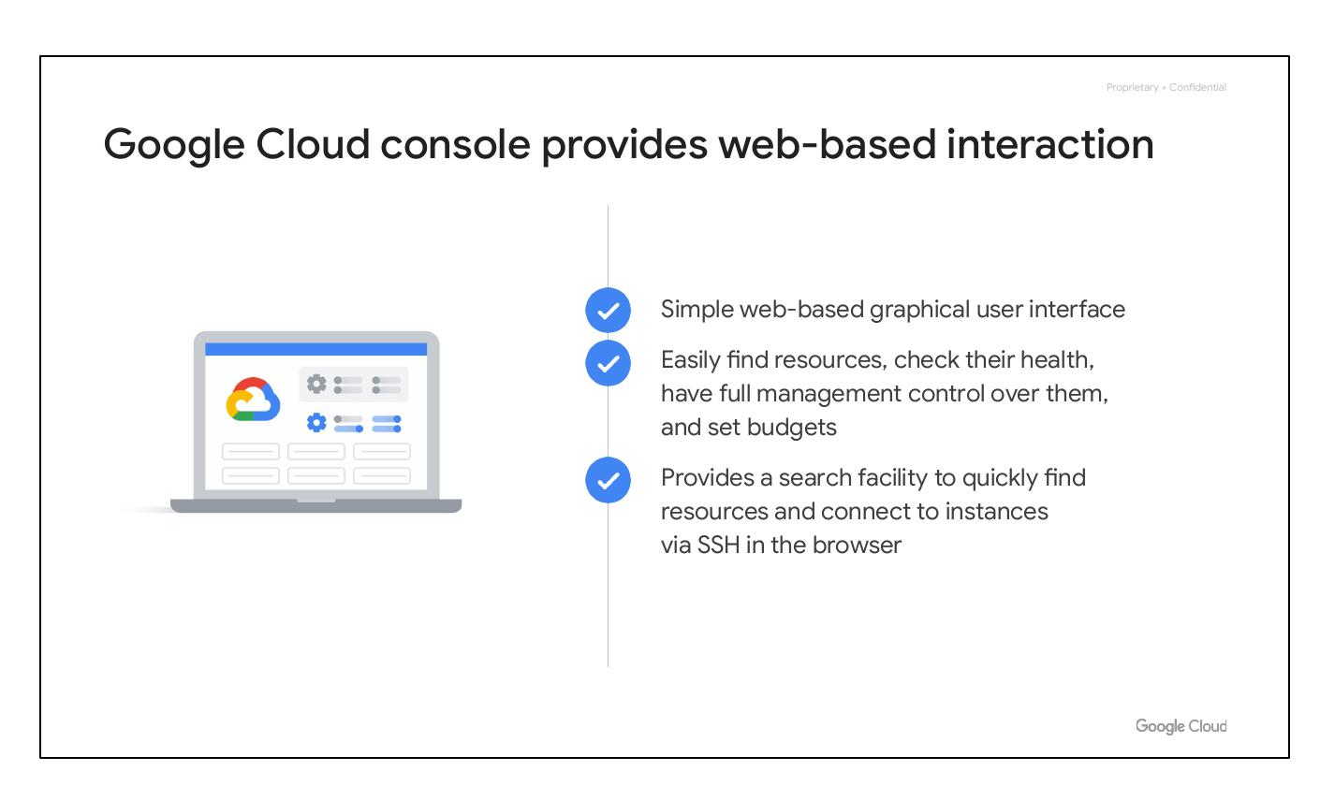
Cloud Identity
Google Cloud resource hierarchy
Identity and Access Management (IAM)
IAM roles
Service accounts
Cloud Identity
Interacting with Google Cloud
Notes:
This slide focuses on Cloud Identity within the Google Cloud context.

Slide 30
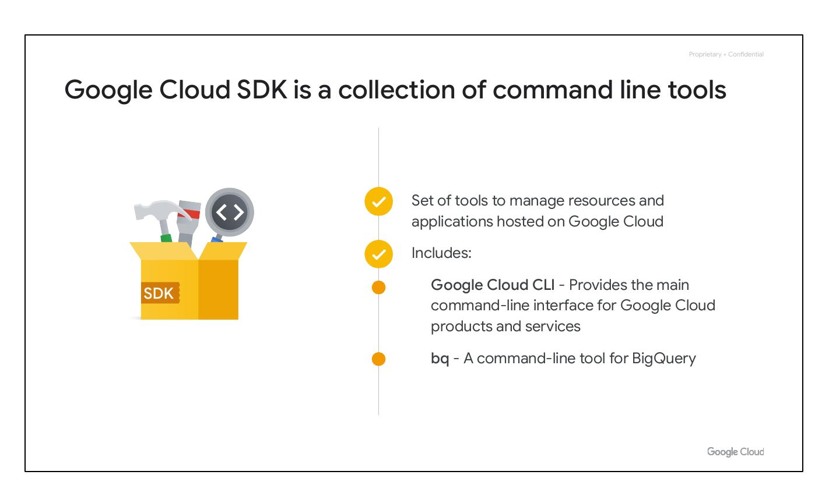
Team and Organization
Gmail account
Google Cloud console
Google Groups
Notes:
Cloud Identity manages team and organization access and policies. Using Gmail accounts and Google Groups is common but can be challenging for centralized management, especially when someone leaves the organization.

Slide 31
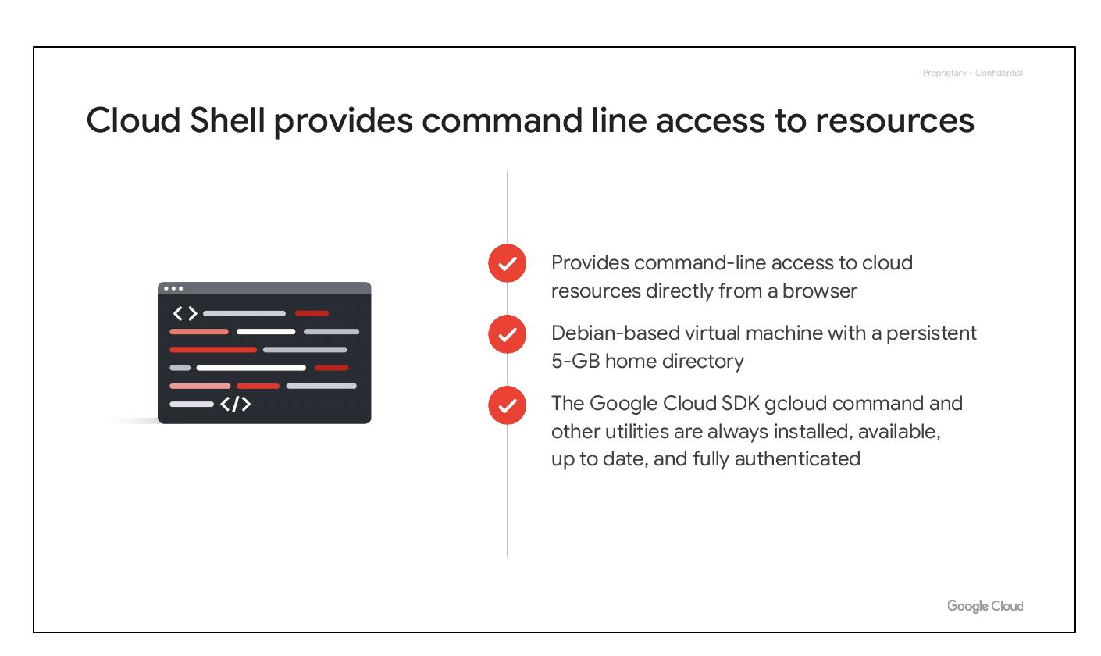
User and Group Policies
Define user policies
Manage users
Google Admin console
Notes:
Cloud Identity lets organizations define policies and manage their users and groups using the Google Admin console, providing centralized control over identities.

Slide 32
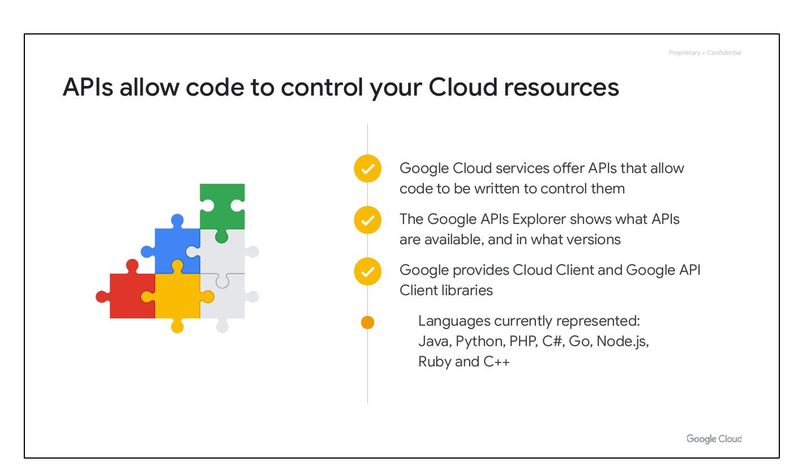
Cloud Identity Features
Manage via Active Directory/LDAP
Disable accounts easily
Free and premium editions
Available to Workspace customers
Notes:
Cloud Identity allows admins to manage resources with existing Active Directory/LDAP credentials. It enables disabling accounts and removing them from groups easily. Cloud Identity is available in free and premium editions and is already available to Google Workspace customers in the Google Admin console.

Slide 33
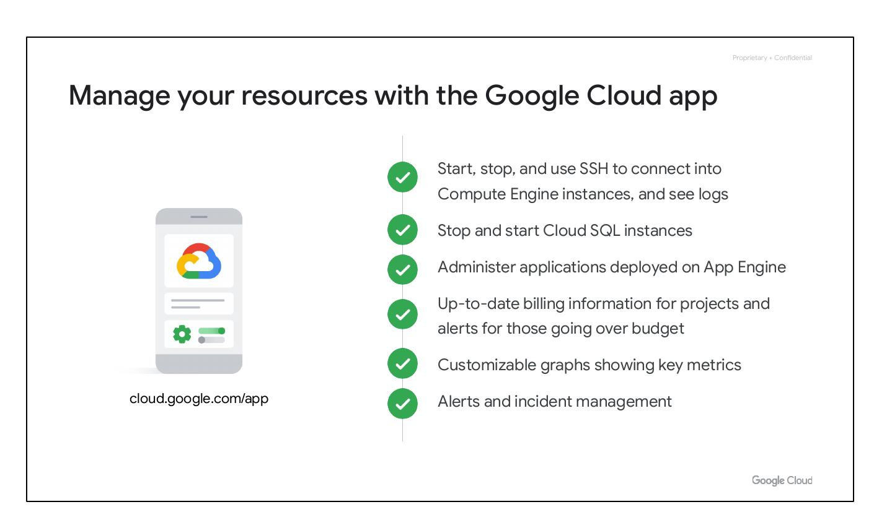
Interacting Ways
Google Cloud resource hierarchy
Identity and Access Management (IAM)
IAM roles
Service accounts
Cloud Identity
Interacting with Google Cloud
Notes:
This section focuses on Interacting with Google Cloud.

Slide 34
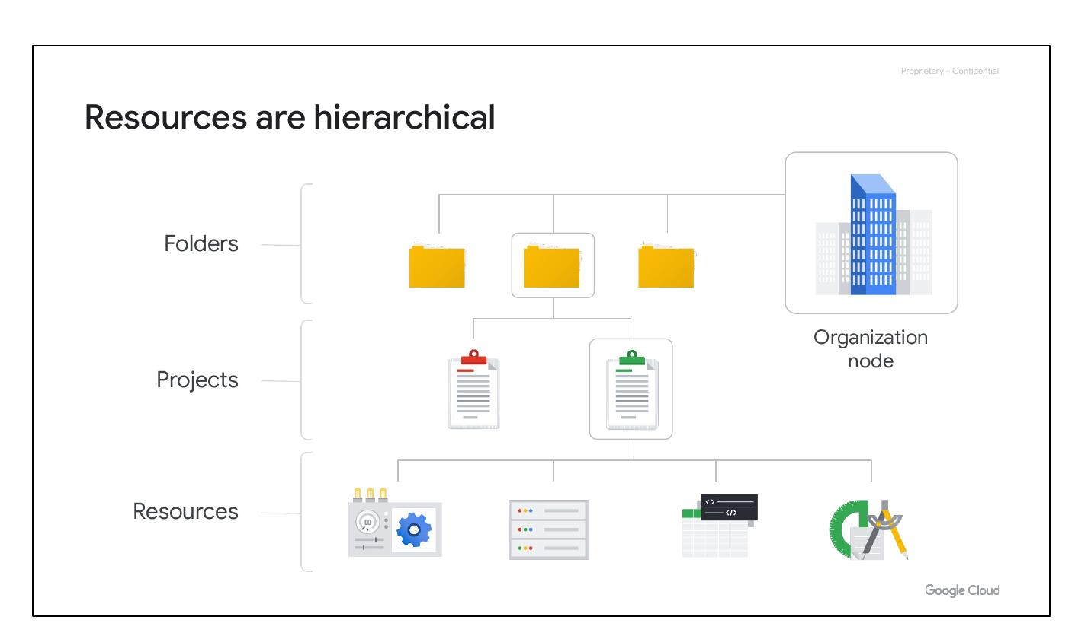
Ways to Access
Four ways to interact:
- Cloud Console
- Cloud SDK/Shell
- APIs
- Cloud App
Notes:
There are four primary ways to interact with Google Cloud: the Google Cloud Console, Google Cloud SDK and Cloud Shell, APIs, and the Google Cloud app.

Slide 35
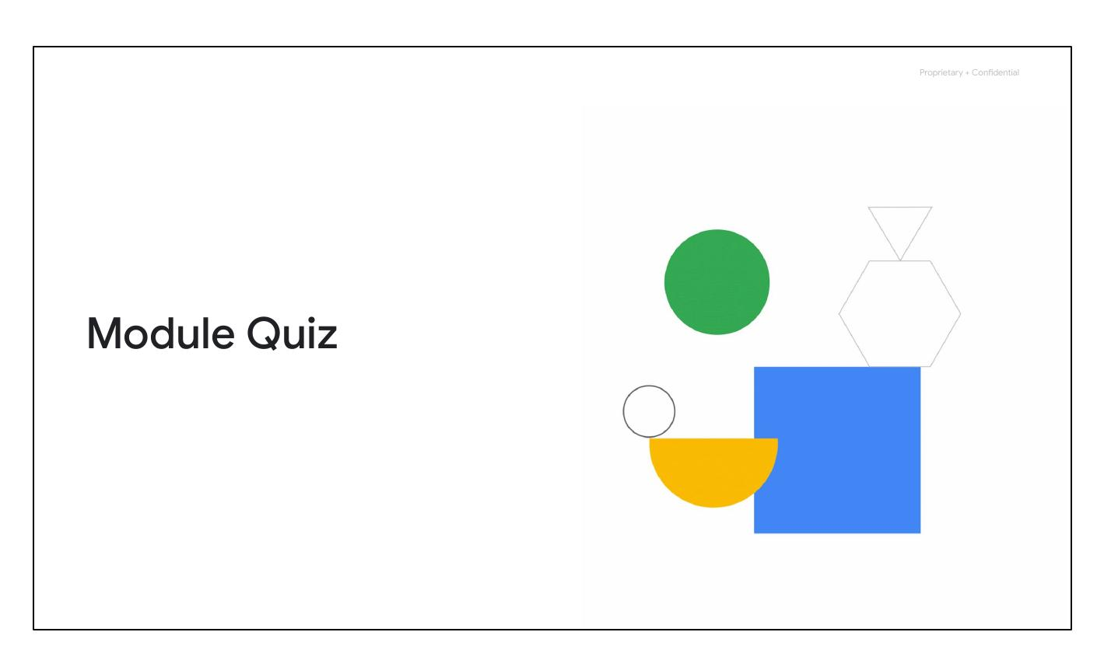
Cloud Console
Web-based interaction
Graphical user interface
Find resources easily
Full management control
Set budgets
Notes:
The Google Cloud Console provides a web-based graphical user interface (GUI) for deploying, scaling, and diagnosing production issues. It enables users to easily find resources, check their health, have full management control, and set budgets.

Slide 36
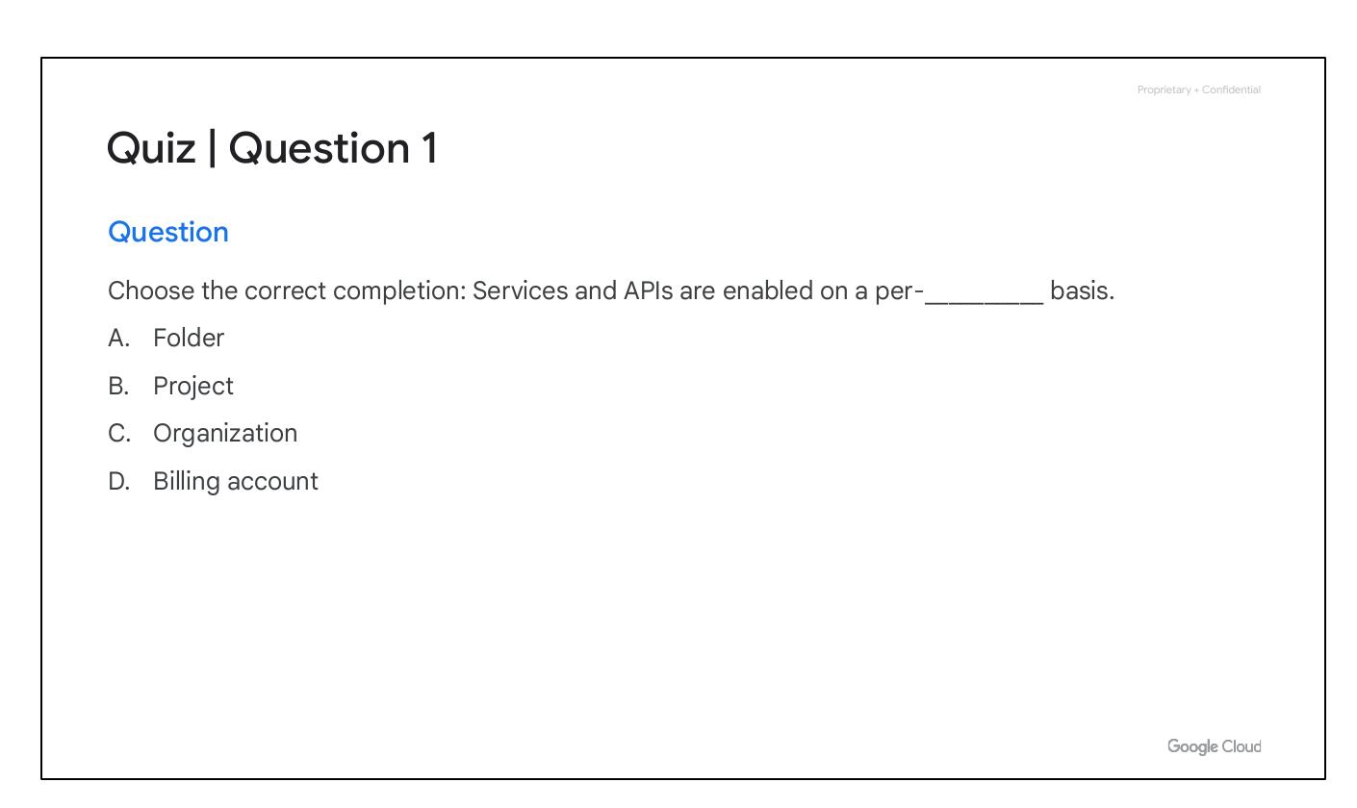
Cloud SDK
Manage resources/applications
Includes Google Cloud CLI
Includes bq tool
Notes:
The Google Cloud SDK is a collection of command-line tools for managing resources and applications on Google Cloud. This includes the gcloud CLI for Google Cloud products/services and bq, a command-line tool for BigQuery.

Slide 37
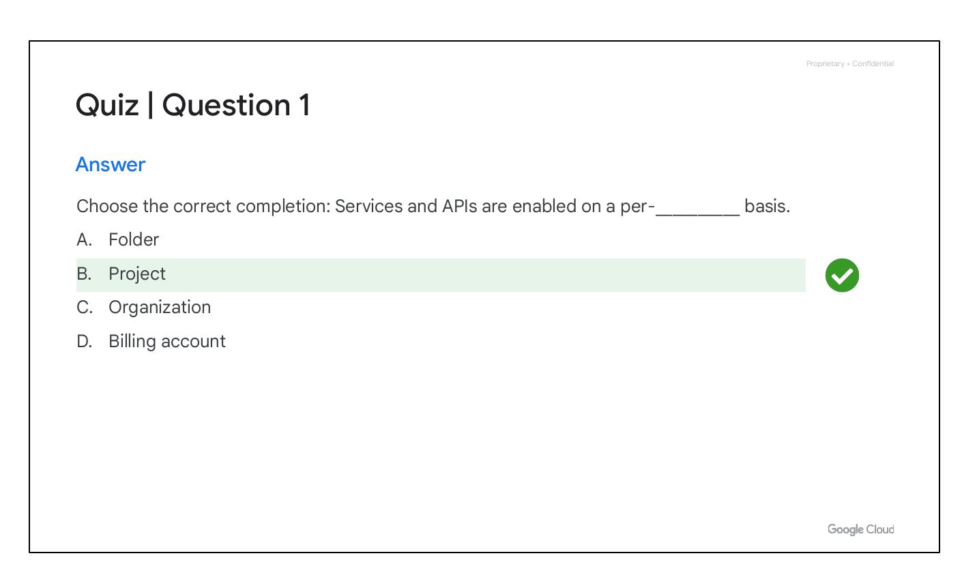
Cloud Shell Access
Command-line access
Debian-based VM
Persistent 5-GB directory
Always installed and authenticated
Notes:
Cloud Shell provides command-line access to cloud resources directly from a browser. It's a Debian-based virtual machine with a persistent 5-GB home directory. The Google Cloud SDK gcloud command and other utilities are always installed, available, up-to-date, and authenticated.

Slide 38
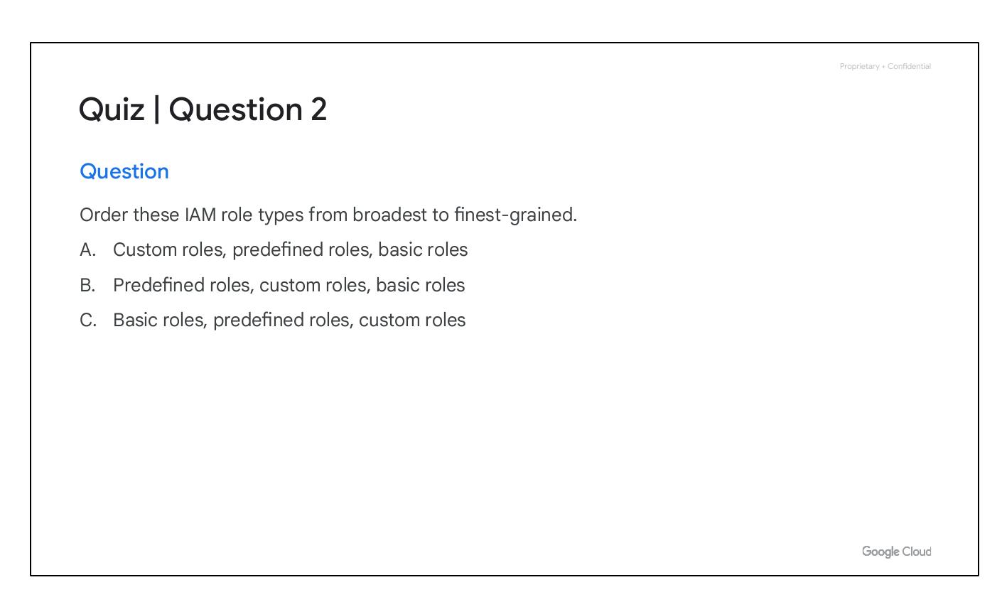
API Control
Code controls Cloud resources
APIs Explorer shows availability
Client libraries available
Multiple languages supported
Notes:
Google Cloud services offer APIs for code control. The Google APIs Explorer shows available APIs and versions. Google provides Cloud Client and Google API Client libraries in Java, Python, PHP, C#, Go, Node.js, Ruby, and C++.

Slide 39
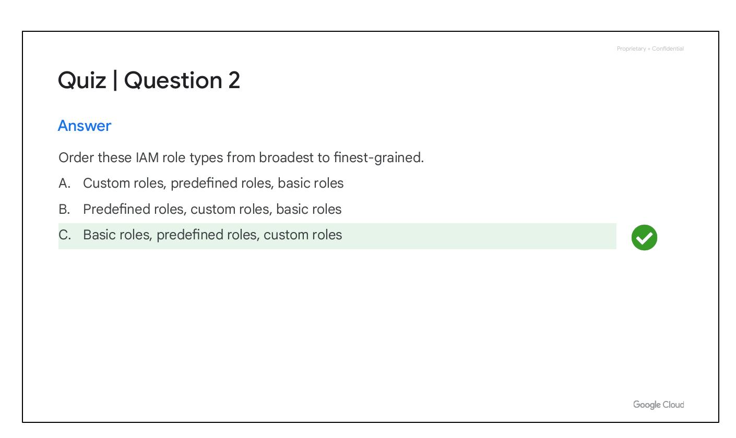
Cloud App
Manage resources
Compute Engine SSH
Cloud SQL stop/start
App Engine admin
Billing information
Notes:
The Google Cloud app can start/stop Compute Engine instances, connect via SSH, see logs, stop/start Cloud SQL instances, and administer applications on App Engine. It also provides up-to-date billing information and alerts.

Slide 40
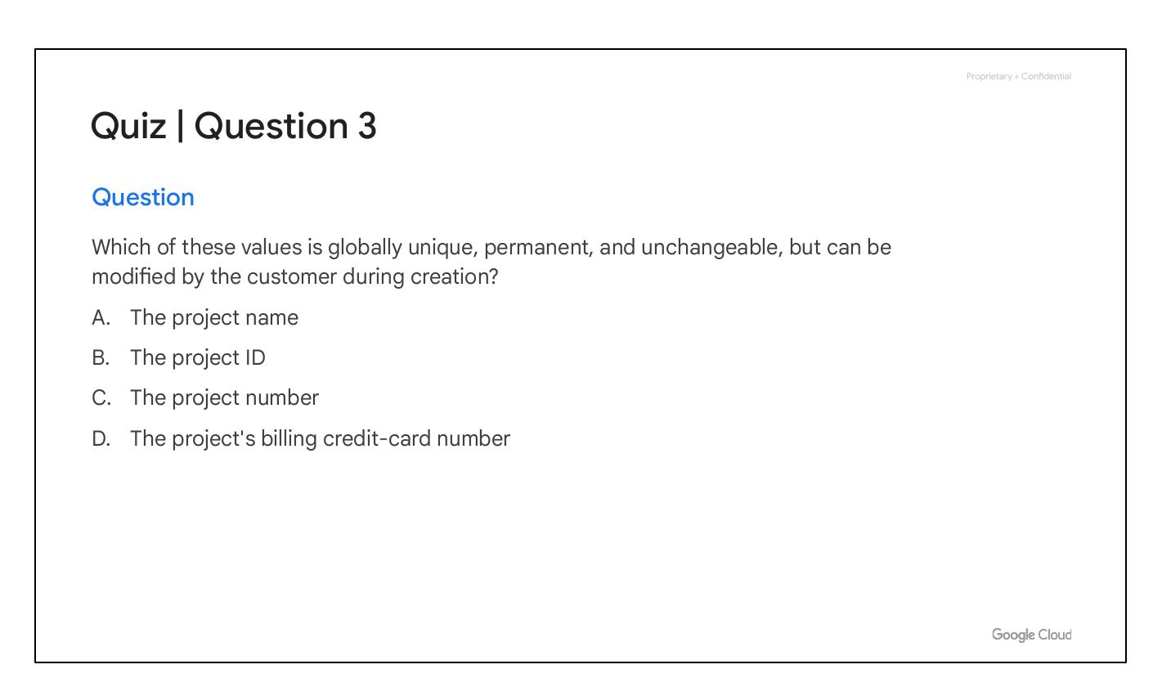
Module Quiz
Notes:
Transition slide to indicate the start of a quiz.

Slide 41
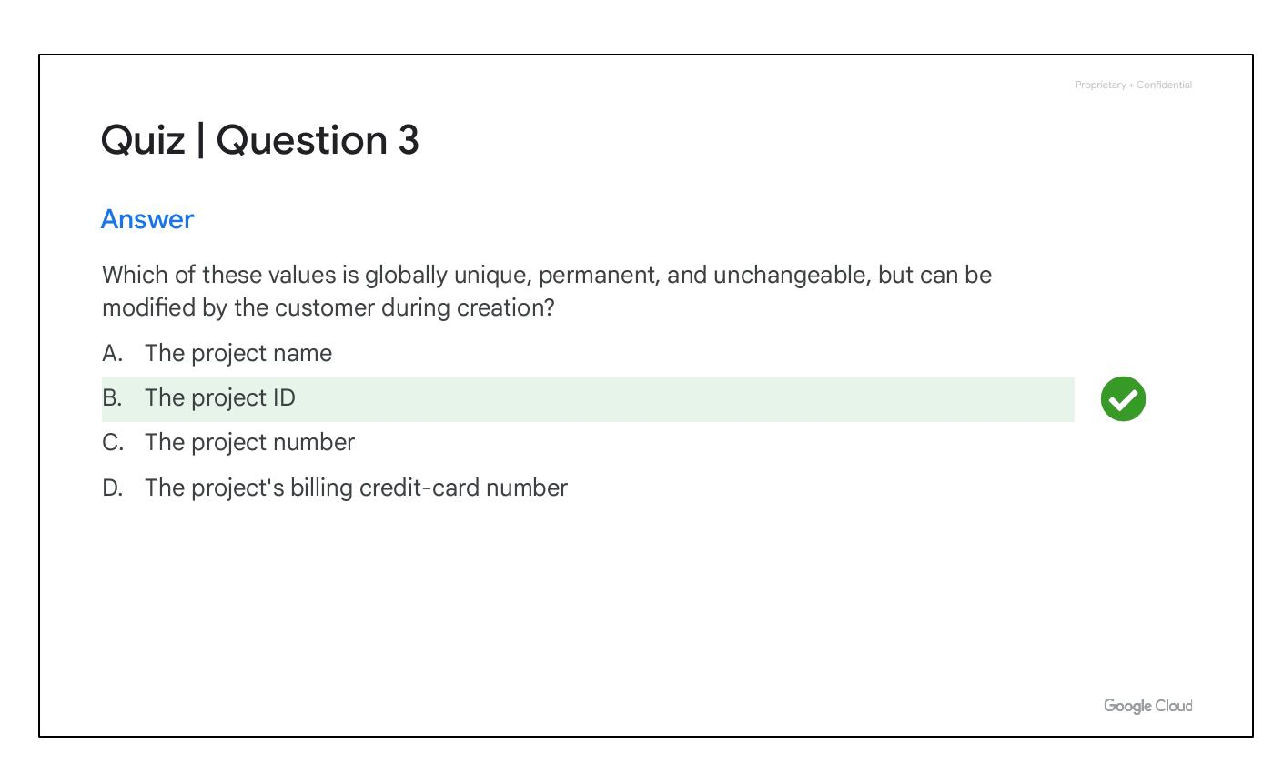
Quiz | Question 1
Notes:
Displays the question for Quiz 1. Services and APIs are enabled on a per-__________ basis.

Slide 42
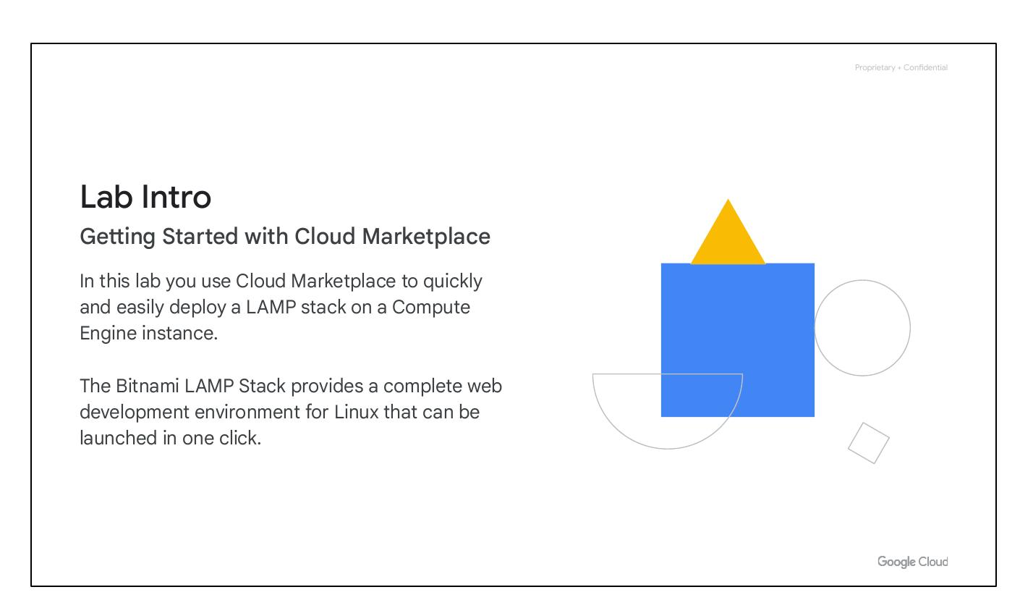
Quiz | Question 1
Notes:
Repeats the question for Quiz 1: Choose the correct completion: Services and APIs are enabled on a per-__________ basis.

Slide 43
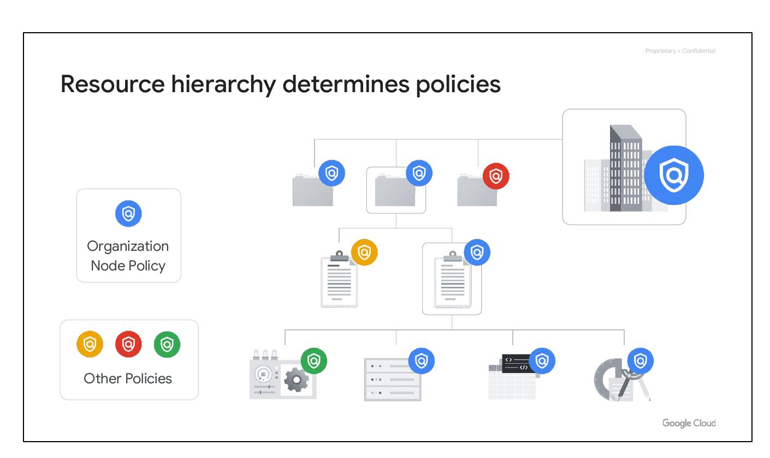
Quiz | Question 1
Notes:
Provides the answer and feedback for Quiz 1. The correct answer is B: Project. Enable or disable APIs on a per-project basis.

Slide 44
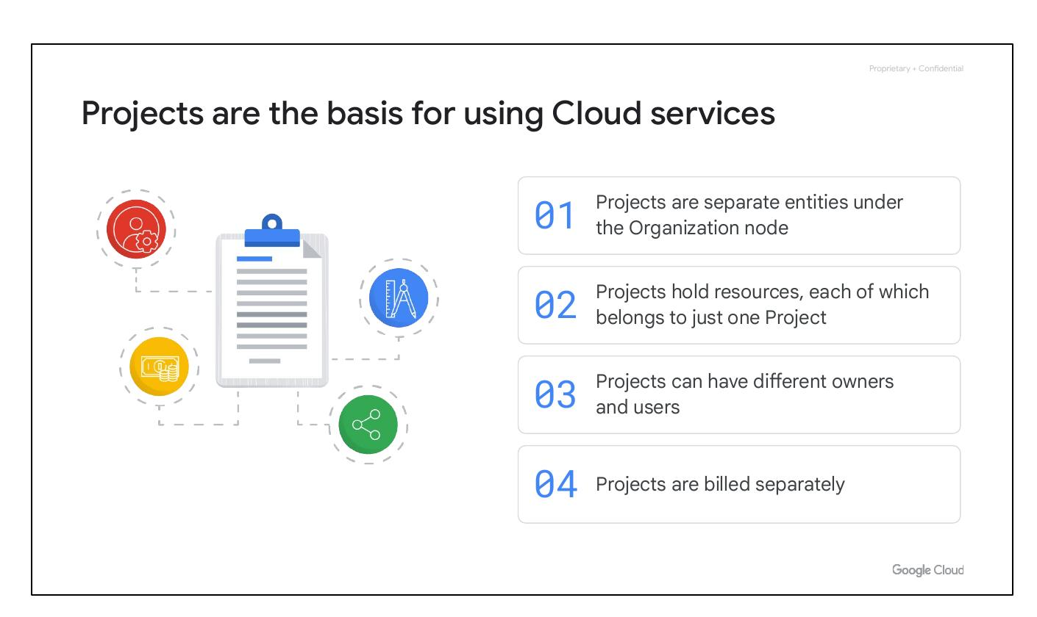
Quiz | Question 2
Notes:
Displays the question for Quiz 2. Order these IAM role types from broadest to finest-grained.

Slide 45
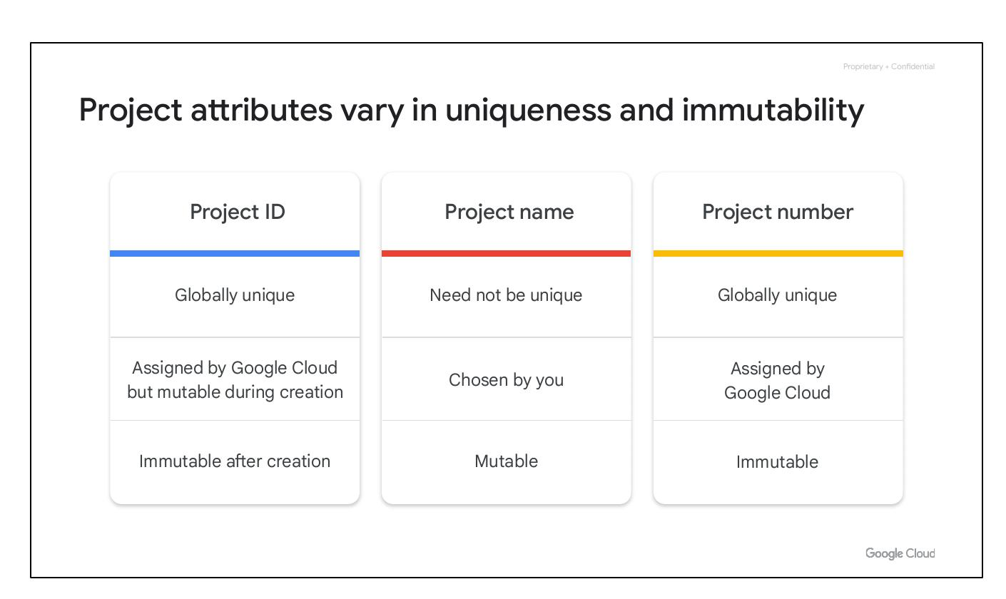
Quiz | Question 2
Notes:
Repeats the question for Quiz 2. Order these IAM role types from broadest to finest-grained.

Slide 46
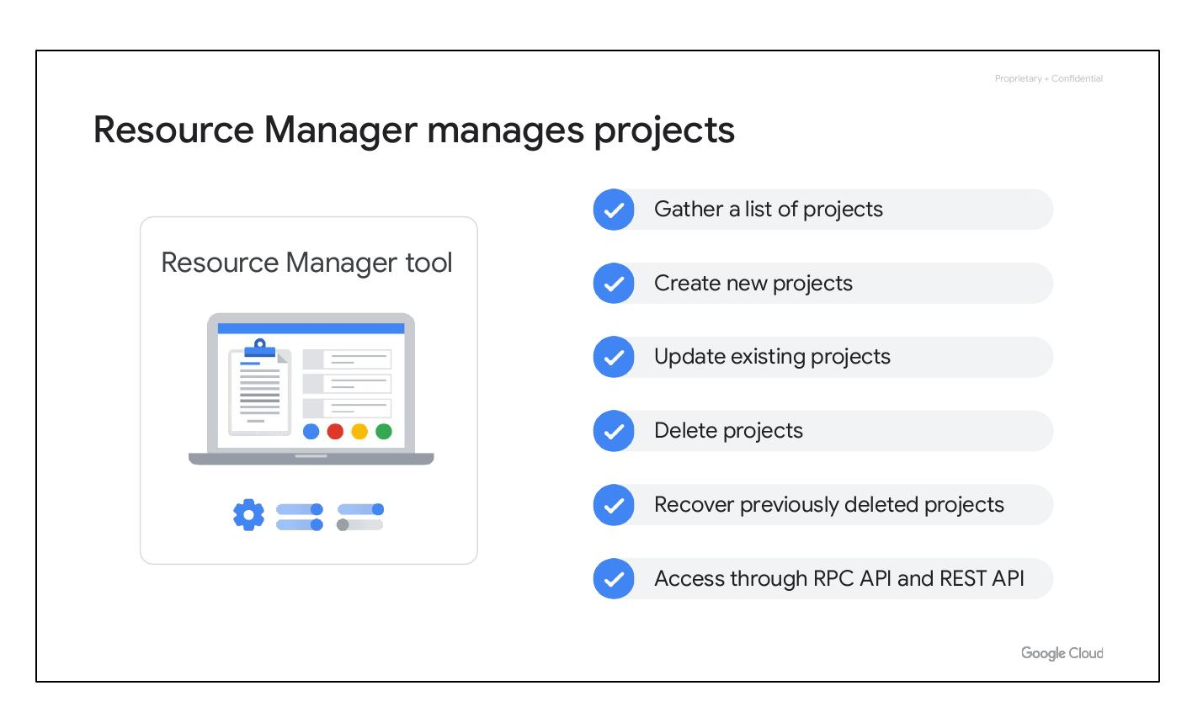
Quiz | Question 2
Notes:
Provides the answer and feedback for Quiz 2. The correct answer is C: Basic roles, predefined roles, custom roles. Basic roles affect all resources in a project.

Slide 47
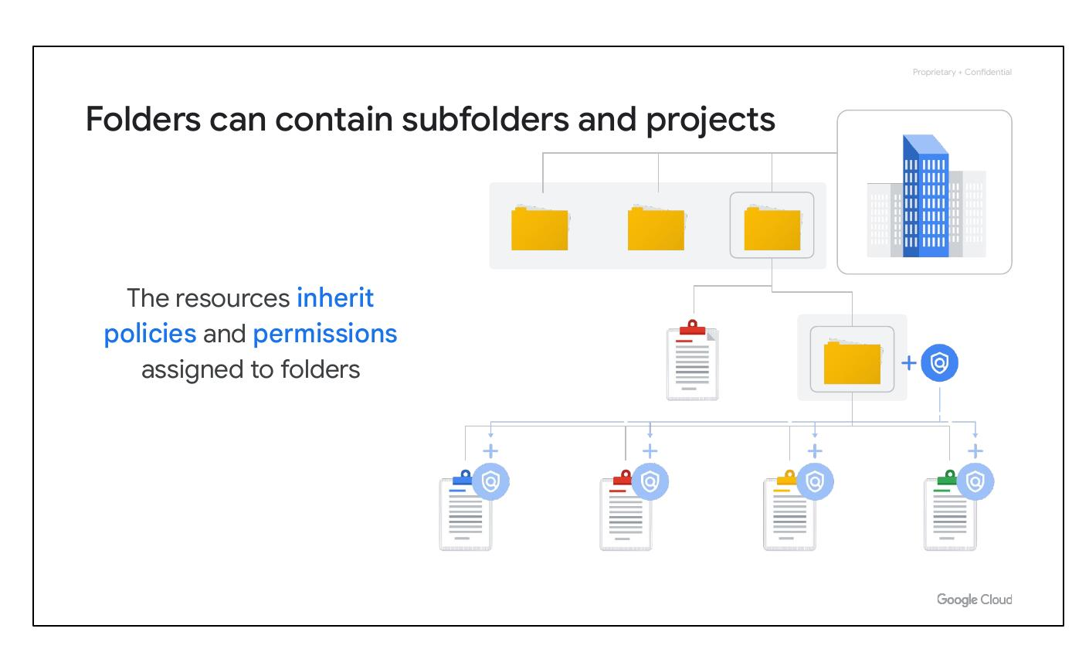
Quiz | Question 3
Notes:
Displays the question for Quiz 3. Which of these values is globally unique, permanent, and unchangeable, but can be modified by the customer during creation?

Slide 48
Quiz | Question 3
Notes:
Repeats the question for Quiz 3. Which of these values is globally unique, permanent, and unchangeable, but can be modified by the customer during creation?

Slide 49
Quiz | Question 3
Notes:
Provides the answer and feedback for Quiz 3. The correct answer is B: The project ID. The project ID is immutable (cannot be changed) after creation, but can be changed during creation.

Slide 50
Lab Intro
Notes:
Introduction to the lab: Getting Started with Cloud Marketplace. In this lab, you'll use Cloud Marketplace to quickly and easily deploy a LAMP stack on a Compute Engine instance. The Bitnami LAMP Stack provides a complete web development environment for Linux that can be launched in one click.

