Slide 1
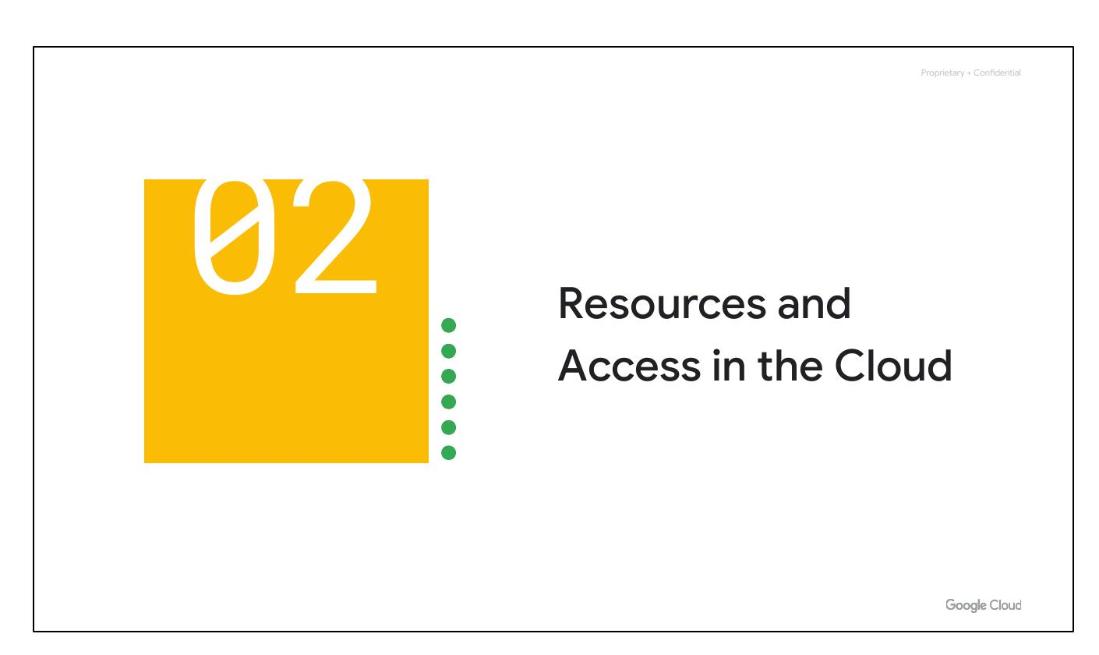
Resources & Access
Cloud computing overview
Google Cloud pricing structure
Google's security & sustainability
Functional structure of Google Cloud
Notes:
This section introduces the functional structure of Google Cloud. It covers cloud computing, Google Cloud's pricing and billing, security measures, and environmental efforts. It transitions into explaining the functional components of the Google Cloud platform.

Slide 2
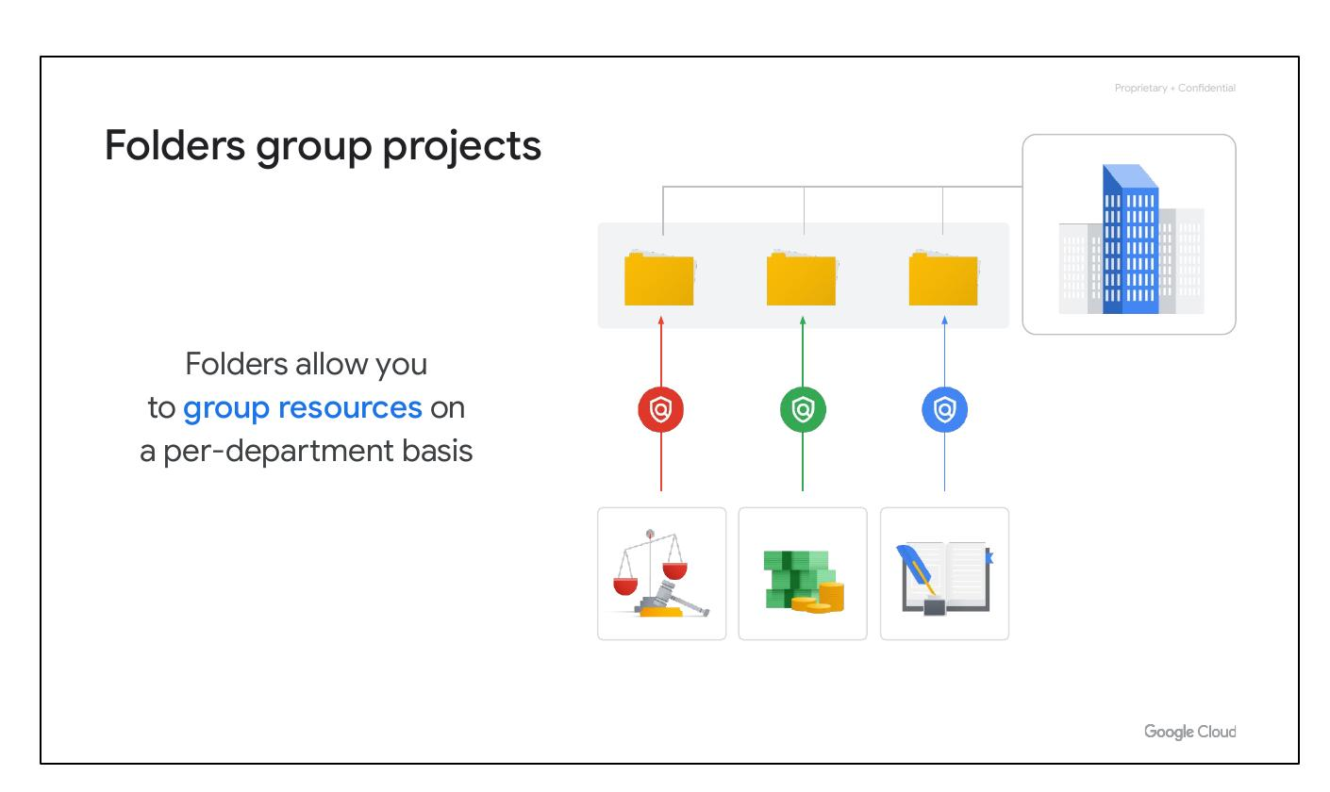
Resource Hierarchy
Resource organization with projects
Access management via IAM
Interaction methods with Google Cloud
Web UI, CLI, and mobile apps
Notes:
This section explains how resources are organized within Google Cloud using projects. It describes how access is managed through Identity and Access Management (IAM). It also discusses the different ways users can interact with Google Cloud, including the web user interface, command-line interface, and mobile apps.

Slide 3
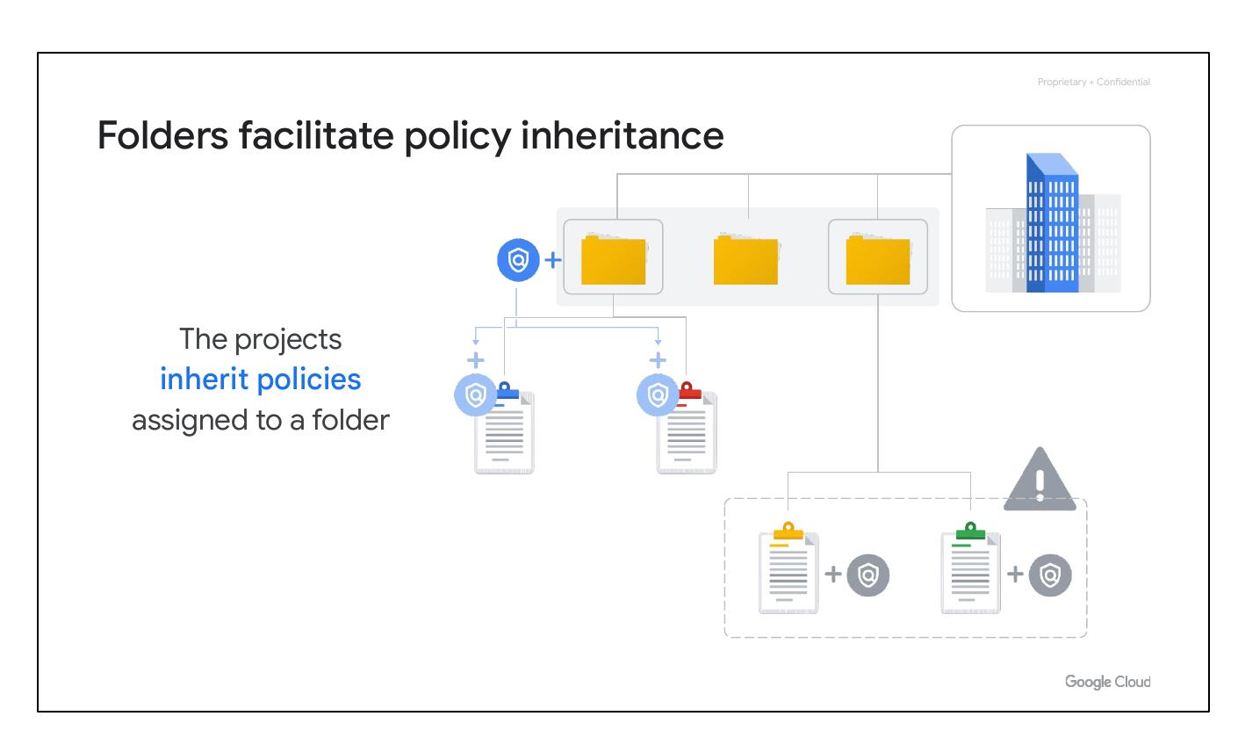
Resource Hierarchy
Google Cloud Resource Hierarchy
Identity and Access Management (IAM)
IAM roles, Service accounts
Cloud Identity and Interaction
Notes:
This slide introduces the Google Cloud Resource Hierarchy and its role in organizing resources. It mentions Identity and Access Management (IAM), IAM roles, service accounts, Cloud Identity, and ways to interact with Google Cloud as key components of the discussed topics.

Slide 4
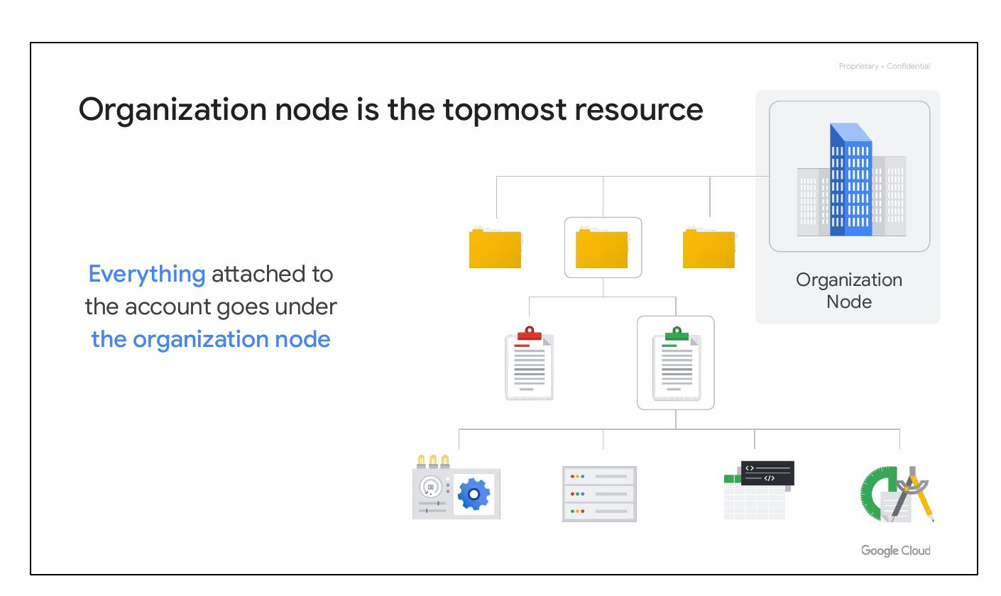
Resource Hierarchy
Four-level hierarchy
Resources: VMs, storage, networks, etc.
Organized into projects
Folders and organization node
Notes:
This slide describes the four levels of the Google Cloud resource hierarchy: resources, projects, folders, and an organization node. Resources represent virtual machines, storage buckets, and other Google Cloud services. Resources are organized into projects, which are further organized into folders. The organization node encompasses all projects, folders, and resources.

Slide 5
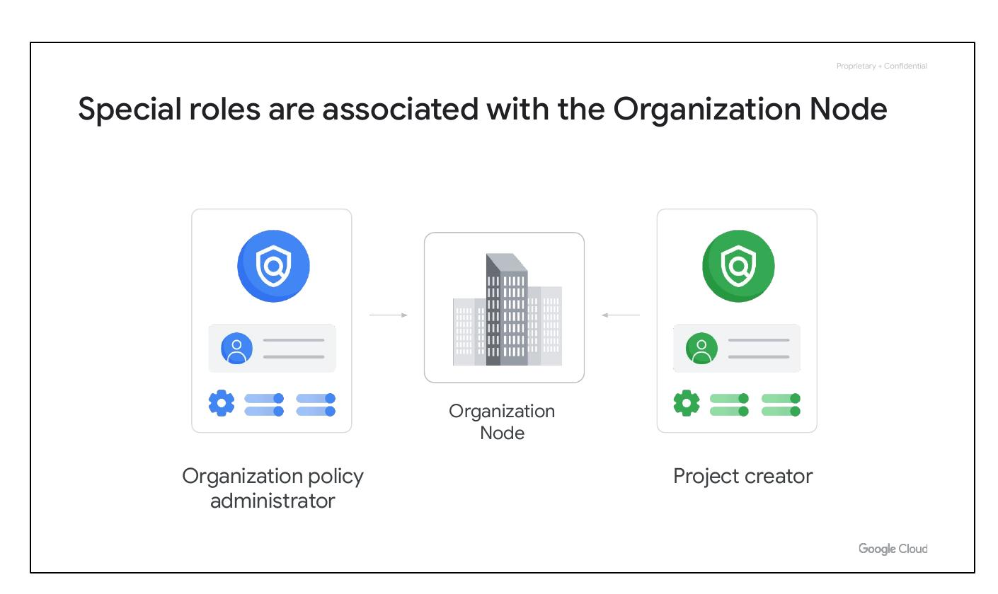
Hierarchy Determines Policies
Resource hierarchy relates to policy
Policies at project, folder, organization
Policies inherited downward
Notes:
The resource hierarchy dictates how policies are managed and applied. Policies can be defined at the project, folder, and organization node levels. Policies are inherited downward, meaning a policy applied to a folder will also apply to all projects within that folder.

Slide 6
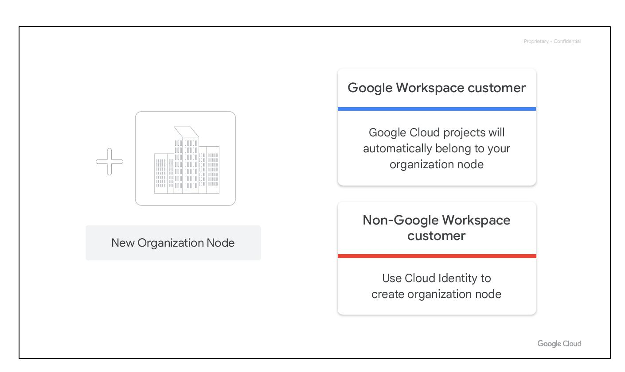
Projects: Cloud Basis
Basis for Cloud services
Different owners/users
Each resource belongs to a project
Projects are billed separately
Notes:
Projects are the foundation for enabling and using Google Cloud services, such as managing APIs, enabling billing, and adding collaborators. Each project is a separate entity, and each resource belongs to exactly one project. Projects can have different owners and users and are billed and managed separately.

Slide 7
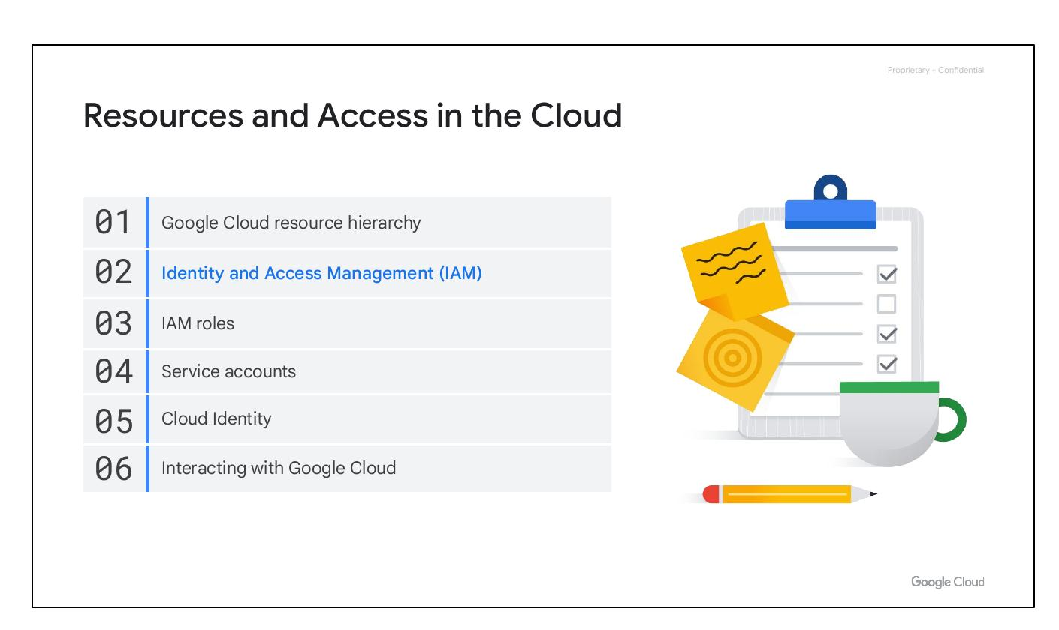
Project Attributes
Project ID: Globally unique, immutable
Project name: Mutable, not unique
Project number: Unique, immutable
Notes:
Each Google Cloud project has three identifying attributes: a project ID, a project name, and a project number. The project ID is a globally unique identifier that cannot be changed after creation. Project names are user-created and can be changed. Google Cloud also assigns each project a unique project number for internal tracking.

Slide 8
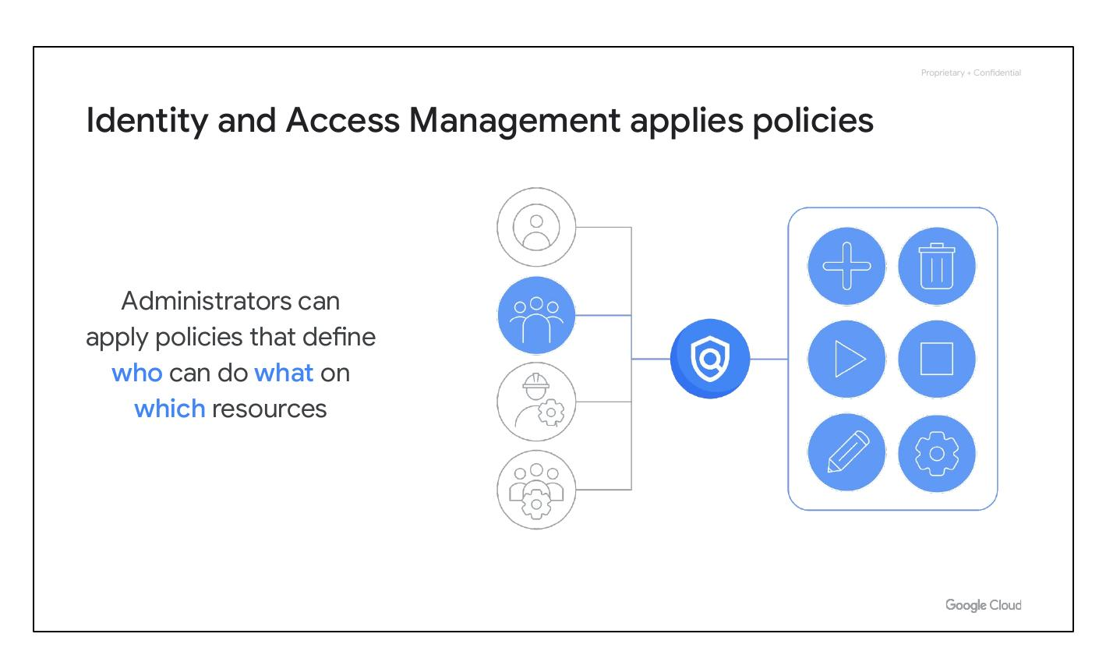
Resource Manager
Manages projects programmatically
Create, update, delete projects
Recover deleted projects
Accessed via RPC and REST APIs
Notes:
The Resource Manager tool is used to programmatically manage projects. It provides an API to list projects, create new projects, update existing projects, and delete projects. It can also recover previously deleted projects and can be accessed through the RPC and REST APIs.

Slide 9
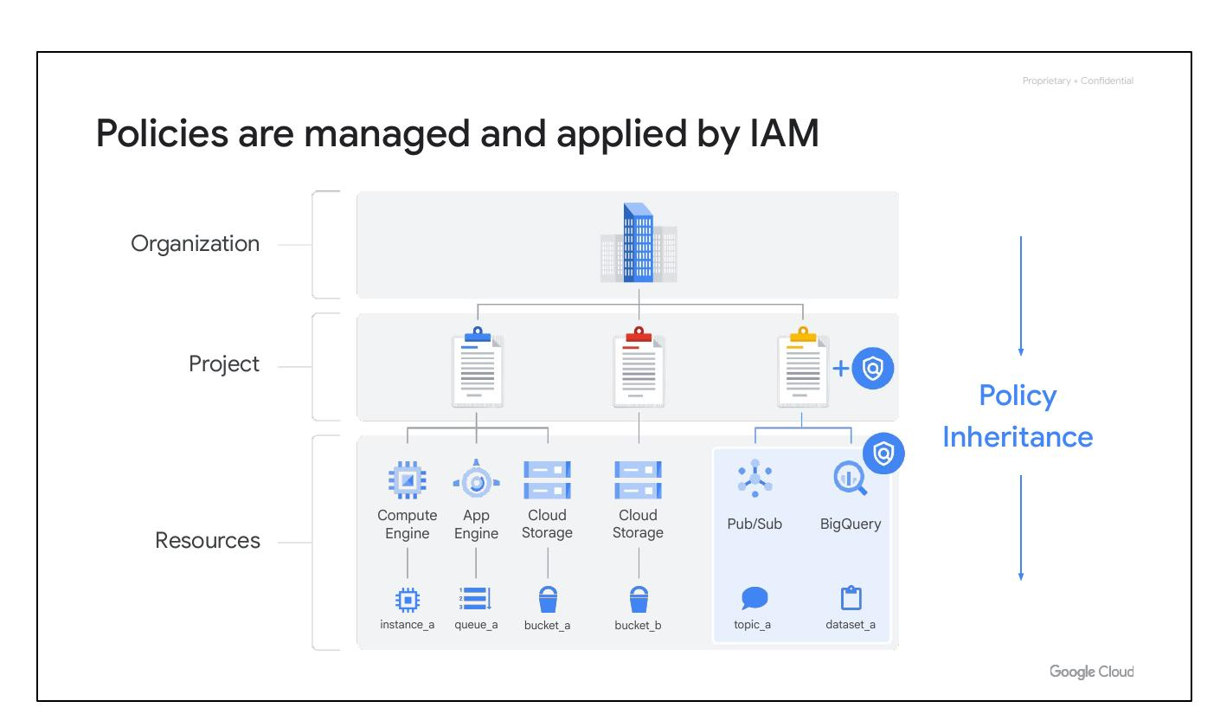
Folders: Granular Policies
Folders contain projects and subfolders
Inherit policies/permissions
Assign policies at granular level
Notes:
Folders allow for assigning policies to resources at a chosen level of granularity. Projects and subfolders within a folder inherit policies and permissions assigned to that folder. A folder can contain projects, other folders, or a combination of both.

Slide 10
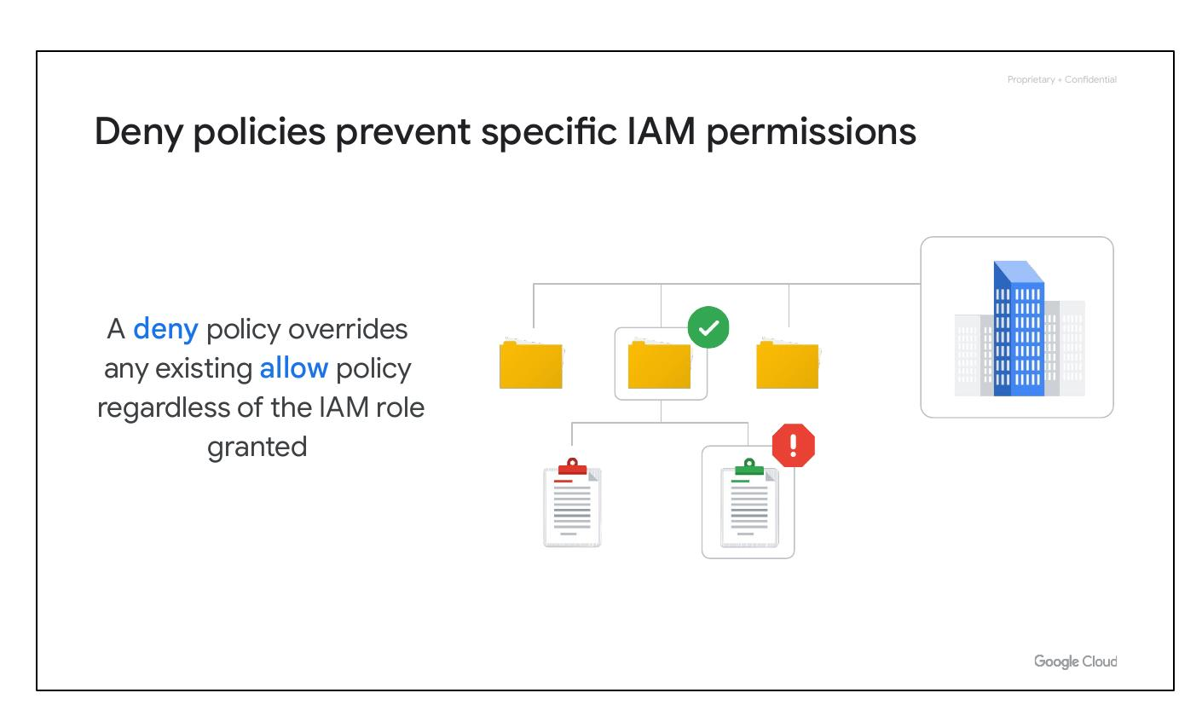
Folders Group Projects
Group projects under hierarchy
Group resources per-department
Delegate administrative rights
Notes:
Folders allow for grouping projects under an organization in a hierarchy. They can be used to group resources on a per-department basis. Folders enable teams to delegate administrative rights, allowing them to work independently.

Slide 11
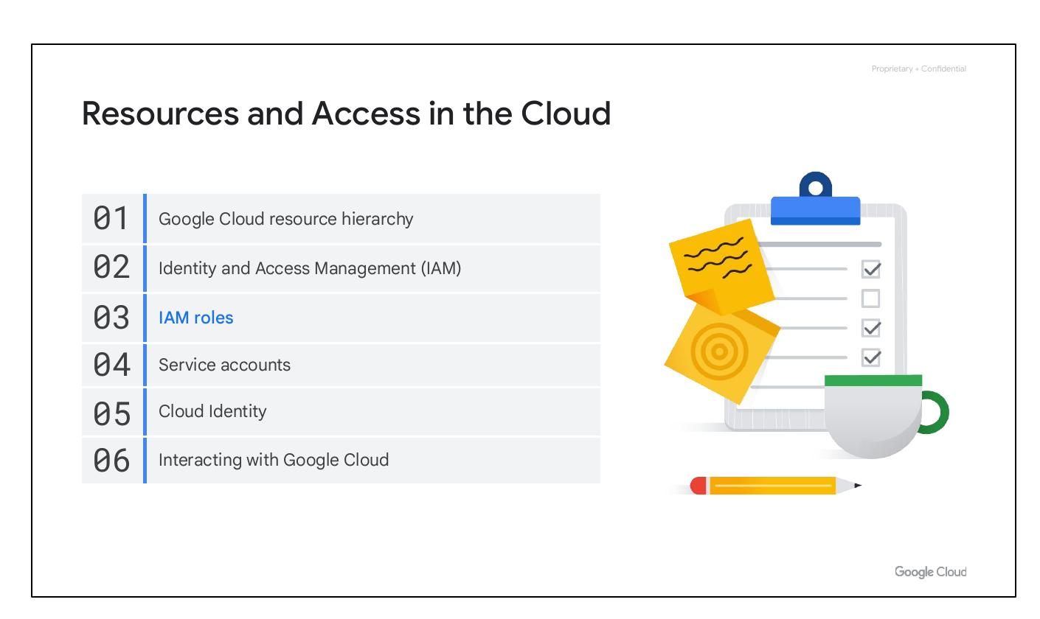
Policy Inheritance
Resources inherit folder policies
Common policies in shared folder
Avoid policy duplication errors
Notes:
Resources in a folder inherit policies and permissions from that folder. Storing common policies in a shared folder ensures consistency and reduces errors compared to duplicating policies across multiple projects.

Slide 12

Organization Node
Topmost resource in hierarchy
Everything attached to account
Notes:
The organization node is the topmost resource in the Google Cloud hierarchy. Everything attached to the account, including projects, folders, and other resources, falls under this node.

Slide 13
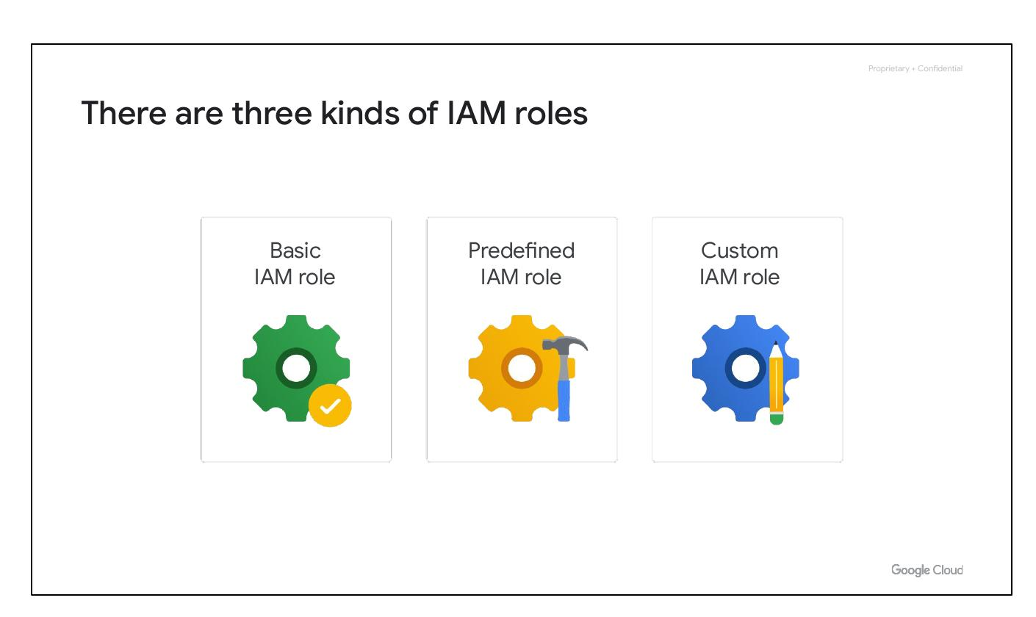
Special Roles
Organization policy administrator
Project creator role
Notes:
There are special roles associated with the organization node. These roles include the organization policy administrator, who can change policies, and the project creator role, which controls who can create projects.

Slide 14
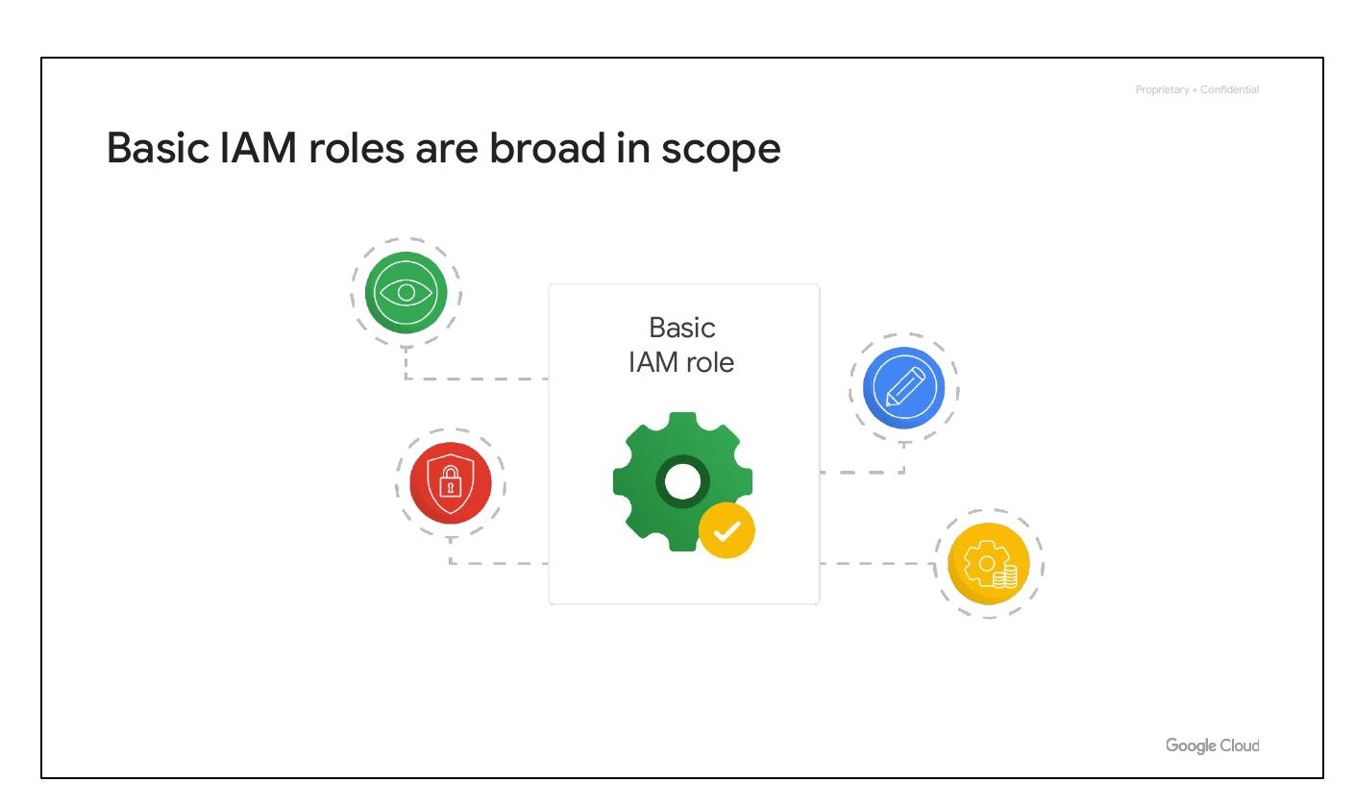
New Organization Node
Workspace customers: auto belong
Non-Workspace: use Cloud Identity
Create folders and projects after
Notes:
Creating an organization node depends on whether the company is a Google Workspace customer. Workspace customers automatically have their Google Cloud projects belong to their organization node. Non-Workspace customers can use Cloud Identity to create one. After creating an organization node, you can create folders and put projects into it.

Slide 15
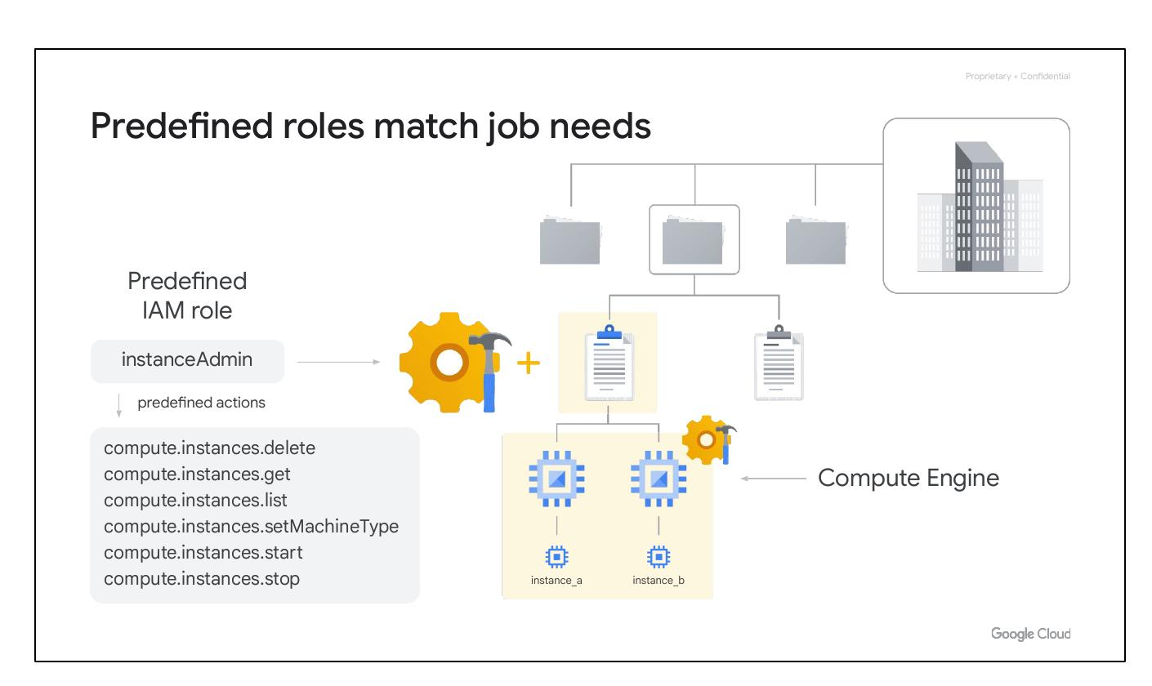
Identity & Access Management
Google Cloud Resource Hierarchy
IAM for access management
IAM roles and service accounts
Cloud Identity
Notes:
This slide highlights Identity and Access Management (IAM) as a key component of Google Cloud. IAM is used for access management, assigning roles, managing service accounts, and leveraging Cloud Identity for centralized user management.

Slide 16
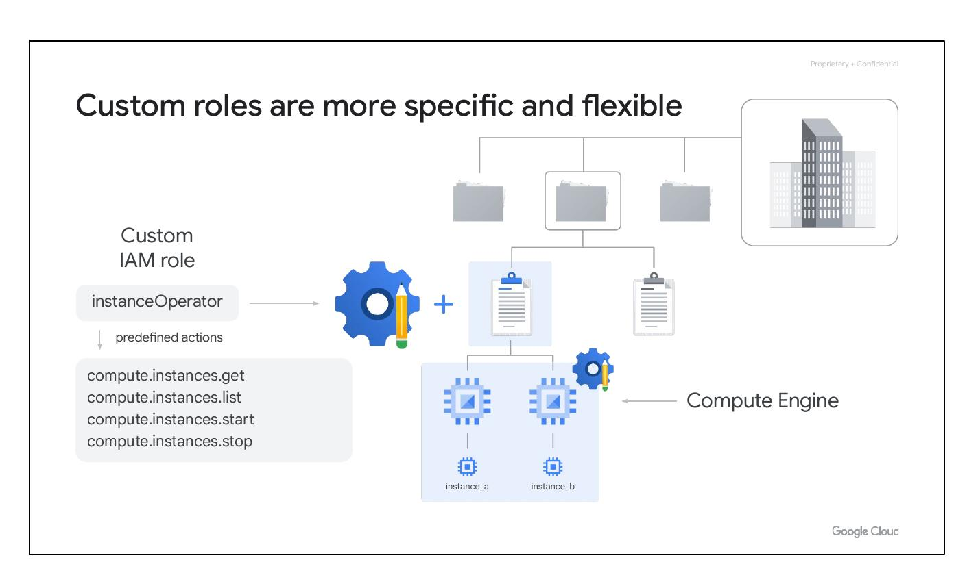
IAM Applies Policies
Administrators define policies
Policies determine access
Principal (who) + Role (can do what)
Notes:
IAM enables administrators to apply policies that define who can do what on which resources. The 'who' is a principal, such as a Google account or service account, and the 'can do what' is defined by an IAM role, which is a collection of permissions.

Slide 17
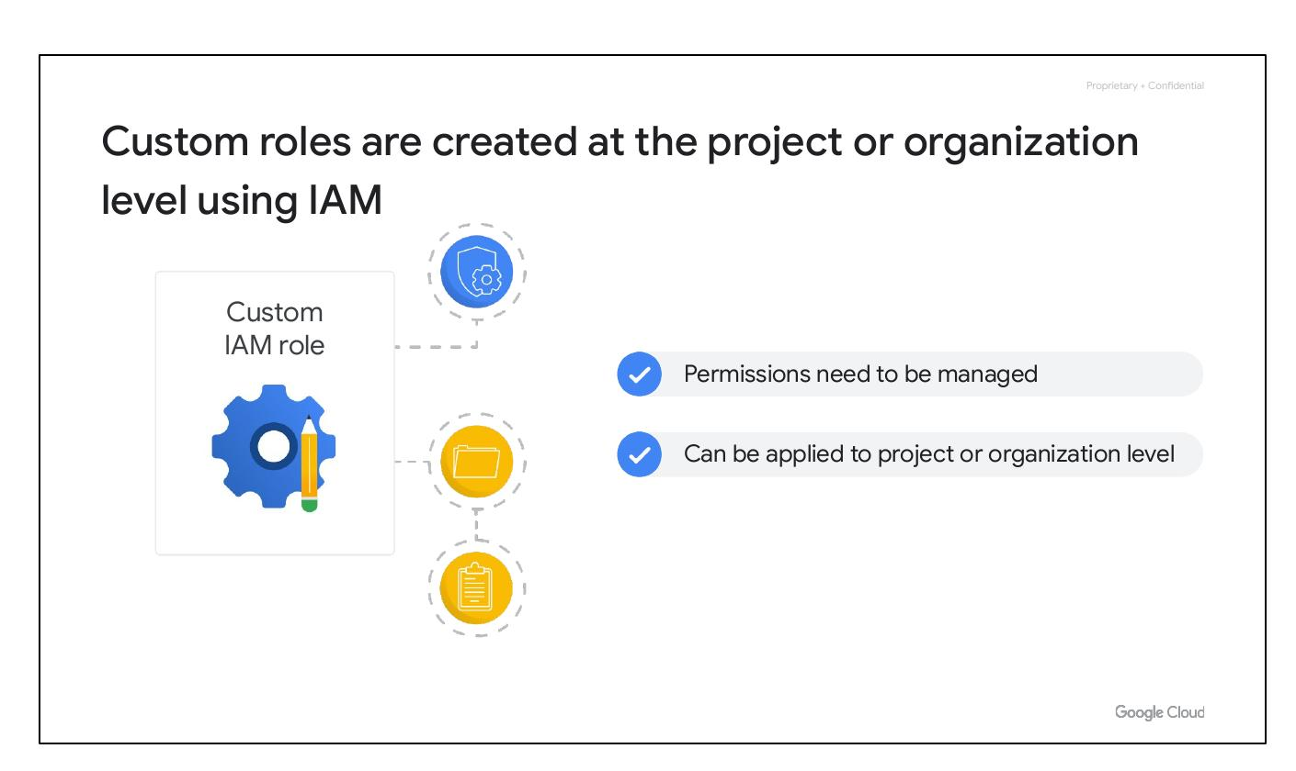
Policy Inheritance
Policies managed and applied by IAM
Policies apply to chosen element
Applied to all elements below in hierarchy
Notes:
When a principal is given a role on a specific element of the resource hierarchy, the resulting policy applies to the chosen element and all elements below it in the hierarchy. This ensures consistent access control across resources.

Slide 18

Deny Policies
Prevent specific IAM permissions
Overrides existing allow policies
Inherited through resource hierarchy
Notes:
Deny policies prevent certain principals from using specific permissions, regardless of the roles they're granted. IAM always checks relevant deny policies before allow policies. Deny policies, like allow policies, are inherited through the resource hierarchy.

Slide 19
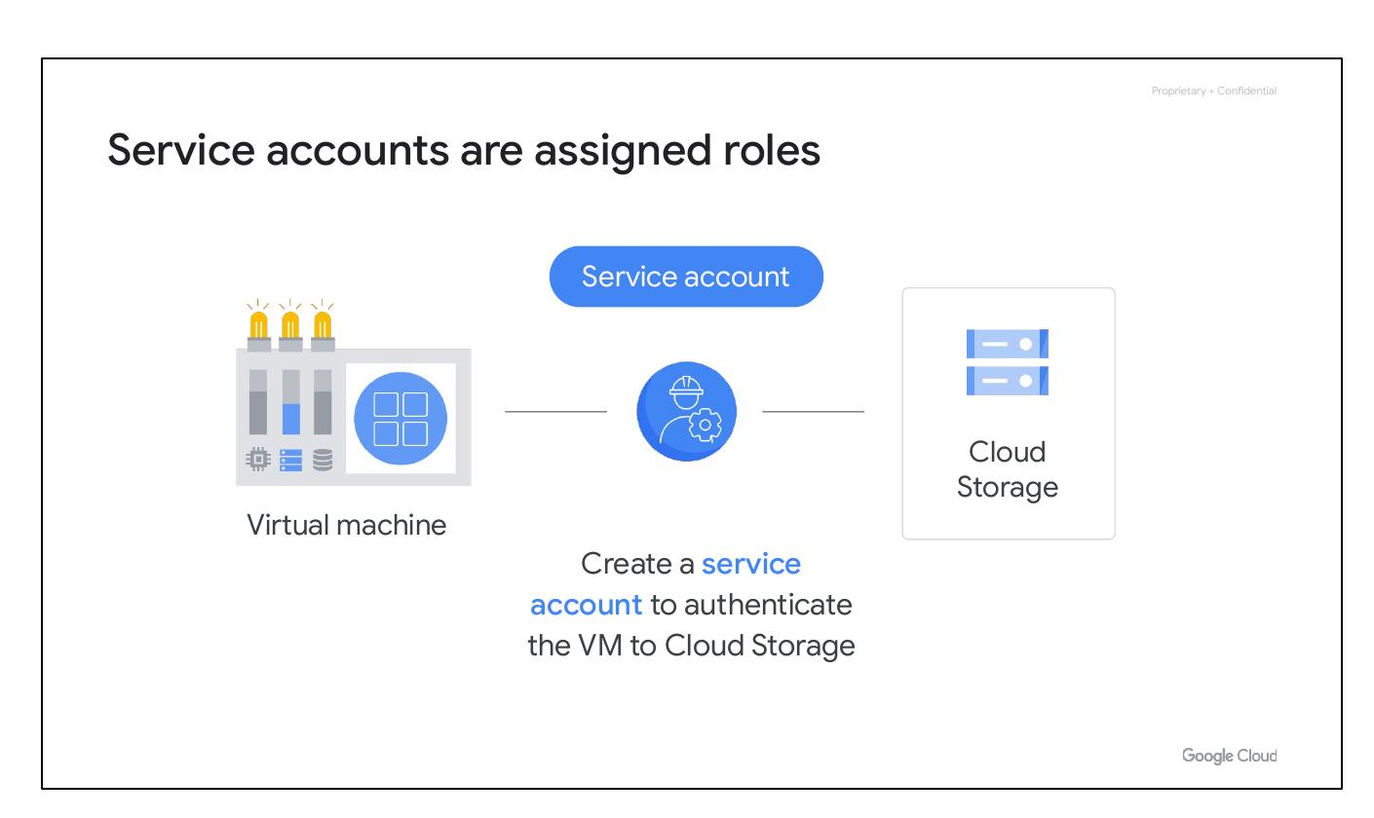
IAM Roles
Google Cloud Resource Hierarchy
Identity and Access Management (IAM)
IAM roles, Service accounts
Cloud Identity
Notes:
This slide serves as a transition to discussing the different types of IAM roles available in Google Cloud. It reinforces the context of the resource hierarchy and the role of IAM in access management.

Slide 20
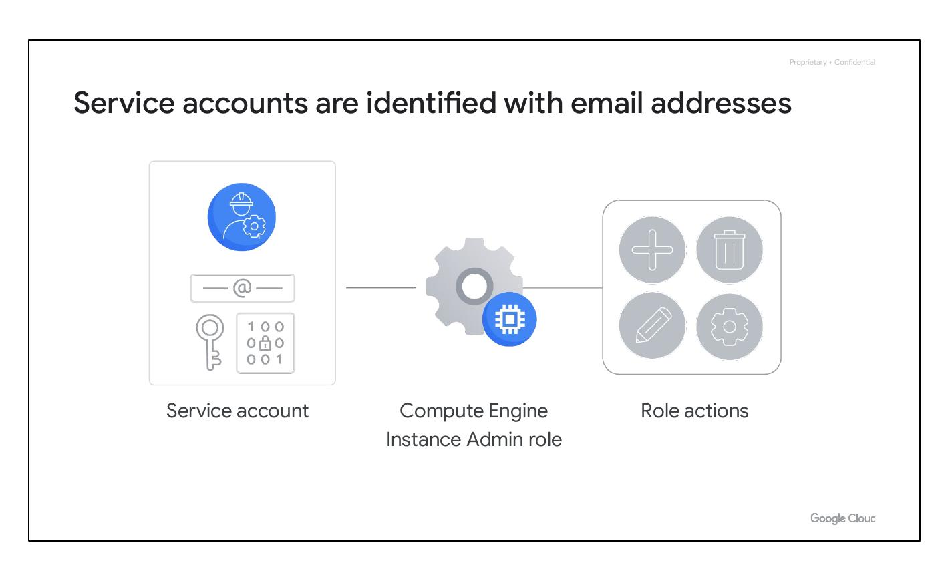
Three Kinds of Roles
Basic IAM Role
Predefined IAM Role
Custom IAM Role
Notes:
There are three types of roles in IAM: Basic, Predefined, and Custom. Each role type offers a different level of granularity and control over permissions.

Slide 21
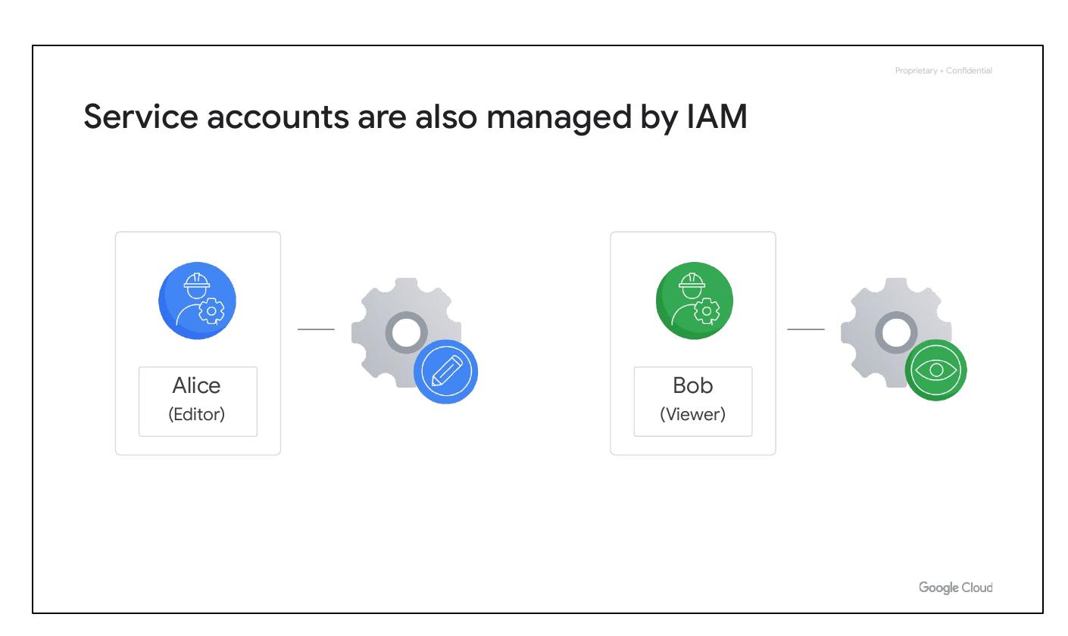
Basic IAM Roles
Broad in scope
Affect all resources in project
Include: Owner, Editor, Viewer, Billing Admin
Notes:
Basic roles are broad in scope and affect all resources within a Google Cloud project. These roles include Project Viewer, Project Editor, Project Owner, and Billing Administrator. Basic roles are often too broad for projects containing sensitive data.

Slide 22

Predefined Roles
Match job needs
Offered by Google Cloud services
Specific actions for Compute Engine
Notes:
Predefined roles are offered by specific Google Cloud services and define where those roles can be applied. For example, Compute Engine offers predefined roles like 'instanceAdmin' that allows users to perform specific actions on Compute Engine resources.

Slide 23

Custom Roles
More specific, flexible permissions
Least-privilege model
Define an instanceOperator role
Notes:
Custom roles provide even more specific permissions. Many companies use a “least-privilege” model, where each person is given the minimal amount of privilege needed to do their job. Custom roles enable defining roles with granular control over permissions.

Slide 24
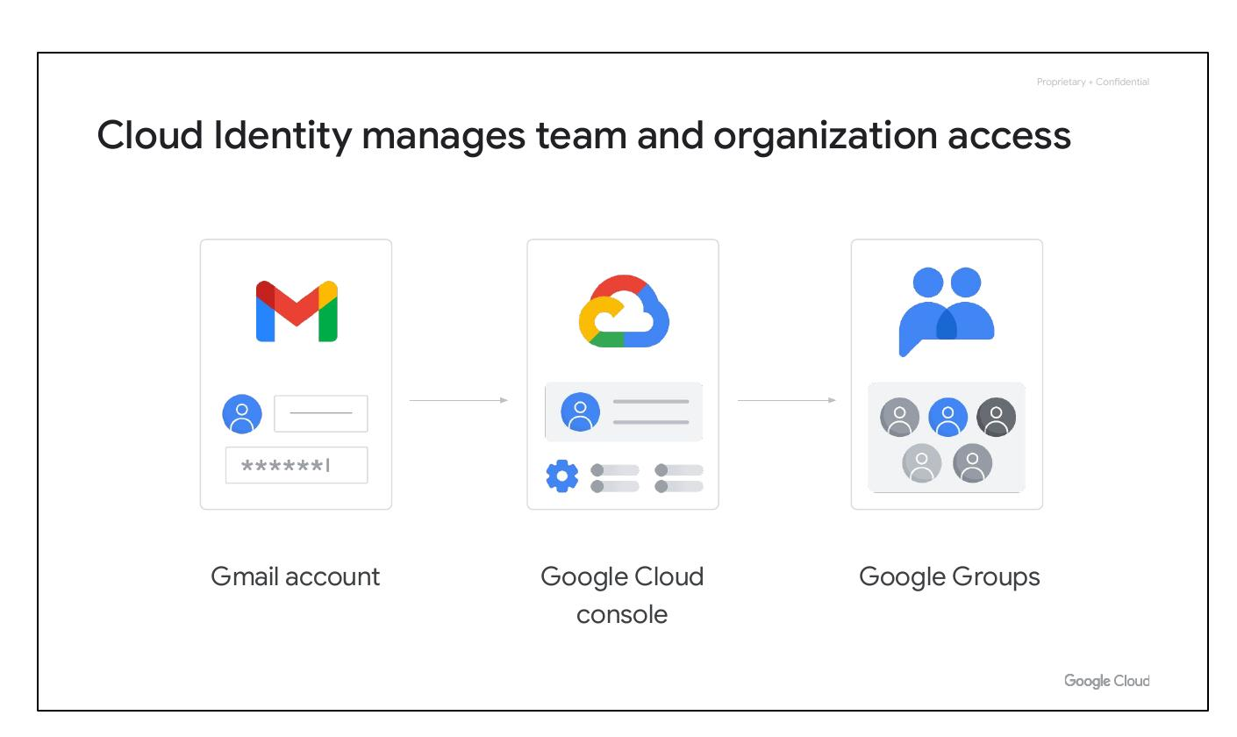
Custom Roles Management
Created at project or organization level
Permissions need to be managed
An organization-level role
A project-level custom role
Notes:
Custom roles can be created at the project or organization level but not at the folder level. Organization-level roles can include any supported IAM permission. Project-level roles can include any supported permission except those only usable at the organization or folder level.

Slide 25
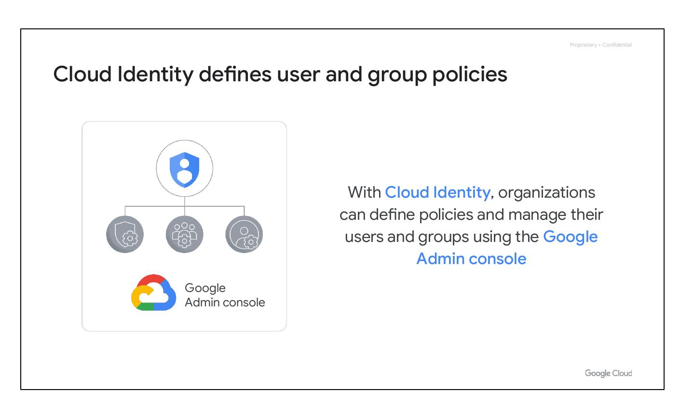
Service Accounts
Google Cloud Resource Hierarchy
Identity and Access Management (IAM)
IAM roles, Service accounts
Cloud Identity
Notes:
Transition slide to introducing service accounts. It places service accounts within the context of the broader Google Cloud Resource Hierarchy and its security features.

Slide 26
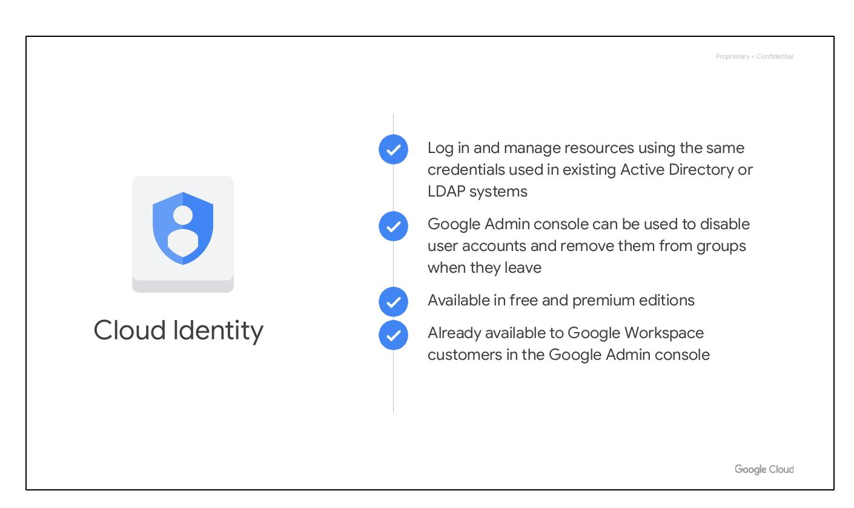
Service Accounts
Assign permissions to VMs
Interact without human intervention
VMs access other cloud services
Notes:
Service accounts allow assigning specific permissions to a virtual machine, enabling it to interact with other cloud services without human intervention. This eliminates the need for manual granting of access for each program run.

Slide 27

Service Account Example
Authenticate VM to Cloud Storage
Create a service account
Prevent Internet Access
Notes:
This example demonstrates creating a service account to authenticate a VM to Cloud Storage. This prevents unauthorized internet access to the data, ensuring only the specific virtual machine can access it.

Slide 28
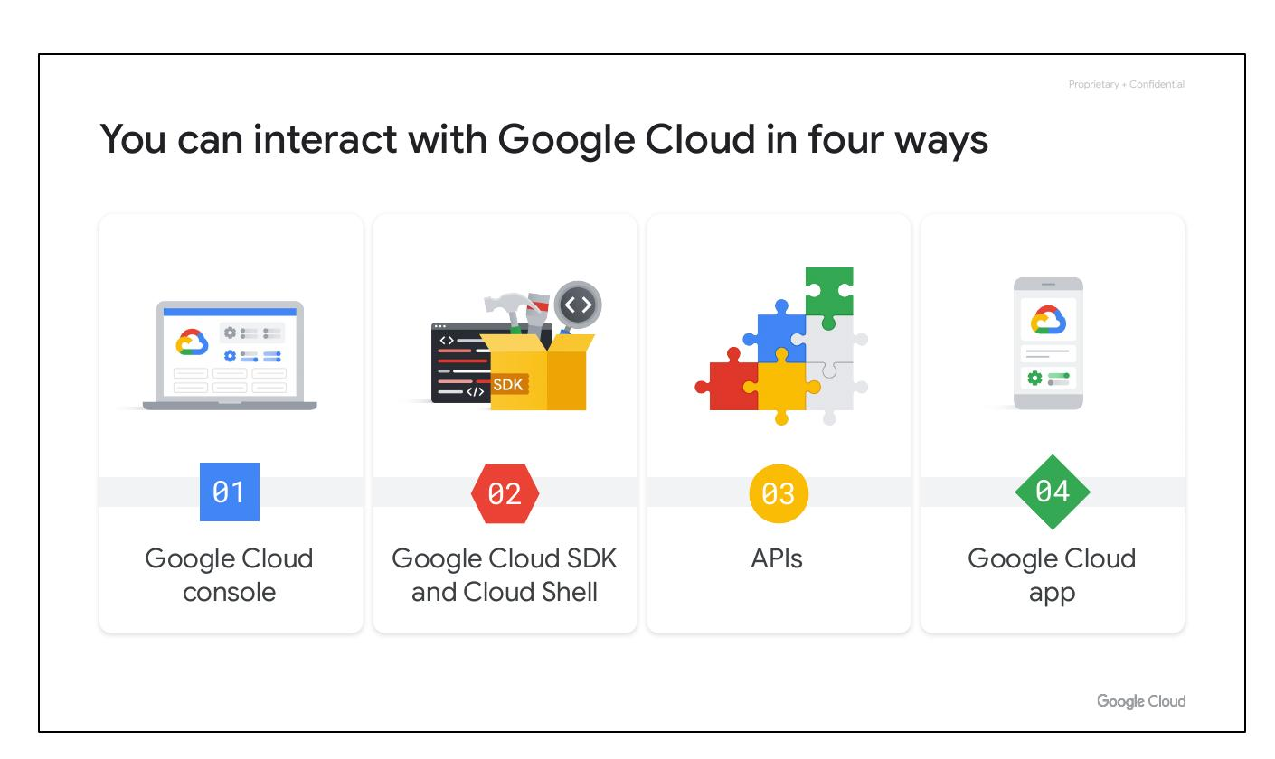
Service Account Details
Identified with email address
Use cryptographic keys
Granted Compute Engine's Instance Admin role
Notes:
Service accounts are named with an email address but use cryptographic keys instead of passwords to access resources. Granting a service account Compute Engine’s Instance Admin role allows an application running in a VM to create, modify, and delete other VMs.

Slide 29
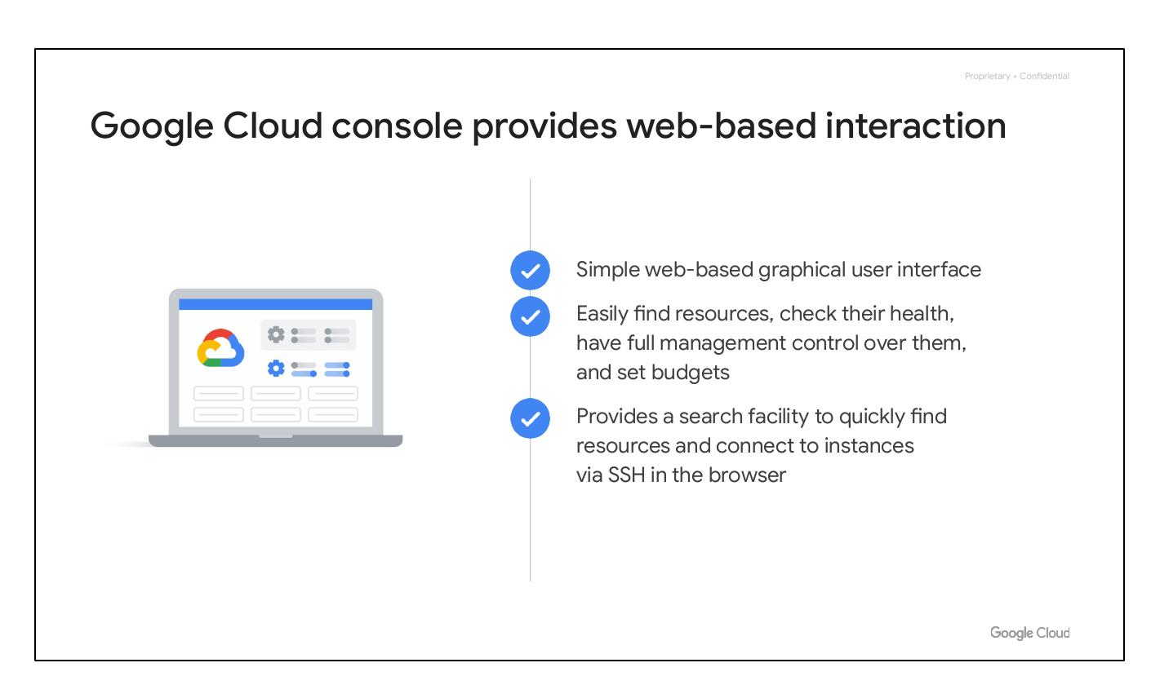
Service Accounts Managed
Service accounts managed by IAM
Alice manages Google accounts
Bob views list of service accounts
Notes:
Service accounts need to be managed like any other resource. IAM policies can be attached to service accounts, allowing administrators to control who can act as service accounts. For example, Alice can manage which accounts can act as service accounts, while Bob can only view the list.

Slide 30
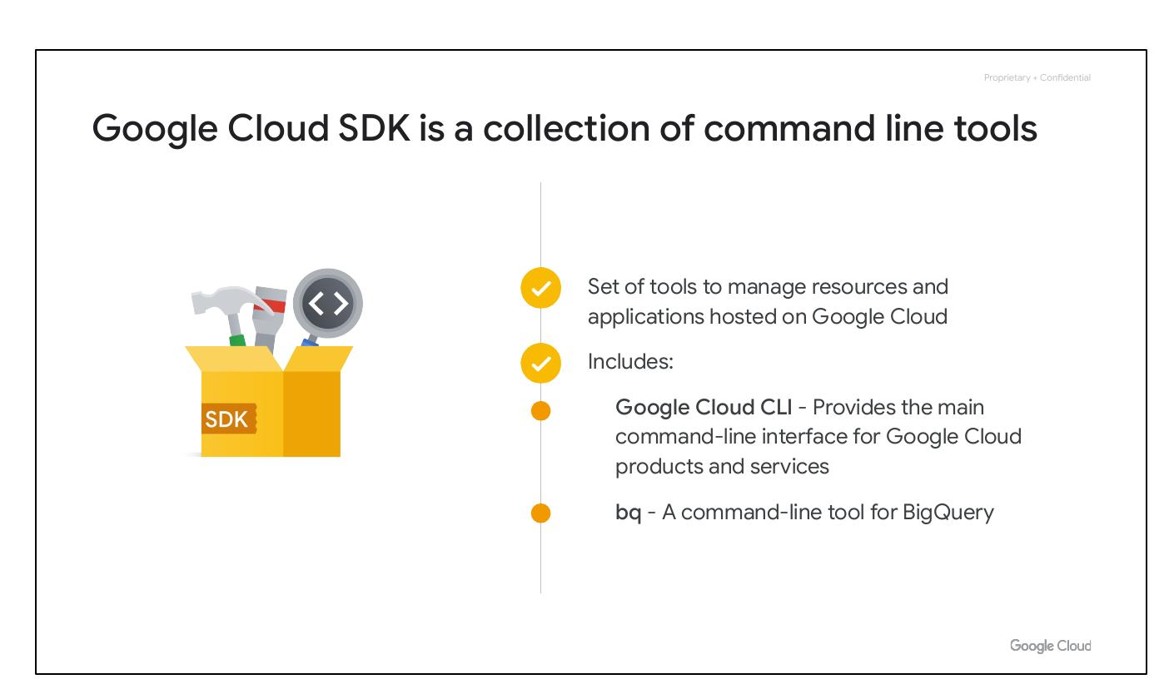
Cloud Identity
Google Cloud Resource Hierarchy
Identity and Access Management (IAM)
IAM roles, Service accounts
Cloud Identity
Notes:
This slide serves as a transition to discussing Cloud Identity, highlighting its relevance within the broader context of Google Cloud's resource hierarchy and access management features.

Slide 31
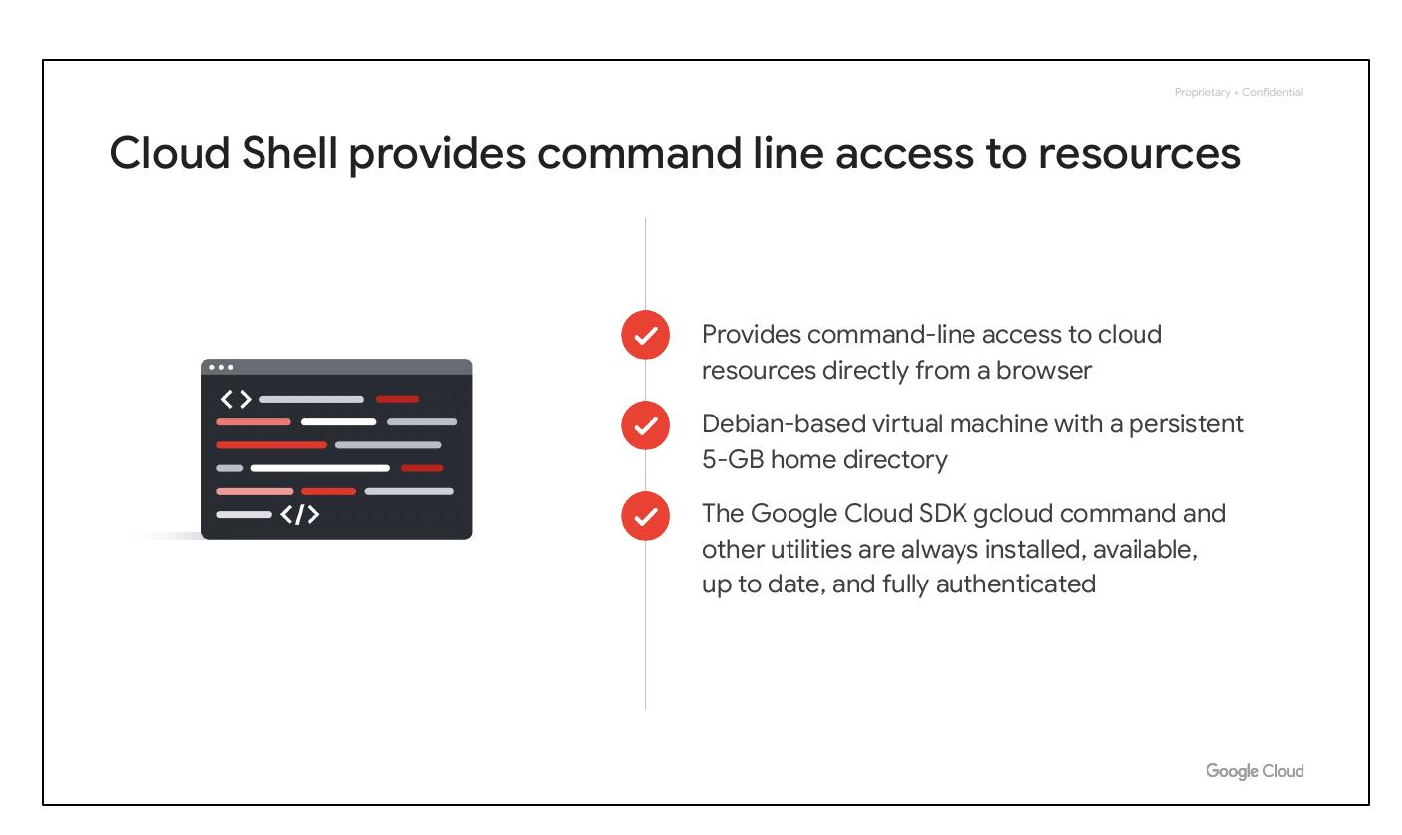
Cloud Identity Overview
Manage team and organization access
Common to log in with Gmail
Centralized identity management
Notes:
Cloud Identity manages team and organization access. It addresses challenges with using Gmail accounts and Google Groups for collaboration, which lack centralized identity management and make it difficult to remove access when someone leaves.

Slide 32
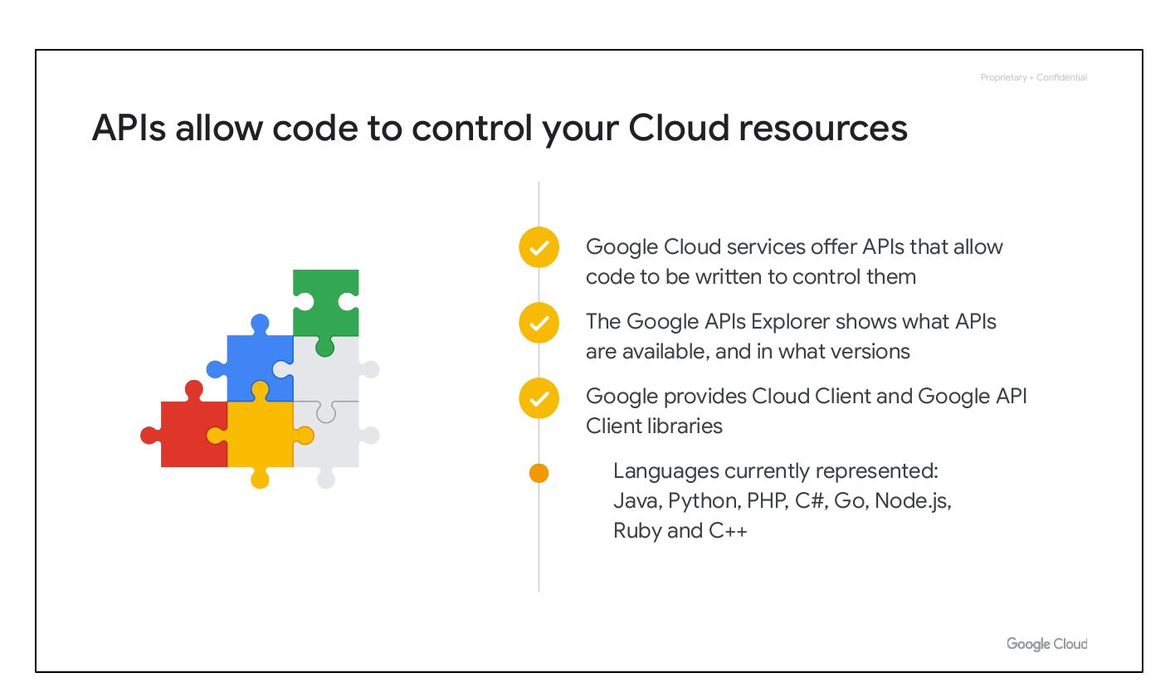
Cloud Identity Policies
Define user and group policies
Manage users in Google Admin console
Notes:
Cloud Identity enables organizations to define policies and manage users and groups using the Google Admin console, providing a centralized way to control access to cloud resources.

Slide 33
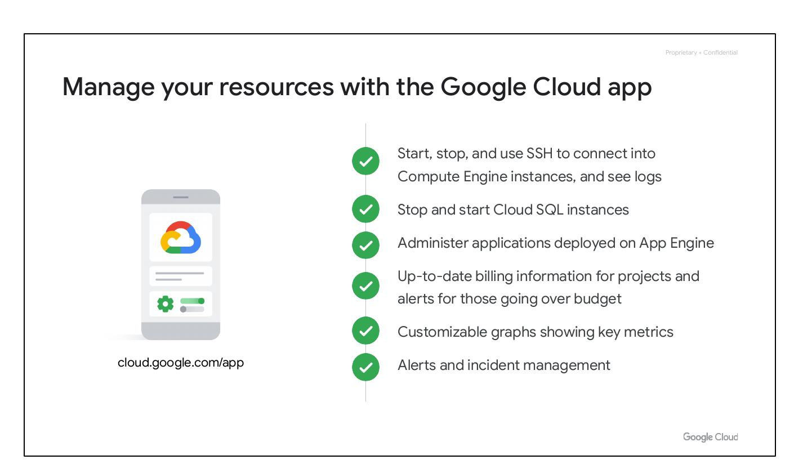
Cloud Identity Benefits
Integrate existing systems
Disable/remove users easily
Available in free and premium editions
Notes:
Cloud Identity allows admins to log in and manage resources using existing Active Directory or LDAP credentials. Admins can also use the Google Admin console to disable user accounts and remove them from groups when they leave the organization. Cloud Identity is available in free and premium editions.

Slide 34
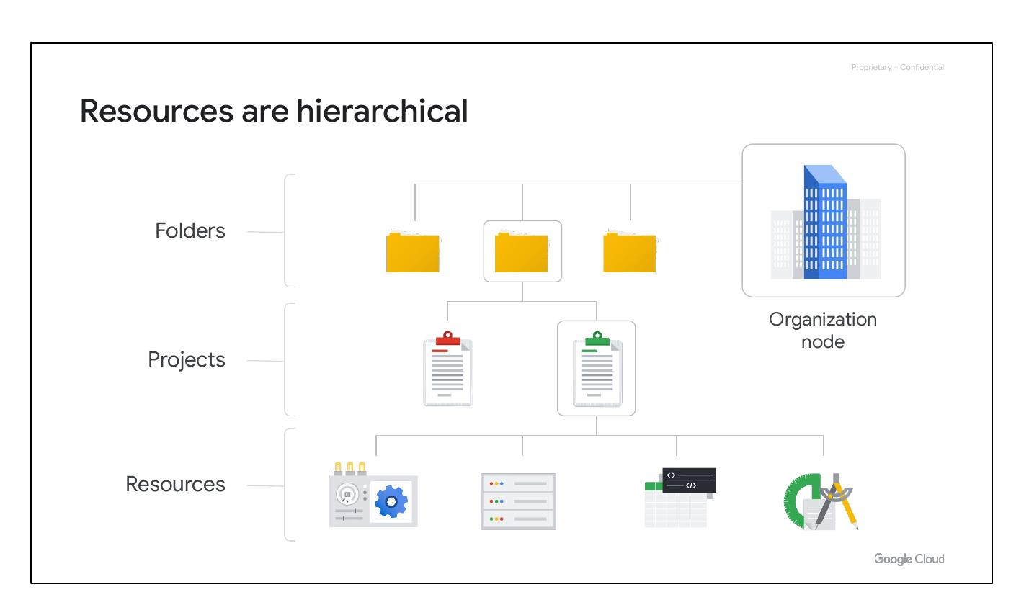
Interact with Cloud
Google Cloud Resource Hierarchy
Identity and Access Management (IAM)
IAM roles, Service accounts
Cloud Identity
Notes:
This slide serves as a transition to discussing the different ways to interact with Google Cloud, highlighting the integration of these interaction methods with the resource hierarchy and security features.

Slide 35
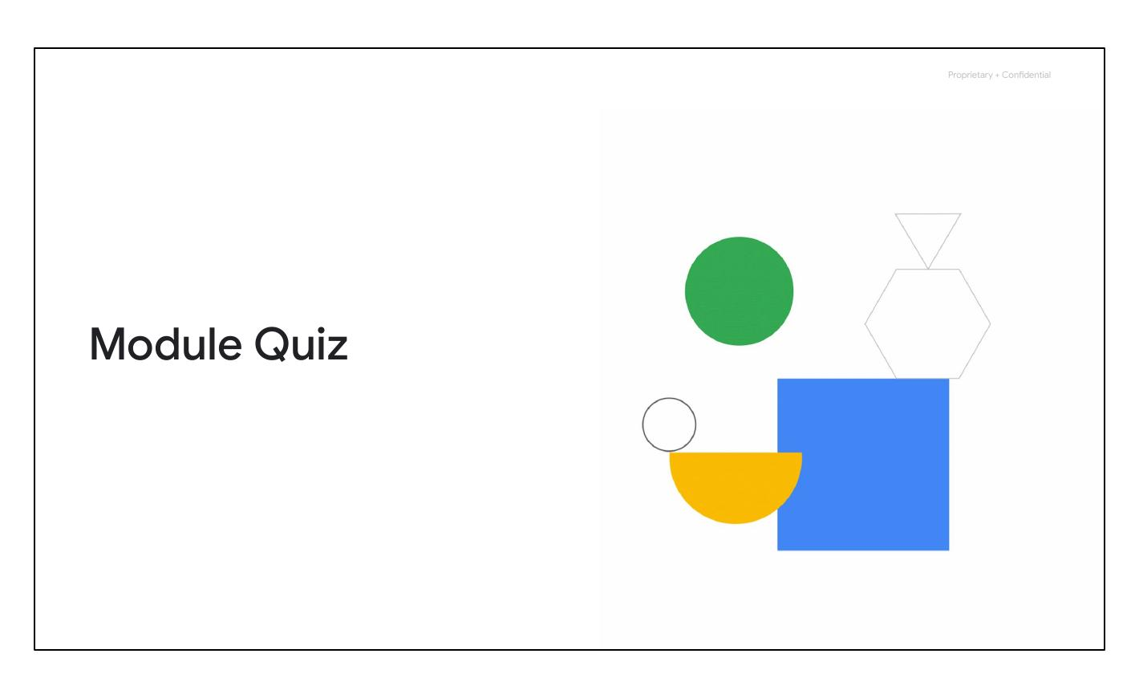
Four Access Methods
Google Cloud Console
Google Cloud SDK
APIs
Google Cloud App
Notes:
This slide outlines the four primary ways to access and interact with Google Cloud: the Google Cloud Console, the Google Cloud SDK and Cloud Shell, APIs, and the Google Cloud app.

Slide 36
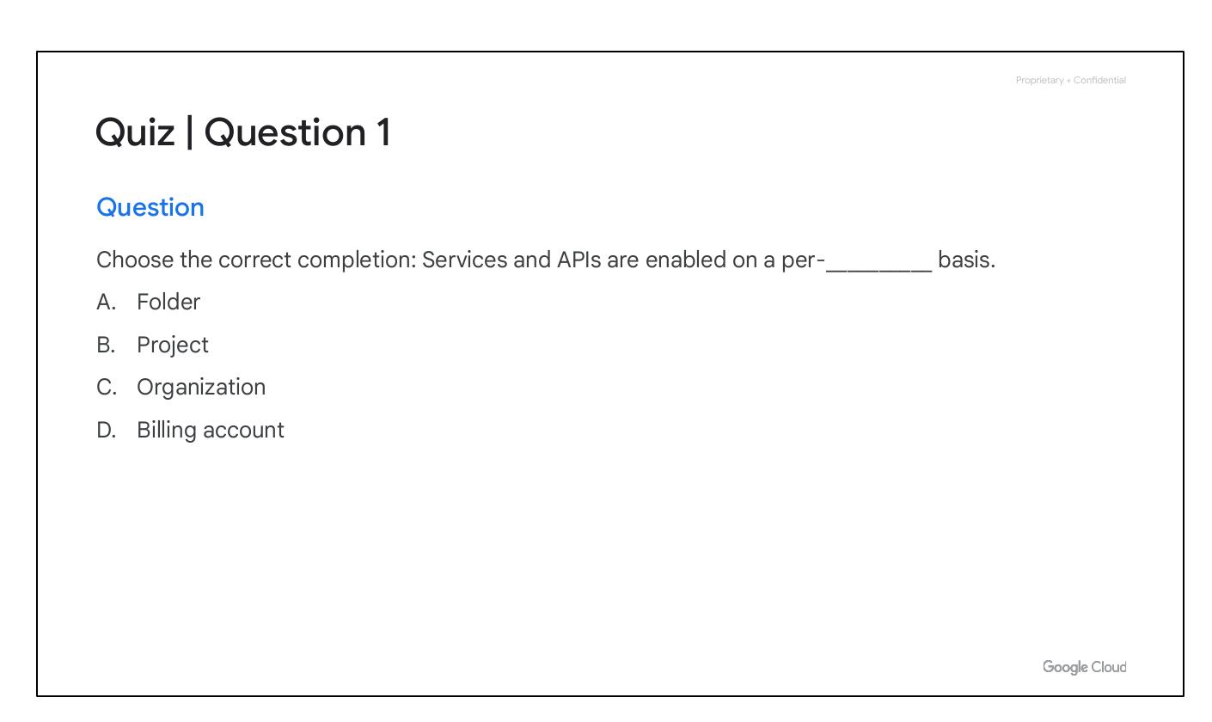
Cloud Console
Web-based interaction
Find resources, check health
Management control, set budgets
Find and connect via SSH
Notes:
The Google Cloud Console provides a simple web-based GUI to deploy, scale, and diagnose production issues. It allows users to easily find resources, check their health, manage them, and set budgets. It also offers a search facility and SSH access in the browser.

Slide 37
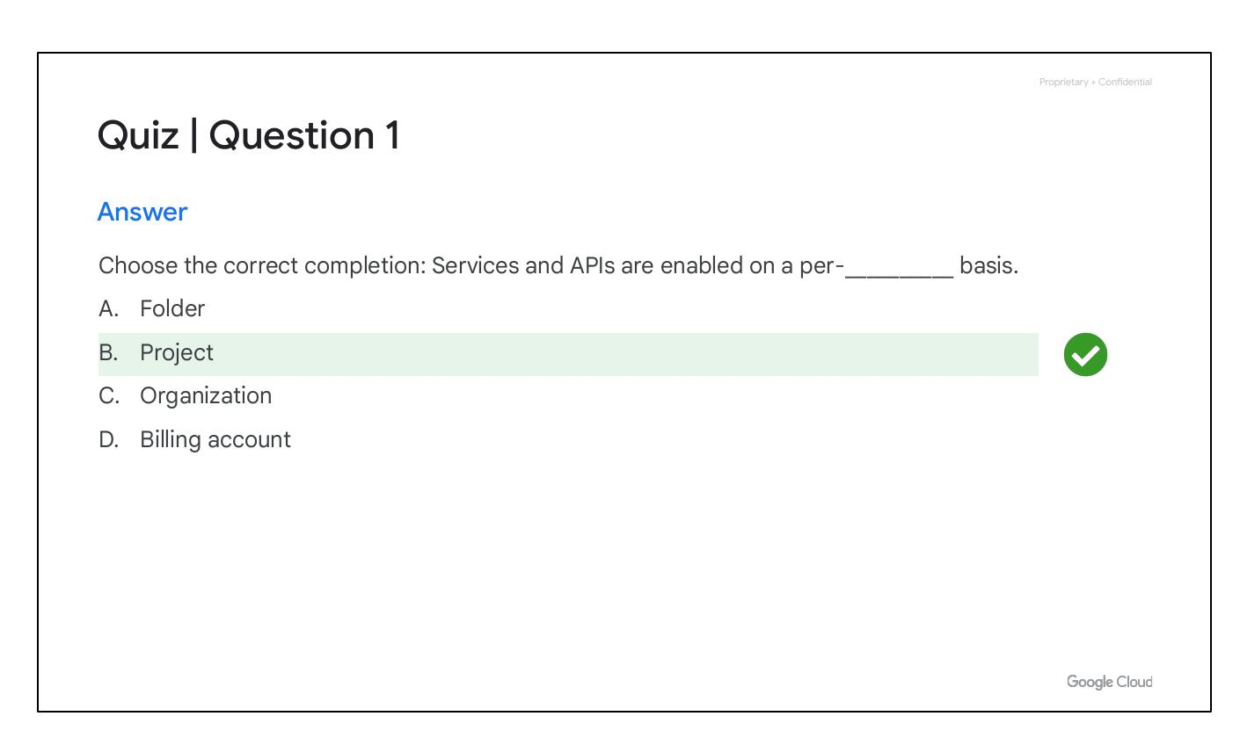
Cloud SDK
Command-line tools
Manage hosted resources
Includes gcloud CLI and bq
Notes:
The Google Cloud SDK is a set of tools to manage resources and applications hosted on Google Cloud. It includes the gcloud CLI for Google Cloud products and services and bq, a command-line tool for BigQuery.

Slide 38
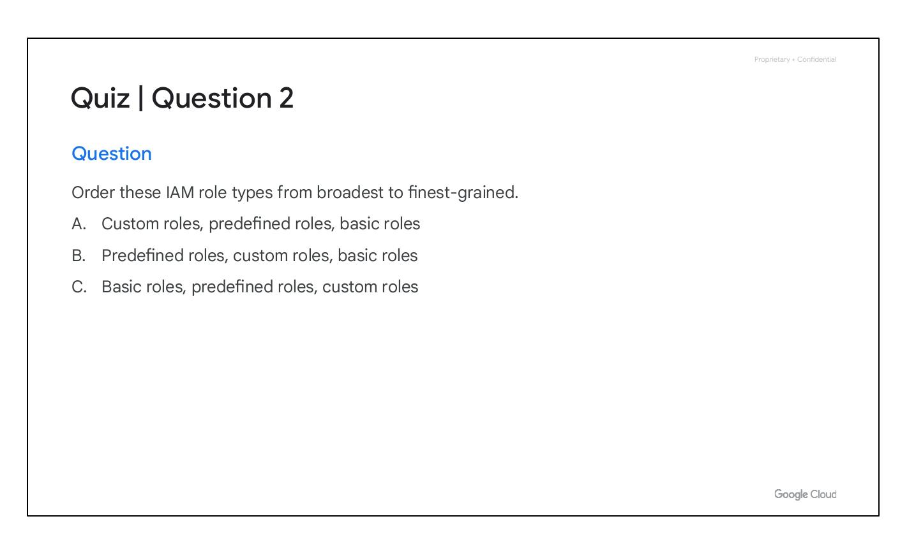
Cloud Shell
Browser-based command line access
Debian-based VM
Persistent 5-GB home directory
SDK always installed/updated
Notes:
Cloud Shell provides command-line access to cloud resources directly from a browser. It's a Debian-based virtual machine with a persistent 5-GB home directory. The Google Cloud SDK gcloud command and other utilities are always installed, available, up to date, and fully authenticated.

Slide 39
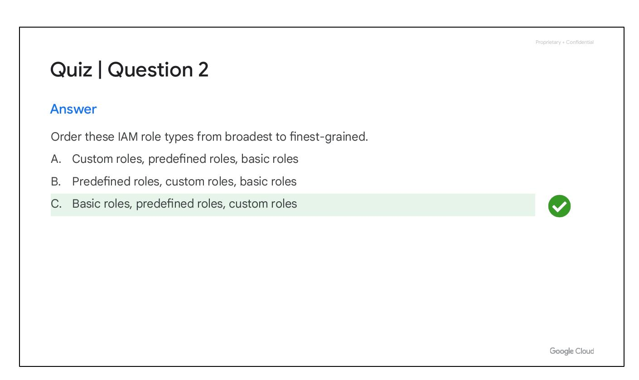
Google Cloud APIs
APIs allow code control
Google APIs Explorer
Cloud Client & Google API Client libraries
Multiple languages
Notes:
Google Cloud services offer APIs to allow code to control them. The Google APIs Explorer shows available APIs and versions. Google provides Cloud Client and Google API Client libraries in various languages to simplify calling Google Cloud from code.

Slide 40
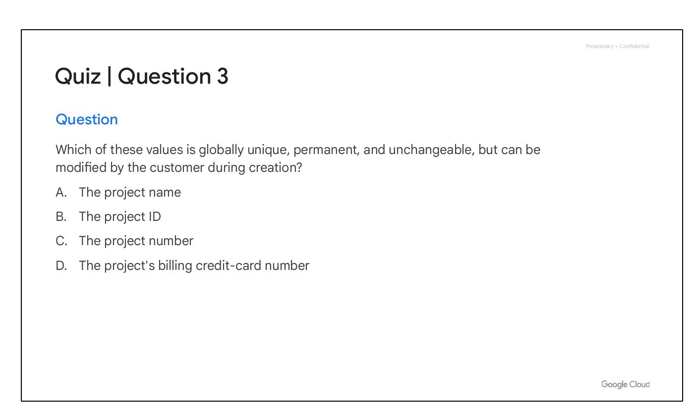
Google Cloud App
Manage resources
Billing information & alerts
Customizable graphs
Alerts and incident management
Notes:
The Google Cloud app allows starting, stopping, and using SSH to connect to Compute Engine instances, viewing logs, stopping and starting Cloud SQL instances, and administering App Engine applications. It also provides billing information, customizable graphs, and alerts for incident management.

Slide 41
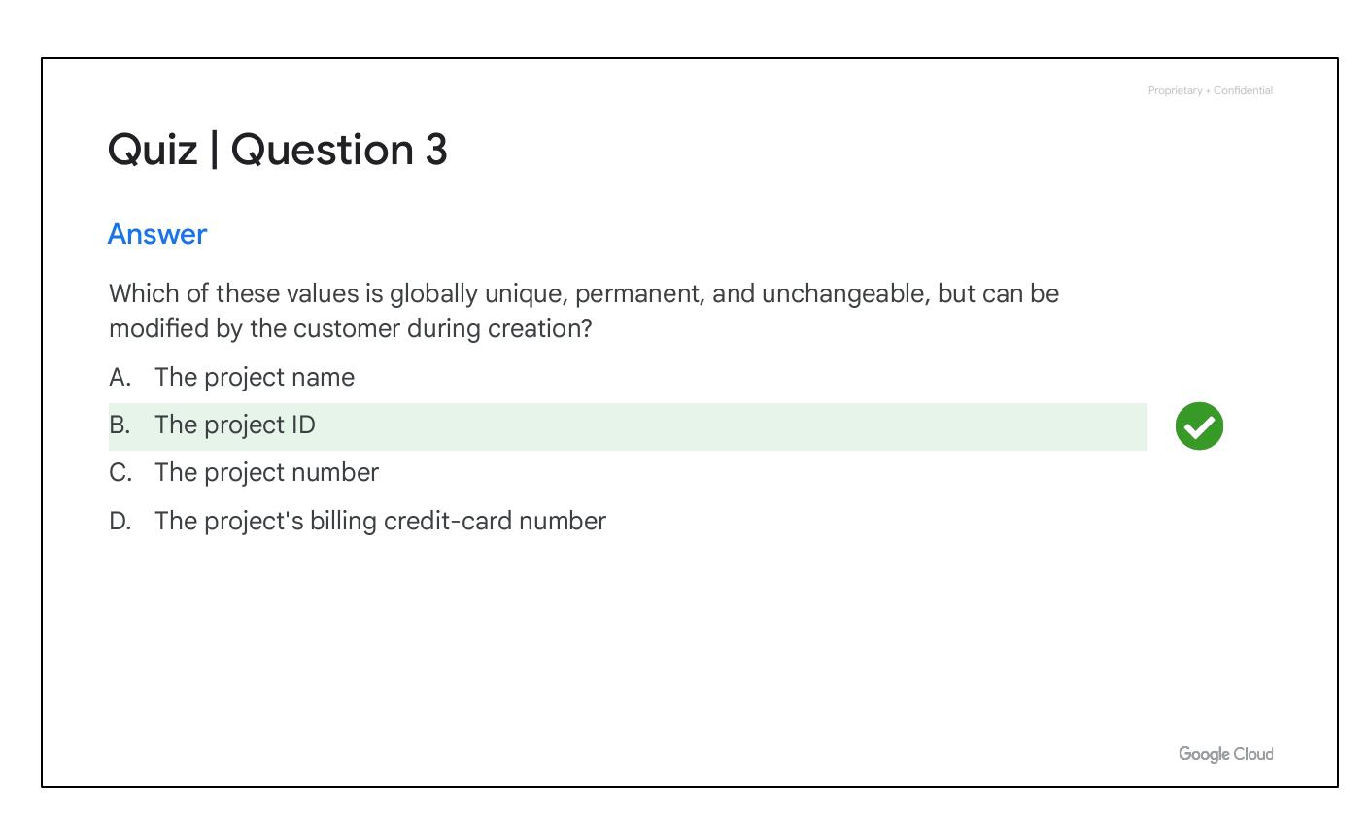
Module Quiz
Notes:
This is a transition slide indicating the start of a quiz to test the audience's understanding of the module's content.

Slide 42
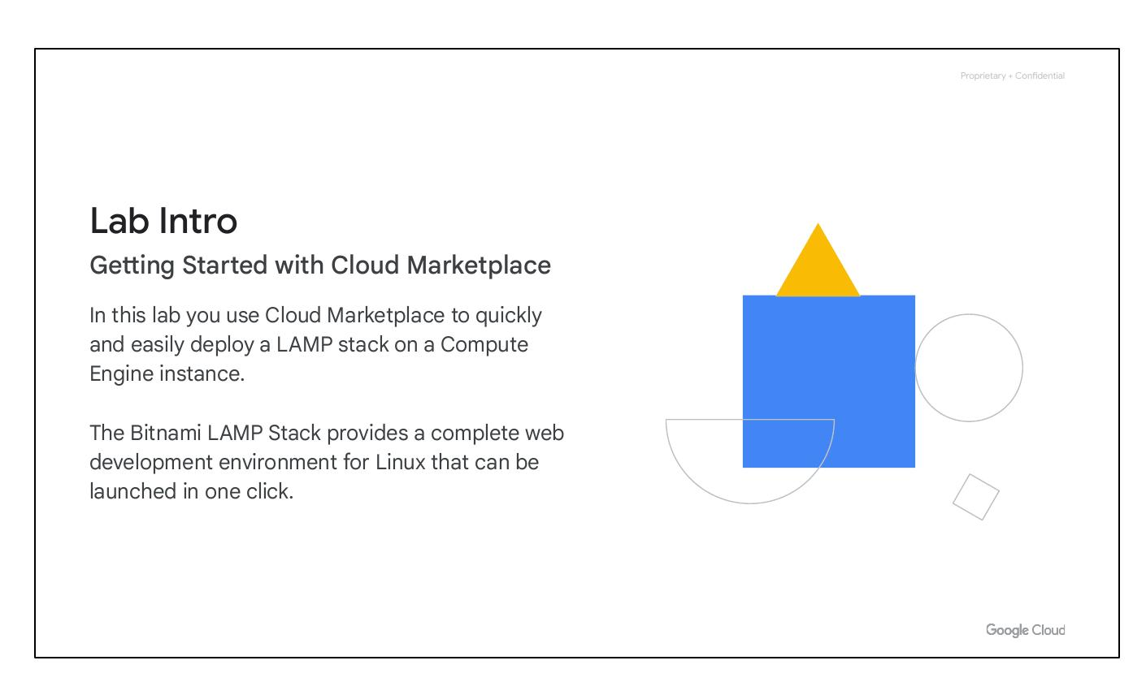
Quiz Question 1
Notes:
This slide presents the first quiz question to the audience, prompting them to choose the correct completion: Services and APIs are enabled on a per-__________ basis.

Slide 43
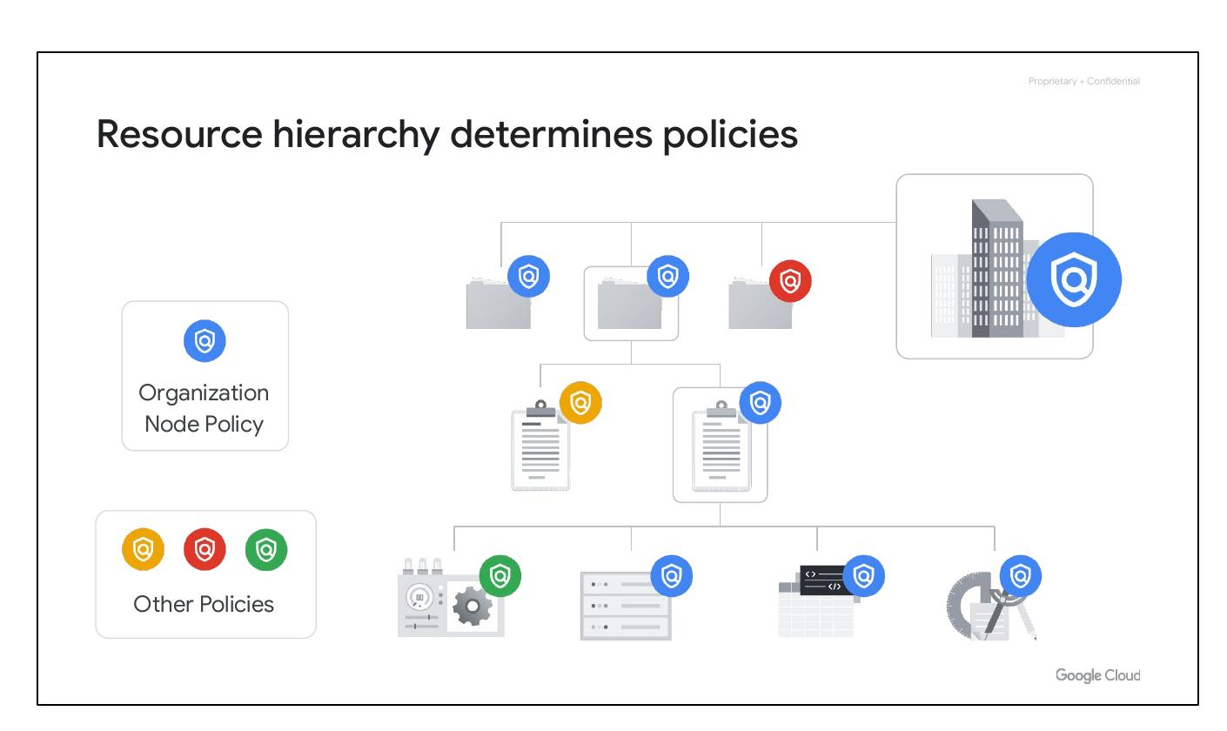
Quiz Question 1
Notes:
This slide reiterates the first quiz question, ensuring the audience has ample time to consider the options and prepare their answer.

Slide 44
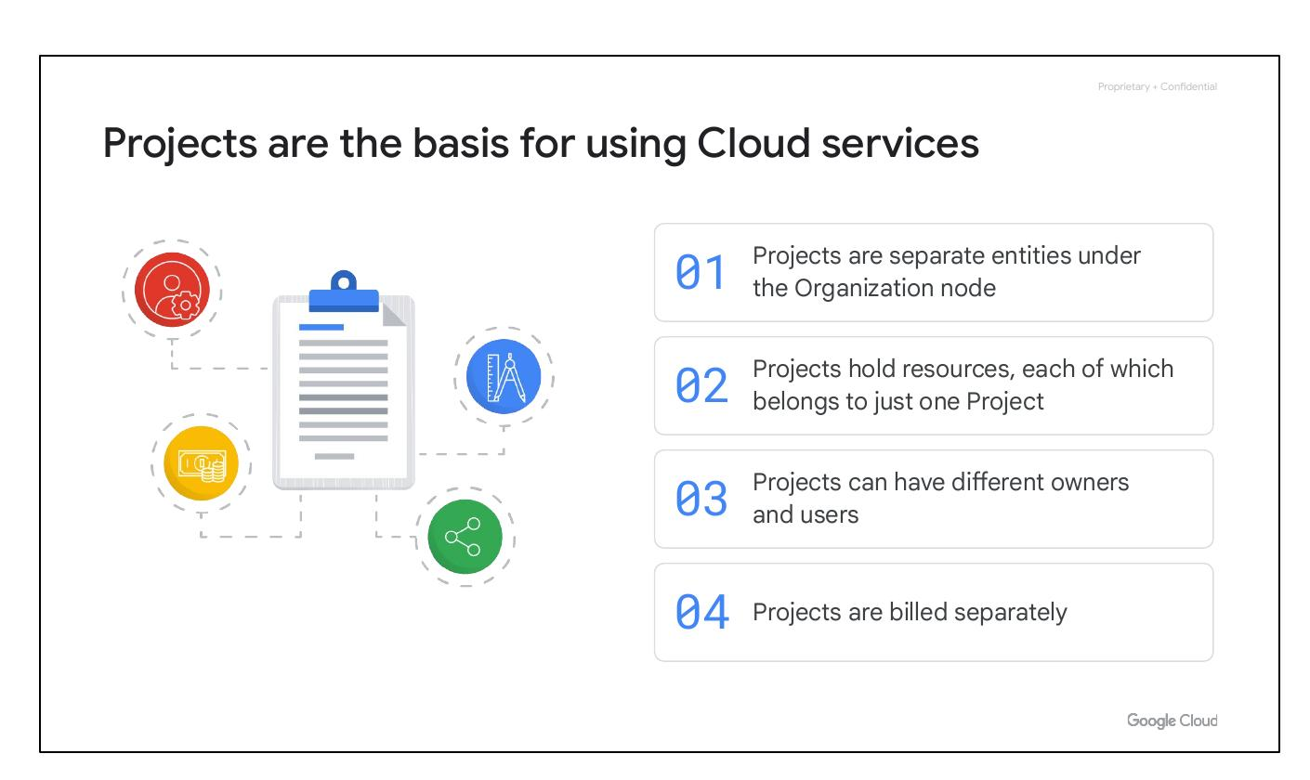
Quiz Answer 1
Notes:
This slide provides the answer to the first quiz question, confirming the correct response as 'Project' and providing feedback for both the correct and incorrect options.

Slide 45
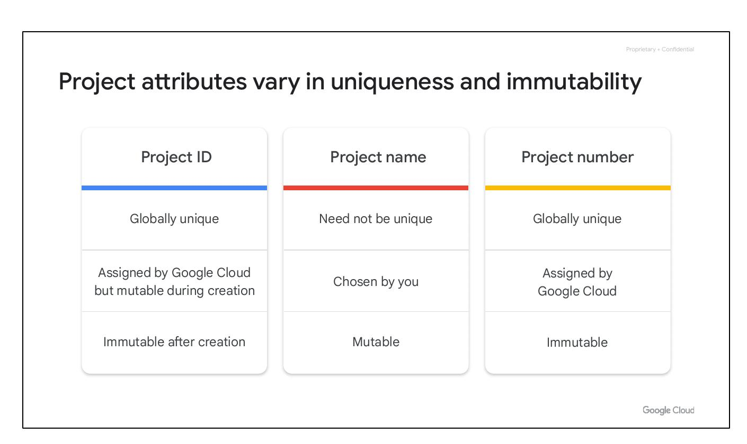
Quiz Question 2
Notes:
This slide introduces the second quiz question, asking the audience to order the IAM role types from broadest to finest-grained.

Slide 46
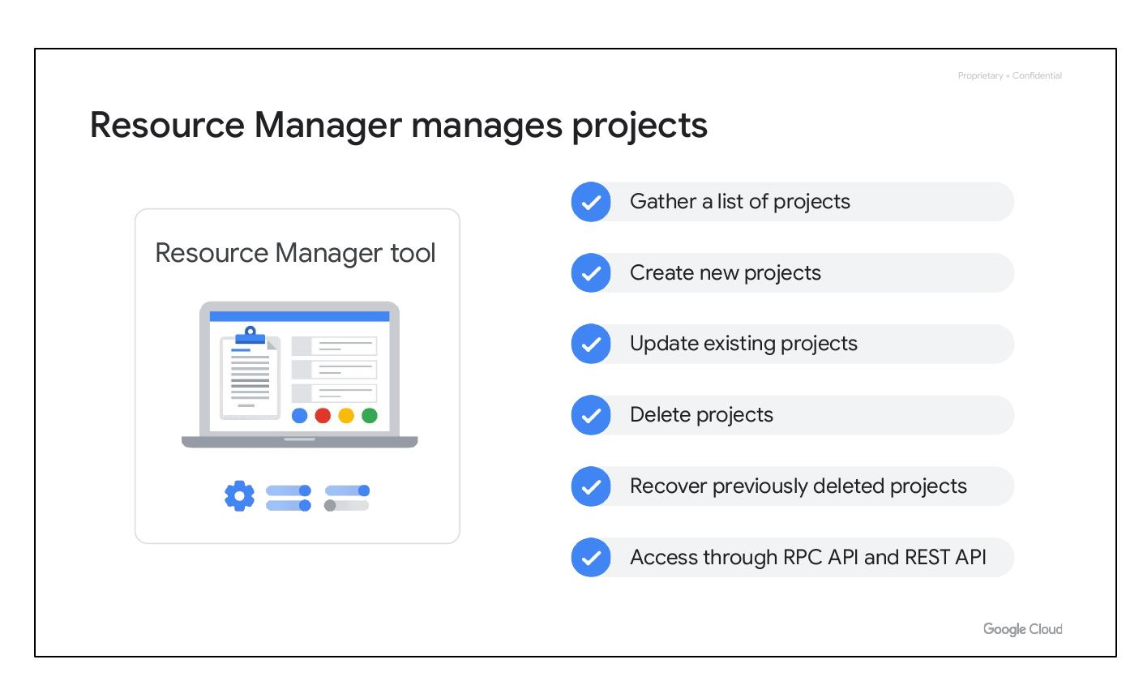
Quiz Question 2
Notes:
This slide repeats the second quiz question, allowing the audience to further contemplate the options and solidify their understanding.

Slide 47
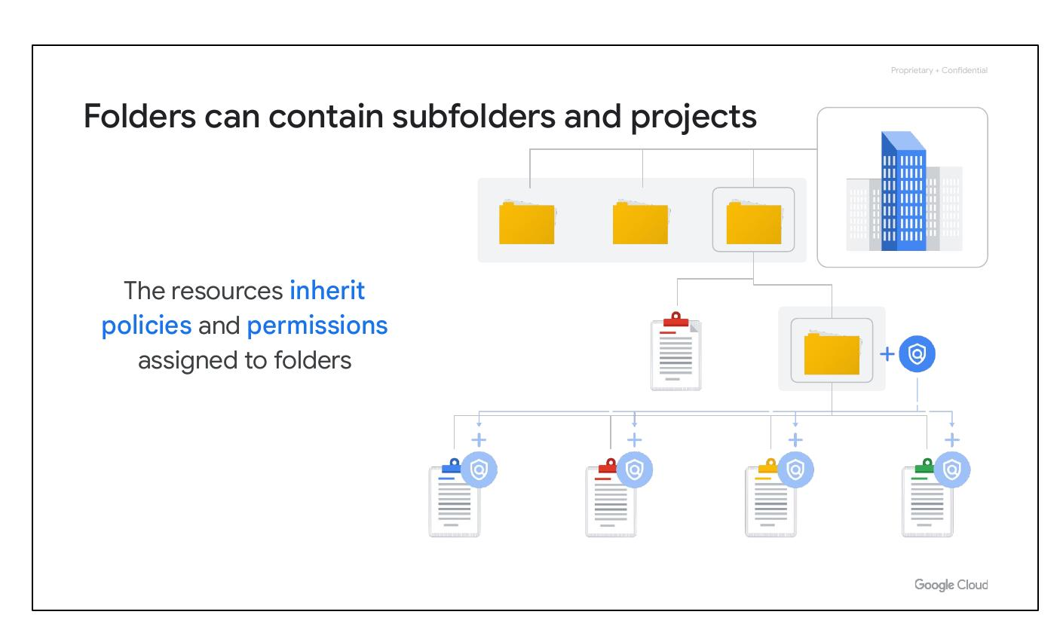
Quiz Answer 2
Notes:
This slide provides the answer to the second quiz question, revealing the correct order as 'Basic roles, predefined roles, custom roles' and offering feedback for each option.

Slide 48
Quiz Question 3
Notes:
This slide presents the third quiz question, probing the audience's knowledge of which value is globally unique, permanent, unchangeable, but modifiable during creation.

Slide 49
Quiz Question 3
Notes:
This slide restates the third quiz question, ensuring the audience has adequate time to analyze the options and formulate their answer.

Slide 50
Quiz Answer 3
Notes:
This slide provides the solution to the third quiz question, identifying 'The project ID' as the correct answer and offering feedback to reinforce understanding.

Slide 51
Lab Intro
Cloud Marketplace deployment
Deploy LAMP stack easily
Bitnami LAMP Stack
Notes:
This slide introduces a lab exercise focused on using Cloud Marketplace to deploy a LAMP stack on a Compute Engine instance. It mentions the Bitnami LAMP Stack as a complete web development environment that can be launched with one click.

