Slide 1

Introduction
Welcome to the presentation
Overview of the topic
Objectives of the discussion
Notes:
This is the introductory slide. We will start by welcoming the audience and providing a brief overview of the topics we will cover in this presentation. The objectives of the discussion will also be outlined, setting the stage for a productive and informative session. We want the audience to understand what we aim to achieve by the end of the presentation. It is important to engage the audience from the very beginning.

Slide 2
Key Concept 1
Explanation of concept
Importance of concept
Real-world application
Notes:
This slide focuses on explaining the first key concept. A clear and concise definition will be provided, followed by a discussion of its importance. To make the concept more relatable, we'll provide a real-world application to illustrate its relevance and practical use. Examples will be used to aid audience understanding.

Slide 3

Key Concept 2
Definition of concept
Relationship to concept 1
Potential challenges
Notes:
This slide introduces the second key concept, defining it and explaining how it relates to the previously discussed concept. We will also address potential challenges or limitations associated with this concept, providing a balanced and realistic perspective. Discussing the connection to the previous concept will reinforce understanding and show how the ideas build on each other.

Slide 4
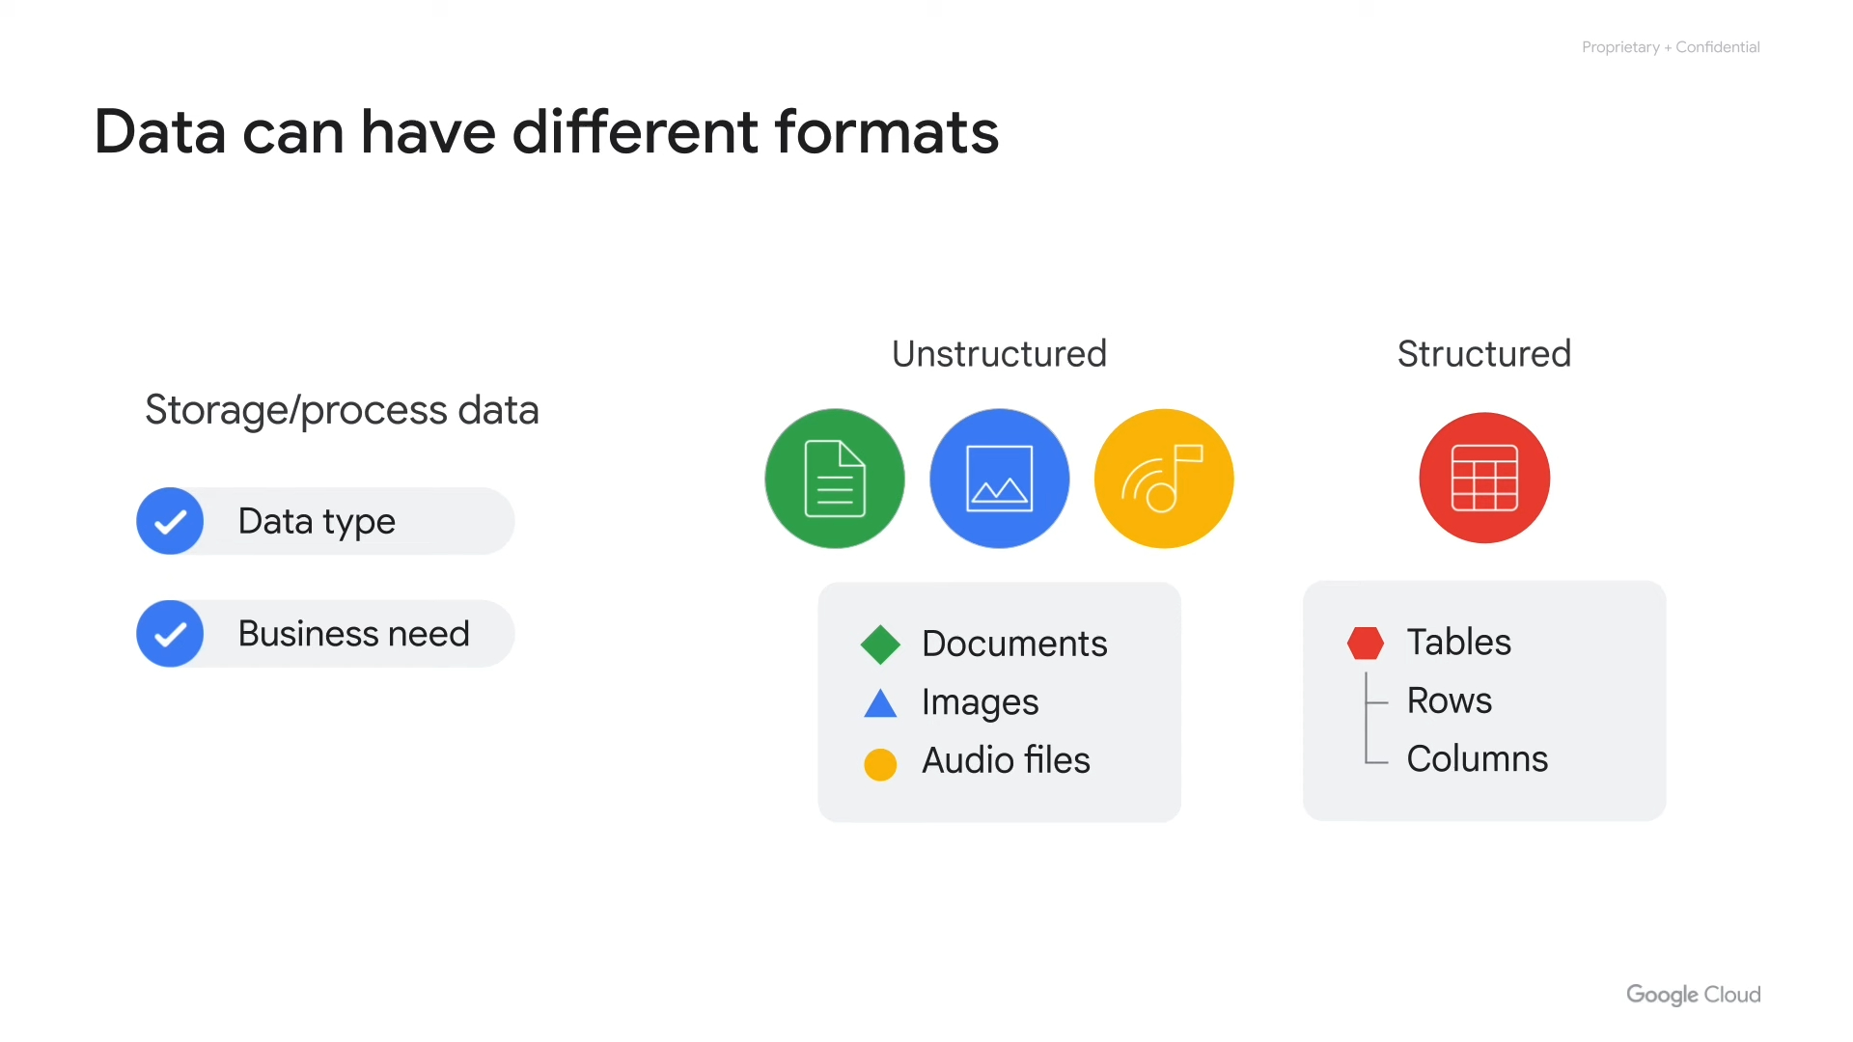
Methodology
Description of methods used
Data collection process
Analysis techniques
Notes:
This slide details the methodology employed. We will describe the specific methods used, outlining the data collection process and explaining the analysis techniques applied. Transparency in methodology builds credibility and allows the audience to understand how the results were obtained. It is important to be clear and concise in describing the different elements. Mention any specific tools or technologies that were utilized during the process.

Slide 5
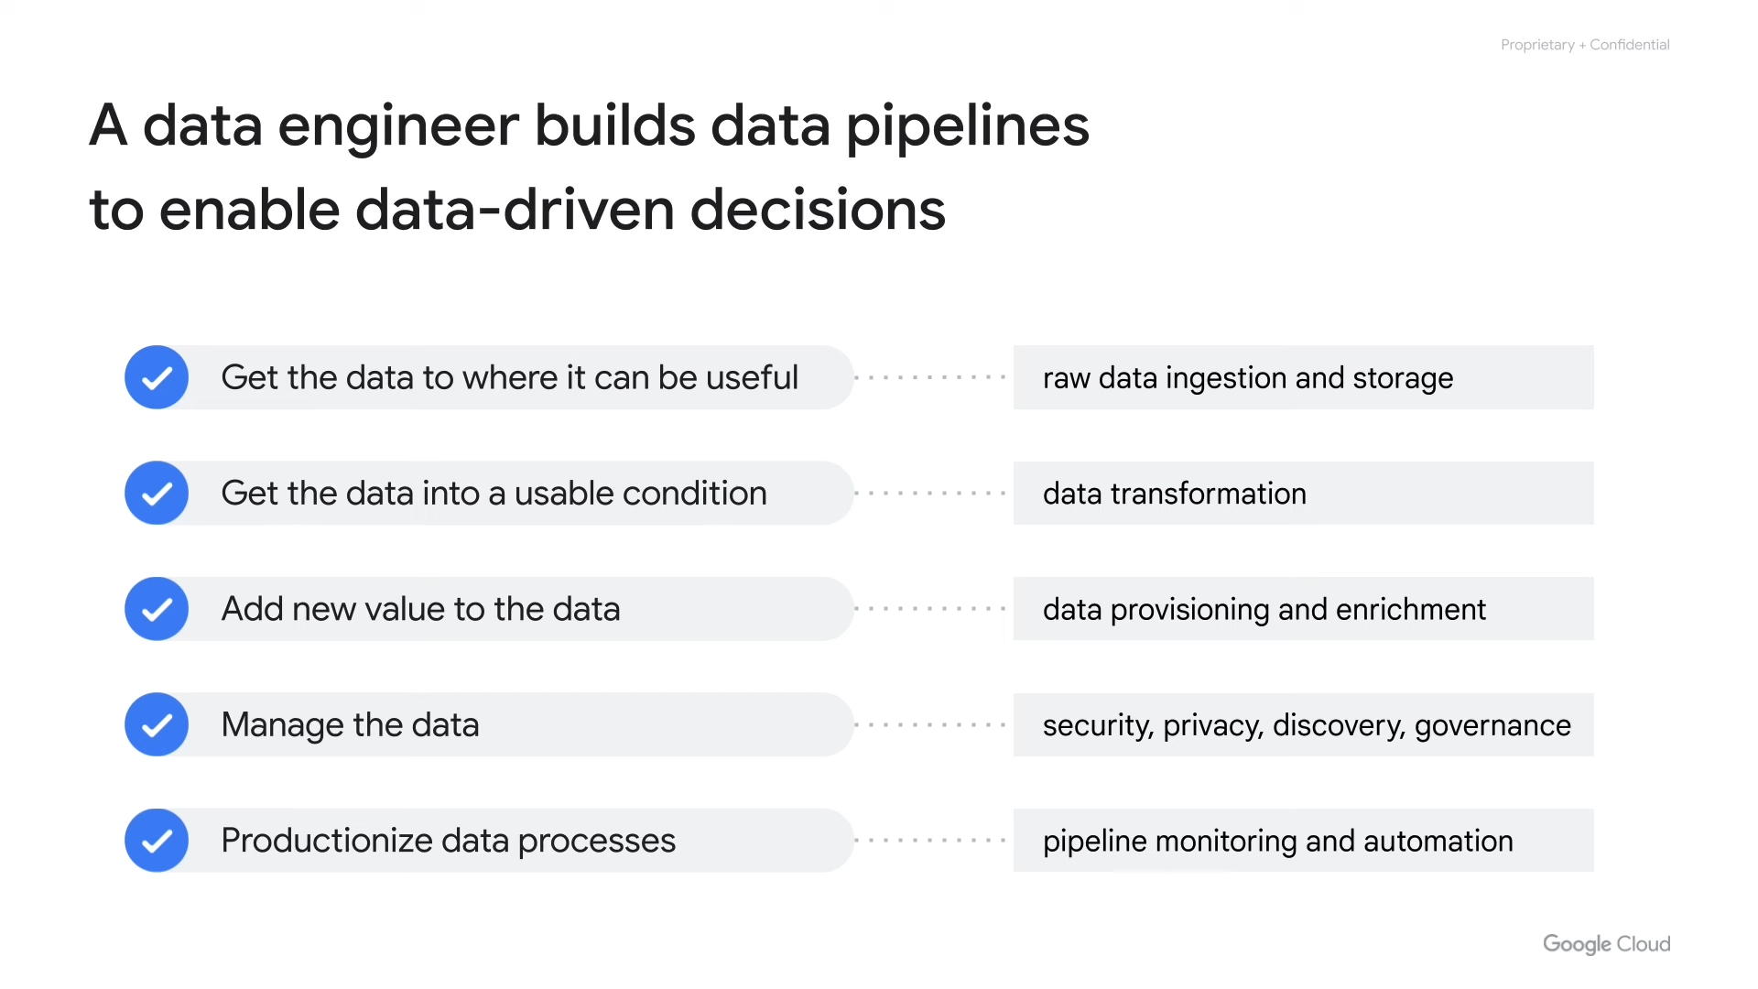
Results Overview
Summary of key findings
Visual representation
Statistical significance
Notes:
This slide provides an overview of the key findings. We will summarize the most significant results, present them visually using charts or graphs, and discuss their statistical significance. Visual representations will enhance understanding and highlight important trends. Mention specific numbers and values when possible. Ensure visual aids are clear and easy to interpret.

Slide 6
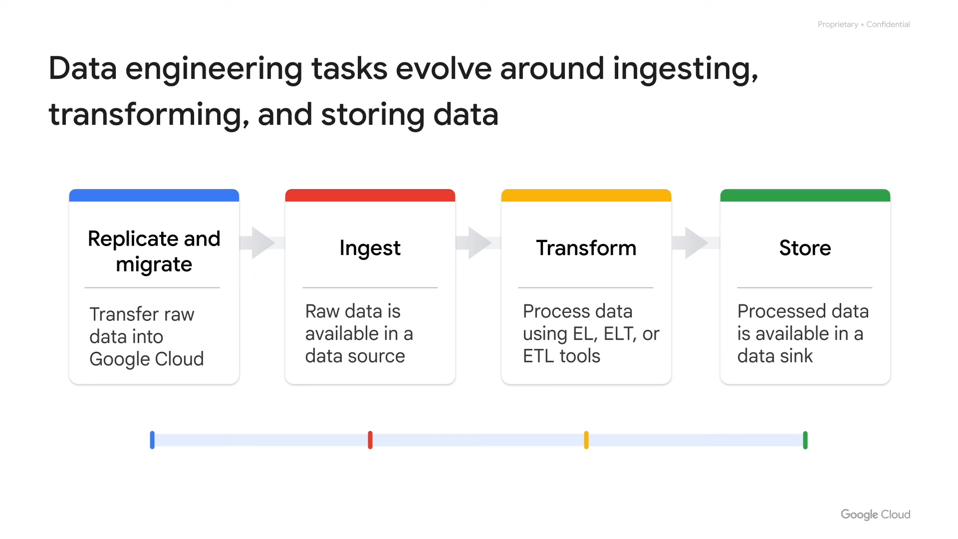
Case Study
Example of successful implementation
Specific details
Benefits achieved
Notes:
This slide presents a case study that demonstrates a successful implementation of the discussed concepts. We will provide specific details of the case and highlight the benefits achieved as a result. The case study will serve as a practical illustration and provide evidence of the concepts’ effectiveness. The specific details will help the audience understand the context and application.

Slide 7
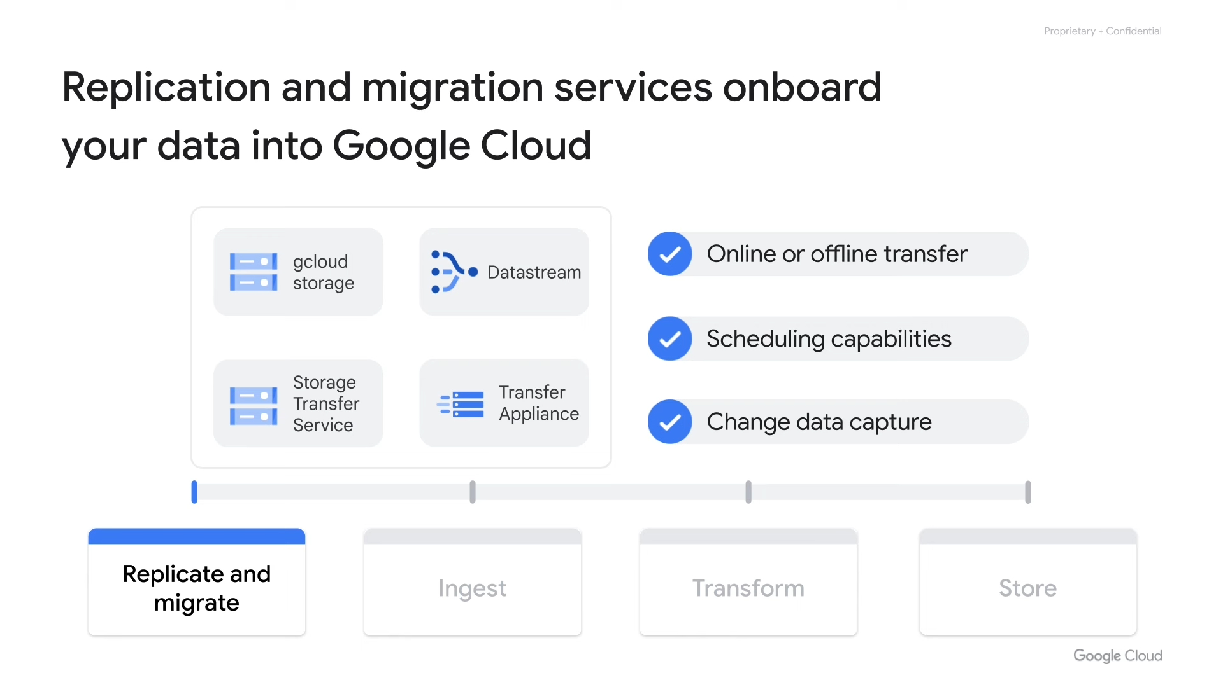
Conclusion
Recap of key points
Future directions
Call to action
Notes:
This slide concludes the presentation by recapping the key points discussed. We will also outline potential future directions for research or implementation and end with a call to action, encouraging the audience to take the next steps. This ensures the audience remembers the main takeaways from the presentation and what they can do with the information.

