Slide 1
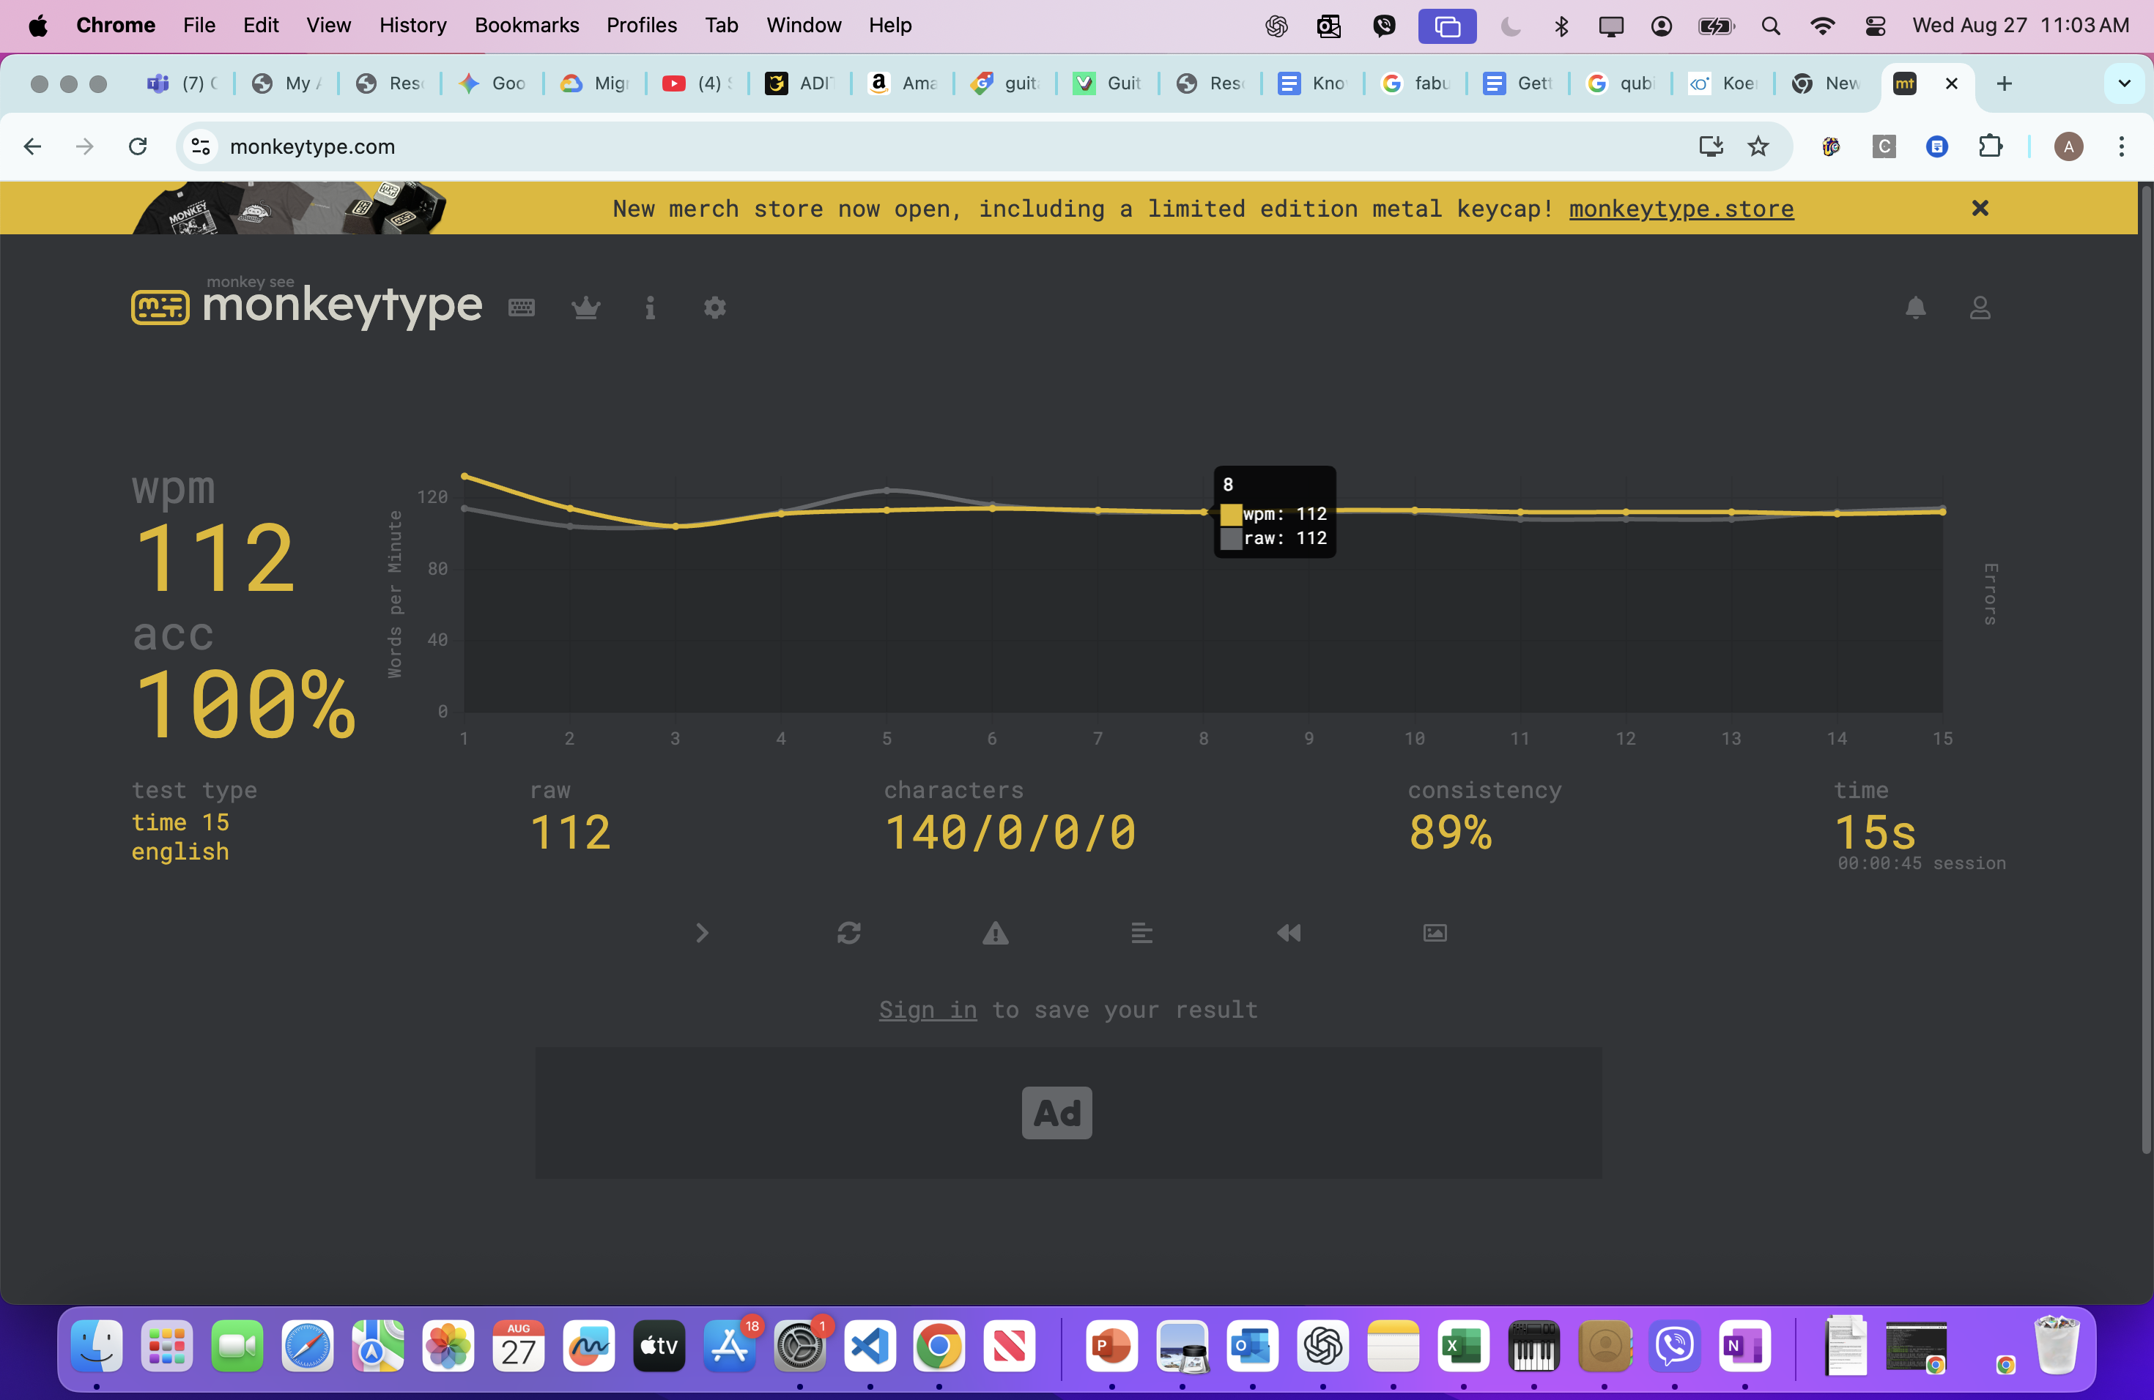
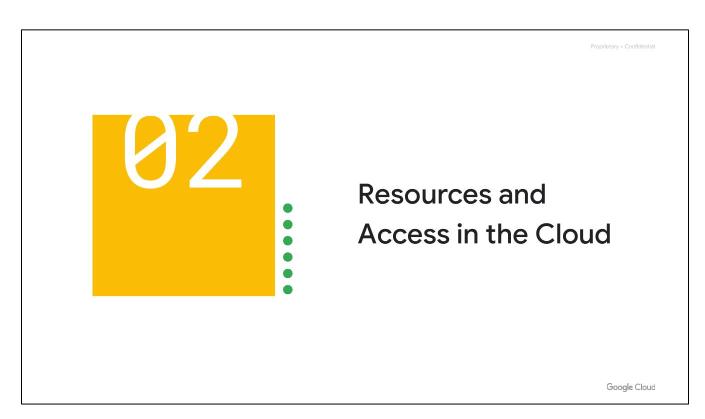
Resources, Access
BY Aman
Notes:
This slide highlights the resources available and their accessibility. We'll cover what's offered and how to access it. (Pause for questions after this section)

Slide 2
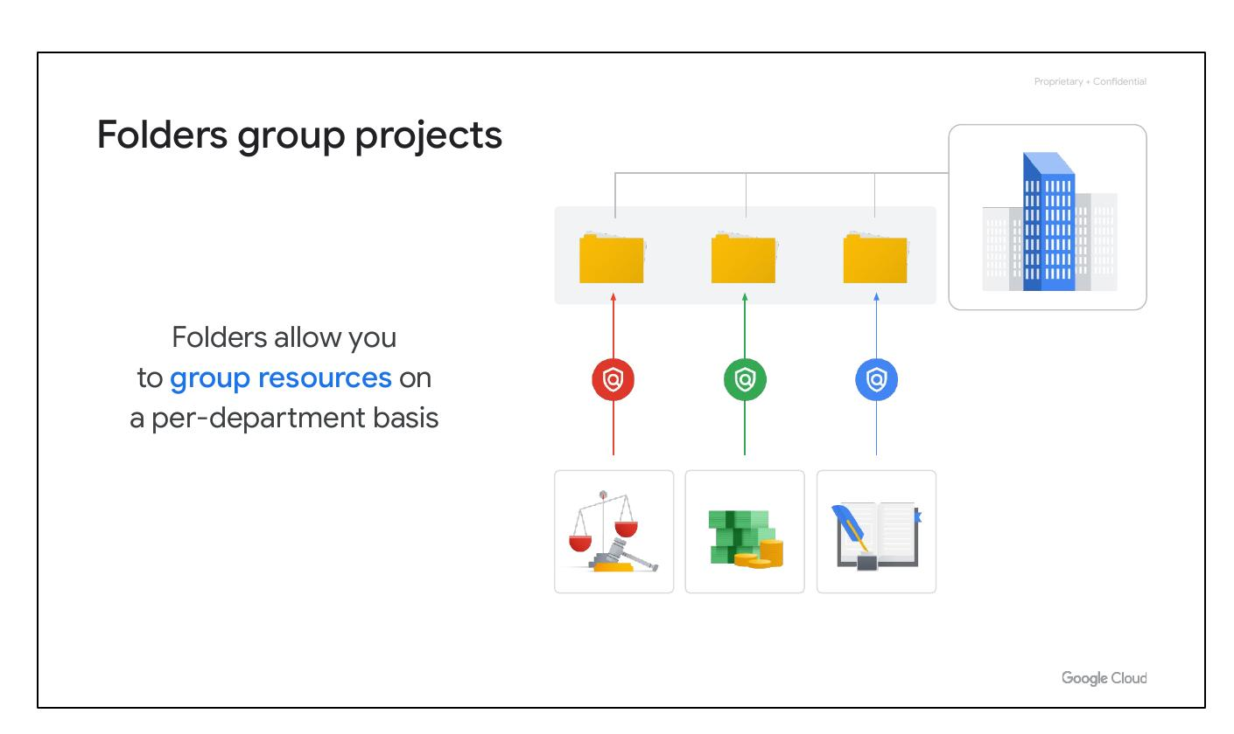
Folders Group
Group resources
Per-department basis
Delegate admin rights
BY Aman
Notes:
This slide shows our new Folders Group structure. Resources are grouped by department, with delegated administrative rights. Implementation by Aman.

Slide 3
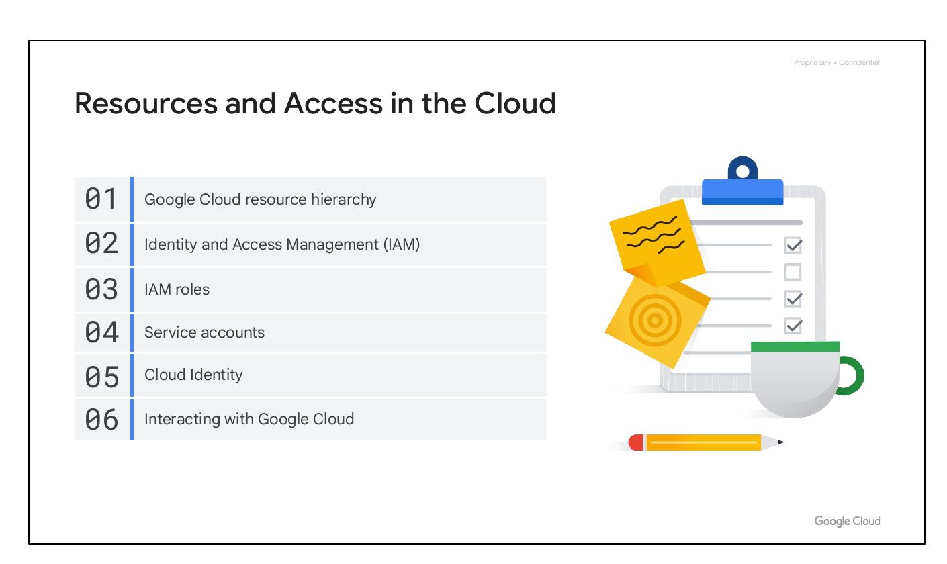
Course Sections
Resource hierarchy
Identity Access Management
Ways to interact
BY Aman
Notes:
This slide outlines the key components of the course: We'll cover course sections, the resource hierarchy, Identity Access Management (IAM), and different ways to interact with the system. All presented by Aman.

Slide 4

Course Sections
Resource hierarchy
Identity Access Management
Ways to interact
BY Aman
Notes:
This slide outlines the key course components. We'll cover course sections, the resource hierarchy for accessing materials, our Identity Access Management system, and how you can interact with the course and your classmates. Prepared by Aman.

Slide 5
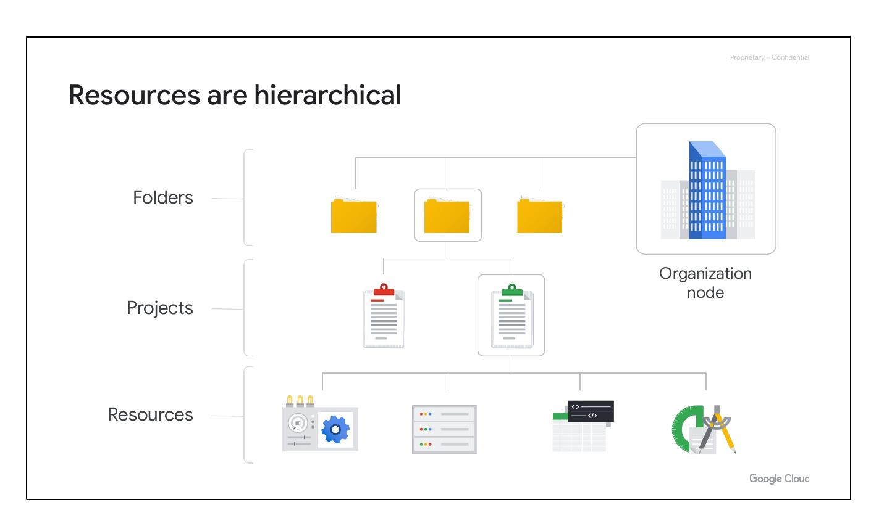
Hierarchical Resources
Four levels of hierarchy:
Resources
Projects, Folders
Organization node
BY Aman
Notes:
This slide outlines the hierarchical structure of our resources. We have four levels: individual Resources, Projects and Folders containing those resources, an Organization node grouping related Projects, and finally, the overall system. This structure, designed by Aman, ensures efficient management and accessibility.

Slide 6
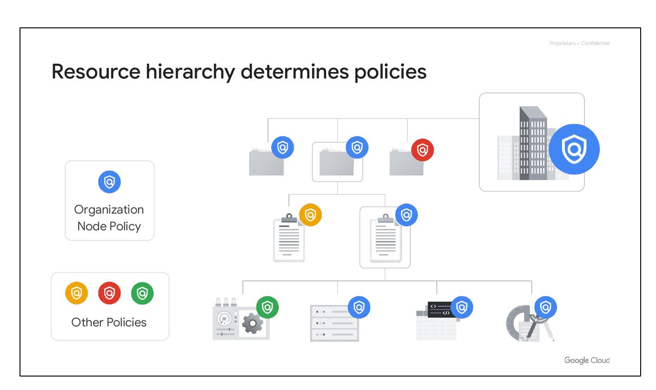
Resource Hierarchy
Hierarchy determines policies
Policies at project, folder, org
Policies inherited downward
BY Aman
Notes:
"This slide illustrates our resource hierarchy. The hierarchy dictates policy application—at the project, folder, and organizational levels. Policies are inherited downwards, ensuring consistent governance. (Credit: Aman)"

Slide 7
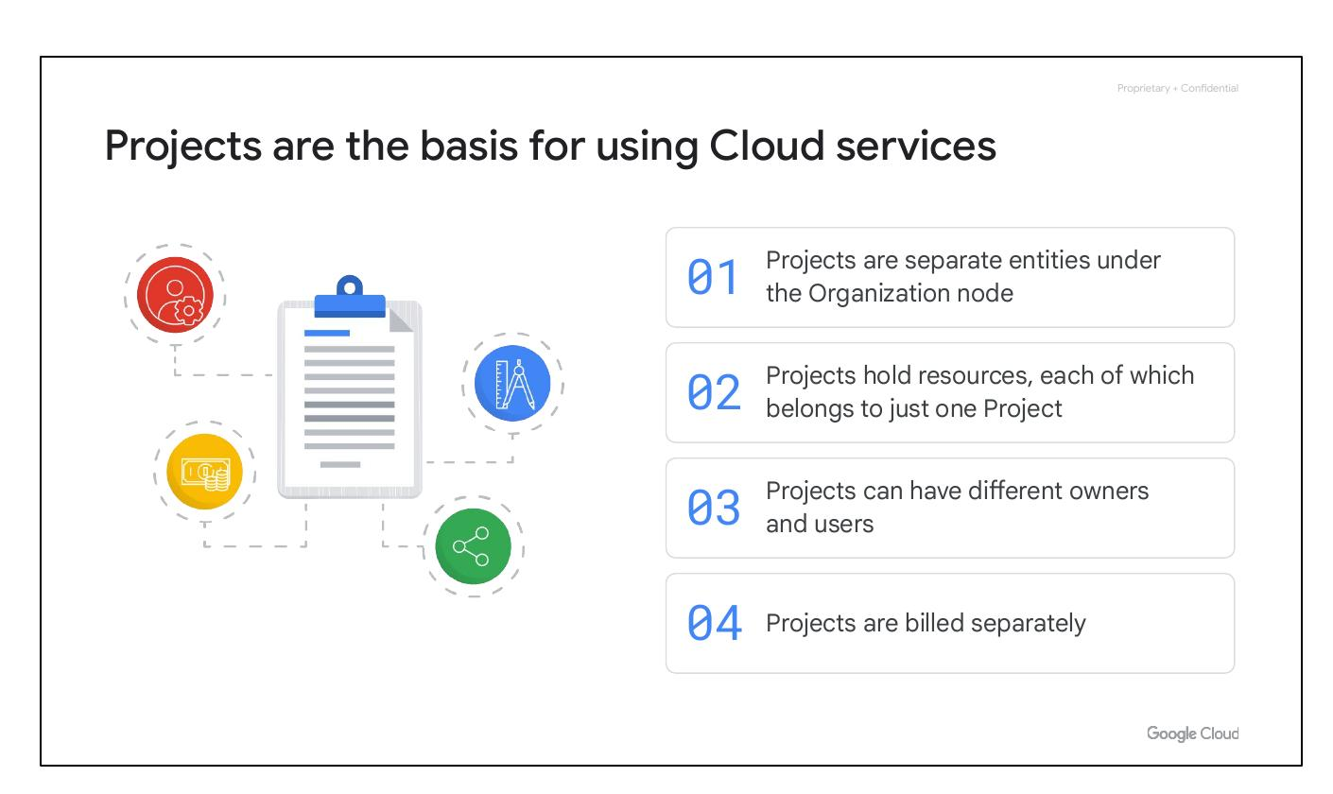
Cloud Projects
Basis for Cloud services
Resources belong to one project
Different owners and users
Projects are billed separately
BY Aman
Notes:
Good morning/afternoon, everyone. This slide outlines our cloud project structure. Each cloud service operates within a distinct project, ensuring resource isolation and clear ownership. Multiple users and owners can be assigned per project, with billing occurring separately for each. This promotes accountability and simplifies cost management.

Slide 8
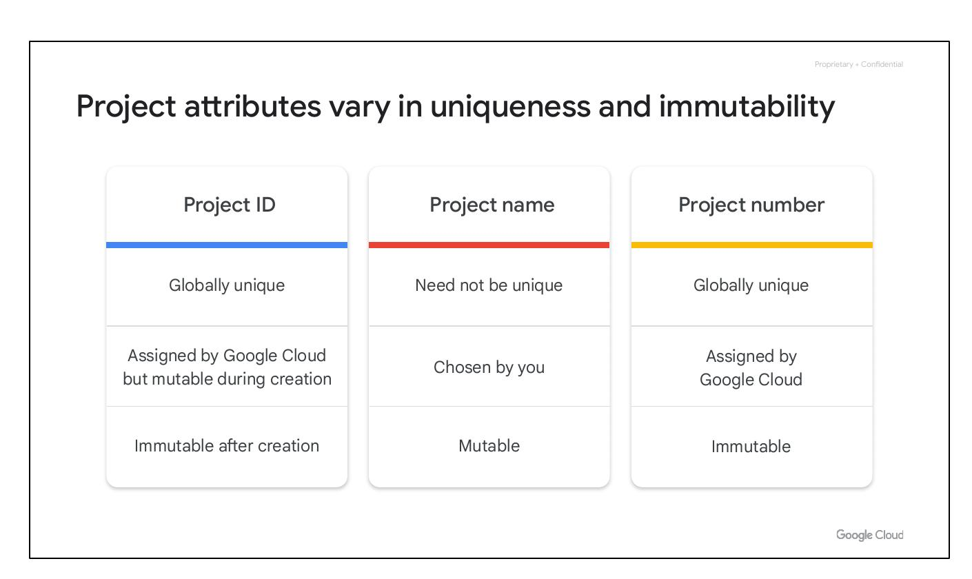
Project Attributes
Project ID: Globally unique
Project Name: Mutable
Project Number: Immutable
BY Aman
Notes:
This slide details key project attributes. Note the project ID is globally unique for easy identification, while the project name allows for flexibility (mutable), but the project number remains constant (immutable). This ensures traceability and consistency.

Slide 9
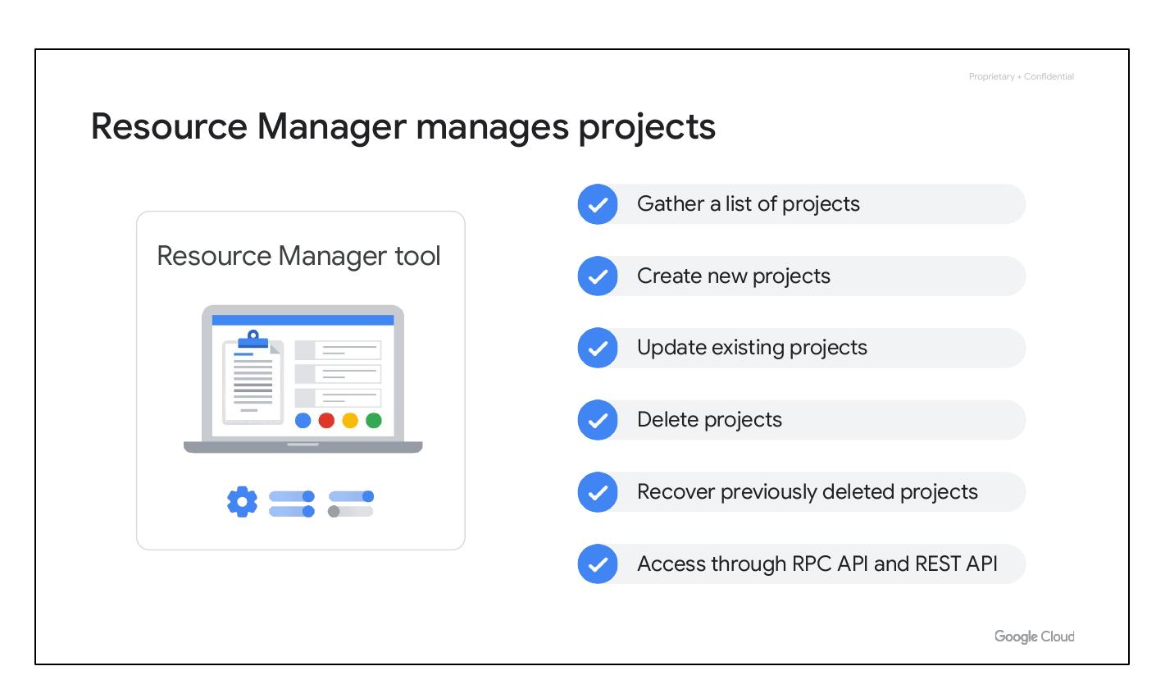
Resource Manager
Manages projects
Gather list of projects
Create, update, delete projects
Access via RPC/REST API
BY Aman
Notes:
"This slide introduces our Resource Manager, developed by Aman. It handles project lifecycle management – creation, updates, deletion, and retrieval of project lists. Access is provided via RPC and REST APIs."

Slide 10
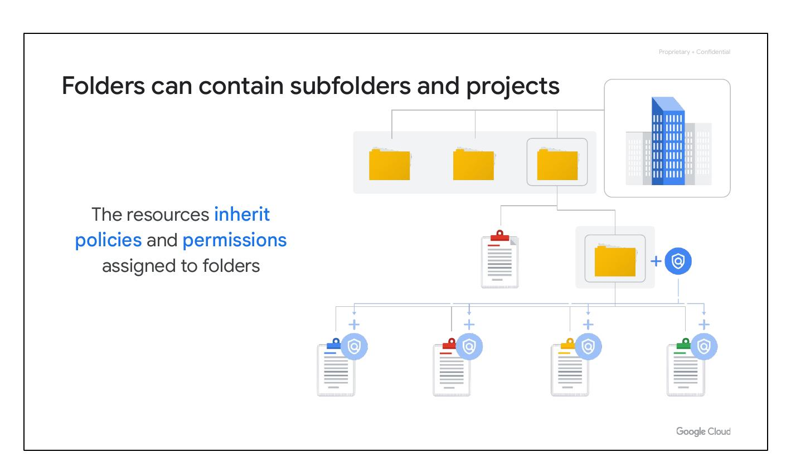
Cloud Folders
Folders contain projects
Resources inherit policies
Group resources by department
BY Aman
Notes:
"This slide highlights our cloud folder structure. Projects are organized within folders, inheriting resource policies for streamlined management. We group resources by department for improved organization and access control. (Slide created by Aman)"

