Slide 1

Introduction
Overview of the topic
Importance of understanding
Key areas to be covered
Notes:
This slide serves as an introduction to the presentation. We will be providing an overview of the subject matter, highlighting why it is crucial to understand this information. Furthermore, we will outline the key areas that will be covered throughout the presentation, setting the stage for a comprehensive understanding of the topic.

Slide 2
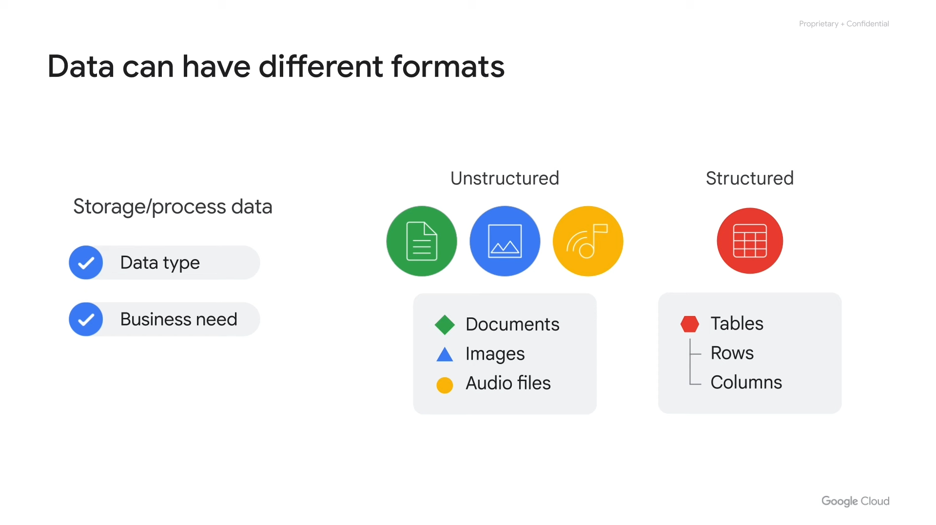
Core Concept
Explanation of the main idea
Supporting details
Examples to illustrate
Notes:
This slide focuses on explaining the core concept of the presentation. It provides a detailed explanation of the main idea, supported by relevant details to add depth and clarity. To further enhance understanding, we include illustrative examples that demonstrate the practical application of the concept.

Slide 3
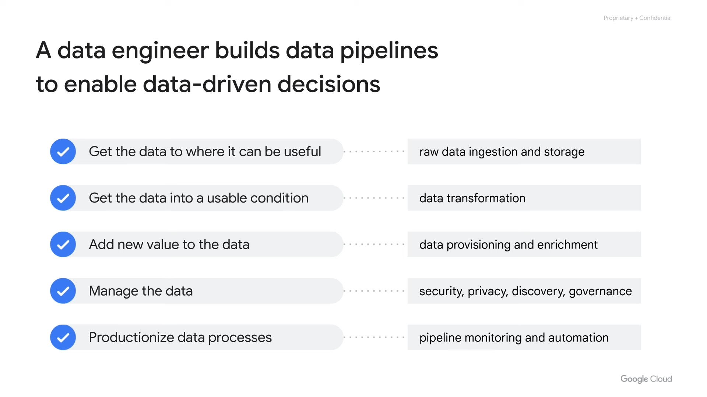
Key Challenges
Identification of obstacles
Reasons for these challenges
Impact of challenges
Notes:
This slide identifies and examines the key challenges related to the topic. We will discuss the specific obstacles that one might encounter, analyze the underlying reasons for these challenges, and assess their overall impact. This section provides a realistic view of the complexities involved.

Slide 4
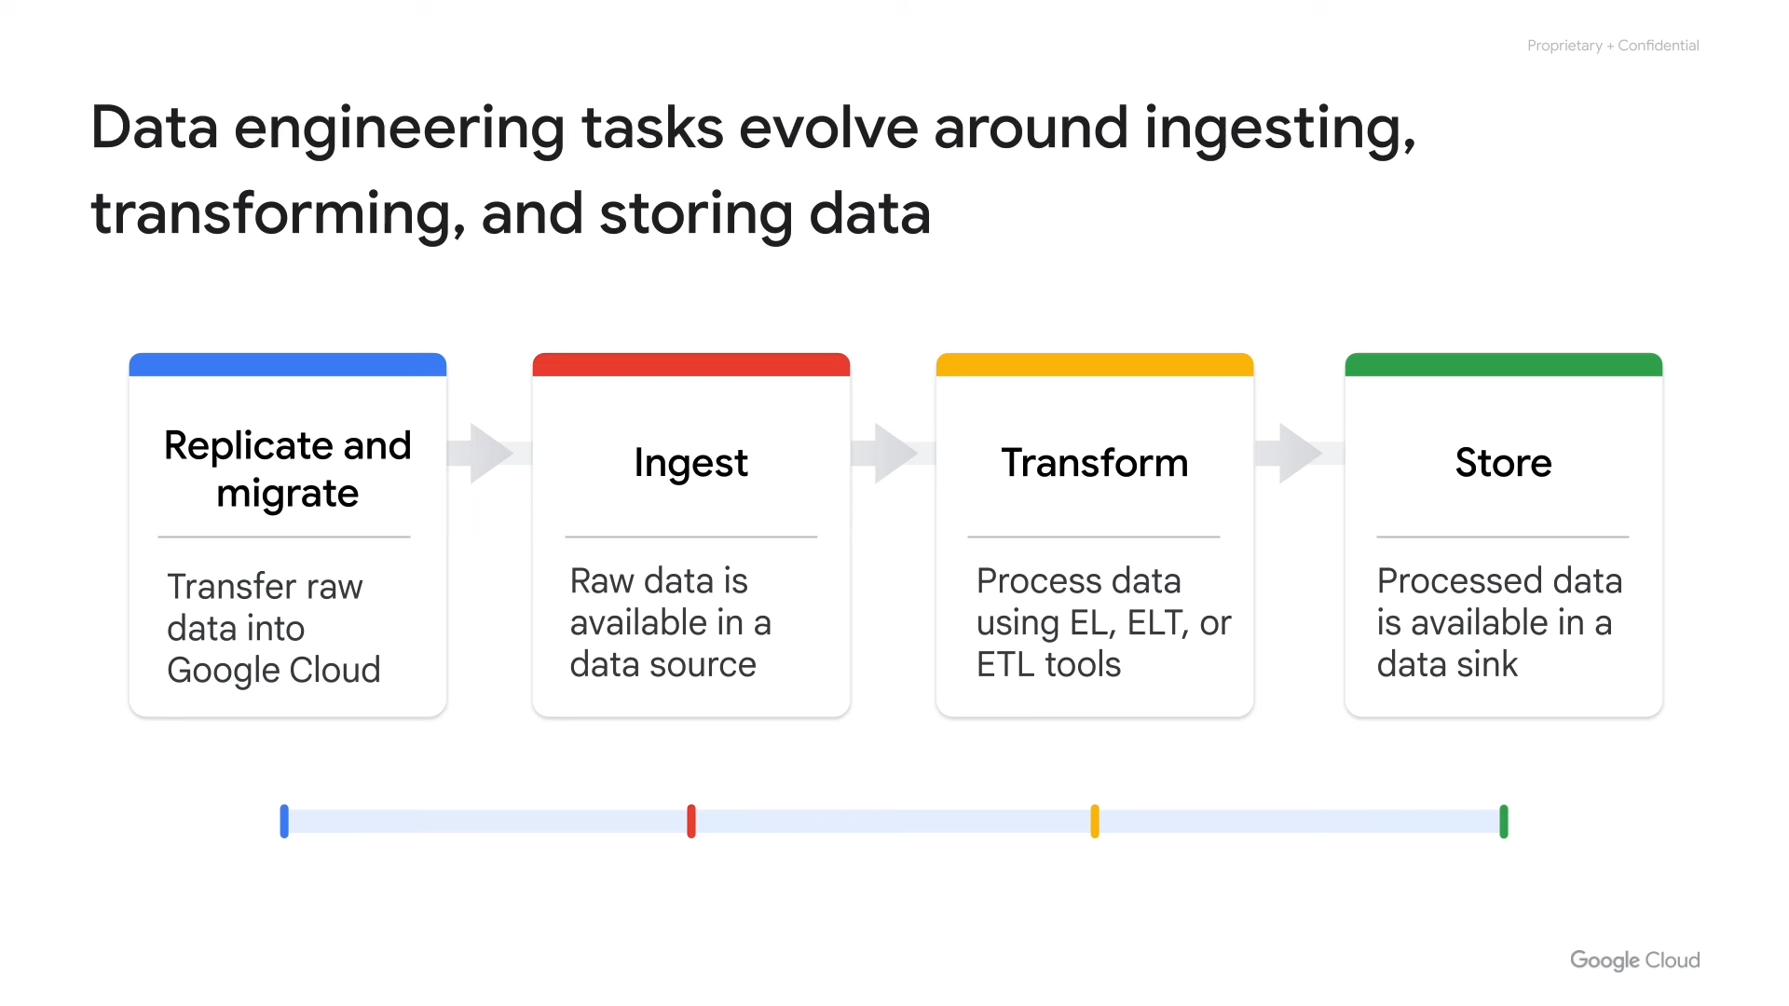
Proposed Solutions
Strategies to overcome
Benefits of each solution
Steps for implementation
Notes:
This slide presents proposed solutions to address the challenges that were previously outlined. We will introduce various strategies designed to overcome these obstacles, highlighting the specific benefits associated with each solution. In addition, we will provide a step-by-step guide for implementing each solution effectively.

Slide 5
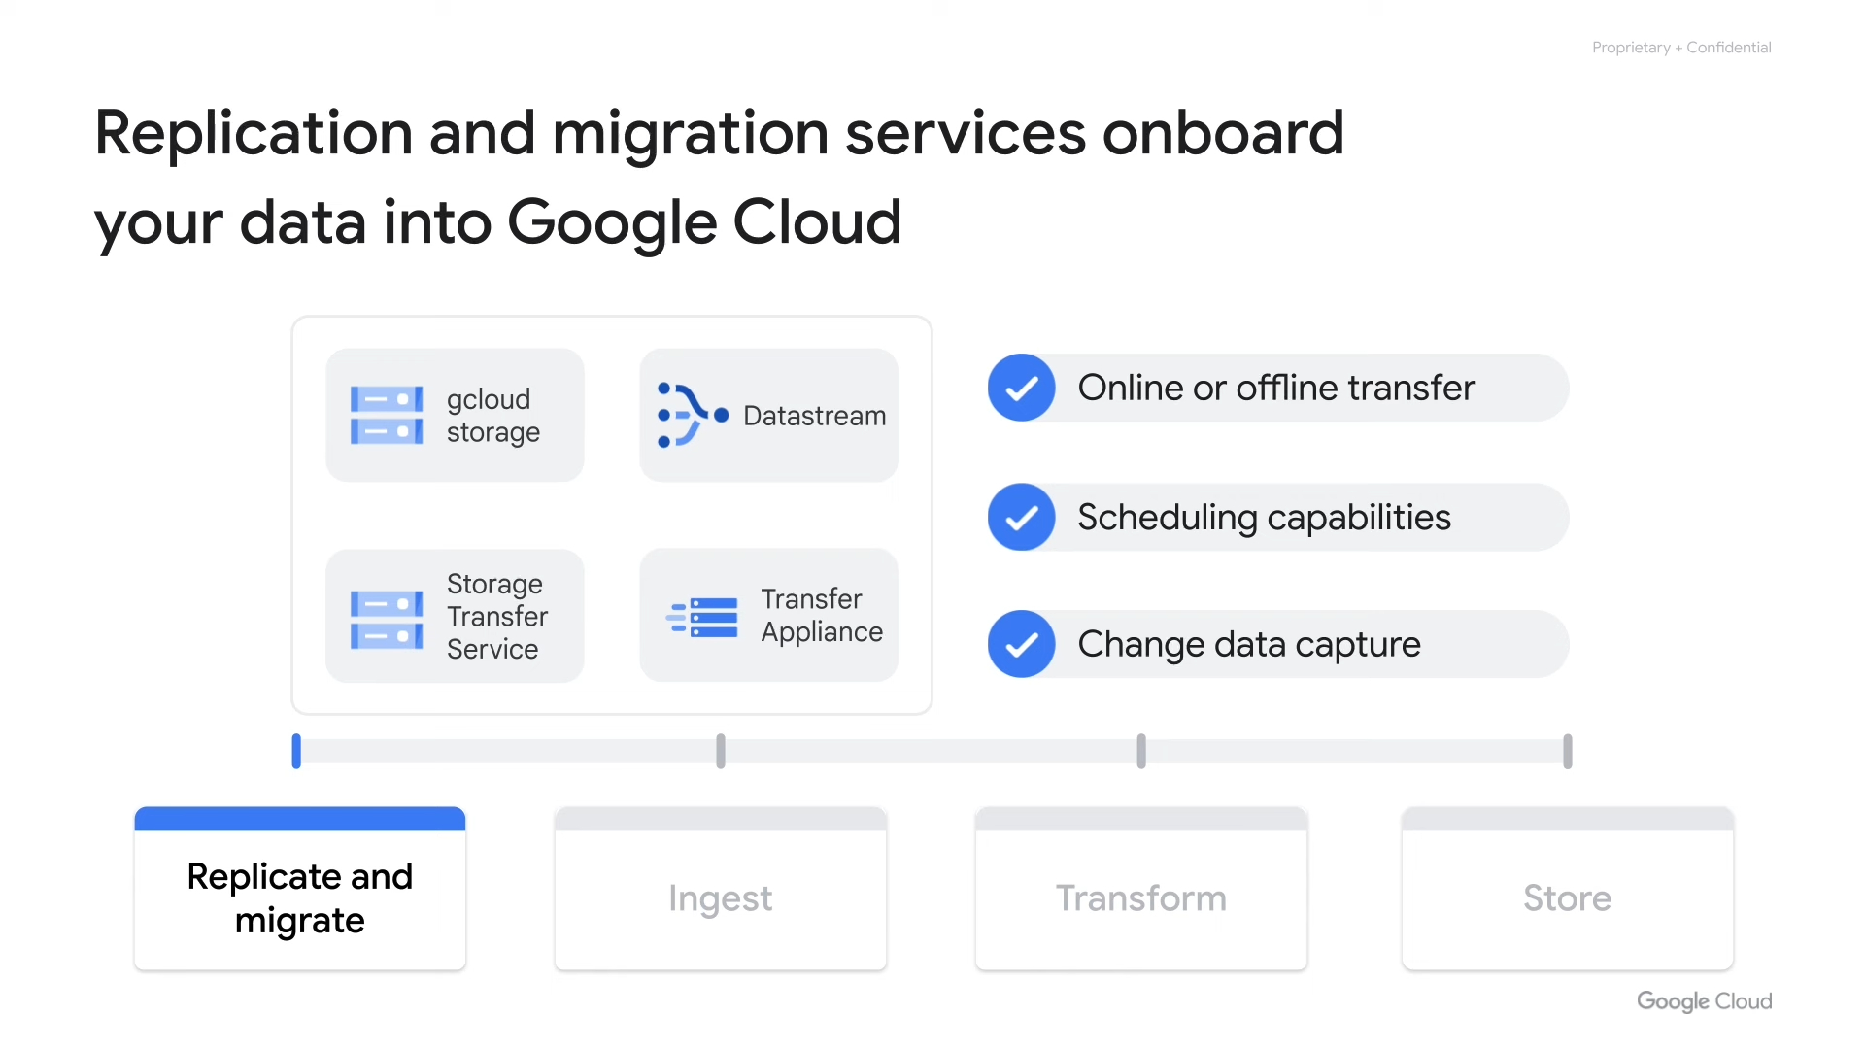
Conclusion
Summary of key takeaways
Future outlook
Call to action
Notes:
This slide provides a conclusion to the presentation. It includes a summary of the key takeaways, reinforcing the most important information. We will also offer insights into the future outlook of the topic, discussing potential developments and trends. Finally, we will end with a clear call to action, encouraging the audience to take specific steps based on what they have learned.

