Slide 1
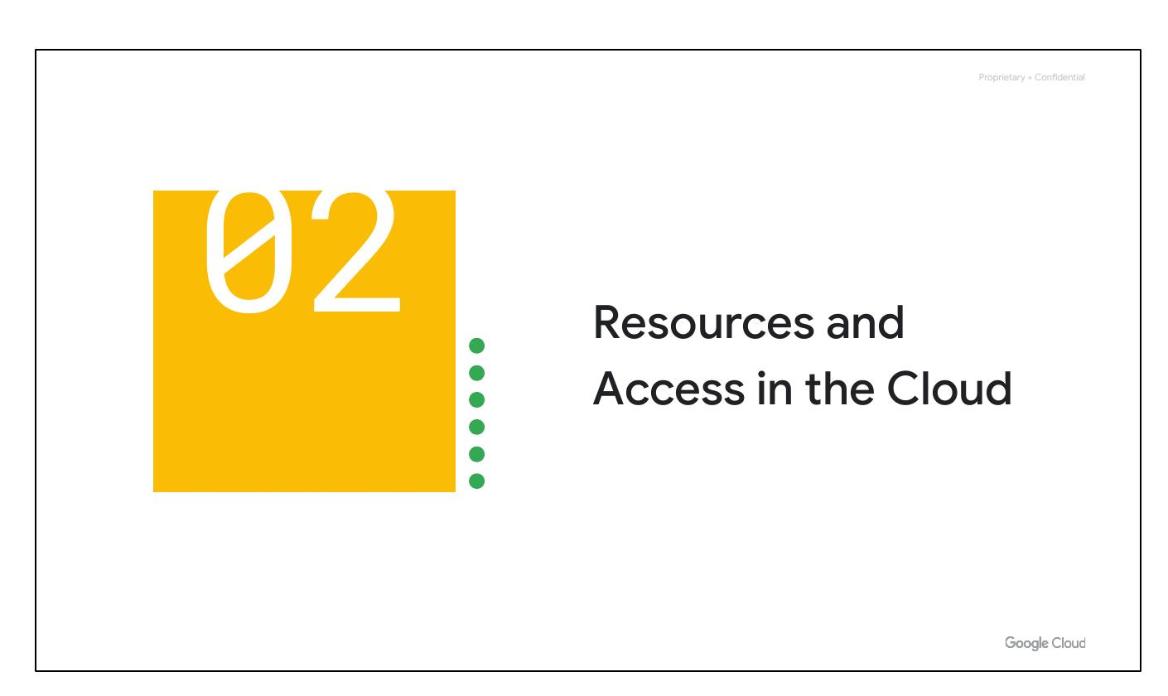
Access in Cloud
Notes:
Now that you've had a chance to explore what cloud computing is, the pricing structure and billing practices available with Google Cloud, and the ways that Google strives to make the platform secure and environmentally friendly, let’s now work to understand the functional structure of Google Cloud.

Slide 2
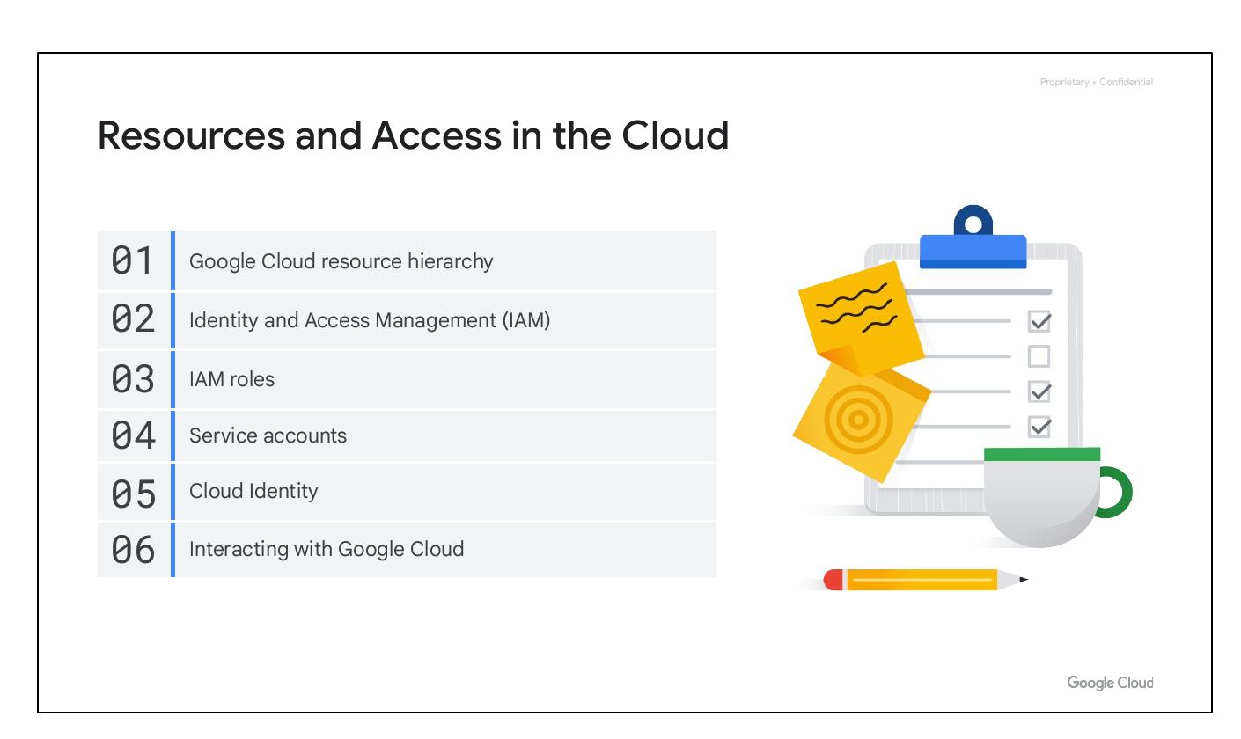
Resources Overview
• Google Cloud resource hierarchy
• Identity and Access Management (IAM)
• IAM roles
• Service accounts
• Cloud Identity
• Interacting with Google Cloud
Notes:
In this section of the course, we’ll see how resources get organized with projects, and how access to those resources gets shared with the right part of a workforce through a tool called Identity and Access Management, or IAM. We’ll also look into the different ways in which you can interact with Google Cloud, including our web user interface, command-line interface, and our mobile apps. We’ll begin with the Google Cloud Resource Hierarchy.

Slide 3

Resources Overview
• Google Cloud resource hierarchy
• Identity and Access Management (IAM)
• IAM roles
• Service accounts
• Cloud Identity
• Interacting with Google Cloud
Notes:
In this section of the course, we’ll see how resources get organized with projects, and how access to those resources gets shared with the right part of a workforce through a tool called Identity and Access Management, or IAM. We’ll also look into the different ways in which you can interact with Google Cloud, including our web user interface, command-line interface, and our mobile apps. We’ll begin with the Google Cloud Resource Hierarchy.

Slide 4
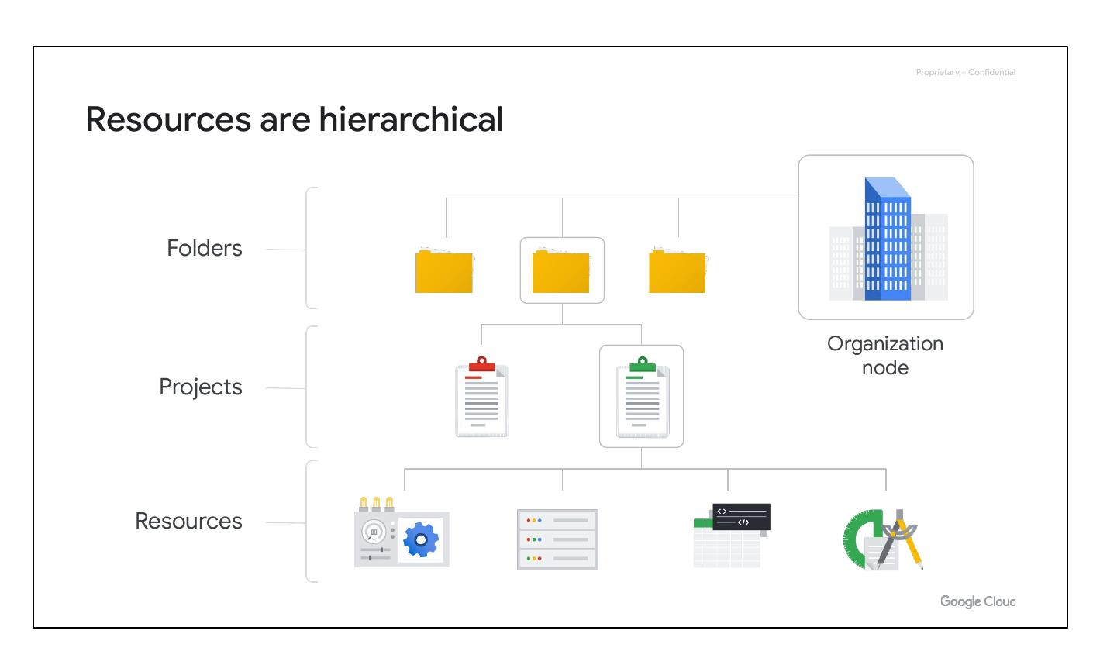
Resource Hierarchy
• Resources are hierarchical
• Four levels:
• Resources
• Projects
• Folders
• Organization node
Notes:
The resource hierarchy is made up of four levels, and starting from the bottom up they are: resources, projects, folders, and an organization node. At the first level are resources, which represent virtual machines, Cloud Storage buckets, Virtual Private Networks (VPCs), tables in BigQuery, or anything else in Google Cloud. Resources get organized into projects, which sit on the second level. Projects can be organized into folders, or even subfolders, which sit at the third level. At the top level is an organization node, which encompasses all the projects, folders, and resources in your organization.

Slide 5
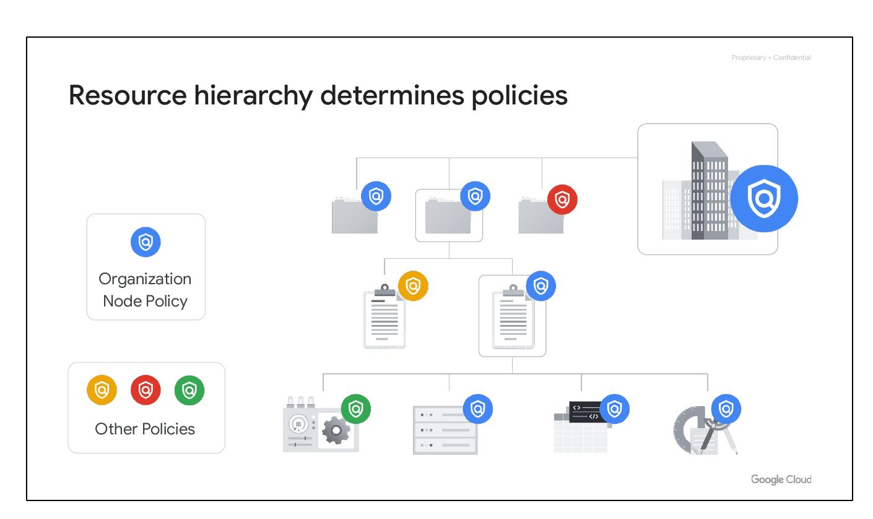
Hierarchy Policies
• Hierarchy determines policies
• Policies at project, folder, org.
• Some services: indiv. resources
• Policies inherited downwards
Notes:
It’s important to understand this resource hierarchy, as it directly relates to how policies are managed and applied when using Google Cloud. Policies can be defined at the project, folder, and organization node levels. Some Google Cloud services allow policies to be applied to individual resources, too. Policies are also inherited downward. This means that if you apply a policy to a folder, it will also apply to all of the projects within that folder.

