Slide 1

Introduction
Welcome to the Presentation
Overview of Key Topics
Setting the Stage
Notes:
Welcome everyone. This presentation will cover a range of topics, starting with an introduction to the fundamentals. We'll then move into more advanced concepts, providing a comprehensive overview. By the end of this presentation, you should have a solid understanding of the core principles and be ready to tackle more complex applications. This initial slide serves to set the stage for a deep dive into the subject matter.

Slide 2
Fundamentals
Basic Concepts
Key Definitions
Core Principles
Notes:
In this section, we'll lay the groundwork by exploring the basic concepts. Understanding these fundamentals is crucial before moving forward. We will also clearly define key terms and introduce the core principles that underpin the entire subject. Pay close attention to these foundational elements, as they will be referenced throughout the presentation. This part of the presentation builds the foundation for further discussion.

Slide 3

Advanced Topics
Complex Models
Advanced Techniques
Real-World Applications
Notes:
Building upon the basic concepts, we will now delve into more advanced topics. This includes exploring complex models, discussing advanced techniques, and examining real-world applications. Prepare to expand your knowledge and see how these concepts are applied in practical scenarios. This section bridges theory and practice, demonstrating how the principles we learned earlier can be utilized in different settings.

Slide 4
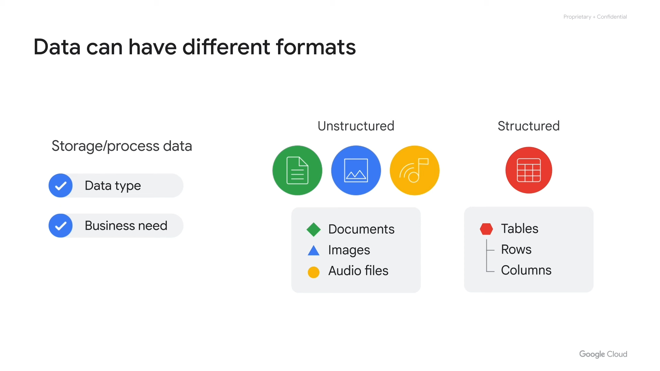
Case Studies
Example 1: Success Story
Example 2: Lesson Learned
Analyzing Key Factors
Notes:
Let's analyze a couple of case studies. The first highlights a success story and the key factors that contributed to it. The second explores a case where lessons were learned and what changes were implemented afterward. By examining these real-world examples, you will gain a deeper understanding of how to apply these concepts in different situations and also learn from past experiences. We'll analyze the strategies employed in each case and extract valuable insights.

Slide 5
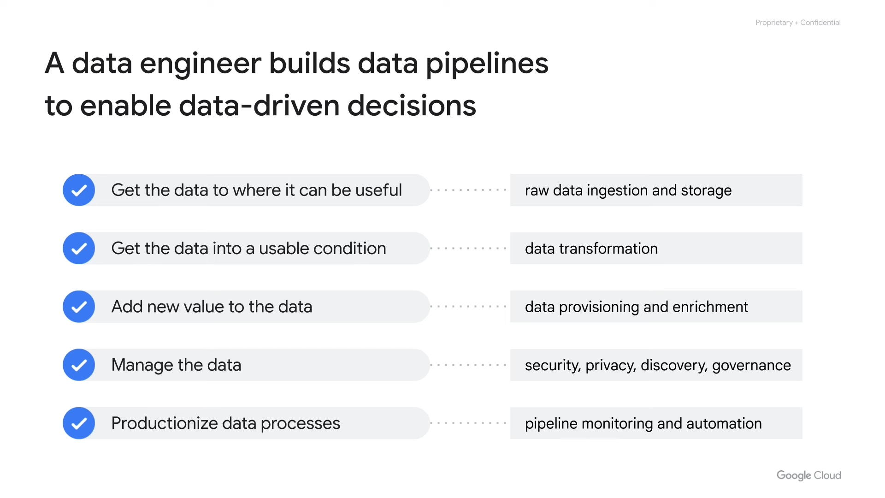
Best Practices
Do's and Don'ts
Tips and Tricks
Avoiding Common Mistakes
Notes:
To ensure you can effectively implement these concepts, we'll outline the best practices. This includes a list of do's and don'ts, helpful tips and tricks, and advice on avoiding common mistakes. By following these guidelines, you can maximize your chances of success and minimize potential pitfalls. Pay close attention to these practical tips to make your experience as smooth as possible.

Slide 6
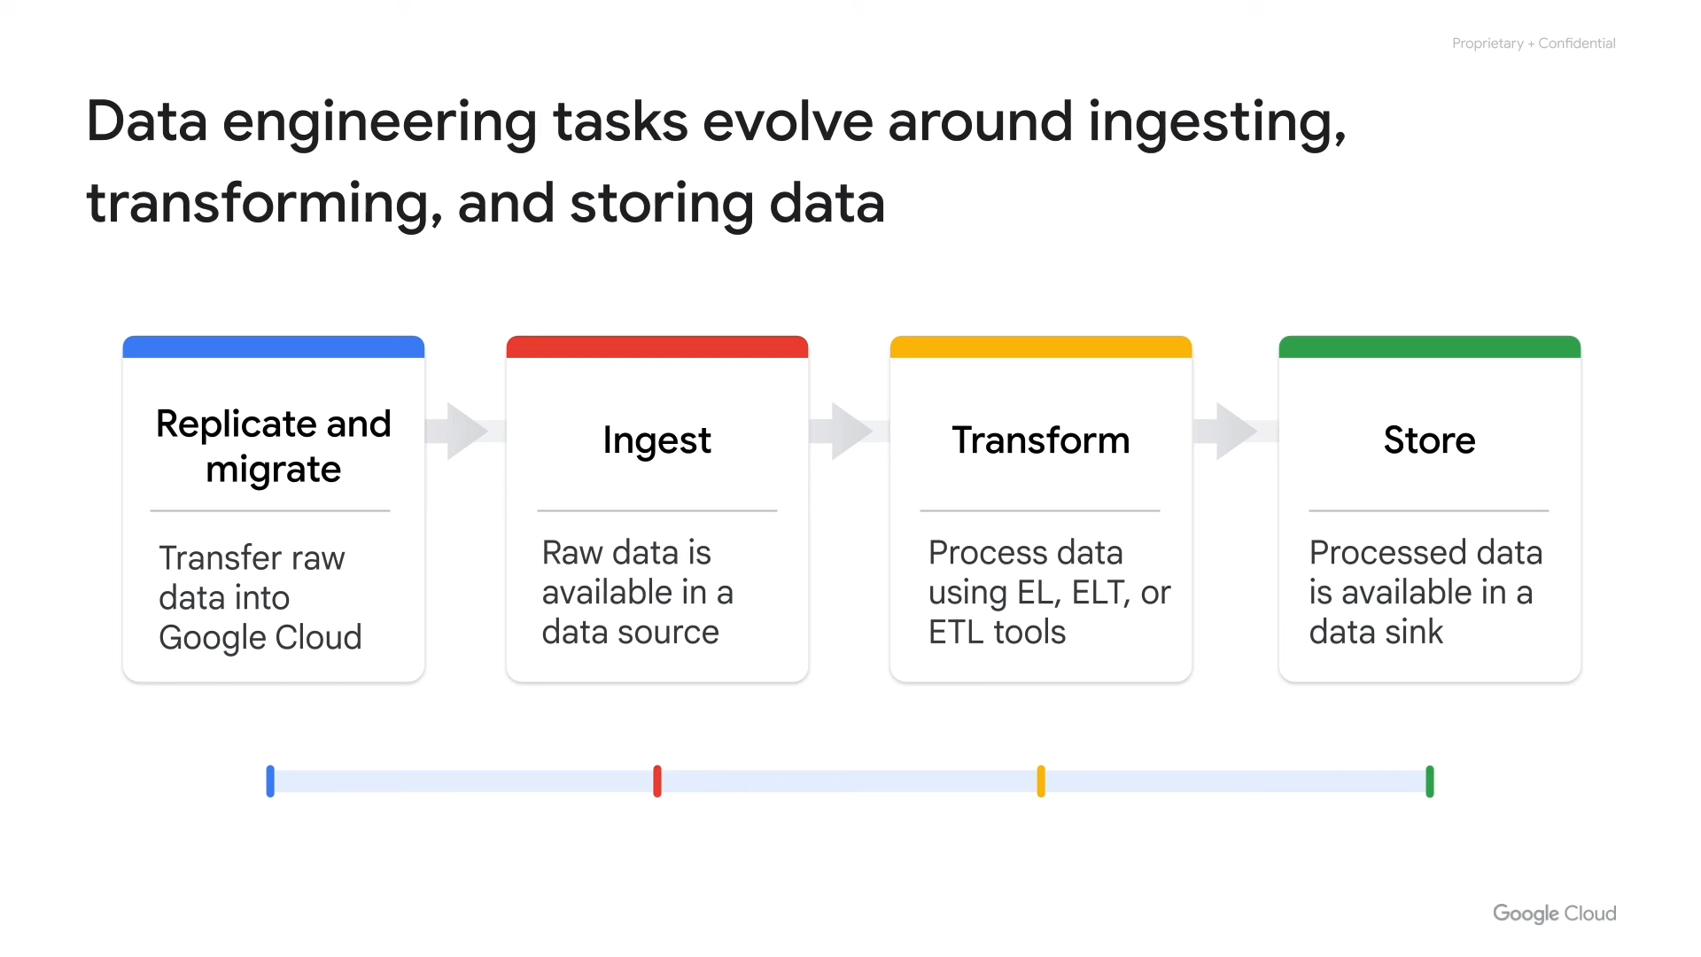
Q&A
Open Forum
Ask Your Questions
Clarifications and Discussion
Notes:
Now it's time for questions and answers. This is an open forum where you can ask any questions you may have. Please feel free to raise your hand, and I'll do my best to provide clear and helpful answers. Let's use this time for clarifications and further discussion to ensure everyone has a solid understanding of the material covered. Your input is highly valued and will help us ensure that we have addressed all of your concerns.

Slide 7
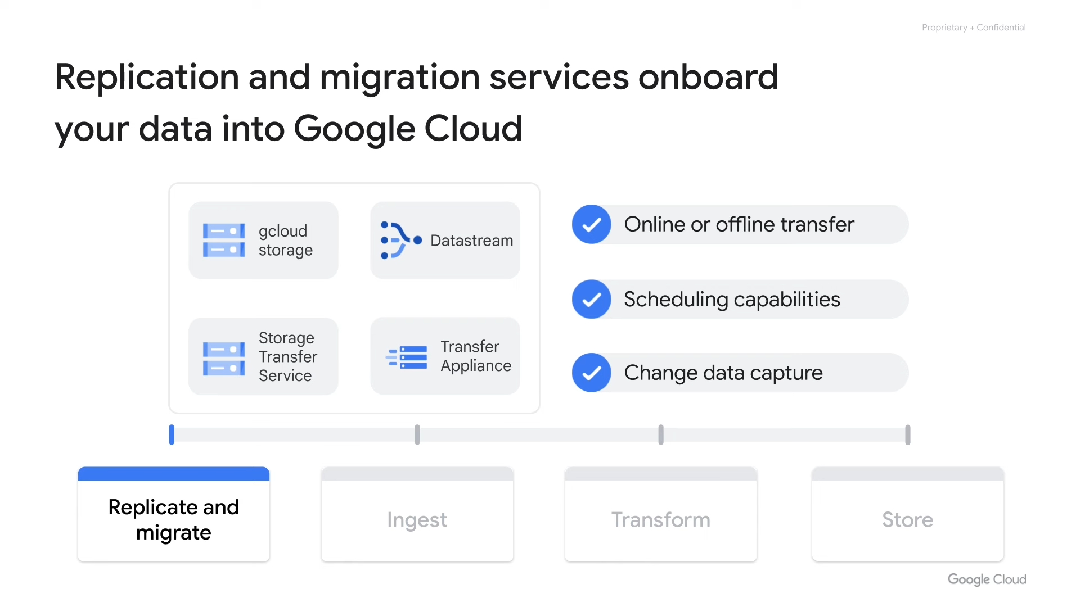
Conclusion
Summary of Key Points
Looking Ahead
Thank You
Notes:
In conclusion, let's briefly summarize the key points covered in this presentation. We'll also discuss looking ahead, providing a glimpse into the future of these concepts and how they might evolve. Finally, I want to express my sincere gratitude for your time and attention. Thank you for participating, and I hope you found this presentation informative and helpful. I also want to express my gratitude for your engagement.

