Slide 1
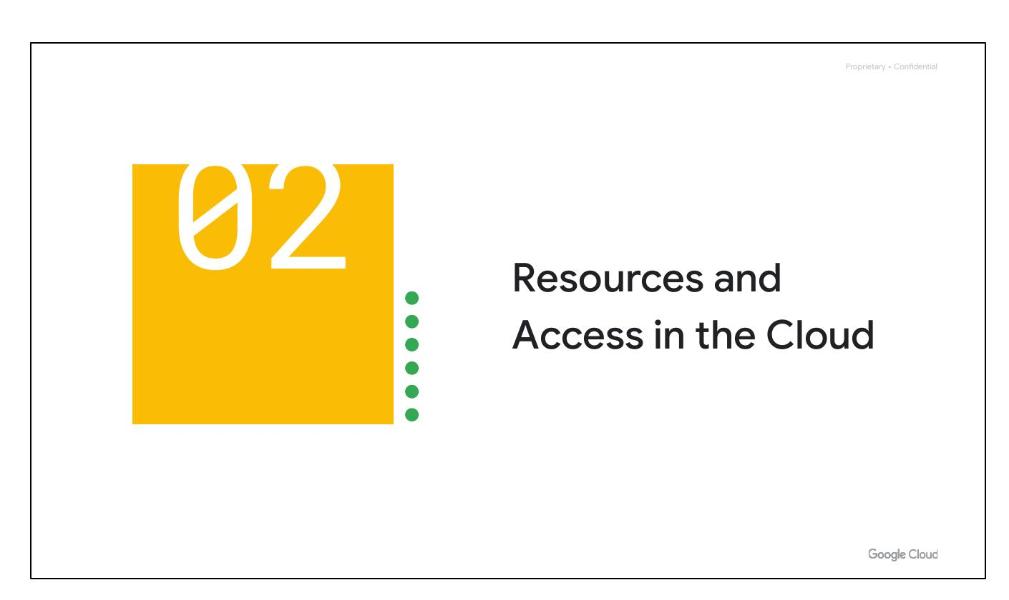
Resources and Access in the Cloud
Notes:
Now that you've had a chance to explore what cloud computing is, the pricing structure and billing practices available with Google Cloud, and the ways that Google strives to make the platform secure and environmentally friendly, let’s now work to understand the functional structure of Google Cloud.

Slide 2
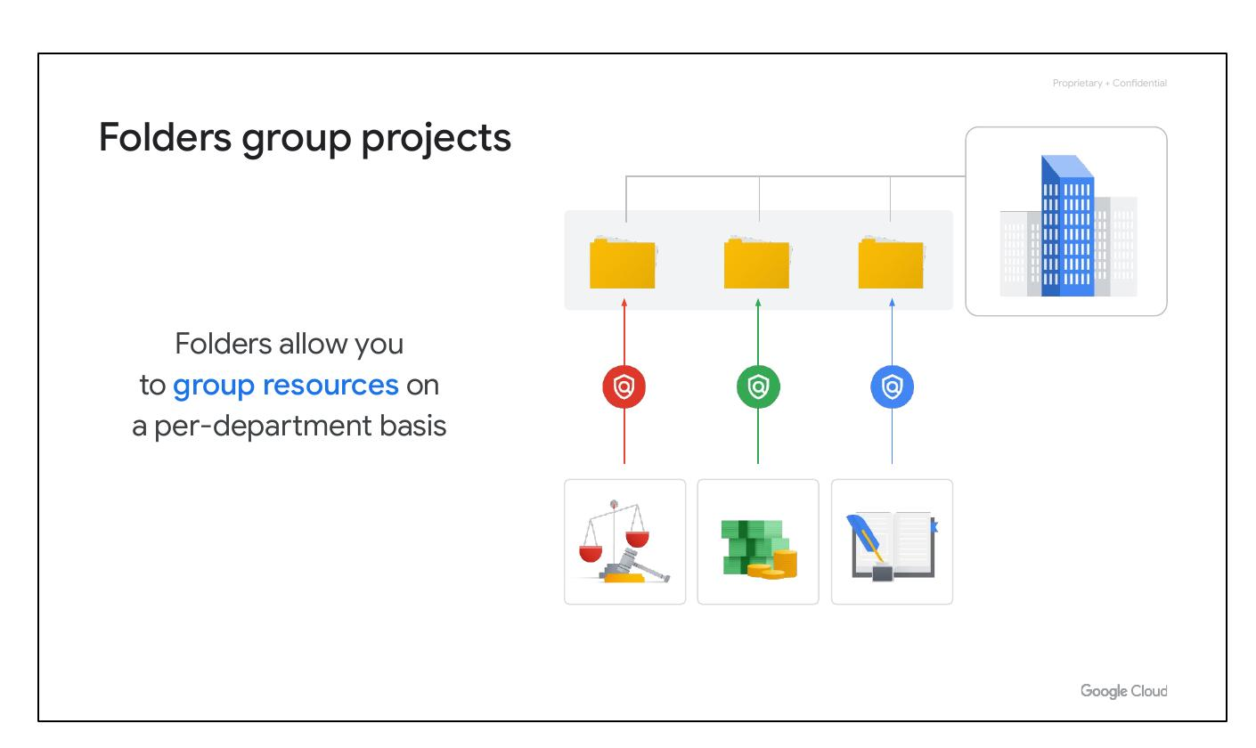
Folders Group Projects
Folders allow you to group resources on a per-department basis.
Folders let you assign policies to resources at a level of granularity you choose.
A folder can contain projects, other folders, or a combination of both.
Notes:
The third level of the Google Cloud resource hierarchy is folders. For example, your organization might contain multiple departments, each with its own set of Google Cloud resources. Folders give teams the ability to delegate administrative rights so that they can work independently.

Slide 3
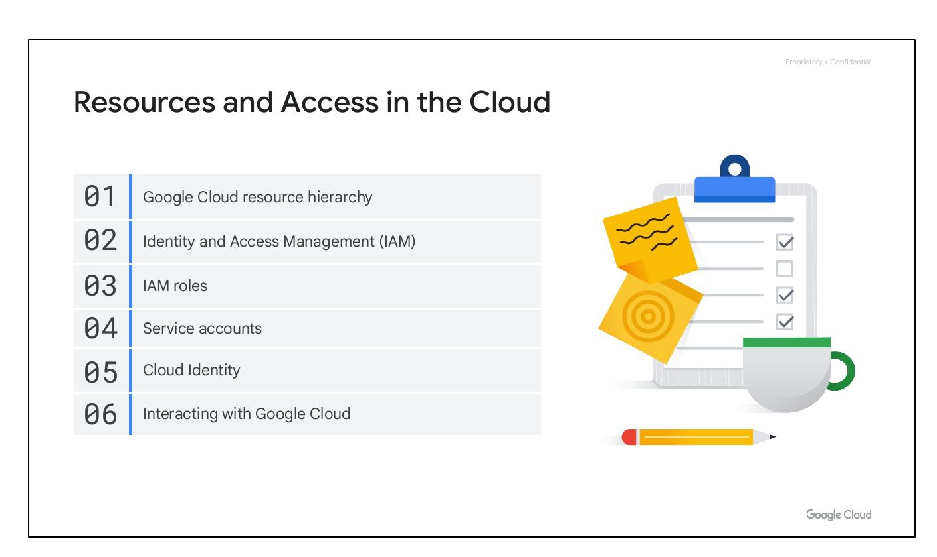
Resources and Access in the Cloud
Google Cloud resource hierarchy
Identity and Access Management (IAM)
IAM roles
Service accounts
Notes:
In this section of the course, we’ll see how resources get organized with projects, and how access to those resources gets shared with the right part of a workforce through a tool called Identity and Access Management, or IAM. We’ll also look into the different ways in which you can interact with Google Cloud, including our web user interface, command-line interface, and our mobile apps.

Slide 4

Resources and Access in the Cloud
Google Cloud resource hierarchy
Identity and Access Management (IAM)
IAM roles
Service accounts
Notes:
In this section of the course, we’ll see how resources get organized with projects, and how access to those resources gets shared with the right part of a workforce through a tool called Identity and Access Management, or IAM. We’ll also look into the different ways in which you can interact with Google Cloud, including our web user interface, command-line interface, and our mobile apps.

Slide 5
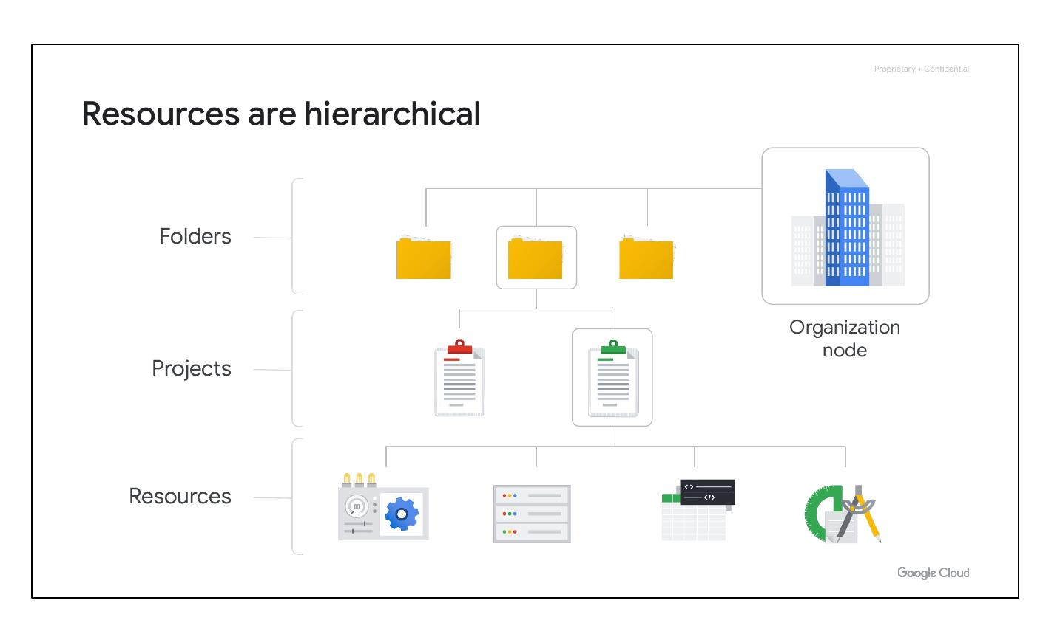
Resources are hierarchical
Resources represent virtual machines, Cloud Storage buckets, Virtual Private Networks (VPCs), tables in BigQuery, or anything else in Google Cloud.
Resources get organized into projects.
Projects can be organized into folders, or even subfolders.
At the top level is an organization node, which encompasses all the projects, folders, and resources in your organization.
Notes:
This hierarchy is made up of four levels, and starting from the bottom up they are: resources, projects, folders, and an organization node.

Slide 6
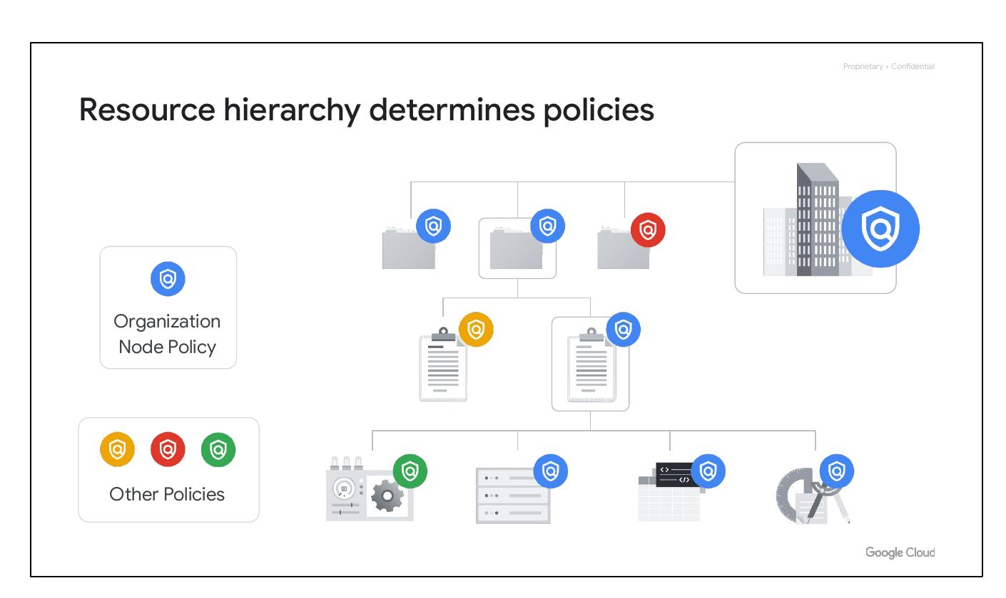
Resource Hierarchy and Policies
The Google Cloud resource hierarchy includes Organization, Folders, Projects, and Resources.
Policies are managed and applied by IAM.
Policies can be defined at the project, folder, and organization levels.
Policies are inherited downward from the Organization Node.
Notes:
Explain how policies are applied and inherited within the resource hierarchy. Emphasize the importance of understanding this hierarchy for effective policy management.

Slide 7
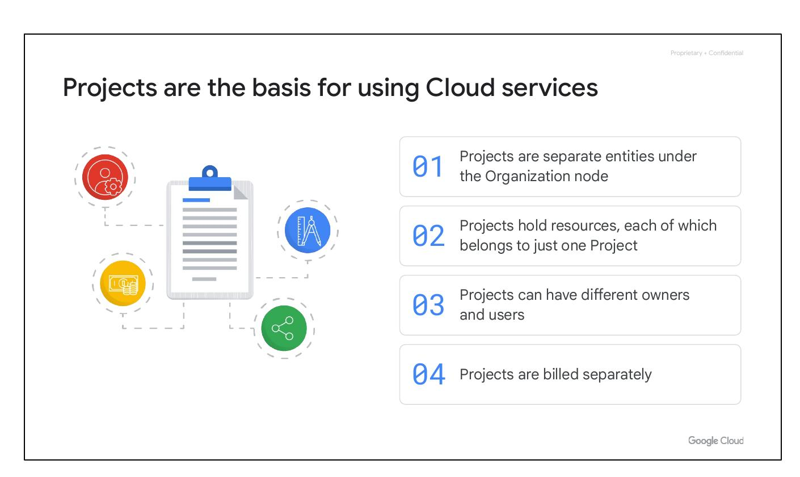
Projects: The Basis for Cloud Services
Projects are the foundation for using Google Cloud services.
Each project holds resources, and each resource belongs to only one project.
Projects are separate entities under the Organization node and can have different owners and users.
Projects are billed separately.
Notes:
Elaborate on the role of projects in enabling and using cloud services. Describe the project as a container for resources and a unit for billing and administration.

Slide 8
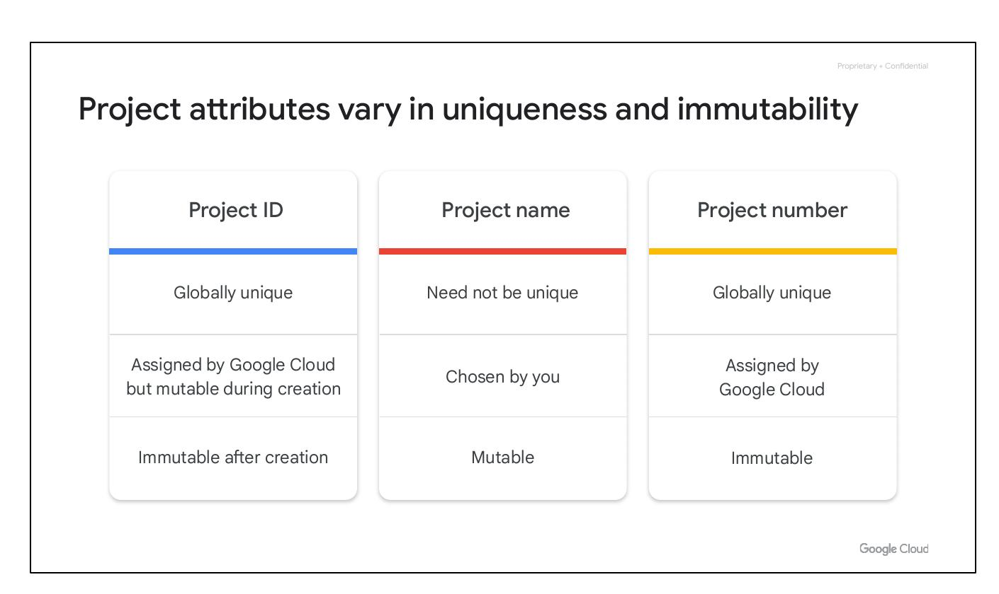
Project Attributes: Uniqueness and Immutability
Each Google Cloud project has a Project ID, a Project Name, and a Project Number.
The Project ID is globally unique, assigned by Google Cloud, and immutable after creation, but mutable during the creation phase.
The Project Name is chosen by the user, need not be unique, and is mutable.
The Project Number is globally unique, assigned by Google Cloud and immutable.
Notes:
Explain the characteristics of each project attribute. Highlight the difference between Project ID and Project Name in terms of uniqueness and mutability.

Slide 9
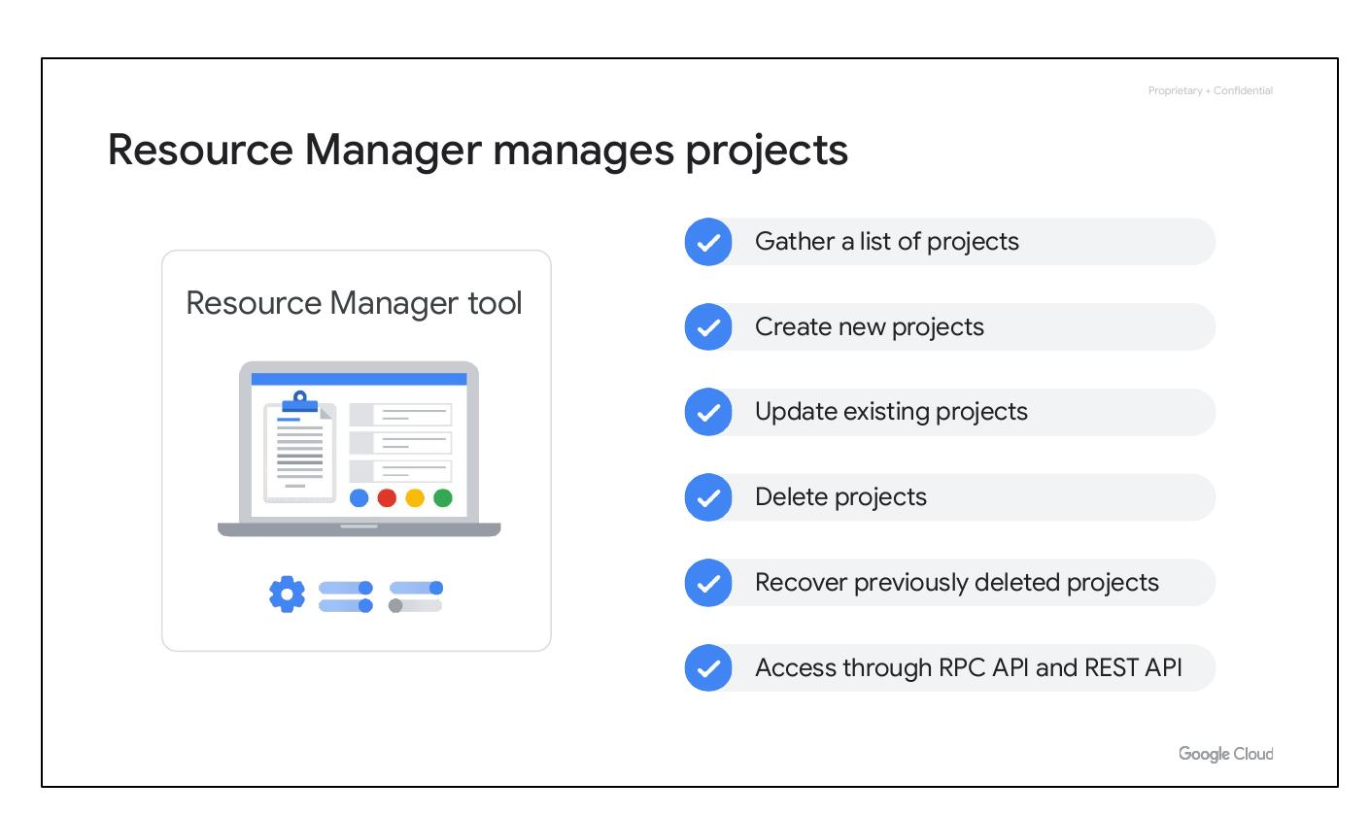
Resource Manager Manages Projects
The Resource Manager tool is used to programmatically manage projects.
It allows you to gather a list of projects, create new projects, update existing projects, and delete projects.
It can also recover previously deleted projects.
It can be accessed through RPC API and REST API.
Notes:
Describe the functionalities offered by the Resource Manager API. Mention the different actions one can perform with it.

Slide 10
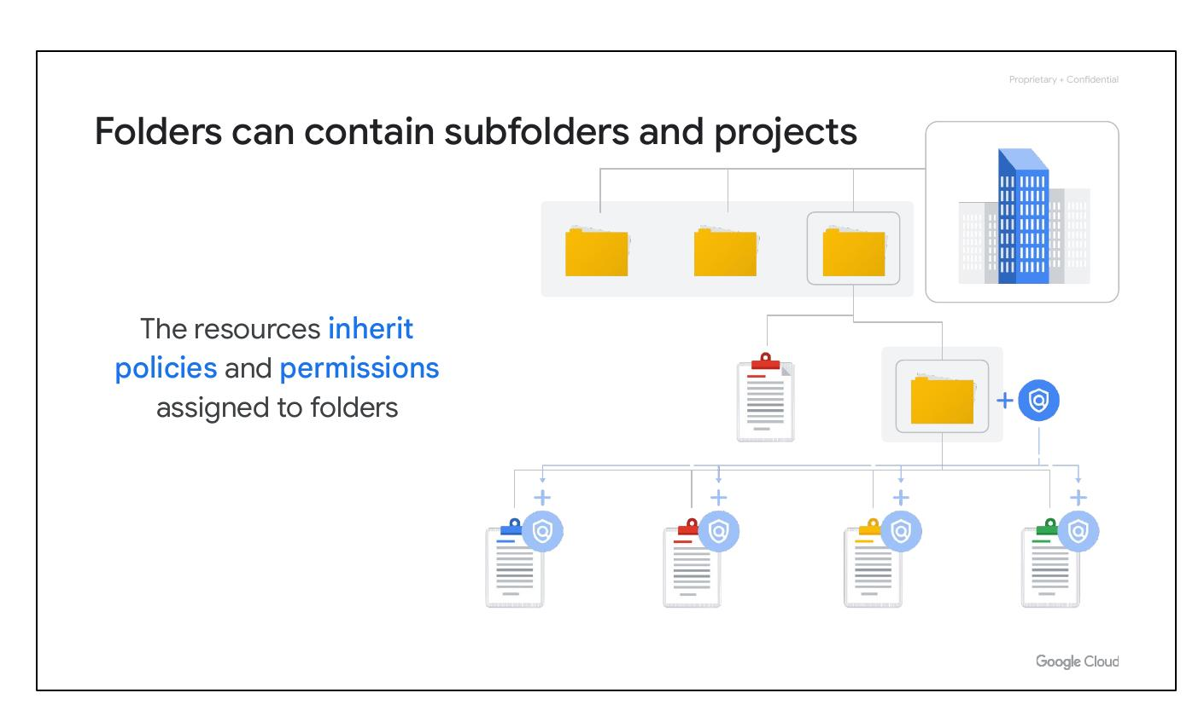
Folders: Organizing Projects and Policies
Folders let you assign policies to resources at a level of granularity you choose.
Folders can contain subfolders and projects.
The resources inherit policies and permissions assigned to folders.
Folders allow you to group resources on a per-department basis.
Notes:
Explain the role of folders in the resource hierarchy. Emphasize policy inheritance and the ability to group resources by department.

