Slide 1
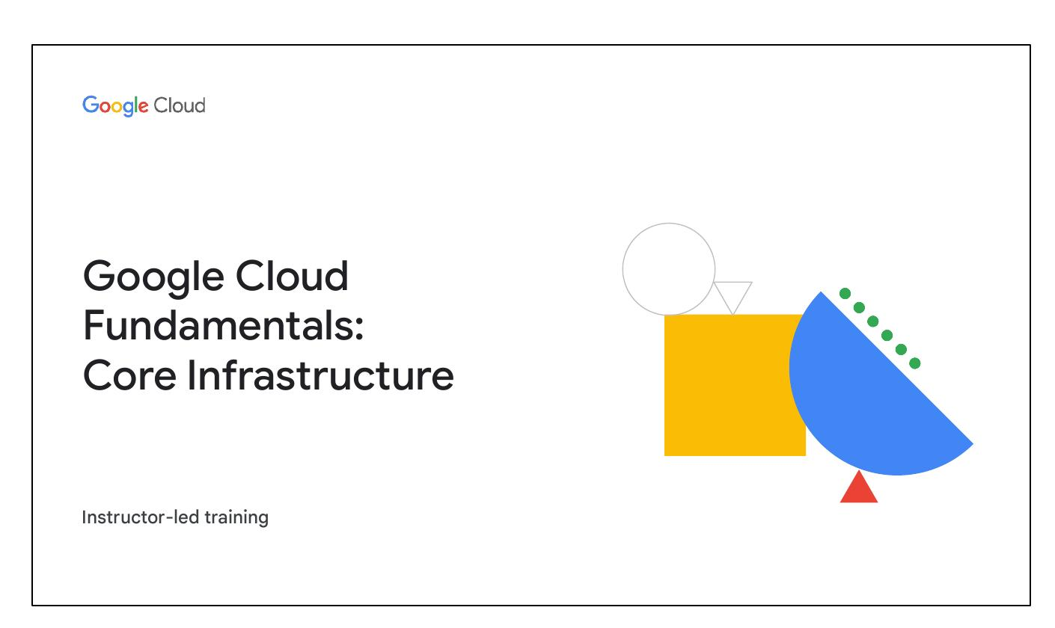
Introducing Google Cloud
Overview of cloud computing
IaaS and PaaS
Google Cloud network
Environmental impact
Security
Open APIs and open source
Pricing and billing
Notes:
This module introduces Google Cloud. It covers cloud computing basics. It will provide an overview of Infrastructure-as-a-Service (IaaS) and Platform-as-a-Service (PaaS). Further topics include the Google Cloud network, environmental impact, security measures, open APIs and open source initiatives, and pricing and billing models.

Slide 2
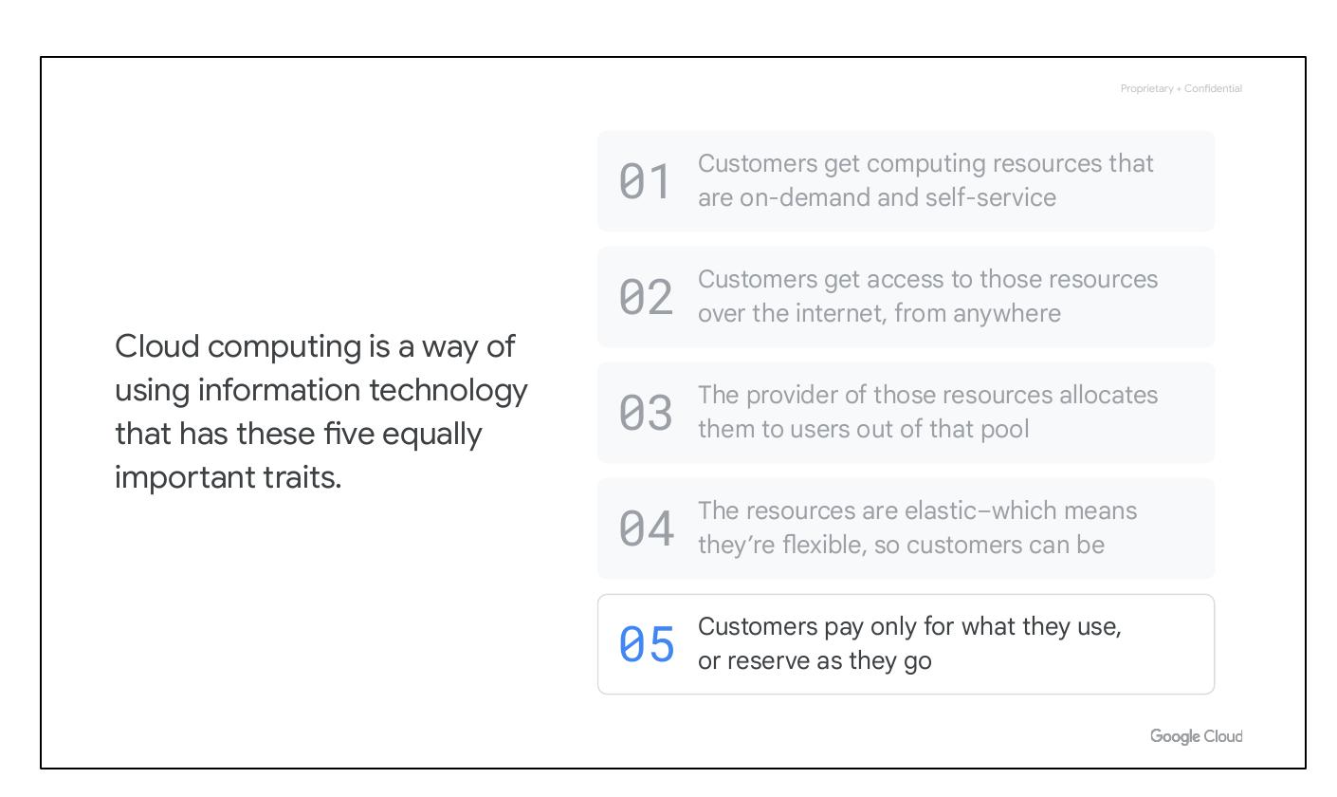
What is Cloud?
US National Institute definition
Term cloud computing: what is it?
Notes:
The cloud is a hot topic these days. The US National Institute of Standards and Technology created the term cloud computing, although, there is nothing US-specific about it.

Slide 3
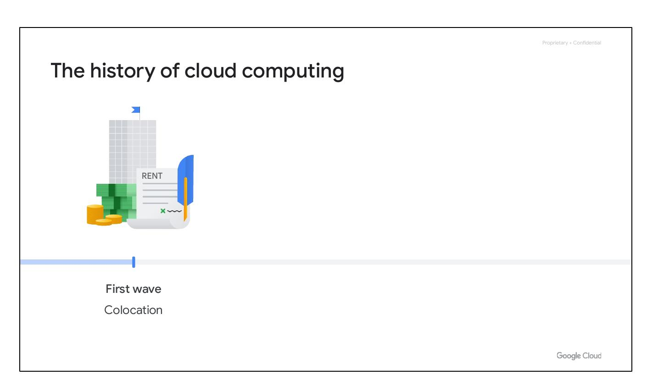
Cloud Computing Traits
On-demand, self-service
Access over the internet
Provider allocates resources
Resources are elastic
Pay only for what you use
Notes:
Cloud computing is a way of using IT that has five equally important traits. Customers get computing resources that are on-demand and self-service. Customers get access to those resources over the internet, from anywhere. The provider allocates resources to users out of that pool. The resources are elastic, and customers pay only for what they use, or reserve as they go.

Slide 4
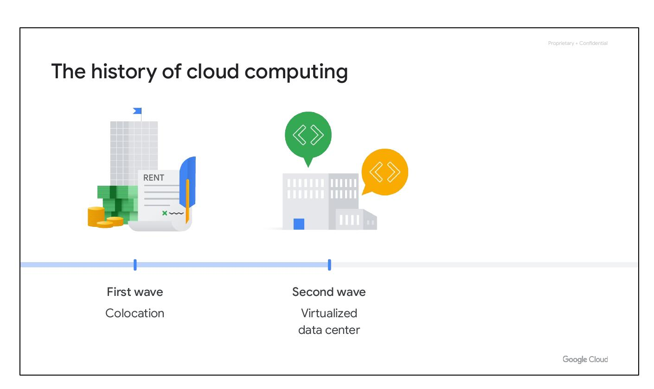
On-Demand Resources
Customers get computing resources
On-demand and self-service
Notes:
First, customers get computing resources that are on-demand and self-service. Through a web interface, users get the processing power, storage, and network they need with no need for human intervention.

Slide 5
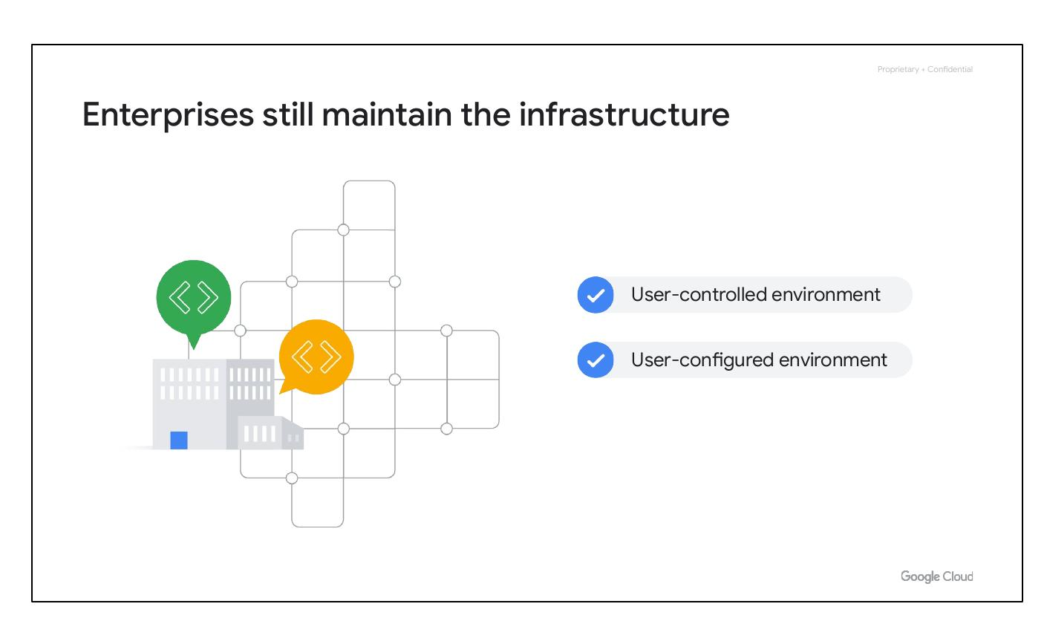
Access over Internet
Customers get access to resources
Over the internet, from anywhere
Notes:
Second, customers get access to those resources over the internet, from anywhere they have a connection.

Slide 6
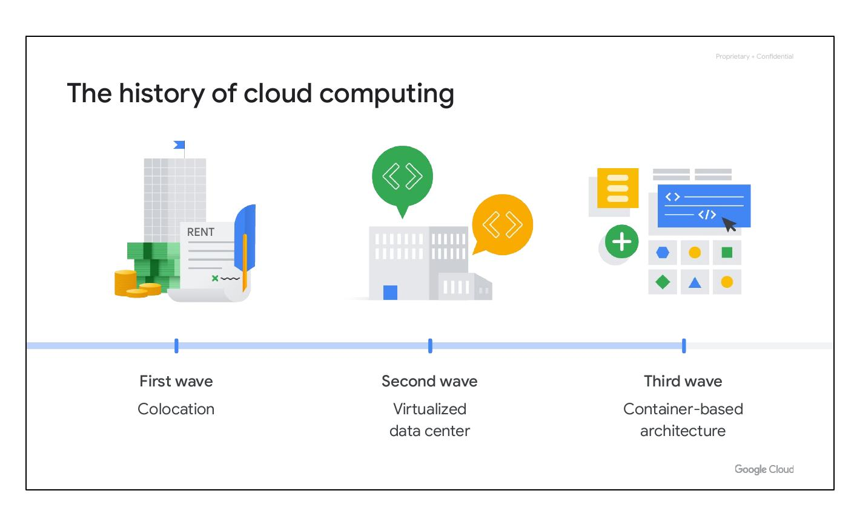
Provider Allocates Resources
Provider allocates to users
Out of that pool
Notes:
Third, the provider of those resources has a big pool of them, and allocates them to users out of that pool. That allows the provider to buy in bulk and pass the savings on to the customers. Customers don't have to know or care about the exact physical location of those resources.

Slide 7
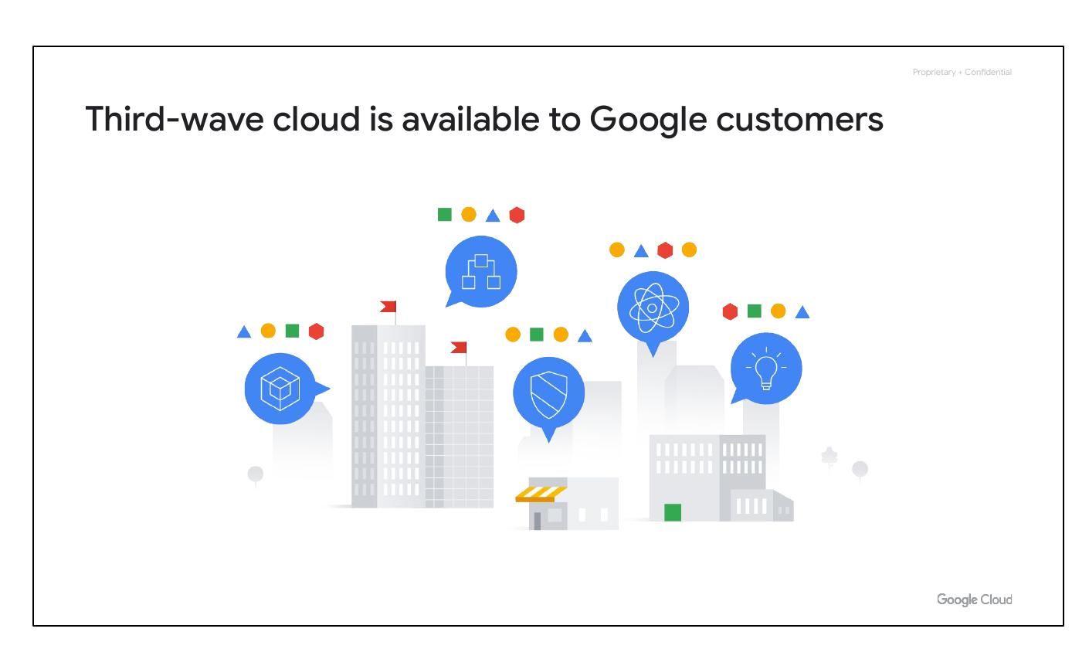
Resources Are Elastic
Resources are flexible
Customers can scale resources
Notes:
Fourth, the resources are elastic–which means they’re flexible, so customers can be. If they need more resources they can get more, and quickly. If they need less, they can scale back.

Slide 8
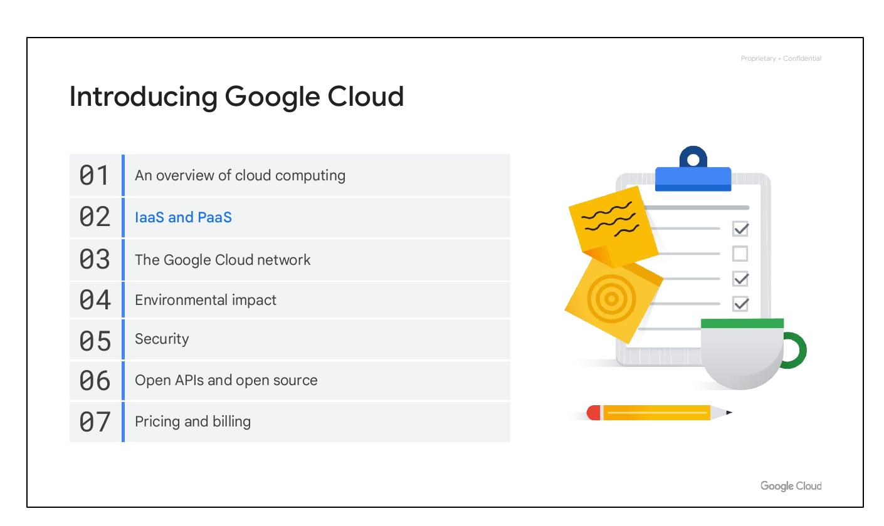
Pay-As-You-Go Model
Pay only for what you use
Or reserve as you go
Notes:
And finally, the customers pay only for what they use, or reserve as they go. If they stop using resources, they stop paying. That's it. That's the definition of cloud.

Slide 9
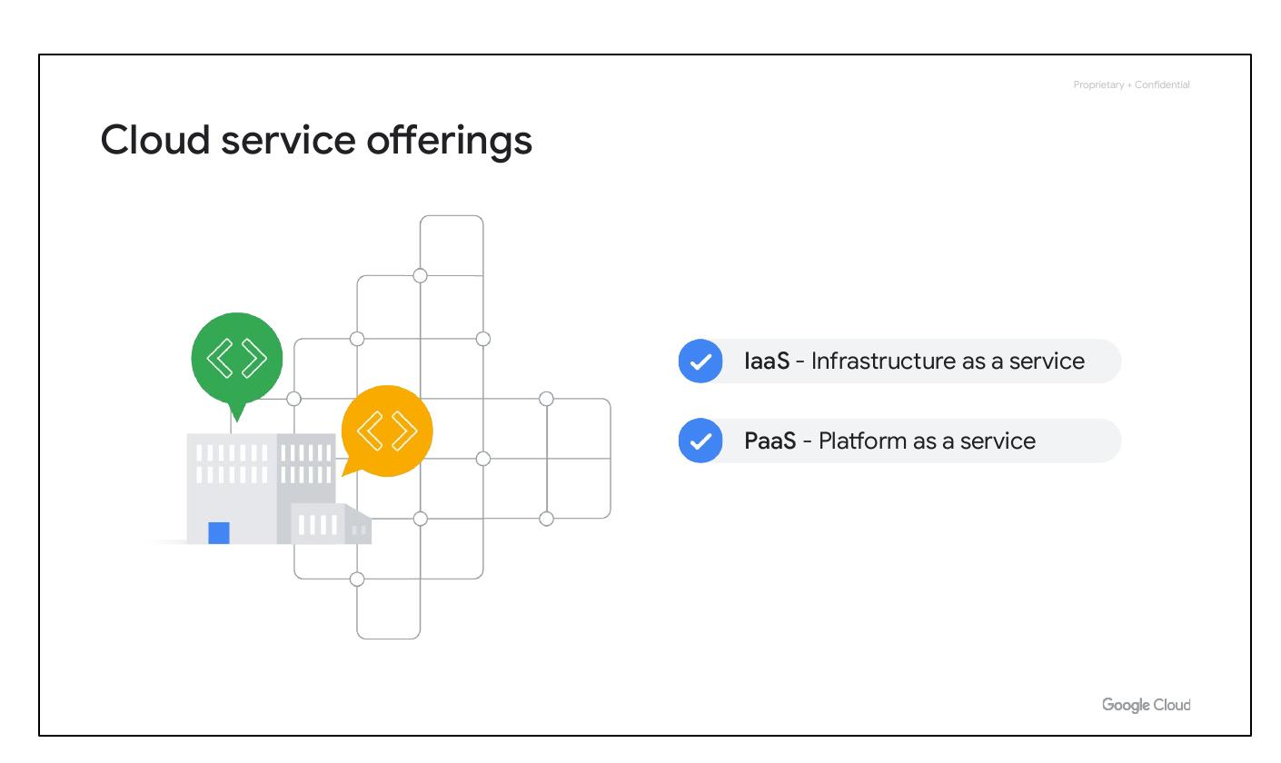
Cloud History: Colocation
First Wave: Rent
Colocation provided efficiency
Notes:
The trend towards cloud computing started with a first wave with something called colocation. Colocation gave users the financial efficiency of renting physical space, instead of investing in data center real estate.

Slide 10
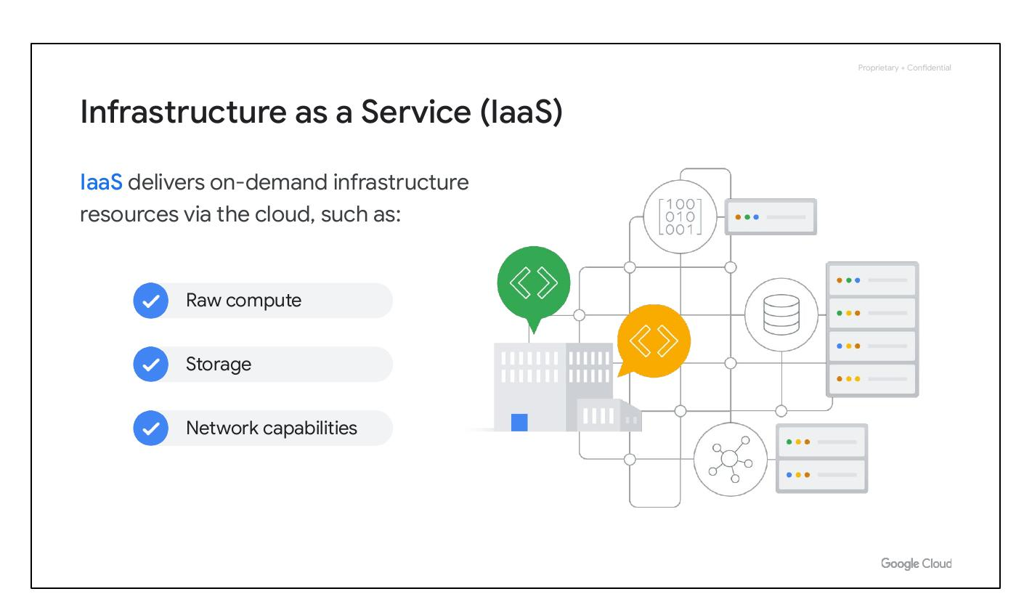
Cloud History: Virtualization
Second Wave
Virtualized data centers
Components are virtual devices
Notes:
Virtualized data centers of today, which is the second wave, share similarities with the private data centers and colocation facilities of decades past. The components of virtualized data centers match the physical building blocks of hosted computing—servers, CPUs, disks, load balancers, and so on—but now they’re virtual devices.

Slide 11
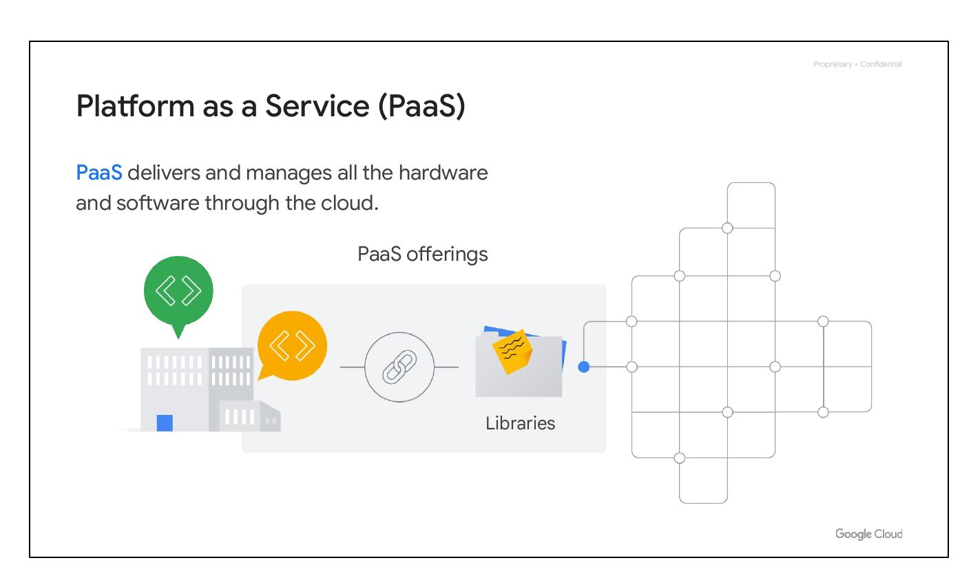
User-Controlled Environment
User-controlled environment
Enterprises maintained infrastructure
Notes:
With virtualization, enterprises still maintained the infrastructure; it’s still a user-controlled and user-configured environment.

Slide 12
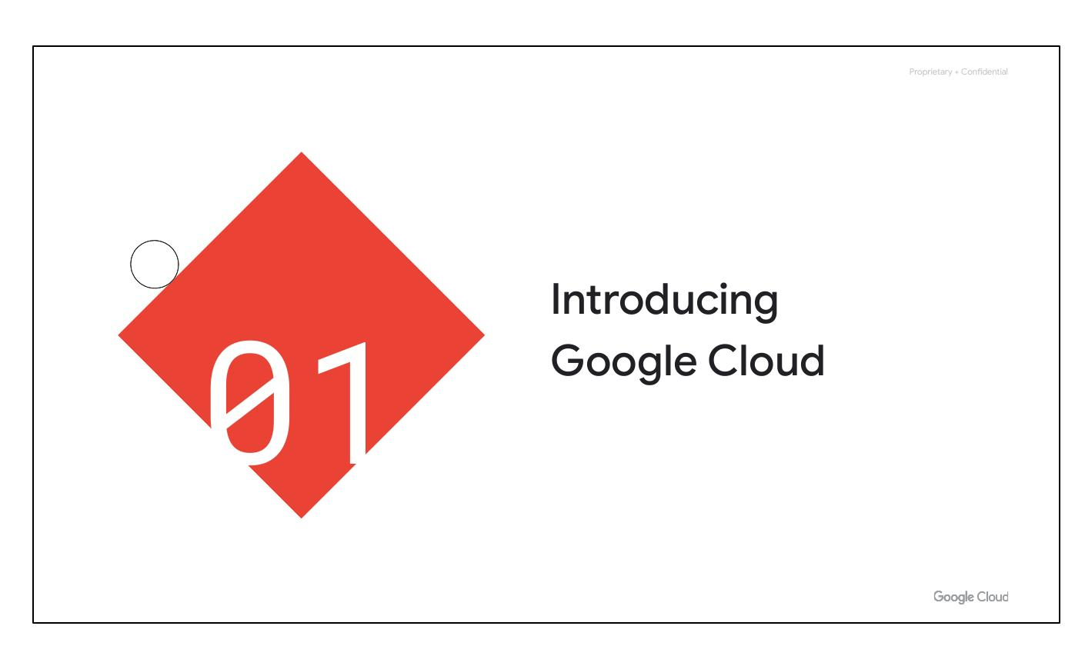
Cloud History: Containerization
Third Wave
Container-based architecture
Automated services and scalable data
Notes:
Several years ago, Google realized that its business couldn’t move fast enough within the confines of the virtualization model. So Google switched to a container-based architecture—a fully automated, elastic third-wave cloud that consists of a combination of automated services and scalable data. Services automatically provision and configure the infrastructure used to run applications.

Slide 13
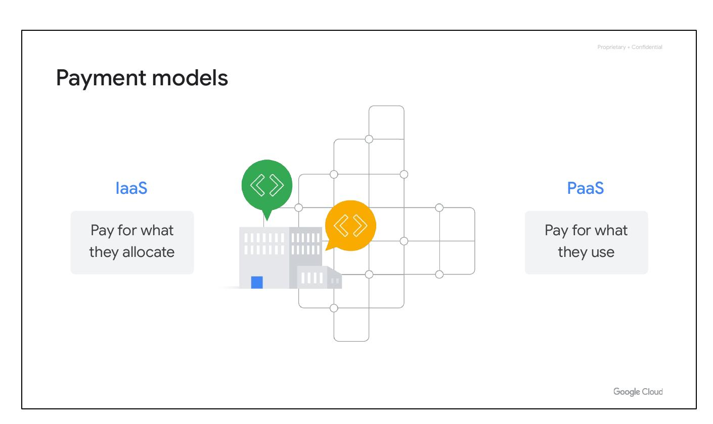
Google's Third-Wave Cloud
Available to Google customers
Every company will be data company
Notes:
Today, Google Cloud makes this third-wave cloud available to Google customers. Google believes that, in the future, every company—regardless of size or industry—will differentiate itself from its competitors through technology. Increasingly, that technology will be in the form of software. Great software is based on high-quality data. This means that every company is, or will eventually become, a data company.

Slide 14
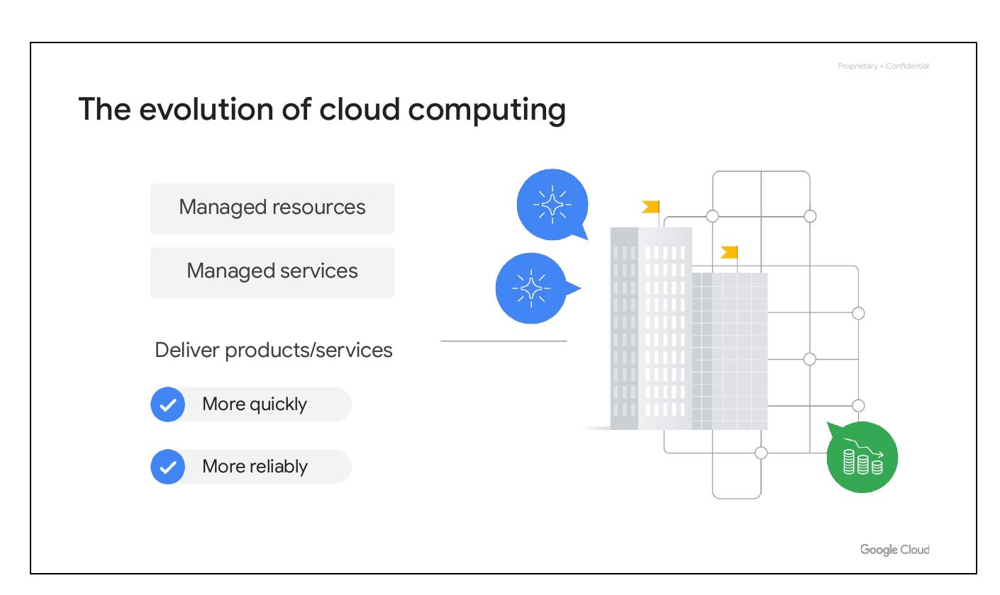
Cloud Service Offerings
IaaS - Infrastructure as a service
PaaS - Platform as a service
Notes:
This move to virtualized data centers introduced customers to two new types of offerings: infrastructure as a service, commonly referred to as IaaS, and platform as a service, or PaaS.

Slide 15
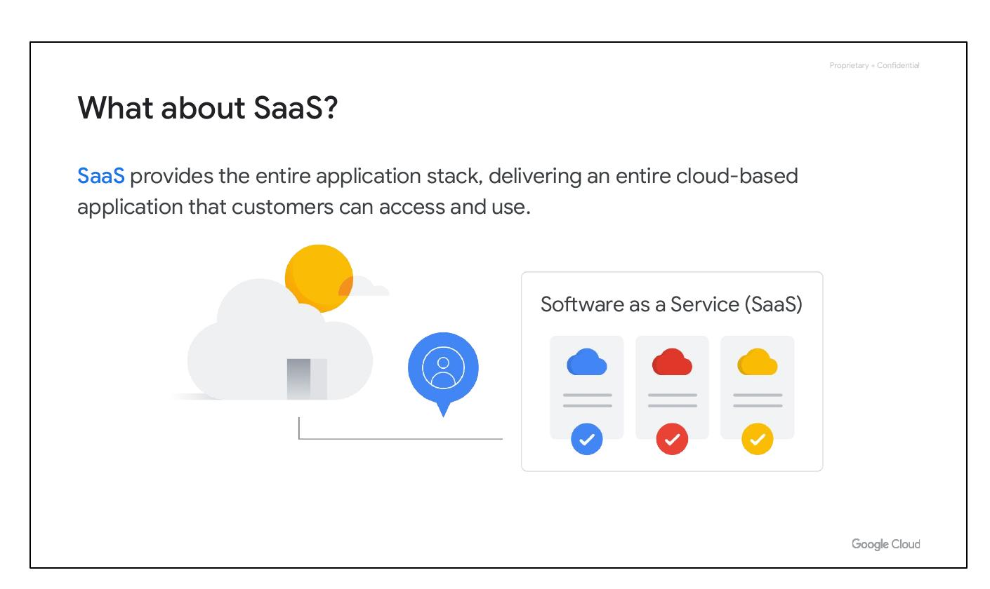
IaaS Overview
Infrastructure as a Service (IaaS)
Delivers on-demand infrastructure
Raw compute, storage, network
Notes:
IaaS delivers on-demand infrastructure resources via the cloud, such as raw compute, storage, and network capabilities, organized virtually into resources that are similar to physical data centers. Compute Engine is an example of a Google Cloud IaaS service.

Slide 16

PaaS Overview
Platform as a Service (PaaS)
Delivers/manages hardware and software
Bind code to infrastructure needs
Notes:
PaaS delivers and manages all the hardware and software through the cloud. PaaS offerings bind code to libraries that provide access to the infrastructure application needs. This allows more resources to be focused on application logic. App Engine is an example of a Google Cloud PaaS service.

Slide 17
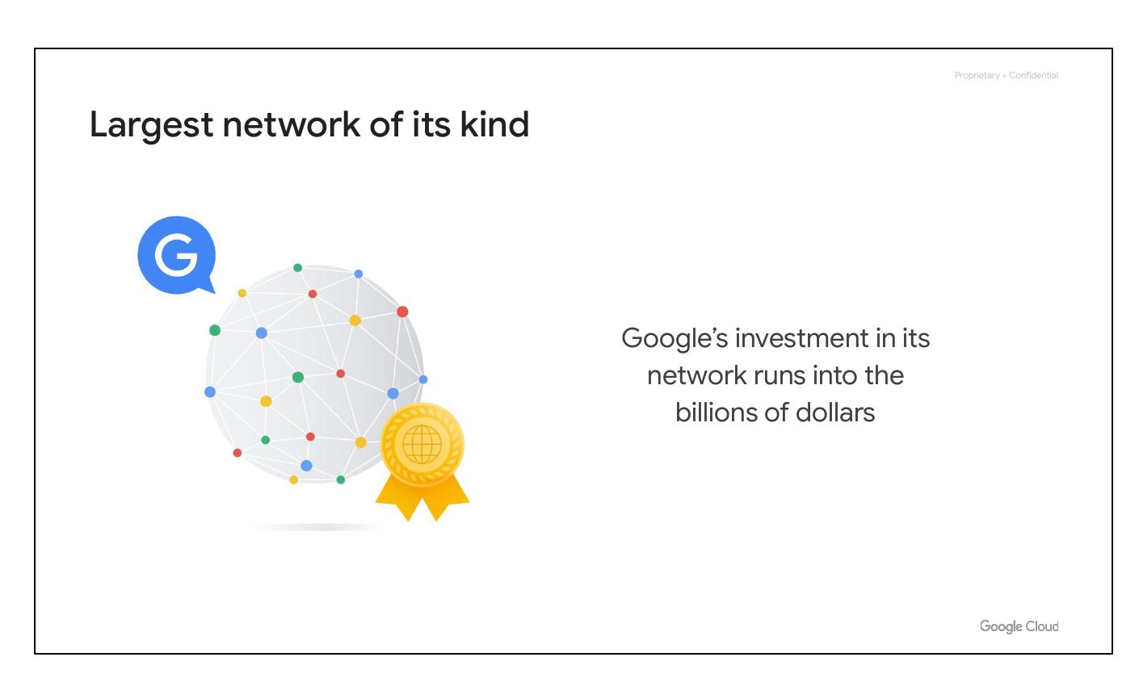
IaaS vs PaaS
IaaS: Pay for what they allocate
PaaS: Pay for what they use
Notes:
In the IaaS model, customers pay for the resources they allocate ahead of time; in the PaaS model, customers pay for the resources they actually use.

Slide 18
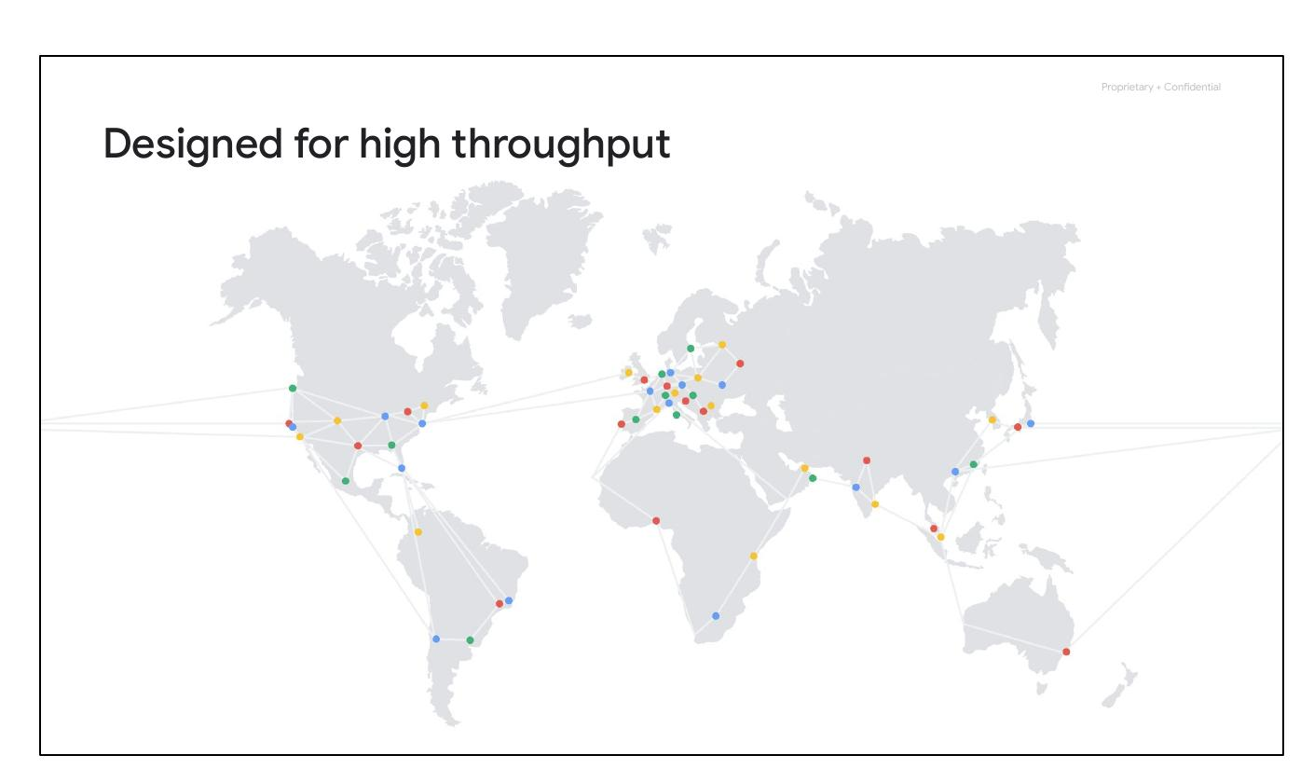
Evolution of Cloud
Managed resources
Managed services
Deliver products/services quickly
More reliably
Notes:
As cloud computing has evolved, the momentum has shifted toward managed infrastructure and managed services. Leveraging managed resources and services allows companies to concentrate more on their business goals and spend less time and money on creating and maintaining their technical infrastructure. It allows companies to deliver products and services to their customers more quickly and reliably. Serverless computing allows developers to concentrate on their code, rather than on server configuration, by eliminating the need for any infrastructure management.

Slide 19
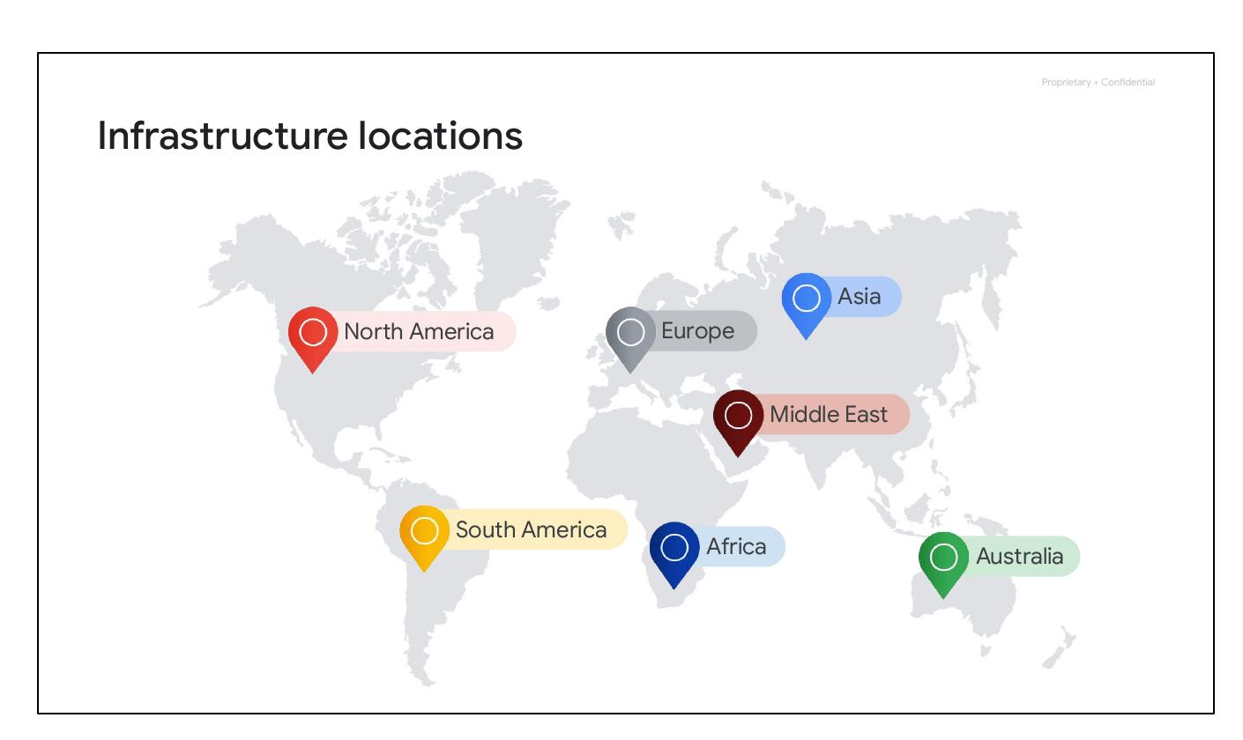
Software as a Service
Entire application stack
Run in cloud as service
Consumed over internet
Notes:
SaaS provides the entire application stack, delivering an entire cloud-based application that customers can access and use. SaaS applications are not installed on your local computer - they run in the cloud as a service and are consumed directly over the internet by end users. Google's popular applications like Gmail, Docs, and Drive, collectively known as Google Workspace, are all classified as SaaS.

Slide 20
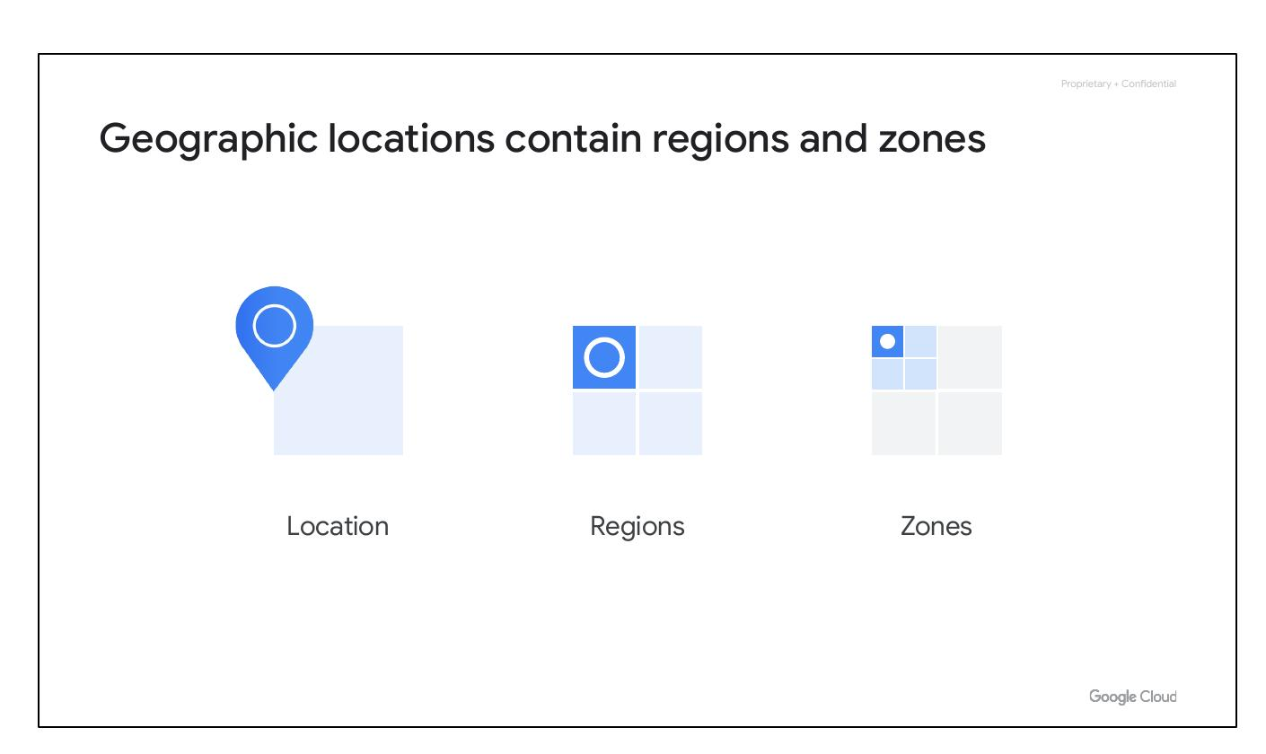
Google's Network
Google's investment: Billions of dollars
Largest network of its kind
Notes:
Google’s network is the largest network of its kind, and Google has invested billions of dollars over the years to build it.

Slide 21
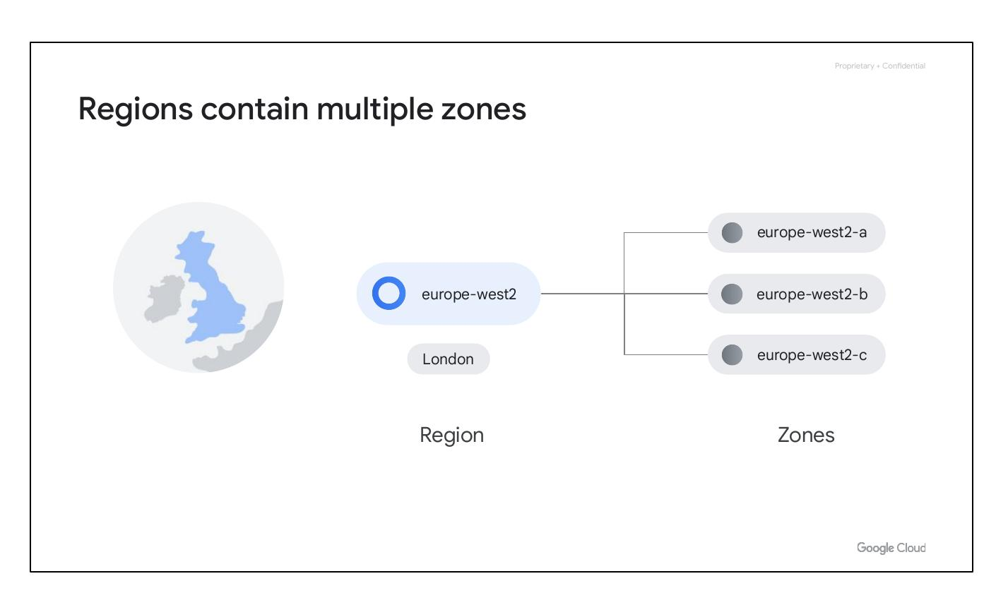
Designed for Throughput
High throughput
Low latencies
100+ content caching nodes
Notes:
Google’s global network is designed to give customers the highest possible throughput and lowest possible latencies for their applications by leveraging more than 100 content caching nodes worldwide–which are locations where high demand content is cached for quicker access–to respond to user requests from the location that will provide the quickest response time.

Slide 22
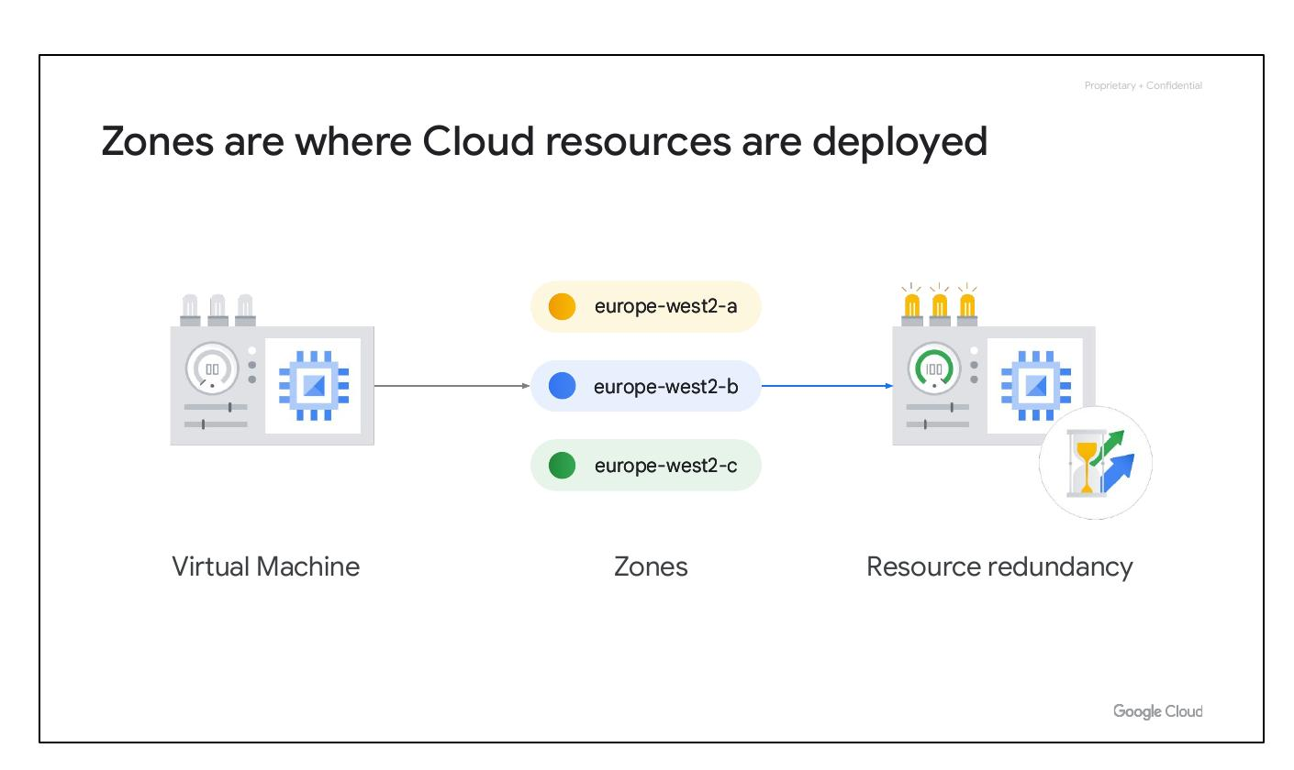
Infrastructure Locations
North America
South America
Europe, Asia, Australia
Middle East, Africa
Notes:
Google Cloud’s infrastructure is based in seven major geographic locations: North America, South America, Europe, Africa, the Middle East, Asia, and Australia. Having multiple service locations is important because choosing where to locate applications affects qualities like availability, durability, and latency, the latter of which measures the time a packet of information takes to travel from its source to its destination.

Slide 23

Regions and Zones
Location
Regions
Zones
Geographic locations
Notes:
Each of these locations are divided into a number of different regions and zones.

Slide 24
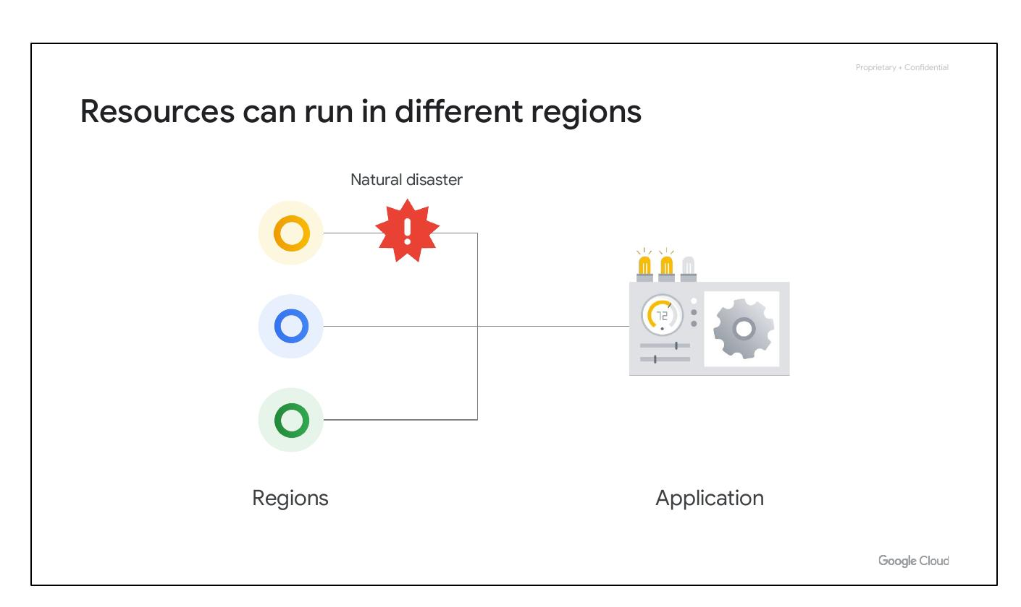
Regions Contain Zones
Region
Zones
London - europe-west2
Notes:
Regions represent independent geographic areas, and are composed of zones. For example, London, or europe-west2, is a region that currently comprises three different zones.

Slide 25
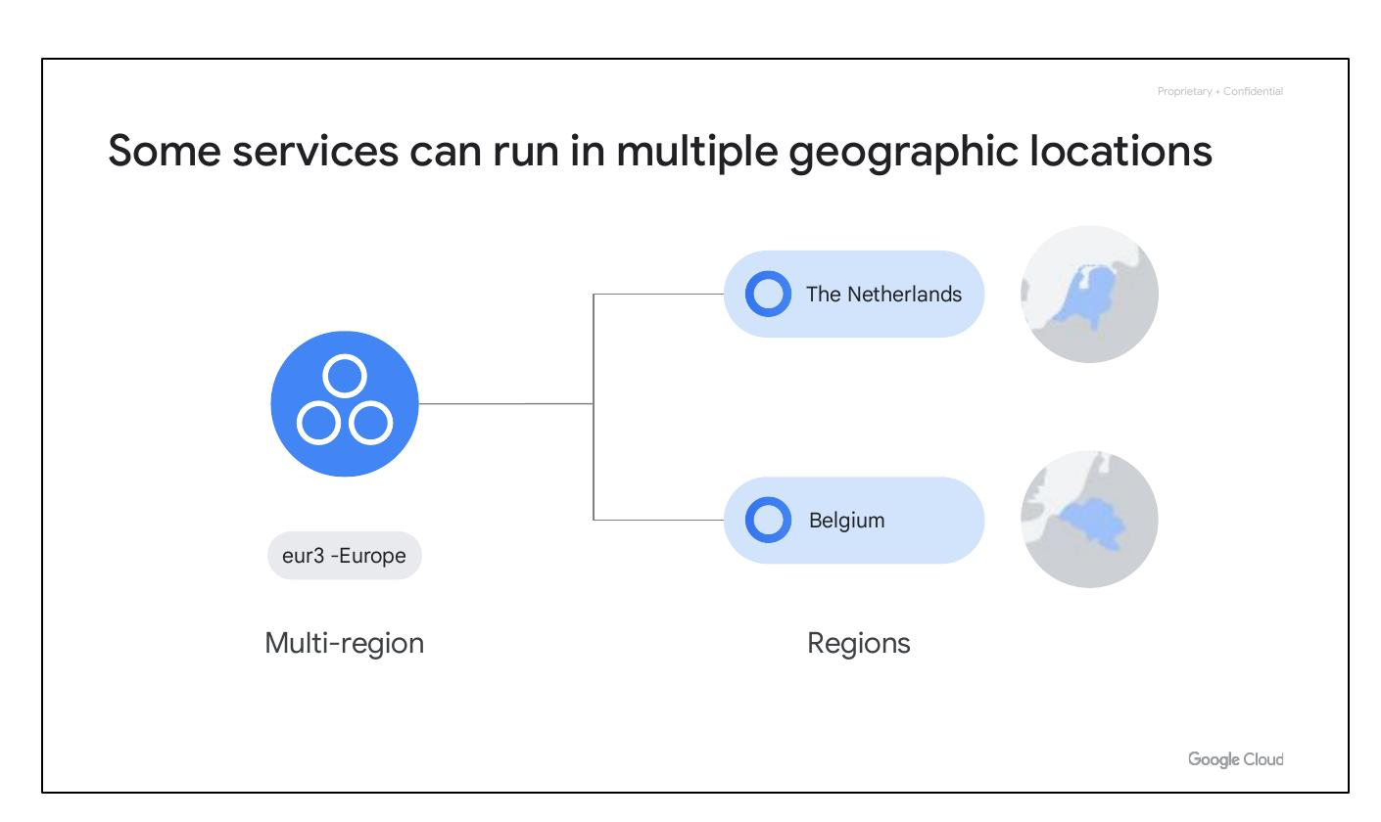
Resource Redundancy
Zones
Resources deployed in zones
Virtual Machine example
Notes:
A zone is an area where Google Cloud resources get deployed. For example, let’s say you launch a virtual machine using Compute Engine–more about Compute Engine in a bit–it will run in the zone that you specify to ensure resource redundancy.

Slide 26
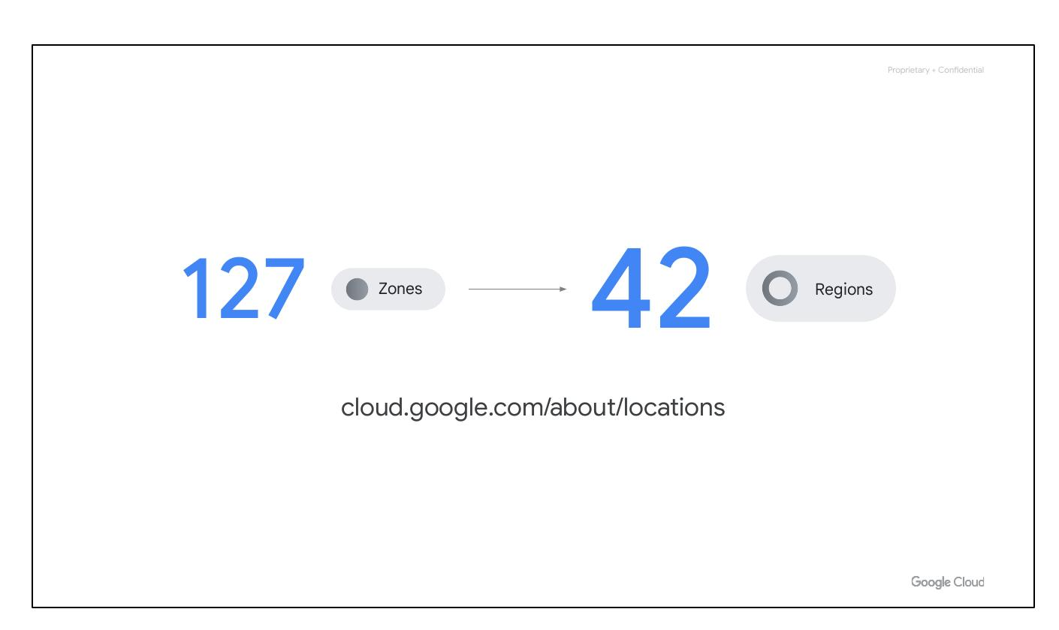
Run Resources in Regions
Resources run in different regions
Closer to users worldwide
Protection against natural disaster
Notes:
You can run resources in different regions. This is useful for bringing applications closer to users around the world, and also for protection in case there are issues with an entire region, say, due to a natural disaster.

Slide 27
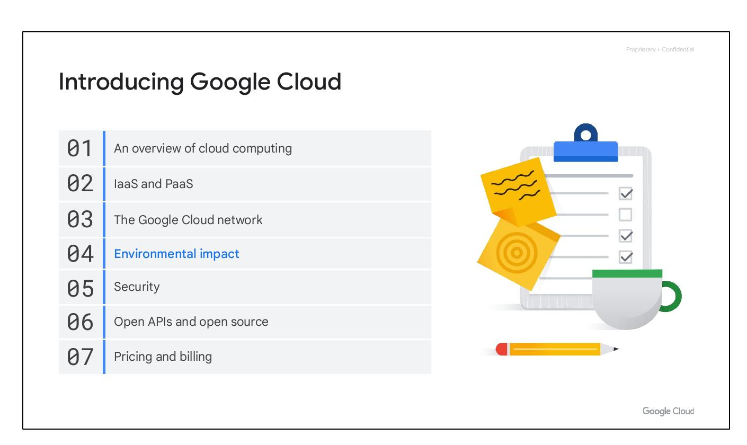
Multi-Region Services
Resources in multiple regions
Example: Spanner
Low latency data reads
Notes:
Some of Google Cloud’s services support placing resources in what we call a multi-region. For example, Spanner multi-region configurations allow you to replicate the database's data not just in multiple zones, but in multiple zones across multiple regions, as defined by the instance configuration. These additional replicas enable you to read data with low latency from multiple locations close to or within the regions in the configuration, like The Netherlands and Belgium.

Slide 28
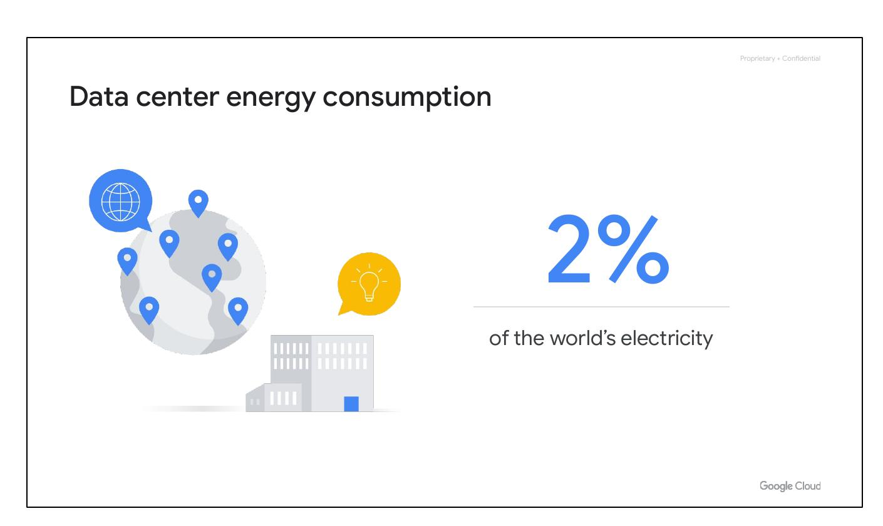
Zones and Regions
Increasing zones and regions
cloud.google.com/about/locations
Notes:
The number of zones and regions Google Cloud supports is increasing all the time. The most up to date info can be found at cloud.google.com/about/locations.

Slide 29
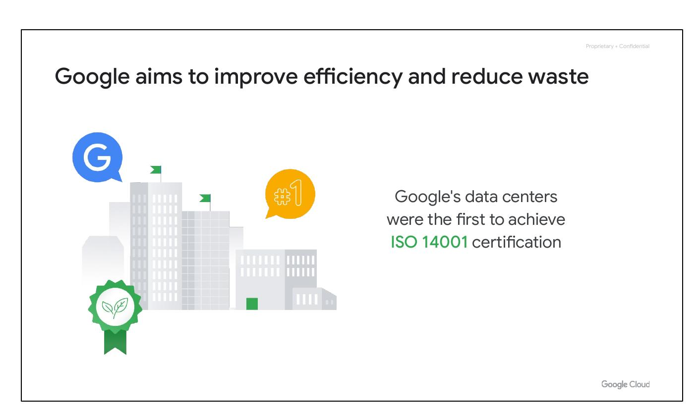
Data Center Energy
2% of world's electricity
Work for efficient data centers
Notes:
Together, all existing data centers use roughly 2% of the world’s electricity. So, Google works to make data centers run as efficiently as possible.

Slide 30
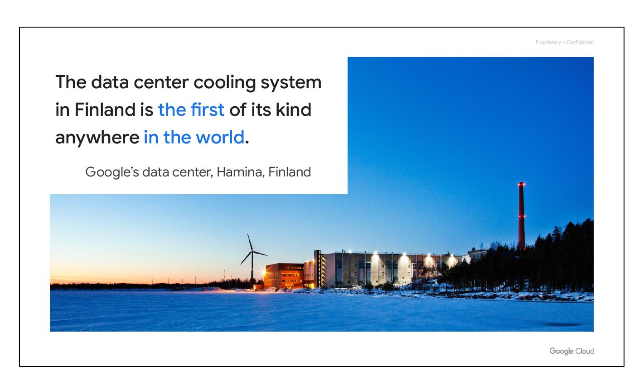
Improving Efficiency
Improve efficiency/reduce waste
ISO 14001 certification achieved
Notes:
Google is trying to do the right things for the planet. Google's data centers were the first to achieve ISO 14001 certification, which is a standard that maps out a framework for improving resource efficiency and reducing waste.

Slide 31
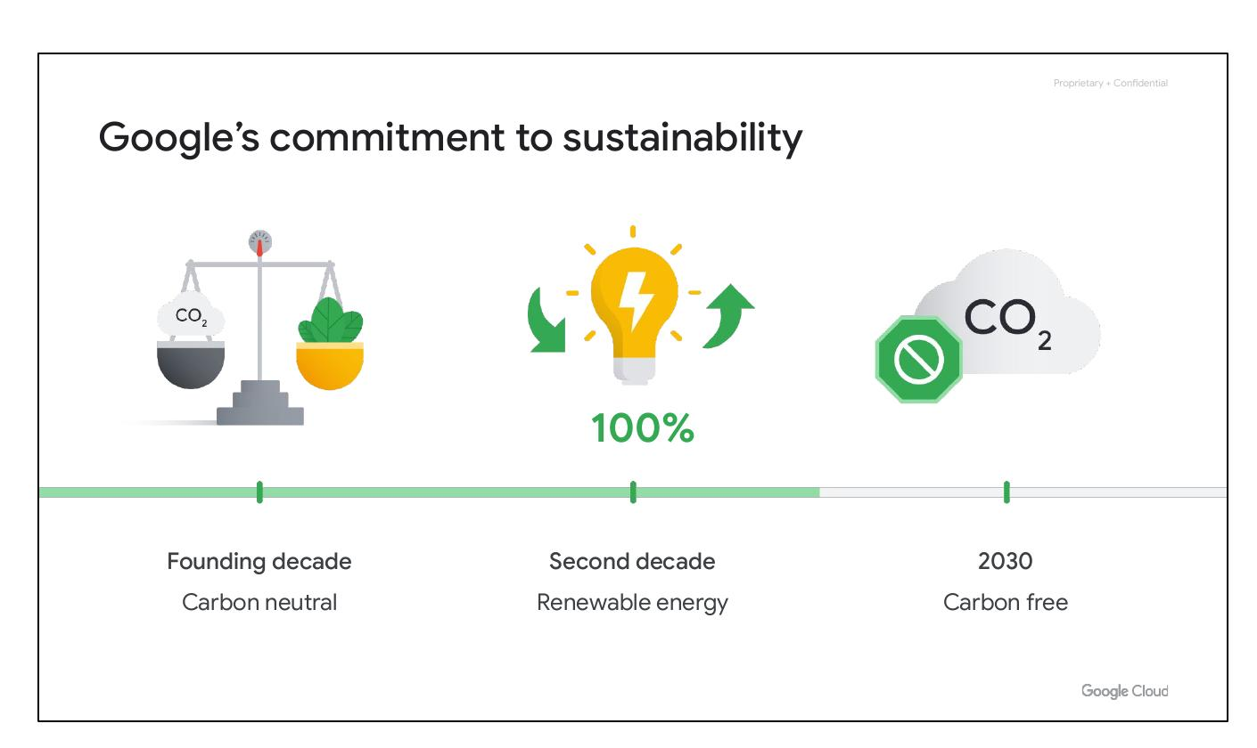
Hamina, Finland
Most advanced/efficient
Cooling system uses sea water
Notes:
This is Google’s data center in Hamina, Finland. The facility is one of the most advanced and efficient data centers in the Google fleet. Its cooling system, which uses sea water from the Bay of Finland, reduces energy use and is the first of its kind anywhere in the world.

Slide 32

Sustainability Commitment
Carbon neutral first
100% renewable energy
Carbon free by 2030
Notes:
In our founding decade, Google became the first major company to be carbon neutral. In our second decade, we were the first company to achieve 100% renewable energy. By 2030, we aim to be the first major company to operate carbon free.

Slide 33
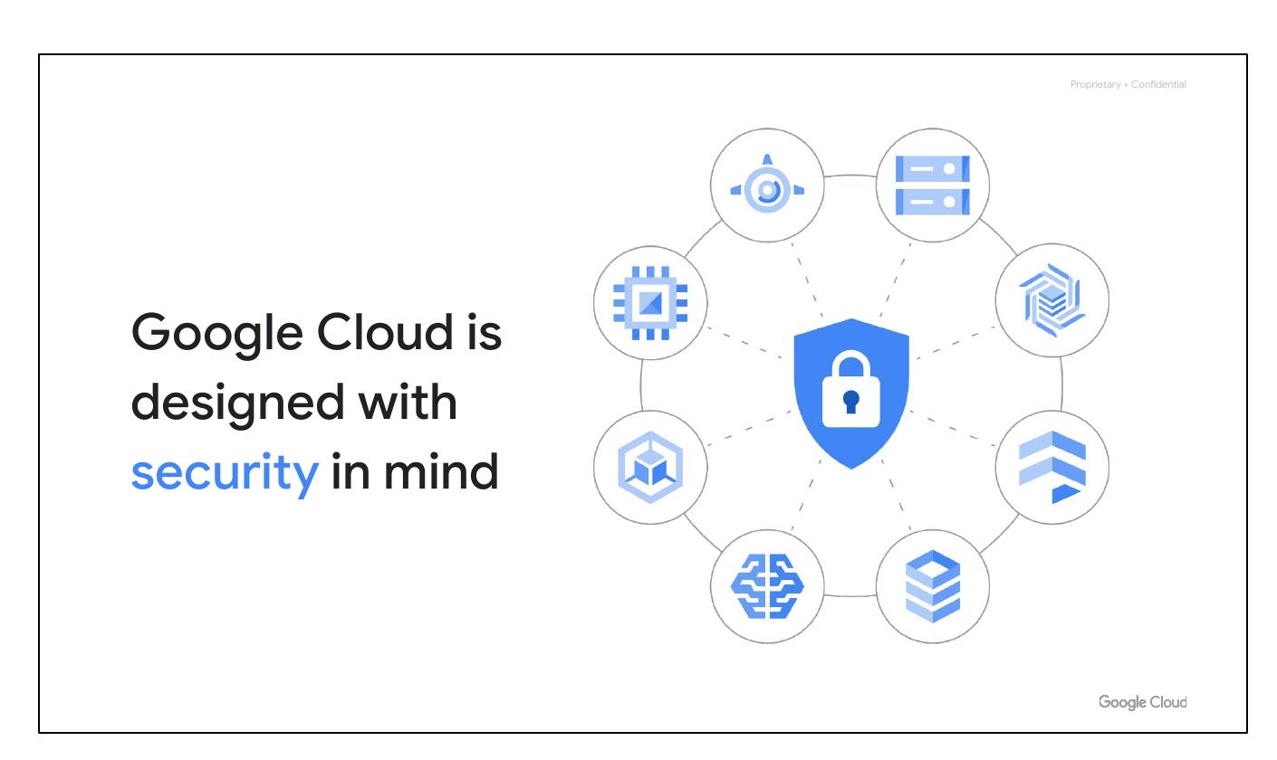
Security in Mind
Designed with security in mind
Nine services with billion+ users
Notes:
Because Google has nine services with more than a billion users, you can bet security is always on the minds of Google's employees. Design for security is prevalent, throughout the infrastructure, that Google Cloud and Google services run-on.

Slide 34
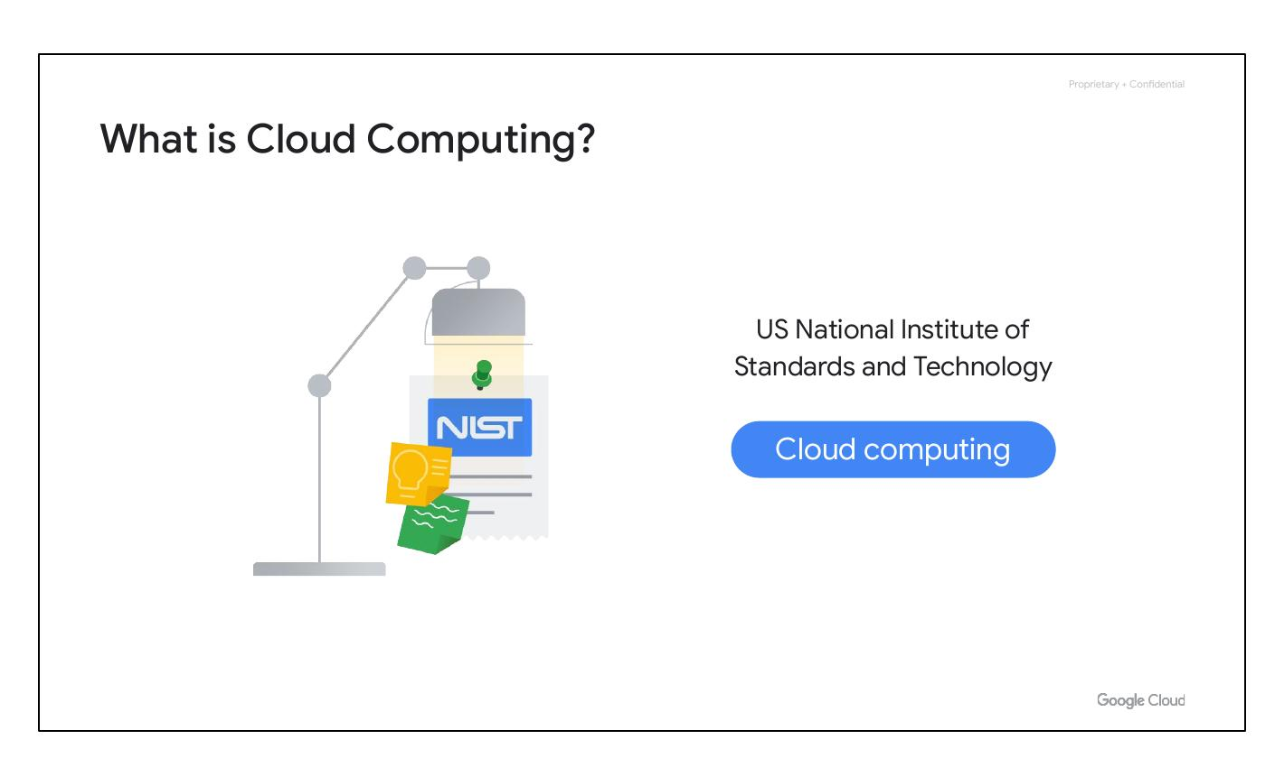
Hardware Infrastructure
Hardware design and provenance
Secure boot stack
Premises security
Notes:
Hardware design and provenance: Both the server boards and the networking equipment in Google data centers are custom designed by Google. Google also designs custom chips, including a hardware security chip that's currently being deployed on both servers and peripherals. Secure boot stack: Google server machines use a variety of technologies to ensure that they are booting the correct software stack, such as cryptographic signatures over the BIOS, bootloader, kernel, and base operating system image. Premises security: Google designs and builds its own data centers, which incorporate multiple layers of physical security protections.

Slide 35
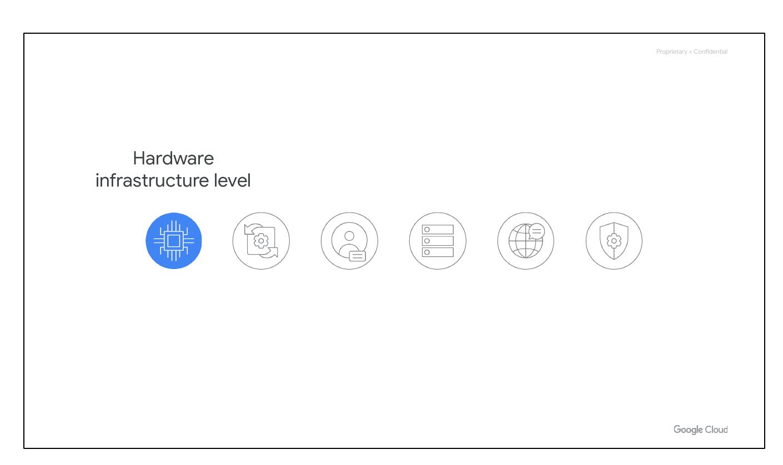
Hardware Design
Server boards, chips designed by Google
Booting the correct software stack
Physical security protections
Notes:
Hardware design and provenance: Both the server boards and the networking equipment in Google data centers are custom designed by Google. Google also designs custom chips, including a hardware security chip that's currently being deployed on both servers and peripherals. Secure boot stack: Google server machines use a variety of technologies to ensure that they are booting the correct software stack, such as cryptographic signatures over the BIOS, bootloader, kernel, and base operating system image. Premises security: Google designs and builds its own data centers, which incorporate multiple layers of physical security protections. Access to these data centers is limited to only a very small fraction of Google employees. Google additionally hosts some servers in third-party data centers, where we ensure that there are Google-controlled physical security measures on top of the security layers provided by the data center operator.

Slide 36
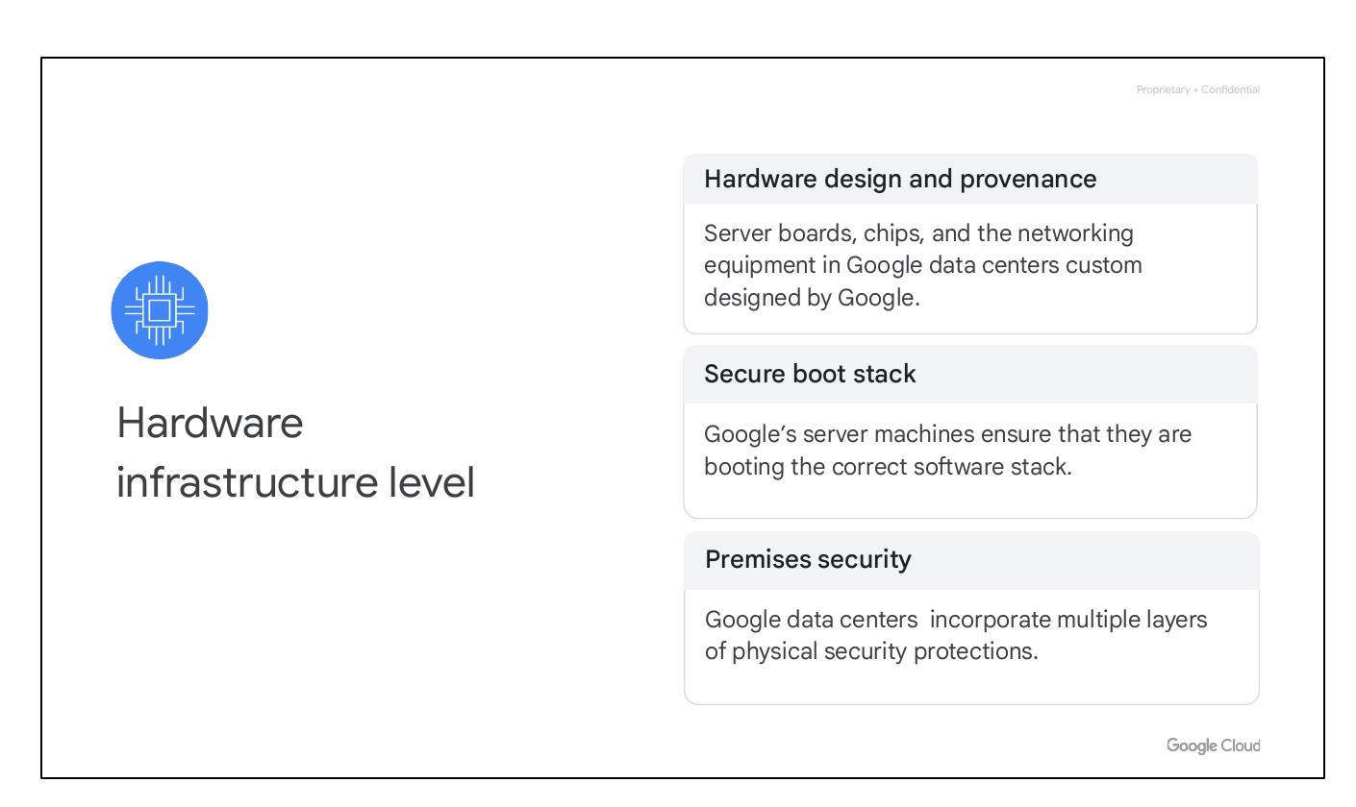
Service Deployment
Encryption of inter-service communication
Using remote procedure calls (RPCs)
Notes:
Encryption of inter-service communication: Google’s infrastructure provides cryptographic privacy and integrity for remote procedure call (“RPC”) data on the network. Google’s services communicate with each other using RPC calls. The infrastructure automatically encrypts all infrastructure RPC traffic which goes between data centers. Google has started to deploy hardware cryptographic accelerators that will allow it to extend this default encryption to all infrastructure RPC traffic inside Google data centers.

Slide 37
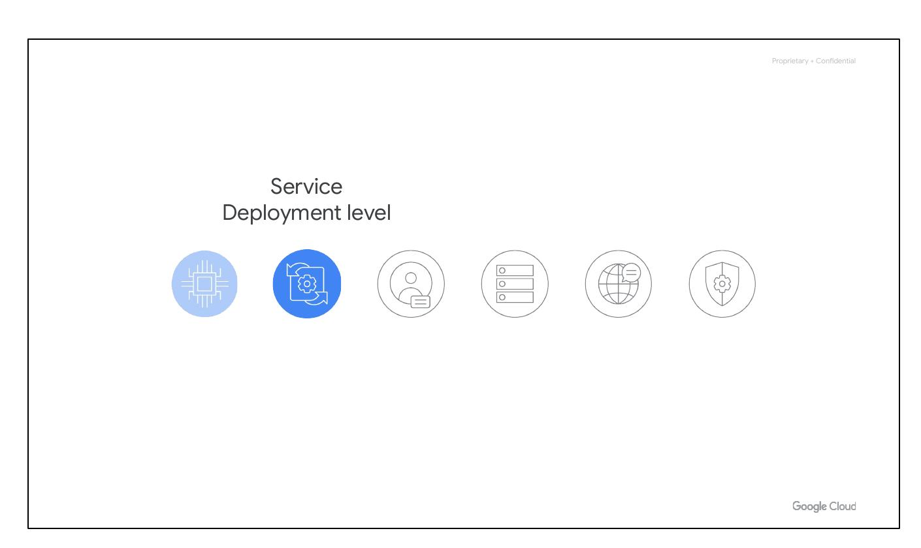
User Identity
User identity
Challenging users for information
Using secondary factors
Notes:
Google’s central identity service, which usually manifests to end users as the Google login page, goes beyond asking for a simple username and password. The service also intelligently challenges users for additional information based on risk factors such as whether they have logged in from the same device or a similar location in the past. Users also have the option of employing secondary factors when signing in, including devices based on the Universal 2nd Factor (U2F) open standard.

Slide 38
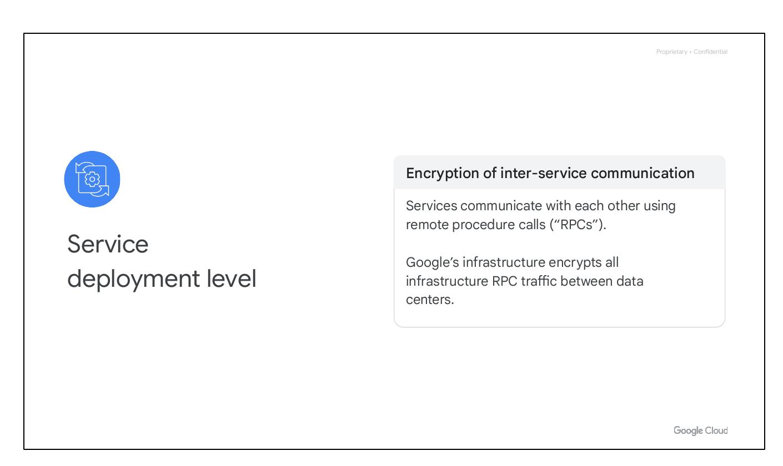
Storage Services
Encryption at rest
Centrally managed keys
Hardware encryption support
Notes:
Encryption at rest: Most applications at Google access physical storage (in other words, “file storage”) indirectly via storage services, and encryption (using centrally managed keys) is applied at the layer of these storage services. Google also enables hardware encryption support in hard drives and SSDs.

Slide 39
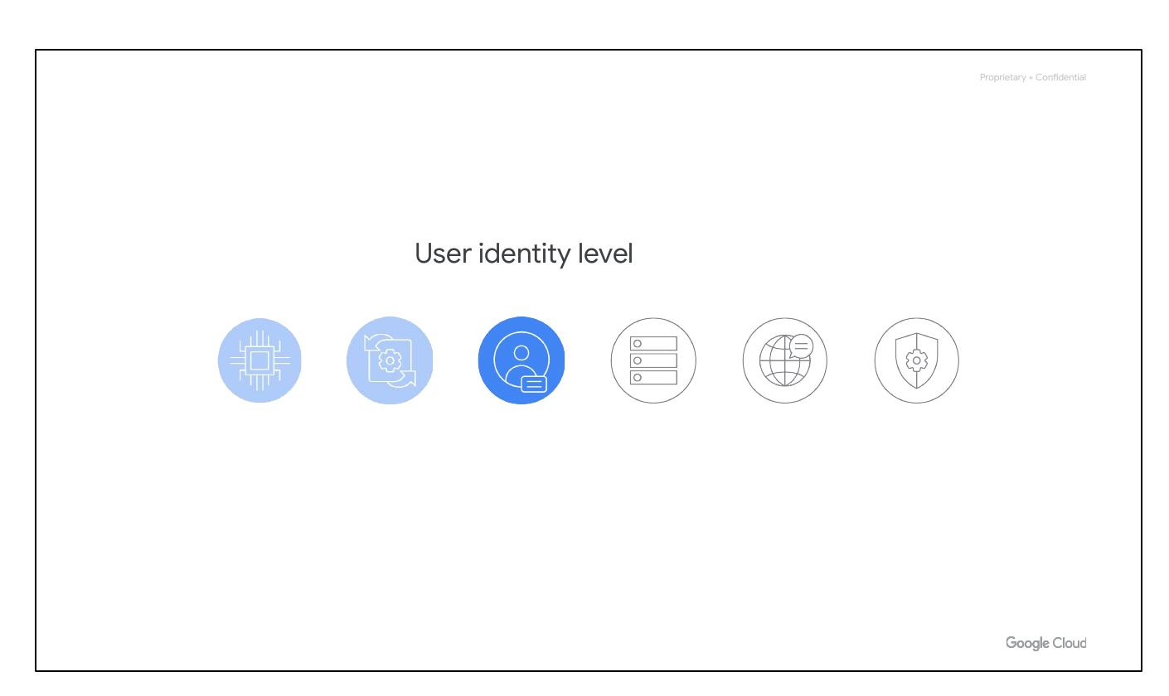
Internet Communication
Google Front End (GFE)
Denial of Service (DoS) protection
Notes:
Google Front End (“GFE”): Google services that want to make themselves available on the Internet register themselves with an infrastructure service called the Google Front End, which ensures that all TLS connections are ended using a public-private key pair and an X.509 certificate from a Certified Authority (CA) as well as following best practices such as supporting perfect forward secrecy. The GFE additionally applies protections against Denial of Service attacks. Denial of Service (“DoS”) protection: The sheer scale of its infrastructure enables Google to simply absorb many DoS attacks. Google also has multi-tier, multi-layer DoS protections that further reduce the risk of any DoS impact on a service running behind a GFE.

Slide 40
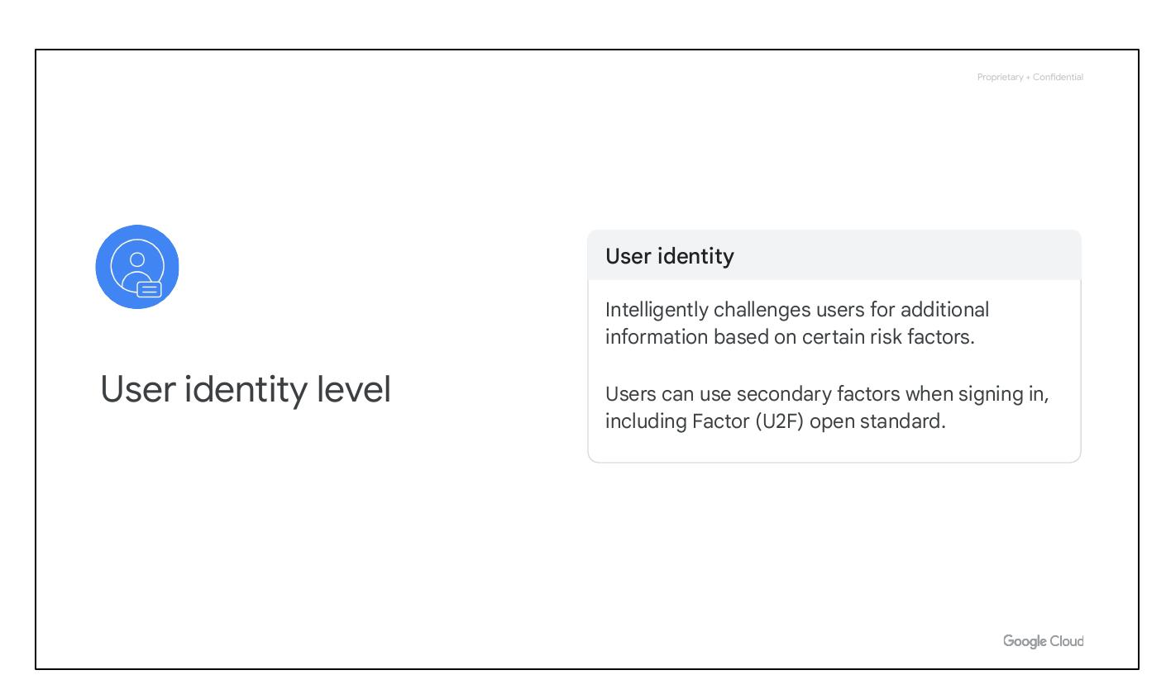
Operational Security
Intrusion detection
Reducing insider risk
Software development practices
Notes:
Intrusion detection: Rules and machine intelligence give Google’s operational security teams warnings of possible incidents. Google conducts Red Team exercises to measure and improve the effectiveness of its detection and response mechanisms. Reducing insider risk: Google aggressively limits and actively monitors the activities of employees who have been granted administrative access to the infrastructure. Employee U2F use: To guard against phishing attacks against Google employees, employee accounts require use of U2F-compatible Security Keys. Software development practices: Google employs central source control and requires two-party review of new code.

Slide 41
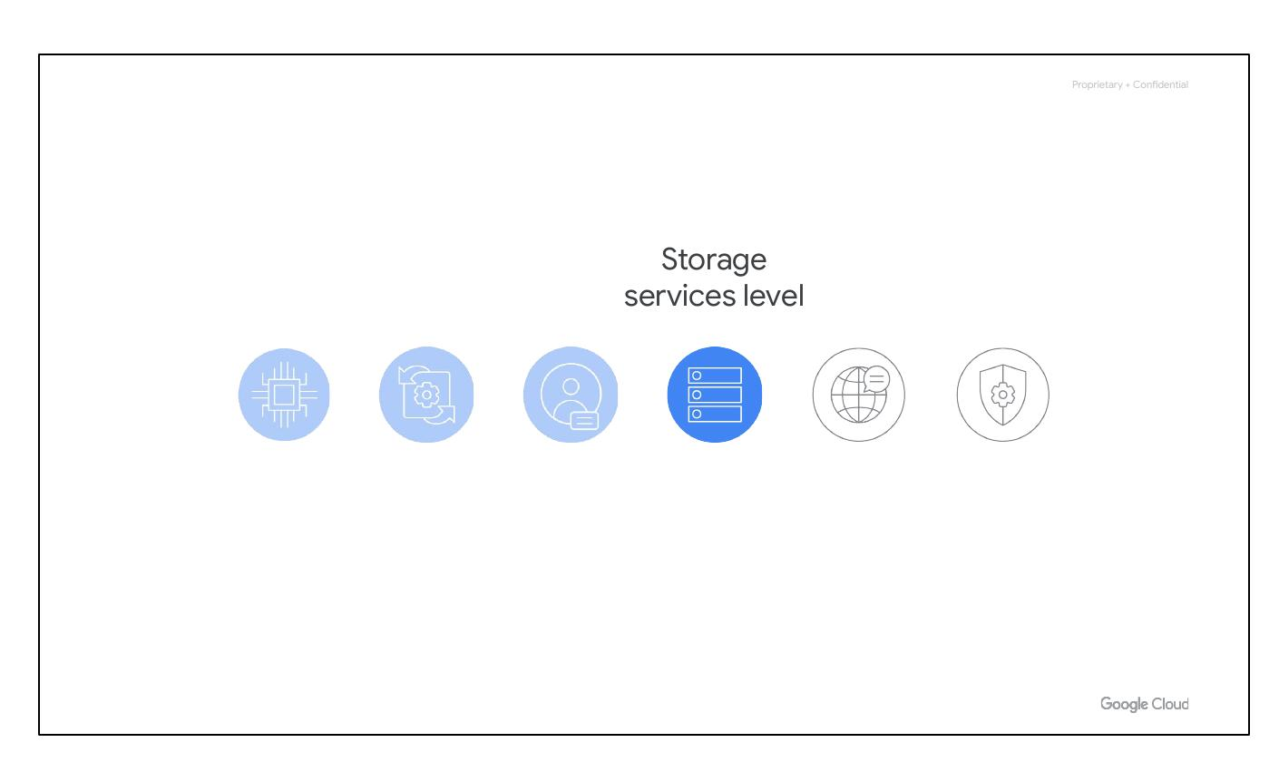
More on Security
Learn more about security
cloud.google.com/security/security-design
Notes:
You can learn more about Google’s technical-infrastructure security at cloud.google.com/security/security-design.

Slide 42
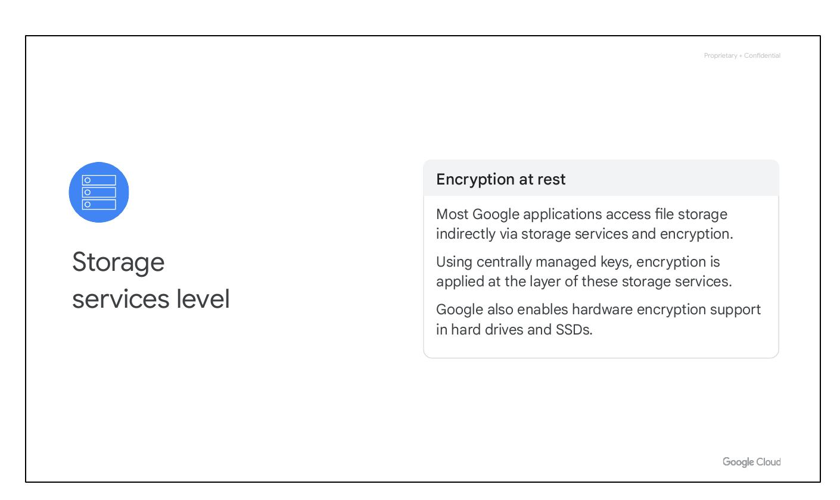
Open Source Friendly
Avoid data locked into vendor
Ability to run applications elsewhere
Publishes key tech elements
Notes:
Some people are afraid to bring their workloads to the cloud because they're afraid they'll get locked into a particular vendor. But if, for whatever reason, a customer decides that Google is no longer the best provider for their needs, we give customers the ability to run their applications elsewhere. Google publishes key elements of technology using open source licenses to create ecosystems that provide customers with options other than Google.

Slide 43
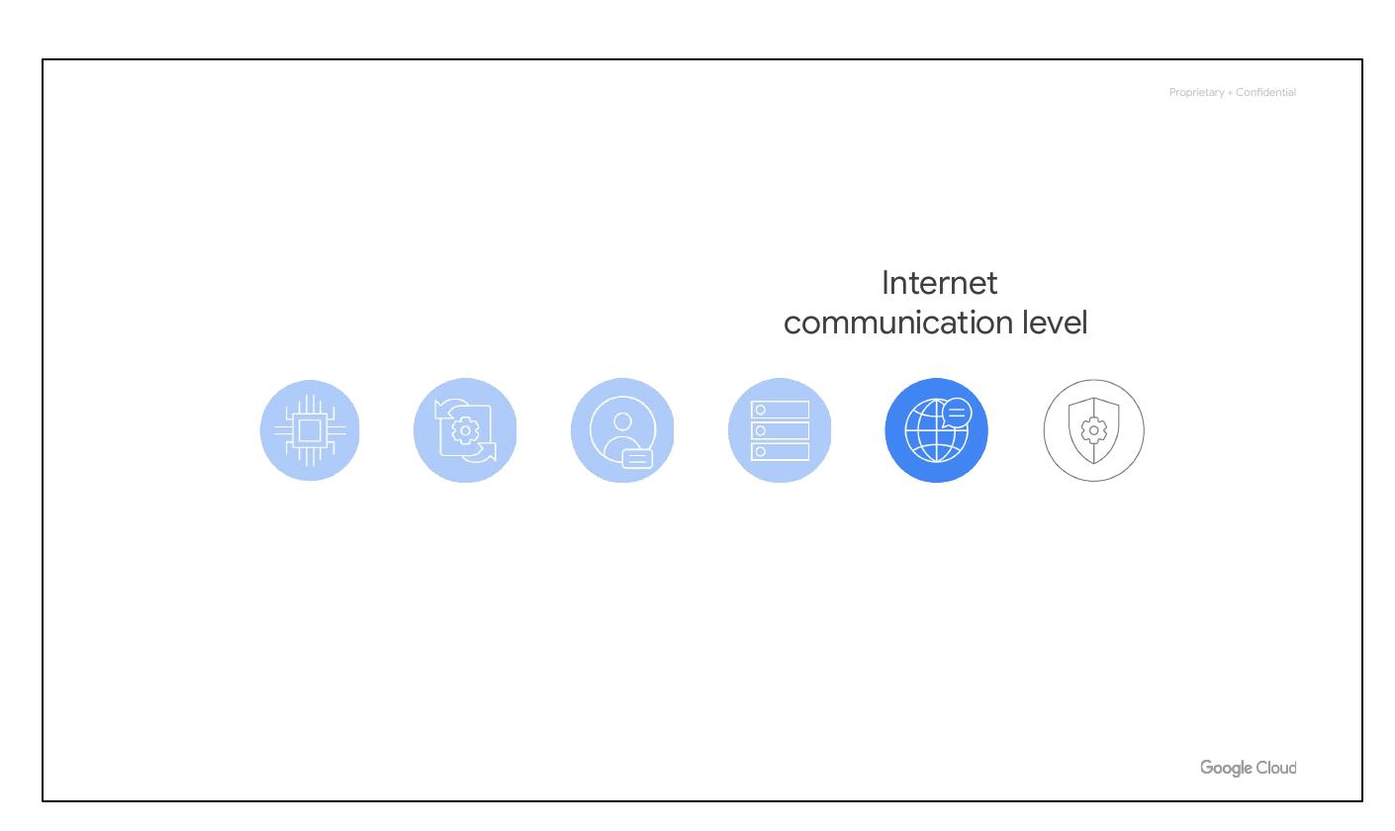
Open-Source TensorFlow
Open source library
For machine learning
Works with Google Cloud
Notes:
For example, TensorFlow, an open source software library for machine learning developed inside Google, is at the heart of a strong open source ecosystem.

Slide 44
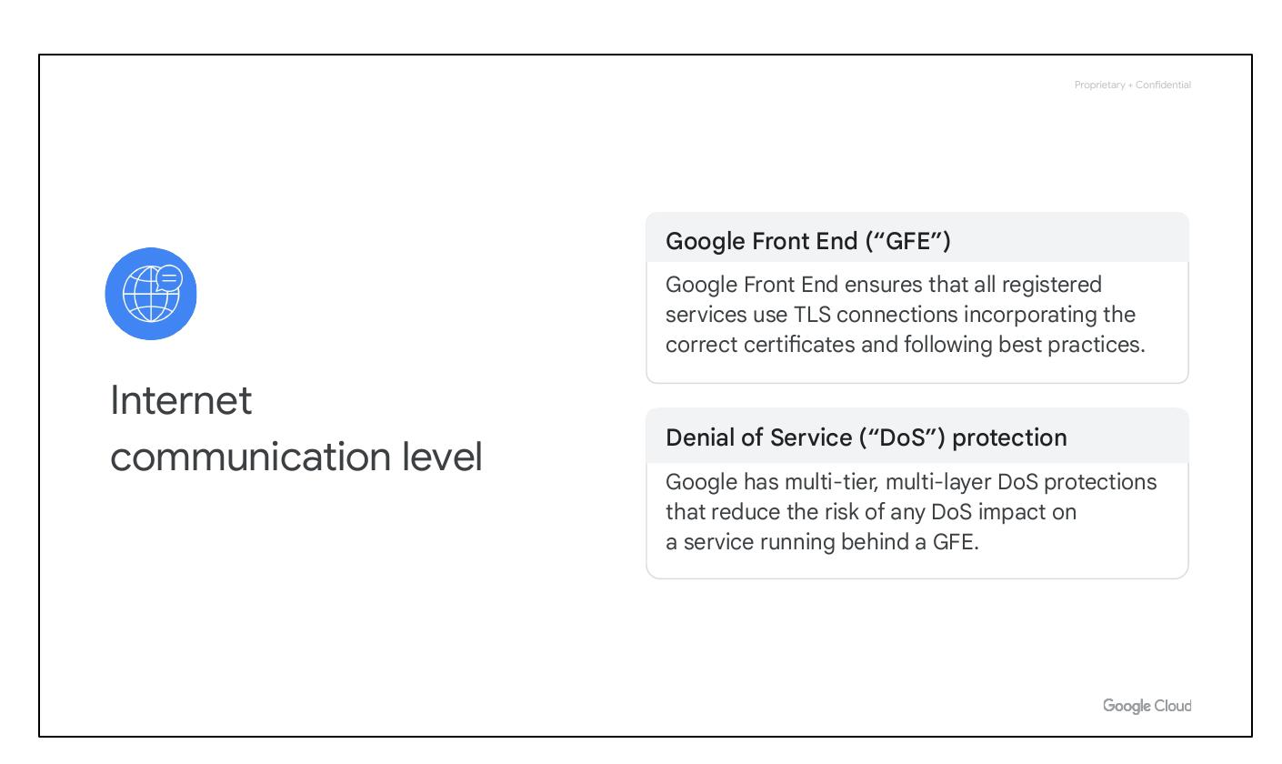
Interoperability
Mix and match microservices
Running across different clouds
Kubernetes, GKE, Observability
Notes:
Google provides interoperability at multiple layers of the stack. Kubernetes and Google Kubernetes Engine give customers the ability to mix and match microservices running across different clouds. Google Cloud Observability lets customers monitor workloads across multiple cloud providers.

Slide 45
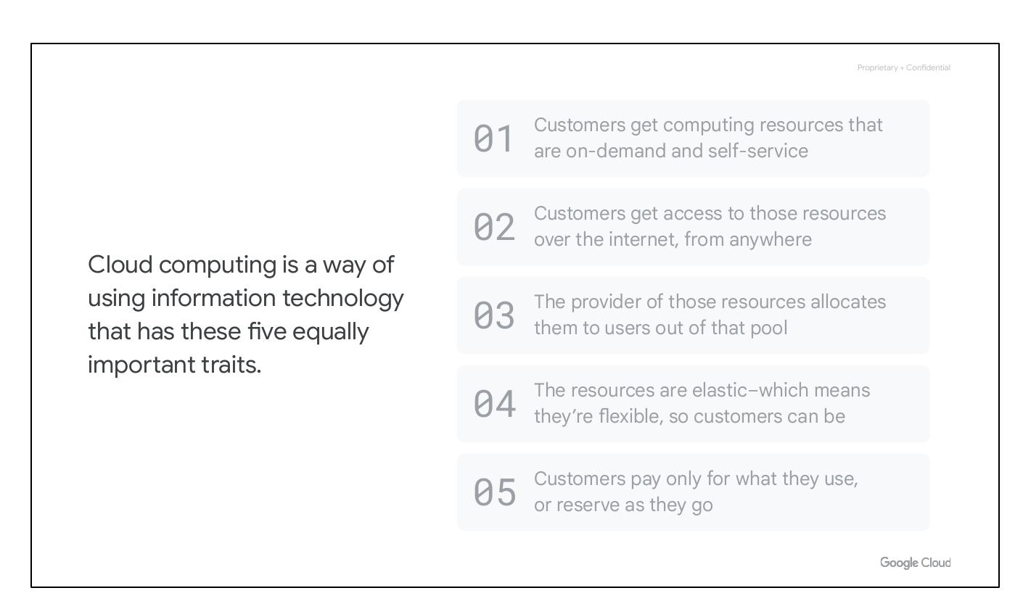
Per-Second Billing
Compute products billed per-second
Compute Engine
Kubernetes Engine
Notes:
Google was the first major cloud provider to deliver per-second billing for its Infrastructure-as-a-Service compute offering, Compute Engine. We’ll explore these products and services later in this course, but per-second billing is offered for users of Compute Engine, Google Kubernetes Engine (container infrastructure as a service), Dataproc (which is the equivalent of the big data system Hadoop, but operating as a service), and App Engine flexible environment VMs (a platform as a service).

Slide 46
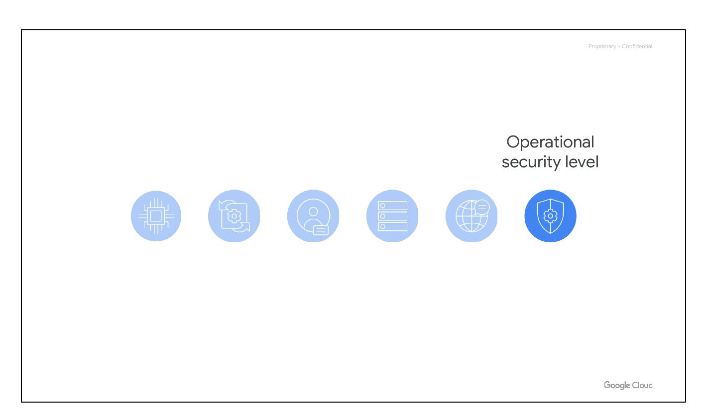
Billing Flexibility
Sustained-use discounts
Custom virtual machine types
Notes:
Compute Engine offers automatically applied sustained-use discounts, which are automatic discounts that you get for running a virtual-machine instance for a significant portion of the billing month. Custom virtual machine types allow Compute Engine virtual machines to be fine-tuned with optimal amounts of vCPU and memory for their applications, so that you can tailor your pricing for your workloads.

Slide 47
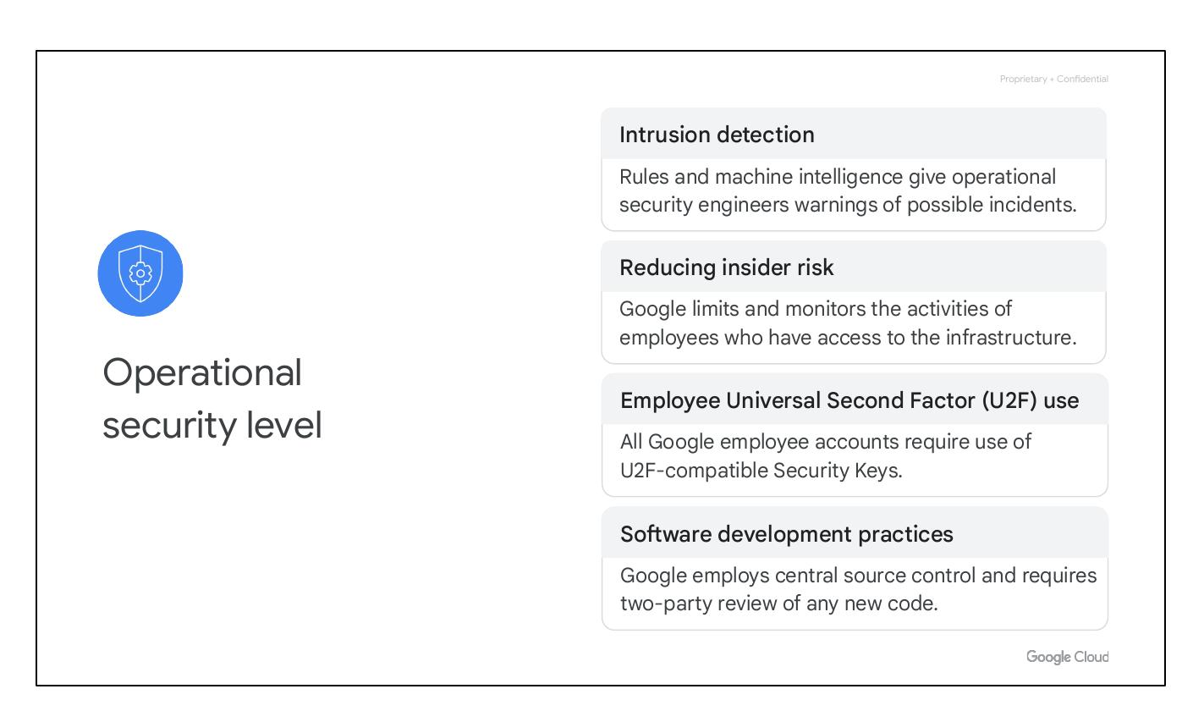
Pricing Calculator
Estimate costs
cloud.google.com/products/calculator
Notes:
Our online pricing calculator can help estimate your costs. Visit cloud.google.com/products/calculator to try it out.

Slide 48
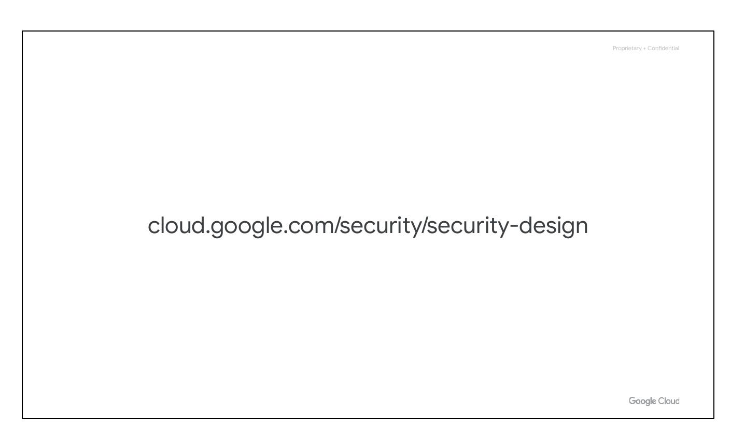
Budget and Monitor
Billing tools help
Budgets, Alerts, Reports
Quotas
Notes:
We provide a few tools to help. You can define budgets at the billing account level or at the project level. A budget can be a fixed limit, or it can be tied to another metric - for example, a percentage of the previous month’s spend. To be notified when costs approach your budget limit, you can create an alert. Reports is a visual tool in the Google Cloud console that allows you to monitor expenditure based on a project or services. Finally, Google Cloud also implements quotas, which are designed to prevent the over-consumption of resources because of an error or a malicious attack, protecting both account owners and the Google Cloud community as a whole.

Slide 49

Quotas at Project
Quotas are allocated project-level
Allocation quota
Rate quota
Notes:
There are two types of quotas: rate quotas and allocation quotas. Both are applied at the project level. Rate quotas reset after a specific time. Allocation quotas govern the number of resources you can have in your projects. Although projects all start with the same quotas, you can change some of them by requesting an increase from Google Cloud Support.

Slide 50
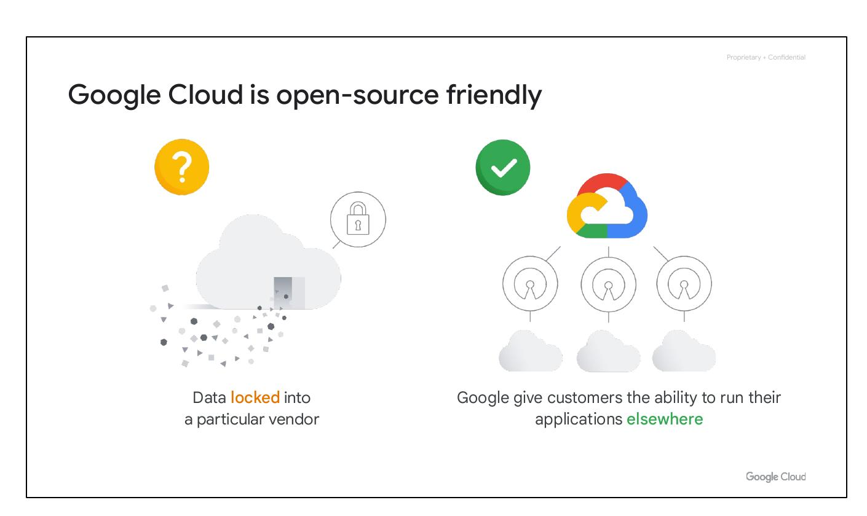
Module Quiz

Slide 51
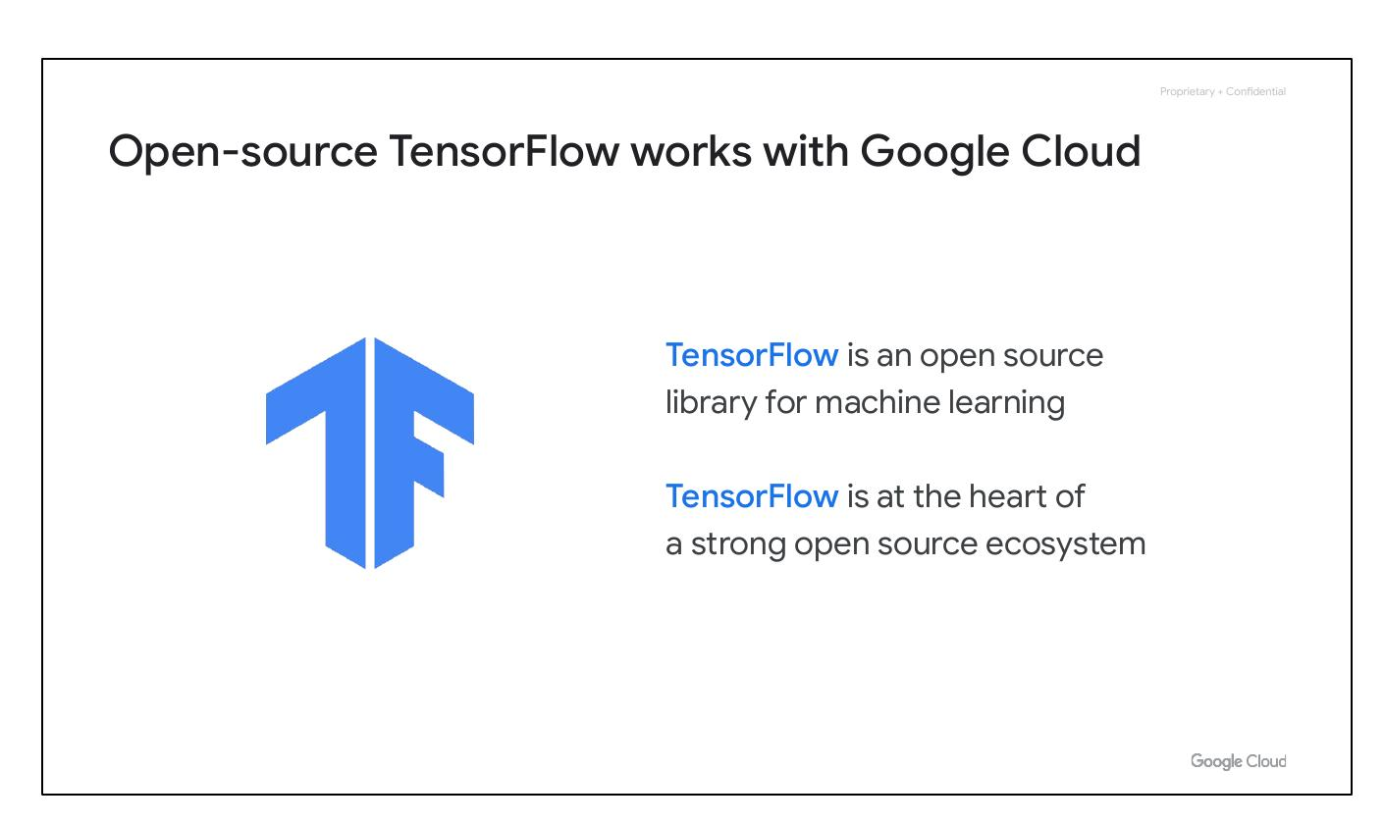
Quiz Question 1
Benefit to Google Cloud Customer
Several zones within a region?
Notes:
Question: What is the primary benefit to a Google Cloud customer of using resources in several zones within a region?

Slide 52
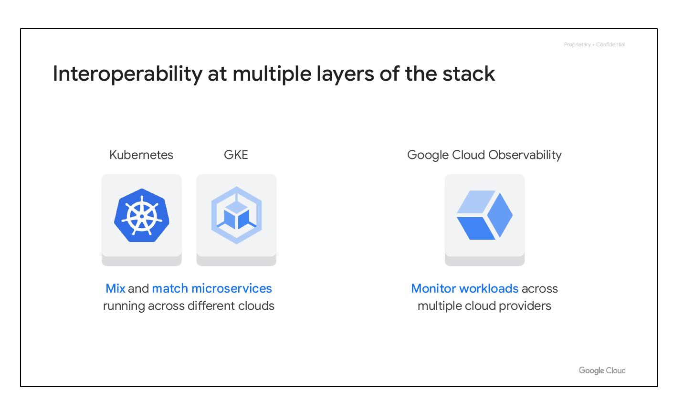
Fault Tolerance
Improved fault tolerance
Notes:
Why might a Google Cloud customer use resources in several zones within a region? A: For improved fault tolerance. Feedback: Correct. As part of building a fault-tolerant application, you can spread your resources across multiple zones in a region.

Slide 53

Quiz Question 2
Bind application code to libraries
Access to infrastructure?
Notes:
Question: What type of cloud computing service lets you bind your application code to libraries that give access to the infrastructure your application needs?

Slide 54
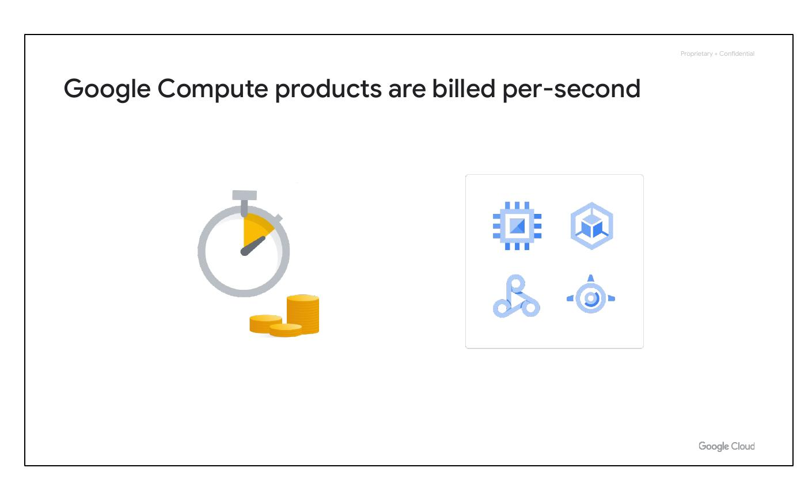
Platform as a Service
Platform as a Service
Notes:
What type of cloud computing service lets you bind your application code to libraries that give access to the infrastructure your application needs? D: Platform as a Service. Feedback: Correct!

Slide 55
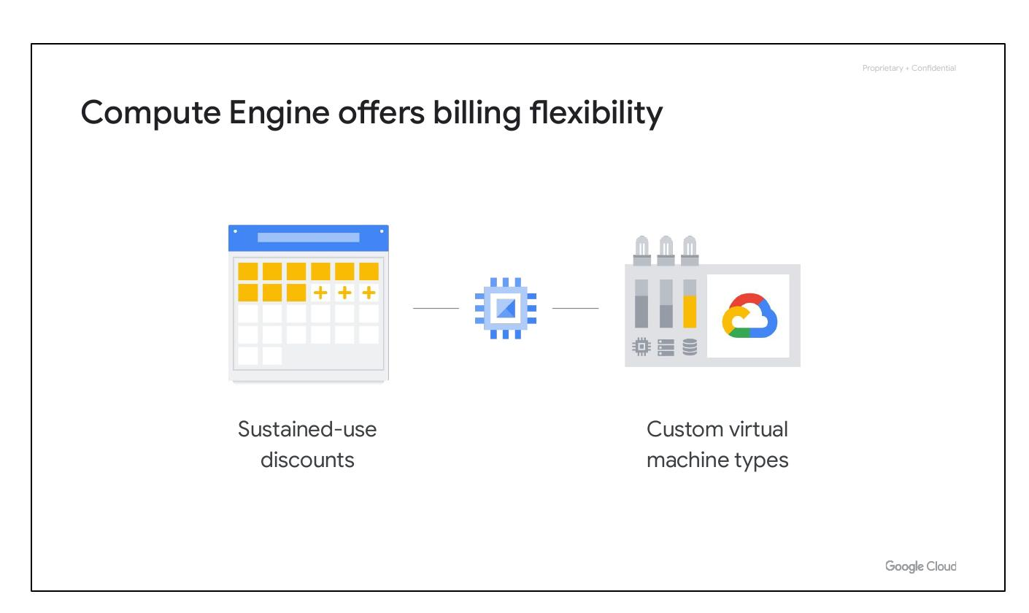
Quiz Question 3
Resources in several regions
Customer use resources
Notes:
Question: Why might a Google Cloud customer use resources in several regions around the world?

Slide 56

Global Fault Tolerance
Bring apps closer to users
Improved fault tolerance
Notes:
Why might a Google Cloud customer use resources in several regions around the world? D: To bring their applications closer to users around the world, and for improved fault tolerance. Feedback: That is correct.

