Slide 1

Tip and trick on
How to Containerized
an
application

Slide 2
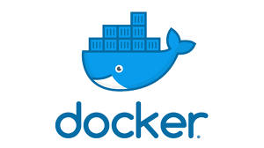



Now that you Know Docker and Dockerfile the question is CAN YOU CONTAINERIZED AN APPLICATION
by

Slide 3
If you answer is NO no worry follow me I will give you some tips and tricks

Slide 4


