Slide 1
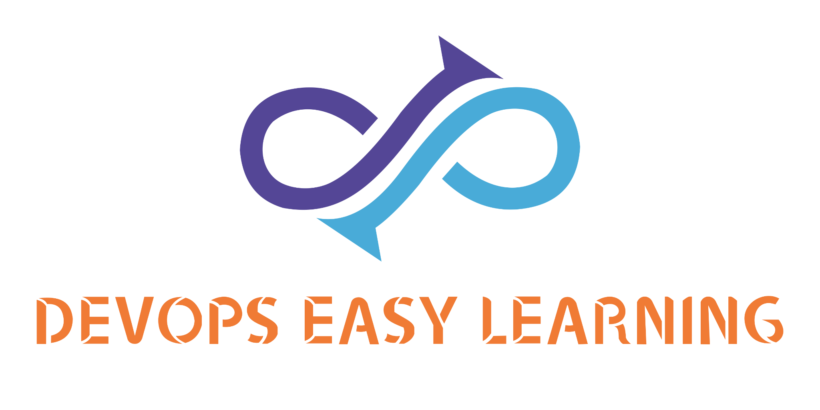
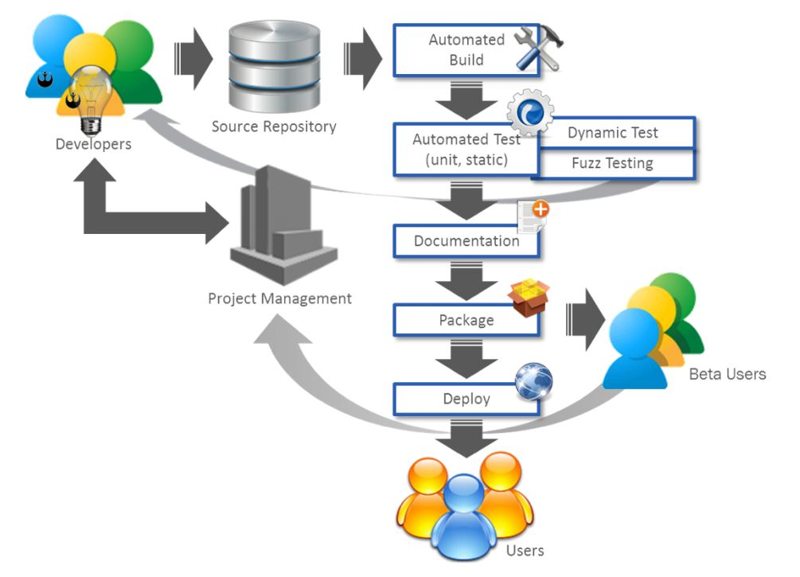

The Software factory-2
At
EK TECH SOFTWARE SOLUTION
Core areas

Slide 2
Introduction
At EK TECH SOFTWARE SOLUTION The Software Factory is made of
1- Infrastructure as a Code (IaC)
2- Software as a Service (SaaS)
3- Infrastructure as a Service (IaaS)
4- Platform as a Service (PaaS)
5- Continue Integration (CI)
6- Continue Deployment(CD)
7- Continue Delivery (CD)
8- Continuous Integration Continuous Deployment (CI/CD)
9- Continue Monitoring
10 Continue code Inspection.

Slide 3

Infrastructure as a Code (IaC)
In the past, managing IT infrastructure was a hard job. System administrators had to manually manage and configure all of the hardware and software that was needed for the applications to run.
The Pain of Managing IT Infrastructure
Historically, managing IT infrastructure was a manual process. People would physically put servers in place and configure them. Only after the machines were configured to the correct setting required by the OS and applications would those people deploy the application. Unsurprisingly, this manual process would often result in several problems.

Slide 4
Infrastructure as a Code (IaC)
The Infrastructure as code allow to provision infrastructure using a code instead

Slide 5

Infrastructure as a Code (IaC) advantages
Speed
The first significant benefit IaC provides is speed. Infrastructure as code enables you to quickly set up your complete infrastructure by running a script. You can do that for every environment, from development to production, passing through staging, QA, and more. IaC can make the entire software development life cycle more efficient.
Consistency
Manual processes result in mistakes, period. Humans are fallible. Our memories fault us. Communication is hard, and we are in general pretty bad at it. As you’ve read, manual infrastructure management will result in discrepancies, no matter how hard you try. IaC solves that problem by having the config files themselves be the single source of truth. That way, you guarantee the same configurations will be deployed over and over, without discrepancies.
Accountability
This one is quick and easy. Since you can version IaC configuration files like any source code file, you have full traceability of the changes each configuration suffered. No more guessing games about who did what and when.
More Efficiency During the Whole Software Development Cycle
By employing infrastructure as code, you can deploy your infrastructure architectures in many stages. That makes the whole software development lif cycle more efficient, raising the team’s productivity to new levels.
Portability
IaC make the infracture portable

Slide 6
Infrastructure as a Code (IaC) Example
Bash shell script
Ansible role
gitlab-ci.yml files
Helm-charts
Docker-compose files
K8S manifests files
Ansible playbook
Terraform
Jenkinsfiles

Slide 7
Software as a Service (SaaS)
SaaS
is on-demand access to ready-to-use, cloud-hosted application software.

Slide 8
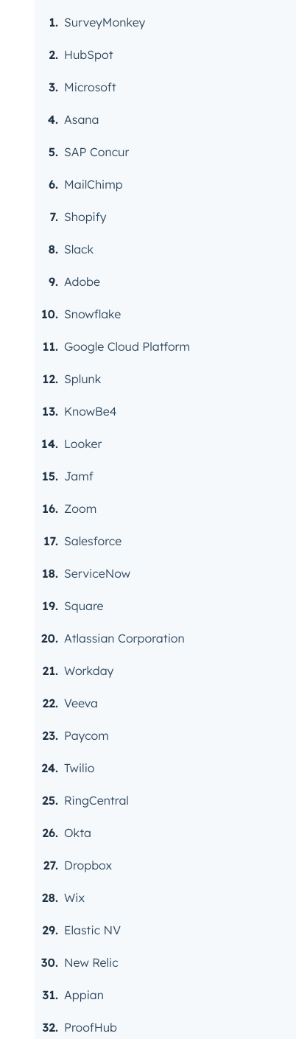
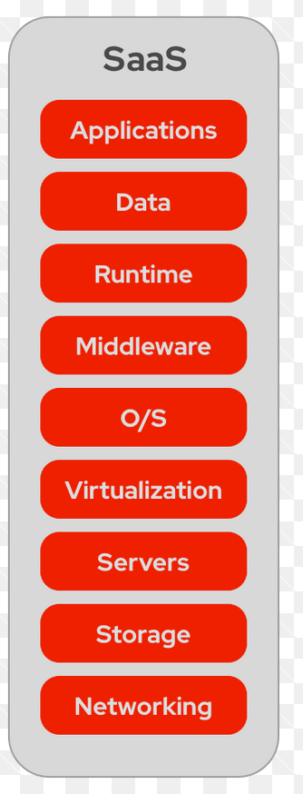
Software as a Service (SaaS)
The Service Provider manage All

Slide 9
Infrastructure as a Service (IaaS)
IaaS
is on-demand access to cloud-hosted physical and virtual servers, storage and networking - the backend IT infrastructure for running applications and workloads in the cloud.

Slide 10
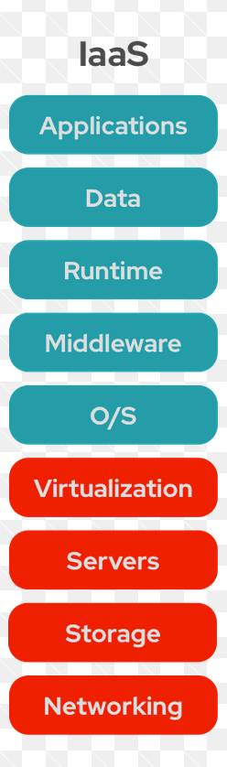

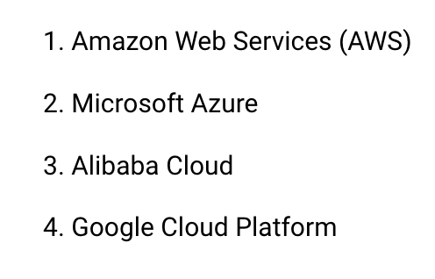
Infrastructure as a Service (SaaS)

Slide 11
Platform as a Service (PaaS)
PaaS
is on-demand access to a complete, ready-to-use, cloud-hosted platform for developing, running, maintaining and managing applications.

Slide 12
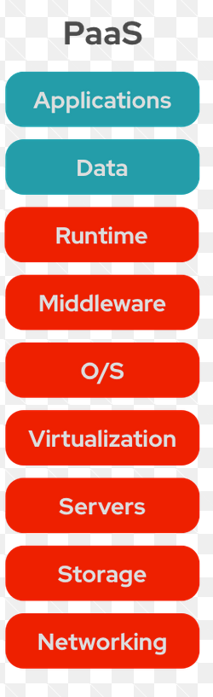
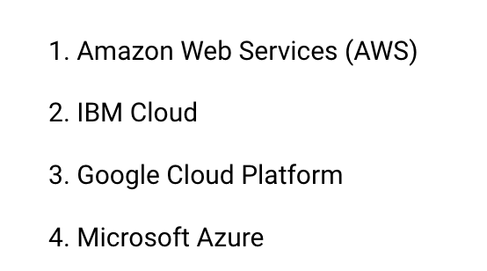
Platform as a Service (SaaS)

Slide 13
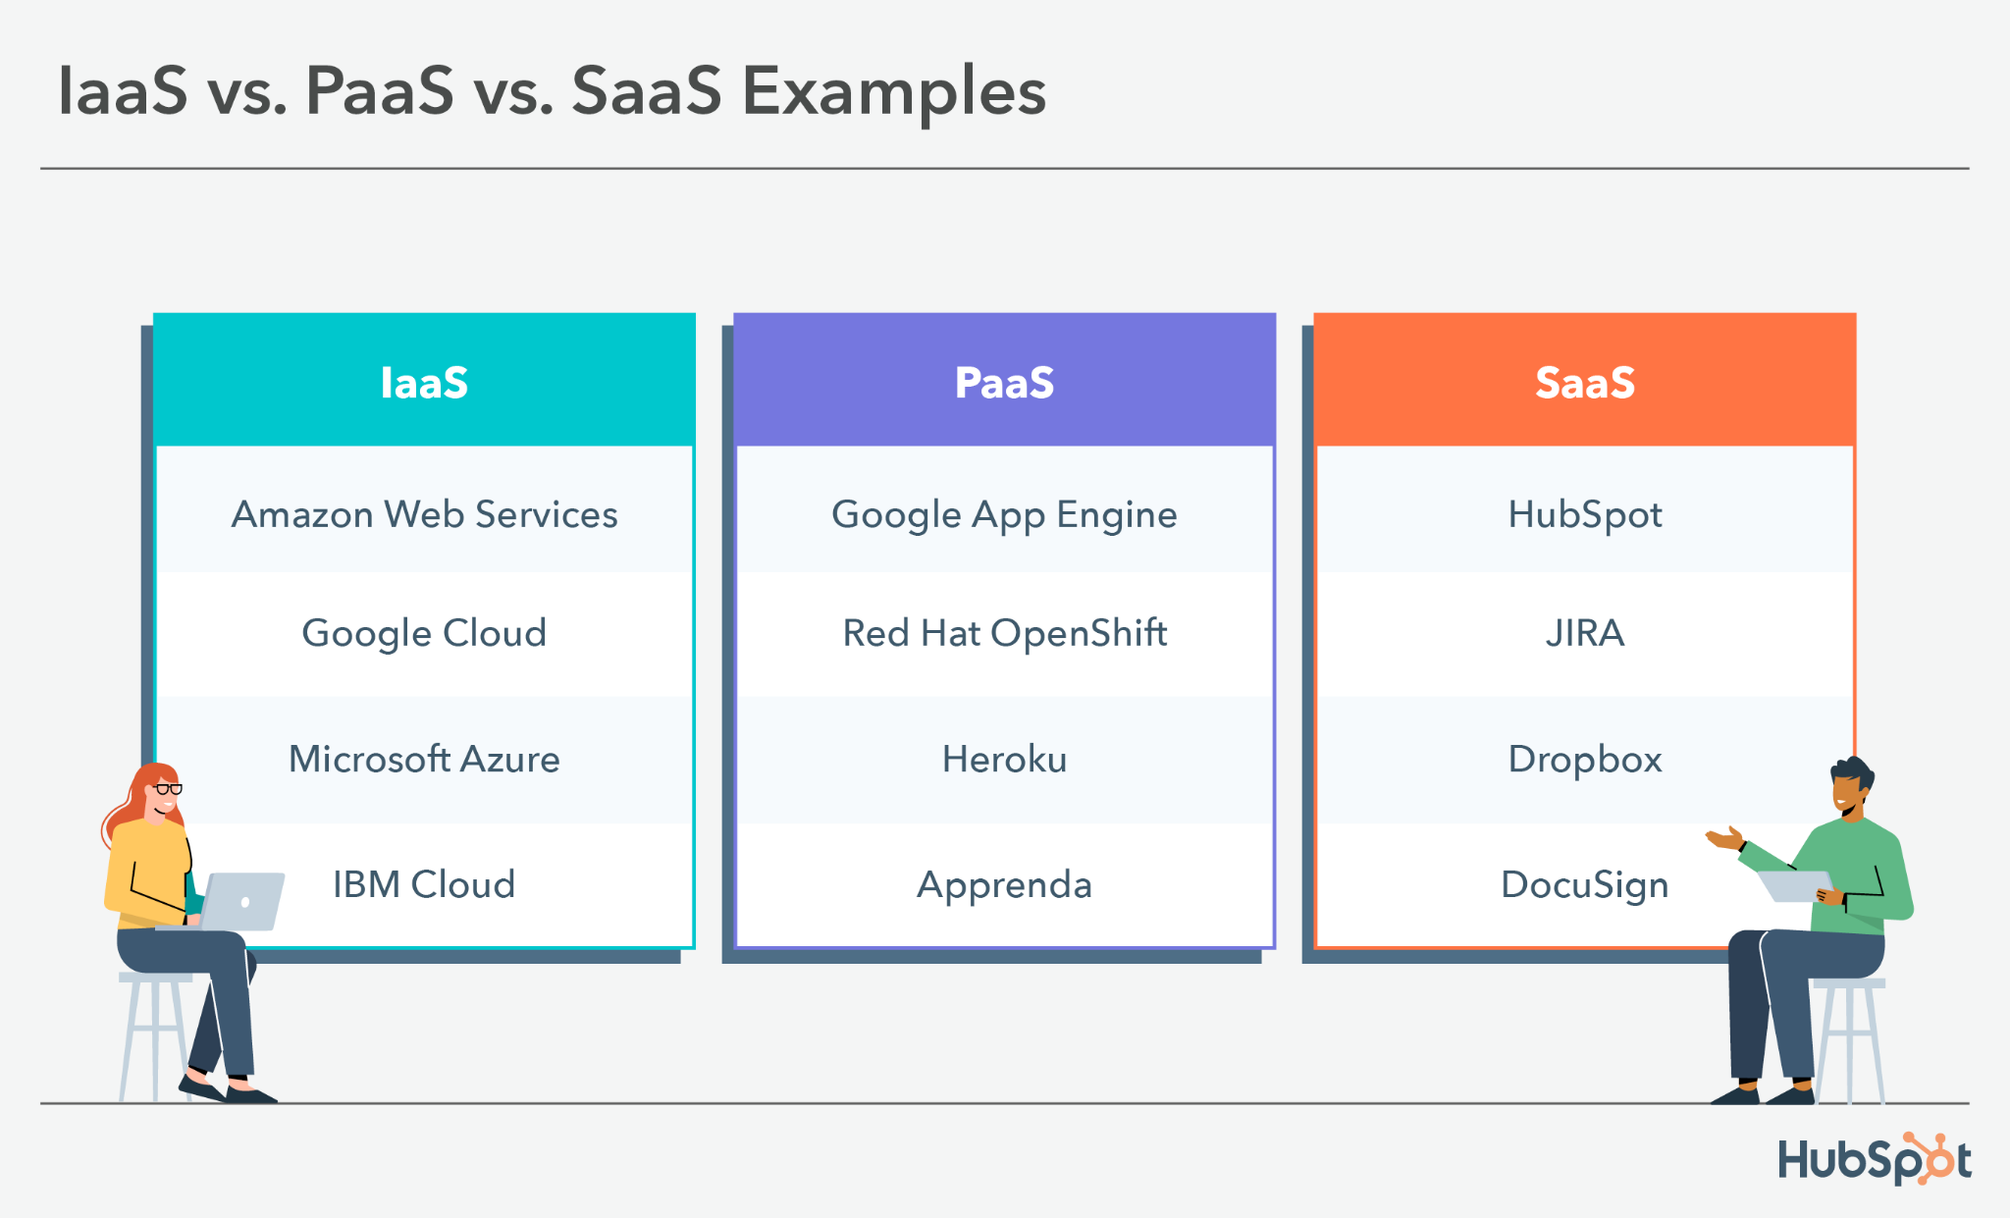
The as a Service’s

Slide 14
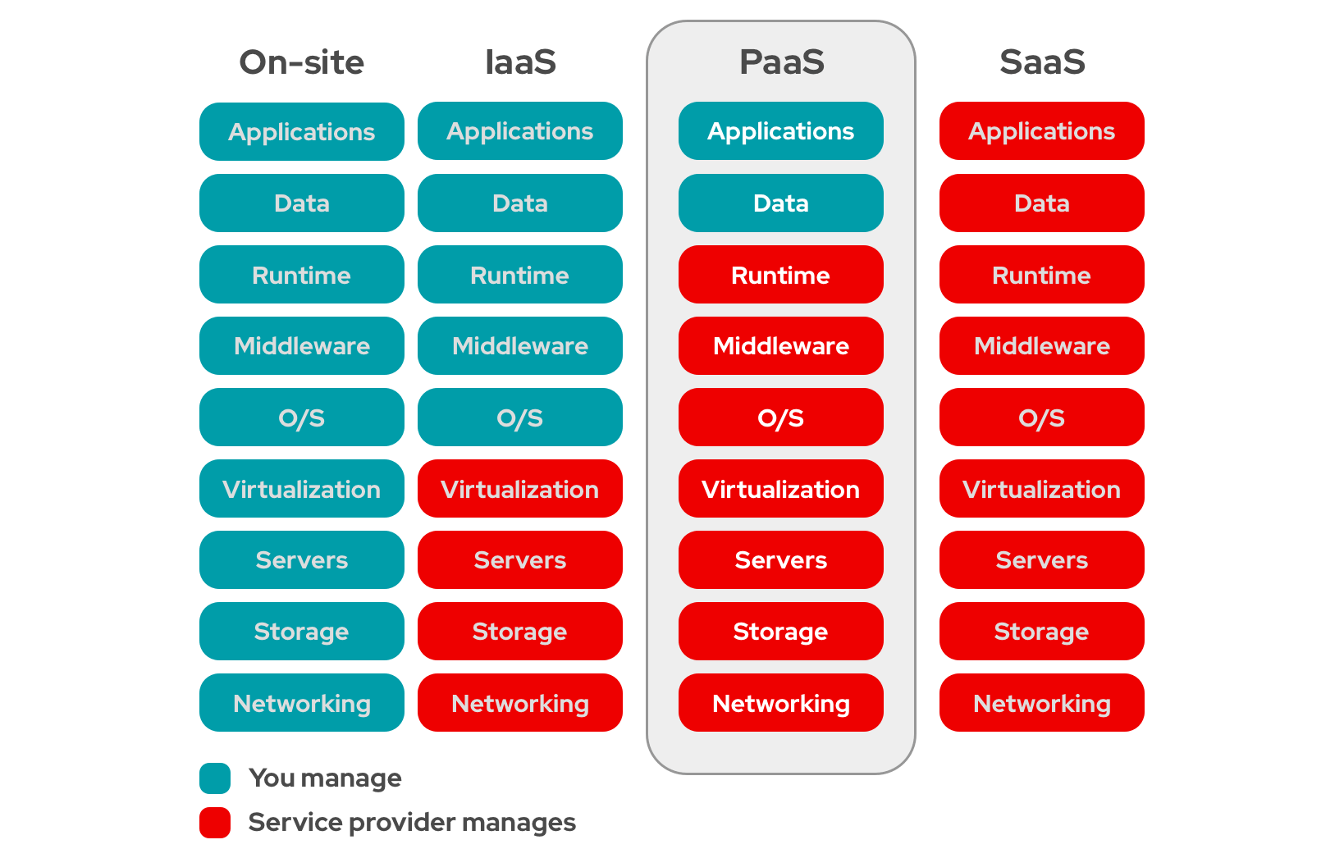
The as a Service’s

Slide 15
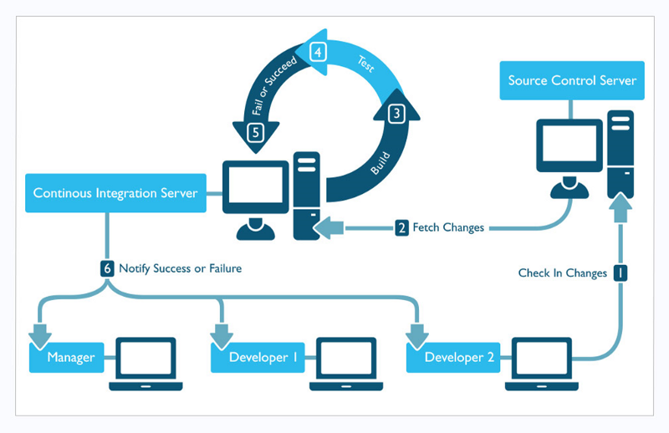
Continuous integration (CI)
Continuous integration (CI)
is a DevOps software development practice where developers regularly merge their code changes into a central repository, after which automated builds and tests are run.

Slide 16
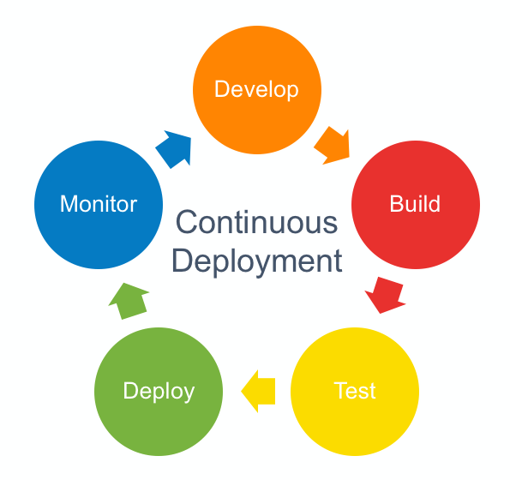
Continue Deployment(CD)
Continuous deployment (CD)
is a software engineering approach in which software functionalities are delivered frequently and through automated deployments.

Slide 17
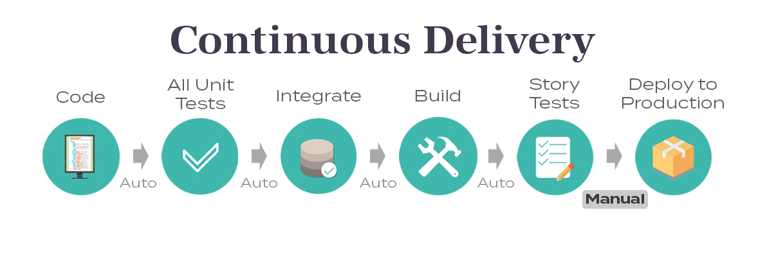
Continue Delivery (CD)
Continuous delivery (CD)
is a software engineering approach in which teams produce software in short cycles, ensuring that the software can be reliably released at any time and, when releasing the software, without doing so manually.

Slide 18
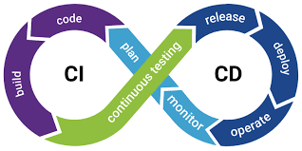
Continue Integration Continue Deployment (CI/CD)
CI/CD
is a method to frequently deliver apps to customers by introducing automation into the stages of app development.

Slide 19
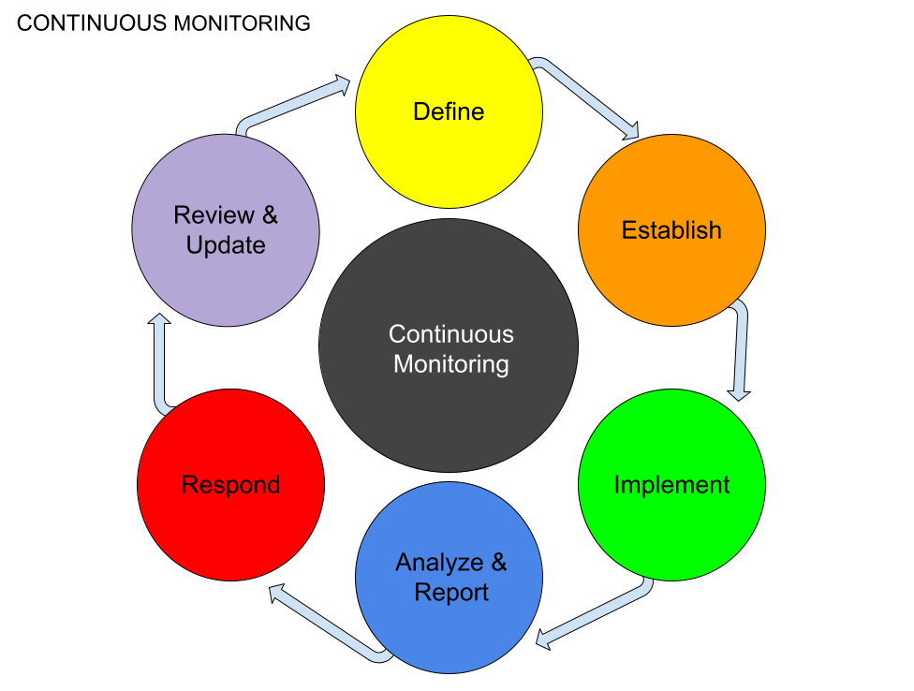
Continue Monitoring
Continuous Monitoring(CM)
sometimes called Continuous Control Monitoring (CCM), is an automated process by which Devops personnel can observe and detect compliance issues and security threats during each phase of the DevOps pipeline.

Slide 20
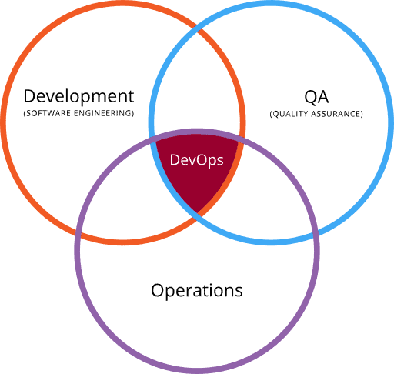
Continue code Inspection
Continuous code inspection
Means continuously test the code to catch any bug or issue before they are built into an image

Slide 21

Now this been said WHAT IS DEVOPS

