Slide 1
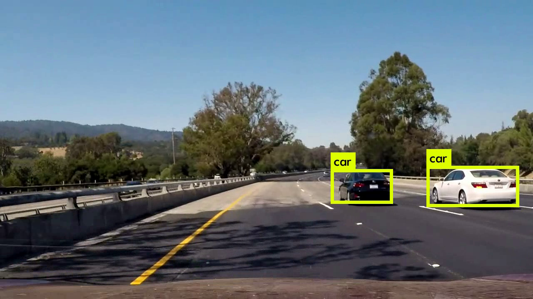
S.N. | Vehicle Type | Vehicle ID
1 | Car | CL 201 534
2 | Car | Not Detected
… | … | …
… | … | …
… | … | …
Suspicious Vehicles in the past 24 hours
S.N. | Vehicle ID | Type | Color | Found in database? | Alert Level
1. | CL 201 534 | Car | Black
2. | MH 342 234 | Truck | White | No | None
Yes
High

