Slide 1
Operating Systems
Orientation
CS 241
January 25, 2012
Copyright ©: University of Illinois CS 241 Staff

Slide 2
Objectives
Explain the main purpose of operating systems and describe milestones of OS evolution
Explain fundamental machine concepts
  Instruction processing
  Memory hierarchy
  Interrupts
  I/O
Explain fundamental OS concepts
  System calls
  Processes
  Synchronization
  Files
Explain the POSIX standard (UNIX specification)
Copyright ©: University of Illinois CS 241 Staff

Slide 3
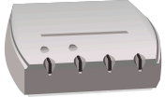
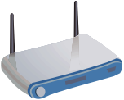
OS Structure
Application Software
Firefox
Second Life
Yahoo
Chat
GMail
Standard Operating System Interface
Operating System
Machine Independent
Read/Write
Standard
Output
Device
Control
File
System
Communication
Machine Specific
Hardware
Network
Copyright ©: University of Illinois CS 241 Staff

Slide 4
POSIX
The UNIX Interface Standard
Application Software
Firefox
Second Life
Yahoo
Chat
GMail
POSIX Standard Interface
Unix
Read/Write
Standard
Output
Device
Control
File
System
Communication
Copyright ©: University of Illinois CS 241 Staff

Slide 5
What is an Operating System?
It is an extended machine
  Hides the messy details that must be performed
  Presents user with a virtualized and simplified abstraction of the machine, easier to use
It is a resource manager
  Each program gets time with the resource
  Each program gets space on the resource
Copyright ©: University of Illinois CS 241 Staff

Slide 6
A Peek into Unix
Application
Libraries
User space/level
Machine-dependent layer
Kernel space/level
Portable OS Layer
User/kernel modes are
supported by hardware
Some systems do not have
clear user-kernel boundary
Copyright ©: University of Illinois CS 241 Staff

Slide 7
Application
Applications
(Firefox, Emacs, grep)
Written by programmer
Compiled by programmer
Use function calls
Libraries
Machine-dependent layer
Portable OS Layer
Copyright ©: University of Illinois CS 241 Staff

Slide 8
Unix: Libraries
Application
Provided pre-compiled
Defined in headers
Input to linker (compiler)
Invoked like functions
May be “resolved” when program is loaded
Libraries (e.g., stdio.h)
Machine-dependent layer
Portable OS Layer
Copyright ©: University of Illinois CS 241 Staff

Slide 9
Typical Unix OS Structure
Application
Libraries
Machine-dependent layer
Portable OS Layer
System calls (read, open..)
All “high-level” code
Copyright ©: University of Illinois CS 241 Staff

Slide 10
Typical Unix OS Structure
Application
Libraries
Bootstrap
System initialization
Interrupt and exception
I/O device driver
Memory management
Kernel/user mode switching
Processor management
Machine-dependent layer
Portable OS Layer
Copyright ©: University of Illinois CS 241 Staff

Slide 11
History of Computer Generations
Pre-computing generation 1792 - 1871
  Charles Babbage’s “Analytical Engine”
  Purely mechanical
  Designed, but never actually built
    Required high-precision gears/cogs that didn’t exist yet
  A man before his time
    When this works, we’ll need software!
    First programming language
    World’s first programmer: Ada Lovelace
Copyright ©: University of Illinois CS 241 Staff

Slide 12
History of Computer Generations
Pre-computing generation 1792 – 1871
First generation 1945 – 1955
  Vacuum tubes, relays, plug boards
  Seconds per operation!
    Focus on numerical calculations
  No programming language
    Everything done using pure machine language or wiring electrical circuits!
  No operating system
    Sign up for your time slot!
  Progress: Punch cards!
Copyright ©: University of Illinois CS 241 Staff

Slide 13
History of Computer Generations
Pre-computing generation 1792 – 1871
First generation 1945 – 1955
Second generation 1955 - 1965
  Transistors, mainframes
  Large human component
Copyright ©: University of Illinois CS 241 Staff

Slide 14

History of Operating Systems
Problem: a lot of time wasted by operators walking around machine room
One solution: An early “batch system” by IBM
  bring cards to 1401
  read cards to tape
  put tape on 7094 which does computing
  put tape on 1401 which prints output
Copyright ©: University of Illinois CS 241 Staff

Slide 15
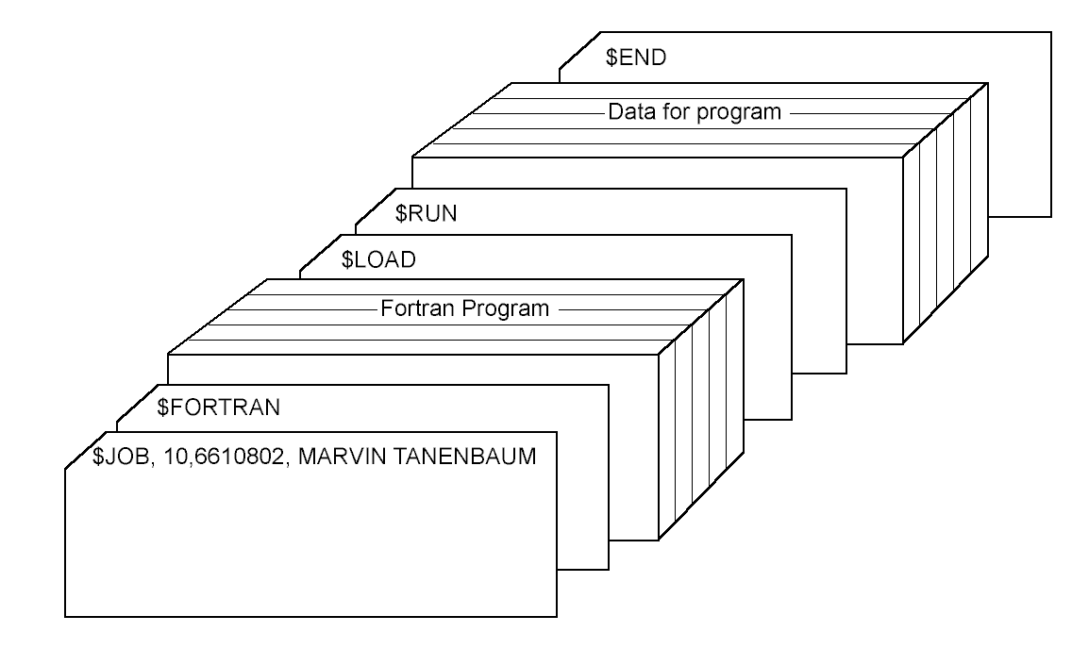
History of Computer Generations
Pre-computing generation 1792 – 1871
First generation 1945 – 1955
Second generation 1955 - 1965
  Transistors, mainframes
  Large human component
  Solution: Batched jobs
Copyright ©: University of Illinois CS 241 Staff

Slide 16
History of Computer Generations
Pre-computing generation 1792 – 1871
First generation 1945 – 1955
Second generation 1955 – 1965
Third generation 1965 – 1980
  Integrated circuits and multiprogramming
  IBM’s New model: all software and OS must work on all platforms
    A beast!
  Progress: Multiprogramming
    Keep the CPU busy
Copyright ©: University of Illinois CS 241 Staff

Slide 17

History of Operating Systems
Memory
Management
Process
Management
Multiprogramming/timesharing system
  Three jobs in memory – 3rd generation
Copyright ©: University of Illinois CS 241 Staff

Slide 18
History of Computer Generations
Pre-computing generation 1792 – 1871
First generation 1945 – 1955
Second generation 1955 – 1965
Third generation 1965 – 1980
  Integrated circuits and multiprogramming
  IBM’s New model: all software and OS must work on all platforms
  Progress: Multiprogramming and timesharing
  Progress: Spooling
    Always have something ready to run
  MULTICS + minicomputers == UNIX!
Copyright ©: University of Illinois CS 241 Staff

Slide 19
History of Computer Generations
Pre-computing generation 1792 – 1871
First generation 1945 – 1955
Second generation 1955 – 1965
Third generation 1965 – 1980
Fourth generation 1980 – present
  Personal computers
  Multi-processors
  Phones
  …
Copyright ©: University of Illinois CS 241 Staff

Slide 20



Computer Hardware Review
Monitor
The “Brains”
Bus
Components of a simple personal computer
Copyright ©: University of Illinois CS 241 Staff

Slide 21
Computer Hardware Review
Monitor
Computer operation and data processing
CPU
Bus
Components of a simple personal computer
Copyright ©: University of Illinois CS 241 Staff

Slide 22
Computer Hardware Review
Communication between CPU, Memory and I/O
Monitor
Stores data and programs
CPU
Memory
Bus
Components of a simple personal computer
Copyright ©: University of Illinois CS 241 Staff

Slide 23

Early Pentium system
Copyright ©: University of Illinois CS 241 Staff
Notes:
Faster buses
direct cpu to memory communication

Slide 24
CPU, From CS231
Fetch instruction from code memory
Fetch operands from data memory
Perform operation (and store result)
(Check interrupt line)
Go to next instruction
'Conventional CPU'
(Ignore pipeline, optimization complexities)
Copyright ©: University of Illinois CS 241 Staff

Slide 25
CPU Registers
Fetch instruction from code memory
Fetch operands from data memory
Perform operation (and store result)
Go to next instruction
Note: CPU must maintain certain state
  Current instructions to fetch (program counter)
  Location of code memory segment
  Location of data memory segment
Copyright ©: University of Illinois CS 241 Staff

Slide 26
CPU Register Examples
Hold instruction operands
Point to start of
  Code segment (executable instructions)
  Data segment (static/global variables)
  Stack segment (execution stack data)
Point to current position of
  Instruction pointer
  Stack pointer
Copyright ©: University of Illinois CS 241 Staff

Slide 27
CPU Register Examples
Hold instruction operands
Point to start of
  Code segment
  Data segment
  Stack segment
Point to current position of
  Instruction pointer
  Stack pointer
    Why stack?
Copyright ©: University of Illinois CS 241 Staff
Notes:
Bc need to know where to push new variable decl

Slide 28
Sample Layout for program image in main memory
High address
Command-line arguments and environment variables
argc, argv, environment
Activation record for function calls
(return address, parameters,
saved registers, automatic variables
stack
heap
Uninitialized static data
Allocations from malloc family
Initialized static data
Processes have three segments: text, data, stack
Low address
Program text (code segment)
Copyright ©: University of Illinois CS 241 Staff

Slide 29
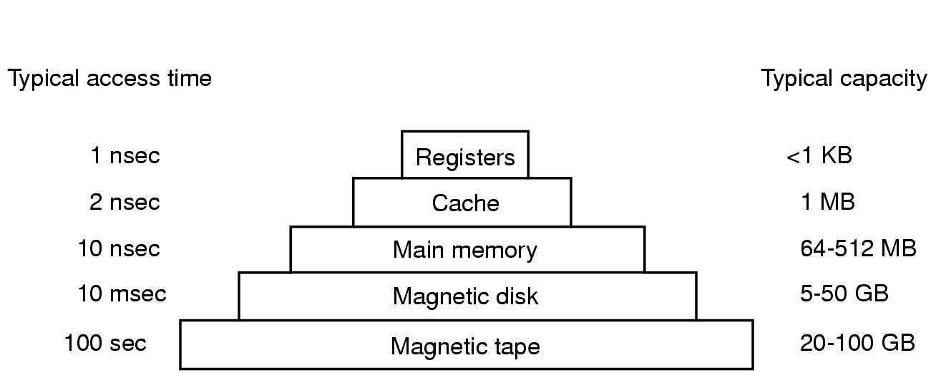
Memory Hierarchy
Leverage locality of reference
Decreasing cost per bit
Increasing capacity
Increasing access time
Decreasing frequency of access
1 KB
128 MB
4 GB
1TB
10 TB
Copyright ©: University of Illinois CS 241 Staff

Slide 30
Computer Hardware Review
Monitor
Move data between computer and external environment
CPU
Memory
I/O
Devices
I/O
Devices
I/O
Devices
I/O
Devices
Bus
Bus
Components of a simple personal computer
Copyright ©: University of Illinois CS 241 Staff

Slide 31
I/O Device Access
System Calls
  Application makes a system call reading from or writing to a device
  Kernel blocks application
  Kernel translates request to specific driver
  Driver starts I/O
  Polls device for completion
    Or waits for interrupt from device
  Kernel obtains results, un-blocks application
Copyright ©: University of Illinois CS 241 Staff
Notes:
Text I removed because I can’t follow what it is saying, or the flow / comparison with the other text:
interrupts
Application makes a system call
Asks for an interrupt upon completion
OS blocks application
Device controller generates interrupt

Slide 32
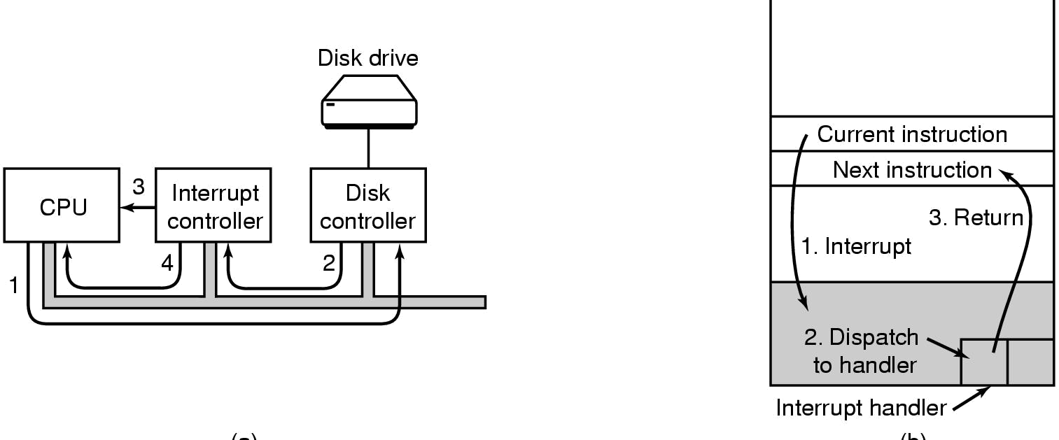
I/O Interrupt Mechanism
(a)
(b)
Application writes into device registers, Controller starts device
When done, device controller signals interrupt controller
Interrupt controller asserts pin on CPU
Interrupt controller puts I/O device number on bus to CPU
Copyright ©: University of Illinois CS 241 Staff

Slide 33
Operating System Concepts
Shared resources
  I have B KB of memory, but need 2B KB
  I have N processes trying to access the disk at the same time
  How would you control access to resources?
Challenges
  Who gets to use the resources?
  How do you control fair use of the resources over time?
  Deadlock
Copyright ©: University of Illinois CS 241 Staff

Slide 34
Operating System Concepts
Process
  An executable instance of a program
  Only one process can use a (single-core) CPU at a time
A process tree
  A created two child processes, B and C
  B created three child processes, D, E, and F
A
Z
B
C
D
E
F
Copyright ©: University of Illinois CS 241 Staff

Slide 35
Operating System Concepts
How would you switch CPU execution from one process to another?
Solution: Context Switching
  Store/restore state on CPU, so execution can be resumed from same point later in time
  Triggers: multitasking, interrupt handling, user/kernel mode switching
  Involves: Saving/loading registers and other state into a “process control block” (PCB)
  PCBs stored in kernel memory
Copyright ©: University of Illinois CS 241 Staff

Slide 36
Operating System Concepts
Context Switching
  What are the costs involved?
Item | Time | Scaled Time in Human Terms (2 billion times slower)
Processor cycle | 0.5 ns (2 GHz) | 1 s
Cache access | 1 ns (1 GHz) | 2 s
Memory access | 15 ns | 30 s
Context switch | 5,000 ns (5 micros) | 167 m
Disk access | 7,000,000 ns (7 ms) | 162 days
System quanta | 100,000,000 (100 ms) | 6.3 years
Copyright ©: University of Illinois CS 241 Staff

Slide 37
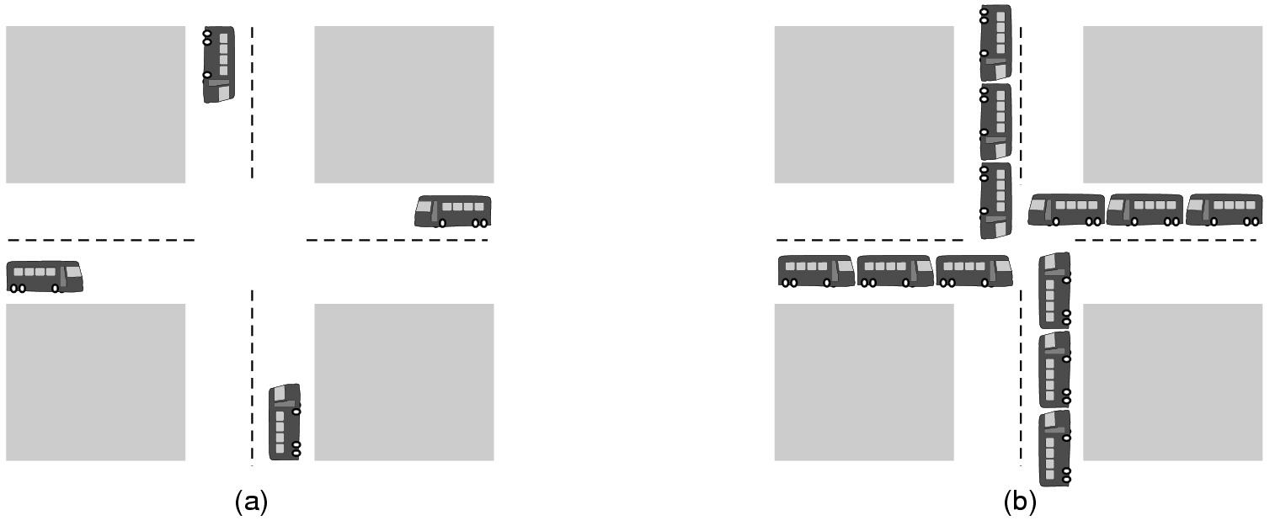
Operating System Concepts
(a) A potential deadlock
(b) An actual deadlock
Another challenge: Deadlock
  Set of actions waiting for each other to finish
Example:
  Process A has lock on file 1, wants to acquire lock on file 2
  Process B has a lock on file 2, wants to acquire lock on file 1
Copyright ©: University of Illinois CS 241 Staff

Slide 38
Operating System Concepts
Inter-process Communication
  Now process A needs to exchange information with process B
  How would you enable communication between processes?
Shared Memory
A
Pipe
B
A
B
Copyright ©: University of Illinois CS 241 Staff

Slide 39
Next up
MP1 released
Discussion sections tomorrow
Friday: System calls
Copyright ©: University of Illinois CS 241 Staff

Slide 40
Summary
Resource Manager
Hardware independence
Virtual Machine Interface
POSIX
Concurrency & Deadlock
Copyright ©: University of Illinois CS 241 Staff

