Slide 1
System Calls and I/O
CS 241
January 27, 2012

Slide 2
This lecture
Goals
Get you familiar with necessary basic system & I/O calls to do programming
Things covered in this lecture
Basic file system calls
I/O calls
Signals
Note: we will come back later to discuss the above things at the concept level

Slide 3
System Calls versus Function Calls?

Slide 4
System Calls versus Function Calls
Function Call
Process
fnCall()
Caller and callee are in the same
Process
- Same user
- Same “domain of trust”

Slide 5
System Calls versus Function Calls
Function Call
System Call
Process
Process
fnCall()
sysCall()
OS
Caller and callee are in the same
Process
- Same user
- Same “domain of trust”
- OS is trusted; user is not.
OS has super-privileges; user does not
Must take measures to prevent abuse

Slide 6
System Calls
System Calls
A request to the operating system to perform some activity
System calls are expensive
The system needs to perform many things before executing a system call
The computer (hardware) saves its state
The OS code takes control of the CPU, privileges are updated.
The OS examines the call parameters
The OS performs the requested function
The OS saves its state (and call results)
The OS returns control of the CPU to the caller

Slide 7
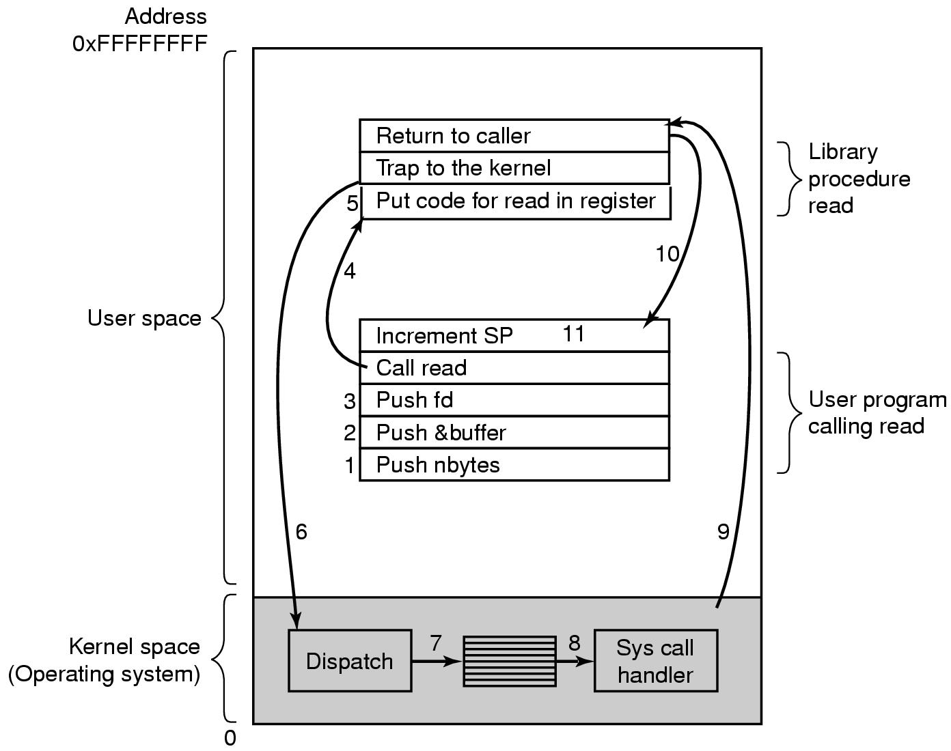
Steps for Making a System Call (Example: read call)
count = read(fd, buffer, nbytes);
9: Return to user mode
6: Switch to kernel mode (return address saved on stack)
10: Return to user program (via trap)
4 – 5: Library call (puts syscall # in CPU register)
11: Clean up
1 – 3: Push parameter (in reverse order)
7: Find system call handler
8: Run handler (index via table of pointers to
syscall handles)

Slide 8
Examples of System Calls
Examples
getuid() //get the user ID
fork() //create a child process
exec() //executing a program
Don’t mix system calls with standard library calls
Differences?
Is printf() a system call?
Is rand() a system call?
man syscalls
Notes:
what is diff bt library and sys call

Slide 9
Major System Calls
Process Management
pid = fork( ) | Create a child process identical to the parent
pid = waitpid(pid, &statloc, options) | Wait for a child to terminate
s = execve(name, argv, environp) | Replace a process’ core image
exit(status) | Terminate process execution and return status
Today
File Management
fd = open(file, how, ...) | Open a file for reading, writing or both
s = close(fd) | Close an open file
n = read(fd, buffer, nbytes) | Read data from a file into a buffer
n = write(fd, buffer, nbytes) | Write data from a buffer into a file
position = lseek(fd, offset, whence) | Move the file pointer
s = stat(name, &buf) | Get a file’s status information

Slide 10
Major System Calls
Directory and File System Management
s = mkdir(name, mode) | Create a new directory
s = rmdir(name) | Remove an empty directory
s = link(name, name) | Create a new entry, name, pointing to name
s = unlink(name) | Remove a directory entry
s = mount(special, name, flag) | Mount a file system
s = umount(special) | Unmount a file system
Miscellaneous
s = chdir(dirname) | Change the working directory
s = chmod(name, mode) | Change a file’s protection bits
s = kill(pid, signal) | Send a signal to a process
seconds = time(&seconds) | Get the elapsed time since January 1, 1970

Slide 11
File System and I/O Related System Calls
A file system
A means to organize, retrieve, and updated data in persistent storage
A hierarchical arrangement of directories
Bookkeeping information (file metadata)
File length, # bytes, modified timestamp, etc
Unix file system
Root file system starts with “/”

Slide 12
Why does the OS control I/O?
Safety
The computer must ensure that if a program has a bug in it, then it doesn't crash or mess up
The system
Other programs that may be running at the same time or later
Fairness
Make sure other programs have a fair use of device

Slide 13
Basic Unix Concepts
Input/Output – I/O
Per-process table of I/O channels
Table entries describe files, sockets, devices, pipes, etc.
Table entry/index into table called “file descriptor”
Unifies I/O interface
user space
kernel
system open file table
file
pipe
Per-process file
descriptor
table
socket

Slide 14
Basic Unix Concepts
Error Model
errno variable
Unix provides a globally accessible integer variable that contains an error code number
Return value
0 on success
-1 on failure for functions returning integer values
NULL on failure for functions returning pointers
Examples (see errno.h)
#define EPERM 1 /* Operation not permitted */
#define ENOENT 2 /* No such file or directory */
#define ESRCH 3 /* No such process */
#define EINTR 4 /* Interrupted system call */
#define EIO 5 /* I/O error */
#define ENXIO 6 /* No such device or address */

Slide 15
System Calls for I/O
Get information about a file
int stat(const char* name, struct stat* buf);
Open (and/or create) a file for reading, writing or both
int open (const char* name, in flags);
Read data from one buffer to file descriptor
size_t read (int fd, void* buf, size_t cnt);
Write data from file descriptor into buffer
size_t write (int fd, void* buf, size_t cnt);
Close a file
int close(int fd);

Slide 16
System Calls for I/O
They look like regular procedure calls but are different
A system call makes a request to the operating system by trapping into kernel mode
A procedure call just jumps to a procedure defined elsewhere in your program
Some library procedure calls may themselves make a system call
e.g., fopen() calls open()

Slide 17
File: Statistics
#include <sys/stat.h>
int stat(const char* name, struct stat* buf);
Get information about a file
Returns:
0 on success
-1 on error, sets errno
Parameters:
name: Path to file you want to use
Absolute paths begin with “/”, relative paths do not
buf: Statistics structure
off_t st_size: Size in bytes
time_t st_mtime: Date of last modification. Seconds since January 1, 1970
Also
int fstat(int filedes, struct stat *buf);
Notes:
don’t just read this. say, “this is stat, it gets you info about file
you can see patterns for what we will see in all system calls

Slide 18
Example - (stat())
#include <unistd.h>
#include <stdio.h>
#include <sys/stat.h>
#include <sys/types.h>
int main(int argc, char **argv) {
struct stat fileStat;
if(argc != 2)
return 1;
if(stat(argv[1], &fileStat) < 0)
return 1;
printf("Information for %s\n",argv[1]);
printf("---------------------------\n");
printf("File Size: \t\t%d bytes\n", fileStat.st_size); printf("Number of Links: \t%d\n", fileStat.st_nlink);
printf("File inode: \t\t%d\n", fileStat.st_ino);
Notes:
you want to go into this some

Slide 19
Example - (stat())
printf("File Permissions: \t");
printf( (S_ISDIR(fileStat.st_mode)) ? "d" : "-");
printf( (fileStat.st_mode & S_IRUSR) ? "r" : "-");
printf( (fileStat.st_mode & S_IWUSR) ? "w" : "-");
printf( (fileStat.st_mode & S_IXUSR) ? "x" : "-");
printf( (fileStat.st_mode & S_IRGRP) ? "r" : "-");
printf( (fileStat.st_mode & S_IWGRP) ? "w" : "-");
printf( (fileStat.st_mode & S_IXGRP) ? "x" : "-");
printf( (fileStat.st_mode & S_IROTH) ? "r" : "-");
printf( (fileStat.st_mode & S_IWOTH) ? "w" : "-");
printf( (fileStat.st_mode & S_IXOTH) ? "x" : "-");
printf("\n\n"); printf("The file %s a symbolic link\n", (S_ISLNK(fileStat.st_mode)) ? "is" : "is not");
return 0;
}

Slide 20
Useful Macros: File types
Is file a symbolic link
S_ISLNK
Is file a regular file
S_ISREG
Is file a character device
S_ISCHR
Is file a block device
S_ISBLK
Is file a FIFO
S_ISFIFO
Is file a unix socket
S_ISSOCK

Slide 21
Useful Macros: File Modes
S_IRWXU
read, write, execute/search by owner
S_IRUSR
read permission, owner
S_IWUSR
write permission, owner
S_IXUSR
execute/search permission, owner
S_IRGRP
read permission, group
S_IRWXO
read, write, execute/search by others

Slide 22
Example - (stat())
Information for testfile.sh
---------------------------
File Size: 36 bytes
Number of Links: 1
File inode: 180055
File Permissions: -rwxr-xr-x
The file is not a symbolic link

Slide 23
File: Open
#include <sys/types.h>
#include <sys/stat.h>
#include <fcntl.h>
int open (const char* path, int flags [, int mode ]);
Open (and/or create) a file for reading, writing or both
Returns:
Return value ≥ 0 : Success - New file descriptor on success
Return value = -1: Error, check value of errno
Parameters:
path: Path to file you want to use
Absolute paths begin with “/”, relative paths do not
flags: How you would like to use the file
O_RDONLY: read only, O_WRONLY: write only, O_RDWR: read and write, O_CREAT: create file if it doesn’t exist, O_EXCL: prevent creation if it already exists
Notes:
interesting parts: “path” is the file you want to use. these are flags. you can combine them, you can do read only AND create – that’s what they don’t understand about create

Slide 24
Example (open())
#include <fcntl.h>
#include <errno.h>
extern int errno;
main() {
int fd;
fd = open("foo.txt", O_RDONLY | O_CREAT);
printf("%d\n", fd);
if (fd=-1) {
printf ("Error Number %d\n", errno);
perror("Program");
}
}
Argument: string
Output: the string, a colon, and a description of the error condition stored in errno
Notes:
you could add a “ | CREATE “ in there too, just to show them how ti works

Slide 25
File: Close
#include <fcntl.h>
int close(int fd);
Close a file
Tells the operating system you are done with a file descriptor
Return:
0 on success
-1 on error, sets errno
Parameters:
fd: file descriptor

Slide 26
Example (close())
#include <fcntl.h>
main(){
int fd1;
if(( fd1 = open(“foo.txt", O_RDONLY)) < 0){
perror("c1");
exit(1);
}
if (close(fd1) < 0) {
perror("c1");
exit(1);
}
printf("closed the fd.\n");
Notes:
ask after close can you still use fd?

Slide 27
Example (close())
#include <fcntl.h>
main(){
int fd1;
if(( fd1 = open(“foo.txt", O_RDONLY)) < 0){
perror("c1");
exit(1);
}
if (close(fd1) < 0) {
perror("c1");
exit(1);
}
printf("closed the fd.\n");
After close, can you still use the file descriptor?
Why do we need to close a file?

Slide 28
File: Read
#include <fcntl.h>
size_t read (int fd, void* buf, size_t cnt);
Read data from one buffer to file descriptor
Read size bytes from the file specified by fd into the memory location pointed to by buf
Return: How many bytes were actually read
Number of bytes read on success
0 on reaching end of file
-1 on error, sets errno
-1 on signal interrupt, sets errno to EINTR
Parameters:
fd: file descriptor
buf: buffer to read data from
cnt: length of buffer
Notes:
you want to get concepts across
todo: add popups for takeways maybe

Slide 29
File: Read
size_t read (int fd, void* buf, size_t cnt);
Things to be careful about
buf needs to point to a valid memory location with length not smaller than the specified size
Otherwise, what could happen?
fd should be a valid file descriptor returned from open() to perform read operation
Otherwise, what could happen?
cnt is the requested number of bytes read, while the return value is the actual number of bytes read
How could this happen?

Slide 30
Example (read())
#include <fcntl.h>
main() {
char *c;
int fd, sz;
c = (char *) malloc(100
* sizeof(char));
fd = open(“foo.txt",
O_RDONLY);
if (fd < 0) {
perror("r1");
exit(1);
}
sz = read(fd, c, 10);
printf("called
read(%d, c, 10).
returned that %d
bytes were
read.\n", fd, sz);
c[sz] = '\0';
printf("Those bytes
are as follows:
%s\n", c);
close(fd);
}

Slide 31
File: Write
#include <fcntl.h>
size_t write (int fd, void* buf, size_t cnt);
Write data from file descriptor into buffer
Writes the bytes stored in buf to the file specified by fd
Return: How many bytes were actually written
Number of bytes written on success
0 on reaching end of file
-1 on error, sets errno
-1 on signal interrupt, sets errno to EINTR
Parameters:
fd: file descriptor
buf: buffer to write data to
cnt: length of buffer

Slide 32
File: Write
size_t write (int fd, void* buf, size_t cnt);
Things to be careful about
The file needs to be opened for write operations
buf needs to be at least as long as specified by cnt
If not, what will happen?
cnt is the requested number of bytes to write, while the return value is the actual number of bytes written
How could this happen?

Slide 33
Example (write())
#include <fcntl.h>
main()
{
int fd, sz;
fd = open("out3",
O_RDWR | O_CREAT |
O_APPEND, 0644);
if (fd < 0) {
perror("r1");
exit(1);
}
sz = write(fd, "cs241\n",
strlen("cs241\n"));
printf("called write(%d,
\"cs360\\n\", %d).
it returned %d\n",
fd, strlen("cs360\n"),
sz);
close(fd);
}

Slide 34
File Pointers
All open files have a "file pointer" associated with them to record the current position for the next file operation
On open
File pointer points to the beginning of the file
After reading/write m bytes
File pointer moves m bytes forward

Slide 35
File: Seek
#include <unistd.h>
off_t lseek(int fd, off_t offset, int whence);
Explicitly set the file offset for the open file
Return: Where the file pointer is
the new offset, in bytes, from the beginning of the file
-1 on error, sets errno, file pointer remains unchanged
Parameters:
fd: file descriptor
offset: indicates relative or absolute location
whence: How you would like to use lseek
SEEK_SET, set file pointer to offset bytes from the beginning of the file
SEEK_CUR, set file pointer to offset bytes from current location
SEEK_END, set file pointer to offset bytes from the end of the file

Slide 36
File: Seek Examples
Random access
Jump to any byte in a file
Move to byte #16
newpos = lseek(fd, 16, SEEK_SET);
Move forward 4 bytes
newpos = lseek(fd, 4, SEEK_CUR);
Move to 8 bytes from the end
newpos = lseek(fd, -8, SEEK_END);

Slide 37
Example (lseek())
c = (char *) malloc(100 * sizeof(char));
fd = open(“foo.txt", O_RDONLY);
if (fd < 0) {
perror("r1");
exit(1);
}
sz = read(fd, c, 10);
printf("We have opened in1, and called read(%d, c, 10).\n", fd);
c[sz] = '\0';
printf("Those bytes are as follows: %s\n", c);
i = lseek(fd, 0, SEEK_CUR);
printf("lseek(%d, 0, SEEK_CUR) returns that the current offset is %d\n\n", fd, i);
printf("now, we seek to the beginning of the file and call read(%d, c, 10)\n", fd);
lseek(fd, 0, SEEK_SET);
sz = read(fd, c, 10);
c[sz] = '\0';
printf("The read returns the following bytes: %s\n", c);
…

Slide 38
Standard Input, Standard Output and Standard Error
Every process in Unix has three predefined file descriptors
File descriptor 0 is standard input (STDIN)
File descriptor 1 is standard output (STDOUT)
File descriptor 2 is standard error (STDERR)
Read from standard input,
read(0, ...);
Write to standard output
write(1, ...);
Two additional library functions
printf();
scanf();

Slide 39
I/O Library Calls
Every system call has paired procedure calls from the standard I/O library:
System Call
open
close
read/write
lseek
Standard I/O call (stdio.h)
fopen
fclose
getchar/putchar, getc/putc, fgetc/fputc, fread/fwrite, gets/puts, fgets/fputs, scanf/printf, fscanf/fprintf
fseek

Slide 40
Stream Processing - fgetc()
int fgetc(FILE *stream);
Read the next character from stream
Return
An unsigned char cast to an int
EOF on end of file
Error
int getchar(void);
Read the next character from stdin
int getc(void);
Similar to , but implemented as a macro, faster and potentially unsafe
Similar functions for writing:
int fputc(int c, FILE *stream);
int putchar(int c);
int putc(int c, FILE *stream);

Slide 41
Stream Processing - fgets()
char *fgets(char *s, int size, FILE *stream);
Read in at most one less than size characters from stream
Stores characters in buffer pointed to by s.
Reading stops after an EOF or a newline.
If a newline is read, it is stored into the buffer.
A '\0' is stored after the last character in the buffer.
Return
s on success
NULL on error or on EOF and no characters read
Similar:
int fputs(const char *s, FILE *stream);

Slide 42
Stream Processing
char *gets(char *s);
Reads a line from stdin
NOTE: DO NOT USE
Reading a line that overflows the array pointed to by s causes undefined results.
The use of is fgets() recommended

Slide 43
Stream Processing - fputs()
int fputs(const char *s, FILE *stream);
Write the null-terminated string pointed to by s to the stream pointed to by stream.
The terminating null byte is not written
Return
Non-neg number on success
EOF on error
char *puts(char *s);
Write to stdout
Appends a newline character

Slide 44
Example: (fgets()- fputs())
#include <stdio.h>
int main() {
FILE * fp = fopen("test.txt", "r");
char line[100];
while( fgets(line, sizeof(line), fp) != NULL ) fputs(line, stdout);
fclose(fp);
return 0;
}

Slide 45
Stream Processing - fscanf()
int scanf(const char *format, ... );
Read from the standard input stream stdin
Stores read characters in buffer pointed to by s.
Return
Number of successfully matched and assigned input items
EOF on error
int fscanf(FILE *stream, const char *fmt, ... );
Read from the named input stream
int sscanf(const char *s, const char *fmt, ... );
Read from the string s

Slide 46
Example: (scanf())
Input: 56789 56a72
#include <stdio.h>
int main() {
int i;
float x;
char name[50];
scanf("%2d%f %[0123456789]", &i, &x, name);
}
What are i, x, and name after the call to scanf()?
What will a subsequent call to getchar()return?
Notes:
56
789
56

Slide 47
Example: stdin
int x;
char st[31];
/* read first line of input */
printf("Enter an integer: ");
scanf("%d", &x);
/* read second line of input */
printf("Enter a line of text: ");
fgets(st, 31, stdin);
What will this code really do?

Slide 48
Example: stdin
int x;
char st[31];
/* read first line of input */
printf("Enter an integer: ");
scanf("%d", &x);
/* read second line of input */
printf("Enter a line of text: ");
fgets(st, 31, stdin);
What will this code really do?
Input is buffered, but scanf() did not read all of the first line

Slide 49
Example: stdin
int x;
char st[31];
/* read first line */
printf("Enter an integer: ");
scanf("%d", &x);
dump_line(stdin);
/* read second line */
printf("Enter a line of text: ");
fgets(st, 31, stdin);
void dump_line( FILE * fp ) {
int ch;
while((ch = fgetc(fp))
!= EOF &&
ch != '\n' )
/* null body */;
}
Read and dump all characters from input buffer until a '\n' after scanf()

