Slide 1
Introduction to Networking
CS 241
April 16, 2014
University of Illinois

Slide 2
Announcements
Last call for Pebble pickup
Right after class today

Slide 3
Networking
What do we expect out of networking?
An channel between two processes on two remote machines.
Making this happen is complex!
Host
Proc
Host
Proc
Ex: Firefox on your machine
Ex: Facebook’s server
Hosts
Routers
Various Links
Applications
Protocols
Hardware
Software
Bit errors
Packet errors
Link failures
Node failures
Message delays
Out-of-order delivery
Eavesdropping

Slide 4
Protocols
A protocol is a message format and rules for exchanging these messages.
You already use a lot of protocols:
Notes:
Web / Http
ssh
SNMP / email

Slide 5


What is a Protocol?
Human protocols
“what’s the time?”
“I have a question”
Introductions
Network protocols
Machines rather than humans
All Internet communication is governed by protocols
Hi
TCP connection
request
Hi
TCP connection
response
Got the
time?
Get http://www.uiuc.edu
2:00
time
<file>

Slide 6
Networking Model: Layers of Protocols
A network channel is effectively only a transmission of 0s and 1s:
How do we translate these 0s and 1s into HTTP packets? How do we get those to the right end-user?
0 1 0 0 1 1 0 1 0 0 0 1 0 1 1 0 0 1 0 1 1 1 1 0 1 0
Host
Proc
Host
Proc

Slide 7
The Internet’s Protocol Stack
The Internet’s core protocols form a “stack”.
Larger seven-layer stack devised by a committee in the 1980s is called the OSI Model
Here we focus on layers commonly used today
Each layer encapsulates data sent by the layers above it and provides specific features to higher-layer protocols.
Application
Transport
Network
Data Link
Physical

Slide 8
Layer 1: Physical Layer
The Physical Layer provides hardware-specific details on how to transmit a 0 vs. 1.
100BASE-T: Ethernet
GSM “Um Interface”: Cell phones
802.11: Wi-Fi
Provides: A digital representation of the underlying signal; a series of 0s and 1s.
Key problem: Analog to digital conversion
Application
Transport
Network
Data Link
Physical
Notes:
So basically we’re dealing with physics. What are some of the physical media we operate over?
Air (radio), light in glass fiber, copper cables

Slide 9

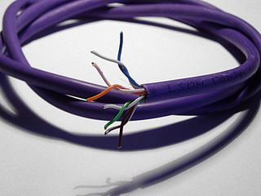
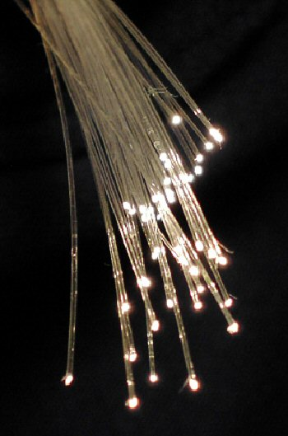
Physical transmission media
[Photos: Wikimedia users Evdaimon, Zephyris, BigRiz]

Slide 10
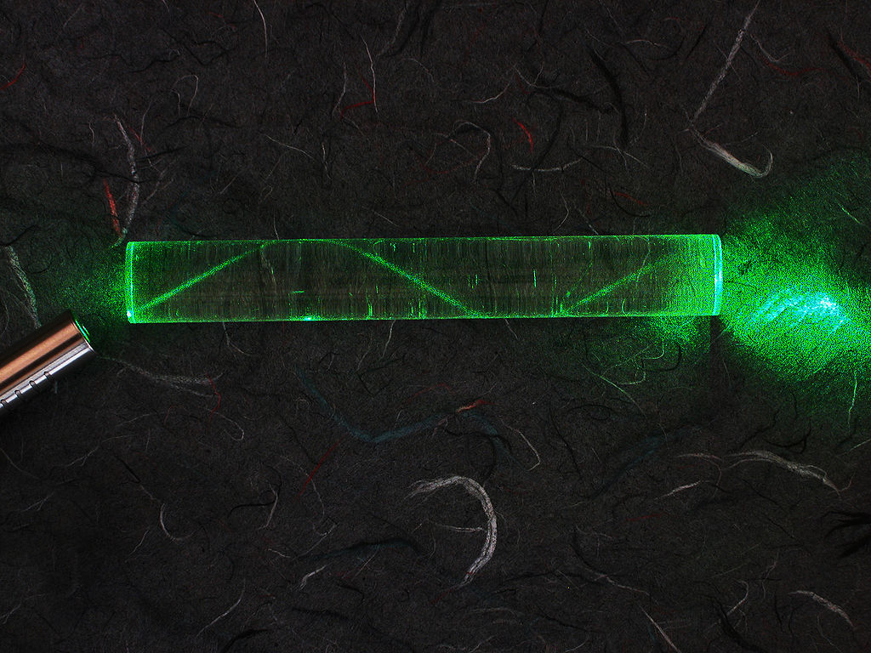
Physical transmission media
[Wikimedia user Timwether]

Slide 11
Layer 2: Data Link Layer
The Data Link Layer sends and receives packets on a transmission medium.
Consider Wi-Fi:
Every computer that is connected to a wi-fi access point uses the same channel: every computer hears every other computer!
How do we know the data that is coming in is for us, not for our neighbor?
Provides: Send/receive packets on a “wire”
Key problems:
Framing, errors
Addressing, resource contention
Application
Transport
Network
Data Link
Physical
Notes:
Run ifconfig, talk about MAC addresses

Slide 12
Layer 2: Data Link Layer
Network Node
Packet:
Data Link Packet
Layer 2 Header
Payload
Network Node
New data link layer between every link!
…but the “payload” remains the same.
Packet:
Data Link Packet
Layer 2 Header
Payload
Network Node

Slide 13
Layer 3: Network Layer
The Network Layer provides host-to-host communications across many “hops”.
One protocol: IP (IPv4 and IPv6)
Provides: Information on the source and destination host.
Where should this packet go?
Who sent this packet in the first place?
Key problems:
Addressing
Heterogeneous transmission media
Routing
Application
Transport
Network
Data Link
Physical
Notes:
Traceroute demo?

Slide 14
Layer 4: Transport Layer
The Transport Layer provides process-to-process communications.
Two main protocols: TCP and UDP
Provides: Information on the source and destination process… and much more.
Uses “network ports”, a globally shared resource on a system that associates a port number with a process.
The process making the connection to a remote process needs to know the port number the remote process is listening on.
Key problems:
Process multiplexing, reliability, congestion...
Application
Transport
Network
Data Link
Physical

Slide 15
TCP vs. UDP
TCP and UDP both provide process-to-process communications via port numbers.
That is about all UDP does. UDP: fast and cheap!
TCP provides several convenience features:
Reliable Transmission:
Packets will arrive in the order that they were sent
All packets will arrive (on an active connection)
All packets will be delivered once (no duplicates)
Flow and Congestion Control:
TCP negotiates a rate of transmission between the hosts so the receiver is not overwhelmed with data

Slide 16
Application Layer (“layer 7”)
The Application Layer refers to any communication software and procedures for particular applications.
May actually be composed of many layers
Examples?
Application
Transport
Network
Data Link
Physical

Slide 17
Where are we as systems programmers?
Most commonly, we write applications using an interface to the transport layer
In this class: the sockets interface
Others exist
Above sockets interface: User code
Below sockets interface: Kernel
Application
Transport
Network
Data Link
Physical

Slide 18
Encapsulation
Application
program
Application
program
Application
program
Application
program
DATA
DATA
IP HDR
DATA
TCP HDR
DATA
Best effort
Service
Reliable
Service
Best effort
Service
Reliable
Service
Host-to-Host
Host-to-Host
TCP HDR
IP HDR
DATA
TCP HDR
IP HDR
DATA
TCP HDR
IP HDR
DATA

Slide 19
Why layering?
It’s all about modularity
Eases maintenance, updating of system
Change of implementation of layer’s service transparent to rest of system
e.g., change in transmission medium (Layer 0) has no effect on network protocol or applications
What other examples of layering have we seen?

Slide 20
Internet Architecture: The “Hourglass” Design
FTP
HTTP
NV
TFTP
TCP
UDP
IP
Ethernet
3G wireless
MPLS
Modem

