Slide 1
DNS
CS 241
April 25, 2014
University of Illinois
Notes:
Slide 5 needs revision

Slide 2
Host Names vs. IP addresses
Host names
Mnemonic name appreciated by humans
Variable length, full alphabet of characters
Provide little (if any) information about physical location
Examples: www.cnn.com and bbc.co.uk
IP addresses
Numerical address appreciated by routers
Fixed length, binary number
Hierarchical, related to host location
Examples: 64.236.16.20 and 212.58.224.131

Slide 3
Separating Naming and Addressing
Names are easier to remember
cnn.com vs. 64.236.16.20 (but not shortened urls)
Addresses can change underneath
Move www.cnn.com to 4.125.91.21
E.g., renumbering when changing providers
Name could map to multiple IP addresses
www.cnn.com to multiple (8) replicas of the Web site
Enables
Load-balancing
Reducing latency by picking nearby servers
Tailoring content based on requester’s location/identity
Multiple names for the same address
E.g., aliases like www.cnn.com and cnn.com

Slide 4
Domain Name System (DNS)
Properties of DNS
Hierarchical name space divided into zones
Zones distributed over collection of DNS servers
Hierarchy of DNS servers
Root (hardwired into other servers)
Top-level domain (TLD) servers
Authoritative DNS servers
Performing the translations
Local DNS servers
Resolver software

Slide 5
Distributed, Hierarchical Database
Root DNS Servers
com DNS servers
org DNS servers
edu DNS servers
yahoo.com
DNS servers
amazon.com
DNS servers
pbs.org
DNS servers
uiuc.edu
DNS servers
umass.edu
DNS servers
Client wants IP for www.amazon.com
Client queries a root server to find com DNS server
Client queries com DNS server to get amazon.com DNS server
Client queries amazon.com DNS server to get IP address for www.amazon.com

Slide 6
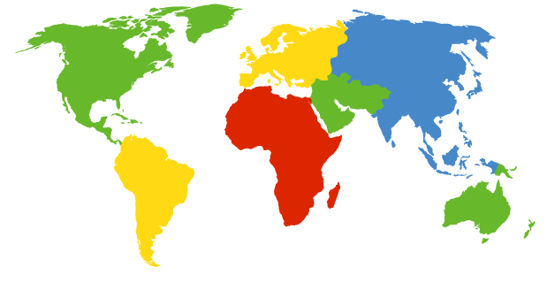
DNS Root
Located in Virginia, USA
How do we make the root scale?
Verisign, Dulles, VA

Slide 7
DNS Root Servers
13 root servers (see http://www.root-servers.org/)
Labeled A through M
Does this scale?
A Verisign, Dulles, VA
C Cogent, Herndon, VA
D U Maryland College Park, MD
G US DoD Vienna, VA
H ARL Aberdeen, MD
J Verisign
K RIPE London
I Autonomica, Stockholm
E NASA Mt View, CA
F Internet Software
Consortium
Palo Alto, CA
M WIDE Tokyo
B USC-ISI Marina del Rey, CA
L ICANN Los Angeles, CA

Slide 8
DNS Root Servers
13 root servers each replicated via any-casting (localized routing for addresses)
A Verisign, Dulles, VA
C Cogent, Herndon, VA (also Los Angeles, NY, Chicago)
D U Maryland College Park, MD
G US DoD Vienna, VA
H ARL Aberdeen, MD
J Verisign (21 locations)
K RIPE London (plus 16 other locations)
I Autonomica, Stockholm (plus 29 other locations)
E NASA Mt View, CA
F Internet Software
Consortium,
Palo Alto, CA
(and 37 other locations)
M WIDE Tokyo
plus Seoul, Paris, San Francisco
B USC-ISI Marina del Rey, CA
L ICANN Los Angeles, CA

Slide 9
TLD and Authoritative Servers
Top-level domain (TLD) servers
Responsible for com, org, net, edu, etc, and all top-level country domains uk, fr, ca, jp.
Network Solutions maintains servers for com TLD
Educause for edu TLD
Authoritative DNS servers
Organization’s DNS servers
Provide authoritative hostname to IP mappings for organization’s servers (e.g., Web, mail).
Can be maintained by organization or service provider

Slide 10
Local Name Server
One per ISP (residential ISP, company, university)
Also called “default name server”
When host makes DNS query, query is sent to its local DNS server
Acts as proxy, forwards query into hierarchy
Reduces lookup latency for commonly searched hostnames
Hosts learn local name server via...
DHCP (same protocol that tells host its IP address)
Static configuration (e.g., can use Google’s “local” name service at 8.8.8.8 or 8.8.4.4)

Slide 11
Applications’ use of DNS
Client application (e.g., web browser)
Extract server name (e.g., from the URL)
Do gethostbyname() to trigger resolver code, sending message to local name server
Server application (e.g. web server)
Extract client IP address from socket
Optional gethostbyaddr() to translate into name

Slide 12
DNS name resolution example
Host at cs.uiuc.edu wants IP address for gaia.cs.umass.edu
Iterated query
Contacted server replies with name of server to contact
“I don’t know this name, but ask this server”
root DNS server
2
3
4
TLD DNS server
5
local DNS server
dns.uiuc.edu
7
6
1
8
authoritative DNS server
dns.cs.umass.edu
requesting host
cs.uiuc.edu

Slide 13
DNS: Caching
Once (any) name server learns mapping, it caches mapping
Cache entries timeout (disappear) after some time
TLD servers typically cached in local name servers
Thus root name servers not often visited

