Slide 1
Networking wrap-up and I/O systems
CS 241
April 28, 2014
University of Illinois
Notes:
Didn’t make it to the I/O part at all.
Need to put the review questions into a SurveyMonkey ... forgot to do that :-(

Slide 2
Today
Network programming tips
Network Address Translation
I/O systems

Slide 3
Tip #1: Can’t bind?
Problem: bind() says “address already in use”
You have stopped your server, and then re-started it right away
The sockets that were used by the first incarnation of the server are still active

Slide 4
setsockopt
int yes = 1;
setsockopt (fd, SOL_SOCKET, SO_REUSEADDR,
(char *) &yes, sizeof (yes));
Call just before bind()
Allows bind to succeed despite the existence of existing connections in the requested TCP port
Connections in limbo (e.g. lost final ACK) will cause bind to fail

Slide 5
Tip #2: Dealing with abruptly closed connection
Notes:
Show main loop of ./37-server.c
Have client connect via telnet, then exit (control-] and type ‘quit’).
What does the server do?
Fix by uncommenting signal line in ./37-server.c.

Slide 6
Tip #2: Dealing with abruptly closed connection
Problem: Socket at other end is closed
Write to your end generates SIGPIPE
This signal kills the program by default!
signal (SIGPIPE, SIG_IGN);
Call at start of main in server
Allows you to ignore broken pipe signals
Can ignore or install a proper signal handler
Default handler exits (terminates process)

Slide 7
Tip #3: Beej’s guide
Beej's Guide to Network Programming
http://beej.us/guide/bgnet/

Slide 8
Review

Slide 9
Threads in your web server
Why are multiple threads useful in your web server – as opposed to serving all clients with a single thread in a single process? (Check all that apply)
Multiple threads can spread work across multiple cores / CPUs to decrease processing time.
Multiple threads have greater memory space to read files and write them to the network.
A single thread would have to switch back and forth between each connection, which is slow and annoying to program.
One thread can be reading/writing from the network while another is waiting to read a file off disk.

Slide 10
DNS caching
Why does the DNS system use caching? (Check all that apply)
Returns more up-to-date results
Improves speed of response
Decreases workload on root and authoritative DNS servers
Improves security
Improves robustness (things still work even if some DNS servers fail)

Slide 11
Network Address Translation (NAT)

Slide 12





The problem
Your ISP gives you one IP address. But...

Slide 13
NAT: Network Address Translation
Approach
Assign one router a global IP address
Assign internal hosts local IP addresses
A box in the middle converts between them
(e.g. wireless router in your home)
When a packet arrives from the Internet, how do you know which internal host it’s destined for?

Slide 14
NAT: Network Address Translation
NAT translation table
WAN side addr LAN side addr
1: host 10.0.0.1
sends datagram to
128.119.40, 80
2: NAT router
changes datagram
source addr from
10.0.0.1, 3345 to
138.76.29.7, 5001,
updates table
138.76.29.7, 5001 10.0.0.1, 3345
…… ……
S: 10.0.0.1, 3345
D: 128.119.40.186, 80
1
10.0.0.1
2
S: 138.76.29.7, 5001
D: 128.119.40.186, 80
10.0.0.4
10.0.0.2
138.76.29.7
S: 128.119.40.186, 80
D: 10.0.0.1, 3345
4
S: 128.119.40.186, 80
D: 138.76.29.7, 5001
3
10.0.0.3
4: NAT router
changes datagram
dest addr from
138.76.29.7, 5001 to 10.0.0.1, 3345
3: Reply arrives
dest. address:
138.76.29.7, 5001

Slide 15
NAT: Benefits
Local network uses just one (or a few) IP address as far as outside world is concerned
No need to be allocated range of addresses from ISP
16-bit port-number field: 60,000 simultaneous connections with a single LAN-side address!
Might use a few IPs in a large private enterprise network
Can change addresses of devices in local network without notifying outside world
Can change ISP without changing addresses of devices in local network
Security
Devices inside local net not explicitly addressable by outside world
Connection needs to be initiated by inside device before a specific host can reach it from the public Internet

Slide 16
NAT example use: load balancing
Load balancing
Balance the load on a set of identical servers, which are accessible from a single IP address
NAT solution
Servers are assigned private addresses
NAT acts as a proxy for requests to the server from the public network
NAT changes the destination IP address of arriving packets to one of the private addresses for a server
Balances load on the servers by assigning addresses in a round-robin fashion
Notes:
For most popular web sites, when you connect to an IP address it’s actually a load balancer with NAT-style functionality that balances load among various servers.

Slide 17
NAT: Consequences
End-to-end connectivity broken
NAT destroys universal end-to-end reachability of hosts on the Internet
A host in the public Internet often cannot initiate communication to a host in a private network
Even worse when two hosts that are in different private networks need to communicate with each other

Slide 18
NAT: Consequences
Broken if IP address in application data
Applications often carry IP addresses in the payload of the application data
No longer work across a private-public network boundary
Hack: Some NAT devices inspect the payload of widely used application layer protocols and, if an IP address is detected in the application-layer header or the application payload, translate the address according to the address translation table

Slide 19
NAT: Consequences
Ossification of Internet protocols
NAT must be aware of port numbers which are inside transport header
Existing NATs don’t support your fancy new transport protocol
and might even block standard protocols like UDP
Result: Difficult to invent new transport protocols
...unless they just pretend to be TCP

Slide 20
I/O systems

Slide 21
Input and Output
A computer’s job is to process data
Computation (CPU, cache, and memory)
Move data into and out of a system (between I/O devices and memory)
Challenges with I/O devices
Different categories: storage, networking, displays, etc.
Large number of device drivers to support
Device drivers run in kernel mode and can crash systems
Goals of the OS
Provide a generic, consistent, convenient and reliable way to access I/O devices
As device-independent as possible
High performance I/O

Slide 22
How does the CPU talk to devices?
Device controller: Hardware that enables devices to talk to the peripheral bus
Host adapter: Hardware that enables the computer to talk to the peripheral bus
Bus: Wires that transfer data between components inside computer
Device controller allows OS to specify simpler instructions to access data
Example: a disk controller
Translates “access sector 23” to “move head reader 1.672725272 cm from edge of platter”
Disk controller “advertises” disk parameters to OS, hides internal disk geometry
Most modern hard drives have disk controller embedded as a chip on the physical device

Slide 23
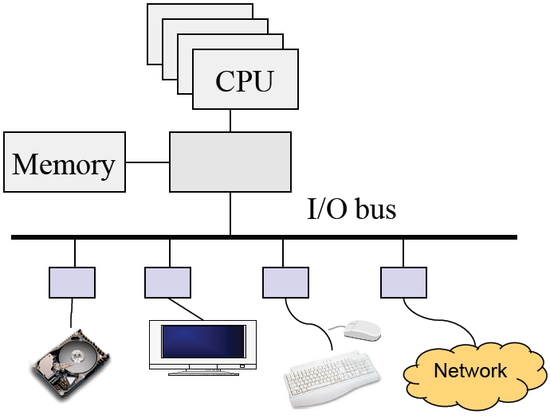
Review: Computer Architecture
Compute hardware
CPU and caches
Chipset
Memory
I/O Hardware
I/O bus or interconnect
I/O controller or adaptor
I/O device
Two types of I/O
Programmed I/O (PIO)
CPU does the work of moving data
Direct Memory Access (DMA)
CPU offloads the work of moving data to DMA controller

Slide 24
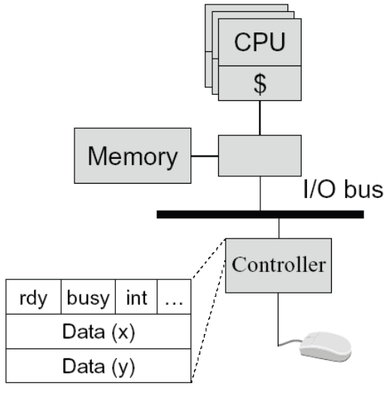
Programmed Input Device
Device controller
Status registers
ready: tells if the host is done
busy: tells if the controller is done
int: interrupt
…
Data registers
A simple mouse design
When moved, put (X, Y) in mouse’s device controller’s data registers
Interrupt CPU
Input on an interrupt
CPU saves state of currently-executing program
Reads values in X, Y registers
Sets ready bit
Wakes up a process/thread or execute a piece of code to handle interrupt

Slide 25
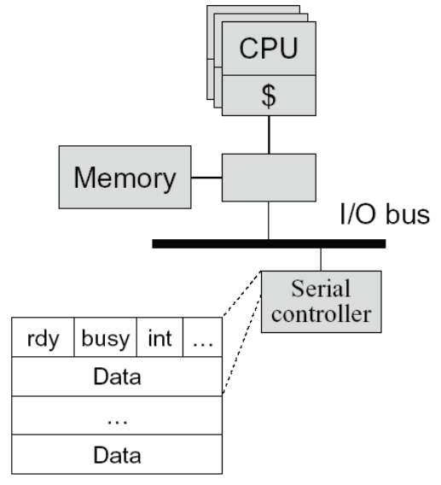
Programmed Output Device
Device
Status registers (ready, busy, … )
Data registers
Example
A serial output device
Perform an output
CPU: Poll the busy bit
Writes the data to data register(s)
Set ready bit
Controller sets busy bit and transfers data
Controller clears the busy bit
Notes:
Wait until ready bit is clear

Slide 26
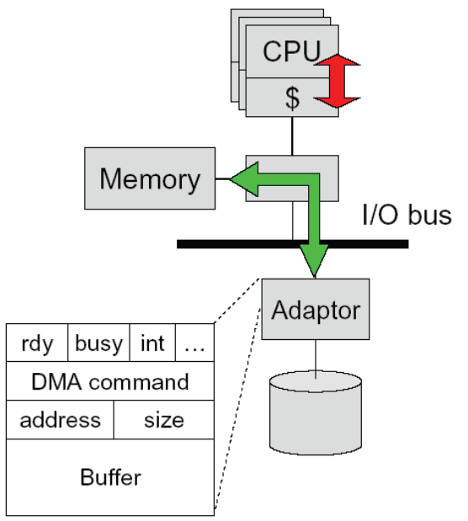
Direct Memory Access (DMA)
DMA controller or adaptor
Status register (ready, busy, interrupt, …)
DMA command register
DMA register (address, size)
DMA buffer
Host CPU initiates DMA
Device driver call (kernel mode)
Wait until DMA device is free
Initiate a DMA transaction (command, memory address, size)
Block
Controller performs DMA
DMA data to device (size--; address++)
Issue interrupt on completion (size == 0)
CPU’s interrupt handler
Wakeup the blocked process

Slide 27
Memory-mapped I/O
Use the same address bus to address both memory and I/O devices
The memory and registers of I/O devices are mapped to address values
Allows same CPU instructions to be used with regular memory and devices
I/O devices, memory controller, monitor address bus
Each responds to addresses they own
Orthogonal to DMA
May be used with, or without, DMA

Slide 28
Polling- vs. Interrupt-driven I/O
Polling
CPU issues I/O command
CPU directly writes instructions into device’s registers
CPU busy waits for completion
Interrupt-driven I/O
CPU issues I/O command
CPU directly writes instructions into device’s registers
CPU continues operation until interrupt
Direct Memory Access (DMA)
Typically done with Interrupt-driven I/O
CPU asks DMA controller to perform device-to-memory transfer
DMA issues I/O command and transfers new item into memory
CPU module is interrupted after completion
Which is better, polling or interrupt-driven I/O?

Slide 29
Polling- vs. Interrupt-driven I/O
Polling
Expensive for large transfers
Better for small, dedicated systems with infrequent I/O
Interrupt-driven
Overcomes CPU busy waiting
I/O module interrupts when ready: event driven

Slide 30
How Interrupts are implemented
CPU hardware has an interrupt report line that the CPU tests after executing every instruction
If a(ny) device raises an interrupt by setting interrupt report line
CPU catches the interrupt and saves the state of current running process into PCB
CPU dispatches/starts the interrupt handler
Interrupt handler determines cause, services the device and clears the interrupt report line
Other uses of interrupts: exceptions
Division by zero, wrong address
System calls (software interrupts/signals, trap)
Virtual memory paging

Slide 31
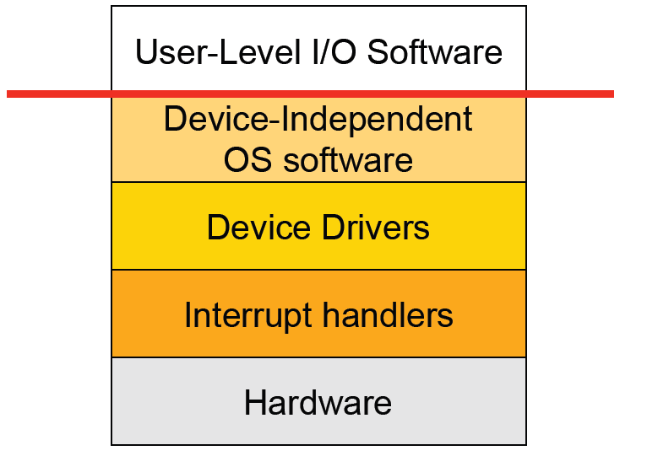
I/O Software Stack
User space
Kernel

Slide 32


Announcements
MPs, Take Two
May resubmit, after MP7 due date and before final
Half credit on resubmissions
Watch Piazza later this week for grading and timing details
Talk today
Scott Shenker (UC Berkeley)
“Software-Defined Networking: Introduction and Retrospective”

Slide 33
Interrupt Handling
Save context (registers that hw hasn’t saved, PSW etc)
Mask interrupts if needed
Set up a context for interrupt service
Set up a stack for interrupt service
Acknowledge interrupt controller, perhaps enable it
Save entire context to PCB
Run the interrupt service
Unmask interrupts if needed
Possibly change the priority of the process
Run the scheduler
Then OS will set up context for next process, load registers and PSW, start running process …

Slide 34
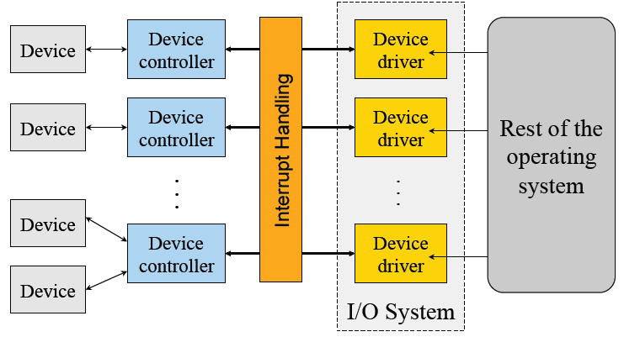
Device Drivers
Manage the complexity and differences among specific types of devices (disk vs. mouse, different types of disks …)
Each handles one type of device or small class of them (eg SCSI)

Slide 35
Typical Device Driver Design
Operating system and driver communication
Commands and data between OS and device drivers
Driver and hardware communication
Commands and data between driver and hardware
Driver responsibilities
Initialize devices
Interpreting commands from OS
Schedule multiple outstanding requests
Manage data transfers
Accept and process interrupts
Maintain the integrity of driver and kernel data structures

Slide 36
Device Driver Behavior
Check input parameters for validity, and translate them to device specific language
Check if device is free (wait or block if not)
Issue commands to control device
Write them into device controller’s registers
Check after each if device is ready for next (wait or block if not)
Block or wait for controller to finish work
Check for errors, and pass data to device-independent software
Return status information
Process next queued request, or block waiting for next
Challenges:
Must be reentrant (can be called by an interrupt while running)
Handle hot-pluggable devices and device removal while running
Complex and many of them; bugs in them can crash system

Slide 37
Types of I/O Devices
Block devices
Organize data in fixed-size blocks
Transfers are in units of blocks
Blocks have addresses and data are therefore addressable
E.g. hard disks, USB disks, CD-ROMs
Character devices
Delivers or accepts a stream of characters, no block structure
Not addressable, no seeks
Can read from stream or write to stream
Printers, network interfaces, terminals
Like everything, not a perfect classification
E.g. tape drives have blocks but not randomly accessed
Clocks are I/O devices that just generate interrupts

Slide 38
Char/Block Device Interfaces
Character device interface
read( deviceNumber, bufferAddr, size )
Reads “size” bytes from a byte stream device to “bufferAddr”
write( deviceNumber, bufferAddr, size )
Write “size” bytes from “bufferAddr” to a byte stream device
Block device interface
read( deviceNumber, deviceAddr, bufferAddr )
Transfer a block of data from “deviceAddr” to “bufferAddr”
write( deviceNumber, deviceAddr, bufferAddr )
Transfer a block of data from “bufferAddr” to “deviceAddr”
seek( deviceNumber, deviceAddress )
Move the head to the correct position
Usually not necessary

Slide 39
Sync vs Asynchronous I/O
Synchronous I/O
read() or write() will block a user process until its completion
OS overlaps synchronous I/O with another process
Asynchronous I/O
read() or write() will not block a user process
user process can do other things before I/O completion
I/O completion will notify the user process

Slide 40
Example: Blocked Read
A process issues a read call which executes a system call
System call code checks for correctness
If it needs to perform I/O, it will issues a device driver call
Device driver allocates a buffer for read and schedules I/O
Controller performs DMA data transfer
Block the current process and schedule a ready process
Device generates an interrupt on completion
Interrupt handler stores any data and notifies completion
Move data from kernel buffer to user buffer
Wakeup blocked process (make it ready)
User process continues when it is scheduled to run

