Slide 1
File systems
CS 241
May 2, 2014
University of Illinois
Based in part on slides by Matt Welsh, Harvard
Notes:
This ran over; had to rush to get to the RAID material even in a brief way. Cut some of the boring stuff.

Slide 2
Announcements
Finals approaching, know your times and conflicts
Ours: Friday May 16, 8-11 am
Inform us by Wed May 7 if you have to take a conflict exam (with justification)
Review information TBA
Honors section demos
Email us your group’s availability by Sunday May 4
Follow the specific instructions on Piazza
https://piazza.com/class/ho7vaxphwq9283?cid=938
MP Grading Round 2
Formula: score = max{ old, new/2 }
Notes:
ADD PICTURE OF DISK

Slide 3
Filesystems
A filesystem provides a high-level application access to storage media
Masks the details of low-level sector-based I/O operations
Provides structured access to data (files and directories)
Caches recently-accessed data in memory
Most common general-purpose file systems
Organized as a tree of directories and files
Byte-oriented: may read and write files a byte at a time
Alternate models exist
(key, value) storage instead of hierarchy
record-oriented files (like a data structure in a file) instead of a flat stream of bytes
Versioning filesystems
Keep track of older versions of files
e.g., VMS filesystem: Could refer to specific file versions: foo.txt;1, foo.txt;2

Slide 4
Filesystem Operations
Filesystems provide a standard interface to files and directories:
Create a file or directory
Delete a file or directory
Open a file or directory – allows subsequent access
Read, write, append to file contents
Add or remove directory entries
Close a file or directory – terminates access
What other features do filesystems provide?
Accounting and quotas – prevent your classmates from hogging the disks
Backup – some filesystems have a “$HOME/.backup” containing automatic snapshots
Indexing and search capabilities
File versioning
Encryption
Automatic compression of infrequently-used files
Caching in memory
Should this functionality be part of the filesystem or built on top?
Classic OS community debate: Where is the best place to put functionality?

Slide 5
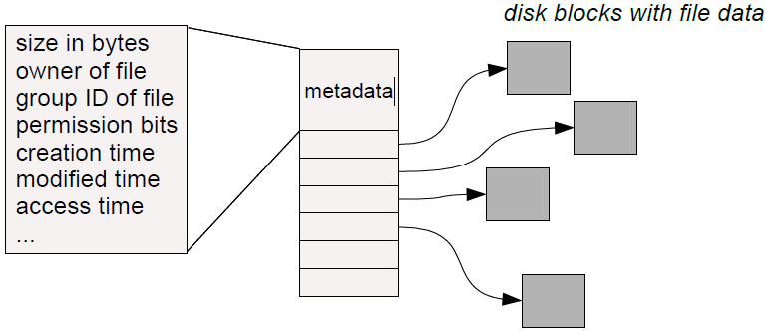
Basic Filesystem Structures
Every file and directory is represented by an inode
Stands for “index node”
Contains two kinds of information:
1) Metadata describing the file's owner, access rights, etc.
2) Location of the file's blocks on disk
inode
Notes:
DEMO: try out ‘stat’ on some files to see the inode numbers, or ‘ls –i’.

Slide 6
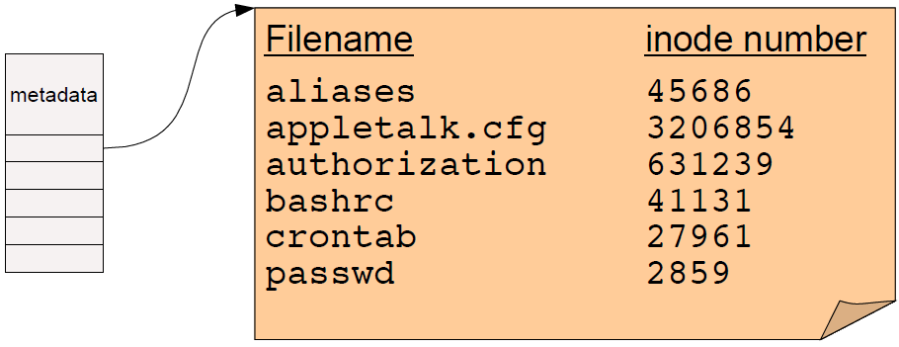
Directories
A directory is a special kind of file that contains a list of (filename, inode number) pairs
These are the contents of the directory “file data” itself – NOT the directory's inode!
Filenames (in UNIX) are not stored in the inode at all!

Slide 7
Finding a file
Two open questions:
How do we find the root directory (“ / ” on UNIX systems)?
How do we get from an inode number to the location of the inode on disk?

Slide 8
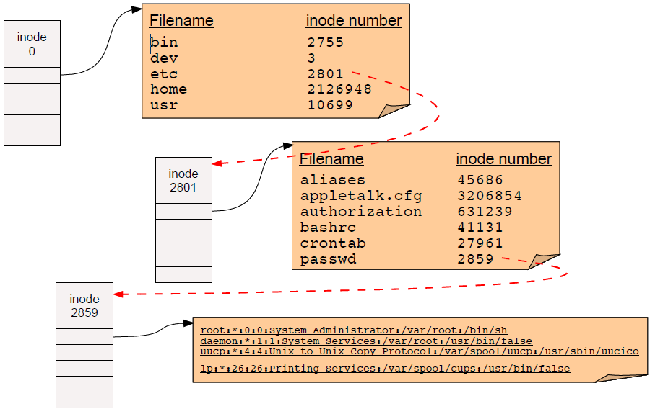
Resolving “/etc/password”
Start at root directory and walk down chain of inodes

Slide 9
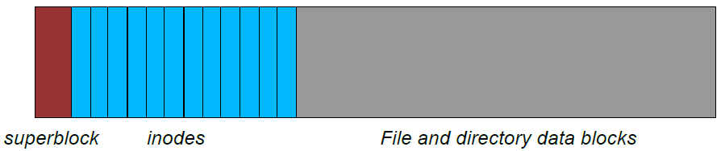
Locating inodes on disk
All right, so directories tell us the inode number of a file.
How the heck do we find the inode itself on disk?
Basic idea: Top part of filesystem contains all of the inodes!
inode number is just the “index” of the inode
Easy to compute the block address of a given inode:
block_addr(inode_num) = block_offset_of_first_inode + (inode_num * inode_size)
This implies that a filesystem has a fixed number of potential inodes
This number is generally set when the filesystem is created
The superblock stores important metadata on filesystem layout, list of free blocks, etc.
Notes:
Other inode layouts are used but this is the basic idea.

Slide 10
Stupid directory tricks
Directories map filenames to inode numbers. What does this imply?
We can create multiple pointers to the same inode in different directories
Or even the same directory with different filenames
In UNIX this is called a “hard link” and can be done using “ln”
bash$ ls -i /home/foo
287663 /home/foo (This is the inode number of “foo”)
bash$ ln /home/foo /tmp/foo
bash$ ls -i /home/foo /tmp/foo
287663 /home/foo
287663 /tmp/foo
“/home/foo” and “/tmp/foo” now refer to the same file on disk
Not a copy! You will always see identical data no matter which filename you use to read or write the file.
Not the same as a “symbolic link”! That links one filename to another.

Slide 11
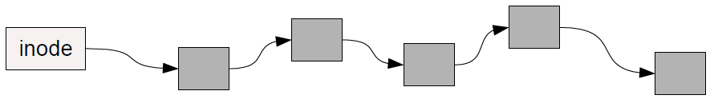
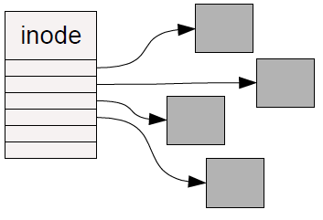
How should we organize blocks on a disk?
Very simple policy: A file consists of linked blocks
inode points to the first block of the file
Each block points to the next block in the file (just a linked list on disk)
What are the advantages and disadvantages??
Indexed files
inode contains a list of block numbers containing the file
Array is allocated when the file is created
What are the advantages and disadvantages??

Slide 12
Multilevel indexed files
inode contains a list of 10-15 direct block pointers
First few blocks of file can be referred to by the inode itself
inode also contains a pointer to a single indirect, double indirect, and triple indirect blocks
Allows file to grow to be incredibly large!!!

Slide 13
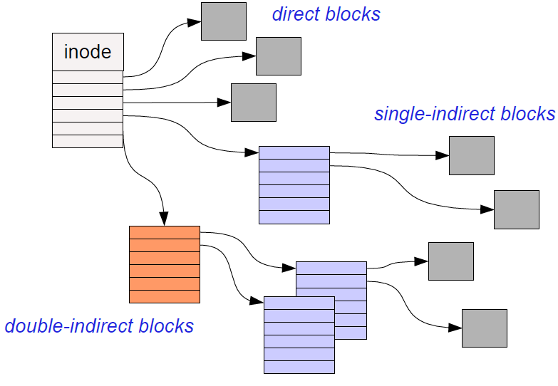
Multilevel indexed files

Slide 14
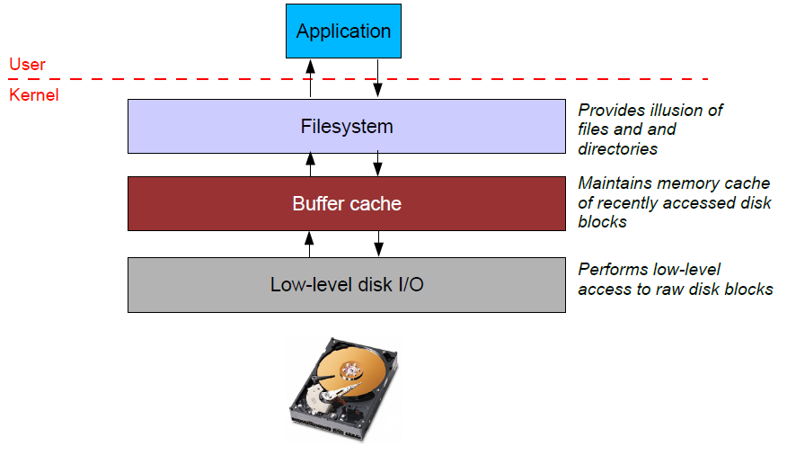
File system caching
Most filesystems cache significant amounts of disk in memory
e.g., Linux tries to use all “free” physical memory as a giant cache
Avoids huge overhead for going to disk for every I/O

Slide 15
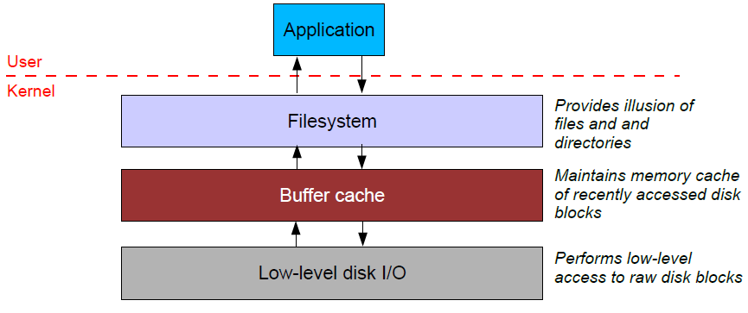
Caching issues (2)
Reliability issues
What happens when you write to the cache but the system crashes?
What if you update some of the blocks on disk but not others?
Example: Update the inode on disk but not the data blocks?
Write-through cache: All writes immediately sent to disk
Write-back cache: Cache writes stored in memory until evicted (then written to disk)
Tradeoffs?
Notes:
Performance vs reliability

Slide 16
Caching issues (2)
“Syncing” a filesystem writes back any dirty cache blocks to disk
UNIX “sync” command achieves this.
Can also use fsync() system call to sync any blocks for a given file.
Warning – not all UNIX systems guarantee that after sync returns that the data has really been written to the disk!
This is also complicated by memory caching on the disk itself.
Crash recovery
If system crashes before sync occurs, a tool like fsck checks the filesystem for errors
Example: an inode pointing to a block that is marked as free in the free block list
Another example: An inode with no directory entry pointing to it
These usually get linked into a “lost+found” directory
inode does not contain the filename so need the sysadmin to look at the file dataand guess where it might belong!

Slide 17
Caching and fsync() example
Running the copy example from last time,
How fast is it the first time, vs. the second time you copy the same file?
What happens if we fsync() after each iteration?
Notes:
Add fsync() after each iteration through the loop. How much slower?

Slide 18
Caching issues (3)
Read ahead
Seek time dominates overhead of disk I/O
So, would ideally like to read multiple blocks into memory when you have a cache miss
Amortize the cost of the seek for multiple reads
Useful if file data is laid out in contiguous blocks on disk
Especially if the application is performing sequential access to the file

Slide 19
Making filesystems resilient: RAID

Slide 20
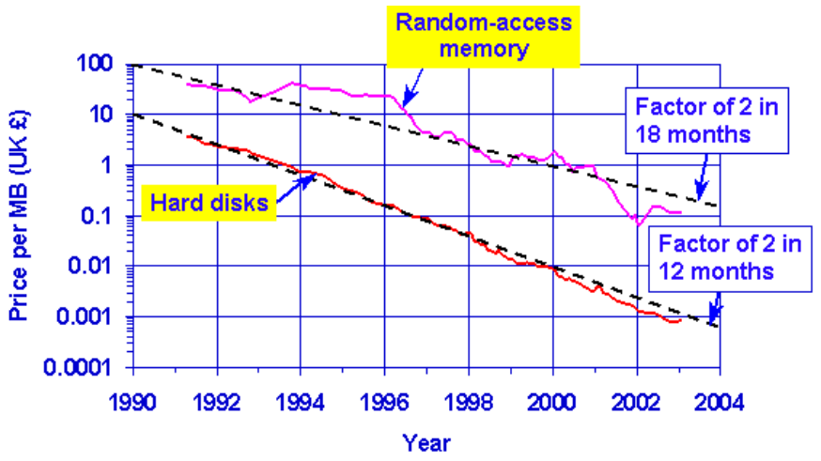
RAID Motivation
Speed of disks not matching other components
Moore’s law: CPU speed doubles every 18 months
SRAM speeds increasing by 40-100% a year
In contrast, disk seek time only improving 7% a year
Although greater density leads to improved transfer times once seek is done
Emergence of PCs starting to drive down costs of disks
(This is 1988 after all)
PC-class disks were smaller, cheaper, and only marginally slower

Slide 21
RAID Motivation
Basic idea: Build I/O systems as arrays of cheap disks
Allow data to be striped across multiple disks
Means you can read/write multiple disks in parallel – greatly improve performance
Problem: disks are extremely unreliable
Mean Time to Failure (MTTF)
MTTF (disk array) = MTTF (single disk) / # disks
Adding more disks means that failures happen more frequently..
An array of 100 disks with an MTTF of 30,000 hours = just under 2 weeks for the array’s MTTF!

Slide 22
Increasing reliability
Idea: Replicate data across multiple disks
When a disk fails, lost information can be regenerated from the redundant data
Simplest form: Mirroring (also called “RAID 1”)
All data is mirrored across two disks
Advantages:
Reads are faster, since both disks can be read in parallel
Higher reliability (of course)
Disadvantages:
Writes are slightly slower, since OS must wait for both disks to do write
Doubles the cost of the storage system!

Slide 23
RAID 3
Rather than mirroring, use parity codes
Given N bits {b₁, b₂, ..., b_{N}}, the parity bit P is the bit {0,1} that yields an even number of “1” bits in the set {b₁, b₂, ..., b_{N}, P}
Idea: If any bit in {b₁, b₂, ..., b_{N}} is lost, can use the remaining bits (plus P) to recover it.
Where to store the parity codes?
Add an extra “check disk” that stores parity bits for the data stored on the rest of the N disks
Advantages:
If a single disk fails, can easily recompute the lost data from the parity code
Can use one parity disk for several data disks (reduces cost)
Disadvantages:
Each write to a block must update the corresponding parity block as well

Slide 24
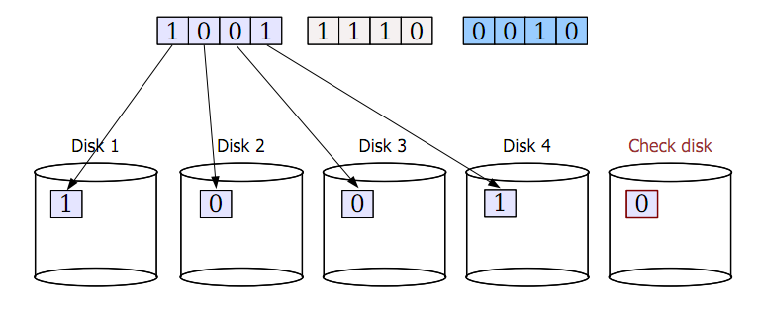
RAID 3 example

Slide 25
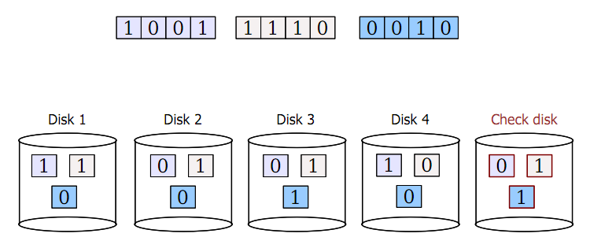
RAID 3 example

Slide 26
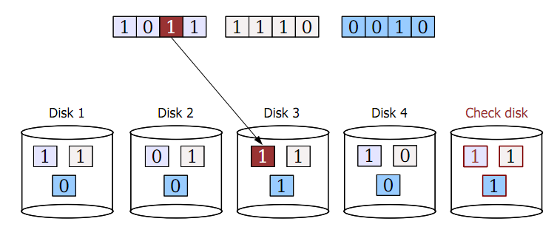
RAID 3 example

Slide 27
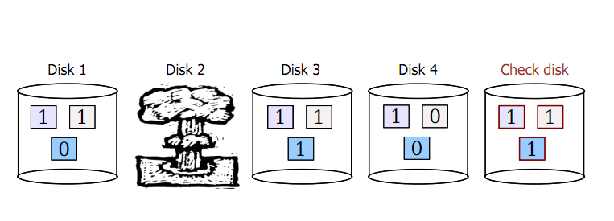
RAID 3 example

Slide 28
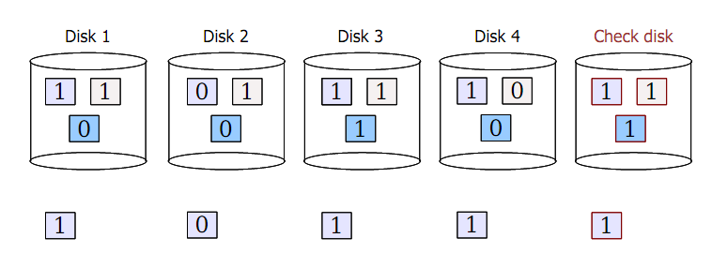
RAID 3 example
1. Read back data from other disks
2. Recalculate lost data from parity code
3. Rebuild data on lost disk

Slide 29
RAID 3 issues
Terminology
MTTF = mean time to failure
MTTR = mean time to repair
What is the MTTF of RAID?
Both RAID 1 and RAID 3 tolerate the failure of a single disk
As long as a second disk does not die while we are repairing the first failure, we are in good shape!
So, what is the probability of a second disk failure?
P(2nd failure) ≈ MTTR / (MTTF of one disk / # disks -1)
Assumes independent, exponential failure rates; see Patterson RAID paper for derivation
10 disks, MTTF (disk) = 1000 days, MTTR = 1 day
P(2nd failure) ≈ 1 day / ( 1000 / 9 ) = 0.009
What is the performance of RAID 3?
Check disk must be updated each time there is a write
Problem: The check disk is then a performance bottleneck
Only a single read/write can be done at once on the whole system!

Slide 30
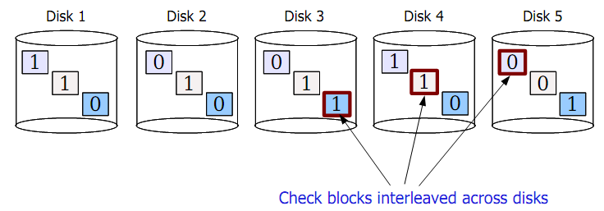
RAID 5
Another approach: Interleaved check blocks (“RAID 5”)
Rotate the assignment of data blocks and check blocks across disks
Avoids the bottleneck of a single disk for storing check data
Allows multiple reads/writes to occur in parallel (since different disks affected)

Slide 31
Reliable distributed storage
Today, giant data stores distributed across 100s of thousands of disks across the world
e.g., your mail on gmail
“You know you have a large storage system when you get paged at 1 AM because you only have a few petabytes of storage left.”
– a “note from the trenches” at Google
Notes:
Source of quote: http://goo.gl/LwFIy

Slide 32
Reliable distributed storage
Issues
Failure is the common case
Google reports 2-10% of disks fail per year
Now multiply that by 60,000+ disks in a single warehouse...
Must survive failure of not just a disk, but a rack of servers or a whole data center
Solutions
Simple redundancy (2 or 3 copies of each file)
e.g., Google GFS (2001)
More efficient redundancy (analogous to RAID 3++)
e.g., Google Colossus filesystem (~2010): customizable replication including Reed-Solomon codes with 1.5x redundancy
More interesting tidbits: http://goo.gl/LwFIy

Slide 33
Caching issues
Where should the cache go?
Below the filesystem layer: Cache individual disk blocks
Above the filesystem layer: Cache entire files and directories
Which is better??

Slide 34
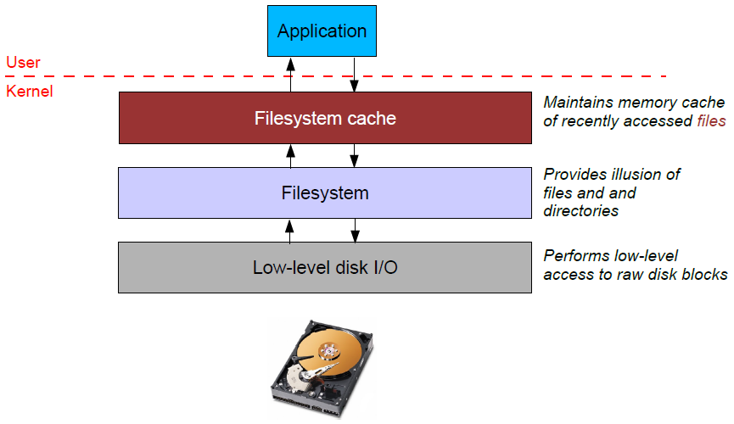
Caching issues
Where should the cache go?
Below the filesystem layer: Cache individual disk blocks
Above the filesystem layer: Cache entire files and directories
Which is better??

