Slide 1
Security
CS 241
May 5, 2014
University of Illinois
Adapted in part from slides by Scott Shenker, Jen Rexford, Ion Stoica, Vern Paxson

Slide 2
“Security” is a very broad topic…
“Security” describes
Hardware
Software
Data
People
Policies
Procedures
Governance
…even the best software algorithm has several points of failure!

Slide 3
Security goals (an incomplete list)
Availability
Can I rely on the service being available when I need it?
Infrastructure compromise, DDoS
Authentication
Who is this person/machine?
Spoofing, phishing
Integrity
Is data preserved in original form?
Confidentiality
Can adversary read the data?
Sniffing, man-in-the-middle
Provenance
Who is responsible for this data?
Forging responses, denying responsibility
Not who sent the data, but who created it

Slide 4
Case Study: AACS encryption
AACS: “Advanced Access Content System”
Copyright protection on HD DVD media
What happened?

Slide 5
Case Study #1: AACS encryption
AACS: “Advanced Access Content System”
Copyright protection on HD DVD media
What happened?
PowerDVD and AnyDVD software stored the “master” decryption key in RAM
Analysis: “nothing was hacked, cracked, or reverse engineered”, “no debugger was used”, “no binaries changed”
09F911029D74E35BD84156C5635688C0

Slide 6
Cryptographic Hash Function
Any general hash function:
Takes in data and produces a numeric result
Java: Object.hashCode()
Used for hash tables, fast string comparisons, etc.

Slide 7
Cryptographic Hash Function
A cryptographic hash function should be:
Easy:
Computing the hash value
Hard / Impossible:
Hard to invert
Hard to generate another input that has the same output
Notes:
compute
invert
find collision

Slide 8
SHA-2/256 Examples
(empty string)
e3b0c44298fc1c149afbf4c8996fb92427ae41e4649b934ca495991b7852b855
The quick brown fox jumps over the lazy dog
d7a8fbb307d7809469ca9abcb0082e4f8d5651e46d3cdb762d02d0bf37c9e592
The quick brown fox jumps over the lazy dog.
ef537f25c895bfa782526529a9b63d97aa631564d5d789c2b765448c8635fb6c
The quick brown fox jumps ovar the lazy dog.
02e4625126139fbd3f91e44749fa51a9f7aeabeb63301cb251be1904b7c668c0
Notes:
DEMO
sha256sum

Slide 9
Storing Passwords
How does Facebook store a password?
Notes:
5e884898da28047151d0e56f8dc6292773603d0d6aabbdd62a11ef721d1542d8

Slide 10
What’s wrong?
“password” ➔ (SHA-256) ➔
5e884898da28047151d0e56f8dc6292773603d0d6aabbdd62a11ef721d1542d8

Slide 11
Storing Passwords
How does Facebook store a password?
“9rjef98wty4h password” ➔ (SHA-256) ➔
4318fd81e7c56701df71b49247d560e797306ea355002baa5f39b16a904b8fe6
Notes:
4a49e8547212a5bda9f5575783aa65da680fb8e8a4bf7ea99171b5043ec100d7

Slide 12
Password Salt
A salt is a (usually random) string added to the input before a hash function is applied.
A different salt must be used for every input.
Why use a salt?
If attacker obtains password hashes and salts,
Cannot use a known dictionary to crack an individual password
Need separate attempts to crack each user
Makes cracking passwords more difficult, not impossible

Slide 13
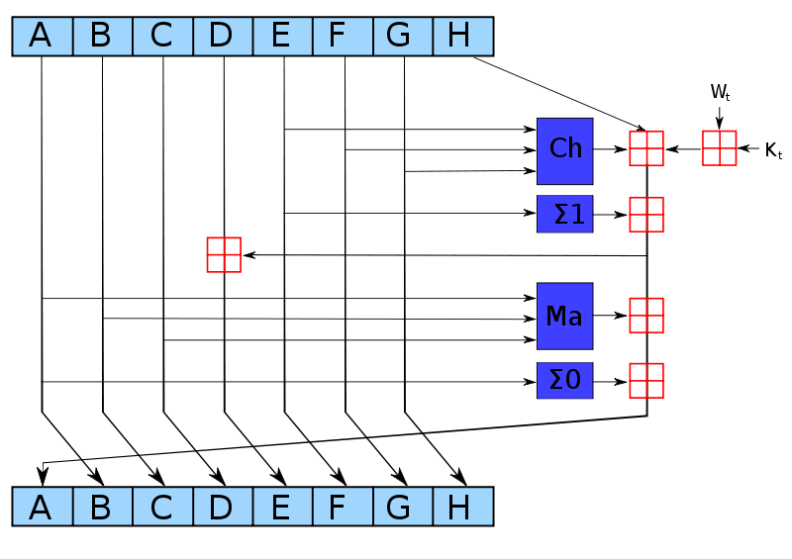
SHA2
SHA2 is a public algorithm
Security in the mathematics, not in keeping the implementation a secret
Process the entire message, 64 times.

Slide 14
SHA2
Right now, SHA2 is considered a secure hash.
Mathematics have not been broken
The complexity of reversing a hash would take more computing power than has ever been created
SHA2 has several variants based on the length of the output desired: SHA-256 (256-bit output) is most common.

Slide 15
Other Algorithms
MD5 (1991):
2005-2008: MD5 was mathematically simplified and available processing power could fake hashes
“should be considered cryptographically broken and unsuitable for further use”
SHA-0 (1993):
1998: Was shown to be easily simplified; some hashes can be reversed in less than an hour!
SHA-1 (1995):
Replacement to concerns about SHA-0
2005: Theoretical attack developed showing some weakness in the mathematics (reverse in <= 2⁶⁹)

Slide 16
Cryptographic toolkit for security
Cryptographic hashes
Symmetric key cryptography
Asymmetric (public) key cryptography
Digital signatures
Public-key infrastructure (PKI)

Slide 17
Yet still...

Slide 18
Case study 2: Denial of Service (DoS)
Attacker prevents legitimate users from using something (network, server)
Motives?
Retaliation
Extortion (e.g., betting sites just before big matches)
Commercial advantage (disable your competitor)
Cripple defenses (e.g., firewall) to enable broader attack
Often done via some form of flooding
Can be done to different systems
Network: clog a link or router with a huge rate of packets
Transport: overwhelm victim’s ability to handle connections
Application: overwhelm victim’s ability to handle requests

Slide 19
Denial of Service (DoS)

Slide 20
DoS: Network Flooding
Goal is to clog network link(s) leading to victim
Either fill the link, or overwhelm their routers
Users can’t access victim server due to congestion
Attacker sends traffic to victim as fast as possible
It will often use (many) spoofed source addresses
Using multiple hosts (slaves, or zombies) yields a Distributed Denial-of-Service attack, aka DDoS
Traffic can be varied (sources, destinations, ports, length) so no simple filter matches it
If attacker has enough slaves, often doesn’t need to spoof - victim can’t shut them down anyway! :-(

Slide 21
Distributed Denial-of-Service (DDoS)
src = random dst = victim
Bot 1
Bot 2
Victim
Master
Bot 3
Bot 4
Control traffic directs slaves at victim
Slaves send streams of traffic (perhaps spoofed) to victim

Slide 22
Very Nasty DoS Attack: Reflectors
Reflection
Cause one non-compromised host to help flood another
E.g., host A sends DNS request or TCP SYN with source V to server R.
Attacker (A)
Reflector (R)
V
R
Internet
Victim (V)

Slide 23
Very Nasty DoS Attack: Reflectors
Reflection
Cause one non-compromised host to help flood another
E.g., host A sends DNS request or TCP SYN with source V to server R.
Attacker (A)
Reflector (R)
Internet
V
R
Victim (V)

Slide 24
Diffuse DDoS: Reflector Attack
Request: src = victim dst = reflector
Reply: src = reflector dst = victim
Reflector 1
Reflector 3
Reflector 4
Slave 1
Reflector 2
Reflector 5
Slave 2
Reflector 6
Victim
Master
Reflector 7
Slave 3
Reflector 8
Reflector 11
Reflector 9
Slave 4
Reflector 10
Control traffic directs slaves at victim & reflectors
Reflectors send streams of non-spoofed but unsolicited traffic to victim

Slide 25
Lessons for building systems
Need to think like an attacker
Think: If I had the power to do X, can I cause bad event Y?
Defensive programming
If a user or code module gives you arbitrarily weird input, could it crash or exhibit other undesirable behavior?
Answering “no” requires well-defined interfaces, good modularization
Think: how could someone crash your web server?

Slide 26
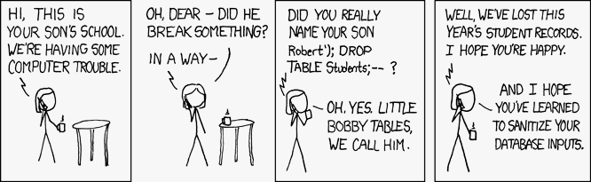

Slide 27


Summary
This cat did not handle
exceptional cases
This cat did.

