Slide 1
Heap allocation: Malloc
CS 241
February 3, 2012

Slide 2
Announcements
There is only one announcement today

Slide 3
Review: Paging
OS solves the external fragmentation problem by using fixed-size chunks of virtual and physical memory
Virtual memory unit called a page
Physical memory unit called a frame (or sometimes page frame)
virtual memory
(for one process)‏
physical memory
page 0
frame 0
page 1
frame 1
page 2
frame 2
page 3
…
...
…
...
frame Y
page X
Notes:
Emphasize the different between physical and virtual pages
Why do the page table entries have to hold physical addresses? If these were virtual addresses you would never be able to find the real physical address since this is the table that makes the mapping.

Slide 4
Definitions
External fragmentation
Unused chunks of memory between allocated chunks
Can’t use for large contiguous allocations
Internal fragmentation
Unused memory within allocated regions
Because we allocated more than the requested size
How does paging affect these?
Zero external fragmentation: all requests and fragments are the same size
Some internal fragmentation: requested size gets rounded up to next integer multiple of page size

Slide 5
Review: Advantages of Paging
Simplifies physical memory management
OS maintains a free list of physical page frames
To allocate a physical page, just remove an entry from this list
No external fragmentation!
Virtual pages from different processes can be interspersed arbitrarily in physical memory
No need to allocate pages in a contiguous fashion
Allocation of memory can be performed at a (relatively) fine granularity
Only allocate physical memory to those parts of the address space that require it
Can swap unused pages out to disk when physical memory is running low
Idle programs won't use up a lot of memory (even if their address space is huge!)

Slide 6
Is paging enough?
How do we allocate memory in here?
(Reserved for OS)
Stack
MMU
Heap
Uninitialized vars
(BSS segment)
Initialized vars
(data segment)
Code
(text segment)
Physical RAM

Slide 7
Memory allocation w/in a process
What happens when you declare a variable?
Allocating a page for every variable wouldn’t be efficient
Allocations within a process are much smaller
Need to allocate on a finer granularity
Solution (stack): stack data structure (duh)
Function calls follow LIFO semantics
So we can use a stack data structure to represent the process’s stack – no fragmentation!
Solution (heap): malloc
This is a much harder problem
Need to deal with fragmentation

Slide 8
Allocation example
p1 = malloc(4)
p2 = malloc(5)
p3 = malloc(6)
free(p2)
p4 = malloc(2)
Notes:
WARNING: THESE COLORS WERE NOT VISIBLE ON THE PROJECTOR IN 1404. MUST MAKE THEM DARKER, OR SOMETHING.

Slide 9
Constraints
Applications
Can issue arbitrary sequence of malloc and free requests
free request must be to a malloc’d block
Allocators
Can’t control number or size of allocated blocks
Must respond immediately to malloc requests
i.e., can’t reorder or buffer requests
Must allocate blocks from free memory
Must align blocks so they satisfy all alignment requirements
8 byte alignment for libc malloc on Linux boxes
Can manipulate and modify only free memory
Can’t move the allocated blocks once they are malloc’d
i.e., compaction is not allowed (why not?)

Slide 10
Goal 1: Speed
Want our memory allocator to be fast!
Minimize the overhead of both allocation and deallocation operations.
Maximize throughput: number of completed alloc or free requests per unit time
E.g., if 5,000 malloc calls and 5,000 free calls in 10 seconds, throughput is 1,000 operations/second.
A fast allocator may not be efficient in terms of memory utilization
Faster allocators tend to be “sloppier”
E.g., don’t look through every free block to find the perfect fit

Slide 11
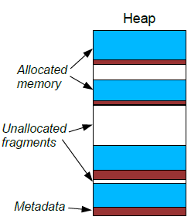
Goal 2: Memory Utilization
Allocators usually waste some memory
Extra metadata or internal structures used by the allocator itself
(example: keeping track of where free memory is located)
Chunks of heap memory that are unallocated (fragments)
Memory utilization =
The total amount of memory allocated to the application divided by the total heap size
Ideal: utilization = 100%
In practice: try to get close to 100%

Slide 12
Fragmentation
Poor memory utilization caused by fragmentation
internal fragmentation
external fragmentation
We saw: OS encounters fragmentation when allocating memory to processes
Now: malloc encounters fragmentation when allocating memory to applications

Slide 13
Internal fragmentation
For a given block, internal fragmentation occurs if payload is smaller than block size
Caused by
Overhead of maintaining heap data structures
Padding for alignment purposes
Explicit policy decisions (e.g., to return a big block to satisfy a small request)
Block
Internal
fragmentation
Payload
Internal
fragmentation

Slide 14
Experiment
Does libc’s malloc have internal fragmentation? How much?
How would you test this?
1. Close Facebook
2. Preheat oven to 375°
Notes:
See 08-fragtest.c

Slide 15
External Fragmentation
Occurs when there is enough aggregate heap memory, but no single free block is large enough
Depends on the pattern of future requests
Thus, difficult to plan for
p1 = malloc(4)
p2 = malloc(5)
p3 = malloc(6)
free(p2)
p4 = malloc(6)
Oops! (what would happen now?)

Slide 16
Conflicting performance goals
Good throughput and good utilization are difficult to achieve simultaneously
A fast allocator may not be efficient in terms of memory utilization
Faster allocators tend to be “sloppier” with their memory usage.
Likewise, a space-efficient allocator may not be very fast
To keep track of memory waste (i.e., tracking fragments), the allocation operations generally take longer time
Trick is to balance these two conflicting goals

Slide 17
Implementation Issues
How do we know how much memory to free just given a pointer?
How do we keep track of the free blocks?
What do we do with the extra space when allocating a memory block that is smaller than the free block it is placed in?
How do we pick which free block to use for allocation?

Slide 18
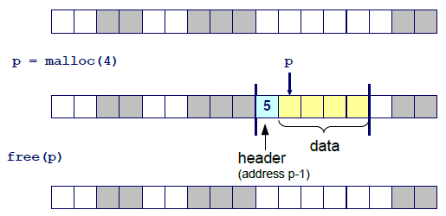
Knowing how much to free
Standard method
Keep the length of the block in the header preceding the block
Requires an extra word for every allocated block

