Slide 1
Processes: A System View
CS 241
February 17, 2012
Copyright © University of Illinois CS 241 Staff

Slide 2
What the OS does: 2 State Model
Processes
dispatch
enter
not running
running
exit
pause

Slide 3
What the OS does: 2 State Model
Processes
System
dispatch
enter
not running
running
exit
pause
queue
enter
dispatch
processor
exit
pause

Slide 4
2 State Model
Processes
System
dispatch
enter
not running
running
exit
pause
queue
enter
dispatch
processor
exit
What information do we need to keep while in the queue?
pause
Notes:
What info do we need to keep? ... various things, which are stored in the PCB....

Slide 5
What the OS stores: PCB
OS stores Process Control Block (PCB) for each process
In-memory OS structure
User processes cannot access it
Contents:
Identifiers
pid & ppid (process ID & parent process ID)
Processor state information
User-visible registers, control and status, stack
Scheduling information
Process state, priority, what event the process is waiting for, ...

Slide 6
What the OS stores: PCB
Contents (cont’d):
Inter-process communication
Signals
Privileges
CPU instructions, memory
Memory Management
e.g., Page tables
Resource ownership and utilization

Slide 7
Five State Process Model
“All models are wrong. Some Models are Useful”
George Box, statistician
2 state model
Too simplistic
What does “Not Running” mean?
7 state model
Considers suspending process to disk
See Stallings book, section 3.2
Next: 5 state model
Notes:
Industrial Statistician from Wisconsin

Slide 8
5 State Model: States
running
not running
Notes:
OK, but why isn’t it running? That makes a difference in what we schedule next!

Slide 9
5 State Model: States
running
ready
blocked
Notes:
What are we missing?

Slide 10
5 State Model: States
running
done
new
ready
blocked

Slide 11
5 State Model: Summary
Running
Currently executing
On a single processor machine, at most one process in the “running” state
Ready
Prepared to execute
Blocked
Waiting on some event
New
Created, but not loaded into memory
Done
Released from pool of executing processes
Notes:
What’s the difference / similarity between these, Ready and Blocked?

Slide 12
5 State Model: Transitions
Null (nothing) to New
New process creation
running
done
enter
new
ready
blocked

Slide 13
5 State Model: Transitions
New to Ready
Move to pool of executable processes
running
done
new
ready
blocked

Slide 14
5 State Model: Transitions
Ready to Running
Chosen to run from the pool of processes (How?)
running
done
new
ready
blocked
Notes:
How do we choose? Well, we have some freedom there – we’ll come back to that – it’s a scheduling decision.

Slide 15
5 State Model: Transitions
What events cause these transitions?
running
done
new
ready
blocked

Slide 16
5 State Model: Transitions
Running to Ready
Preempted by OS
Running to Blocked
Request for an unavailable resource
Running to Done
Terminated / completed
running
done
new
ready
blocked

Slide 17
5 State Model: Transitions
Blocked to Ready
Resource is now available
running
done
new
ready
blocked

Slide 18
5 State Model: Transitions
Ready to Done
Terminated by another process
Blocked to Done
Terminated by another process
running
done
new
ready
blocked

Slide 19
5 State Model: Transitions
normal or abnormal termination
running
done
selected to run
enter
I/O request
created
quantum expired
new
ready
blocked
terminated
I/O complete

Slide 20
Process Queue Model
2 State Model: What is missing?
queue
enter
dispatch
processor
exit
ready queue
enter
dispatch
processor
exit
timeout
Process exceeds time quanta
blocked queue
Process makes systems call
event wait

Slide 21
Process Queue Model
ready queue
enter
dispatch
processor
exit
timeout
event 1 queue
event 1 wait
What do we gain with multiple queues?
event 2 queue
event 2 wait
…
event 3 queue
event n wait

Slide 22
Process Queue Model
ready queue
enter
dispatch
processor
exit
timeout
priority 1 queue
priority 1 wait
What do we gain with multiple queues?
priority 2 queue
priority 2 wait
…
priority 3 queue
priority n wait

Slide 23
Take-away questions
What would happen if user processes were allowed to disable interrupts?
In a single CPU system what is the maximum number of processes that can be in the running state?
Notes:
Did we talk about interrupts yet?

Slide 24
From Processes to Threads
CS 241
February 17, 2012
Copyright © University of Illinois CS 241 Staff

Slide 25
[code example]

Slide 26
Processes vs. threads
Process
Fork is expensive (time & memory)
Thread
A lightweight process: little memory, fast startup
Shared memory among threads in a process

Slide 27
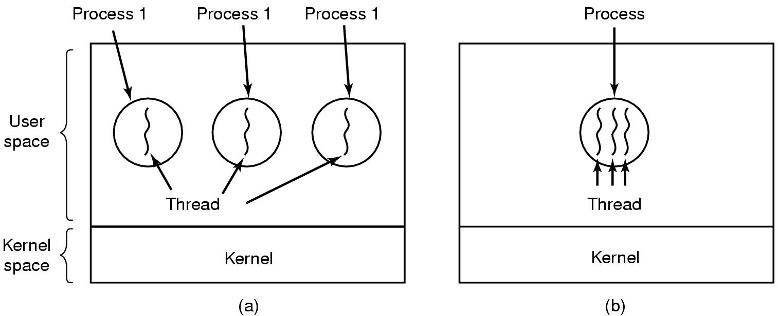
Processes vs. threads
Environment (resource)
execution
Three processes each with
one thread
One process with
three threads
Notes:
A process gives you a separate environment (memory, OS resources, etc.) and a separate line of concurrent execution.
With threads, you get the concurrent execution, but with one environment (one set of resources: memory, etc.).

Slide 28
Processes vs. threads
Each process can include many threads
All threads of a process share:
Process ID
Memory (program code and global data)
Open file/socket descriptors
Working environment (current directory, user ID, etc.)
Semaphores (covered later in the course)
Signal handlers and signal dispositions (covered later in the course)

Slide 29
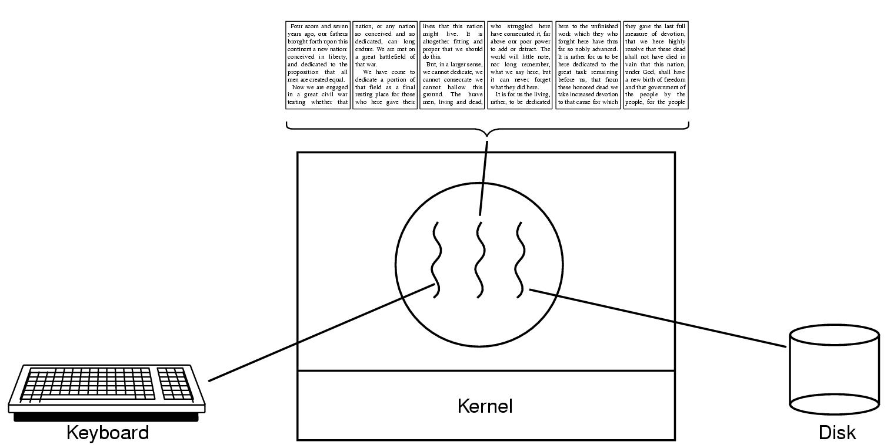
Thread usage: word processor
Working file can only be accessed by one process at a time
What would happen if this were single-threaded?
Notes:
Writing to disk would block user input
Writing to disk would block updating the display
etc...

Slide 30
Thread usage: word processor
Working file can only be accessed by one process at a time

Slide 31
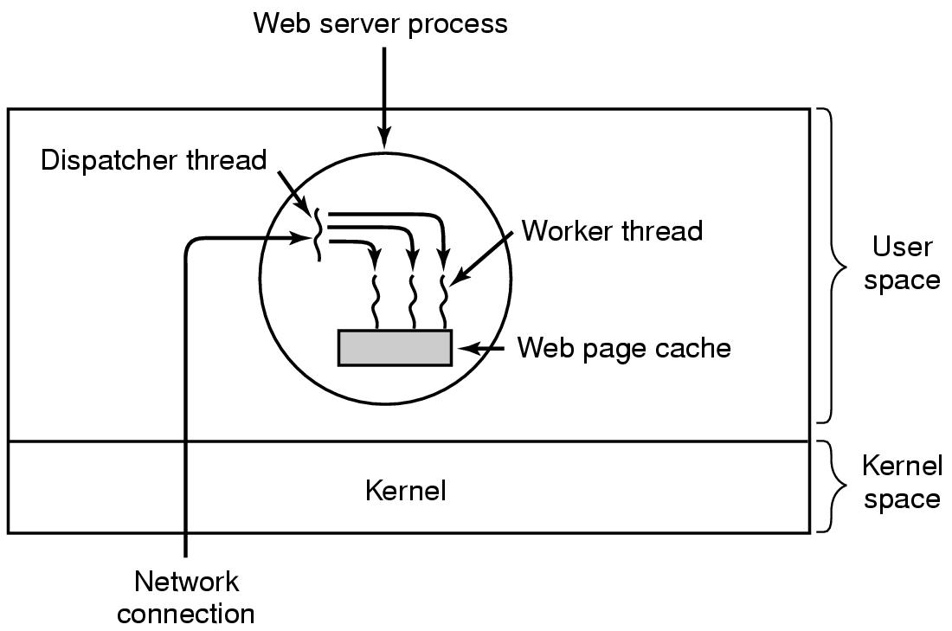
Thread usage: web server
What would happen if this were single-threaded?
Notes:
Ask: why might this be a good choice for threads instead of processes?

Slide 32
Web Server
Pseudo-code for previous slide
Dispatcher thread
Worker thread
Alternative
Dispatcher thread
Worker thread
while (TRUE) {
get_next_request(&buf);
handoff_work(&buf);
}
while (TRUE) {
get_next_request(&buf);
handoff_work(&buf);
}
while (TRUE) {
wait_for_work(&buf);
look_for_page_in_cache(&buf, &page);
if (page_not_in_cache( &page))
read_page_from_disk(&buf, &page);
return_page(&page);
}
work (&buf) {
look_for_page_in_cache(&buf, &page);
if (page_not_in_cache( &page))
read_page_from_disk(&buf, &page);
return_page(&page);
}
What is the difference?
Notes:
First one: one thread does stuff and sticks around to do more.
Alternative: we spawn a new thread for each unit of work.
(At least that’s my interpretation of the point of this slide ... am I missing anything?)

Slide 33
Thread of execution
Sequential set of instructions
Each has its own function calls & automatic (local) variables
Need program counter and stack for each thread

Slide 34
Normal 1-thread function call
Calling program
Called function
processfd();
processfd() {
}
Thread of execution

Slide 35
Compare: Threaded function call
Creating program
Created thread
pthread_create();
processfd() {
}
Calling program
Called function
processfd();
Thread creation
processfd() {
}
Thread of execution
Notes:
So thread creation is going to work differently than fork(). It doesn’t duplicate the current execution environment. It’s more similar to a function call which branches off into another thread of execution.

Slide 36
Thread Execution States
Events associated with a change in thread state:
Spawn (another thread)
Block
Should blocking a thread block other, or all, threads?
Unblock
Finish (thread)
De-allocate register context and stacks

Slide 37
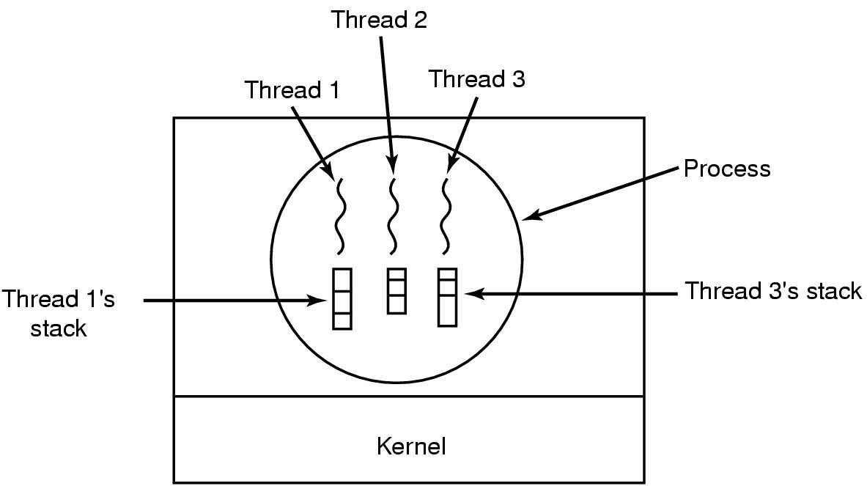
Thread-Specific Resources
Each thread has its own
Thread ID (integer)
Stack, Registers, Program Counter
Threads in one process can communicate via shared memory
Must be done carefully!

Slide 38
Processes vs. Threads
Per Process Items | Per Thread Items
Address space Global variables Open files Child processes Pending alarms Signals and signal handlers Accounting information | Program counter Registers Stack State
Each thread executes separately
Threads in the same process share many resources
No protection among threads!! (What?)

Slide 39
Process vs. thread creation
Platform | fork() |  |  | pthread_create()
 | real | user | sys | real | user | sys
AMD 2.3 GHz Opteron (16 cpus) | 12.5 | 1.0 | 12.5 | 1.2 | 0.2 | 1.3
AMD 2.4 GHz Opteron (8 cpus) | 17.6 | 2.2 | 15.7 | 1.4 | 0.3 | 1.3
IBM 4.0 GHz POWER6 (8 cpus) | 9.5 | 0.6 | 8.8 | 1.6 | 0.1 | 0.4
IBM 1.9 GHz POWER5 p5-575 (8 cpus) | 64.2 | 30.7 | 27.6 | 1.7 | 0.6 | 1.1
IBM 1.5 GHz POWER4 (8 cpus) | 104.5 | 48.6 | 47.2 | 2.1 | 1.0 | 1.5
INTEL 2.4 GHz Xeon (2 cpus) | 54.9 | 1.5 | 20.8 | 1.6 | 0.7 | 0.9
INTEL 1.4 GHz Itanium2 (4 cpus) | 54.5 | 1.1 | 22.2 | 2.0 | 1.2 | 0.6
http://www.llnl.gov/computing/tutorials/pthreads.
Timings reflect 50,000 process/thread
Creations were performed with the time utility, and units are in seconds, no optimization flags.
Notes:
Creating a thread is 37x faster!

Slide 40
Key points
Threads are lightweight
Is this good or bad?
Threads share memory and other resources
(Still have own stack, registers, PC, state)
Is this good or bad?
Notes:
Ask for example of when thread is better and when process is better
e.g.: web server: can share in-memory cache more easily
e.g.: web server: when running a user’s code (CGI script)

Slide 41
Key points
Threads are lightweight
Is this good or bad?
Good!
Threads share memory and other resources
(Still have own stack, registers, PC, state)
Is this good or bad?
Yes!
Easier communication among threads
Lack of protection among threads
Notes:
Ask for example of when thread is better and when process is better
e.g.: web server: can share in-memory cache more easily
e.g.: web server: when running a user’s code (CGI script)

Slide 42
Next time
Monday: Using threads
Tuesday: MP3 Shell due

