Slide 1
Threads: use & systems view
CS 241
February 22, 2012
Copyright © University of Illinois CS 241 Staff
Notes:
Note: This lecture cut out a bunch of material. There were nice examples there but I ran out of time to fit them in (I’d been going at a somewhat slower pace in general).
In particular there was one cute example using multiple languages which would be nice to include.
However, other than that, most of the key material was covered in the next lecture (17).
Here is what was NOT covered from 09-pthread-examples.ppt Fall 2011:
some parts of passing args (09 slides 2-9)
passing complex arguments (09 slides 10-14)
returning an int, badly and well (09 slides 19-20)
exit() bug, detach bug, return bug (09 slides 21-24)
and from 10-threads-sys.ppt I so far covered only user level vs. kernel level threads (slides 8-16 of the old file) and thread safety (27-30). Again, most of this I did end up covering in lecture 17, in particular the complex arguments and returning variables correctly.

Slide 2
Today
MP4 released
Multithreaded merge sort
Terminating threads
Finishing up from last time
Whose memory is it, anyway?
Passing arguments
Thread safety
Systems view of threads
User space vs. kernel

Slide 3
Terminating threads

Slide 4
Terminating Threads: pthread_exit()
int pthread_exit(void * retval);
Terminate the calling thread
Makes the value retval available to any successful join with the terminating thread
Returns
pthread_exit() cannot return to its caller
Parameters
retval: Pointer to data returned to joining thread
Note
If main() exits before its threads via pthread_exit(), the other threads continue. Otherwise, they will be terminated when main() ends.
Notes:
Hmmm, can you return a value just by returning from the thread’s start_routine?

Slide 5
Termination example
#include <pthread.h>
#define NUM_THREADS 5
void *PrintHello(void *threadid) {
printf("\n%d: Hello World!\n", threadid);
pthread_exit(NULL);
}
Notes:
Header type code ... let’s just get this out of the way first
NOTE: this example (on this and the next slide) was cut and pasted from a later sequence of slides. So, it may not quite fit perfectly here – it may be shortened, for example.

Slide 6
Termination example
int main (int argc, char *argv[]) {
pthread_t threads[NUM_THREADS];
int rc, t;
for(t=0;t < NUM_THREADS;t++) {
printf("Creating thread %d\n", t);
rc = pthread_create(&threads[t], NULL,
PrintHello, (void *)t);
if (rc) {
printf("ERROR; pthread_create() return code is %d\n”,
rc);
exit(-1);
}
}
}
Will all threads get a chance to execute?
pthread_exit(NULL);
Notes:
Will they all get a chance to execute? Maybe not.
How about if there are no errors returned by pthread_create? Still not guaranteed! When main ends all threads are terminated.

Slide 7
Termination example
Will all threads get a chance to execute before the parent exits?
int main (int argc, char *argv[]) {
pthread_t threads[NUM_THREADS];
int rc, t;
for(t=0;t < NUM_THREADS;t++) {
printf("Creating thread %d\n", t);
rc = pthread_create(&threads[t], NULL,
PrintHello, (void *)t);
if (rc) {
printf("ERROR; pthread_create() return code is %d\n”,
rc);
exit(-1);
}
}
pthread_exit(NULL);
}
for(t=0;t < NUM_THREADS;t++) {
pthread_join(thread[t], NULL); printf(“Joined thread %d\n”,t);
}
Notes:
Will they all get a chance to execute? No
How about if there are no errors returned by pthread_create? Still no!

Slide 8
Thread Lifetime
A thread exists until...
It returns from the function or calls pthread_exit()
The whole process terminates
The machine catches fire

Slide 9
So, your process terminates when…
Any thread calls exit();
The main thread returns
main() {
pthread_create(); return 0;
}
Segmentation fault
*(char*)0 = 0;
There are no more threads left to run

Slide 10
Whose memory is it, anyway?

Slide 11
Example: argument passing
#include <pthread.h>
#include <stdio.h>
#include <stdlib.h>
#define NUM_THREADS 8
void *PrintHello(void *threadid)
{
int *id_ptr, taskid;
sleep(1);
id_ptr = (int *) threadid;
taskid = *id_ptr;
printf("Hello from thread %d\n", taskid);
pthread_exit(NULL);
}
Notes:
TO DO: simplify this code. No need for sleeping and some of the variables. Will have to change later slides too.

Slide 12
Example: argument passing
int main(int argc, char *argv[]) {
pthread_t threads[NUM_THREADS];
int rc, t;
for(t=0;t<NUM_THREADS;t++) {
printf("Creating thread %d\n", t);
rc = pthread_create(&threads[t], NULL,
PrintHello, (void *) &t);
if (rc) {
printf("ERR; pthread_create() ret = %d\n", rc);
exit(-1);
}
}
pthread_exit(NULL);
}
Does this code work?

Slide 13
Example: argument passing
The loop that creates threads modifies the contents of the address passed as an argument, possibly before the created threads can access it.
int main(int argc, char *argv[]) {
pthread_t threads[NUM_THREADS];
int rc, t;
for(t=0;t<NUM_THREADS;t++) {
printf("Creating thread %d\n", t);
rc = pthread_create(&threads[t], NULL,
PrintHello, (void *) &t);
if (rc) {
printf("ERR; pthread_create() ret = %d\n", rc);
exit(-1);
}
}
pthread_exit(NULL);
}
What is the possible output?

Slide 14
Candidate “contracts” for thread args
main owns the memory
main creates memory (e.g., integer arguments from last example)
Threads can use it briefly to get their argument
main can later modify & is responsible for freeing
child thread owns the memory
main malloc’s memory
main transfers “ownership” of argument memory to thread at startup
thread can read/write/free, main can’t touch it (until thread is done)
nobody owns the memory
global variable; nothing to free()
once created by main(), no one writes to the memory
Notes:
FIXME: This seemed nice at 4 a.m., but in retrospect I’m not sure it’s the best taxonomy. Maybe should emphasize what we really need --- while one is writing/modifying/freeing, no one else can be touching it --- and then give examples of how to structure it that way.
NOTE: First one is a little ambiguous. Lots of folks thought it would work. And I guess it *could* if you make sure that “briefly” and “later” are enforced correctly. However actually, I think my description is OK: if you make it work like that, effectively main does not own it the entire time ... “ownership” is transferred from main to the child thread and back.

Slide 15
Candidate “contracts” for thread args
X
main owns the memory
main creates memory (e.g., integer arguments from last example)
Threads can use it briefly to get their argument
main can later modify & is responsible for freeing
child thread owns the memory
main malloc’s memory
main transfers “ownership” of argument memory to thread at startup
thread can read/write/free, main can’t touch it (until thread is done)
nobody owns the memory
global variable; nothing to free()
once created by main(), no one writes to the memory
Conflict

Slide 16
Better argument passing
for(t=0;t<NUM_THREADS;t++) {
task_id = (int *) malloc(sizeof(int));
*task_id = t;
printf("Creating thread %d\n", t);
rc = pthread_create(&threads[t], NULL, PrintHello,
(void *) task_id);
if (rc) {
printf("ERR; pthread_create() ret = %d\n", rc);
exit(-1);
}
}
pthread_exit(NULL);
}

Slide 17
Better argument passing
#include <pthread.h>
#include <stdio.h>
#include <stdlib.h>
#define NUM_THREADS 8
void *PrintHello(void *threadid)
{
int *id_ptr, taskid;
sleep(1);
id_ptr = (int *) threadid;
taskid = *id_ptr;
printf("Hello from thread %d\n", taskid);
free(threadid);
pthread_exit(NULL);
}
PrintHello thread owns
the memory; so PrintHello is responsible for freeing memory

Slide 18
How about this?
pthread_t threads[NUM_THREADS];
void make_thread(int arg) {
rc = pthread_create(&threads[arg], NULL, PrintHello,
(void *) &arg);
if (rc) {
printf("ERR; pthread_create() ret = %d\n", rc);
exit(-1);
}
}
int main() {
for(t=0;t<NUM_THREADS;t++) {
make_thread(t);
}
pthread_exit(NULL);
}
Notes:
So now I have it in its own function, with its own local variable (the argument to the function). Does this work? obvy not.

Slide 19
How about this?
pthread_t threads[NUM_THREADS];
void make_thread(int arg) {
rc = pthread_create(&threads[arg], NULL, PrintHello,
(void *) &arg);
if (rc) {
printf("ERR; pthread_create() ret = %d\n", rc);
exit(-1);
}
}
int main() {
for(t=0;t<NUM_THREADS;t++) {
make_thread(t);
}
pthread_exit(NULL);
}
Violates “thread owns” rule:
arg is destroyed here, while thread
is still running
Notes:
So now I have it in its own function, with its own local variable (the argument to the function). Does this work? obvy not. Violates the ownership rule: The thread still is running and should “own” the memory for its argument, but make_thread modifies it while the thread is running (by returning from the function, which destroys the variable on the stack).

Slide 20
Example: pthread error handling
Recall errno: global error code variable
Problem: which of the many threads “owns” errno?
Compared to normal TCP system calls, pthreads functions...
Similarity
Returns 0 on success
Differences
Returns error code on failure
Does not set errno
What about errno?
Each thread has its own
Define _REENTRANT (-D_REENTRANT switch to compiler) when using pthreads

Slide 21
Pitfalls
Global variables
Problem: No protection between threads
Solutions:
Disallow all global variables
Introduce new thread-specific global variables
Are my libraries thread-safe?
May use local variables
May not be designed to be interrupted
Create wrappers
Notes:
Removed text from first half, at end: Introduce new library functions

Slide 22
Unsafe Library Calls
#include <string.h>
char *token;
char *line = "LINE TO BE SEPARATED";
char *search = " ";
/* Token will point to "LINE". */
token = strtok(line, search);
/* Token will point to "TO". */
token = strtok(NULL, search);
#include <string.h>
char *token;
char *line = "LINE TO BE SEPARATED";
char *search = " ";
/* Token will point to "LINE". */
token = strtok_r(line, search);
/* Token will point to "TO". */
token = strtok_r(NULL, search);
Notes:
TO DO: make the text larger. copy & paste it into a new text box so it’s not double spaced.

Slide 23
Thread-safe Library Calls
#include <string.h>
char *token;
char *line = "LINE TO BE SEPARATED";
char *search = " ";
char *state;
/* Token will point to "LINE". */
token = strtok_r(line, search, &state);
/* Token will point to "TO". */
token = strtok_r(NULL, search, &state);
#include <string.h>
char *token;
char *line = "LINE TO BE SEPARATED";
char *search = " ";
char *state;
/* Token will point to "LINE". */
token = strtok_r(line, search, &state);
/* Token will point to "TO". */
token = strtok_r(NULL, search, &state);

Slide 24
System & library functions that are not required to be thread-safe
asctime | dirname | getenv | getpwent | lgamma | readdir
basename | dlerror | getgrent | getpwnam | lgammaf | setenv
catgets | drand48 | getgrgid | getpwuid | lgammal | setgrent
crypt | ecvt | getgrnam | getservbyname | localeconv | setkey
ctime | encrypt | gethostbyaddr | getservbyport | localtime | setpwent
dbm_clearerr | endgrent | gethostbyname | getservent | lrand48 | setutxent
dbm_close | endpwent | gethostent | getutxent | mrand48 | strerror
dbm_delete | endutxent | getlogin | getutxid | nftw | strtok
dbm_error | fcvt | getnetbyaddr | getutxline | nl_langinfo | ttyname
dbm_fetch | ftw | getnetbyname | gmtime | ptsname | unsetenv
dbm_firstkey | gcvt | getnetent | hcreate | putc_unlocked | wcstombs
dbm_nextkey | getc_unlocked | getopt | hdestroy | putchar_unlocked | wctomb
dbm_open | getchar_unlocked | getprotobynumber | inet_ntoa | pututxline
dbm_store | getdate | getprotoent | l64a | rand

Slide 25
Key take-away points
Easiest way to coordinate between threads:
Be clear which thread “owns” a piece of memory at any time
Others must not write to it, or destroy it via free() or via returning from a function
Not everything falls into this category
Make sure your library calls are thread-safe
All the above only works if one thread needs the memory
...so we can have an “owner”
General-purpose coordination between threads: next week

Slide 26
The Operating System’s view of threads

Slide 27
Thread Packages
Kernel thread packages
Implemented and supported at kernel level
User-level thread packages
Implemented at user level
Kernel perspective: everything is a single-threaded process

Slide 28
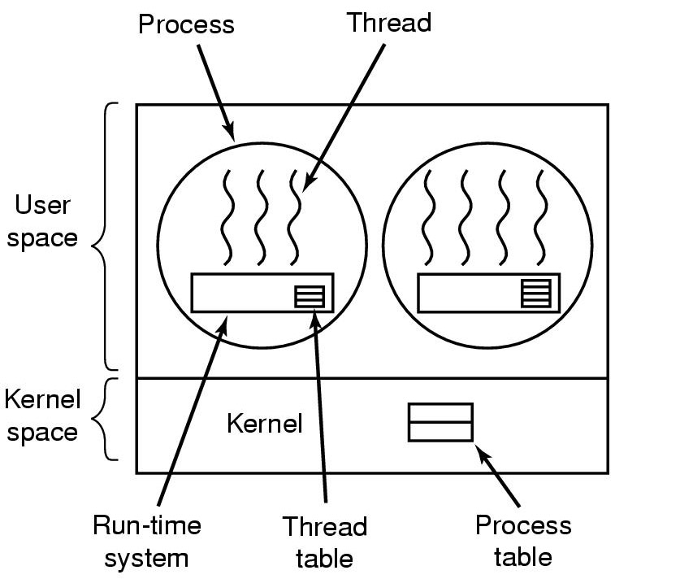
Threads in User Space (Old Linux)
Collection of procedures that manages the threads
Keep track of threads in process (analogous to kernel process table)

Slide 29
User-level Threads
Advantages
Fast Context Switching: keeps the OS out of it!
User level thread libraries do not require system calls
No call to OS and no interrupts to kernel
thread_yield
Save the thread information in the thread table
Call the thread scheduler to pick another thread to run
Saving local thread state scheduling are local procedures
No trap to kernel, low context switch overhead, no memory switch
Customized Scheduling (at user level)

Slide 30
User-level Threads
Disadvantages
What happens if one thread makes a blocking I/O call?
Change the system to be non-blocking
Always check to see if a system call will block
What happens if one thread never yields?
Introduce clocked interrupts
Multi-threaded programs frequently make system calls
Causes a trap into the kernel anyway!

Slide 31
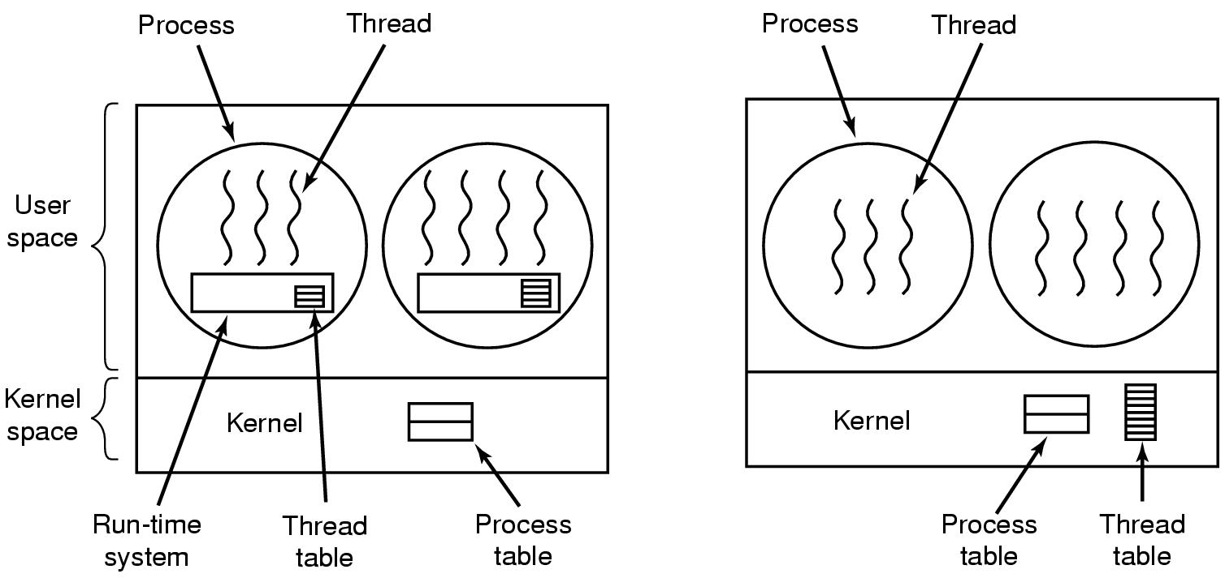
User vs. Kernel Threads
User-level Threads
Kernel-level Threads

Slide 32
Kernel-level Threads
Advantages
Kernel schedules threads in addition to processes
Multiple threads of a process can run simultaneously
Now what happens if one thread blocks on I/O?
Kernel-level threads can make blocking I/O calls without blocking other threads of same process
Good for multicore architectures
Q: Why is this more efficient than process context switching?

Slide 33
Kernel-level Threads
Disadvantages
Overhead in the kernel… extra data structures, scheduling, etc.
Thread creation is expensive
Have a pool of waiting threads
What happens when a multi-threaded process calls fork()?
Which thread should receive a signal?

Slide 34
Trade-offs?
Kernel thread packages
Each thread can make blocking I/O calls
Can run concurrently on multiple processors
Threads in user-level
Fast context switch
Customized scheduling
No need for kernel support

Slide 35
Things to think about for the future
Who gets to go next when a thread blocks/yields?
Scheduling!
What happens when multiple threads are sharing the same resource?
Synchronization!

