Slide 1
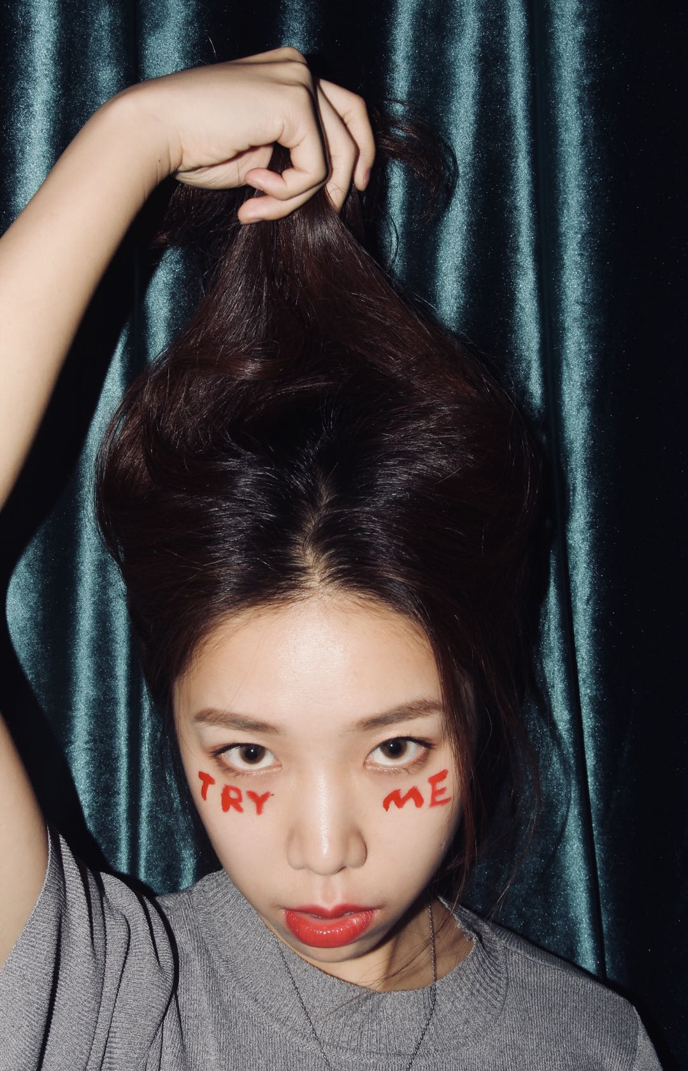
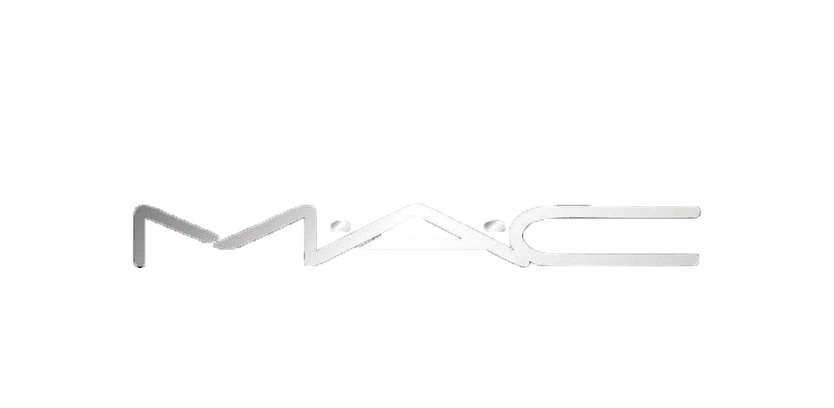
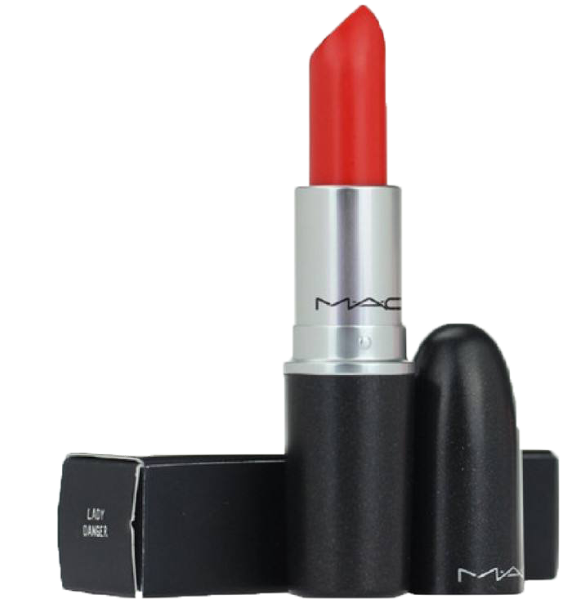
Suri’s
House

Slide 2

Suri’s
House
current issue
M.A.C is a Canada brand. If the lipsticks suit on yellow-skin person becomes a problem.
Limited real lipstick-on-lip picture (fashion bloggers usually post a few pictures).
Scattered information on different platforms.
cooperation website

Slide 3
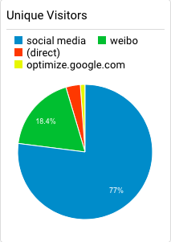
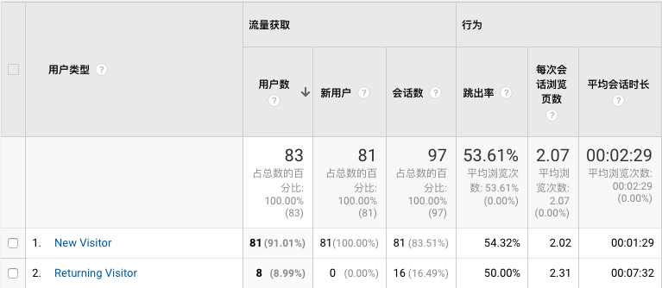
Suri’s
House
How to evaluate
page views: to see if the campaign does well
visiting lengths: to see if the website is good enough to draw people’s attention
conversion rate: to see how many people click “buy now” when browsing my website

Slide 4
Suri’s
House
THANK YOU
1155112767 Chen Siyu

