Slide 1

Ham or Spam
Abdullah Alharbi
Taisuke Usumi
Prashant Karki

Slide 2
Background
Spam messages accounted for 54.68 percent of e-mail traffic in September 2019 [1].
Emails are sometimes marked as spam wrongly and go in spam.
Recognizing the spam message with high accuracy is important.

Slide 3
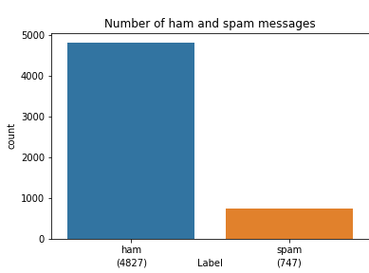
Dataset
Getting the dataset from Kaggle [2].
No missing value in the data
The total number of data is
5,574 (ham: 4,827, spam: 747).

Slide 4
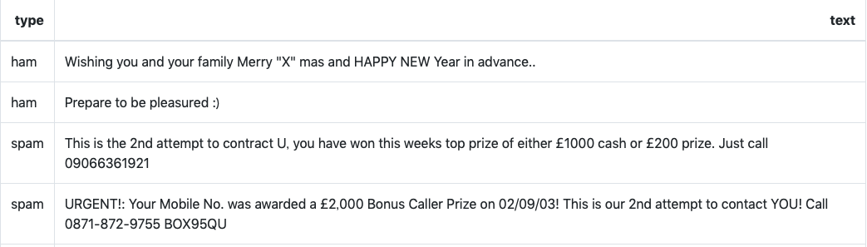
Dataset
Sample messages

Slide 5
Text Analytics
Creating a Corpus of Tokens
Tokenization.
Lemmatization
Removing punctuations, stop words, numbers etc.
Word Count
Word Cloud
To detect the common features/hidden pattern of each category.

Slide 6
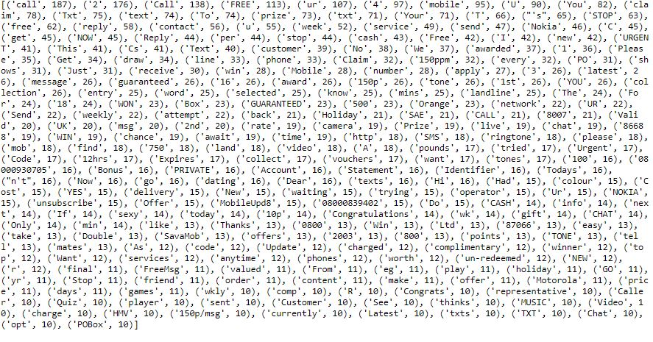
Most Frequent 250 Words (Spam)
The visualization shows the most frequent words from Spam Category.
Words like Call, Free, Offer, Congratulations, prize etc. were the most frequent words.

Slide 7
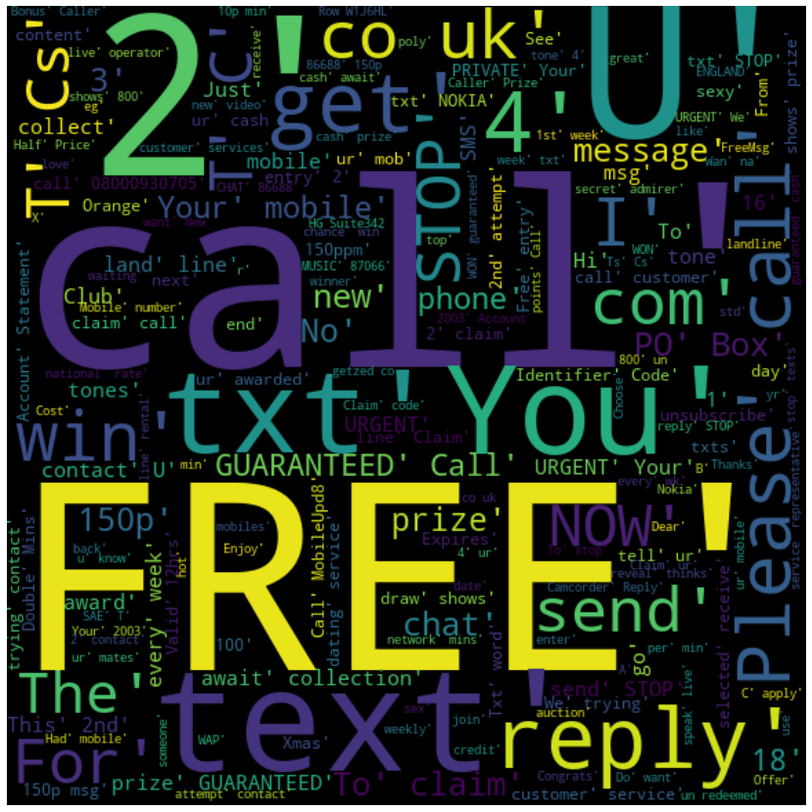
Word Cloud (Spam)
The visualization is the word cloud of the words from the span category.
We can analyze the most frequent words based on size.

Slide 8
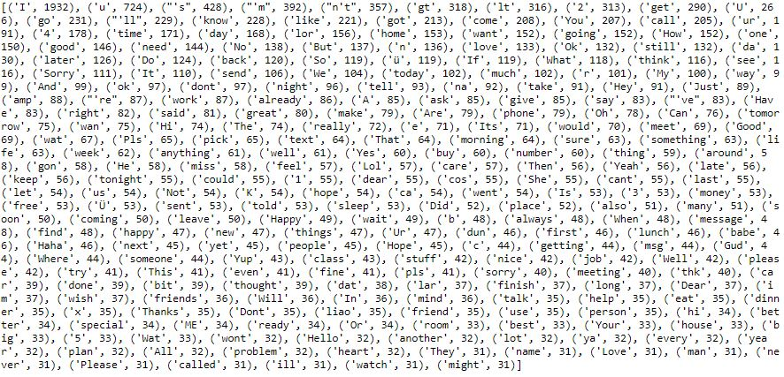
Most Frequent 250 Words (ham)
The visualization shows the most frequent words from Ham Category.
As compared to word frequency of Spam we can see, more generalized and common words used in valid emails or conversations.

Slide 9
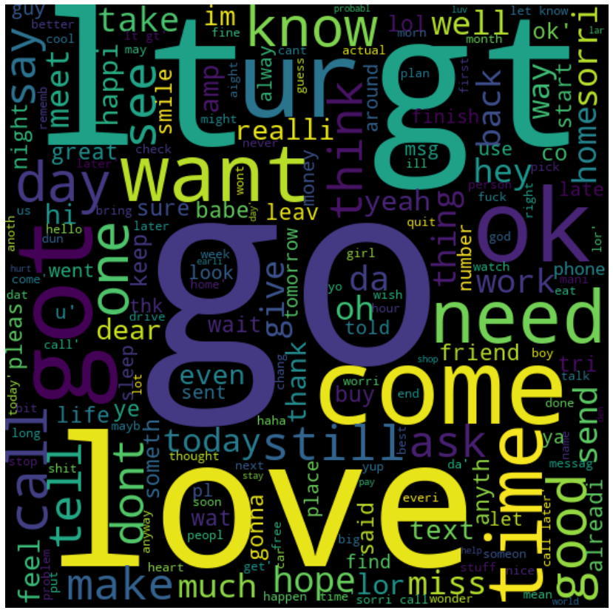
Word Cloud (Ham)
The visualization is the word cloud of the words from the ham category.
We can analyze the most frequent words based on size.

Slide 10

Prediction
Creating three classification models to predict if the e-mail is spam or not.
Logistic Regression
Bernoulli Naïve Bayes Classifier
LSTM (Long Short-Term Memory)
Dividing the dataset into a training set, test set (and validation set only for deep learning model) to train and test the model.
Comparing the result for three models.

Slide 11
Prediction (Pre-Processing)
Categorical Encoding
Corpus for all rows of email.
Text Cleaning (Remove punctuation, numbers, stop words, etc.).
Bag of words Model.
Sparse Matrix
(Max features = 5000)

Slide 12
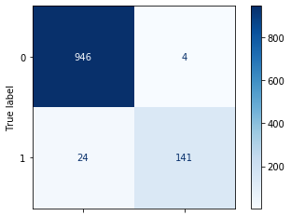
Prediction (Logistic Regression)
Logistic regression is a statistical model that in its basic form uses a logistic function to model a binary dependent variable.
Classifier Score: 97.28
Confusion Matrix

Slide 13
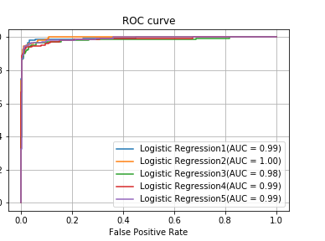
Prediction (Logistic Regression w/ k-fold)
K-Fold CV is where a given data set is split into a K number of sections/folds where each fold is used as a testing set
Predicting the spam using the logistic regression model and 5-fold cross-validation to evaluate the model.
Average accuracy is 97.4% and average MSE (mean squared error) is 0.0362.
ROC curve for each models.

Slide 14

Prediction (Bernoulli Naive Bayes Classifier)
A Naive Bayes Classifier is a supervised machine-learning algorithm that uses the Bayes' Theorem, which assumes that features are statistically independent.
Classifier Score: 97.4
Confusion Matrix

Slide 15
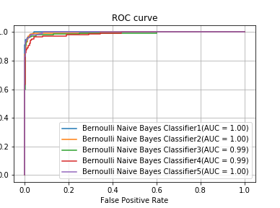
Prediction (Bernoulli Naive Bayes Classifier)
Predicting the spam using the Bernoulli Naive Bayes Classifier and 5-fold cross-validation to evaluate the model.
Average accuracy is 98.1% and average MSE (mean squared error) is 0.0192.
ROC curve for each model.

Slide 16
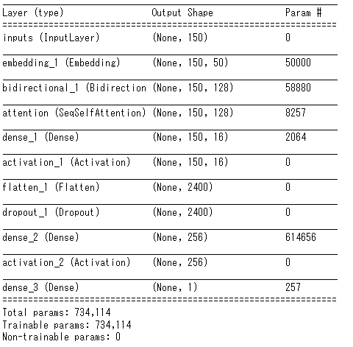
Prediction (LSTM)
Creating the deep learning
model to predict the spam.
Creating the prediction model
using Keras.

Slide 17
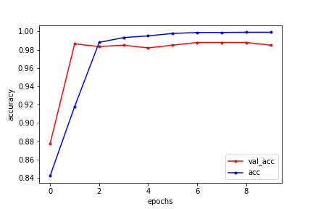
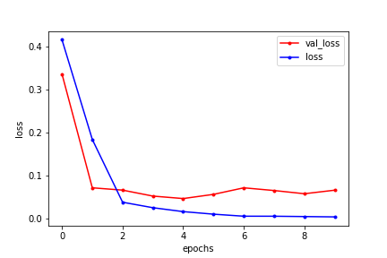
Prediction (LSTM)
The best accuracy is 98.2%.
Loss and Accuracy is the following.

Slide 18
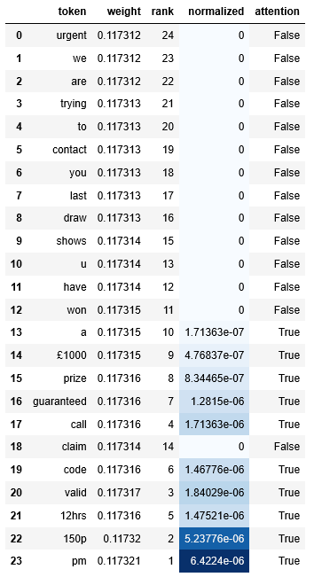
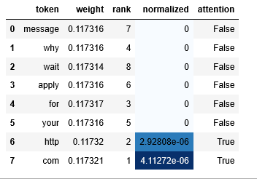
Prediction (LSTM)
The following pictures are about how the model recognized if the email is spam or not.
The word with darker blue greatly
affects the prediction result.
Email:
URGENT We are trying to contact you Last weekends draw show u have won a ￡1000 prize GUARANTEED call 09064017295 Claim code K52 Valid 12hrs 150p pm
Label: Spam
Prediction: Spam
Email: Bloomberg-Message center +447797706009 Why wait? Apply for your future http://careers. bloomberg.com
Label: Spam, Prediction: Spam

Slide 19
Result and Future Work
Recognizing the spam email using three models (Logistic Regression, Bernoulli Naive Bayes Classifier, LSTM) and LSTM model achieved the highest accuracy among the three models.
Need to do more research about deep learning model to improve the prediction accuracy.
Need to get more data to generalize the model and achieve higher accuracy.

Slide 20
Reference
[1] Statista:
https://www.statista.com/statistics/420391/spam-email- traffic-share/
[2] Kaggle:
https://www.kaggle.com/hdza1991/sms-spam

Slide 21
Thank you for listening

